Slide 1
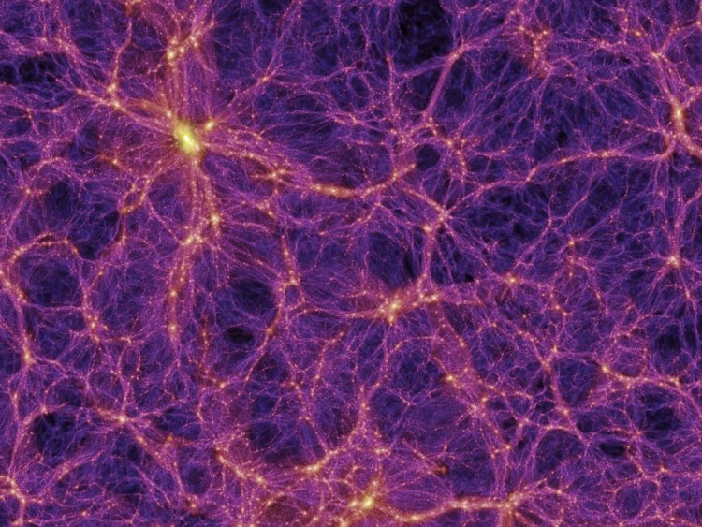
Higher order Hamiltonian Monte Carlo Sampling for Cosmological Large Scale Structure Analysis
Mónica Hernández Sánchez
Advisor:
Francisco-Shu Kitaura
Collaborators:
Metin Ata
Sergio Rodríguez Torres
Claudio Dalla Vecchia
VII MEETING ON FUNDAMENTAL COSMOLOGY
Madrid 9/09/19

Slide 2
CONTENTS
Introduction
1.1. Motivation and Objectives
1.2. The BIRTH code
Bayesian Statistics
2.1. Hamiltonian Monte Carlo sampling
Fourth order Leapfrog algorithm
3.1. Study of the $i$ parameter and the stepsize
3.2. Convergence of the method
BIRTH Results
Conclusions
Mónica Hernández Sánchez
VII MEETING ON FUNDAMENTAL COSMOLOGY
1/20
Notes:
2

Slide 3
1. INTRODUCCION
1.1. Motivation and objectives
Structures have been formed from the gravitational instability of primordial fluctuations, which are assumed to be closely Gaussian distributed; generating a process of collapse and originating the Cosmic Web (non-Gaussian).
Galaxies are biased discrete tracers of the dark matter field.
We aim at reconstructing the initial conditions of the Universe from Galaxy catalogues with a statistical Bayesian framework: Hamiltonian Monte Carlo sampling.
We aim at improving the efficiency of the method through the implementation of a higher order discretization of the equations of motion: the fourth order Leapfrog algorithm.
Mónica Hernández Sánchez
VII MEETING ON FUNDAMENTAL COSMOLOGY
2/20
Notes:
3

Slide 4
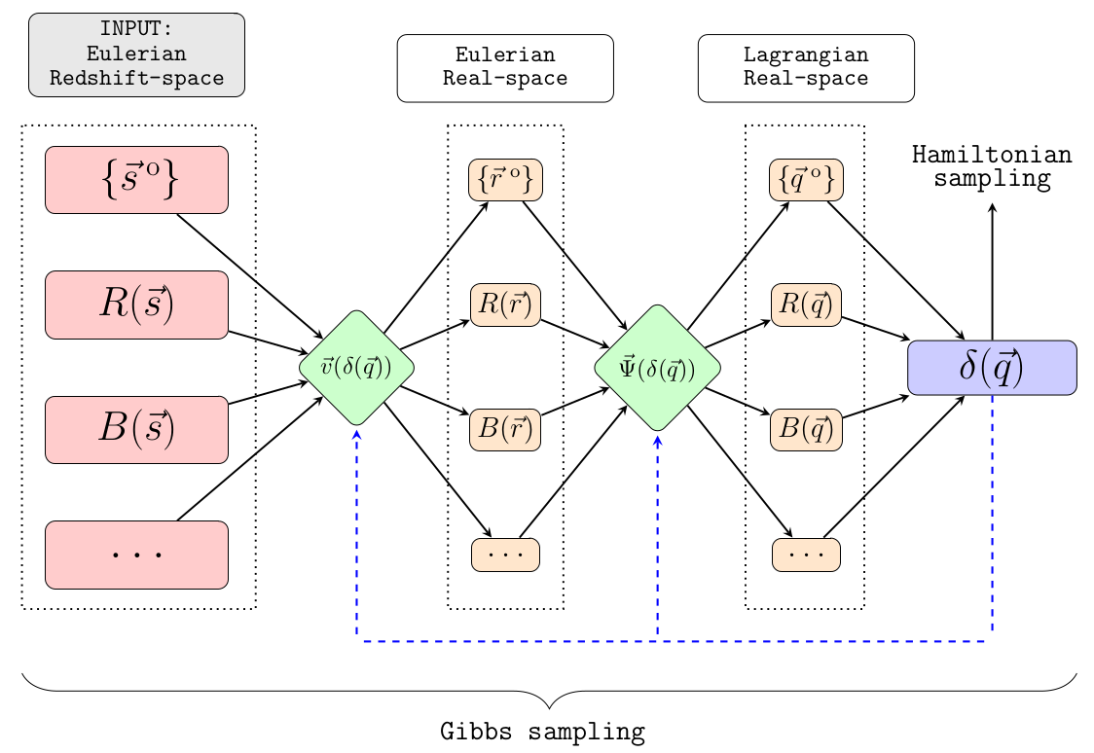
INTRODUCCION
1.2. BIRTH Code
Bayesian Inference for Reality vs THeory
Bayesian inference algorithm to reconstruct the primordial evolved cosmic density field from galaxy surveys on the light-cone.
General to any structure formation model.
Self consistent treatment of the
survey geometry and selection function.
Non-linear Lagrangian bias.
Redshift-space distortions modelling.
Higher order Hamiltonian Monte Carlo sampling.
Kitaura et al. (Mónica Hernández-Sánchez) in preparation
Mónica Hernández Sánchez
VII MEETING ON FUNDAMENTAL COSMOLOGY
3/20
Notes:
4

Slide 5
INTRODUCCION
1.2. BIRTH Code
Nested Gibbs-Hamiltonian sampling
In a first step we assume the data is in Lagrangian real-space at high redshift:
Power-law bias
Almost Poisson distribution of galaxies: Poissonian likelihood
Lognormal prior
In a second step: forward modelling to obtain :
Likelihood comparison:
Mónica Hernández Sánchez
VII MEETING ON FUNDAMENTAL COSMOLOGY
4/20
Notes:
5

Slide 6
INTRODUCCION
1.2. BIRTH Code
Nested Gibbs-Hamiltonian sampling
In a first step we assume the data is in Lagrangian real-space at high redshift:
Power-law bias
Almost Poisson distribution of galaxies: Poissonian likelihood
Lognormal prior
In a second step: forward modelling to obtain :
Likelihood comparison:
Mónica Hernández Sánchez
VII MEETING ON FUNDAMENTAL COSMOLOGY
4/20
Notes:
6

Slide 7
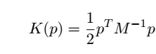
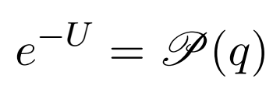
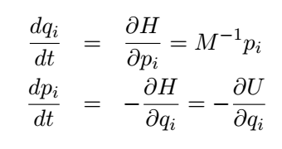
BAYESIAN STATISTICS
2.1. Hamiltonian Monte Carlo Sampling
$q$ variable we want to sample: primordial fluctuations
$p$ artificially introduced to evolve the system
We can write:
As we are interested on evolving the system with the momenta we use:
We evolve the system solving the Hamilton’s equations:
(Jasche & Kitaura, 2010)
Mónica Hernández Sánchez
VII MEETING ON FUNDAMENTAL COSMOLOGY
5/20
Notes:
7

Slide 8
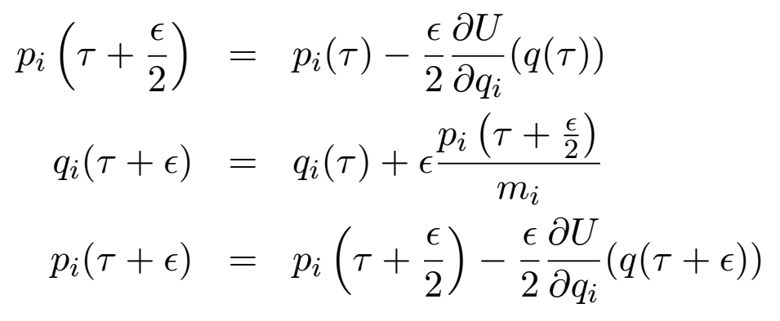
BAYESIAN STATISTICS
2.1. Hamiltonian Monte Carlo Sampling
We discretize them with the Leapfrog algorithm:
We accept or reject the steps with the Metropolis-Hastings criterion
Second order Leapfrog:
Higher order Leapfrog:
Mónica Hernández Sánchez
VII MEETING ON FUNDAMENTAL COSMOLOGY
6/20

Slide 9
BAYESIAN STATISTICS
2.1. Hamiltonian Monte Carlo Sampling
We discretize them with the Leapfrog algorithm:
We accept or reject the steps with the Metropolis-Hastings criterion
Second order Leapfrog:
Higher order Leapfrog:
Mónica Hernández-Sánchez (Kitaura) et al. in preparation
Mónica Hernández Sánchez
VII MEETING ON FUNDAMENTAL COSMOLOGY
6/20

Slide 10
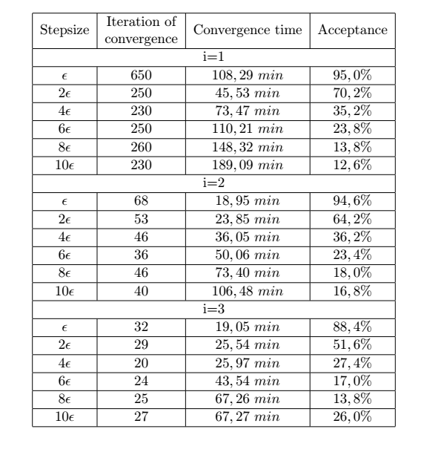
FOURTH ORDER LEAPFROG ALGORITHM
3. 1. Study of the $i$ parameter and the stepsize
For the second order Leapfrog was found to be optimal a stepsize $ε=0.06$
Mónica Hernández Sánchez
VII MEETING ON FUNDAMENTAL COSMOLOGY
7/20

Slide 11
FOURTH ORDER LEAPFROG ALGORITHM
3. 1. Study of the $i$ parameter and the stepsize
Mónica Hernández Sánchez
VII MEETING ON FUNDAMENTAL COSMOLOGY
7/20

Slide 12
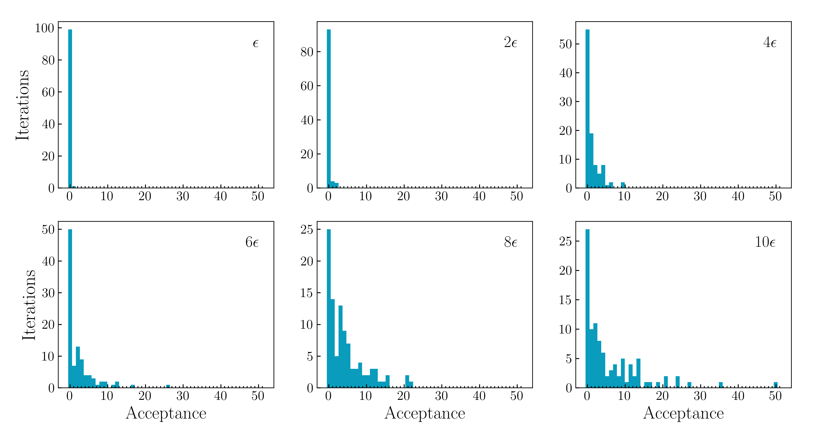
FOURTH ORDER LEAPFROG ALGORITHM
3. 1. Study of the $i$ parameter and the stepsize
Acceptance:
$$i=1$$
Mónica Hernández Sánchez
VII MEETING ON FUNDAMENTAL COSMOLOGY
8/20

Slide 13
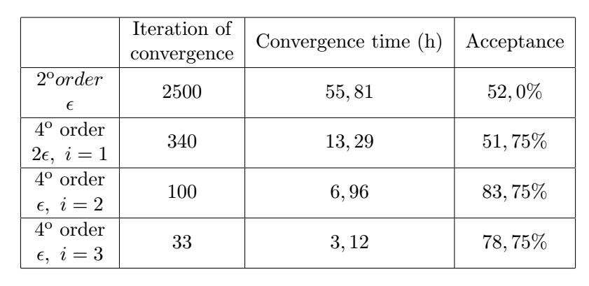
FOURTH ORDER LEAPFROG ALGORITHM
3. 2. Convergence of the Method
Comparison between second and fourth order Leapfrgog algorithm:
Mónica Hernández Sánchez
VII MEETING ON FUNDAMENTAL COSMOLOGY
9/20

Slide 14
FOURTH ORDER LEAPFROG ALGORITHM
3. 2. Convergence of the Method
Comparison between second and fourth order Leapfrgog algorithm:
Fourth order Leapfrog algorithm is 18 times faster than the second order algorithm
Mónica Hernández Sánchez
VII MEETING ON FUNDAMENTAL COSMOLOGY
9/20

Slide 15
FOURTH ORDER LEAPFROG ALGORITHM
3. 2. Convergence of the Method
Second order Leapfrog
Fourth order Leapfrog
Mónica Hernández Sánchez
VII MEETING ON FUNDAMENTAL COSMOLOGY
10/20

Slide 16
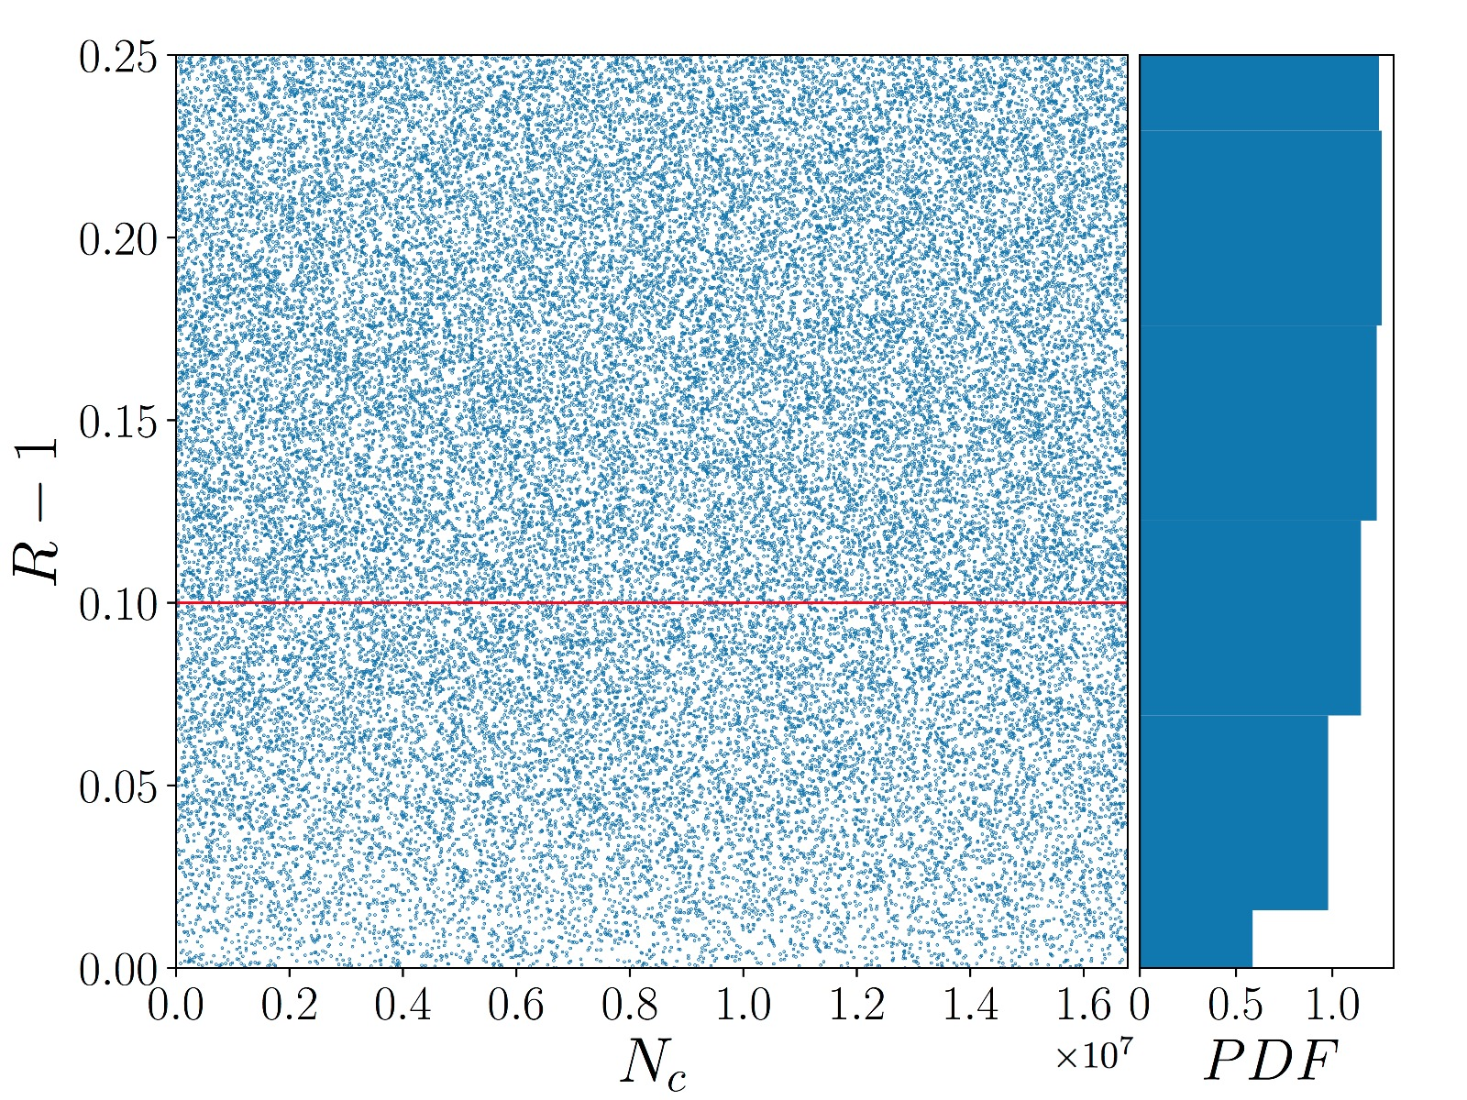
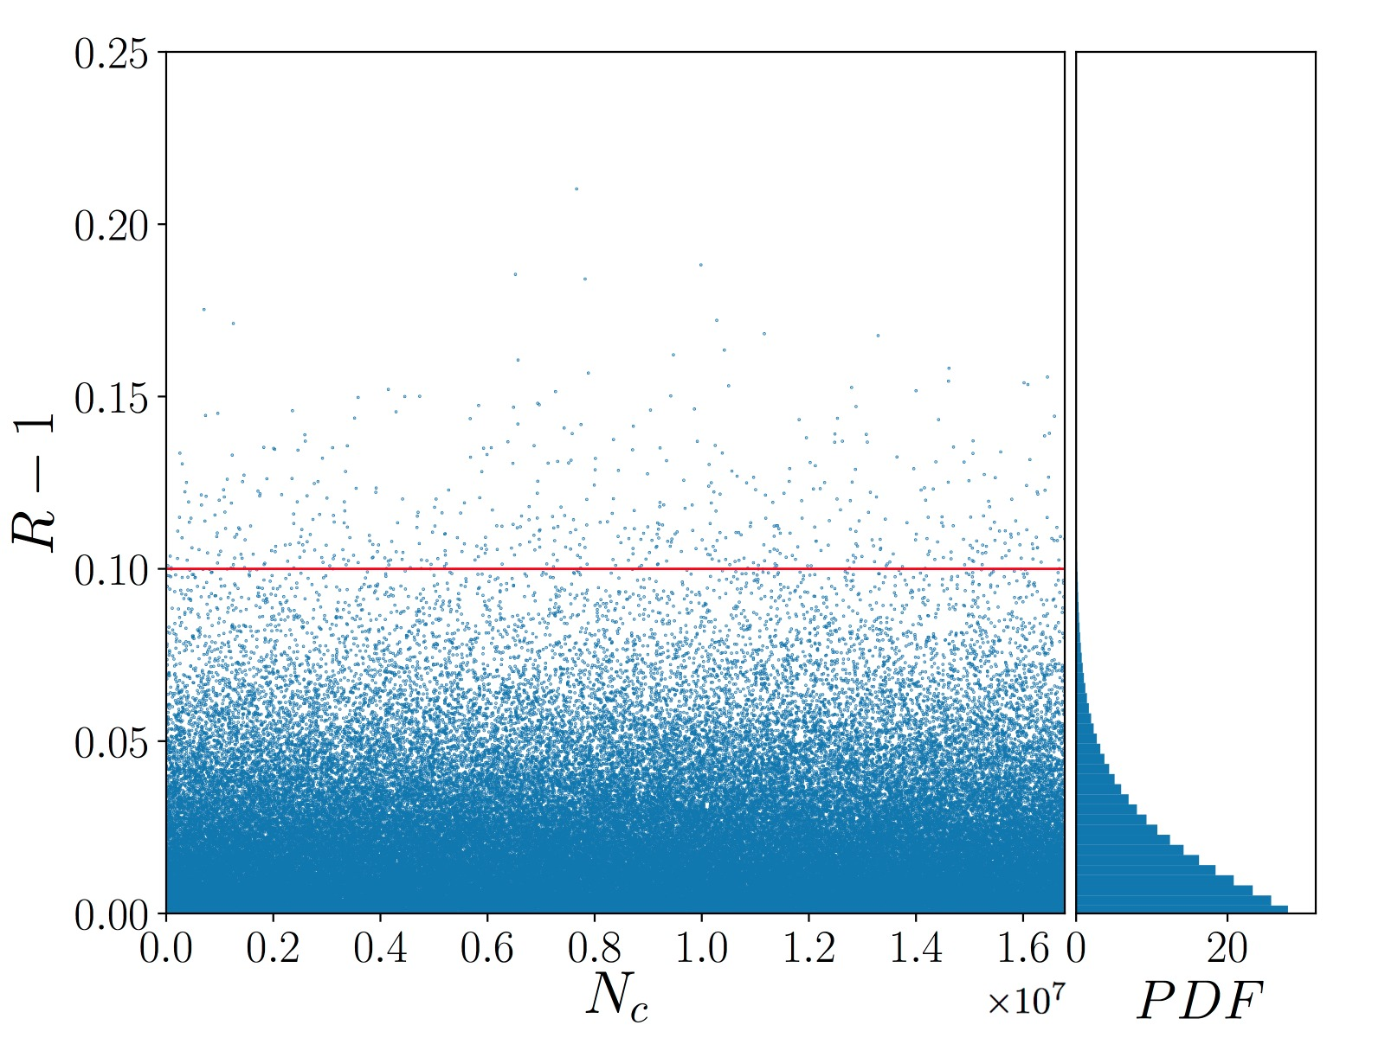
FOURTH ORDER LEAPFROG ALGORITHM
3. 2. Convergence of the Method
Gelman-Rubin test:
Second order Leapfrog
3000-3460 iterations
Fourth order Leapfrog
40-500 iterations
Mónica Hernández Sánchez
VII MEETING ON FUNDAMENTAL COSMOLOGY
11/20

Slide 17
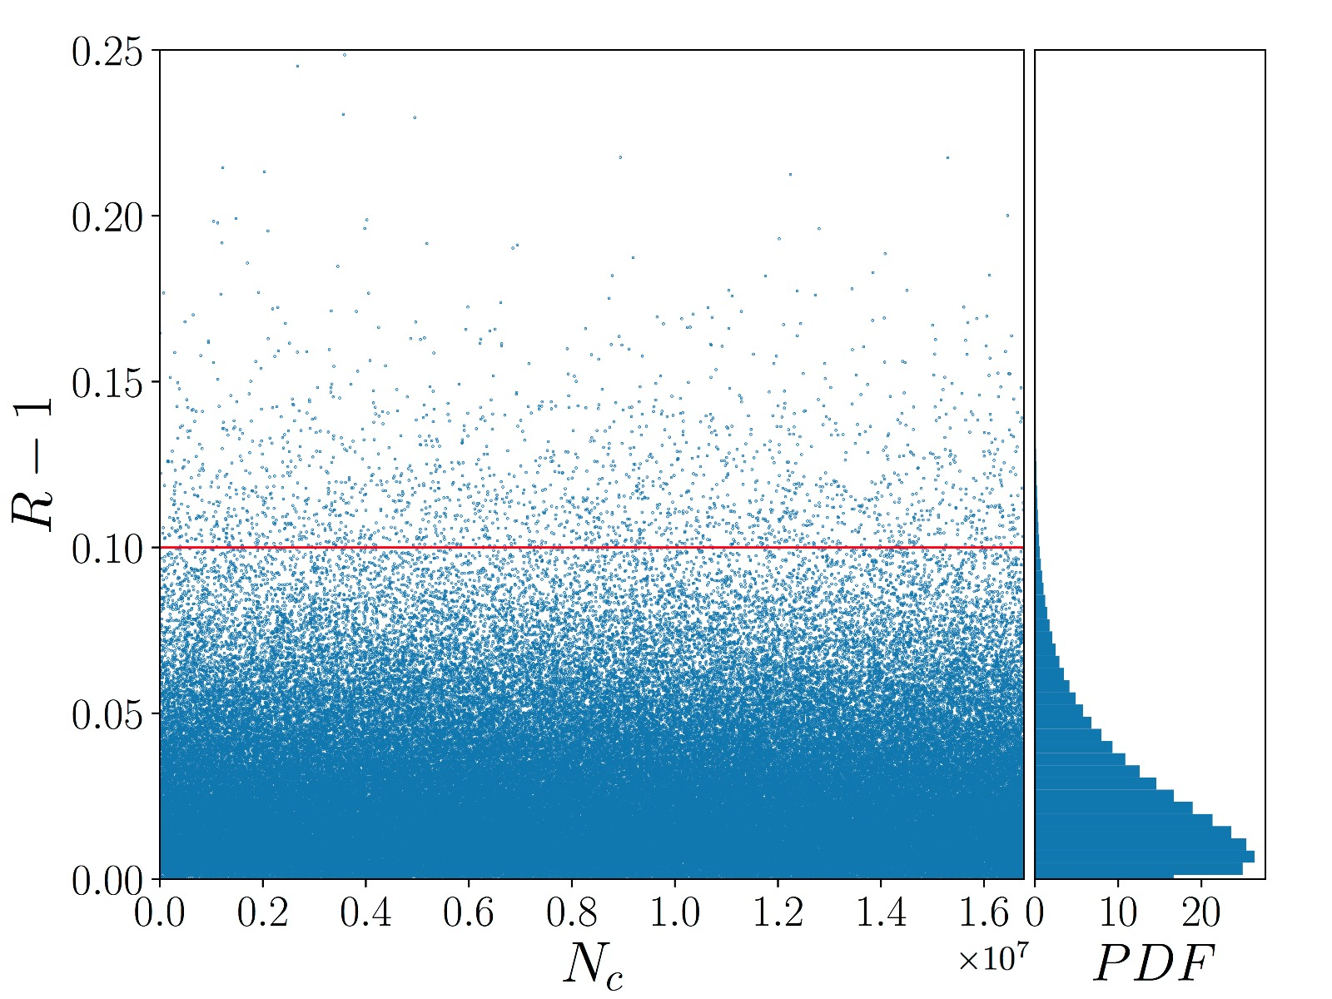
FOURTH ORDER LEAPFROG ALGORITHM
3. 2. Convergence of the Method
Gelman-Rubin test:
Second order Leapfrog
3000-12000 iterations
Fourth order Leapfrog
40-500 iterations
Mónica Hernández Sánchez
VII MEETING ON FUNDAMENTAL COSMOLOGY
11/20

Slide 18
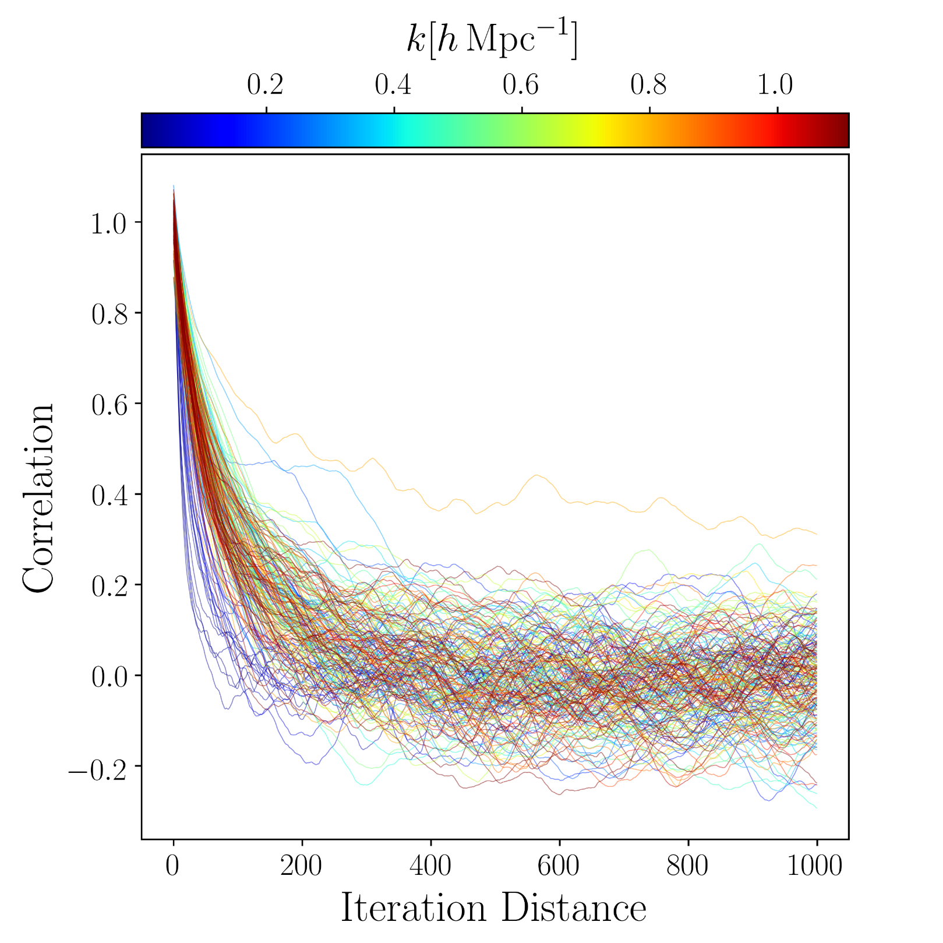
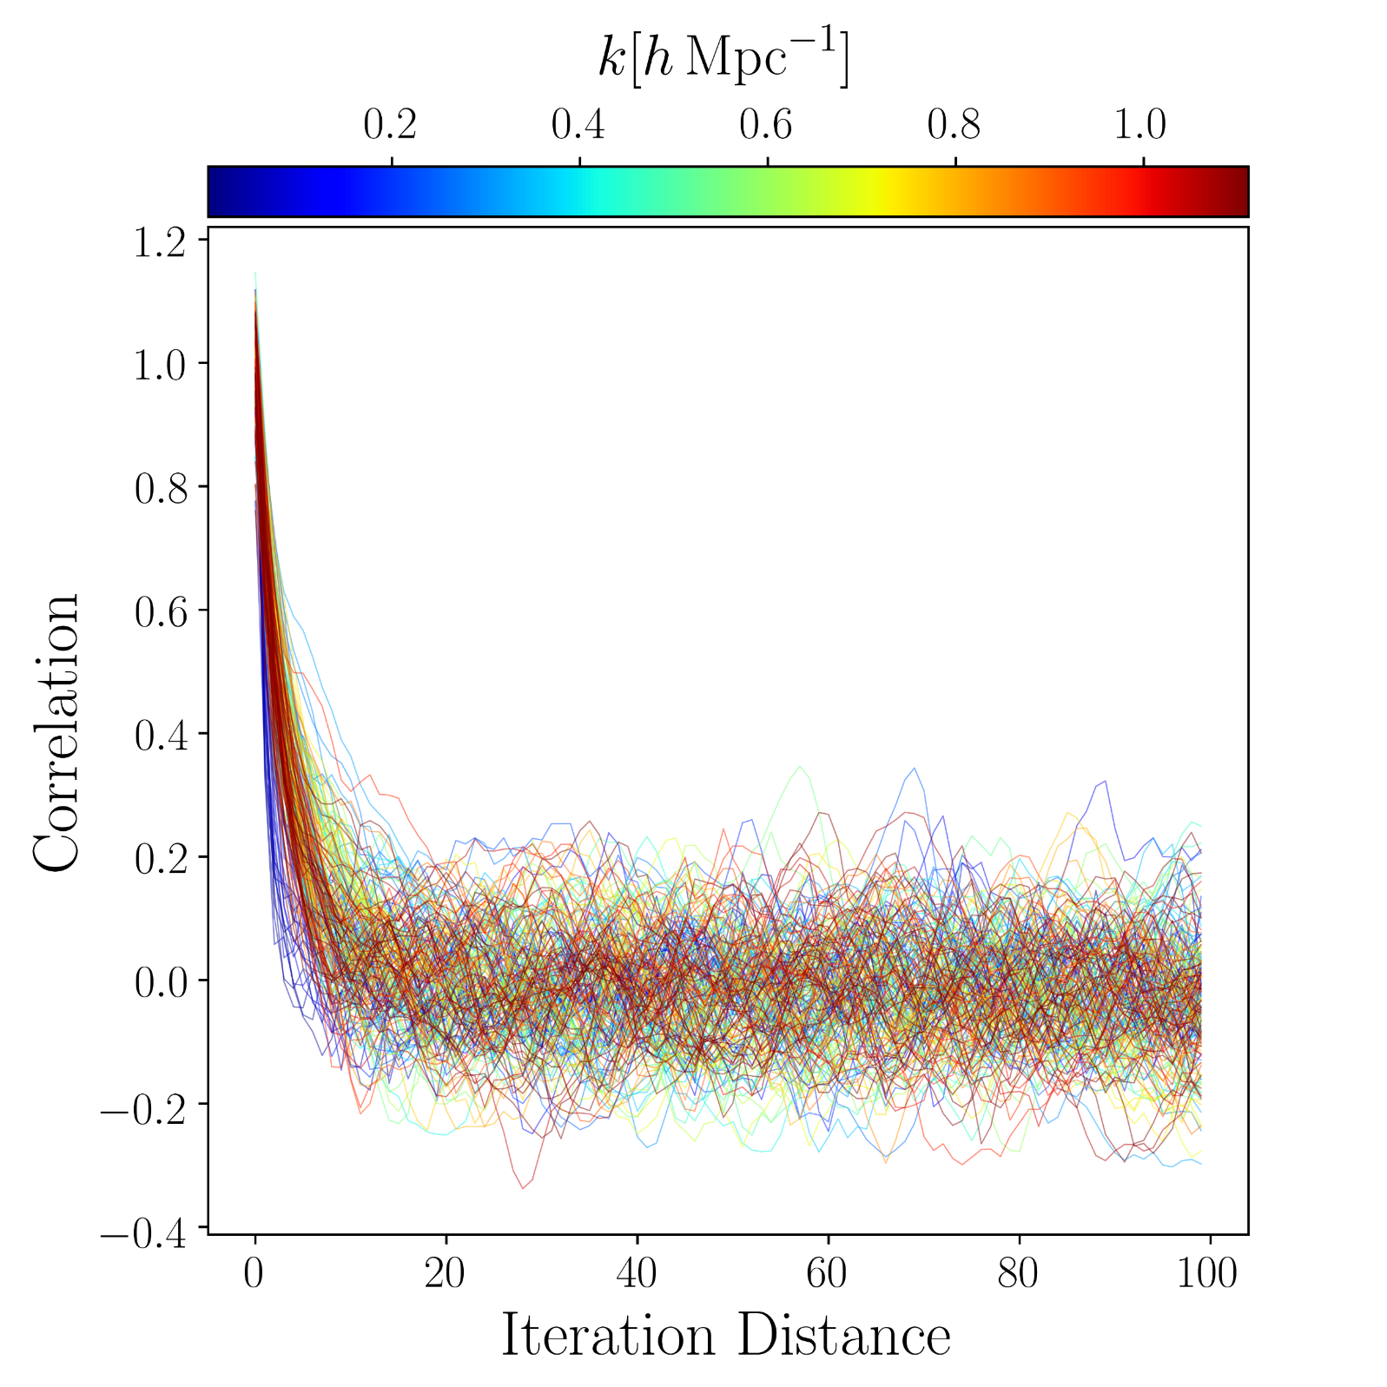
FOURTH ORDER LEAPFROG ALGORITHM
3. 2. Convergence of the Method
Correlation Length:
Second order Leapfrog
Fourth order Leapfrog
Mónica Hernández Sánchez
VII MEETING ON FUNDAMENTAL COSMOLOGY
12/20

Slide 19
FOURTH ORDER LEAPFROG ALGORITHM
3. 2. Convergence of the Method
Correlation Length:
Second order Leapfrog
Fourth order Leapfrog
300
10
Mónica Hernández Sánchez
VII MEETING ON FUNDAMENTAL COSMOLOGY
12/20

Slide 20
4. BIRTH RESULTS
Mónica Hernández Sánchez
VII MEETING ON FUNDAMENTAL COSMOLOGY
13/20

Slide 21
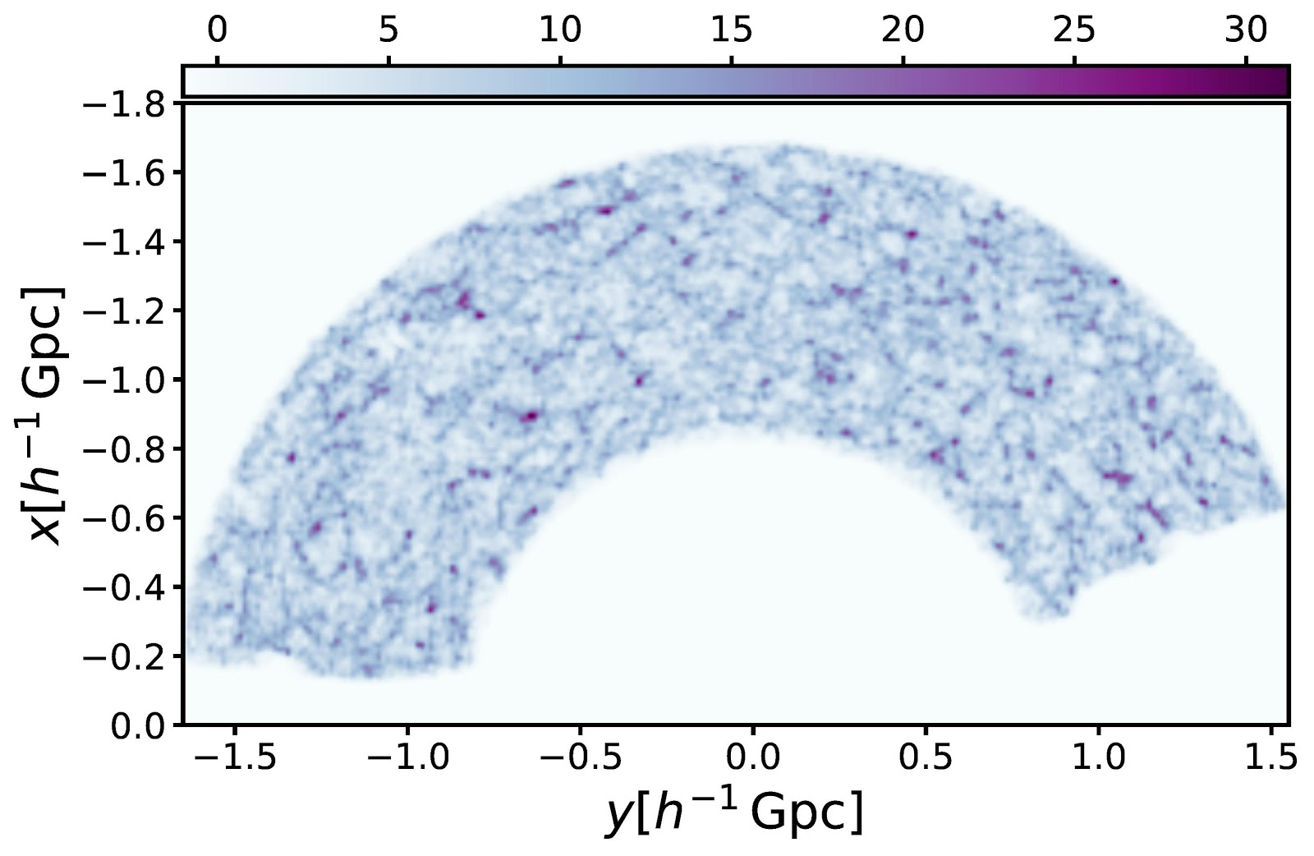
from the BigMD sim with light-cone evolution
4. BIRTH RESULTS
Dark matter from the BigMD simulation with light-cone evolution
Klypin et al, 2016
Mónica Hernández Sánchez
VII MEETING ON FUNDAMENTAL COSMOLOGY
14/20

Slide 22
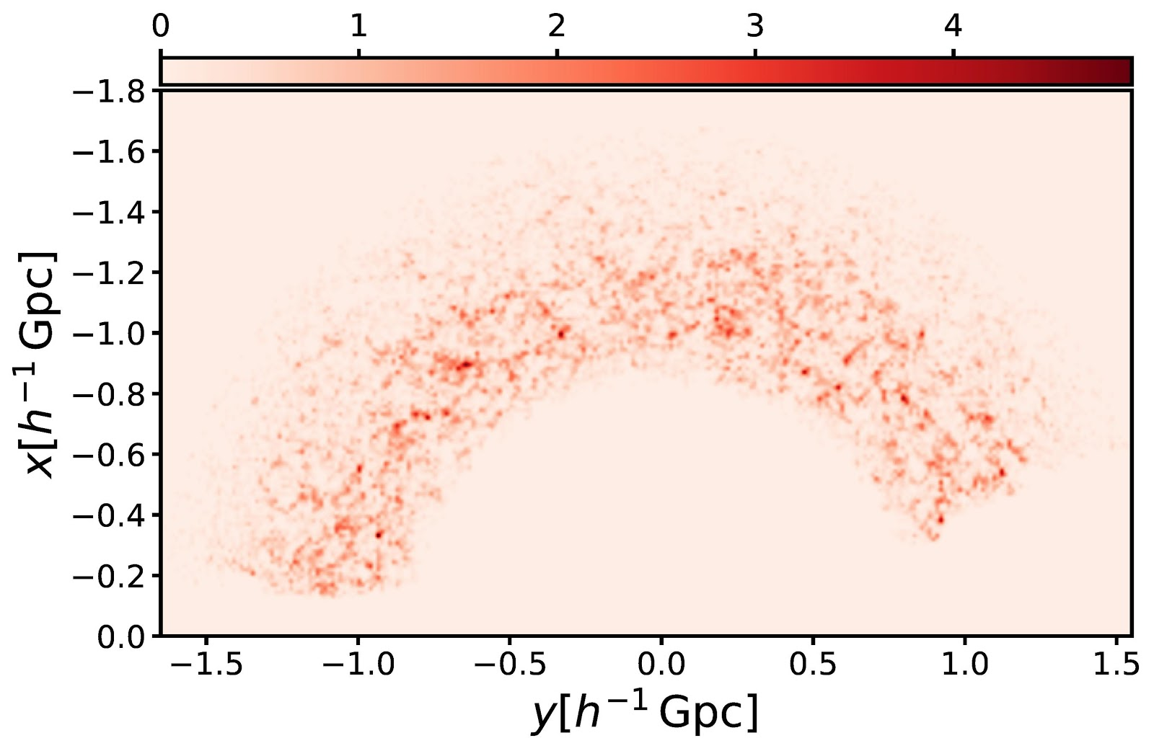
4. BIRTH RESULTS
Galaxy number counts in Eulerian
Galaxy number counts in Lagrangian
Mónica Hernández Sánchez
VII MEETING ON FUNDAMENTAL COSMOLOGY
15/20

Slide 23
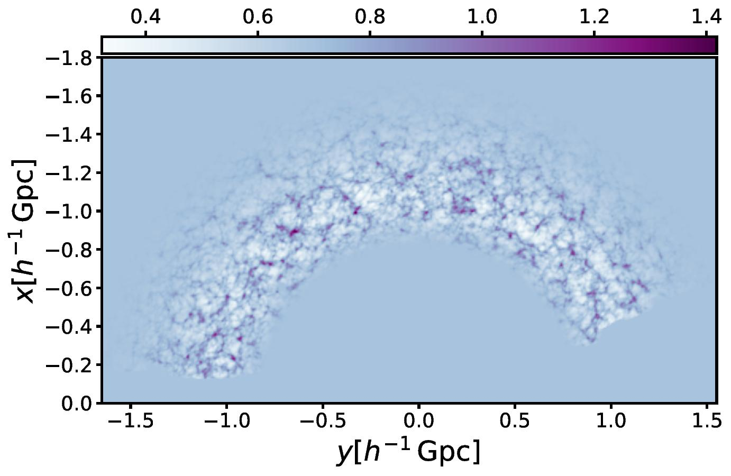
4. BIRTH RESULTS
Dark matter reconstruction
Kitaura et al. (in prep)
Mónica Hernández Sánchez
VII MEETING ON FUNDAMENTAL COSMOLOGY
16/20

Slide 24
from the BigMD sim with light-cone evolution
4. BIRTH RESULTS
Dark matter from the BigMD simulation with light-cone evolution
Kitaura et al. (in prep)
Mónica Hernández Sánchez
VII MEETING ON FUNDAMENTAL COSMOLOGY
16/20

Slide 25
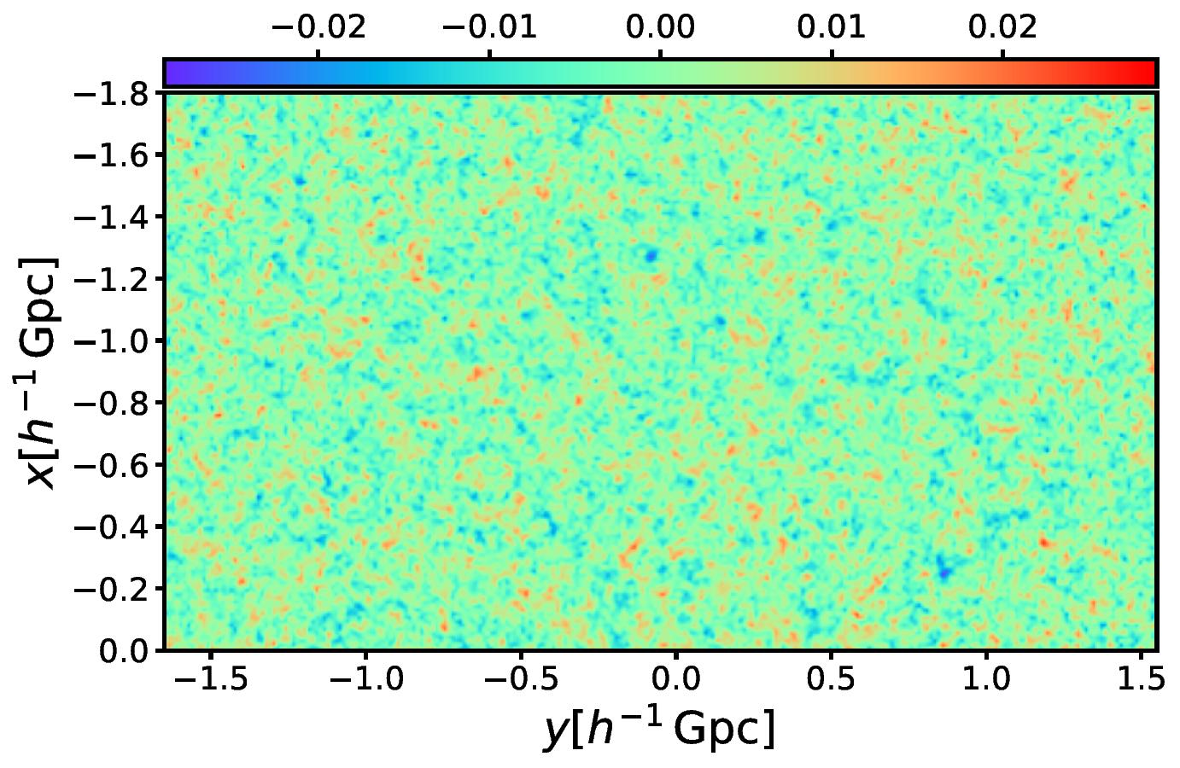
4. BIRTH RESULTS
Sampled Gaussian field at z=100
Kitaura et al. (in prep)
Mónica Hernández Sánchez
VII MEETING ON FUNDAMENTAL COSMOLOGY
17/20

Slide 26
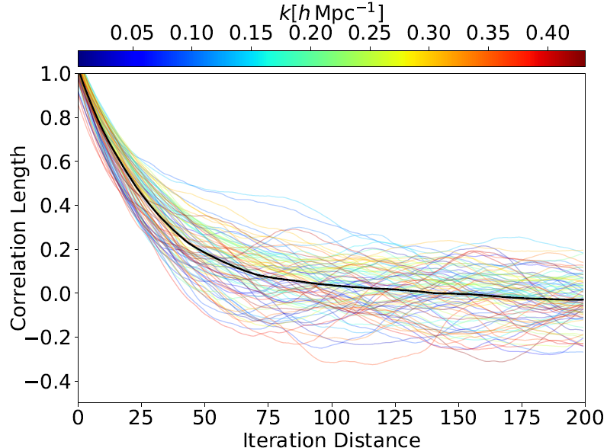
4. BIRTH RESULTS
Correlation length:
Mónica Hernández Sánchez
VII MEETING ON FUNDAMENTAL COSMOLOGY
18/20

Slide 27
4. BIRTH RESULTS
Correlation length:
60
Mónica Hernández Sánchez
VII MEETING ON FUNDAMENTAL COSMOLOGY
18/20

Slide 28
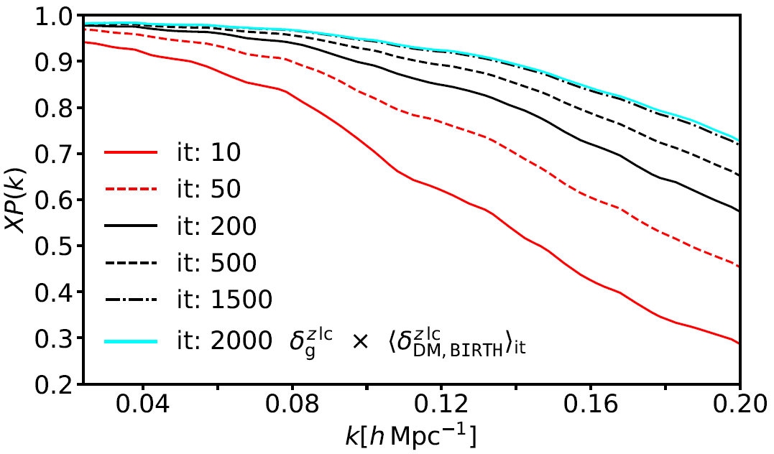
4. BIRTH RESULTS
Number of independent samples for a fair estimation of the posterior mean:
Kitaura et al. (in prep)
Mónica Hernández Sánchez
VII MEETING ON FUNDAMENTAL COSMOLOGY
19/20

Slide 29
5. CONCLUSIONS
We have implemented a fourth order Leapfrog algorithm for the discretizaton of the Hamilton’s equations.
Several tests have been developed to study the convergence, the computational time, the acceptance of the iterations and the correlation length:
We get convergence in $\sim 30$ iterations, two orders of magnitude less than with the second order algorithm.
We have reduced the computational time needed to reach the convergence a factor $\sim 20.$
We can obtain independent samples each $10th$ iterations as opposed to every $300$ iterations with the old scheme.
We have implemented this method in a realistic case with light-cone evolution, survey geometry, selection function, non-linar bias, RSD, displacements…
Mónica Hernández Sánchez
VII MEETING ON FUNDAMENTAL COSMOLOGY
20/20

Slide 30
THANK YOU FOR YOUR ATTENTION

