Slide 1
Large Scale Structure Systematics: weights from observing condition maps
Martín Rodríguez Monroy
in collaboration with Jack Elvin-Poole and Aurelio Carnero
VII Meeting on Fundamental Cosmology, Madrid, Spain. 11 September 2019

Slide 2
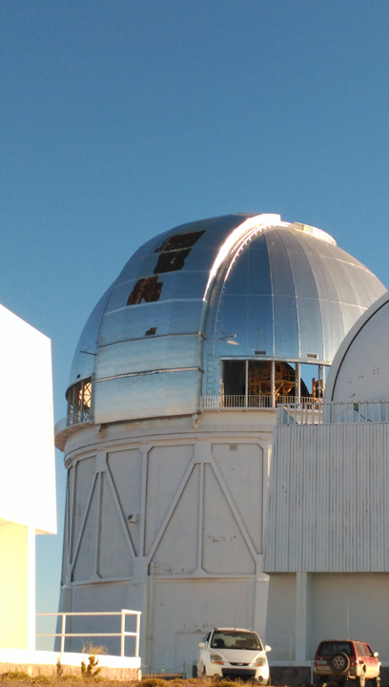
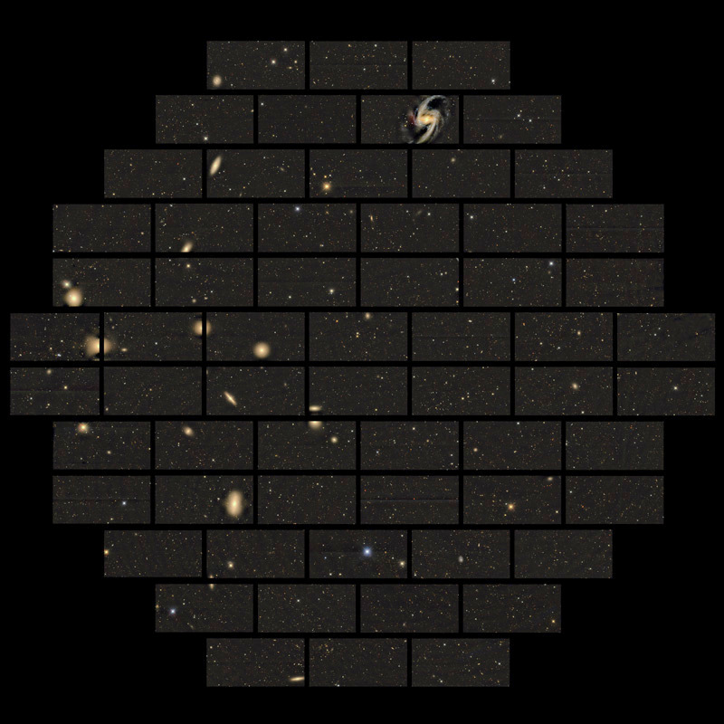
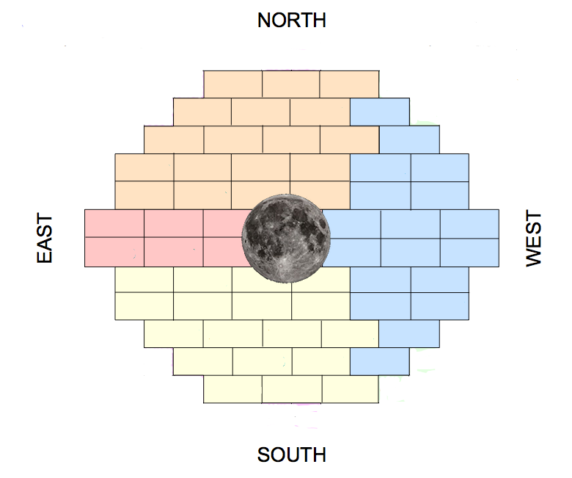
Dark Energy Survey
DECam: 62 CCDs in an hexagonal pattern ($\text{FoV} \sim 3 deg$)
5 photometric bands: $grizY$ ($400 −1080 nm$)
Depth $i_{AB}=24.0$
Photometric redshifts, up to $z\sim 1.0$
Victor Blanco Telescope, 4m, Cerro Tololo, Chile

Slide 3
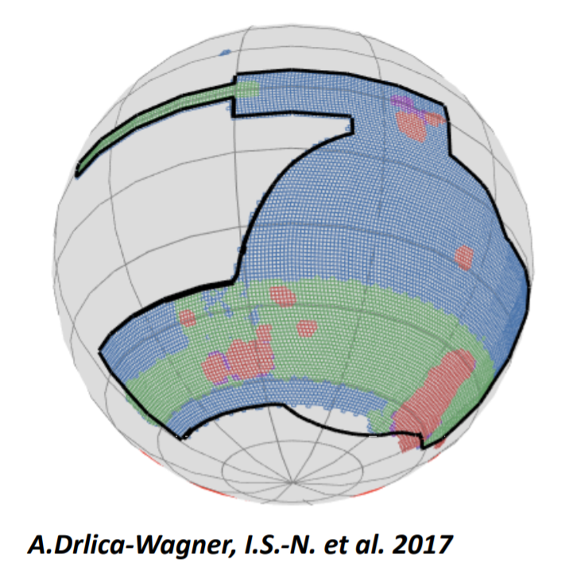
Dark Energy Survey
DECam: 62 CCDs in an hexagonal pattern ($\text{FoV} \sim 3 deg$)
5 photometric bands: $grizY$ ($400 −1080 nm$)
Depth $i_{AB}=24.0$
Photometric redshifts, up to $z\sim 1.0$
Victor Blanco Telescope, 4m, Cerro Tololo, Chile
1/8 of the sky observed
SV: $\sim 250 \deg^{2}$
Y1: $\sim 1800 \deg^{2}$
Y3/Y5-Y6: $\sim 5000 \deg^{2}$
Observing from 2013 to 2019
Surveying Dark Energy with 4 probes:
Large Scale Structure
Weak lensing
Supernovae
Cluster Counts

Slide 4
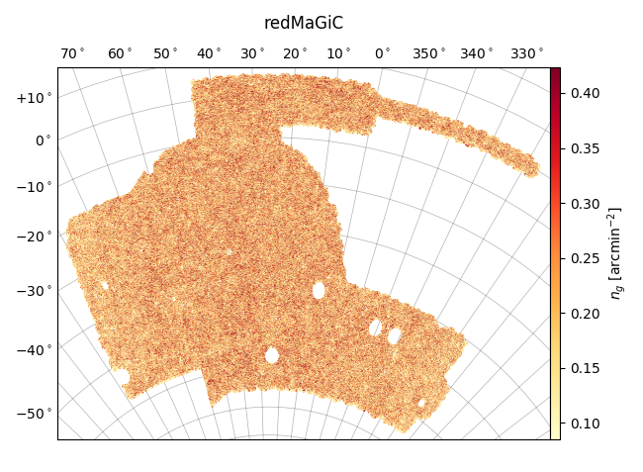
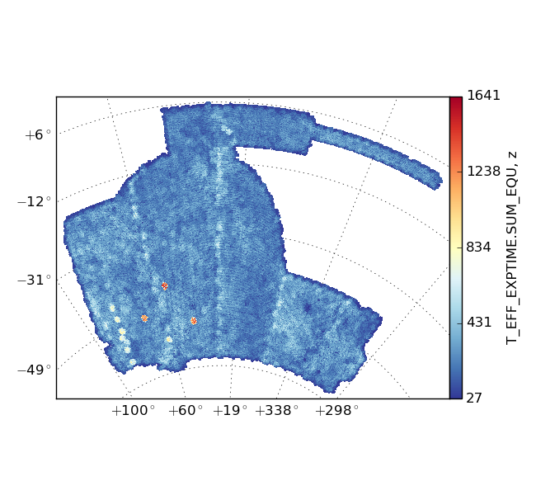
Survey Property maps (SPs)
Observing conditions (seeing, exposure time, …) have an impact in the clustering signal of the galaxies
This non-cosmological signal can bias our measurements
How can we characterize the observing conditions? -> Survey Property maps (SPs)
SP = healpix map that keeps track of the spatial variation of a certain statistic concerning the imaging conditions of the survey across the sky
Assume $δ_{obs}= δ_{true}+ \sum_{i}{α_{i}}δ_{SP}^{i}$
(M. Crocce et al., arXiv:1507.05360)
Effective exposure time, z-band
Effective exposure time, z-band
$$−\sum_{i}{α_{i}}$$
$$δ_{obs}$$
$$δ_{SP}^{i}$$
$$=δ_{true}$$

Slide 5
Survey Property maps (SPs)
DES Y3 -> 4 photometric bands x 25 SPs + 1 extinction map + 1 stellar density map = 102 SPs
Some of these maps correspond to the same physical quantity derived using different statistics for the stacked images: minimum, maximum, weighted averaged mean or sum of the quantity among all the contributing images
In other cases, a map is a function of other SPs, e.g., the depth maps
This means that many of these SP maps will be strongly correlated -> we can reduce their number by studying their spatial correlations at first
This previous study is performed per photometric band separately. Correlations between bands will be dealt with later by our pipeline

Slide 6
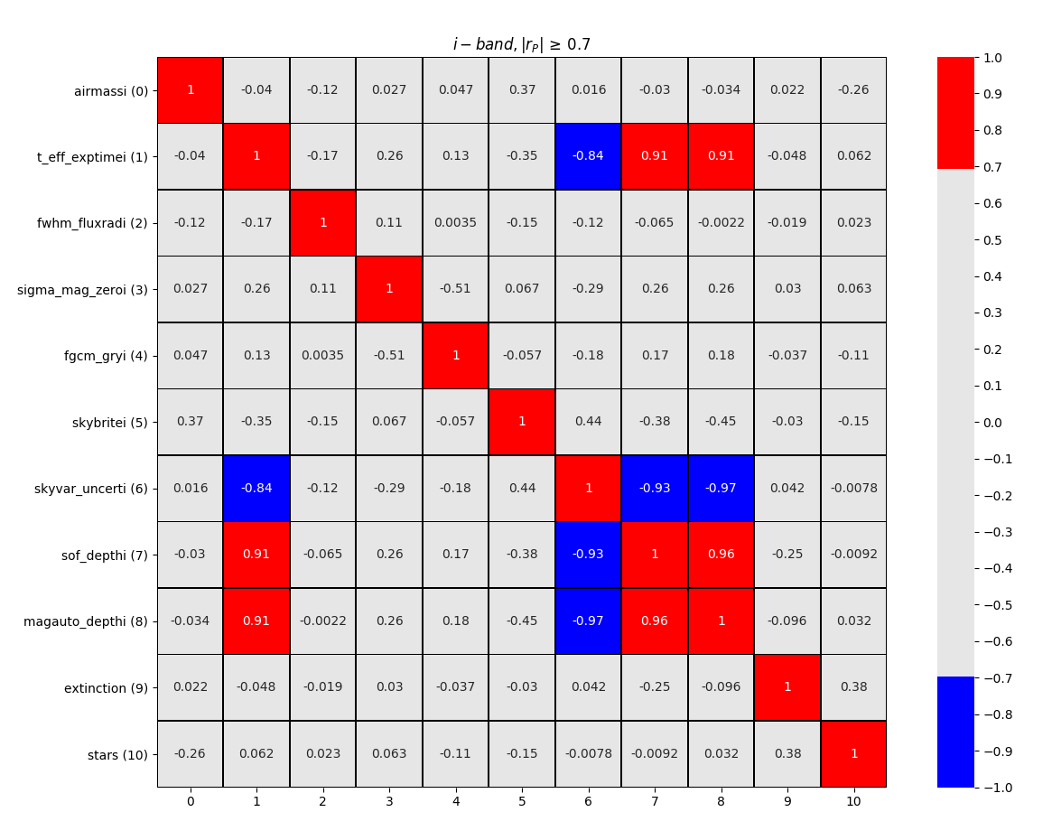
Survey Property maps (SPs)
Pearson’s correlation coefficient, $r_{p}$, helps to identify these “families” of SPs
It also allows to identify correlations between other maps
Set different cuts for $r_{p}$
We fix $\left|r_{p}\right|≥0.7$ to define a family. When posible, we take the weighted averaged mean as representative
102 SPs -> 34 SPs
0.7
-0.7

Slide 7
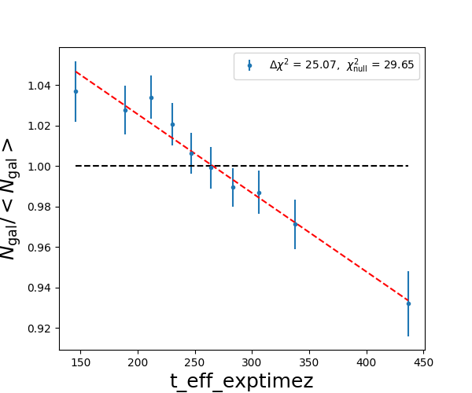
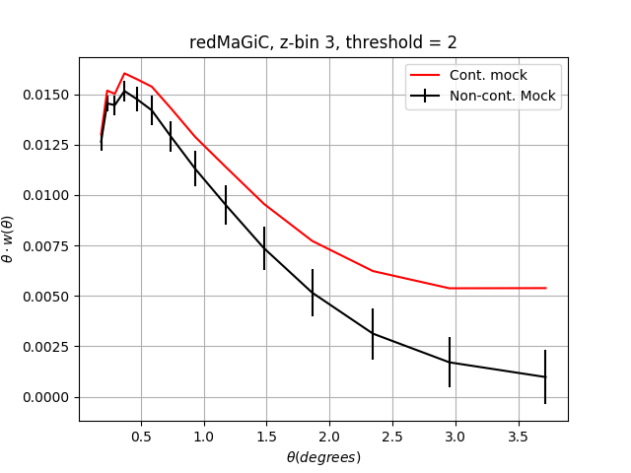
Systematics mitigation: definitions
How can we quantify the impact of the SPs on the data? -> Relation between the galaxy number density ($n_{gal}$) at each region of the sky and the SP map value there
Goal: determine whether the impact is significant and mitigate it
If significant, how do we mitigate it? -> Weighting the data
Data
Simulations
Before weighting
Before weighting

Slide 8
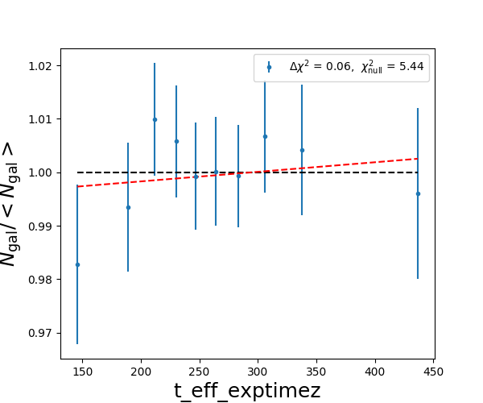
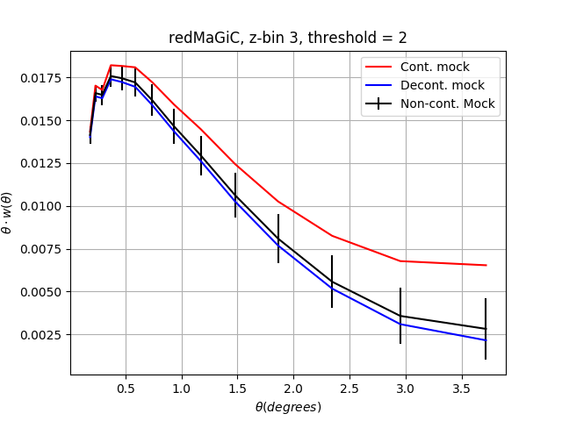
Systematics mitigation: definitions
How can we quantify the impact of the SPs on the data? -> Relation between the galaxy number density ($n_{gal}$) at each region of the sky and the SP map value there
Goal: determine whether the impact is significant and mitigate it
If significant, how do we mitigate it? -> Weighting the data
Data
Simulations
After weighting
After weighting

Slide 9
Systematics mitigation: definitions
Determine the significance of the SP signal:
$χ_{null}^{2}$: fit to ${N_{gal}}/{\left\langle N_{gal}\right\rangle }=1$
$χ_{model}^{2}$: fit to ${N_{gal}}/{\left\langle N_{gal}\right\rangle }=F(s)$
Model: $F\left(s\right)=m⋅s+c$
Define $Δχ^{2}=χ_{null}^{2}−χ_{model}^{2}$

Slide 10
Systematics mitigation: definitions
$$Δχ_{data}^{2}$$
Effective exposure time, z-band

Slide 11
Systematics mitigation: definitions
$$Δχ_{data}^{2}$$
Effective exposure time, z-band
However, this tells nothing about the significance of this signal. We need realizations of the Universe to check this

Slide 12
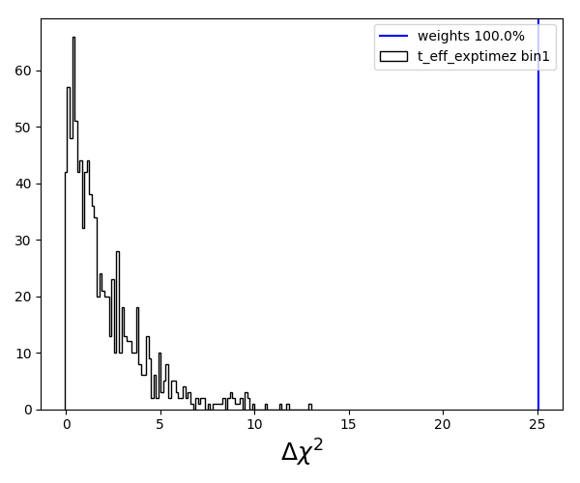
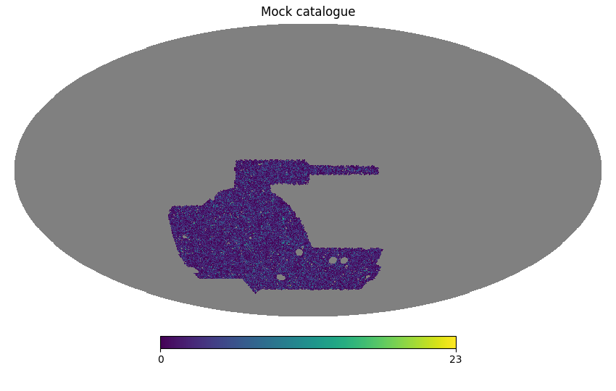
Systematics mitigation: definitions
1000
$Δχ_{mock}^{2}$
Effective exposure time, z-band
Define our significance:
$$sig^{2}= \frac{Δχ_{data}^{2}}{Δχ_{mock}^{2}(68)}$$

Slide 13
Systematics mitigation: iterative process
(J. Elvin-Poole et al., arXiv:1708.01536)
In order to remove the systematic impact, an iterative process is run. First of all, we must:
Calculate the significance of each SP
Set a threshold for the significance
Sort the SPs from highest to lowest significance and identify the SP with highest one over the threshold
$$\frac{Δχ_{data}^{2}}{Δχ_{mock}^{2}(68)} ≥threshold$$

Slide 14
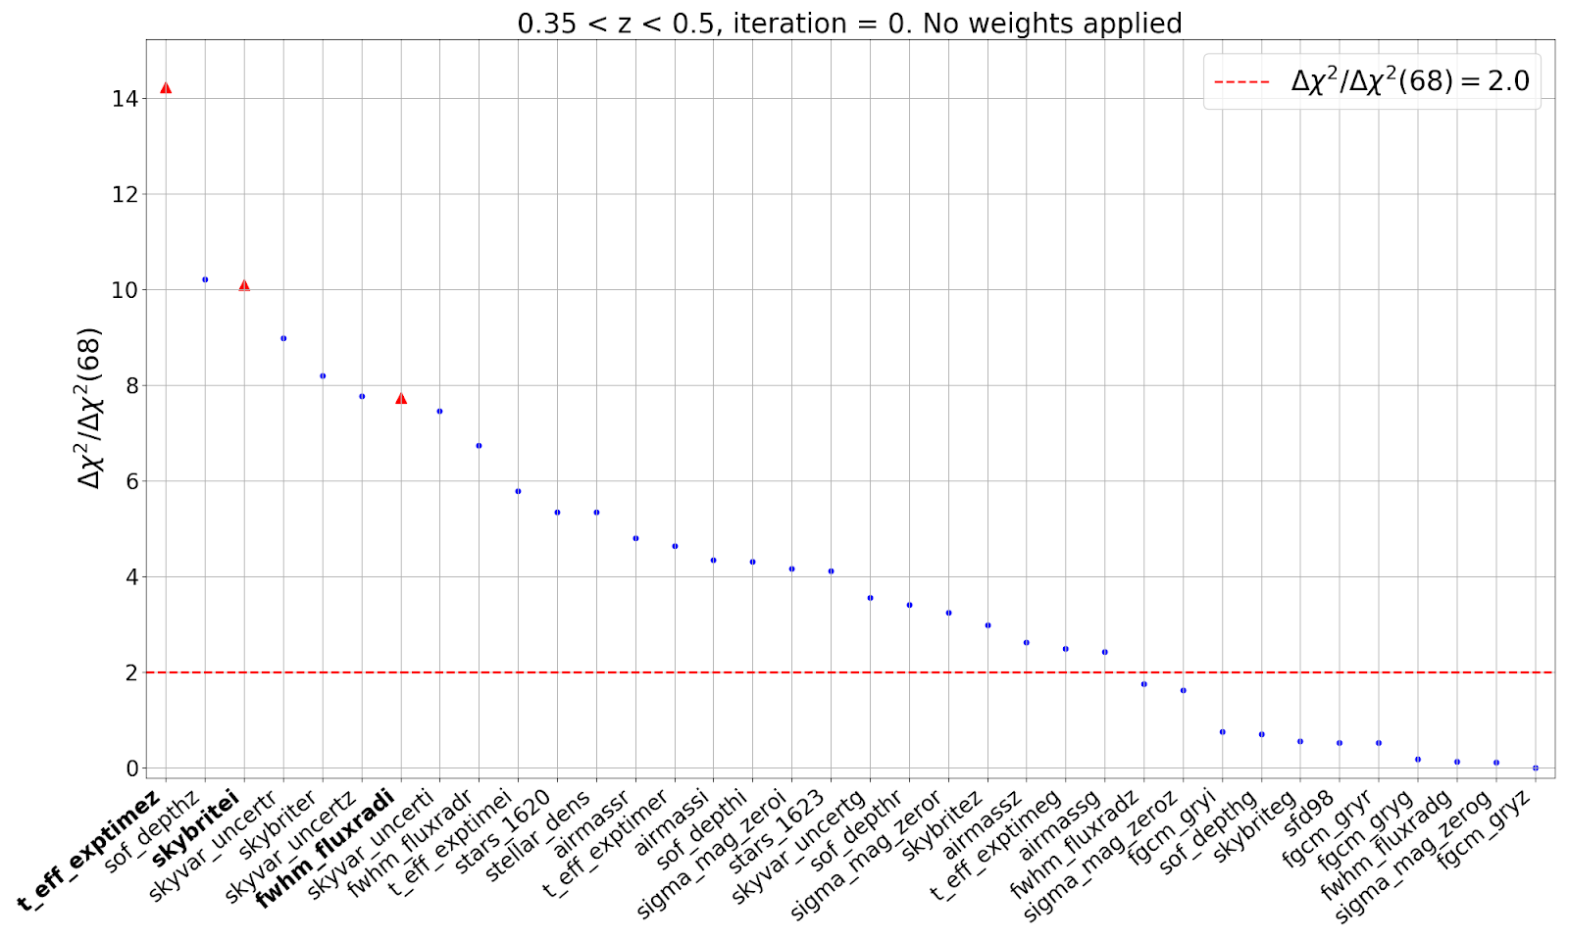
Systematics mitigation: iterative process
Most significant SP = Eff. exp. time-z

Slide 15
Systematics mitigation: iterative process
Fit ${N_{gal}}/{\left\langle N_{gal}\right\rangle }$ to $F\left(s\right)= \left\{\begin{aligned}m⋅s+c \\ m⋅\sqrt{s}+c\end{aligned}\right.$
Define the weight $w_{SP}= 1/{F_{SP}(s)}$
Apply the weight map to the Galaxy catalogue: $n_{gal, i} → n_{gal, i, weighted}=n_{gal, i}⋅w_{SP, i}$
Iterative process:
Compute again the SP significances and sort them from highest to lowest
SP with $sig^{2}≥threshold$? -> Go back to 1, 2 and 3
Repeat until all SPs have significance under threshold or max. number of iterations reached

Slide 16
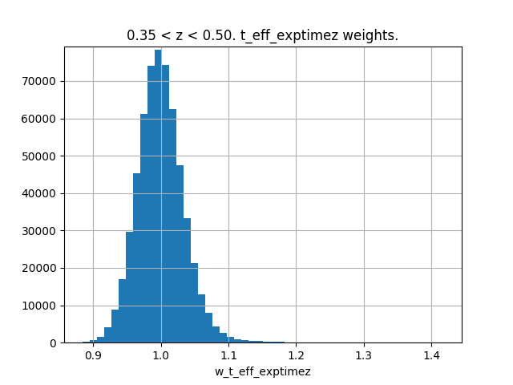
Systematics mitigation: iterative process
Fit ${N_{gal}}/{\left\langle N_{gal}\right\rangle }$ to $F\left(s\right)= \left\{\begin{aligned}m⋅s+c \\ m⋅\sqrt{s}+c\end{aligned}\right.$
Define the weight $w_{SP}= 1/{F_{SP}(s)}$
Apply the weight map to the Galaxy catalogue: $n_{gal, i} → n_{gal, i, weighted}=n_{gal, i}⋅w_{SP, i}$
Iterative process:
Compute again the SP significances and sort them from highest to lowest
SP with $sig^{2}≥threshold$? -> Go back to 1, 2 and 3
Repeat until all SPs have significance under threshold or max. number of iterations reached

Slide 17
Systematics mitigation: iterative process
Fit ${N_{gal}}/{\left\langle N_{gal}\right\rangle }$ to $F\left(s\right)= \left\{\begin{aligned}m⋅s+c \\ m⋅\sqrt{s}+c\end{aligned}\right.$
Define the weight $w_{SP}= 1/{F_{SP}(s)}$
Apply the weight map to the Galaxy catalogue: $n_{gal, i} → n_{gal, i, weighted}=n_{gal, i}⋅w_{SP, i}$
Iterative process:
Compute again the SP significances and sort them from highest to lowest
SP with $sig^{2}≥threshold$? -> Go back to 1, 2 and 3
Repeat until all SPs have significance under threshold or max. number of iterations reached

Slide 18
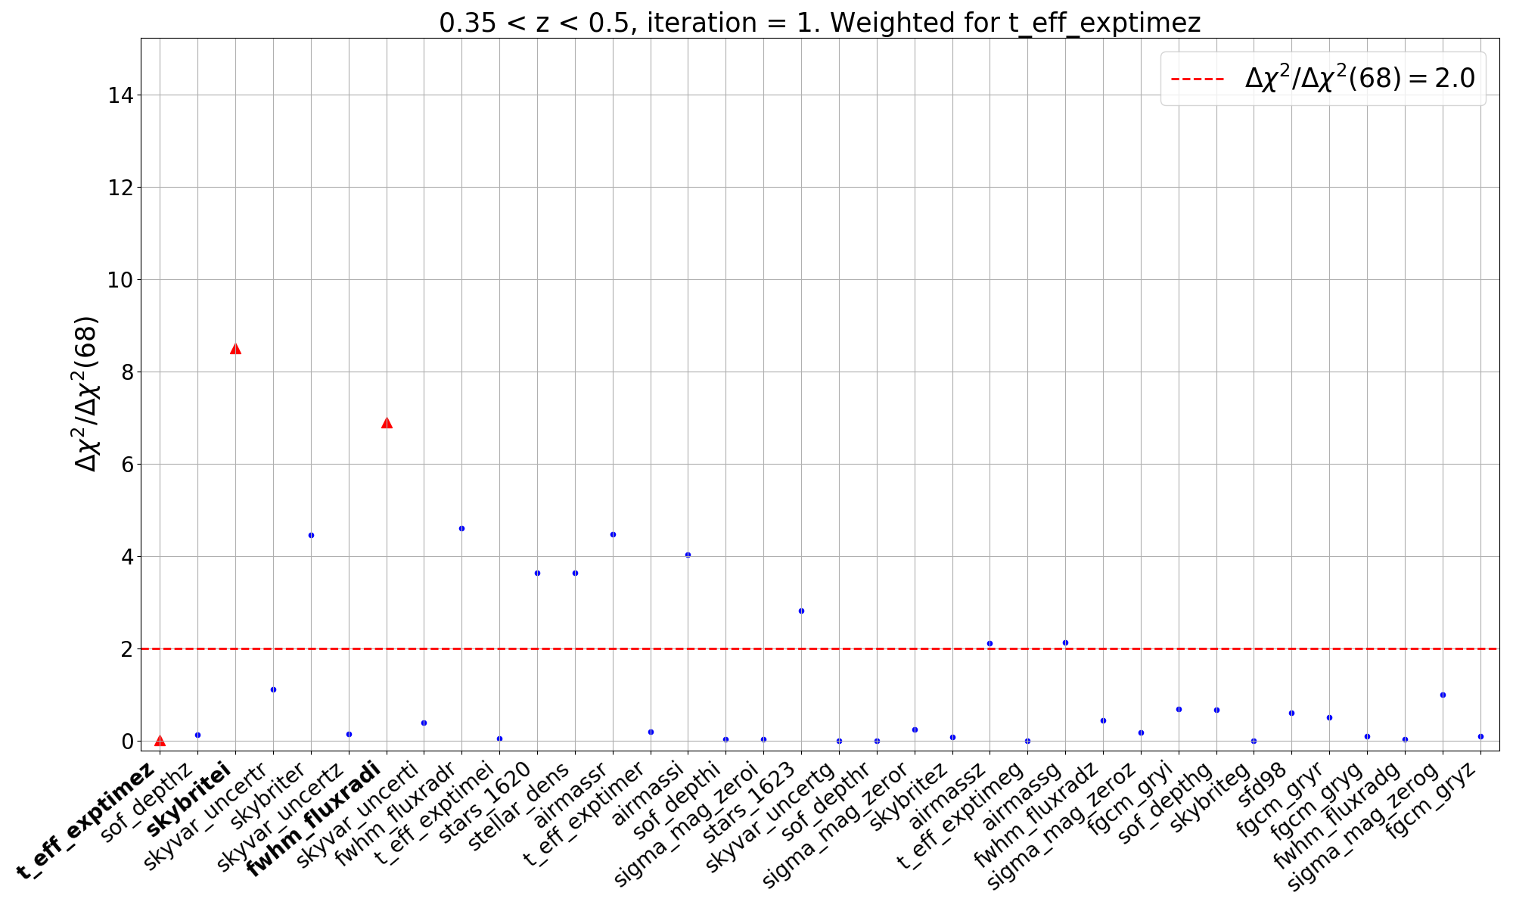
Systematics mitigation: iterative process
Fit ${N_{gal}}/{\left\langle N_{gal}\right\rangle }$ to $F\left(s\right)= \left\{\begin{aligned}m⋅s+c \\ m⋅\sqrt{s}+c\end{aligned}\right.$
Define the weight $w_{SP}= 1/{F_{SP}(s)}$
Apply the weight map to the Galaxy catalogue: $n_{gal, i} → n_{gal, i, weighted}=n_{gal, i}⋅w_{SP, i}$
Iterative process:
Compute again the SP significances and sort them from highest to lowest
SP with $sig^{2}≥threshold$? -> Go back to 1, 2 and 3
Repeat until all SPs have significance under threshold or max. number of iterations reached

Slide 19
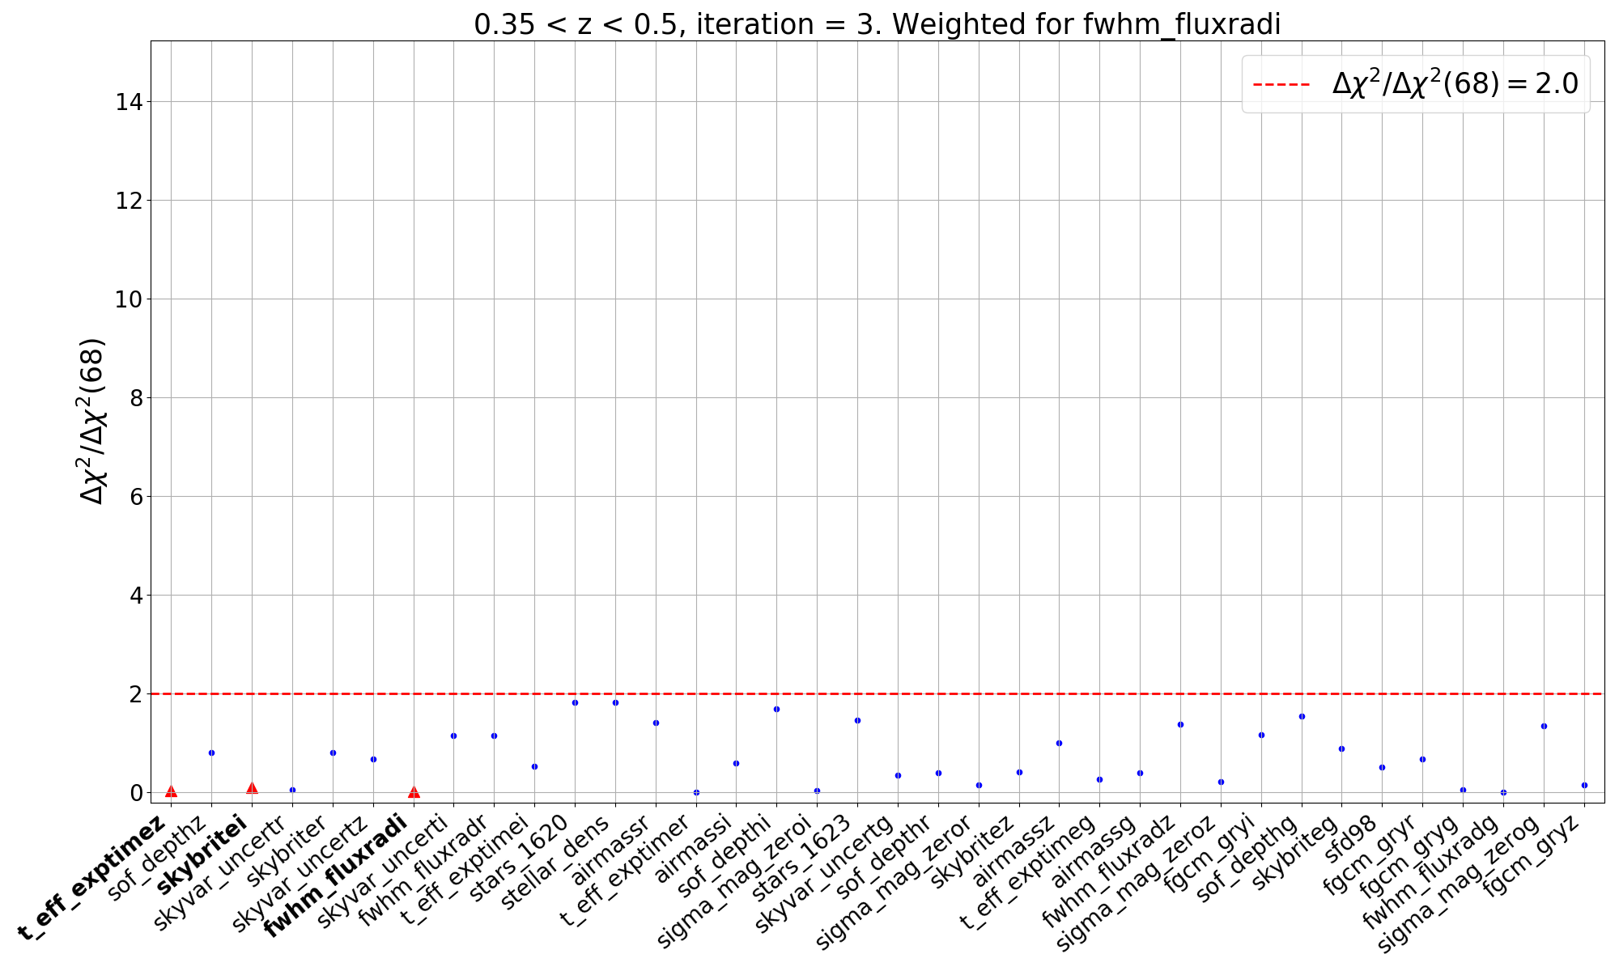
Systematics mitigation: iterative process
Fit ${N_{gal}}/{\left\langle N_{gal}\right\rangle }$ to $F\left(s\right)= \left\{\begin{aligned}m⋅s+c \\ m⋅\sqrt{s}+c\end{aligned}\right.$
Define the weight $w_{SP}= 1/{F_{SP}(s)}$
Apply the weight map to the Galaxy catalogue: $n_{gal, i} → n_{gal, i, weighted}=n_{gal, i}⋅w_{SP, i}$
Iterative process:
Compute again the SP significances and sort them from highest to lowest
SP with $sig^{2}≥threshold$? -> Go back to 1, 2 and 3
Repeat until all SPs have significance under threshold or max. number of iterations reached
$$w_{total}=\prod_{SP}{w_{SP}}$$

Slide 20
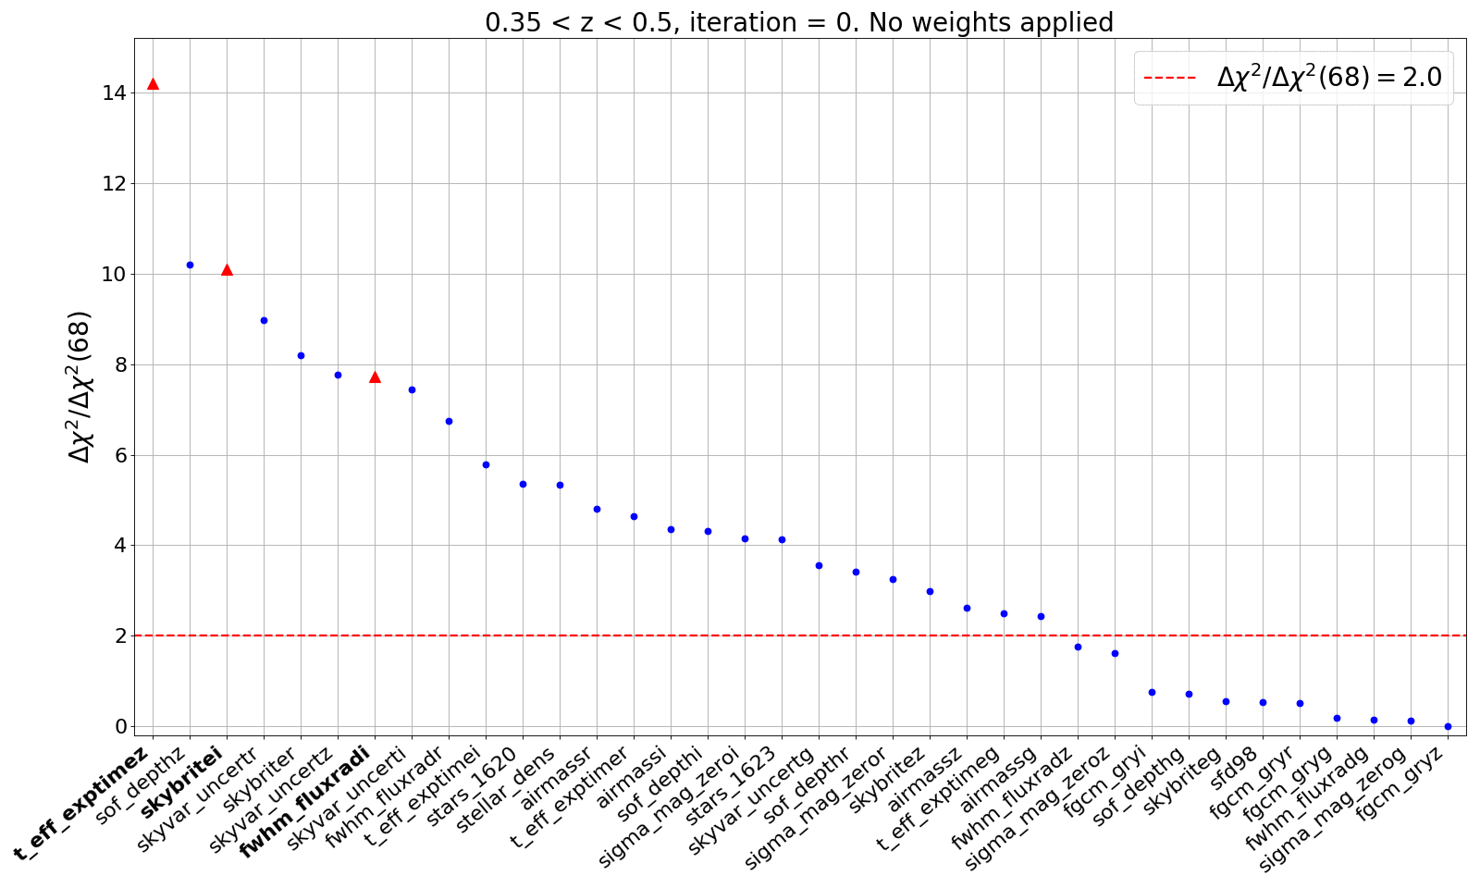
Systematics mitigation: iterative process
SPs we have to weight for ( ):
Eff. exp. time-z
Sky brightness-i
FWHM-i

Slide 21
Systematics mitigation: testing the impact
Results from DES Y1
0.15 < z < 0.3
0.3 < z < 0.45
0.45 < z < 0.6
(J. Elvin-Poole et al., arXiv:1708.01536)
Y3 results coming soon

Slide 22
THANK YOU

Slide 25
POST-CREDITS SCENES

Slide 26
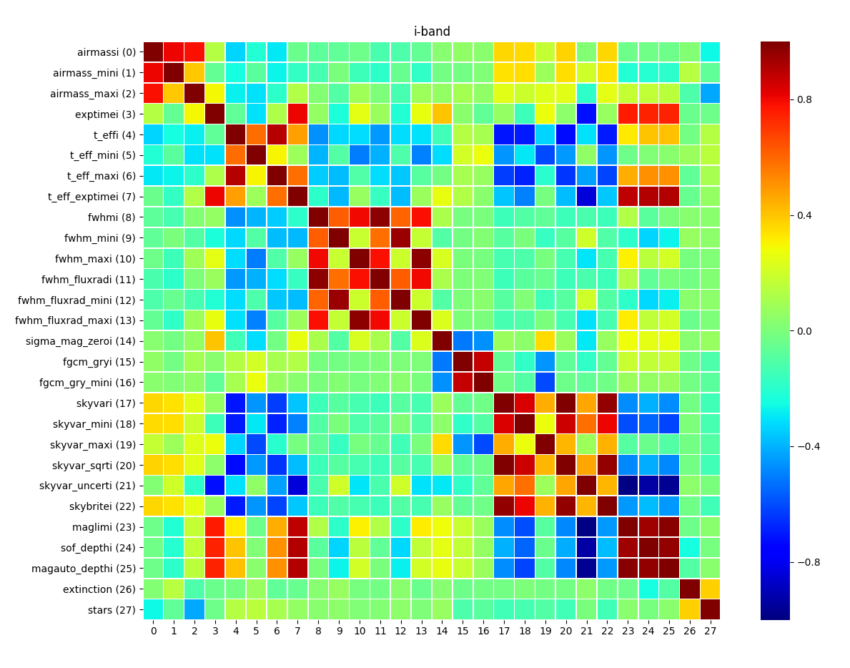
Survey Property maps (SPs)
Pearson’s correlation coefficient, $r_{p}$, helps to identify these “families” of SPs
It also allows to identify correlations between other maps

Slide 27
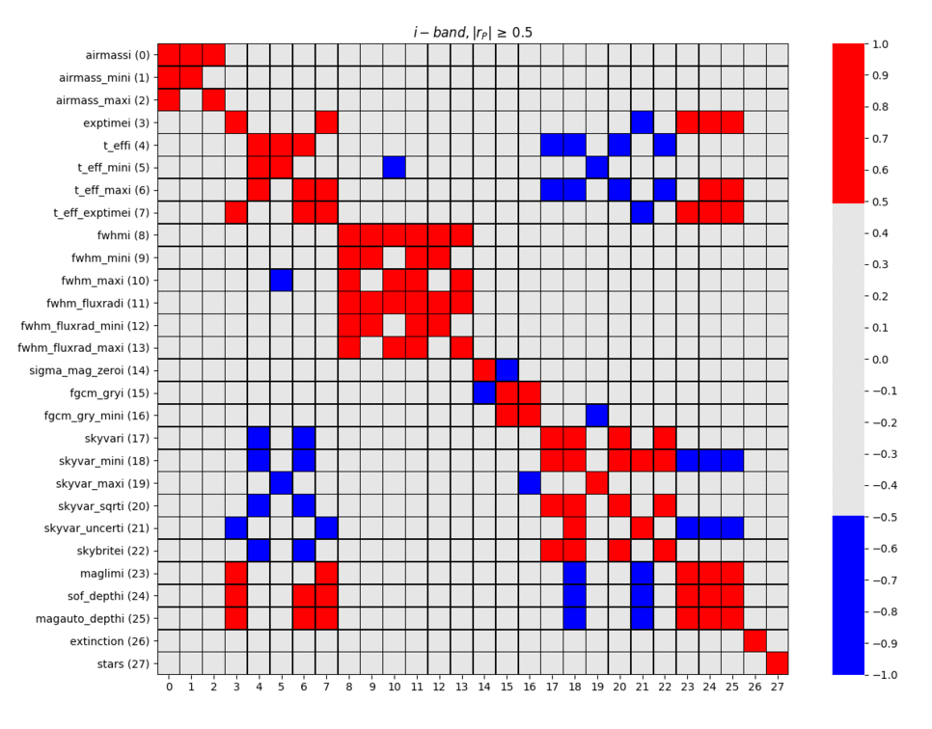
Survey Property maps (SPs)
Pearson’s correlation coefficient, $r_{p}$, helps to identify these “families” of SPs
It also allows to identify correlations between other maps
Set different cuts for $r_{p}$

Slide 28
Survey Property maps (SPs)
Pearson’s correlation coefficient, $r_{p}$, helps to identify these “families” of SPs
It also allows to identify correlations between other maps
Set different cuts for $r_{p}$
We fix $\left|r_{p}\right|≥0.7$ to define a family. When posible, we take the weighted averaged mean as representative
102 SPs -> 34 SPs
0.7
-0.7

Slide 29
Systematics mitigation: testing the impact
Results from DES Y1
Y3 results coming soon
(J. Elvin-Poole et al., arXiv:1708.01536)

Slide 30
Systematics mitigation: testing the impact
Results from DES Y1
0.15 < z < 0.3
0.3 < z < 0.45
0.45 < z < 0.6
(J. Elvin-Poole et al., arXiv:1708.01536)
Y3 results coming soon

Slide 31
Systematics mitigation: testing the impact
Results from DES Y1
0.6 < z < 0.75
0.75 < z < 0.9
(J. Elvin-Poole et al., arXiv:1708.01536)
Y3 results coming soon

Slide 32
Systematics mitigation: weights validation
How do we validate these weights?
Selection of a threshold:
Do we correct for the 102 SPs using only the 34 representatives?
Does the selection of a significance threshold impact our constraints?
Is there a threshold that is too high, so systematic contamination is left without correcting?
Biases:
Does the pixel estimator for $w(θ)$ introduce a bias due to the weighting method itself?
Is there a threshold that is too strict, so we overcorrect?
Increase uncertainty:
Is the weighting method affecting the covariance?

Slide 33
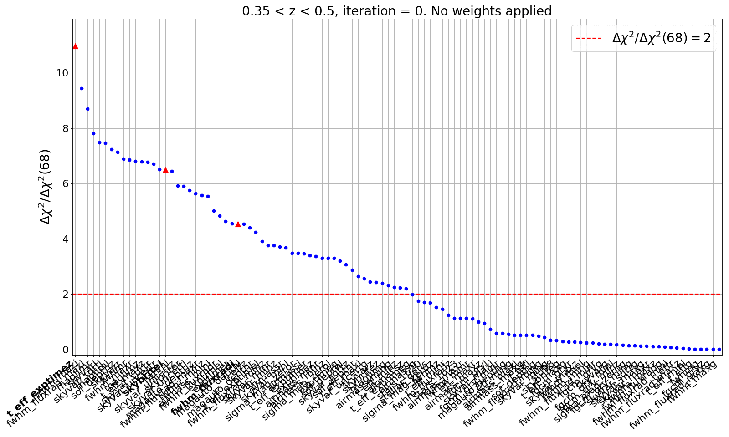
Systematics mitigation: weights validation
Do we correct for the 102 SPs using only the 34 representatives?
SPs we have to weight for ( ):
Eff. exp. time-z
Sky brightness-i
FWHM-i

Slide 34
Systematics mitigation: weights validation
Does the selection of a significance threshold impact our constrains?
0.15 < z < 0.3
0.3 < z < 0.45
0.45 < z < 0.6
(J. Elvin-Poole et al., arXiv:1708.01536)

Slide 35
Systematics mitigation: weights validation
Does the our pixel estimator for $w(θ)$ introduce a bias due to the weighting method itself?
$${\hat{w}}_{1,2}\left(θ\right)= \sum_{i=1}^{N_{pix}}{\sum_{j=1}^{N_{pix}}{\frac{(N_{i,1}−\overline{N_{1}})(N_{j,2}−\overline{N_{2}})}{\overline{N_{1}}⋅\overline{N_{2}}}}}Θ_{i,j}$$
Landy-Szalay $w(θ)$ estimator (pixel version):
$$w_{est−bias}=\frac{1}{N}\left(\sum_{i=1}^{N}{w_{no−sys, i}}−\sum_{j=1}^{N}{w_{weighted j}}\right)$$
Define estimator bias:
Is there a threshold that is too strict, so we overcorrect?
$$w_{false−corr}(thr)=\frac{1}{N}\left(\sum_{i=1}^{N}{w_{no−sys, i}}−\sum_{j=1}^{N}{w_{no−sys, weighted, j}}(thr)\right)$$
Define false correction bias:

Slide 36
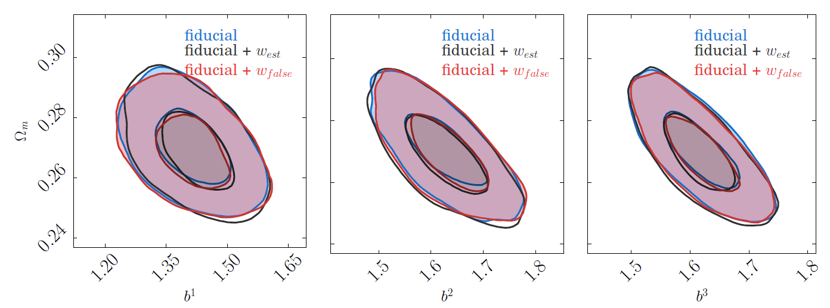
Systematics mitigation: weights validation
Does the our pixel estimator for $w(θ)$ introduce a bias due to the weighting method itself?
Is there a threshold that is too strict, so we overcorrect?
0.15 < z < 0.3
0.3 < z < 0.45
0.45 < z < 0.6
(J. Elvin-Poole et al., arXiv:1708.01536)

Slide 37
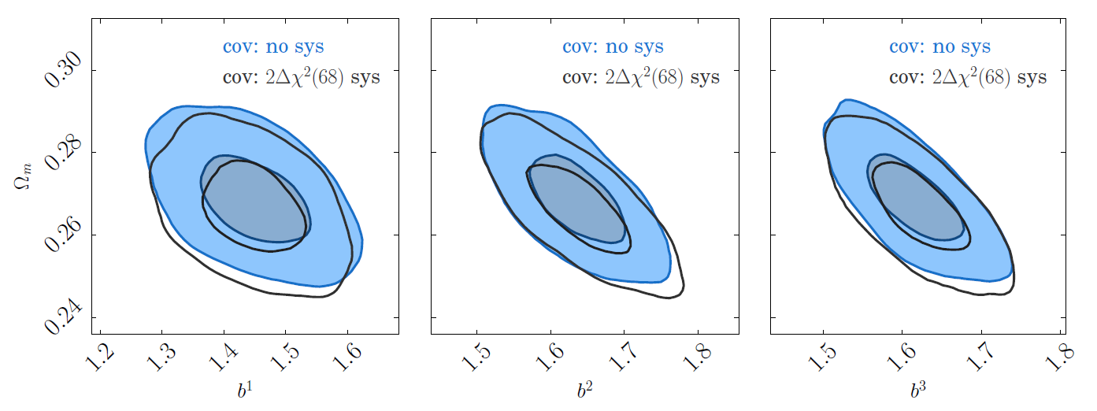
Systematics mitigation: weights validation
Is the weighting method affecting the covariance?
0.15 < z < 0.3
0.3 < z < 0.45
0.45 < z < 0.6
(J. Elvin-Poole et al., arXiv:1708.01536)

