Slide 1
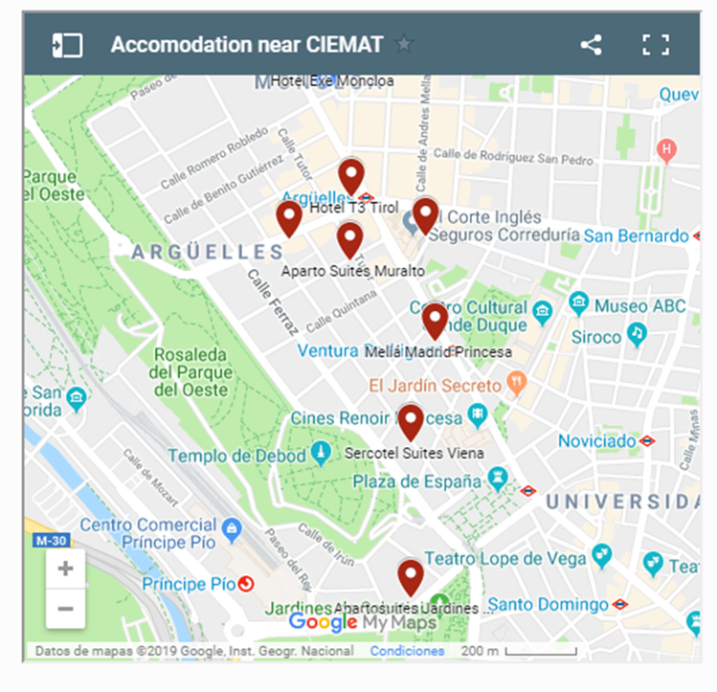
HOTEL EXE MONCLOA 4**** Rate
Calle Arcipreste de Hita, 10 110€ double room for single use
28015 MADRID 120€ double room use
(The accommodation includes bed and breakfast. Rates per night and room VAT included (10%)
If you are interested, please, fill in this form in CAPITALS and e-mail it by 21st November at the
following address: mineico.ciemat@globaliact.com Att. Mrs Sonia Peña.
2.- T3 Tirol
wwwT3tirol.com/web-oficial
C/. Marqués de Urquijo, 4. 28008 –MADRID-
3.- Aparto Suites Muralto
www.muralto.es
C/. Buen Suceso, 3. 28008 –MADRID-
4.- Aparto-Hotel Rosales
www.apartohotel-rosales.com
C/. Marqués de Urquijo, 23. 28008 –MADRID-
5.- Courtyard By Marriott Madrid Princesa
www.marriott.com/hotels/travel/madcy-courtyard-madrid-princesa
C/. Princesa, 40. 28008 – MADRID –
6.- Sercotel Suites Viena
www.suitesviena.com
C/. Juan Álvarez de Mendizábal, 17. 28008 – MADRID -

