Slide 1
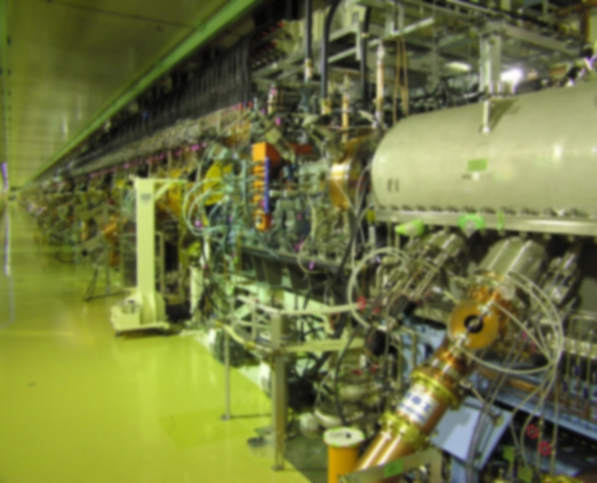
Beam Instrumentations in J-PARC Linac
Akihiko Miura
Beam Monitor Gr., J-PARC

Slide 2
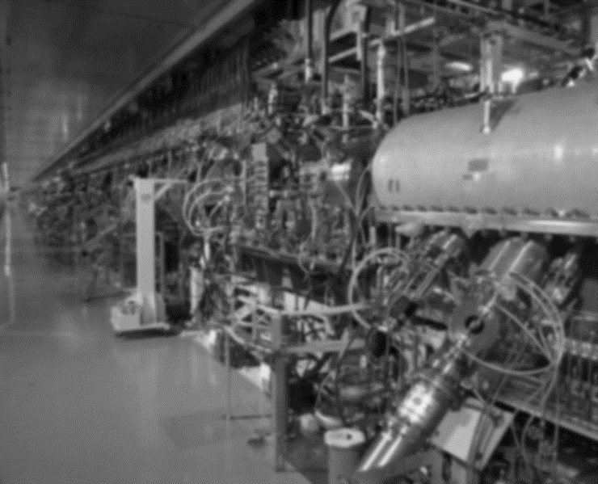
Contents
Akihiko Miura, J-PARC
1. Introduction
  About J-PARC Linac & its Instrumentations
2. Topics of Beam Instrumentations
  Accelerator Tuning & Ordinal Observations of Operation
  Beam Profile Monitors (trans. and long. Profiles)
  Beam Loss Monitors
3. Summary

Slide 3
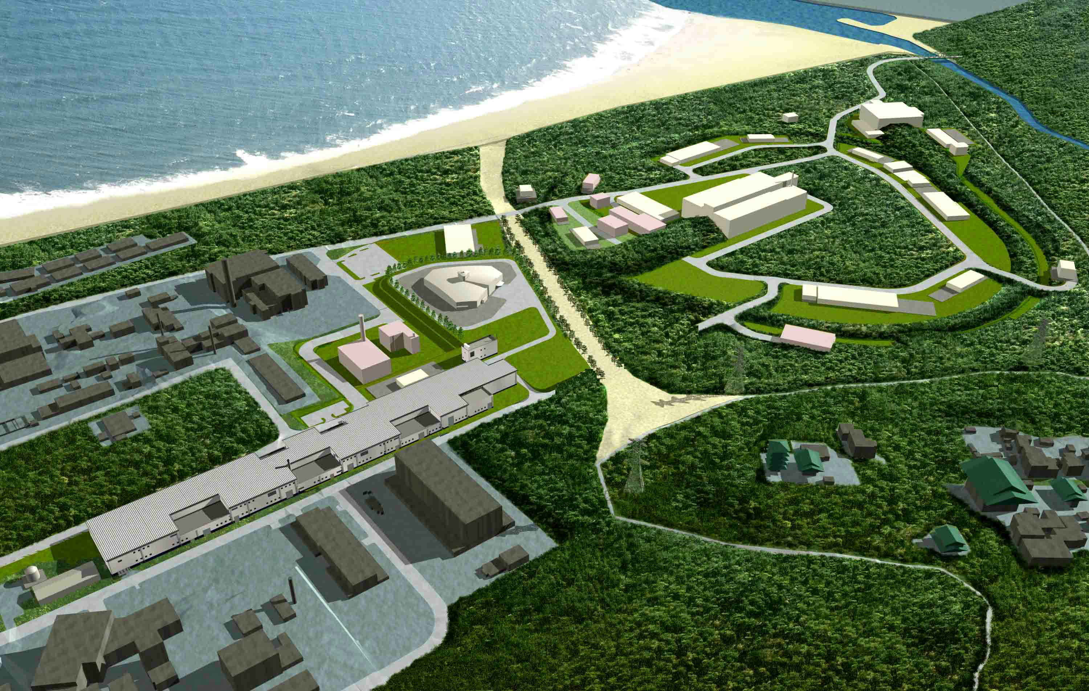

1. Introduction
Akihiko Miura, J-PARC
J-PARC Linac
Pacific Ocean
Hadron Beam Facility
Materials and Life Science
Experimental Facility
５００ｍ
Neutrino to Kamiokande
(for T2K experiment)
3 GeV Rapid Cycle Synchrotron (RCS)
30 GeV Main Ring (MR)
Linac
(400 MeV)
J-PARC = Japan Proton Accelerator Research Complex

Slide 4
1. Introduction
Akihiko Miura, J-PARC
Parameters of J-PARC Linac
Ion species: Negative hydrogen ion
RF frequency: 324 MHz (972 MHz for ACS cavities)
Output energy: 400 MeV
Peak current: 50 mA, (60 mA trial already completed)
Pulse width: 0.5 msec
Repetition rate: 25 Hz
Chopper beam-on ratio: 54% (MLF) / 56% (MR)
Beam power: 135 kW (MLF) / 140 kW (MR)
RCS injection
L3BT 2nd arc
Transverse
halo scrapers
L3BT
1st arc
50keV
3MeV
50MeV
191MeV
400MeV
MEBT1
MEBT2
L3BT
Debuncher
Cavity
IS
RFQ
DTL
SDTL
ACS since 2012

Slide 5
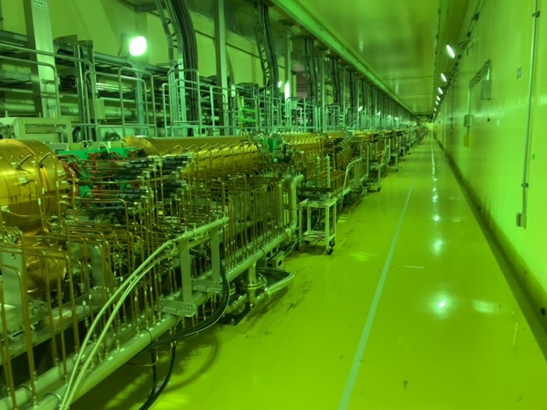
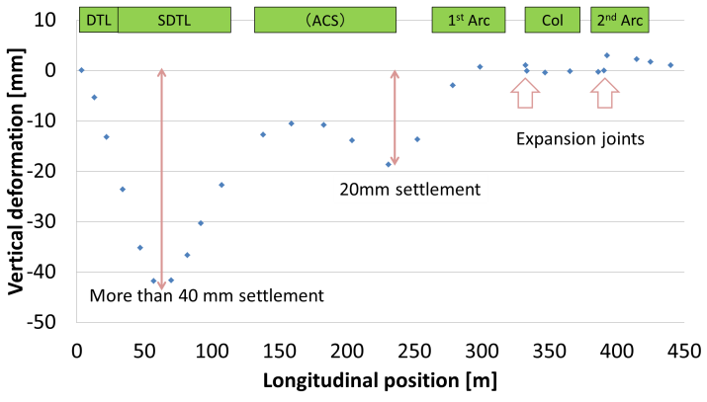
1. Introduction
Akihiko Miura, J-PARC
I: Peak Beam Current
P: Output at 3-GeV exit
Operation History
Year | 2008 | 2009 | 2010 | 2011 | 2012 | 2013 | 2014 | 2015 | 2016 | 2017 | 2018 | 2019 | 2020
I [mA] | 5 | 5 ~ 15 | 15 | 15 | 15 | 15 | 15 ~ 30 | 30 | 30 ~ 40 | 40 | 40 ~ 50 | 50 | 50
P [kW] | - | ~ 100 | 100 ~ 200 | 100 | 200 ~ 300 | 300 | 300 ~ 400 | 500 | 150 ~ 200 | 150~ 400 | 400 ~ 500 | 500 | 500
Event of
Beam
Interruption
Tohoku
Earthquake
Hadron
Facility
Accident
Energy Upgrade
from 181 to
400 MeV
MLF Target Failure
10
0
-10
-20
Vertical Deformation [mm]
20mm
-30
-40
40mm
-50
0
100
200
300
400
Longitudinal Position [m]
Damage on Accelerator Tunnel
ACS Accelerator Cavities
K. Hasegawa, et. al., JPS Conf. Proc. , 011012 (2015)

Slide 6
Contents
Akihiko Miura, J-PARC
1. Introduction
  About J-PARC Linac & its Instrumentations
2. Topics of Beam Instrumentations
  Accelerator Tuning & Ordinal Observations of Operation
  Beam Profile Monitors (trans. and long. Profiles)
  Beam Loss Monitors
3. Summary

Slide 7
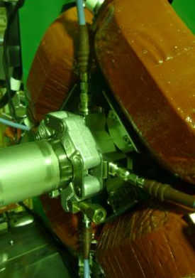
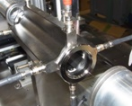
2. Topics of Beam Instrumentations
Akihiko Miura, J-PARC
Accelerator Tuning & Ordinal Observations of Operation
FCT/SCT
FCT/SCT
Acceleration Cavity
Acceleration Cavity
WS
BPM
BPM (Beam Position Monitor)
beam orbit correction
Beam Current Monitor (Slow CT)
cavity transmission optimization
Beam Phase Monitor (Fast CT)
amplitude and phase setting of cavity
Trans. Profile Monitor (Wire Scanner)
optics of beam transfer (settings of quadrupoles)
Strip-line type BPM
Resolution
Δx<~0.1 mm
Δy<~0.1 mm
Quadrupole Magnet
Fast & Slow current transformer for the beam phase & current monitor.
Dynamic Range
SCT: 0.1 – 80 mA
FCT: > 30dB
Winding coil,
SCT: Fifty turns
FCT: Single turn
Resolution,
SCT: ΔI_{beam} < 1.0 %,
I_{min} ~ 0.1 mA
FCT: Δφ_{beam} < 1.0 deg.
Energy: < 0.1 %
BPM
Beam line
A. Miura, et. al., IOP Conf. Series: Journal of Physics: Conf. Series 874 (2017) 012080

Slide 8
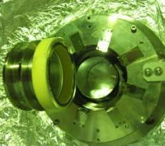
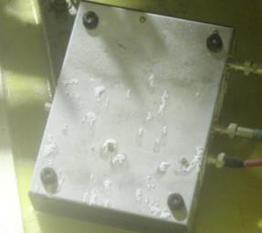
2. Topics of Beam Instrumentations
Akihiko Miura, J-PARC
Accelerator Tuning & Ordinal Observations of Operation
Earthquake attack (Vacuum leakage)
Great earthquake occurred on March 11, 2011.
The seismic intensity: 6-minus (JMA scale)
Because the tsunami-height was fortunately below the floor level of J-PARC, alkali water leakage occurred from cracks of concrete wall.
Corroded pre-amplifier boxes on the floor by strong alkaline.
Brazing section between the ceramic tube and stainless duct was broken.
A. Miura, et. al., WEPC144, Proceedings of IPAC2011, San Sebastián, Spain

Slide 9
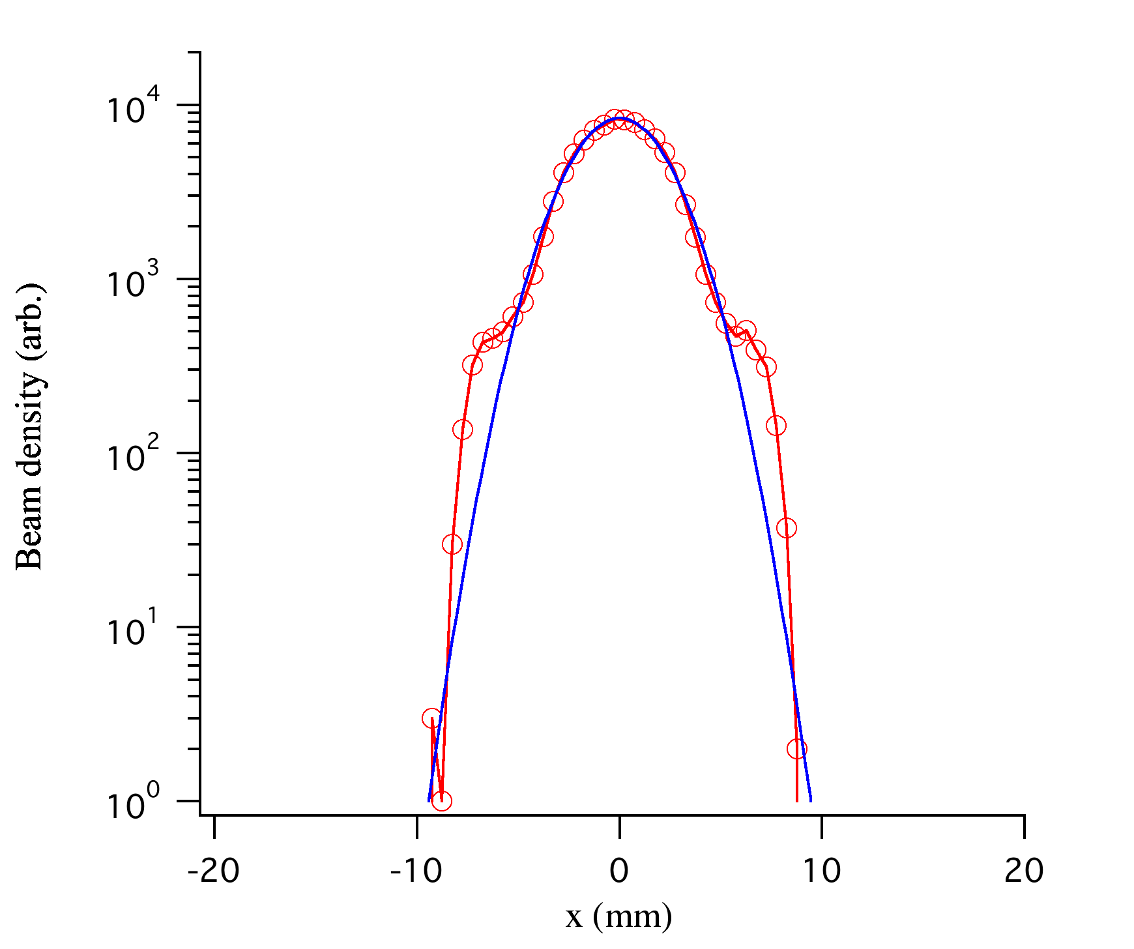
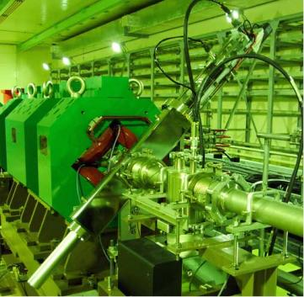
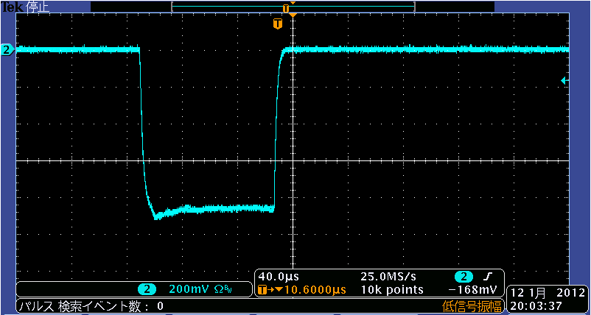

2. Topics of Beam Instrumentations
Akihiko Miura, J-PARC
Beam Profile Monitors (trans. and long. Profiles)
Transverse Profile Monitor, “Wire Scanner”
halo
SDTL03A
Range
Motor Unit
45 deg.
Horizontal Profile
Tungsten
Wire
Carbon Plate for
Vertical Beam Size
Pulse Height
Resolution
σx < 0.1 mm
σy < 0.1 mm
Ceramic Frame
200 mV/div, 40 us/div
Signal Obtained at the Peak of Beam Pulse
A. Miura, et. al., Journal of the Korean Physical Society, Vol. 69, No. 6, September 2016, pp. 1005

Slide 10
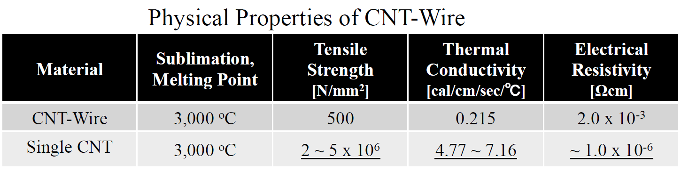
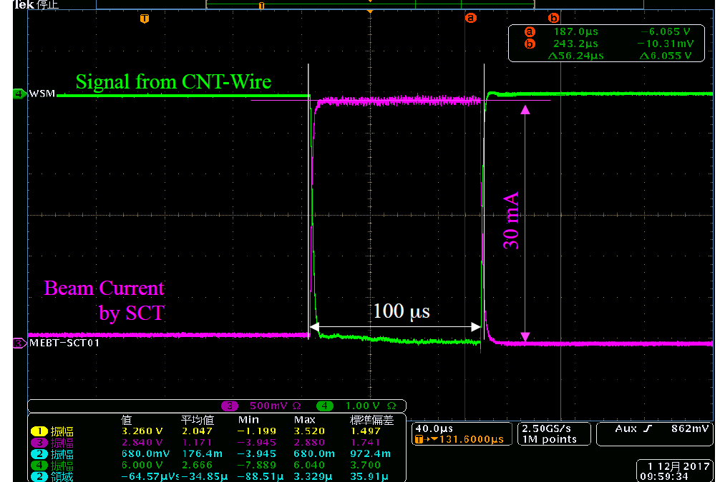
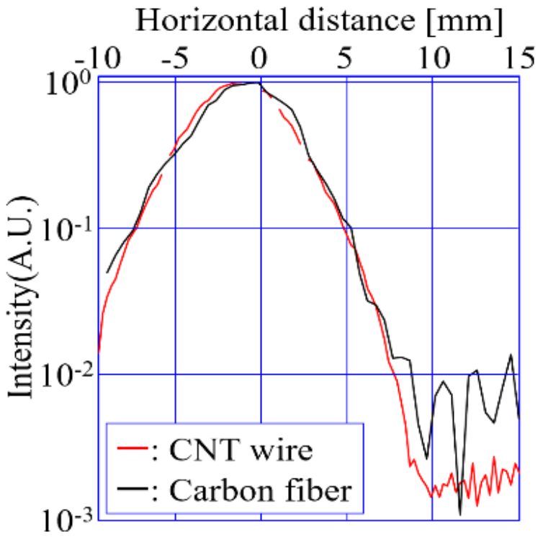
2. Topics of Beam Instrumentations
Akihiko Miura, J-PARC
Beam Profile Monitors (trans. and long. Profiles)
Transverse Profile Monitor, “Wire Scanner”
Application of carbon nanotube wire
Waveform of Signal from CNT Wire at 100 μs operation.
Beam profile taken by CNT wire and carbon fiber
A. Miura, et. al., IOP Conf. Series: Journal of Physics: Conf. Series 1067 (2018) 072020

Slide 11
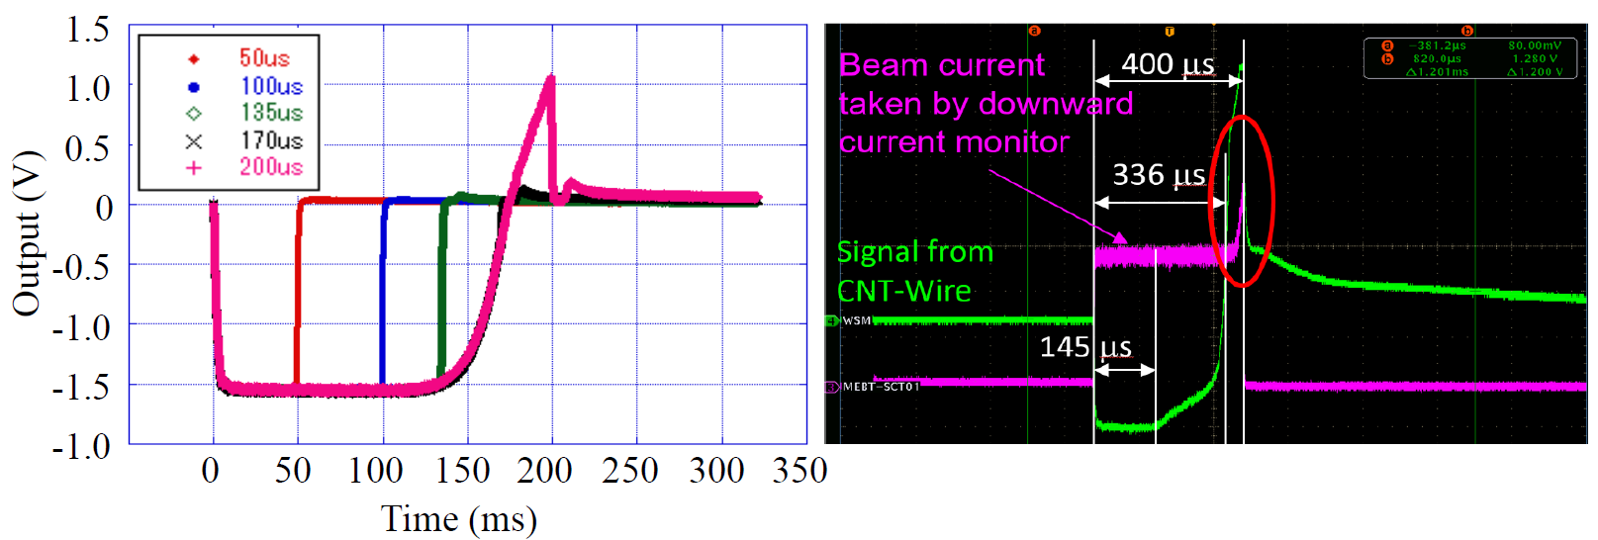
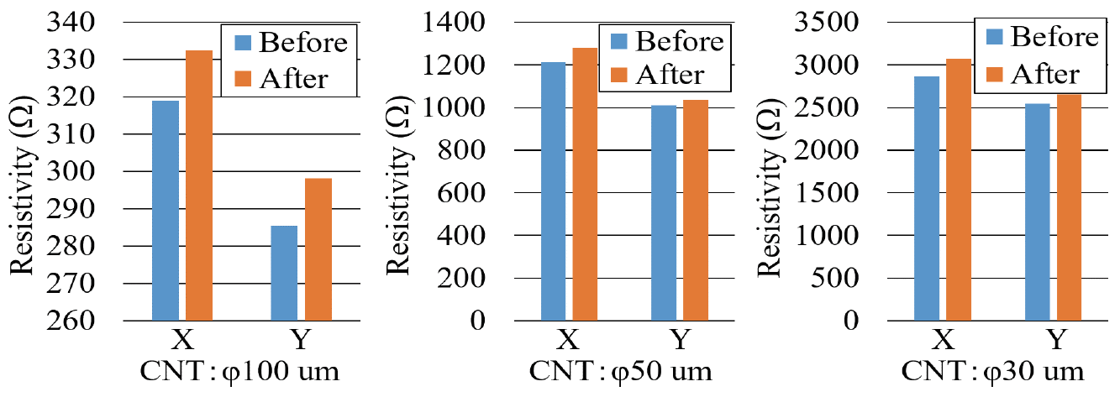
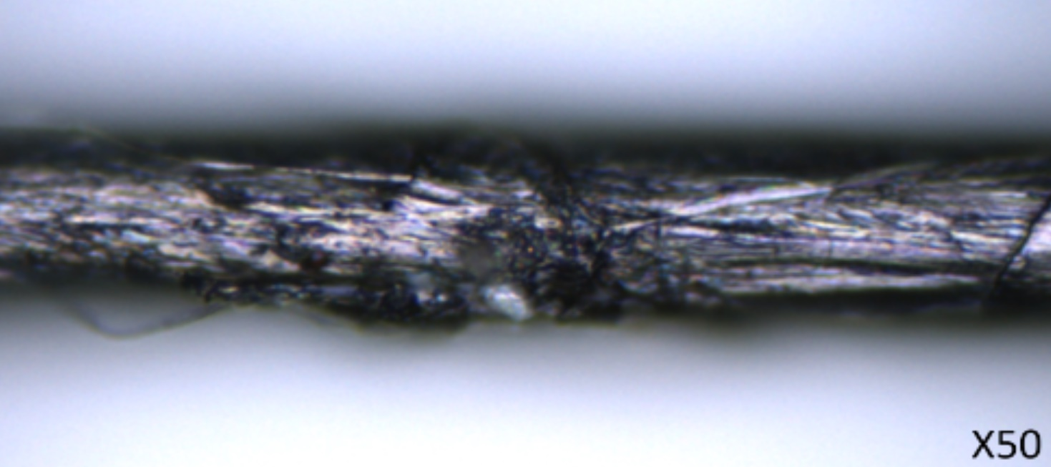
2. Topics of Beam Instrumentations
Akihiko Miura, J-PARC
Beam Profile Monitors (trans. and long. Profiles)
Transverse Profile Monitor, “Wire Scanner”
Application of carbon nanotube wire
Wire Damage
Direct observation by microscope (x50)
A. Miura, et. al., IOP Conf. Series: Journal of Physics: Conf. Series 1067 (2018) 072020

Slide 12
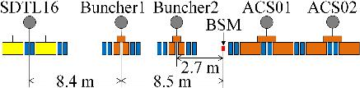
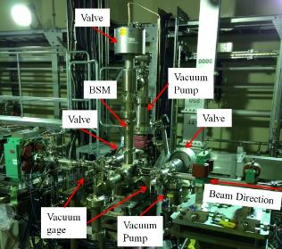
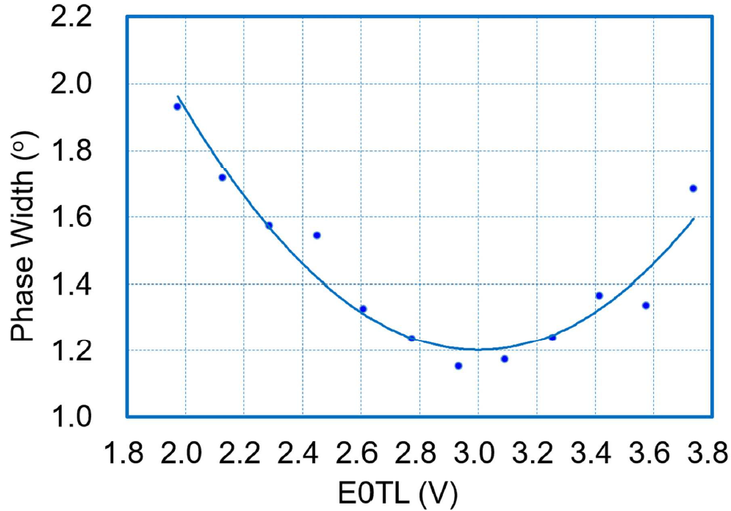
2. Topics of Beam Instrumentations
Akihiko Miura, J-PARC
Beam Profile Monitors (trans. and long. Profiles)
Longitudinal Profile Monitor, “Bunch Shape Monitor”
Amplitude tuning using scan curve and Twiss parameters is trying.
σ²_{BSM}= ε_{z}[(1+Lk)²β_{B}-2L(1+Lk)α_{B}+L²γ_{B}]
ε_{z} is emittance,
L is drift length,
α_{B}, β_{B}, γ_{B} are Twiss parameter,
k is longitudinal focusing force.
Optimization of buncher settings based on the amplitude scan.
Bunch shape monitor installed at beginning of ACS section
Amplitude Scan by Buncher 1
IOP Conf. Series: Journal of Physics: Conf. Series 874 (2017) 012080

Slide 13
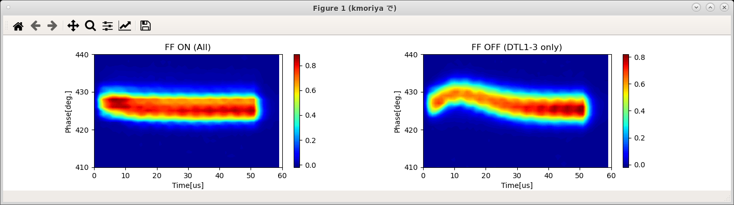
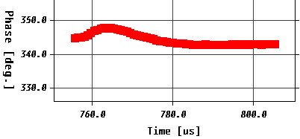
2. Topics of Beam Instrumentations
Akihiko Miura, J-PARC
Beam Profile Monitors (trans. and long. Profiles)
Investigation on RF-abnormarity
Detection of the RF-feed forward/back failure utilized by bunch shape monitor
Unsatisfied beam-loading compensation can be found in deformed pulse shape.
Consistency can be obtained by FCT.
Adjustment of the RF-feed forward power
FF region
Waveform taken by FCT located at downstream of BSM
Failure of the RF-feed forward power
(example: failure at DTL1, 2 and 3)

Slide 14
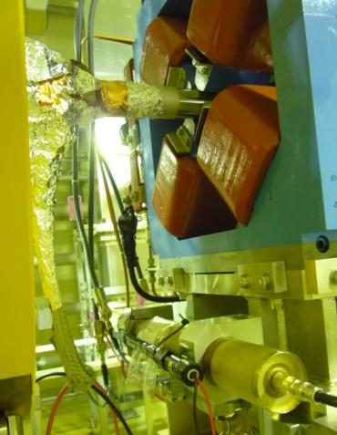
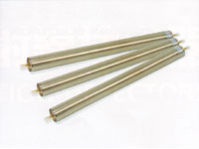
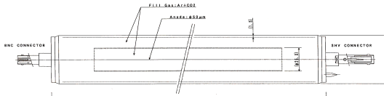
2. Topics of Beam Instrumentations
Akihiko Miura, J-PARC
Beam Loss Monitors
Beam Loss Monitor (BLM)
Sensitive for charged particle, X-ray and gamma-ray
Time response
τ < 1.0 μs
SDTL Cavity
Quadrupole Magnet
Beam line
Gas Proportional BLM, E6876 - 600
Toshiba Electron Tubes & Devices Co. Ltd.,
Length: 600mm
Diameter: 50.8 mm
Gas pressure: 1 atm
Gas Proportional Counter
Scintillation Monitor
Anode Pt Wire, Φ50um
(Gas: Ar+CO2)

Slide 15
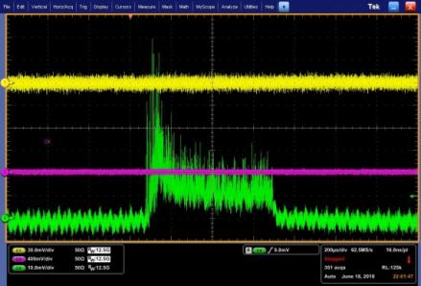
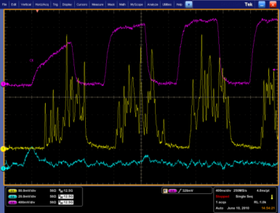
2. Topics of Beam Instrumentations
Akihiko Miura, J-PARC
Accelerator Tuning & Ordinal Observations of Operation
Beam Loss Monitor (BLM), Scintillation Beam Loss Monitor
Gas proportional BLM is sensitive to X-ray from the cavity.
Yellow: S15_SCT01
Pink: S13B_Scintillator
Green: S13B_BLM
Less X-ray sensitivity
Clear beam loss signals with low noise
High time resolution
600us
Beam (CT)
40ns
160ns
160ns
Scintillator
600ns
Photo-multiplier: Hamamatsu H3164-10
(gain : 1.1 x 10⁶, peak wavelength : 420 nm)
Plastic scintillator: Saint-Gobain BC-408
(peak emission wavelength: 425 nm)
Proportional
A. Miura, et. al., MOPD43, Proceedings of DIPAC2011, Hamburg, Germany

Slide 16
Summary
Akihiko Miura, J-PARC
1. Introduction
  About J-PARC Linac & its Instrumentations
  Parameters of J-PARC Linac
  Operation History
2. Topics of Beam Instrumentations
  Accelerator Tuning & Ordinal Observations of Operation
  Earthquake attack (Vacuum leakage)
  Beam Profile Monitors (trans. and long. Profiles)
  Transverse Profile Monitor; Wire Scanner
  Longitudinal Profile Monitor, “Bunch Shape Monitor”
  Beam Loss Monitors
  Gas Proportional Counters
  Scintillation Beam Loss Monitor
3. Summary

Slide 17
Akihiko Miura, J-PARC
Thank You

