Slide 1



Experiences during Hadron LINAC Commissioning
Virtual workshop January 25th to 29th, 2021
Organized by CIEMAT & GSI
European Union funding via ARIES-ADA

Slide 2
ARIES and Network ADA
First of all: Thank you very much for contributing to this workshop!
ARIES integrating activity:
Accelerator Research and Innovation for European Science and Society
Funded by European Union from 2016 to 2021
41 participating institutions from 18 countries coordinated by M. Vretenar CERN
18 work-packages on many aspects for accelerator research
Work-package Network ADA = Advanced Diagnostics for Accelerators
Exchanges of knowledge by special topic workshops and exchange of personnel
Organized by ALBA, CERN, DESY and GSI with support of further institutes
8 previous workshops as face-to-face event with 30 to 85 participants
2 remote workshops
4 upcoming workshops: mechanical issues, BLMs, FPGA and radiation hardness
Personnel exchanges between several institutes, presently on halt

Slide 3
Workshop on LINAC Commissioning
Workshop related to ‘Experiences during Hadron LINAC Commissioning’
Many LINACs started operation or will be commissioned soon:
➢ Normal and super-conducting ➢ Pulsed and cw operation ➢ Protons and ions
Exchange of experiences related to:
Commissioning from first day to regular operation
Requirements, realization and adequacy of beam instrumentation
Interaction between beam dynamics, diagnostics and operation
Feedback on applications and ‘lessons learned’ from existing LINACs
Improvements for actual and recommendations for planned LINAC commissioning
Workshop execution 2pm to 5:30pm CET = UTC+1h:
Remote presentation from ‘home’ PC, followed by 5 min for direct comments
For speakers: Please upload your presentation at latest 4 h beforehand
Plenary discussion of ≈15 min after 3 talks + summary discussion on Friday
Break-out rooms for your private discussion
More information by ‘local organizer’ Ivan Podadera and Diego Obradors
Thanks to
Program Committee: A. Aleksandrov SNS, P. Forck GSI, J. Marroncle CEA/Saclay,
I. Podadera CIEMAT, F. Roncarolo CERN, V. Scarpine FNAL
& Chairpersons: PC members + W. Blokland SNS, O. Kester TRIUMF,
C. Oliver CIEMAT, A. Reiter GSI , L. Yong KEK

Slide 4
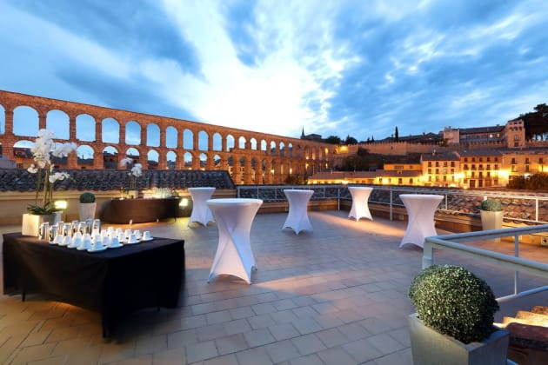
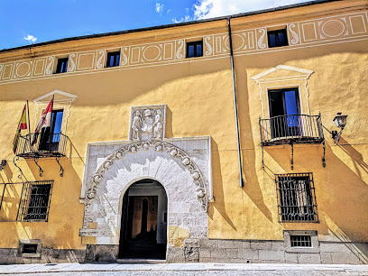
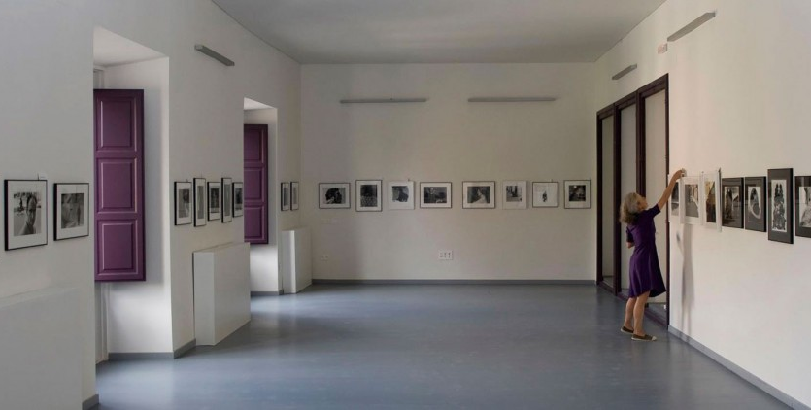


Originally planned Face-to-Face Workshop
Workshop originally planned for June 2020:
Organized by Ivan Podadera, Diego Obradors et al.
Location historical Palacio del Quintanar, Segovia (Spain, 100 km from Madrid)
Duration 2.5 days
European Union would have sponsored: Hotel, tasty Spanish tapas and excellent vine
We are looking forward to a fruitful remote workshop and personal meetings in future!

Slide 5
Technical Hints for the Workshop
One Main Meeting room for the presentations and discussions:
  Zoom ID: 846 3959 6684
  Ten Break-up rooms are accessible from the Main Room for all participants for small group chatting and specific discussion (from main room you can find who is inside)
Since the Main Meeting Room will be closed at the end of the day, three other Zoom Parallel meeting rooms are free for use of the participants to continue the discussions:
  Parallel Room 1 – Zoom ID: 830 0410 8143
  Parallel Room 2 – Zoom ID: 823 2351 9533
  Parallel Room 3 – Zoom ID: 837 8432 9198
All the rooms share the same Password: PLINAC
You can find the agenda and the presentations for download at: https://agenda.ciemat.es/event/1229/timetable/#all.detailed
Please mute your mic and stop your video while you are not talking
Please use your correct name to be recognizable
Short Q&A (5’) at the end of each talk
Longer discussion at the end of each session
Final wrap-up in Friday at the end of the workshop

Slide 6
Technical Hints for the Workshop
To ask a questions:
  Either raise your hand during or at the end of the talk, or write the question in the chat to the chairmen or prior to the meeting
  The chairmen will moderate and give you the floor. Please try to be concise as we are
  many participants.
VIRTUAL CONFERENCE PHOTO:
TUESDAY 26th @ 15:15 CET (UTC+1h) → DON’T MISS IT!
FOR SPEAKERS: We strongly recommend to connect 30-40 min before the start of each day meeting in order to test your connection and presentation. You could also test it during the workshop in break-out rooms
In case you find any technical problem or doubt, please contact us at Plinac@ciemat.es

Slide 7
Thanks for the participation and have fun!

