Slide 1
Warm and cold SNS LINAC commissioning
Warm and cold SNS LINAC commissioning
A. Aleksandrov
Spallation Neutron Source,
Oak Ridge National Laboratory, TN USA

Slide 2
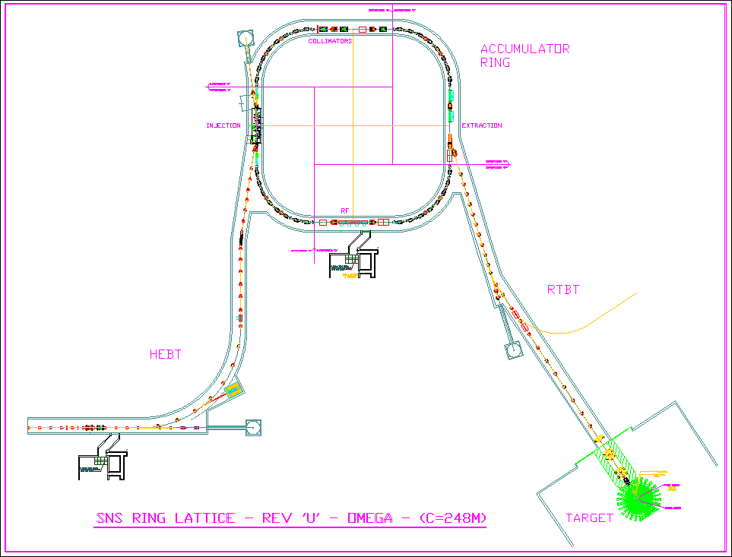
SNS Accelerator Complex
Front-End: Produce a 1-msec long, chopped, low-energy H- beam
LINAC: Accelerate the beam to 1 GeV
Accumulator Ring: Compress 1 msec long pulse to 700 nsec
H- stripped to protons
Deliver beam to Target
2.5 MeV
86.8 MeV
186 MeV
387 MeV
1000 MeV
Ion Source
RFQ
DTL
CCL
SRF, β=0.61
SRF, β=0.81
P beam on target : 1.44MW
I beam average: 1.44mA
Maximum Beam energy: 1 GeV
Duty factor: 6%
Rep. rate: 60Hz
Pulse width: 1ms
Current
1ms

Slide 3
SNS beam pulse temporal structure
Macro-pulse
Structure (made by the Ion Source)
16.7ms (1/60 Hz)
15.7ms
1ms
Mini-pulse
Structure (made by the choppers)
945 ns (1/1.059 MHz)
645 ns
300 ns
260 micro-pulses
Micro-pulse
structure
(made by the RFQ)
2.4845 ns (1/402.5 MHz)

Slide 4
SNS commissioning timeline

Slide 5
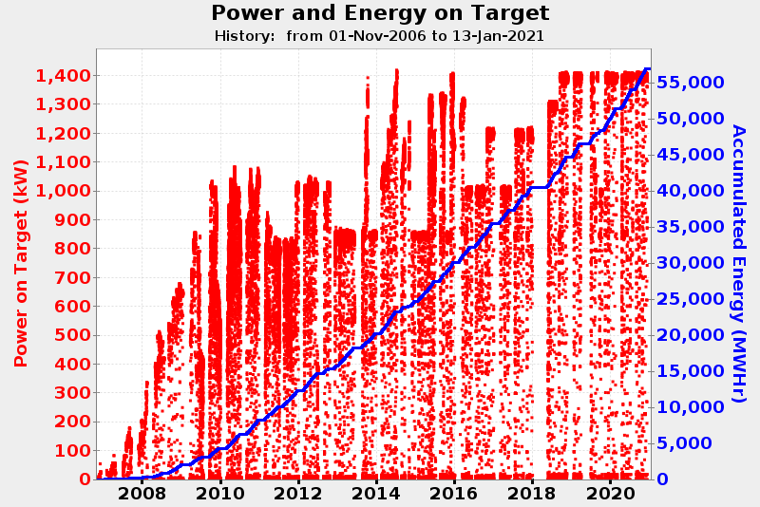
SNS power ramp up and operation timeline
STS, 2.8MW
~ (3 + 1) years to ramp to nominal 1.4MW power
PPU,2MW

Slide 6
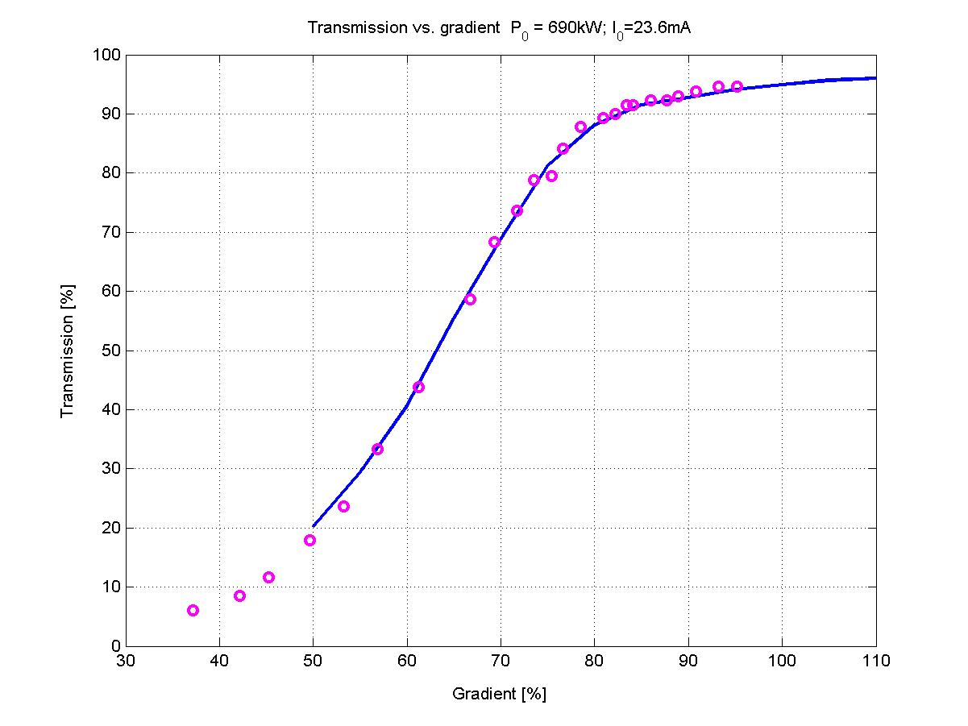
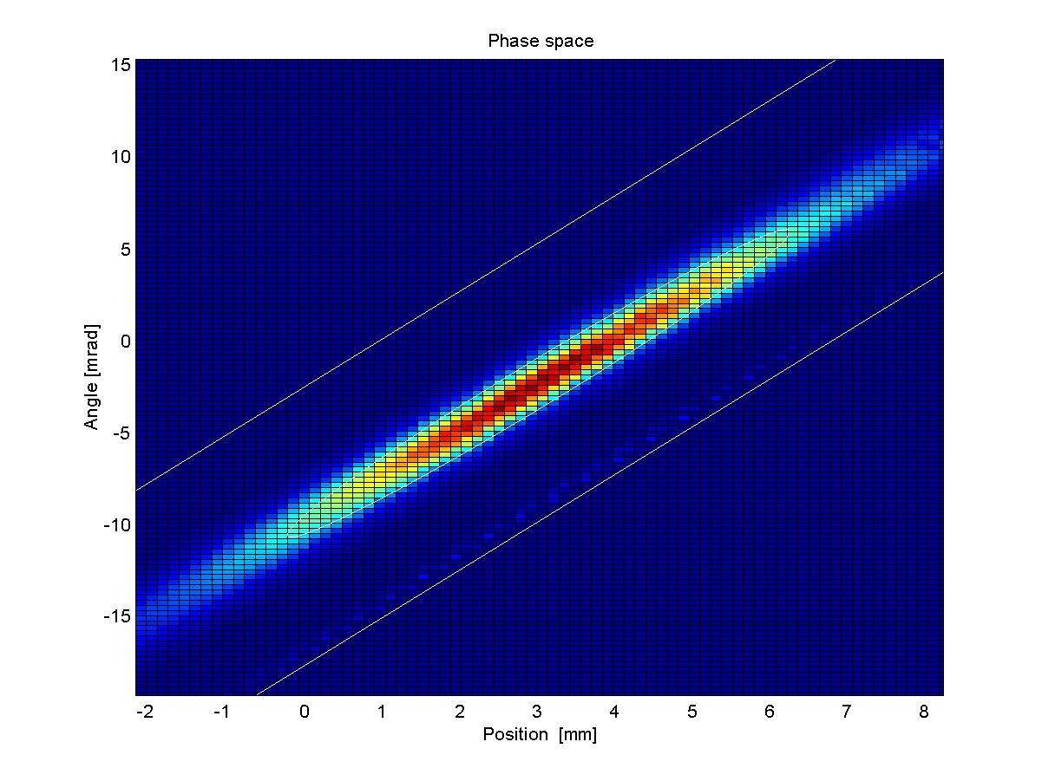
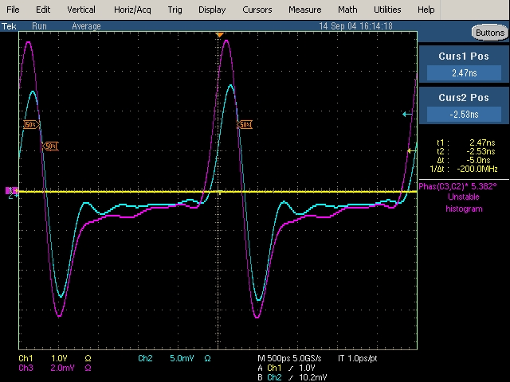
2.5MeV 402.5MHZ RFQ
Output current vs. RF amplitude
Initial commissioning at Berkeley
  Half of full power beam test
  Output beam current (‘’transmission’’)
  Transverse beam emittance
Re-commissioning at SNS
  Beam energy (Time-of-Flight)
  Full power beam test
Vertical beam emittance
Raw signal from two BPMs
No surprises encountered

Slide 7
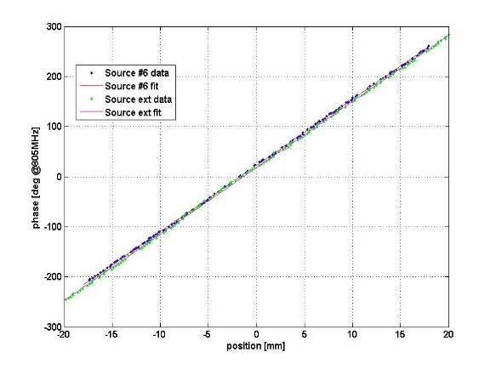
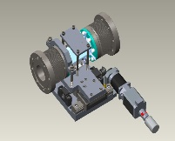
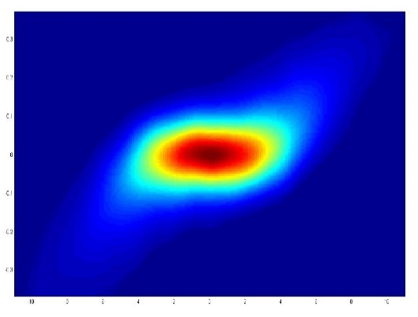
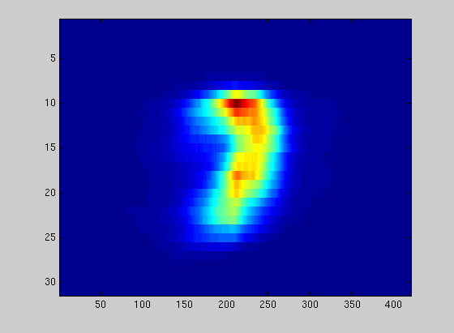
Testing new RFQs at SNS Beam Test Facility
Beam Transmission
Beam Energy
Beam emittances (Kiersten Ruisard’s talk on Thursday)
  6-dimensional or any projection
Beam halo
  High Dynamic Range (10⁶) 2-dimensional scan
RF amplitude x-ray calibration
Full beam power test
Proton contamination fraction
phase
Movable phase detector (BPM)
position
y’ [radian]
y [mm]
energy
phase

Slide 8
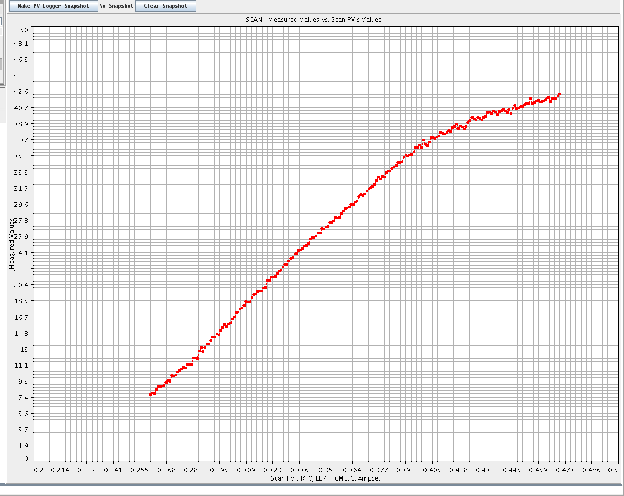
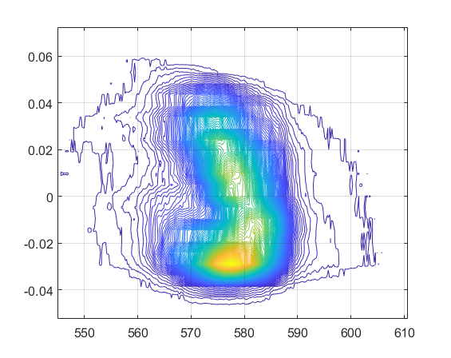
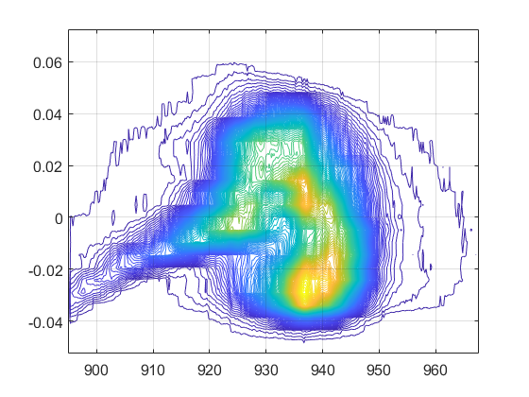
What we learned about SNS RFQ
~85%
Very robust machines, capable to take some abuse
RF amplitude acceptable range is much larger than expected
Transmission is major figure of merit
SNS linac does not require significant tuning when changing RFQ amplitude in wide range
~65%
Transmission
RF filed
~83%
100%

Slide 9
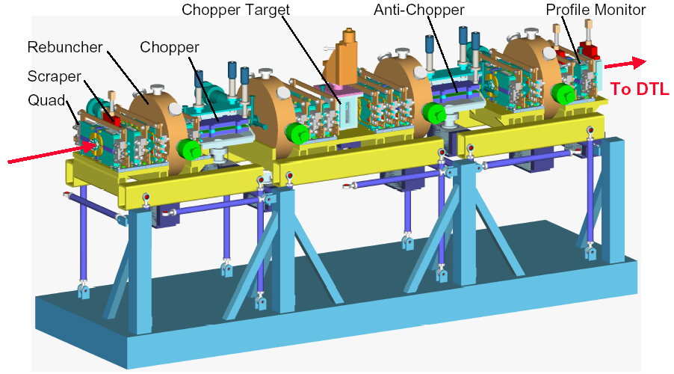
2.5MeV SNS MEBT (fast chopper beamline)

Slide 10
MEBT in-line diagnostics
 | Measured parameter | quantity | Use for commissioning | Use for machine tuning | Use in operation | Use in Beam study
Beam Loss Monitor (BLM) | radiation Ionizing, n | 2 | Yes | No | No | No
Beam Current Monitor (BCM) | beam current | 2 | Yes | Yes | Yes | Yes
Beam Position Monitor (BPM) | x, y, z position | 6 | Yes | Yes | No | Yes
Wire scanner (WS) | x, y 1-d profile | 5 | Yes | No | No | Yes
Differential BCM | In-out beam current | 1 | No | No | Yes | No
Emittance Scanner | x, y 2-d emittance | 1 | Yes | No | No | Yes
Chopper monitor (ChoMPS) | Fast, HDR beam current | 1 | No | No | Yes | No
Laser Wire | longitudinal 1-d profile | 1 | Yes | No | No | No*
X
eliminated
added later

Slide 11
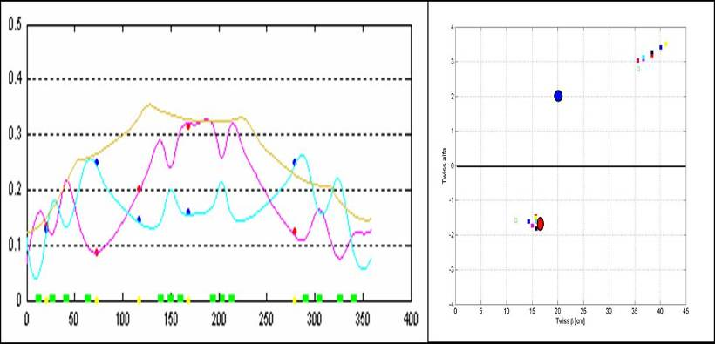


What we learned about SNS MEBT
Can operate without fast chopper
  Chopper was removed
Linac operation is not very sensitive to MEBT optics
Measure transverse profiles using 5 wire scanners
Search for input Twiss parameters to best fit model to measured data
Repeat several times with different quad settings
horizontal
$$α$$
vertical
$$β$$

Slide 12
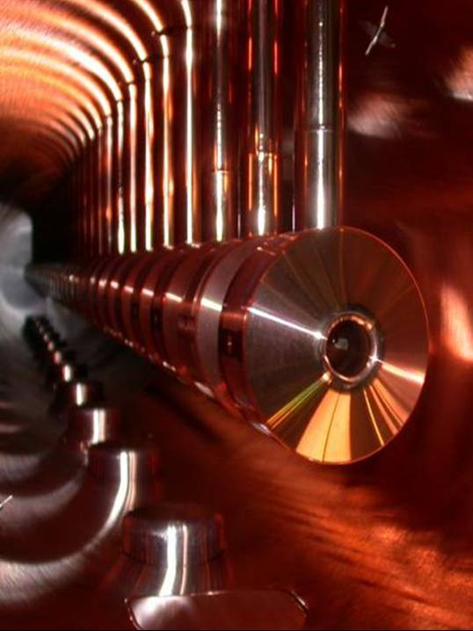
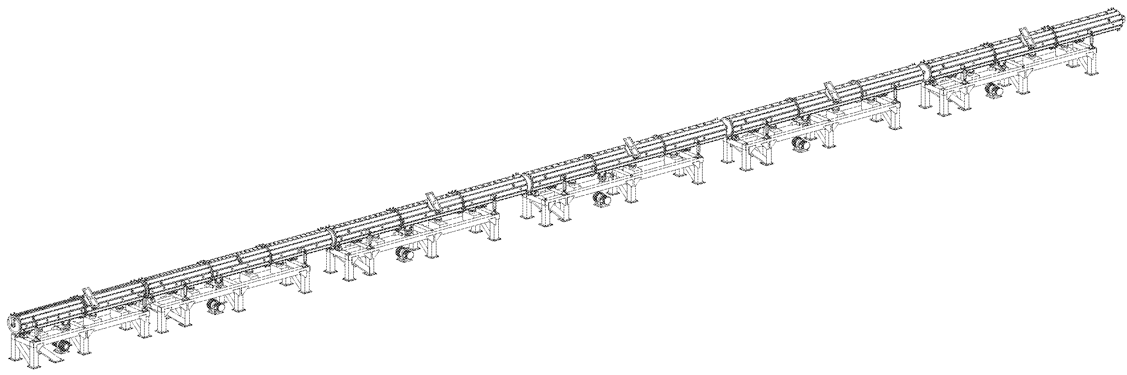
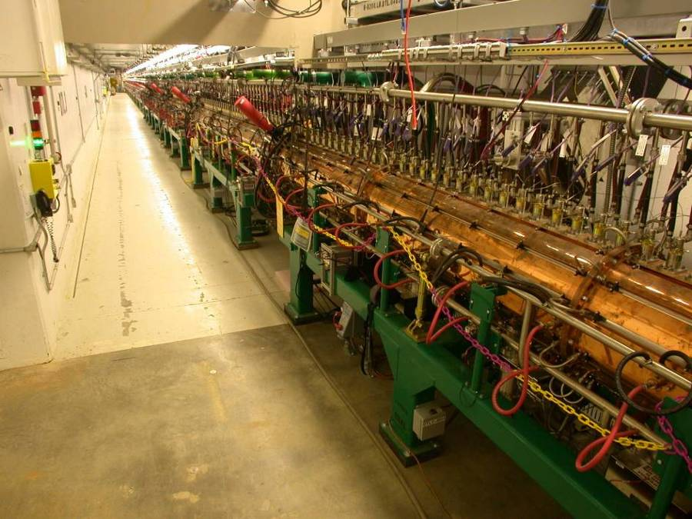
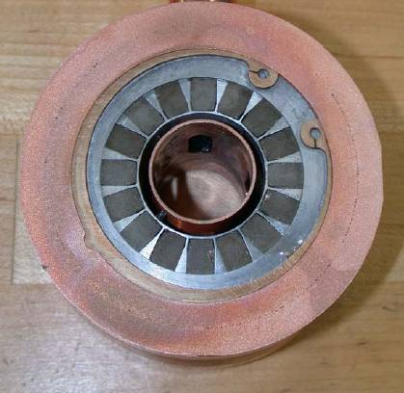
86.7 MeV 402.5MeV Drift Tube Linac (DTL)
Tank 6
86 MeV
Tank 5
Tank 4
Tank 3
Tank 2
Tank 1
36.57 meters
2.5 MeV
Six tanks accelerate beam to 87 MeV
System includes 210 drift tubes, transverse focusing via PM quads, 24 e/m dipole correctors, and beam diagnostics
12 well-defined set points to establish: 6 RF amplitudes, and 6 RF phases

Slide 13
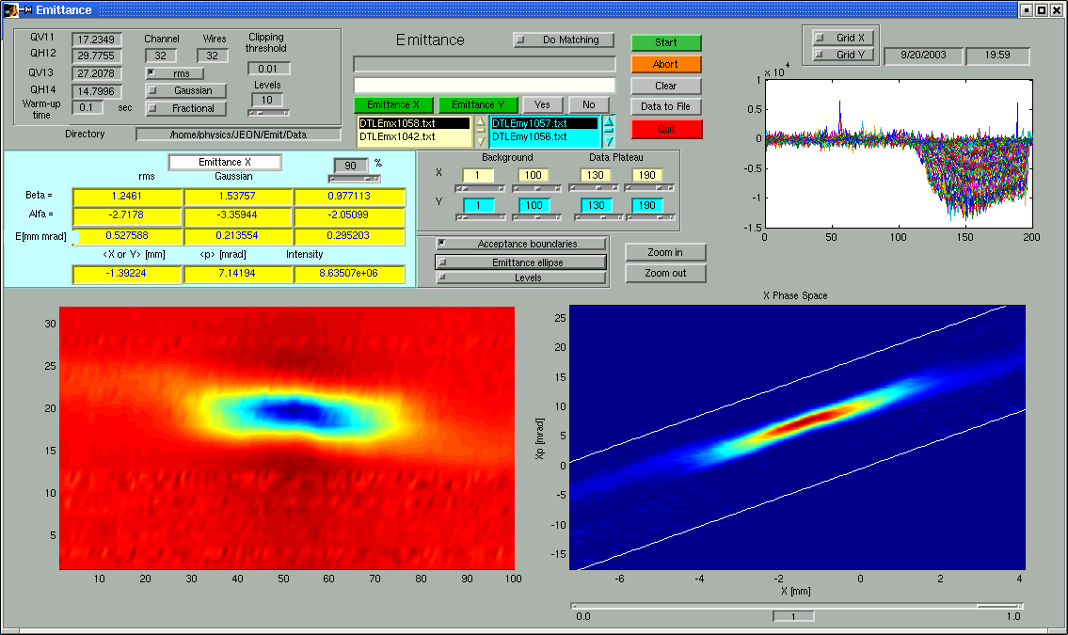
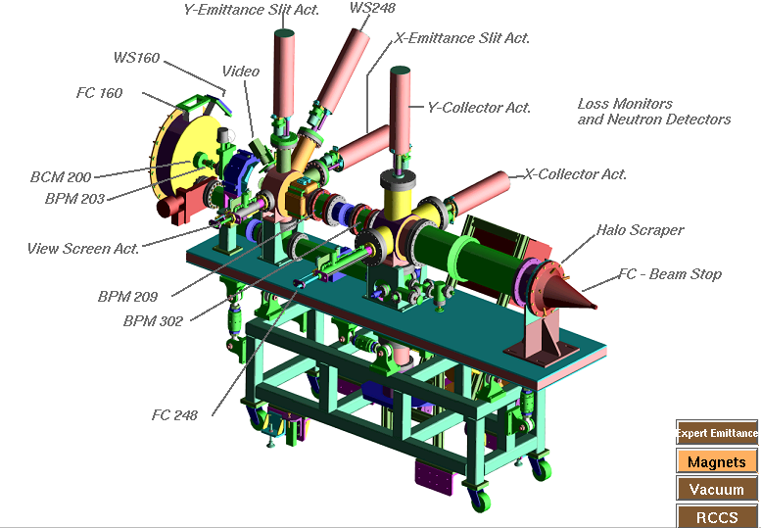
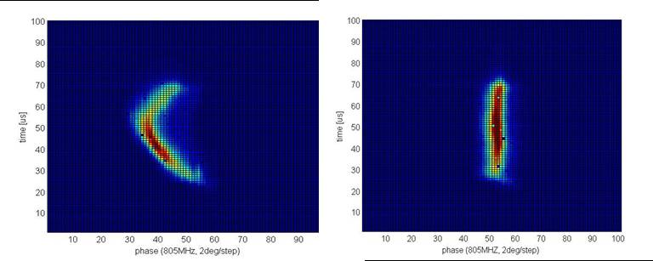
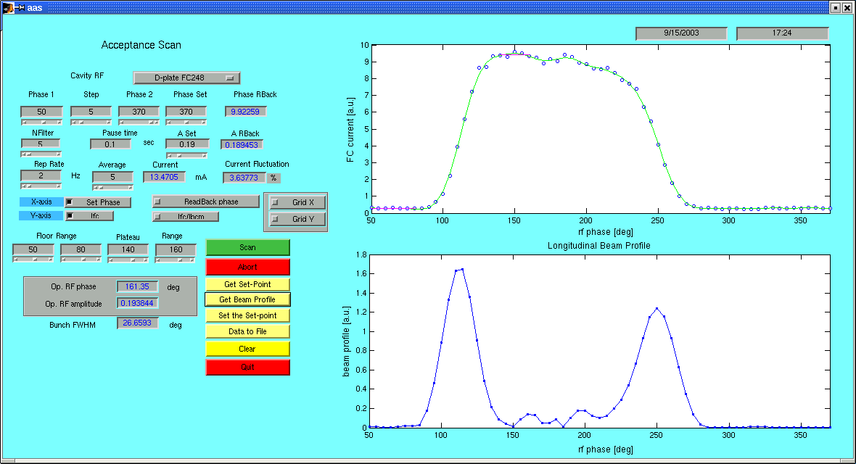
DTL Tank 1 was commissioned using temporary “D-plate”
Bunch Shape Monitor
(BSM)
No surprises encountered

Slide 14
DTL in-line diagnostics
 | Measured parameter | quantity | Use for commissioning | Use for machine tuning | Use in operation | Use in Beam study
Beam Loss Monitor (BLM) | radiation Ionizing, n | 11+12 | Yes | Yes | Yes | Yes
Beam Current Monitor (BCM) | beam current | 6 | Yes | No | No | No
Beam Position Monitor (BPM) | x, y, z position | 10 | Yes | Yes | No | Yes
Wire scanner (WS) | x, y 1-d profile | 6 | Yes | No | No | Yes
Differential BCM (DBCM) | In-out beam current | 1 | No | No | No | No
Faraday Cup with energy degrader (FC) | beam current above energy cutoff | 6 | Yes | Yes | No | Yes

Slide 15
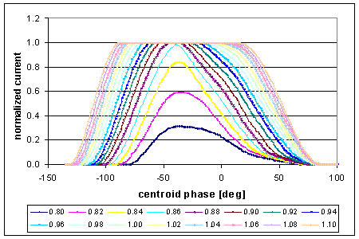
What we learned about DTL
The RF amplitude acceptable range is larger than expected
Is DTL a collimator?

Slide 16
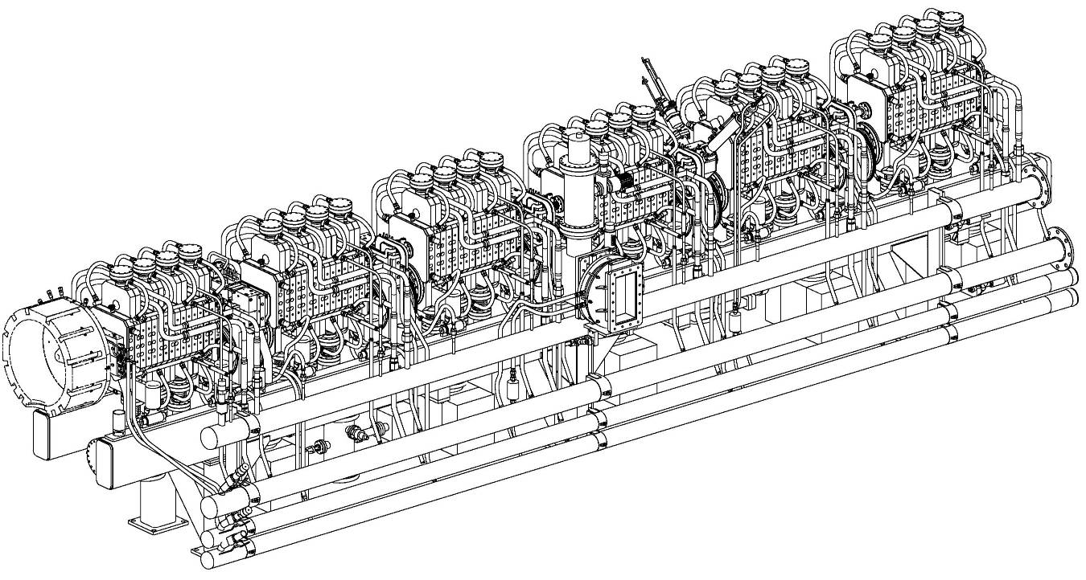
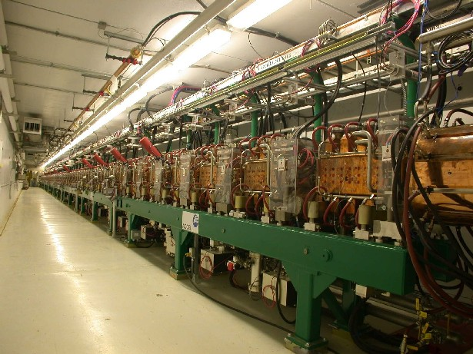
187MeV 805 MHz Coupled-Cavity Linac (CCL)
48 accelerating segments,
48 quadrupoles, 8+8 independent power supplies, 40 trims
32 steering magnets and diagnostics
8 well-defined RF set points to establish: 4 RF amplitudes, and 4 RF phases
16 loosely-defined set points for quadrupoles power supplies

Slide 17
CCL baseline diagnostics
 | Measured parameter | quantity | Use for commissioning | Use for machine tuning | Use in operation | Use in Beam study
Beam Loss Monitor (BLM) | radiation Ionizing, n | 48* + 10 | Yes | Yes | Yes | Yes
Beam Current Monitor (BCM) | beam current | 2 | Yes | No | No | No
Beam Position Monitor (BPM) | x, y, z position | 10 | Yes | Yes | No | Yes
Wire scanner (WS) | x, y 1-d profile | 8 | Yes | No | No | Yes
Beam Shape Monitor (BSM) | longitudinal 1-d profile | 3 + 1 | Yes | No | No | Yes*
eliminated
X

Slide 18
What we learned about SNS CCL
The RF amplitude acceptable range is larger than expected
The transverse optics is more flexible than expected
There is significant flux of field emitted electrons coming out
Transverse alignment of RF cavities is questionable

Slide 19
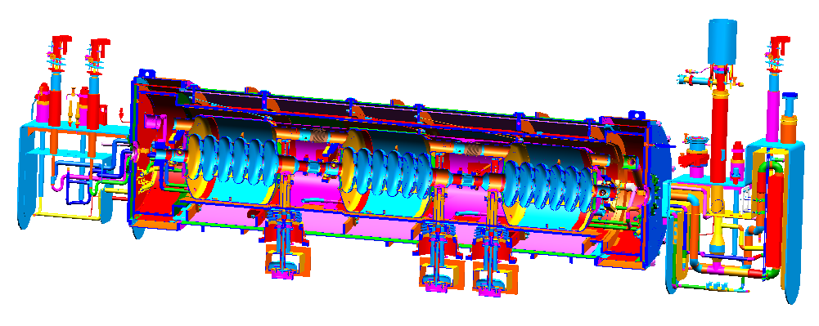
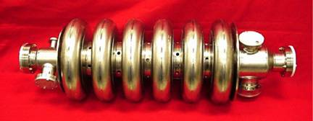
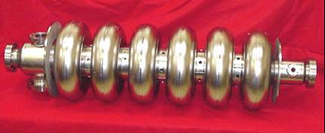
1GeV 805 MHz Superconducting Linac (SCL)
23 cryomodules with 81 SC cavities operating at 2.1K
32 Doublets of quadrupole magnets and diagnostics in warm sections between cryo-modules
Medium beta cavity
162 loosely-defined RF set points to establish: 81 RF amplitudes, and 81 RF phases
32 loosely-defined set points for magnets power supplies
High beta cavity

Slide 20
SCL baseline diagnostics
 | Measured parameter | quantity | Use for commissioning | Use for machine tuning | Use in operation | Use in Beam study
Beam Loss Monitor (BLM) | radiation Ionizing, n | 76 + 23 | Yes | Yes | Yes | Yes
Beam Position Monitor (BPM) | x, y, z position | 32 | Yes | Yes | No | Yes
Laser Wire (LW) | x, y 1-d profile | 9 | Yes | No | No | Yes
Laser Emittance Scanner (LES) | x,y 2-d emittance; longitudinal 1-d profile | 1 | No* | No | No | Yes
added later

Slide 21
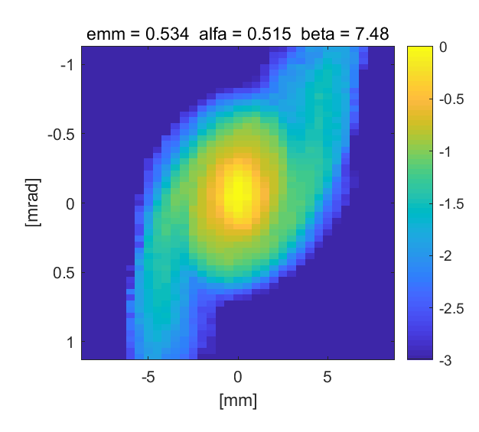
What we learned about SNS SCL
Intra-beam stripping is significant source of beam loss
  Major discovery during commissioning
  All beam diagnostics were important for discovery
Very flexible tuning parameters
  Large flexibility of synchronous phase profile
  Can operate with missing RF cavities or even cryomodules
  Empirical tuning of transverse beam dynamics
Use reduced charge beam pulse for tuning
  <1us, <1mA
No clear relation between RMS parameters and beam loss
  Output RMS emittance ~3 times larger than design value when tuned for minimum beam loss

Slide 22
Diagnostics performance during commissioning
In general, performance was better than documented requirements
  BPM design minimum beam current and pulse width were 6mA, 5us. Works well with <1mA, <1us pulse
  Wire Scanner design dynamic range was <100. Achieve >10,000 with software modification and diagonal wire removal
Possible improvements
  Add gain control for BPMs
  Use 402.5MHz operating frequency instead of 805MHz (or both) for MEBT BPMs
  Reduce laser beam reflections in SCL laser wire
  Increase BSM resolution to ~1ps

Slide 23
What’s for the future?
Can we control beam loss based on knowledge rather than empirically?
  Beam distribution measurements with dynamic range relevant for beam loss, e.g., up to 1ppm (halo)
  Bunch characterization in 6-dimensional phase-space
  Tools and techniques for model vs. real machine benchmarking
  ???

Slide 24
Summary
SNS linac was successfully commissioned for design power operation in ~6 years
Baseline diagnostics were, in general, sufficient for all commissioning stages
SNS linac design is robust with larger tuning margins than anticipated
Beam Position and Phase Monitors are major tool for linac tuning
Beam Loss Monitors are major tool for empirical loss minimization at high power
We did not find good ways of using measured RMS beam parameters for linac tuning or operation
Motivation and direction for future SNS diagnostics development is to enable knowledge-based loss control

