Slide 1
POLICY WORKSHOP ORGANIZATION WP10
Discussion points
Objective of the policy workshop
Timing and location
Available budget
People to invite
Format of the workshop that best suit our objective (presentations, open discussions, etc…)
Possible link with the WP3 workshop
Others?

Slide 2
Objectives of the policy workshop
Task 10.3: Derivation of action plan and policy recommendations (Month 30 – 36) (Lead: CSIC, further partners: Fraunhofer ISI, IASS, TU WIEN, UPRC, CIEMAT-UASE, ESTELA)
In doing so, it is the major objective of this task to support national and European policymakers in designing sustainable and cost-efficient policy packages for the support of CSP which consider the interaction between different policy areas as well as co-effects of environmental policies.
Building on the previous two tasks of this work package, this task will address the key lessons learnt from the other WPs by providing concrete policy recommendations and suggestions for the evaluation, design and monitoring of CSP related policies and regulatory incentives. The recommendations aim to support national and European policymakers in the design of adequate legal frameworks and cost-efficient policy packages that regard the interaction between different policy areas as well as electricity market design.
The core aim of the task is to develop concrete policy recommendations supporting the implementation of individual steps laid out in the CSP roadmaps in task 2.
For completion of this task, a specific focus will be on the stakeholder interaction within WP 3 of the project to ensure that feasible and targeted-oriented recommendations are developed. To this end, the project group will present preliminary policy recommendations to a broad range of stakeholders in order to discuss them in the context of a policy options workshop. The results of this workshop will enable the project team to fine-tune, sharpen and expand the recommendations and thus to increase their political relevance. We consider this as a central element of this work package, because it constitutes a ‘reality check’ of our project work and ensures that the policy recommendations are relevant, comprehensive, consistent and practical.

Slide 3
Objectives of the policy workshop
Present our preliminary views from D10.1
EC presents the CEF program as a possible opportunity for a cooperation project. They are interested. They have made the first move and have shown a great interest in what coul come up from MUSTEC in terms of a possible coop project
Sit together hosts and off-takers, they can find a window opportunity for a possible cooperation project taking advantage of this CEF
Try to engage them in a kind of agreement for an application to the CEF in October

Slide 4
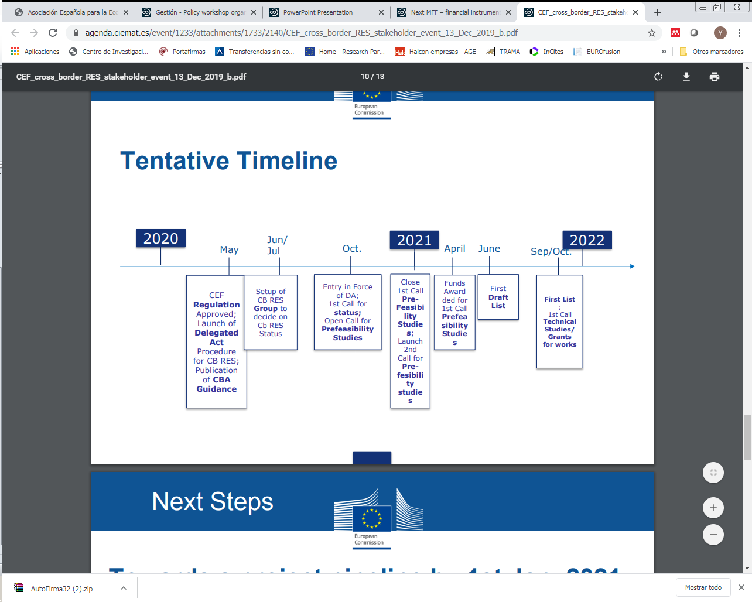
Timing and location
Doing it at the time of the Final conference is too late in order to incorporate their feedback and also too late for the CEF program
Spring 2020 in Madrid?

Slide 5
Available budget

Slide 6
People to invite
Important: right people with some decision power! We cannot miss this opportunity
Other host countries ?

Slide 7
Format of the workshop that best suit our objective (presentations, open discussions, etc…)
Possible link with the WP3 workshop (Christian ?)
Others?

