Slide 1
Proposal for launching a Cross-Cutting JP on Digitalization for Energy
CIEMAT
(On behalf of EoCoE-II)

Slide 2
Context – 2019 Summer Strategic Meeting in Espoo – final report
SSM Report - Topic 2: Cross-cutting topics - Suggested actions
2.1 Leverage on existing cross-cutting knowledge in EERA and implement a corresponding framework
Many JPs have topics reflected in their structure that offer connection points with other JPs. In addition, participants in JPs also often have expertise in other domains that are not reflected in their particular JP, and/or are participating in several JPs. In order to benefit from these hidden sources of knowledge and create synergies, an inventory of existing cross-links should be the starting point.
Steps
1. Analyse JP sub-programmes to identify existing cross-cutting programmes
2. Identify persons in JPs with specific cross-cutting knowledge
3. Identify persons involved in different JPs
4. Identify mapping activities that have already been executed and can help as a starting point
5. Compile inventory
6. Develop strategy for a sustainable, but light-weight framework that makes use of the existing structures

Slide 3
Potential outcomes
7. The strategy could possibly include coordinators of cross-cutting topics that can follow up on building up a network around these topics (“Cross-Cutting Coordinators”, CCCs)
8. It could possibly also lead to the creation of a platform at EERA to better address these issues
a. Enable exchange between CCCs
b. Identify further cross-cutting topics not addressed yet, e.g. through workshops
c. Include JPCs of JPs that are by nature cross-cutting
d. Organise common activities, e.g. through workshops
e. Organise ongoing monitoring of cross-cutting activities
f. Look into funding possibilities/seed money for keeping these activities alive
g. Push for calls addressing cross-cutting activities
9. Organise an actions session at each JPC meeting and invite people e.g. from the JP Management Boards in order to motivate the researchers to collaborate cross-JP

Slide 4
Current JP structure and connection
EERA AISBL
ExCo (chair, vice-chair)
ExCoop
Secretariat (Sec. Gen., staff, external)
JPA-Coord.
JPB-Coord.
…
JPI-Coord.
…
JPN-Coord.
JP co-C, deputy- C, secr., …
JP A
…
…
…
JP B
…
…
…
JP I
…
…
…
JP N
…
…
…
JP A Management Board
SP A1
SP B1
SP I1
SP N1
SPA2C
SP A2
SP B2
SP I2
SP N2
…
…
SPAiC
SP Ai
SP Bi
SP Ii
SP Ni
JP A Steering Committee
SPAnC
SP An
SP Bn
SP In
SP Nn
Notes:
Currently each joint programme (JP) has a vertical and largely in-silo structure, with a coordinator that chairs both a management board (MB) and a steering committee (SC). The MB is composed by the coordinators of the different subprogrammes, plus, in a way that differs between joint programmes, often a deputy coordinator (or a co-coordinator) and other figures such as a (scientific or actual) secretary, and/or members in charge for specific tasks. The SC includes a representative for each full member ascribed to the specific joint programme. This structure implies that a strict accountancy must be kept of who are the full members that belong to a given JP and who are the associate members of the JP, associated with which full member, in connection (or not) with the payment of the relevant fees. The SC has the task of representing both full and associate members and of making decisions on their behalf. The MB has a more executive function, while proposing to the SC the actions to be taken, including importantly the selection or preparation of project proposals that the SC endorses. The joint programme coordinator (JPC) is the only interface between the JP and EERA AISBL, which has a Secretary General, an Executive Committee composed of 15 selected full members of EERA, and a chair and vice-chair of the ExCo. This creates de facto a separation between EERA AISBL and each JP, which is difficult to overcome. Recently, a subset of the ExCo, with inclusion of SecGen and representatives of the JPs, has been put together to form the ExCoop, which tries to filter the decisions to be made by the ExCo, with more frequent meetings and interactions. While this is good, and in principle each ExCo member is associated with a JP as link, the separation between ExCo and JPs remains and, in particular, THIS STRUCTURE DOES NOT DO ANYTHING TO FOSTER TRANSVERSAL ACTIVITIES THROUGH JP, EXCEPT THROUGH THE COORDINATORS (see next slide).

Slide 5
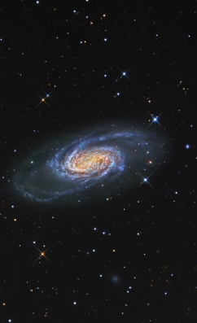
Current JP structure and connection: summary
The JPC is the only connection point between realities that sometimes seem to be apart
ExCo
EERA
Sec
JPC
JPC
JPC
JP
The JPCs are also de facto the only (loose) connection between JPs
MB
SC
The JPs are in practice the JPMB + (loosely) JPSC, but these do not know each other

Slide 6
How to foster trans-JP collaboration
First step: identification of cross-cutting /systemic issues on Digitalization in the ongoing JPs
Second step: creation in each concerned JP of SPs where the cross-cutting/systemic topic is explicitly addressed for the specific technology
- A clear example is digitalization activities
JP A
JP B
JP C
(Digitalization is not an issue)
JP I
JPN
HPC (for B)
BD (for D)
AI (for N)
Digitalization activities
HPC (for A)

Slide 7
How could a transversal JP be implemented?
Technology oriented JPs
JP A
(JPC-A, MB-A, SC-A)
…
…
JP B
(JPC-B, MB-B, SC-B)
…
…
JP I
(JPC-I, MB-I, SC-I)
…
…
JP N
(JPC-N, MB-N, SC-N)
…
…
EERA ExCo
SP A1
SP B1
SP I1
SP N1
ExCo = SC of the JP-t
Represents all EERA members
(by default all EERA members
belong to the JP-t)
SP A2
SP B2
SP I2
SP N2
SP Ai
SP Bi
SP Ii
SP Ni
tJP 1 …
tJP1-C
tJP1-MB
SP 11
SP 12
SP Aj1k
SP Bj1l
SP Ij1m
tJP 2 …
tJP2-C
tJP2-MB
SP Ak2k
SP Bk2l
SP Nj2m
SP 21
SP 22
Notes:
The transversal JPs (tJPs) may be formed by the collection of all the SPs that belong to the technology oriented JPs, but are explicitly devoted to a cross-cutting/systemic issue, plus SPs that are specific for the tJP (dealing with issues or methodologies that represent disciplines in themselves, independently of the technology of application). These transversal JPs will have a MB composed by many people (the SPC of each SP, both specific and belonging to the different technologies), with a coordinator as chair. Instead of creating specific SCs for the tJPs, the idea is that the EERA ExCo acts directly as the SC of th tJPs. This avoids the need for the accountancy of the full and associate members belonging to each JP: by default, all EERA members are considered as members of the tJPs and the ExCo represents them all. The EERA fees are considered as funds for these tJPs, as well.
In this way these tJPs have the possibility of developing project proposals that can be either specific of the tJP field (SPs that are not in any intersection) or applied to one or more technologies. It is also possible that SPs at the intersection find commonalities between them through tJPs. The tJPs in thsi scheme also have their own specific decisional body in the ExCo, which, in turn, will necessarily have to be very close to the activities of these tJPs and thus, indirectly, also closer than now to what is happening in the technology-oriented JPs. However, for the technology-oriented JPs the change will be minimal, with the advantage that they will be able to count on the expertise provided by the tJPs and that it will be easier to set up joint projects that involve several JPs, because the tJPs act as glue. This structure will also be much more solid and flexible when presented to outside world.

Slide 8
The tJP DfE is then prosposed that way as a prototype
JPNM
JP E3S
JP Hydro
tJP DfE …
SP4 & SP6 Structural materials modelling, Fuel modelling
SP DfE1: High Performance
Computing
SP DfE2: Big Data & Artificial Intelligence
SP4
Energy models for energy futures
SP6
Digitalization
“SP7”
Materials health monitoring
This modular approach allows easily integrating new SPs on digitalization in the future (approaching digital twins, for example)
On the basis of this experience, in the future other tJPs can be designed and the EERA structure progressively adapted.

Slide 9
tJP DfE: proposal for its structure
A lightweight transversal cross-cutting JP with one JP Coordinator, a Deputy and the Management Board
Integrating 2 initial SPs devoted to HPC and BD+AI
Integrating in a modular basis SPs belonging to current JPs with interests on digitalization
Designed as a forum where there are already activities and new ones will be designed and planned
JPs with confirmed interest
Economic, Environmental and Social Impacts
SP4: Energy models for a system assessment of European low-carbon energy futures: markets, environmental and economic impacts
Hydropower
SP6: Digitalization
Nuclear Materials
SP4: Physical modelling and modelling-oriented experiments for structural materials
SP6: Physical modelling and separate effect experiments for fuels
“SP7: Materials health monitoring”

Slide 10
tJP DfE: proposal for its structure
JPs with potential interest (to be contacted)
AMPEA
SP2: Physical modelling
Energy Systems Integration
SP1: Modelling
SP2: Forecasting, aggregation & control
Fuel Cells and Hydrogen
SP5 Modelling, Validation and Diagnosis
Geothermal
SP8 Computing and Data Management
All of this would sum up to 7 JPs providing up to 10 SPs
For sure there will be more SPs interested as 10 JPs showed a deep interest in HPC in a EERA internal survey (FCH, Ampea, Wind, ESI, Geo, SC, NM, E3S, CSP, PV)… And massive data has arrived!!!

Slide 11
Interested partners in a tJP on DfE

Slide 12
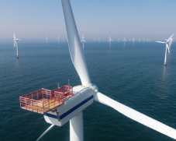
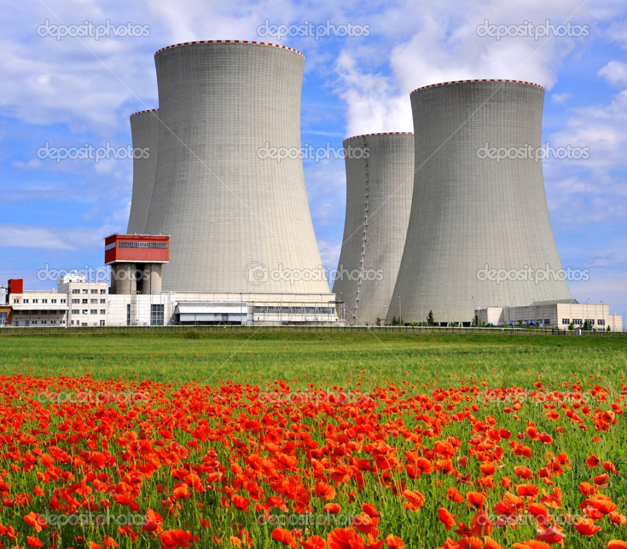
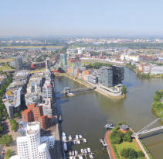
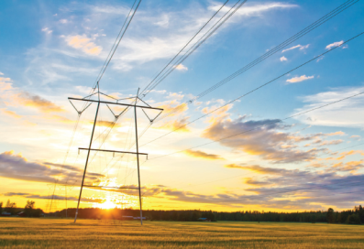
Thank you for your attention

Slide 13
Annex I: Examples of Digital activities on Energy
HPC
Weather forecast or turbines in off- and on-shore wind energy
Molecular dynamics or ab initio calculi in the study of the interaction of the media on structural and functional materials, new advanced materials and processes
Integrated energy system analysis, energy mix and further distribution in the electricity grid
Design of new devices such as turbines, solar thermal plants, collectors, etc.
CFD analysis of heat transfer between solar radiation, materials, and fluids
Multiscale simulations
Economic energy models
Etc.

Slide 14
Annex I: Examples of Digital activities on Energy
Data Science
Standardisation of data and metadata within many JPs (Geo, NM, ESI, E3S…)
Harvesting, curation, and exploitation of data (Geo, NM, ESI, E3S…)
Artificial intelligence methodologies (Smart Grid, ESI, EEIP…)
Machine Learning
Deep Learning
Open Access (all)
FAIR principles (all)

Slide 15
Annex II: Examples of Science to be carried out
There exists a clear line of research on Digitalization for Energy, which is actually the main aim of this new JP
Deeper understanding of the physics behind the energy sources, for example, multiscale simulation or of the atmospheric flow for wind farm operation through CFD–RANS or LES simulation coupled to mesoscale models taking advantage of the capabilities offered by exascale computing
New designs of Fluids Structure Interactions (FSI), for example, for full rotor simulations coupled to CFD simulations.
Structural dynamics (fatigue) in different devices, which affects almost every JP
Designs of customised machine and deep learning techniques
Optimization of codes by the means on new mathematical kernels, not simply computational porting
New computing paradigms arriving (EoCoE-II expertise)
Integration of different computing platforms seamlessly combining HPC, HTC, and HPDA methodologies
Efficient implementation of digital platforms
Design of Digitalized Intelligent Energy Systems, for example, their application to cities in which zero emissions buildings or intelligent power systems are pursued
This kind of cross-cutting research clearly needs a multidisciplinary approach

Slide 16
Annex III: Examples of additional activities
To agree on key research priorities regarding cross–cutting activities between Energy and IT services
To set up a fluent communication and exchange of information with major IT–related European initiatives outside EERA (EuroHPC, PRACE, EOSC, BDVA, etc.)
Collaborate in drafting HEU Calls
Build up synergies
Access to Pan-European IT infrastructures (PRACE/EuroHPC)
To exchange information and feedback from the IT European industry and Technology and Innovation Platforms
To promote EERA and the JP itself via dissemination, networking, and outreach activities
To complete a map of numerical codes and databases
To produce added value reports profiting from a permanent contact with the rest of JPs
To gather regularly the EERA community in workshops and meetings to ensure a continuous exchange of knowledge
To promote student exchange and research visits
To organize Hands–on and hackathon meetings

