Slide 1
WP7: Policy pathways
Status update: results and next steps
Johan Lilliestam & Richard Thonig (and IASS colleagues)

Slide 2
This has easily been the best, nicest and most productive project
I have ever been involved in.
And it’s been A LOT of fun – absolutly great, in every respect!

Slide 3
THANK YOU!
Also: we must continue and build on MUSTEC in further projects (with or without CSP).
Let’s think about each other when putting together future consortia!

Slide 4
IASS MUSTEC output

Slide 5
IASS MUSTEC spin-offs: the China connection

Slide 6
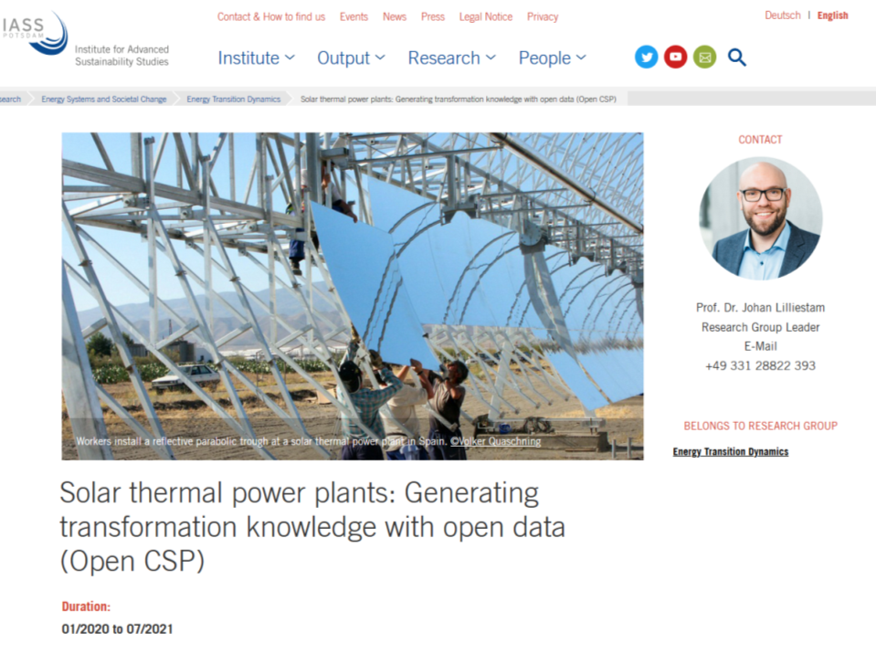
MUSTEC spinoff: Open CSP data
+
=

Slide 7
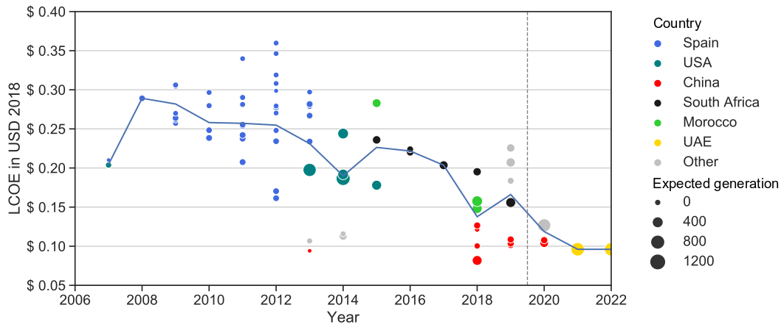
Technology-wise, CSP is doing great
Now with 2020 data!
Source: Lilliestam et al. (in review), Energy Sources Part B

Slide 8
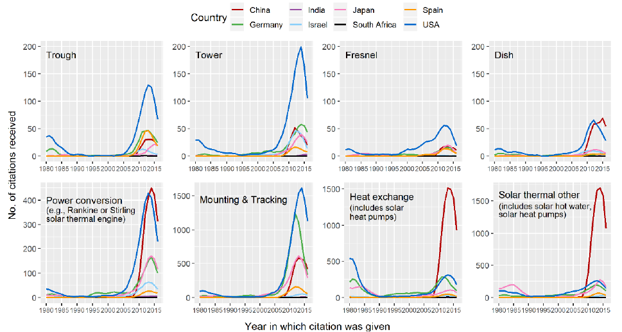
China is catching up in CSP technology development
Source: Gosens, Gilmanova, Lilliestam (in review), Technological forecasting & social change

Slide 9
Project pipeline: does not look good
nothing
Almost nothing
Source: Lilliestam et al. (in review), Energy Sources Part B

Slide 10
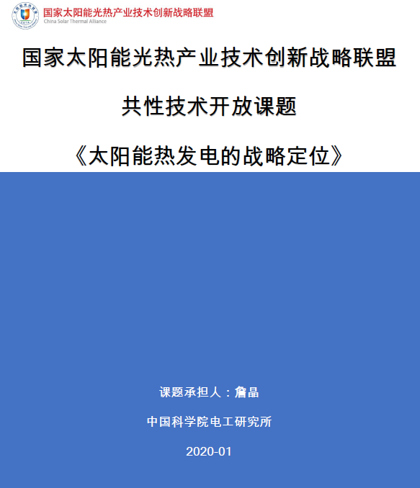
The China connection
Secret (even to me!) report for the Chinese government, written in the first days of January 2020
Key message: things are going great and you will conquer the CSP tower market and learn the trough technology, if you continue the support scheme
Ministry and National Energy Admin.: yeah...no!
Some provinical ministries: maybe.

Slide 11
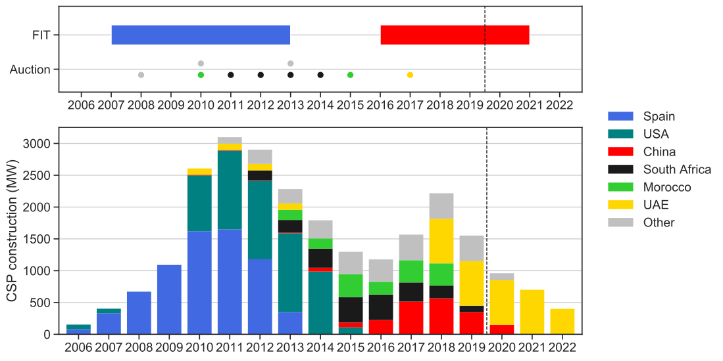
All markets (currently) failing
All support scheduled to end
Source: Lilliestam et al. (in review), Energy Sources Part B

Slide 13
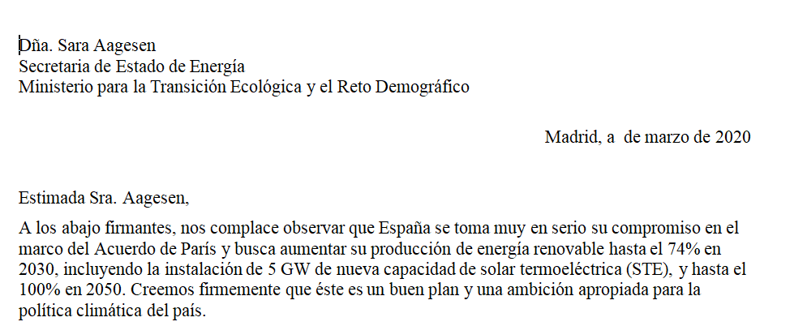
Open letter to Spanish gov. for rapid CSP support
Continue?
→ Online somehow?

Slide 15
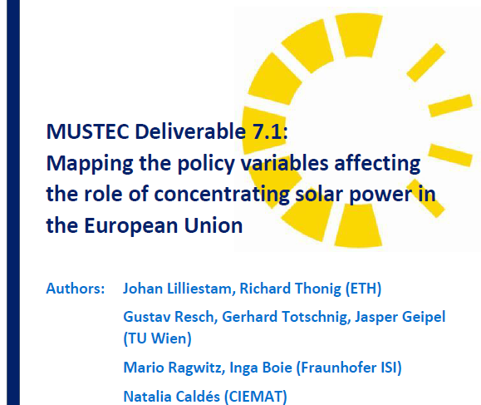
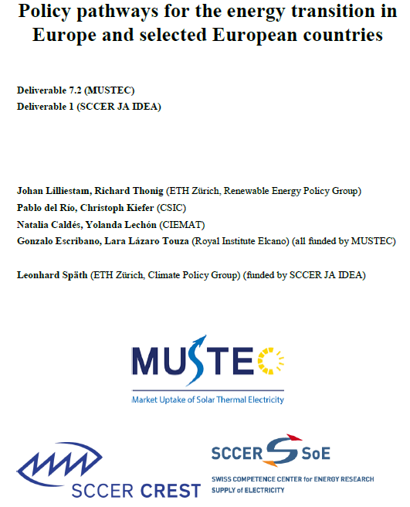
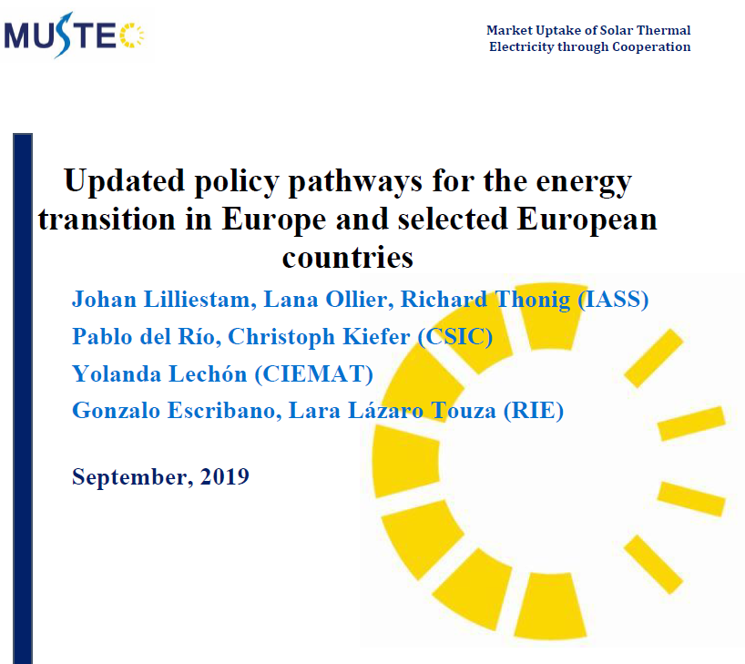
Policy pathways in Europe: what do they mean for CSP?

Slide 16
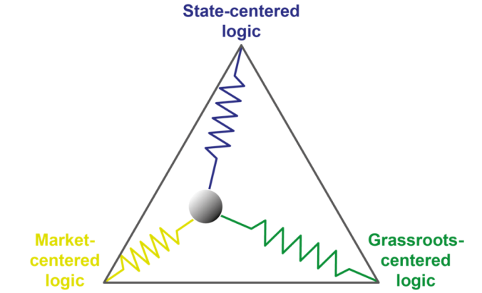
Ontology of WP7
The future doesn’t ”happen”, it is created
The future is the sum of all decisions between now and then
How does the future look if all plans play out as envisioned?
Source: Lilliestam et al. (2019), MUSTEC Deliverable 7.3

Slide 17
European plans
2050 targets
Source: Lilliestam et al. (2019), MUSTEC Deliverable 7.3

Slide 18
European plans
2030 targets
Source: Lilliestam et al. (2019), MUSTEC Deliverable 7.3

Slide 19
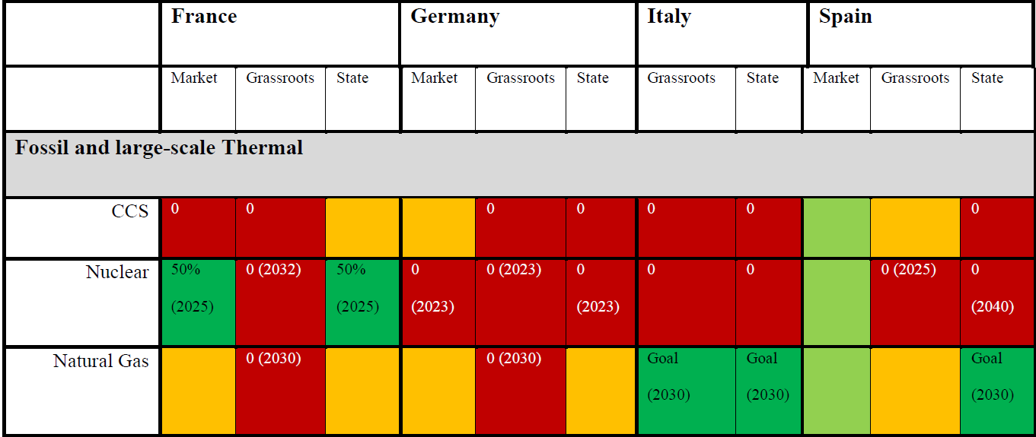
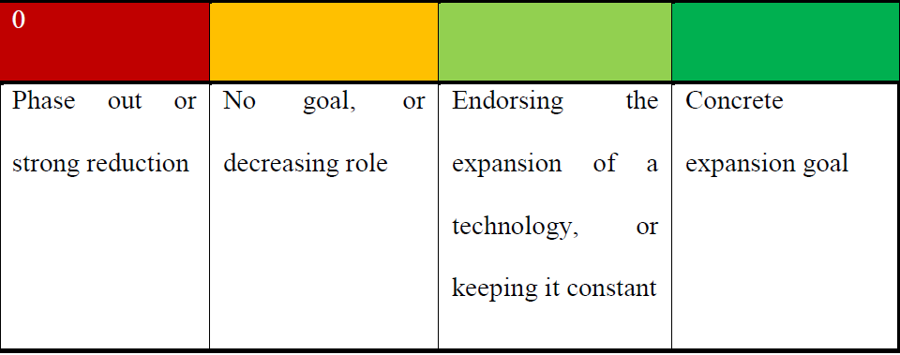
Most current dispatchable capacity to be decommissioned
Source: Thonig et al. (in review), Energy Sources Part B

Slide 20
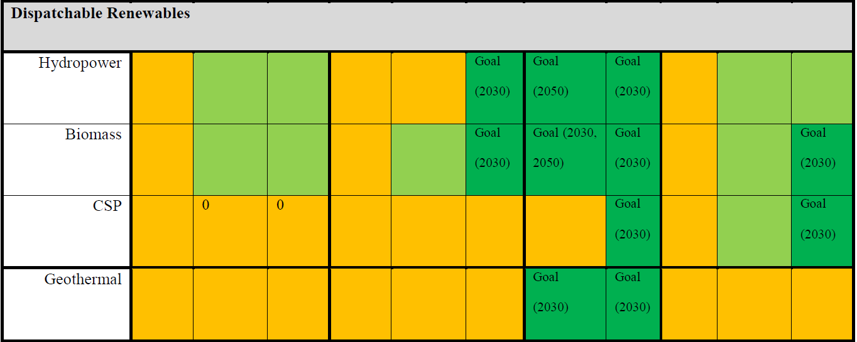
No plans for adding dispatchable renewables
Source: Thonig et al. (in review), Energy Sources Part B

Slide 21
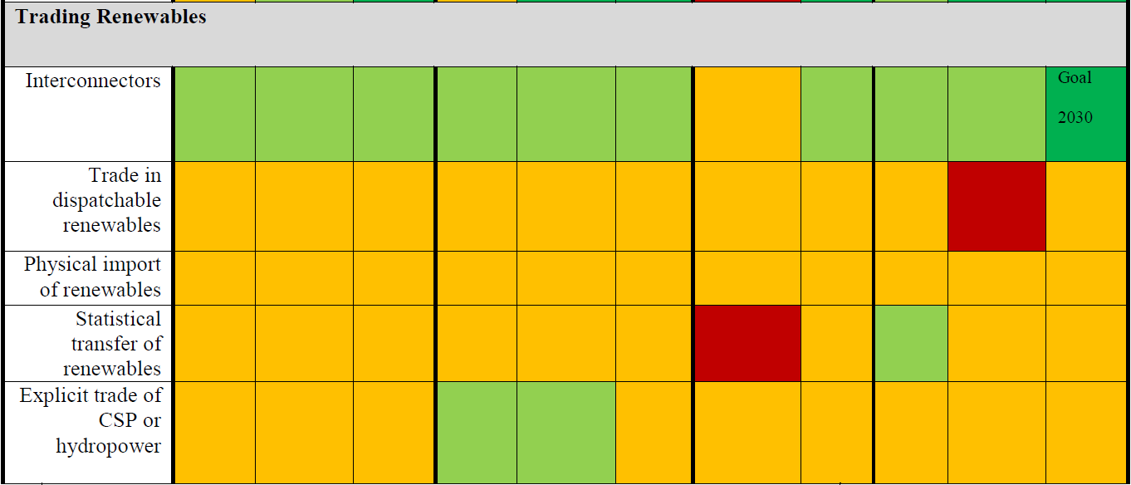
Weak or no plans for adding new flexibility
Source: Thonig et al. (in review)

Slide 22
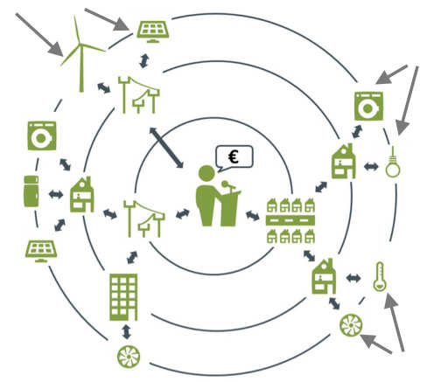
What do these plans – pathways – mean for CSP?
Is there room for CSP – CAN we have CSP, MUST we have it?
Balance the increasing fluctuating PV/wind fleets as fossil dispatchable capacity is decommissioned?
On which decisions does the need for CSP depend?
Play out the dominant scenarios
Include single measures from the minority pathways
Models of TU Wien & ISI

Slide 23
Prof. Dr. Johan Lilliestam
Professor of Energy Policy
Energy Transition Dynamics group
Institute for Advanced Sustainability Studies
Write: johan.lilliestam@iass-potsdam.de
Visit: www.iass-potsdam.de
Tweet: @JLilliestam

