Slide 1
MUSTEC project meeting: progress of the work in WP9
Impact assessment of potential STE cooperation projects in Europe
Santacruz Banacloche Sánchez
Yolanda Lechón Pérez
CIEMAT – UASE
12-14 May 2020, Madrid, Spain

Slide 2
Presentation Outline
Data sources
Preliminary results

Slide 3
Data sources
EXIOBASEv3 & SHDB (year 2011):
Value added
Employment
Climate change
Water consumption
Wage assessment
Child labor
Data display:
7 Regions: ES, DE, CN, WL, REU,
OECD, ROW
42 Sectors
FISA
Cost
data

Slide 4
Data sources
Detailed list of the investment and O&M costs
Country-origin of CSP components
Location of the CSP plants
Technical aspects (i.e. technology, lifespan)

Slide 5
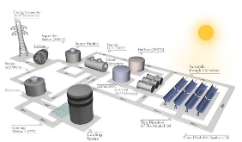
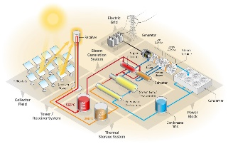
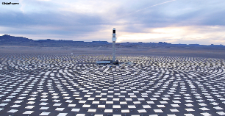
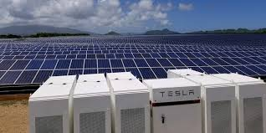
Data sources
SAM modelling for PT and CR provided by CIEMAT
Cost breakdown recalculated, based on D8.1 assumptions for PT, CR and PV+ESS
3 Scenarios
2 CSP Technologies
1 Comparison
Parabolic Trough (PT)
Central Receiver (CR)

Slide 6
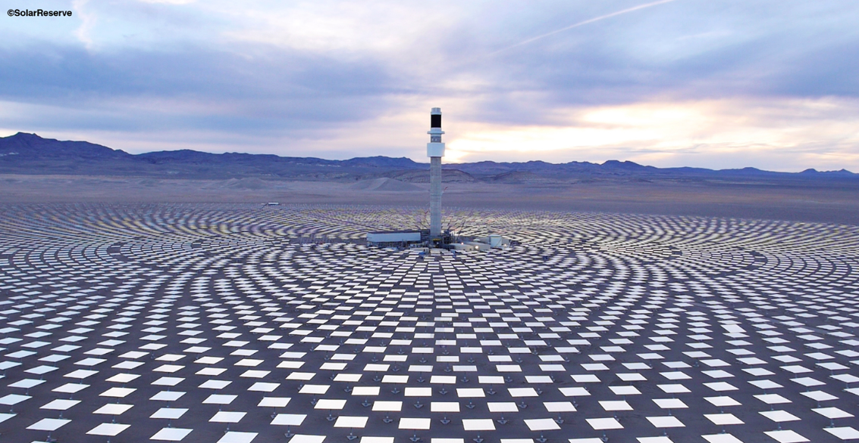
Data sources
CSP
PV+ESS

Slide 7
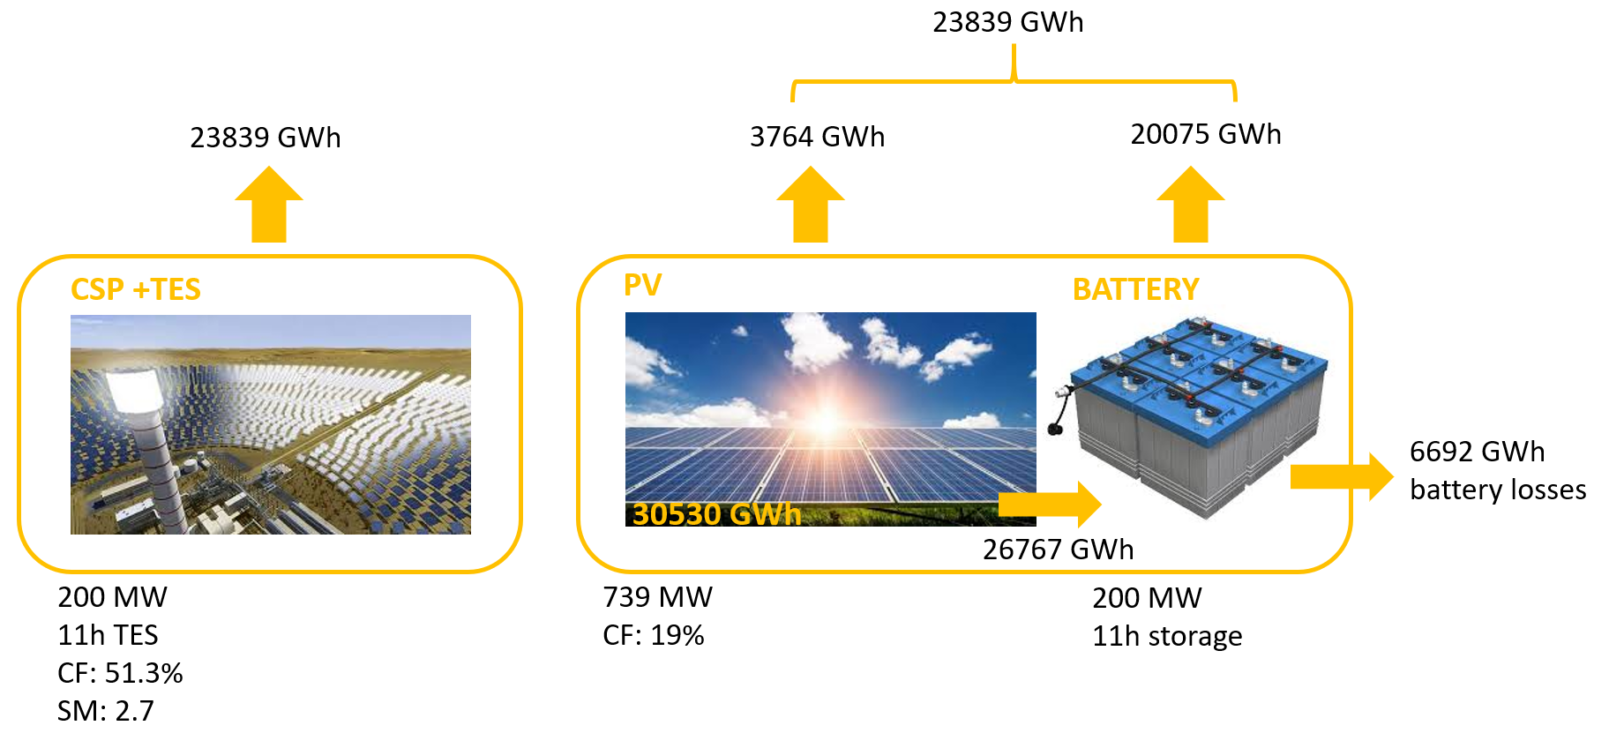
Data sources

Slide 8
Preliminary results
Generate value added in Europe?

Slide 9
Value added

Slide 10
Value added

Slide 11
Value added

Slide 12
Value added

Slide 13
Preliminary results
Generate value added in Europe?
CR_S2

Slide 14
Preliminary results
Generate value added in Europe?
Generate employment in Europe?
CR_S2

Slide 15
Employment

Slide 16
Employment

Slide 17
Preliminary results
Generate value added in Europe?
Generate employment in Europe?
CR_S2
CR_S1

Slide 18
Preliminary results
Generate value added in Europe?
Generate employment in Europe?
Minimize the overall environmental impacts?
CR_S2
CR_S1

Slide 19
GHG emissions

Slide 20
GHG emissions

Slide 21
GHG emissions

Slide 22
Water consumption

Slide 23
Water consumption

Slide 24
Preliminary results
Generate value added in Europe?
Generate employment in Europe?
Minimize the overall environmental impacts?
CR_S2
CR_S1
CR_S2
Notes:
CR_S2, CR_S1 less gCO2eq/kWh
Looking just as a producer… S3: PV+BATT, PT, CR… assuming that as a politician you want not to loose employment and gdp growth, also CR_S2, CR_S1…
Besides, we are investing in a green energy transition
The same happens with WC

Slide 25
Preliminary results
Generate value added in Europe?
Generate employment in Europe?
Minimize the overall environmental impacts?
Minimize the social risks embodied in global value chains?
CR_S2
CR_S1
CR_S2

Slide 26
Sweatfree wage

Slide 27
Sweatfree wage

Slide 28
Child labour

Slide 29
Child labour

Slide 30
Preliminary results
Generate value added in Europe?
Generate employment in Europe?
Minimize the overall environmental impacts?
Minimize the social risks embodied in global value chains?
CR_S2
CR_S1
CR_S2
CR_S2

Slide 31
Preliminary results
Generate value added in Europe?
Generate employment in Europe?
Minimize the overall environmental impacts?
Minimize the social risks embodied in global value chains?
CR

Slide 32
Preliminary results
CR

Slide 33
Preliminary results
CR

Slide 34
Preliminary results
CR

Slide 35
Preliminary results
CR

Slide 36
Preliminary results
CR

Slide 37
Preliminary results
CR

Slide 38
Next steps
Deepen into ROW region
Include direct employment at the Operation Stage
Explore the PV+ESS BAU scenario?
Sector-level analysis

Slide 39
How to contact us
E-mail:
santacruzp.banacloche@ciemat.es
Skype:
santacruz.banacloche@gmail.com
Phone:
+34 913 46 63 56

Slide 40
Santacruz Banacloche Sánchez
santacruzp.banacloche@ciemat.es

