Slide 1
6th MUSTEC PROJECT MEETING
12th, 13th and 14th May 2020

Slide 2
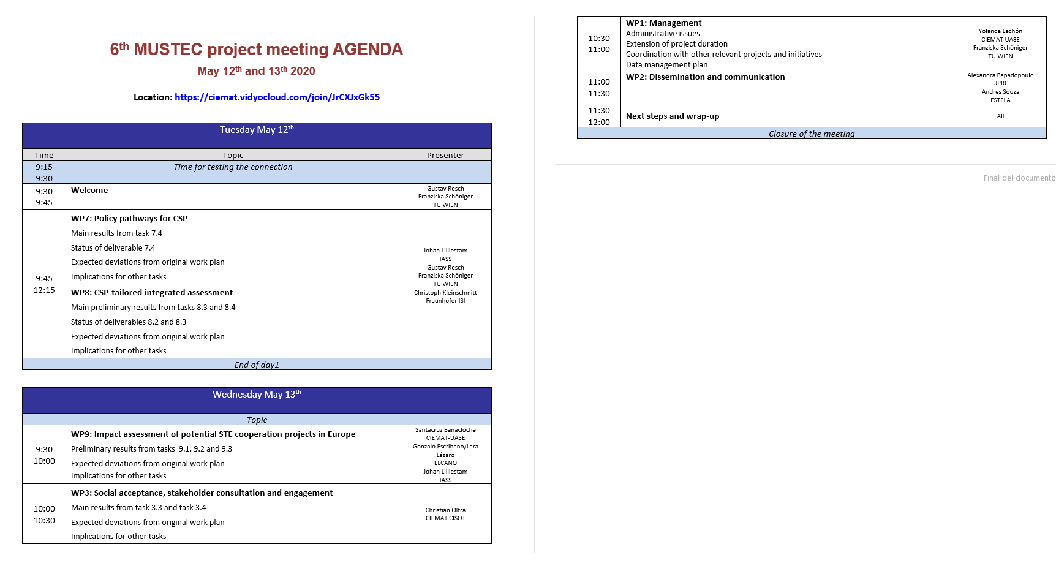
Agenda of the meeting

Slide 3
https://agenda.ciemat.es/event/1530/
Virtual room
JOIN URL: https://ciemat.vidyocloud.com/join/JrCXJxGk55

Slide 4
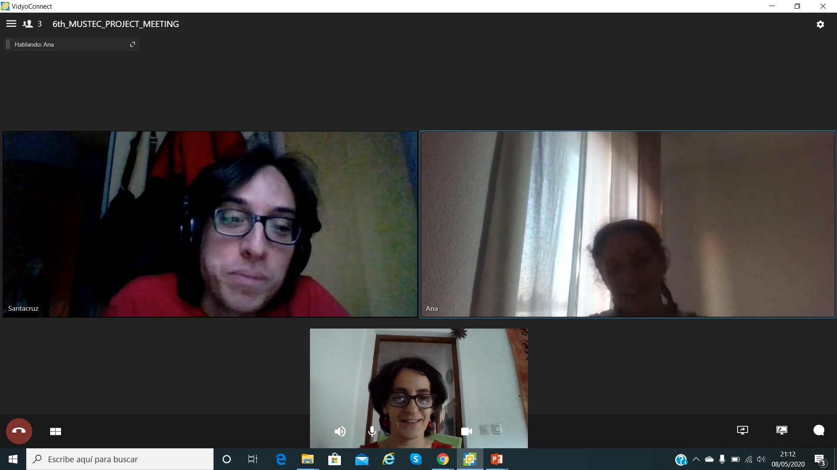
Before we start: lets take a photo!

