Slide 1
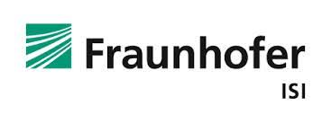

WP3. Social acceptance, stakeholder consultation and engagement
Project Meeting, 12th May 2020.
Christian Oltra (CIEMAT), Roser Sala (CIEMAT), Uta Burghard (Fraunhofer-ISI), Sergi López-Asensio (CIEMAT), Elisabeth Dütschke (Fraunhofer-ISI).

Slide 2
Key research questions of WP3
What are the levels of societal acceptance of cooperation projects of the RES Directive to supply electricity from Concentrated Solar Power (CSP) plants in the South of Europe to Central and Northern Europe in potential hosting and off-taking countries?
What are the perceived benefits and risks and the general attitude towards “joint projects” among the general public and key stakeholders (including policy makers, industry, science, opinion shapers at the local-regional, national, European)?

Slide 3
Tasks
Task 3.1. Identification of relevant stakeholders
Task 3.2. Stakeholder consultation
Task 3.3. Survey of public acceptance
Task 3.4. Stakeholder engagement exercise
 | 2017 | 2018 |  |  | 2019 |  |  | 2020
 | III | I | II | III | I | II | III | I | II | III
Task 3.1 |  | D3.1 (M6)
Task 3.2 |  |  |  |  | D3.2 (M18)
Task 3.3 |  |  |  |  |  |  | D3.3 (M24)
Task 3.4 |  |  |  |  |  |  |  |  | D3.4 (M32)

Slide 4
Task 3.3. Public acceptance of cooperation projects

Slide 5
Multi-country Survey study
To estimate levels of public acceptance and support and related attitudinal dimensions (affect, norms, trust) regarding joint projects in selected potential host and off-taker countries.
To identify key individual, attitudinal, socio-demographic and contextual determinants of public attitudes and acceptance of joint projects;
To report on cross-country comparisons in public awareness, attitudes towards and acceptance of joint projects.

Slide 6
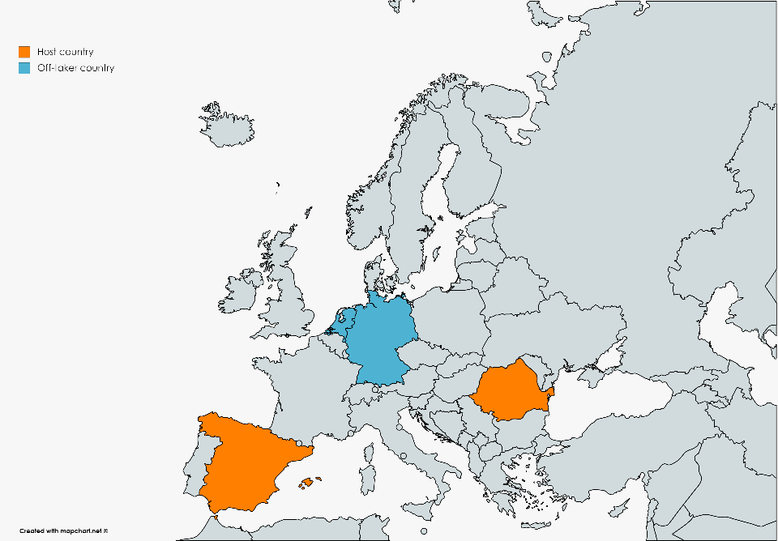
Multi-country Survey study
Nationally representative online survey in four countries (host and off-taker)
Questionnaire with provision of information
Table. Characteristics of the sample (shares in %)
 | Spain | Germany | The Netherlands | Romania
Women | 51 | 48 | 51 | 51
Men | 49 | 52 | 49 | 49
18-29 | 17 | 16 | 19 | 20
30-39 | 21 | 14 | 16 | 19
40-49 | 20 | 20 | 20 | 18
50-64 | 22 | 25 | 26 | 25
65 and older | 21 | 25 | 20 | 18
Non-university | 45 | 78 | 64 | 41
University | 55 | 22 | 36 | 59
N | 800 | 802 | 800 | 800

Slide 7
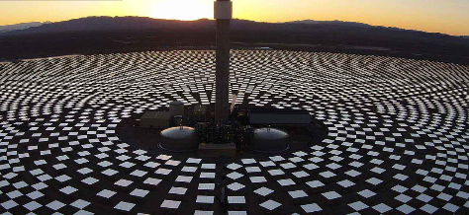
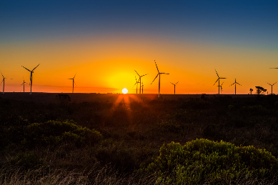
Solar S3
Nero Renewables
The idea of Solar S3 is to build a solar power plant (see photo below) in South-West Spain and transfer the electricity generated to the onshore network and ultimately to German consumers
Nero Renewables plans to install 362 wind turbines at 3 different sites in South-East Romania and transfer the electricity generated to the onshore network and ultimately to consumers in The Netherlands

Slide 8
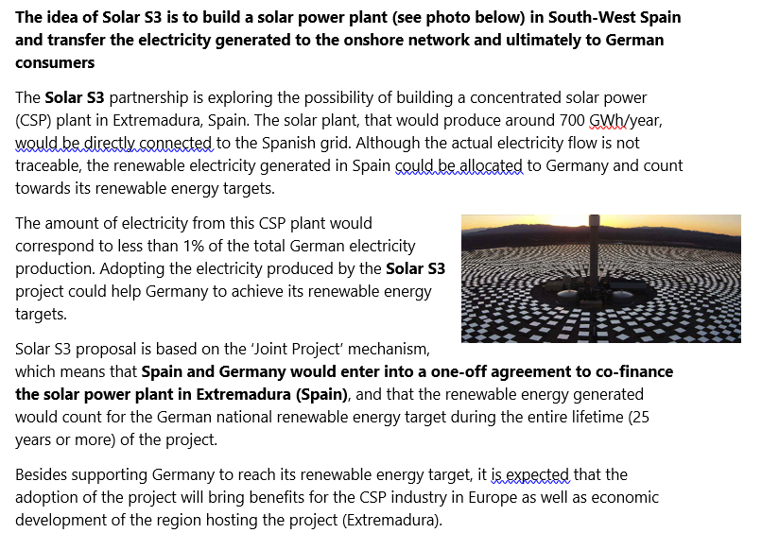
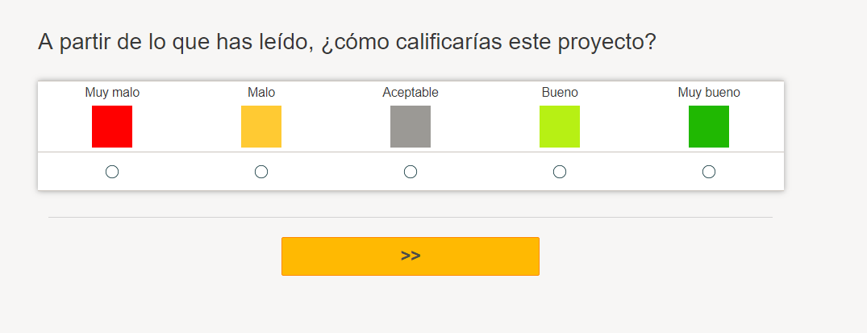
Questionnaire

Slide 9
Results
SPAIN
GERMANY

Slide 10


Results
Relatively high level of acceptance of Solar S3 in both countries (65-78%)
Relatively high level of support for public investments in Solar S3 in both countries (around 60%)

Slide 11
Results
Significantly higher levels of acceptance of the Project in Spain relative to Germany (dif. of 15%)

Slide 12
Results
More positive emotional reaction among Spanish respondents relative to German respondents

Slide 13
Results
Perceived as more beneficial (in terms of socio-economic impacts) among Spanish citizens relative to German cititzens

Slide 14
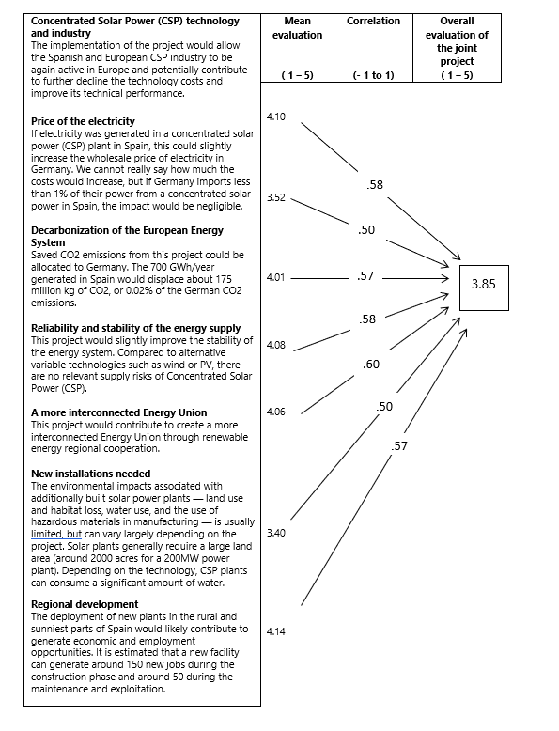
Evaluation of consequences excercise (Spanish participants)

Slide 15
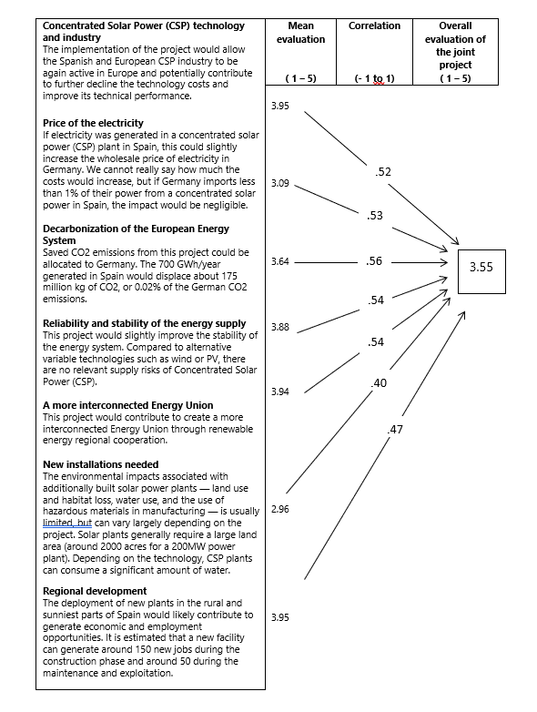
Evaluation of consequences excercise (German participants)

Slide 16
Socio-demographic predictors of support
Table. Support for public investment in the joint project by socio-demographics (as % of respondents, total sample)
 | % of support
Sex
Women | 58%
Men | 63%*
Age
18-29 | 59%
30-39 | 59%
40-49 | 58%
50-64 | 60%
> 65 | 66%*
Education
Did not graduate from high school | 43%
High school graduate | 56%
Vocational education | 57%
University | 68%*
* the difference between categories is statistically significant, p<0.01

Slide 17
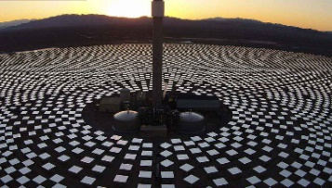
Supporters and sceptics
SUPPORTERS
SCEPTICS

Slide 18
Results: Predictors of support
Figure. Path analysis with direct and indirect effects on support of public investments for a joint project of distinct variables (standardized coefficients)
PRIOR ATTITUDES
EMOTIONS AND BELIEFS
Attachment (European)
.18
Problem perception
.33
.32
Affect
.06
Environmental self-image
.17
.27
Attitude
.47
Support
.07
.37
.18
.30
.18
Perceived benefits/costs
Preference for cooperation
.15
.24
.17
Perceived equity

Slide 19
Results: Predictors of support
Table 7. Direct and indirect effects on support of public investments on a joint project of distinct variables (standardized coefficients β)
 | Direct effect | Indirect effect (one step) | Indirect effect (two steps)
Overall evaluation | .47*
Problem perception |  | .03
Affect |  | .13*
Perceived benefits/costs |  | .17*
Perceived equity |  | .08*
Place attachment (EU) |  |  | .12*
Environmental self-image |  |  | .07*
Preference for cooperation |  |  | .03*
* sig. <0,05

Slide 20
Conclusion
Medium to high levels of acceptance of joint projects in the four studied countries
Significant differences in acceptance between participants in host and off-taker countries
Perception of benefits and costs and emotions as main predictors of acceptance.
Prior attitudes (attachment to European Union, environmental attitudes and preference for cooperation) are also relevant determinants

Slide 21
Task 3.4. Delphi Study

Slide 22
Task 3.4. Stakeholder engagement: Delphi study
A Delphy study with European energy experts has been designed on the possible future of CSP cooperation in Europe. Specifically, they were consulted about how will cross-border cooperation agreements on renewable energies develop in the European Union in the medium term?

Slide 23
Data collection
Multi-stage survey procedure with a group of energy experts to estimate future trends or developments.
Online implementation with personal email invitation
2 rounds (December 2019-April 2020)
Country | N 1st round | N 2nd round
Spain | 4 | 4
Germany | 4 | 2
Other countries | 3 | 3
Total | 11 | 9

Slide 24
Explored dimensions
Brief information about cooperation mechanisms.
Assessment of Scenario 1: Dominant pathway: market-centred.
Assessment of Scenario 2: Minority pathway: grassroots-centred.
Cross-border cooperation agreements on renewable energy between European countries based on the RES Directive (type of scheme and type of technology).
Perceived likelihood of a Joint project to co-fund a Concentrated Solar Power (CSP) plant.
Recommendations to foster CSP cooperation projects.

Slide 25
Findings
Scenario 1. Dominant pathway: market-centred
Do you think this scenario accurately represents the currently dominant pathway in the EU?
Thinking in very long term (20-40 years), how likely do you think is that it will become real?

Slide 26
Findings
Scenario 2. Minority pathway: grassroots-centred
Do you think this scenario accurately represents the currently dominant pathway in the EU?
Thinking in very long term (20-40 years), how likely do you think is that it will become real?

Slide 27
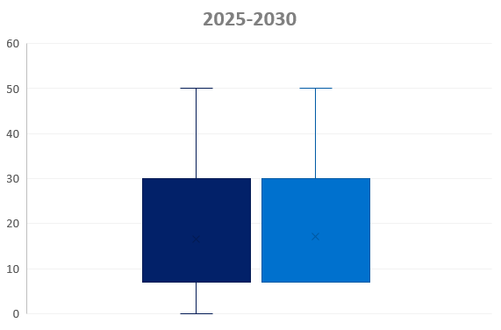
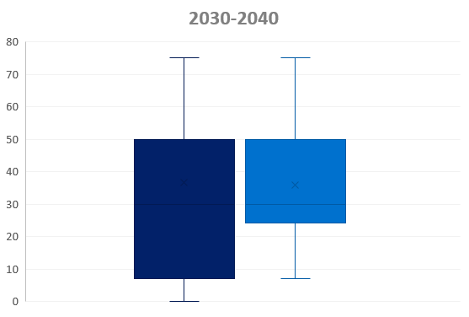
Findings
Likelihood (%) of a joint project involving CSP trade from South (e.g. Extremadura, Spain) to Northern Europe (e.g. Germany)
Round 1
Round 2
Round 1
Round 2

Slide 28
Next steps
Task 3.4. Stakeholder acceptance workshop (June-September, 2020)
Germany: Webinar will take place on 24 June 2020, 13:00-14:30 (in German)
Goal: identify drivers and barriers for CSP projects that can supply renewable electricity to countries, like Germany.
Target group: representatives from industry, science, NGOs and policy makers
Topics:
  Political framework conditions for RE cooperation projects in Europe: Introduction to the political background
  What opportunities and potentials do European cooperation projects have? Empirical studies on the social acceptance of CSP in Europe
  Open questions and discussion on drivers and barriers for European cooperation projects on renewable energies

