Slide 1
Progress of WP1: Management
6th MUSTEC PROJECT MEETING, teleconference
Yolanda Lechón CIEMAT

Slide 2
Presentation Outline
Extension of project duration
Coordination with other relevant projects and initiatives

Slide 3
Extension of project duration
Agreed with the Project Officer a 3 months extension until Dc 2020. From 36 months to 39 months project duration
We are not asking for any change to the total requested EU contribution, only an increase in the duration of the project.
Applies only to WP10 (Synthesis, road map and action plan), WP1 (Management) and WP 2 (Dissemination and Communication), related to the organization of the final conference and the overall project management, respectively

Slide 4
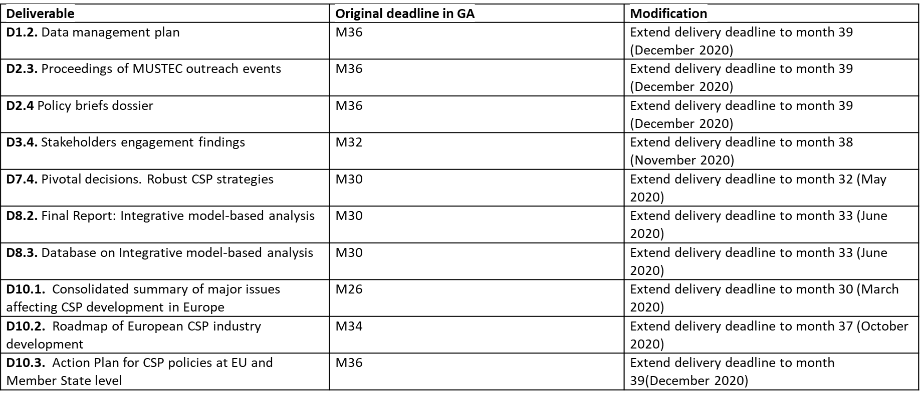
New deadlines for deliverables

Slide 5
Extension of project duration
Reasons for the extension request were originally:
Timely production of the CSP roadmap and action plan in WP10 (incorporate in an appropriate manner the comments and findings from the policy and industrial stakeholder workshops)
Conduction of the final conference in a more convenient timing
A minor extension of all energy-related modelling works was needed
The PO officer is also open for a further extension of the project duration if needed due to the COVID
The official process of extension has not started yet

Slide 6
Extension of project duration
We should decide whether we ask for an additional extension or not
Main advantage of an extension: -> the possibility to hold a physical final conference in Spring 2021
The situation is still uncertain and then we should be prepared for a virtual Final Conference –> in that case the extension wouldn’t be necessary
The request for an extension takes time and we should decide soon

Slide 7
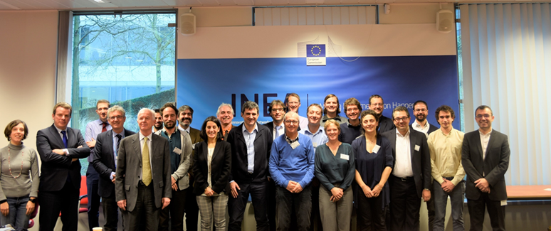
Coordination with other relevant projects
Task 1.3: Coordination with other relevant projects and initiatives
3rd Clustering meeting for H2020 projects in the area of CSP at INEA - November 26th 2019
CA-RES meeting in Brussels November 27-28th in Brussels

Slide 8
Quick reminder on data management
Please…
… keep Franziska updated about the status of data sets
… upload your data sets to TU OwnCloud if possible (not publicly accessible)
… generate DOIs for data sets and make them publicly accessible if possible (e.g. via zenodo)
… contact Franziska if there are any questions regarding the data management.

Slide 9
Annex: Different platforms in MUSTEC
Only accessible by consortium
Dropbox
All documents, reports, deliverables, meeting minutes, presentations, …
TU OwnCloud
All data sets collected and used within the project
Only accessible via link and password
Desirable: Public accessible data platform
E.g. Zenodo
To aid discoverability of the data sets, it is aimed to obtain digital object identifiers (DOIs) where possible.
In addition, the underlying scientific publications (reports and peer-reviewed journal articles) will cross-reference these data sets.
The intention is that data sets will be made available to reviewers of the resulting publications to aid transparency in the review process.
Publicly accessible

