Slide 1
WP8: CSP integrated assessment
MUSTEC Internal Meeting ONLINE | 12 & 13 May 2020
Gustav Resch, Franziska Schöniger (TU WIEN)
Christoph Kleinschmitt, Katja Franke, Frank Sensfuß (Fraunhofer ISI)

Slide 2
Agenda
CSP integrated assessment – WP 8 – D8.2, D8.3
  Modelling framework (TUW)
  Scenario definition - Link to WP 7 (TUW)
  Modelling results (FH ISI)
Pivotal decisions and key factors for robust CSP strategies
– D7.4 (TUW)
Discussion … nevertheless, PLEASE interrupt us at any time
in case of questions, etc.!

Slide 3
WP 8 – CSP integrated assessment
Status quo
WP-overview
Organisation
Gustav Resch – TU Wien

Slide 4
… there is a need for CSP …

Slide 5
WP 8 objectives
Assess, in an integrative manner through quantitative forward-looking analysis the possibilities for an enhanced take up of electricity generation from CSP within the European Union
Conduct an in-depth modelling to provide answers on the questions how CSP could be taken up at the electricity system level.
Shed light on expected impacts arising from related RES cooperation on Member States’ energy systems as well as on resulting costs and benefits.

Slide 6
WP8 approach & linkages
These issues will be tackled by a closely coordinated interplay of three energy models (with complementary strengths)
We will build on the conceptualisation of distinct policy pathways (WP7) and incorporate findings on past experiences related to RES cooperation (WP4).
Case studies (bottom-up assessment (WP5)) will shed light on
the opportunities of particular CSP technology concepts …
… whereas the overarching model-based integrated assessment aims
to establish a sound basis for the subsequent policy evaluation and
derivation of action plans on the way forward (WP9 and WP10)

Slide 7
Tasks and Subtasks
Task 8.1 Model and database preparation. Month 6-18.
(Lead: TU Wien, Contribution: FH ISI, ETHZ)
Undertake all preparatory works necessary for the execution of the distinct different model-based assessments to be conducted subsequently, incl. …
  incorporate into the modelling system all specifics of assessed CSP technology concepts in adequate manner, including techno-economic parameter of the CSP technology power system concepts including the complementary storage facilities. (WP5)
  incorporate the set of general assumptions necessary for the execution of scenarios (WP7 … definition of the pathway and scenario scope done within Task 7.1 where common normative aims of the scenarios, boundaries, exogenous developments shared by all scenarios are defined)
Tasks and subtasks
COMPLETED

Slide 8
Tasks and Subtasks
Task 8.2 Exploratory case study analysis of different CSP technology concepts (→ CASE STUDIES … WP5). Month 12-20.
(Lead: TU Wien, Contribution: FH ISI, CSIC, CIEMAT-UASE).
Look into specific Southern European countries where CSP could be used, assessing the techno-economic performance of different CSP technology concepts, incl. complementary technologies etc. by means of case studies. → sensitivity analysis related to the evaluation of the pros and cons of different alternatives for CSP projects (WP5 (Task 5.3))
  A conceptualisation of the case study specifics, incl. assumptions
  and framework conditions;
  Modelling done mainly by use of TU Wien’s (newly adapted & applied) power system model Balmorel (i.e. an open-source model originally developed & provided by DTU)
  → identify how the market value & the overall economic viability
  may change by the underlying technology concept (incl. also size of storage unit);
  A complementary assessment of the outcomes of the modelling
  exercise done at case study level
Tasks and subtasks
COMPLETED

Slide 9
Tasks and Subtasks
Task 8.3 Comprehensive scenario-based pathway assessment of RES cooperation. Month 15-28. (Lead: TU Wien, Contribution: FH ISI, IASS)
Distinct scenarios will be analysed concerning overall ambition level, underlying RES policy concepts and pathways, infrastructural prerequisites as well as technological development and policy pathways related to CSP (and other RES technologies).
The work will build on the conceptualisation undertaken within (WP7 – subtasks 7.2 & 7.4)
  Subtask 8.3.1 Techno-economic (RES) policy assessment …
  Green-X modelling (Lead: TU Wien, Contribution: FH ISI, IASS)
  Subtask 8.3.2 Power system analysis … Power system modelling done in Enertile (Lead: FH ISI, Contribution: TU Wien)
Task 8.4 Consolidation of outcomes and reporting.
Month 15-33. (Lead: TU Wien, Contribution: FH ISI, ETHZ, CIEMAT-UASE)
Tasks and subtasks

Slide 10
Deliverables
D8.1 Interim Report: Case Studies analysis of prospects for CSP (M20) – TU WIEN
D8.2 Final Report: Integrative model-based analysis (M33 (end of June)) – TU WIEN
D8.3 Database on Integrative model-based analysis (M33 (end of June)) – TU WIEN
D7.4 Pivotal decisions. Robust CSP strategies (M32 (end of May)) – TU WIEN

Slide 11
WP 8 – Modelling framework
Our modelling suite
Green-X & Enertile
Gustav Resch – TU Wien,

Slide 12
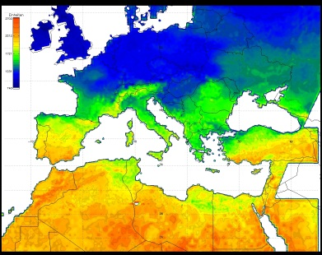
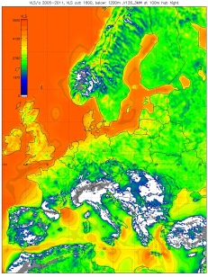
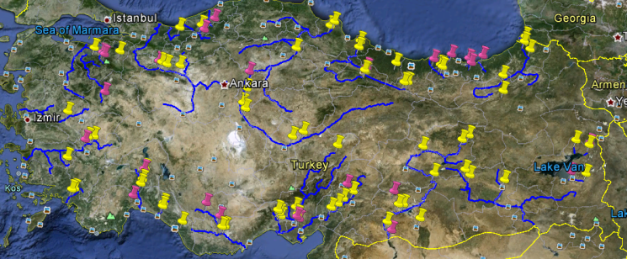
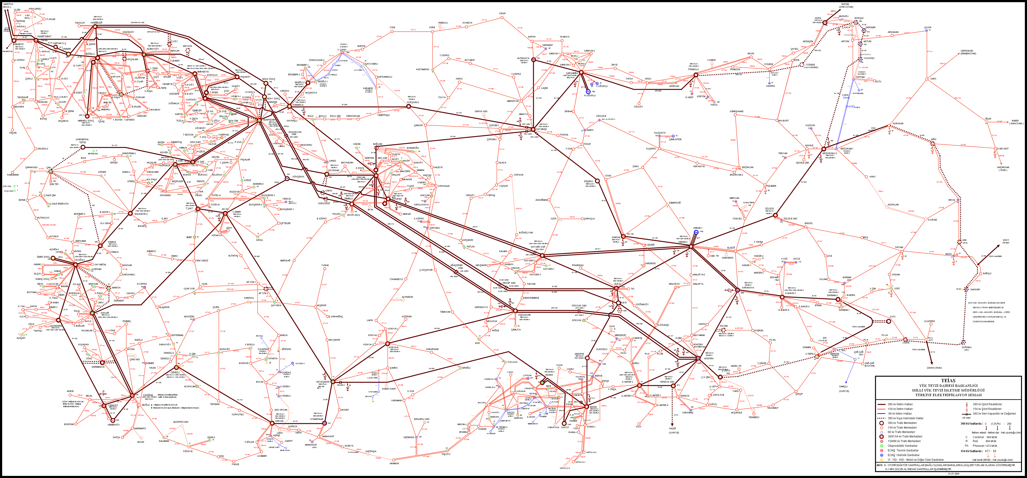
WP8
Locational power plant database
Solar PV / CSP
Transmission Grid
Wind
The applied modelling system
Energy/CO₂-price development
Default (2010) technology costs
Energy demand development
Yearly time resolution (2006 -2050),
years modelled: 2015 to 2050
Green-X
Balmorel
Hourly time resolution (8760h), years modelled: 2020, 2030 & 2050
Green-X: analysis of RES investments,
RES developments and related impacts on costs, expenditures and benefits
Balmorel & Enertile: interplay between supply, storage and demand in the electricity market.
RES policy
Financing conditions
ITERATION
Enertile
Demand
Non-economic barriers
Supply
Storage
RES deployment
Dynamic cost development (technological learning)
Dynamic cost-potential curves, Policy interaction, Investment decision
Common electricity
market model
RES LRMC [€/MWh]
Feedback on RES market values
Feedback on curtailment of RES
Feedback on electricity prices
Need for flexibility & use of flexibility options (incl. CSP)
[MWh]
RES deployment (electricity, heat, transport)
RES system costs
System flexibility impact of enhanced market coupling (heat market)
Power plant dispatch & -commitment
RES support expenditures
Assessment of benefits (CO₂ & fossil fuel avoidance)
Transmission grid expansion
RES investments
Electricity prices
Total system costs
Notes:
Moreover, both models are equipped with specific features that complement each other well: while HiREPS allows for a detailed analysis of system flexibility thanks to incorporated linkages between electricity and heating & cooling as well as transport, Enertile has complementary strengths in the incorporation of investment decisions into fossil and alternative low-carbon technologies.

Slide 13
Interplay & Iterations: Green-X & Enertile
  Modelled years: 2030, 2040, 2050
  Covered geographic area: EU28
  + NO + CH
Deployment of variable renewables (solar PV, wind, hydro),
certain biomass fractions (biowaste, …)
Two (and a half) iterations
for each scenario:
Green-X calculates default (variable)
RES use* (iteration 0)
Enertile calculates optimal dispatch & investment in certain flex options (CSP, Natural gas/biogas**, P2G+G2P, other storage options) (iteration 0)
Green-X recalculates (variable) RES use based on adapted market values and electricity prices (iteration 1)
Enertile recalculates dispatch & investments in certain flex options (iteration 1)
Green-X recalculates RES costs & support expenditures (incorporating market values, ele prices, dispatchable RES use) (iteration 2)
*Based on policy pathways (WP7)
** Assumption in case of full decarbonisation: natural gas is replaced by green gas/biogas until 2050 (at a higher price than natural gas)
Green-X: renewables deployment and related costs, expenditures and benefits by country on a yearly basis (2015 to 2050).
Country- and technology-specific RES capacities and generation in the electricity sector for selected years (2030, 2040, 2050)
Enertile: optimisation of hourly dispatch and investment in
- CSP
- Natural gas … biogas
- P2G+G2P (hydrogen)
- Other storage options
- (Wind offshore)
Results: investment and dispatch of power plant portfolio, flexibility options and transmission grid
Market values & electricity prices,
for final recalculation: use of dispatchable RES (incl. CSP)

Slide 14
CSP in the Enertile model
Storage size of 11 full load hours
Site-specific ratio between field and generator (can lead to variance in costs)
Cost assumptions (11 hours storage):
WACC (Weighted Average Cost of Capital) constant within Europe (7%)
Overnight Investment Costs (literature) [€₂₀₁₀/kW} | Storage duration [h] | 2020 | 2030 | 2040 | 2050
PRIMES modelling input | 8 | 5092 | 3923 | 3182 | 2847
ESTELA (2019) | 8 | 3241 | 2755 | 2479 | 2231
DII (2050 Desert Power) | 8 |  |  |  | 1900
SET-Nav project | 8 |  | 3300 | 3050 | 2660
CSP.guru (for all projects in 2019 and 2020) | on average > 9 | 4099
Year | Lifetime years | Specific investment [€₂₀₁₀/kW] | Fix O&M cost [€₂₀₁₀/(kW a)] | Var. O&M cost [€₂₀₁₀/MWh] | Efficiency
2030 | 30 | 3525 | 66.7 | 0.046 | 44%
2040 | 30 | 3078 | 53.3 | 0.046 | 49%
2050 | 30 | 2554 | 40.0 | 0.046 | 52%

Slide 15
Key assumptions (I)
Fossil fuel price trends taken from IEA 450 scenario
(IEA WEO 2016)
… reflecting strong climate ambition globally
… price trends are significantly lower than EC recommendations (PRIMES)
(-40% oil, -25% gas)
Aiming for full decarbonisation by 2050 as default, specifically in the electricity sector
… (fossil) CCS is no option; only RES & nuclear are applicable
… strong increase in carbon prices used in modelling to achieve full decarbonisation
… nuclear expansion is an exogenous assumption, depending on policy pathway (range: 29 TWh … 466 TWh at EU level)
… natural gas is replaced by renewable/green gas by 2050 (at a higher price)
Fuel prices in €₂₀₁₀/MWh_{th} | gas | Hard-coal | oil | lignite | nuclear
2030 | 28.9 | 7.4 | 48.4 | 3.7 | 3.1
2040 | 30.5 | 6.6 | 44.5 | 3.7 | 3.1
2050 | 31.2 | 6.2 | 42.5 | 3.7 | 3.1

Slide 16
Key assumptions (II)
Strong increase in electricity demand as default,
caused by increased sector coupling
(e-mobility, e-heat/industry)
… assumptions on sector-coupling set in accordance with recently completed H2020 project SET-Nav (www.set-nat.eu) ,
Diversification pathway (→ building on a comprehensive analysis undertaken for all energy sectors, assuming full decarbonisation,
… and some general trends like
  Decentralisation,
  Heterogeneity of actors,
  Coordination (beyond markets)
  Digitalisation,
  Regulatory changes
  Disruption for incumbents
… nevertheless, these trends gain here, in this analysis, less importance
(serving to justify assumed increases in demand)
The uptake of variable RES, specifically of onshore wind energy is strong …
… BUT has certain limits
(of social acceptance)

Slide 17
Scenario design
Scenarios … looking into the glassball
Pathway processing from WP7
Gustav Resch – TU Wien

Slide 18
Acronym | Characterisation | RES-E (RES) targets |  | ETS (overall) GHG reduction targets | In accordance with WP7 policy characterisation | Uptake in modelling
EU level |  | 2030 | 2050 | 2050
EU majority (market-centred) | Market-centred, aiming for full decarbonisation in a "least cost manner" | n.a. (>32%) | n.a. (n.a.) | 100% (100%) | YES | YES
EU grassroots | Grass-root centred across the EU, with accelerated full decarbonisation (2040) | n.a. (>45%) | 100% (100%) | 100% (100%) | YES | Partly (infeasibility due to diffusion constraints demonstrated with Green-X)
FR
FR majority (state-centred) | FR state-centred, aiming for full decarbonisation, done by maintaining its supply portfolio (nuclear and RES) | 40% (34%) | 50% (n.a.) | n.a. | YES | YES - in combination with majority paths of other countries and the (rest of) EU
FR rassemblement national | FR rassemblement national puts energy indepency in focus, maintains the strong role of nuclear power and increases slightly the contribution of RES. | n.a. | n.a. | n.a. | YES | ? - no pendant identified in other MSs or at EU level
FR grassroots | FR grass-root centred, with mediocre decarbonisation (85%) by 2050 and a strong RES-E uptake (to 100% by 2050) | n.a. | 100% (n.a.) | 100% (ca. 85%) | Partly (limitations on early nuclear phase-out) | Partly (infeasibility due to diffusion constraints demonstrated with Green-X)
FR market-centred (with low decarb targets) | FR market centred, with low decarbonisation (75%) by 2050 | 40% (n.a.) | n.a. (n.a.) | n.a. (ca. 75%) | YES | YES - in combination with corresponding paths of other MSs
DE
DE majority (state-centred) | DE state-centred, aiming for full decarbonisation, done by increasing the domestic RES-E portfolio to (above) 80% | 65% (30%) | >80% (60%) | 100% (80-95%) | YES | YES - in combination with majority paths of other countries and the (rest of) EU
DE grassroots | DE grass-root centred, with strong decarbonisation (100% in electricity) and a strong RES-E uptake (to 100%) by 2030 | 100% (n.a.) | 100% (n.a.) | 100% (>95%) | YES | Partly (infeasibility due to diffusion constraints demonstrated with Green-X)
DE market-centred (with low decarb targets) | DE market-centred, aiming for (comparatively low) decarbonisation in a "least cost manner" | n.a. (n.a.) | n.a. (n.a.) | n.a. (>80%) | YES | YES - in combination with corresponding paths of other MSs
IT
IT majority (market-centred) | IT market-centred, aiming for full decarbonisation, done by strongly increasing the domestic RES-E portfolio | 55.4% (>30%) | 100% (implicitly due to decarbonisation needs) (n.a.) | 100% (100%) | YES | YES - in combination with majority paths of other countries and the (rest of) EU
IT grassroots | IT grass-root centred, with strong decarbonisation (100% in electricity) and a strong RES-E uptake | n.a. (n.a.) | 100% (n.a.) | n.a. (n.a.) | YES (to a large extent) | Partly (comparatively similar system impacts as in IT majority path)
ES
ES majority (state-centred) | ES state-centred, aiming for full decarbonisation, done by strongly increasing the domestic RES-E portfolio | >74% (42%) | 100% (100%) | 100% (>90%) | YES | YES - in combination with majority paths of other countries and the (rest of) EU
ES grassroots | ES grass-root centred, with strong decarbonisation (100% in electricity) and a strong RES-E uptake (100% by 2045) | 80% (45%) | 100% (100%) | 100% (95%) | YES | Partly (infeasibility due to diffusion constraints demonstrated with Green-X)
ES market-centred (with low decarb targets) | ES market centred, aiming for (comparatively low) decarbonisation in a "least cost manner" | n.a. (n.a.) | n.a. (n.a.) | n.a. (80%) | YES | YES - in combination with corresponding paths of other MSs

Slide 19
Acronym | Characterisation | Policy pathway selection
 |  | Rest of EU | DE | FR | IT | ES
EU level
Cooperation | Market-centred, aiming for full decarbonisation in a "least cost manner" | EU majority | EU majority | EU majority | EU majority | EU majority
Grassroots | Grass-root centred across the EU, with accelerated full decarbonisation (2040), and with consideration of national preferences (DE, FR, IT, ES) | EU grassroots | DE grassroots | FR grassroots | IT grassroots | ES grassroots
National preferences | State-centred in DE, FR and ES - whereas in the remainder of the EU a market-centred approach is followed, aiming for full decarbonisation in a "least cost manner" | EU majority | DE majority (state-centred) | FR majority (state-centred) | IT majority (market-centred) | ES majority (state-centred)
National preferences, low demand | Market-centred, aiming for full decarbonisation in a "least cost manner" - but thanks to strong energy efficiency and/or less emphasis on sector-coupling electricity demand growth is moderate (i.e. comparatively low) at least in the "big 4" (DE, FR, IT, ES) | EU majority | DE majority (state-centred) | FR majority (state-centred) | IT majority (market-centred) | ES majority (state-centred)
National preferences, with low flexibility from sector coupling | Market-centred, aiming for full decarbonisation in a "least cost manner" - and low flexibility provision from sector coupling (due to incentivisation and corresponding regulation) | EU majority | DE majority (state-centred) | FR majority (state-centred) | IT majority (market-centred) | ES majority (state-centred)
National preferences, with grid expansion restrictions | Market-centred, aiming for full decarbonisation in a "least cost manner". Grid expansion faces difficulties across the EU due to low public acceptance | EU majority | DE majority (state-centred) | FR majority (state-centred) | IT majority (market-centred) | ES majority (state-centred)
Cooperation, low demand | Market-centred, aiming for full decarbonisation in a "least cost manner" - but thanks to strong energy efficiency and/or less emphasis on sector-coupling electricity demand growth is moderate (i.e. comparatively low) at least in the "big 4" (DE, FR, IT, ES) | EU majority | EU majority | EU majority | EU majority | EU majority
Cooperation, deep but not full decarbonisation | Market-centred, aiming for a deep but not full decarbonisation, done in a "least cost manner" (implies less emphasis on RES-E) | EU majority | DE market-centred (with low decarb targets) | FR market-centred (with low decarb targets) | EU majority | ES market-centred (with low decarb targets)
Cooperation, with low flexibility from sector coupling | Market-centred, aiming for full decarbonisation in a "least cost manner" - and low flexibility provision from sector coupling (due to incentivisation and corresponding regulation) | EU majority | EU majority | EU majority | EU majority | EU majority
Cooperation, with grid expansion restrictions | Market-centred, aiming for full decarbonisation in a "least cost manner". Grid expansion faces difficulties across the EU due to low public acceptance | EU majority | EU majority | EU majority | EU majority | EU majority
ü
ü
ü
ü
ü
ü

Slide 20
Modelling results
Results & Conclusions
Derived from Enertile power-sector modelling
Christoph Kleinschmitt, Katja Franke – FH ISI

Slide 21
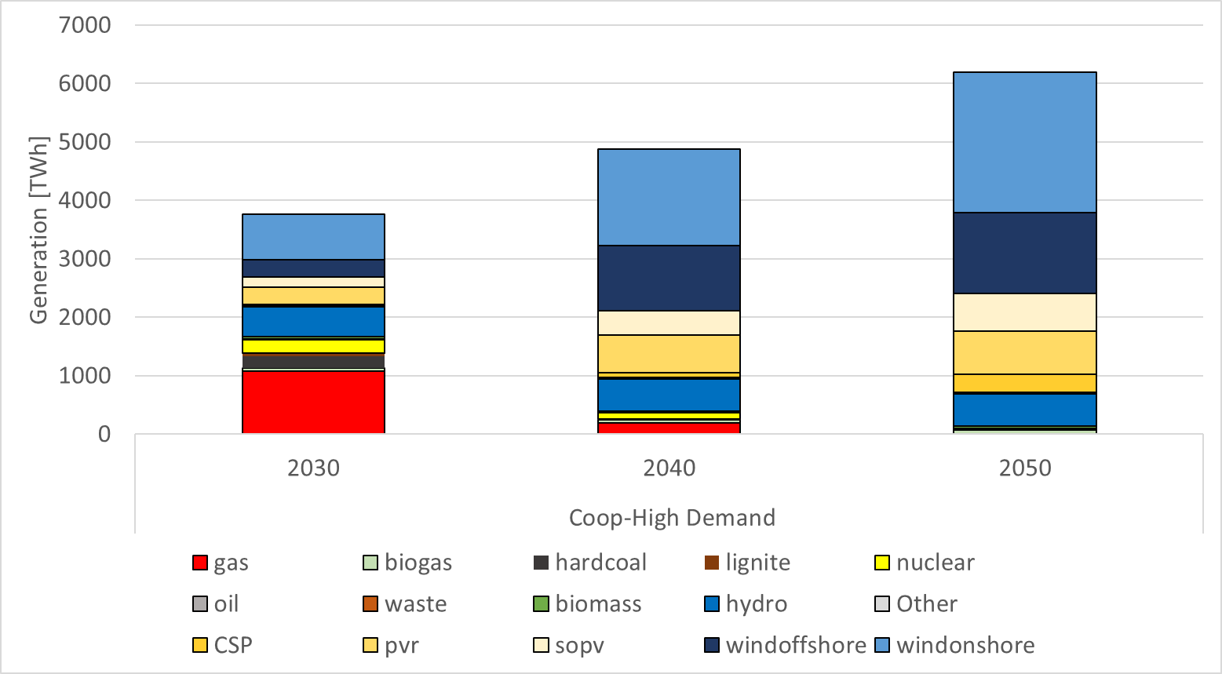
Generation (2030 – 2050)
Scenario:
Cooperation
High Demand

Slide 22
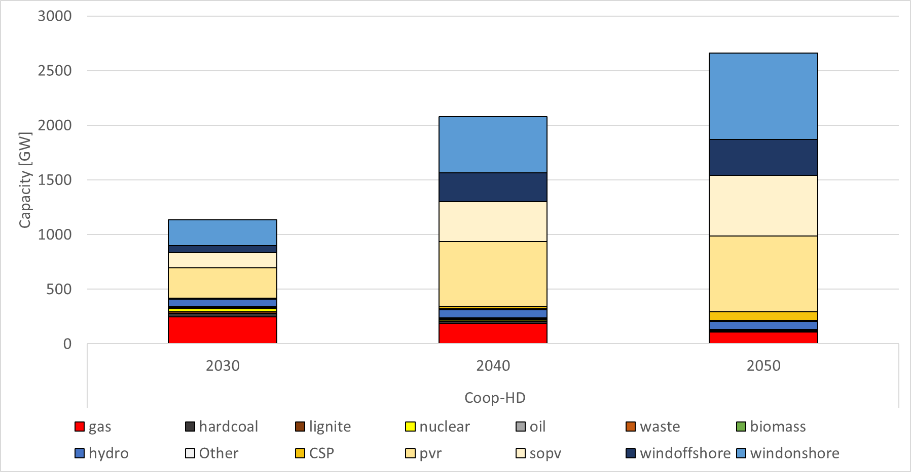
Capacity (2030 – 2050)
Scenario:
Cooperation
High Demand

Slide 23
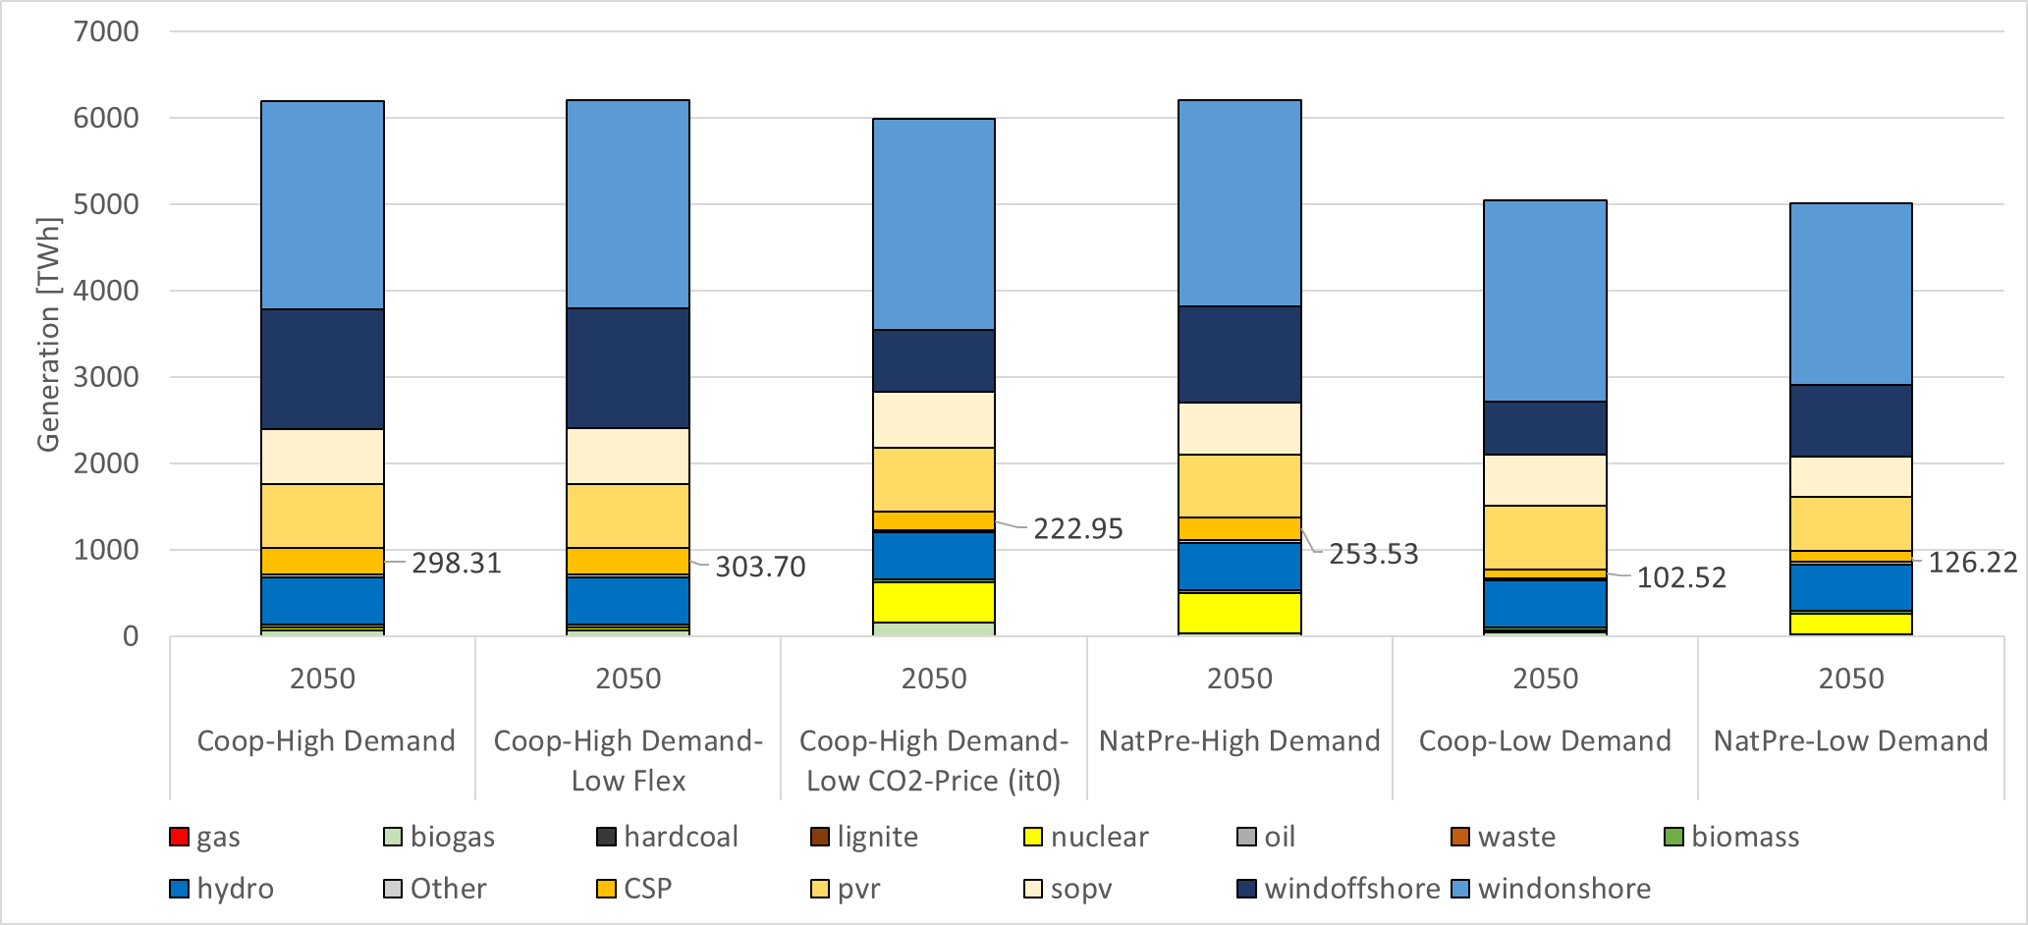
Generation 2050

Slide 24
Generation 2050 (TWh/year)
 | Coop-High Demand | Coop-High Demand-Low Flex | Coop-High Demand-Low CO2-Price (it0) | NatPre-High Demand | Coop-Low Demand | NatPre-Low Demand
gas/biogas | 67,2 | 66,4 | 151,3 | 26,0 | 40,1 | 19,7
hardcoal | 0,5 | 0,5 | 4,3 | 0,3 | 0,2 | 0,6
lignite | 0,0 | 0,0 | 0,0 | 0,0 | 0,0 | 0,0
nuclear | 28,6 | 28,6 | 466,3 | 474,1 | 28,0 | 233,4
oil | 0,0 | 0,0 | 0,0 | 0,0 | 0,0 | 0,0
waste | 0,0 | 0,0 | 0,2 | 0,0 | 0,0 | 0,0
biomass | 36,0 | 36,0 | 36,0 | 36,0 | 36,0 | 36,0
hydro | 549,6 | 549,5 | 538,5 | 545,3 | 540,9 | 540,7
Other (Geoth.) | 34,9 | 34,9 | 22,9 | 34,1 | 23,3 | 25,9
CSP | 298,3 | 303,7 | 222,9 | 253,5 | 102,5 | 126,2
pvr | 744,1 | 744,1 | 738,5 | 733,1 | 734,9 | 627,6
sopv | 641,7 | 642,2 | 646,3 | 602,9 | 599,9 | 462,1
windoffshore | 1381,2 | 1383,5 | 721,5 | 1109,1 | 610,5 | 840,0
windonshore | 2412,0 | 2412,3 | 2442,2 | 2387,0 | 2332,6 | 2098,1

Slide 25
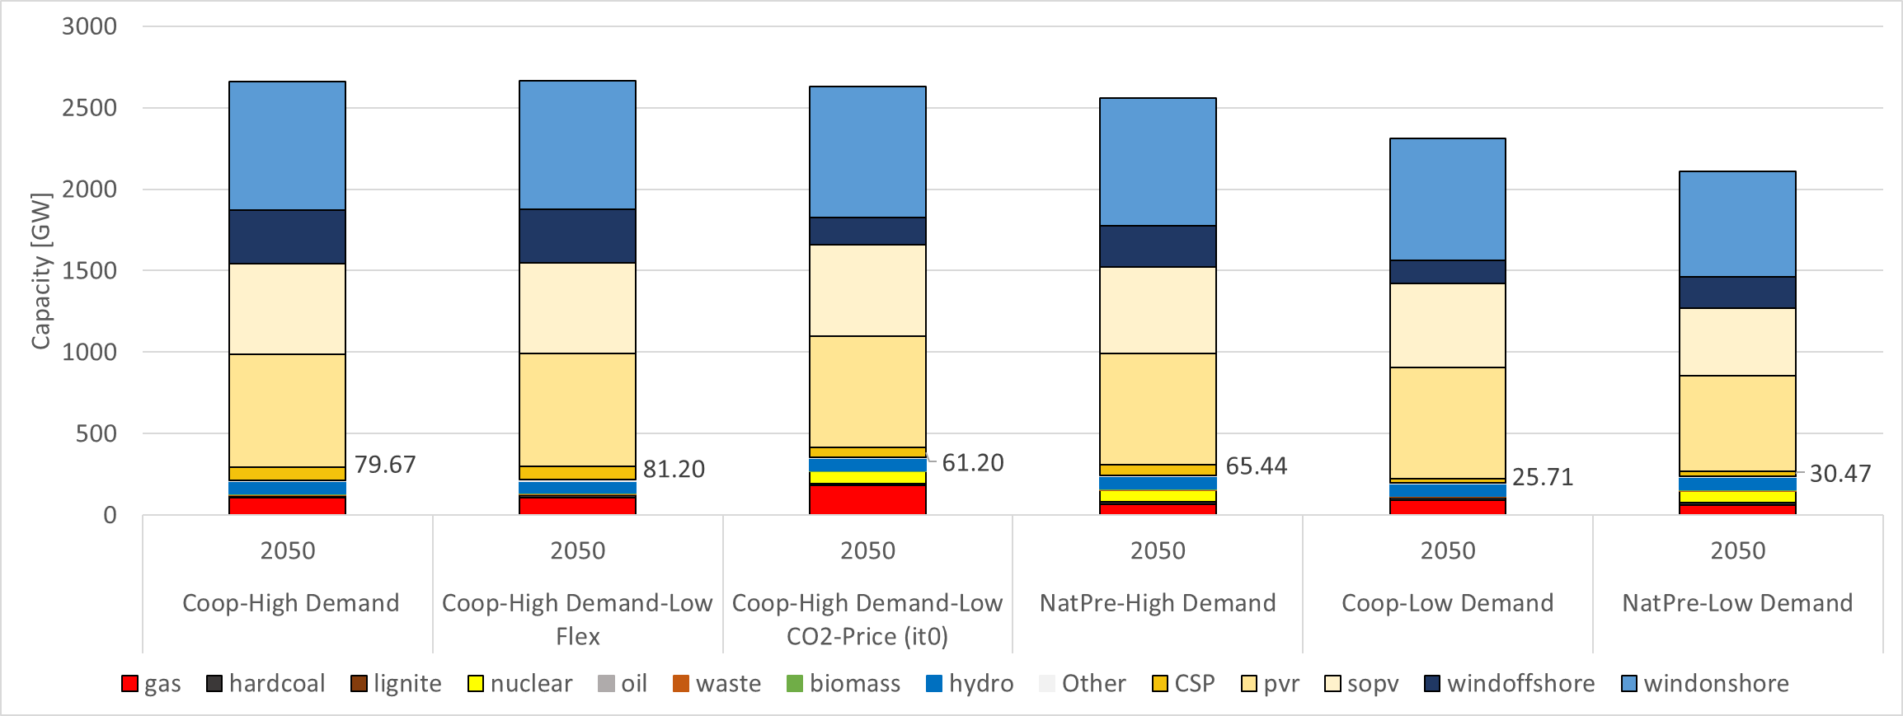
Capacity (2050)

Slide 26
Capacity 2050 (GW)
 | Coop-High Demand | Coop-High Demand-Low Flex | Coop-High Demand-Low CO2-Price (it0) | NatPre-High Demand | Coop-Low Demand | NatPre-Low Demand
gas/biogas | 106,0 | 109,1 | 180,0 | 68,0 | 92,9 | 63,0
hardcoal | 11,5 | 11,5 | 11,5 | 11,5 | 11,5 | 11,5
lignite | 1,0 | 1,0 | 1,0 | 1,0 | 1,0 | 1,0
nuclear | 4,1 | 4,1 | 73,5 | 73,5 | 4,1 | 73,5
oil | 0,0 | 0,0 | 0,0 | 0,0 | 0,0 | 0,0
waste | 4,9 | 4,9 | 4,9 | 4,9 | 4,9 | 4,9
biomass | 4,5 | 4,5 | 4,5 | 4,5 | 4,5 | 4,5
hydro | 74,2 | 74,2 | 72,1 | 73,4 | 72,6 | 72,5
Other (Geoth.) | 8,7 | 8,7 | 5,7 | 8,5 | 5,8 | 6,5
CSP | 79,7 | 81,2 | 61,2 | 65,4 | 25,7 | 30,5
pvr | 692,9 | 692,9 | 685,6 | 683,3 | 683,4 | 589,6
sopv | 555,6 | 555,9 | 559,1 | 526,9 | 517,0 | 410,2
windoffshore | 328,6 | 329,3 | 166,6 | 256,6 | 140,5 | 192,0
windonshore | 789,7 | 789,9 | 802,9 | 780,3 | 746,0 | 651,8

Slide 27
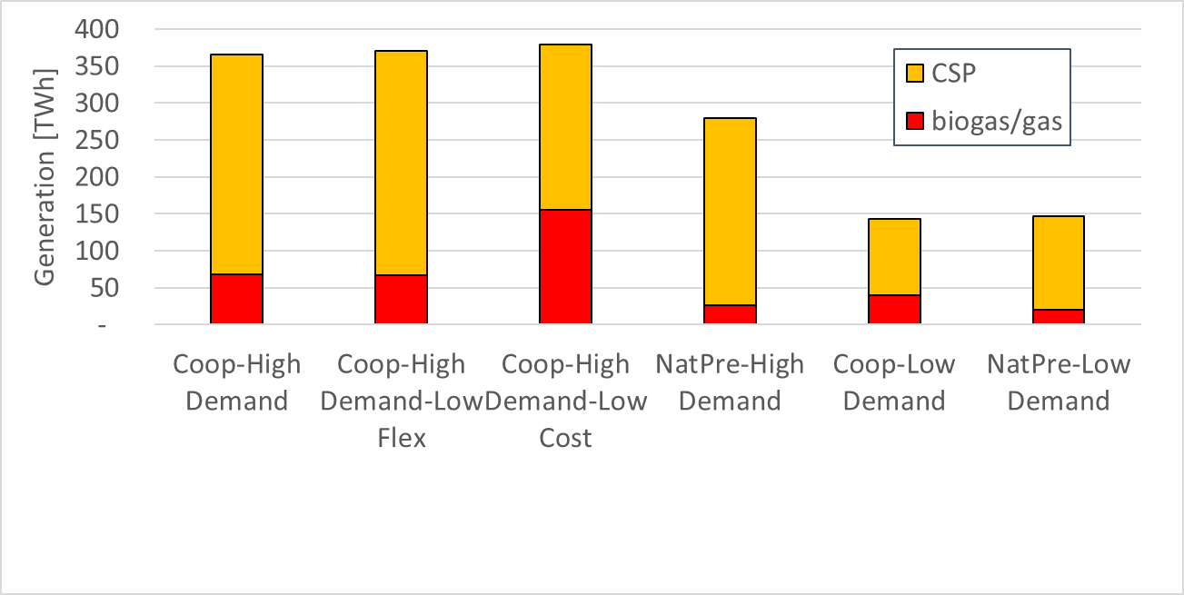
Generation-Gap in Enertile
CO₂-Price (Low Climate Ambition)

Slide 28
CSP-Generation per Country (2050))

Slide 29
CSP-Capacity per Country (2050)

Slide 30
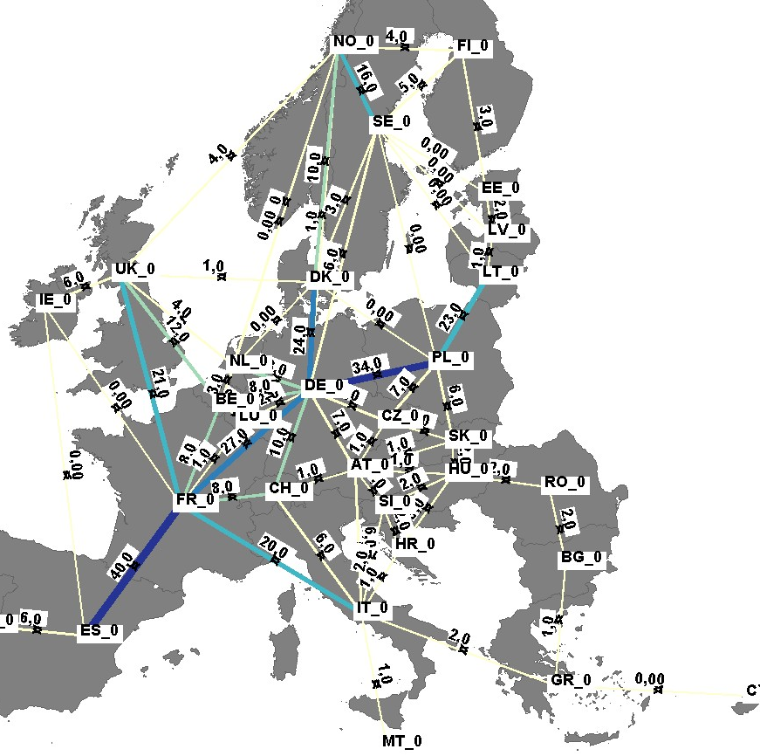
Interconnector capacities
Capacity > 30 GW
Capacity > 20 GW
Capacity > 10 GW
Capacity > 0 GW

Slide 31
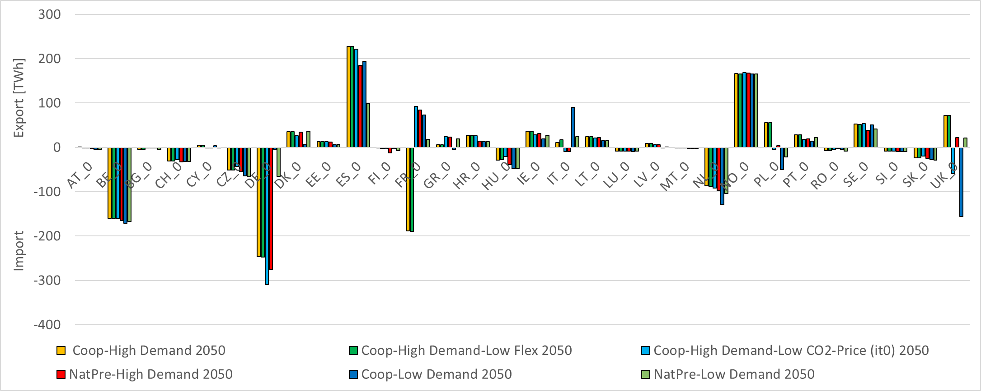
Electricity Trade (yearly balance)

Slide 32
CO2-Emissions
Sensitivity scenario:
Low
Climate Ambition
Reference 1990:
1.500 Mt.
-91%

Slide 33
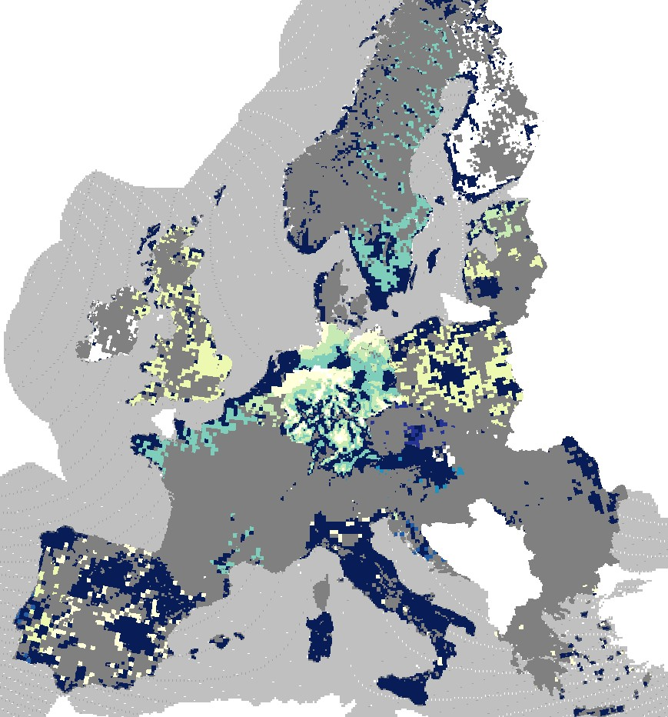
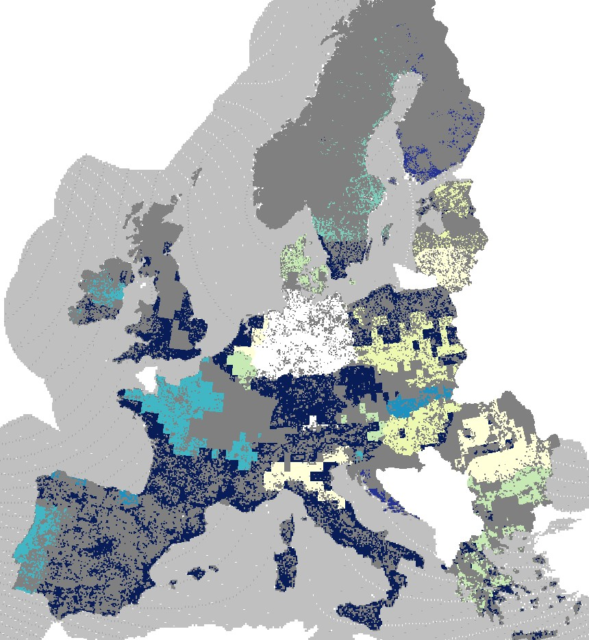
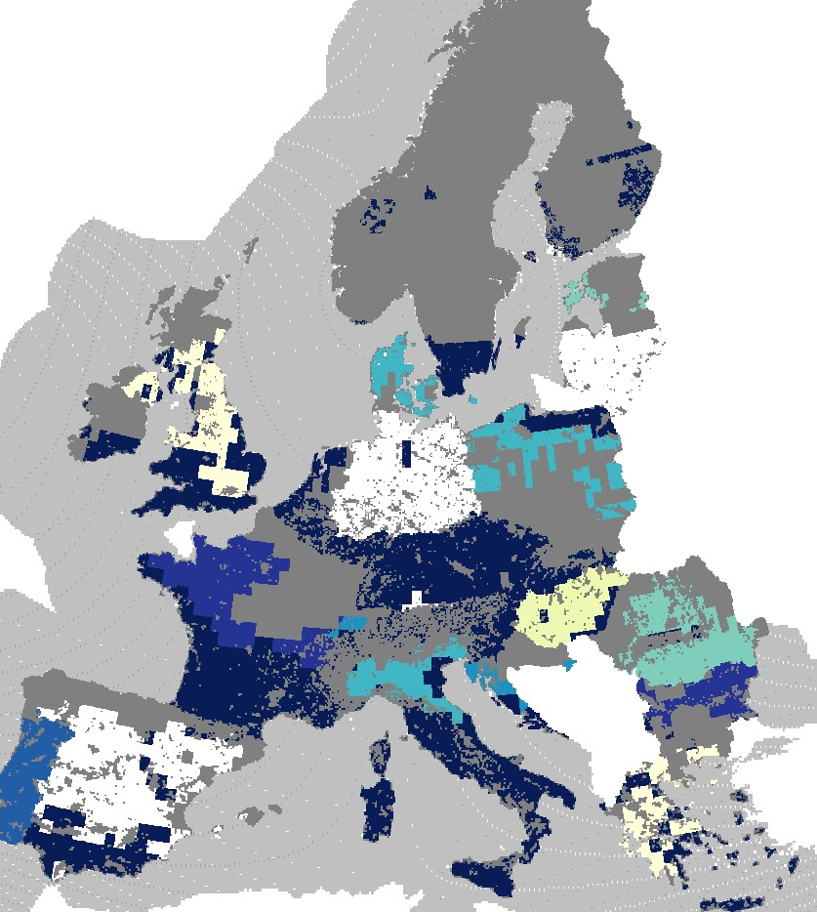
Potential usage
Wind onshore
PV (rooftop)
PV (utility scale)

Slide 34
Hourly dispatch 2050 (summer)

Slide 35
Hourly dispatch 2050 (summer)

Slide 36
Hourly dispatch 2050 (winter)

Slide 37
Hourly dispatch 2050 (winter)

Slide 38
Summary & Conclusions (I)
There is a strong need for CSP to provide system flexibility
in a fully decarbonized EU electricity market of tomorrow
  Overall range: 103 … 304 TWh by 2050
  Higher electricity demand (driven by sector-coupling) increases demand for CSP:
  103 (low) vs. 298 TWh (high demand) in the Cooperation scenarios
  The policy choice (National preferences vs. Cooperation) has an ambiguous impact on CSP use
    In high demand scenarios we see that Cooperation is beneficial for CSP:
    298 (Cooperation) vs. 254 TWh (National Preferences)
    In low demand scenarios we see the opposite trend:
    103 (Cooperation) vs. 126 TWh (National Preferences)
    Underlying nuclear expansion is of relevance (i.e. more nuclear reduces to gap to be filled (by CSP, renewable gas)
    Nevertheless, Cooperation would decrease the financing cost for CSP (due to improved financing conditions in host countries)

Slide 39
Summary & Conclusions (II)
There is a strong need for CSP to provide system flexibility
in a fully decarbonized EU electricity market of tomorrow
  Lower flexibility provided by sector-coupling (e-mobility, heat pumps) increases the demand for CSP only to a small extent:
  298 (high) vs. 304 TWh (lower flexibility) in the Cooperation scenarios, high demand
Lowering the climate ambition leads to a decline of the need for CSP
– but according to our analysis the impact is less pronounced:
298 (high) vs. 223 TWh (low climate ambition) in the Cooperation scenarios, high demand
These positive developments indicated for CSP can only materialize
if CSP costs can be reduced as assumed!!!

Slide 40
Pivotal decisions and key factors for robust CSP strategies – D7.4
Franziska Schöniger – TU Wien

Slide 41
Decarbonization & CSP cost reduction: High carbon price levels as precondition but not guarantee for increased CSP deployment
300 €/t CO₂
200 €/t CO₂
77 €/t CO₂
Policy implication I
Policies for effective carbon pricing without allowing for CCS are important for CSP to be able to play a role.
Notes:
Effective carbon pricing (i.e. high CO2 prices): key for successful CSP deployment. Policies that allow for CCS are hindering the development of alternative, CO2-free technology options like CSP.
Technology cost reductions of all CSP components are necessary in order to keep this technology competitive and available for the transformation of our electricity systems. Since absolute CSP capacities installed are relatively small, policies for targeted support for CSP can foster high learning rates.

Slide 42
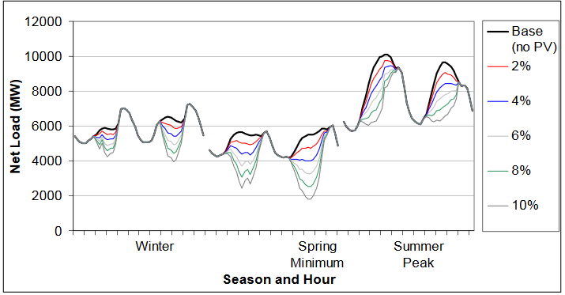
Decisions on technology phase-in/phase-out: Systems with a high share of variable renewables (especially solar PV) will need a complementary technology option
Policy implication IV
National or international policies causing high renewable shares and nuclear (and/or coal) phase-out create a need for alternative dispatchable technologies, which can be well covered by CSP.
Load Shapes in Colorado with various WECC PV Penetration Scenarios (Denholm, Margolis, & Milford, 2008)
Complementary technology concepts PV and CSP. Source: (Souza, 2018)
Notes:
CSP and PV can fulfil complementary tasks which can be addressed by renewable policies. Competitive specific auctions can help to rate the system contribution of different technology options and value the dispatchability of CSP. Both, PV and CSP, will be needed in the electricity system of 2050.

Slide 43
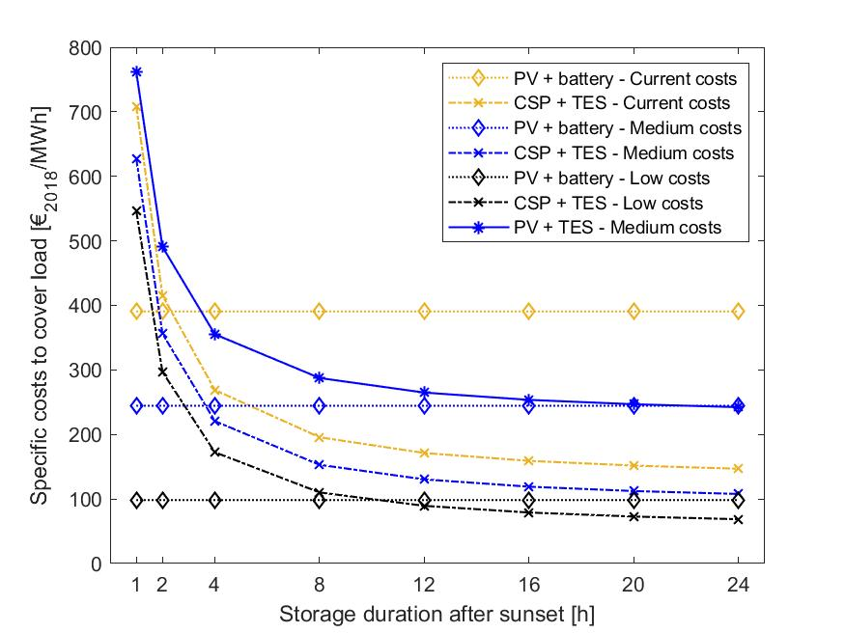
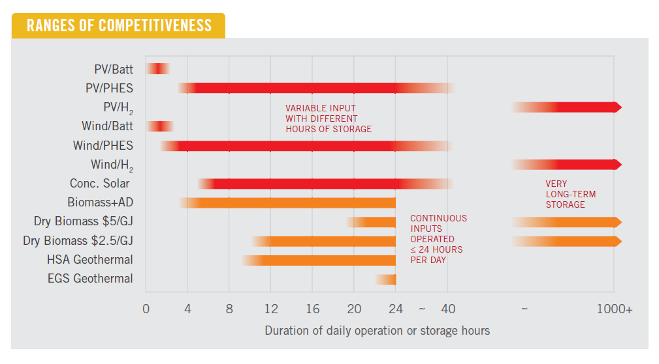
Different niches for CSP and PV + storage: Storage duration as important factor for distinction
Policy implication III
There will be different niches for both, CSP and PV with storage, in the future electricity system. In order to have both technologies ready and competitive, it is necessary to design targeted support, e.g. through competitive specific auctions.
Policy implication II
Thermal storage capacities are a valuable flexible option for future electricity systems. Targeted support of CSP enhances this option.
Comparison of dispatchable renewable electricity options. Source: (Lovegrove et al., 2018)
Specific costs for different hours of continuous generation (100 MW) from storage. Source: (Schöniger, Thonig, Resch, & Lilliestam, 2019, in review)
Notes:
Thermal energy storage is a cost-effective flexibility option for longer storage durations. Support for CSP enhances at the same time this flexibility option.

Slide 44
Pivotal factors for CSP deployment and related policy decisions
Effective carbon pricing (i.e. high CO2 prices): key for successful CSP deployment. Policies that allow for CCS are hindering the development of alternative, CO2-free technology options like CSP.
Technology cost reductions of all CSP components are necessary in order to keep this technology competitive and available for the transformation of our electricity systems. Since absolute CSP capacities installed are relatively small, policies for targeted support for CSP can foster high learning rates.
CSP and PV can fulfil complementary tasks which can be addressed by renewable policies. Competitive specific auctions can help to rate the system contribution of different technology options and value the dispatchability of CSP. Both, PV and CSP, will be needed in the electricity system of 2050.
Thermal energy storage is a cost-effective flexibility option for longer storage durations. Support for CSP enhances at the same time this flexibility option.
EU policies are clearly targeted at increased cooperation and grid integration (cf. e.g. Directive 2009/28/EC). Electricity grid extensions have different effects on CSP deployment. On the one side, a lack of export opportunities hinders CSP and it benefits from transmission capacities from Southern countries to central Europe. But on the other side, increased transmission capacities are a flexibility option which is competing against CSP.

Slide 45
Outlook
Franziska Schöniger – TU Wien

Slide 46
Tasks & time plan
Date | What | Notes | Who
12th/13th May | Internal Meeting ONLINE | Collection of feedback on scenario runs, preliminary results | TUW
Rest of May | Incorporation of feedback |  | TUW, ISI
M32 (May 2020) | D7.4 Pivotal decisions. Robust CSP strategies (M32) – TU WIEN | Includes the most important results from modelling with regard to the policy pathways | TUW, IASS
M33 (June 2020) | Review & submit: D8.2 Final Report: Integrative model-based analysis (M33) – TU WIEN D8.3 Database on Integrative model-based analysis (M33) – TU WIEN |  | TUW, ISI
Afterwards | Supporting synthesis of results for WP10 – Synthesis, roadmap & action plan

Slide 47
Discussion

Slide 48
Literature
Denholm, P., Margolis, R., & Milford, J. (2008). Production Cost Modeling for High Levels of Photovoltaics Penetration. In Technical Report NREL/TP-581-42305.
Lovegrove, K., James, G., Leitch, D., Ngo, M. A., Rutovitz, J., Watt, M., & Wyder, J. (2018). Comparison of dispatchable renewable electricity options. In Technologies for an Orderly Transition. Retrieved from https://arena.gov.au/assets/2018/10/Comparison-Of-Dispatchable-Renewable-Electricity-Options-ITP-et-al-for-ARENA-2018.pdf
Schöniger, F., Thonig, R., Resch, G., & Lilliestam, J. (2019). Making the sun shine at night: comparing concentrating solar power and photovoltaics with storage. Energy Sources, Part B: Economics, Planning, and Policy, (Special Issue: Dispatchable RES and Flexibility in High RES Penetration Scenarios: Solutions for Further Deployment).
Souza, A. (2018). Selection of representative and strategic STE projects potentially suitable for cooperation. Deliverable 5.1, MUSTEC project, ESTELA, Brussels.

Slide 49
Gustav Resch, Franziska Schöniger, TU Wien / EEG
e-mail: {resch|schoeniger}@eeg.tuwien.ac.at
Phone: +43-1-58801-370354
Christoph Kleinschmitt, Katja Franke, Frank Sensfuß. FH ISI
e-mail: {katja.franke|christoph.kleinschmitt|frank.sensfuss}@isi.fraunhofer.de

Slide 50
Backup Slides

Slide 51
Lessons learned from previous scenarios
Factors which enable relevant use of CSP:
ambitious GHG mitigation targets → high CO2 price
high electricity demand
high usage of (other) RES potentials
low capacity of nuclear, fossil CCS, or other dispatchable power plants
competitive CSP costs
Ambivalent factor:
electricity grid extensions
Knockout factor for CSP:
cheap electricity storage combined with PV → BUT: thermal storage competitive for longer storage durations!

