Slide 1

Welcome to the ARIEL H2020
international on-line school on nuclear data: the path from the detector to the reactor calculation - NuDataPath
The local organising committee:
Víctor Alcayne Aicua
Francisco Álvarez (coordinator)
Vicente Bécares
Daniel Cano-Ott (director)
Emilio Mendoza (coordinator)
Julio Plaza del Olmo
Susana Falcón (secretary)
ARIEL: https://www.ariel-h2020.eu/
Contact: nudatapath@ciemat.es

Slide 2
Index
Introduction about the organising institution – CIEMAT
Welcome by the ARIEL EC project (https://www.ariel-h2020.eu/)
Practical info about the school
Quick tour around the timetable
Questions

Slide 3
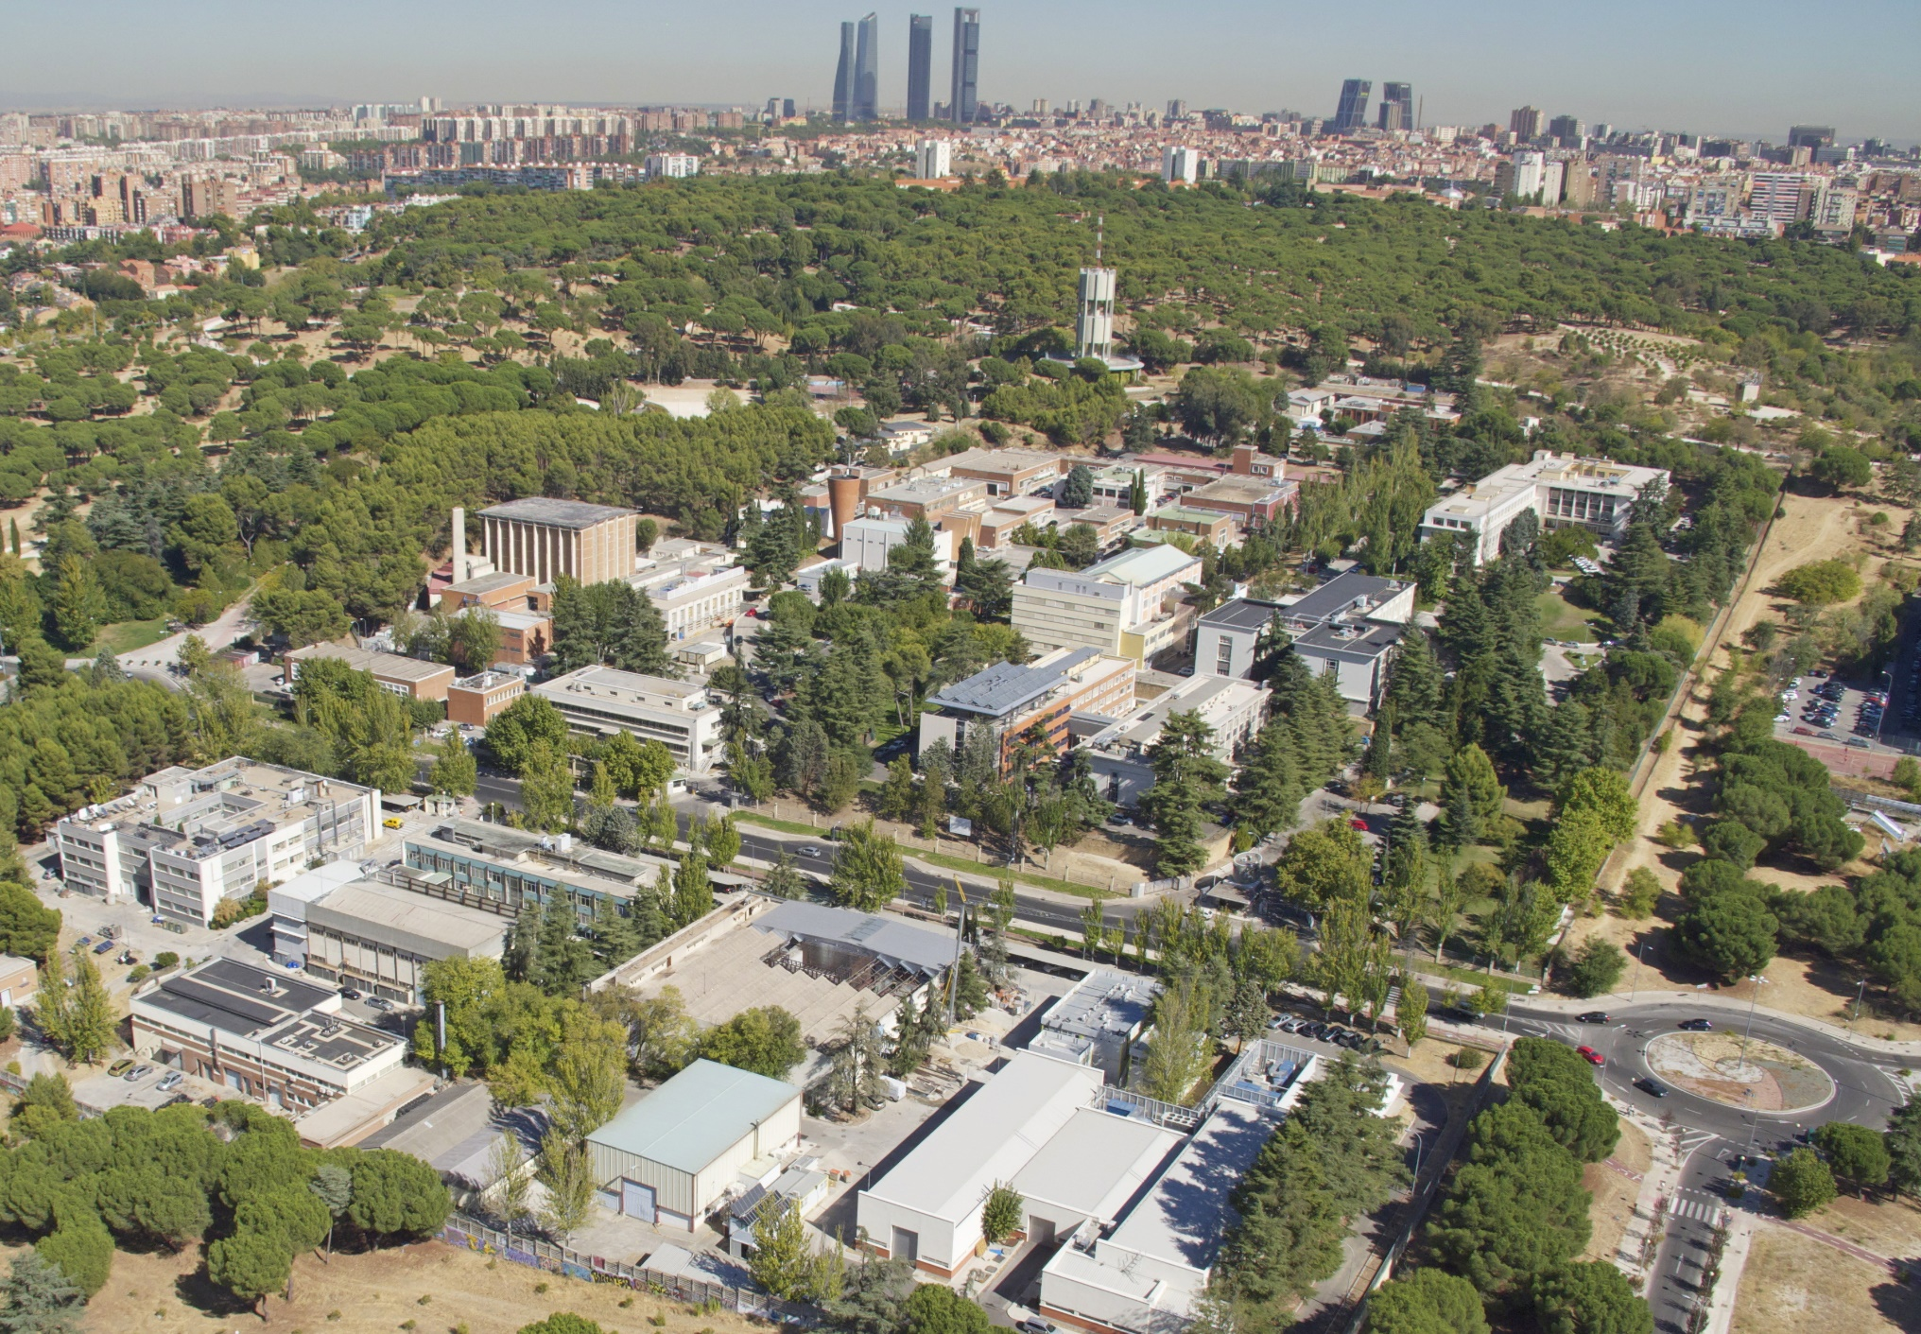
CIEMAT
The CIEMAT (Centro de Investigaciones Energéticas, Medioambientales y Tecnológicas - Madrid) is a Spanish public research body assigned to the Ministry of Science and Innovation of Spain, focusing on energy and environment and associated technologies.
CIEMAT’s Department of Energy has a Division of Nuclear Fission carrying out a wide set of activities to support the safe operation of Spanish Nuclear power plants and the safe and sustainable management of its waste. It has coordinated the last three nuclear data projects ANDES, CHANDA and SANDA and also hosts the National Fusion Laboratory for the development of fusion by magnetic confinement and the TJ-II stellerator.

Slide 4
Practical info
School duration: 5 + 5 working days during the morning sessions
Time table: https://agenda.ciemat.es/e/nudatapath (check for possible changes)
Open seminars specialists on the most relevant topics related to the nuclear data cycle. (The current zoom link you are using). The seminars will introduce the concepts necessary for the hands-on lectures
Hands-on interactive lectures with computer restricted to the school participants: 3 groups of 8 students + lecturer. (A different zoom link that the school participants should have received via email).
The presentations will be publicly available.

Slide 5
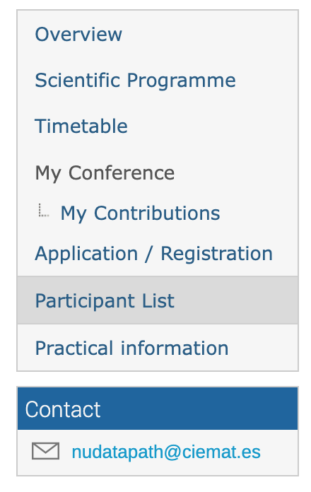
Practical info
Check the group that has been assigned to you.
https://agenda.ciemat.es/event/3201/registrations/participants
You will have to log in on a web server with a username that has been assigned. Emails will be sent tomorrow with the link to the server and username to each participant.
Only for participants: don’t forget to register for the lecture Zoom sessions (if you didn’t do it)

Slide 6
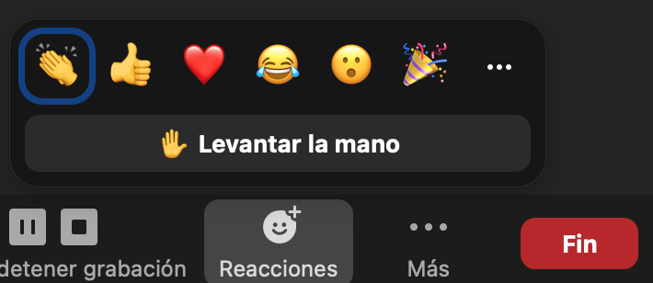
Practical info
We encourage the students to interact with the speakers!
During the seminars, raise your hand in Zoom application or post your questions in the chat. There will be 15 minutes for answering your questions at the end of each talk. Please keep your microphones muted during the presentations.
During the lectures, the reduced number of participants per group will allow a closer interaction. Raise your hand or speak directly if nobody else is speaking.

Slide 7
Practical info
Attendance certificates will be distributed to the participants of the school (seminars + lectures).
Please don’t miss the lectures and the seminars.
For the lecturers, please keep the time allocated to your talks. The timetable is very tight.

Slide 8
Simplified agenda
Start of the school at 9:00 AM
1st week |  | 2nd week
Monday | Seminars | Monday | Lectures + seminar
Tuesday | Seminars | Tuesday | Lectures + seminar
Wednesday | Lectures | Wednesday | Seminars
Thursday | Lectures + seminar | Thursday | Lectures + seminar
Friday | Seminars | Friday | Lectures + seminar
https://agenda.ciemat.es/event/3201/timetable/#20220221.detailed

Slide 9
Questions?

