Slide 1
Dark Matter group: P.N. 2022-2025 R.Santorelli on behalf of DM-CIEMAT

Slide 2
The CIEMAT DM people
Dark Matter-DD with argon and detector developments
Group members:
Pablo Garcia (physicist) → 100%
Luciano Romero (physicist) → 100%
Roberto Santorelli (physicist) → 100%
Vicente Pesudo (physicist) → 100%
Miguel Cardenas (physicist) → ∼50%
J.M. Cela (physicist) → ∼50%
Manuel Daniel (engineer) → ∼50%
Estefania Conde (chemist) → ∼50%
Ana Barrado (chemist) → ∼50%
Marta Fernandez (chemist) → ∼50%
Technicians:
PhD student:
L. Luzzi (2nd yr)
J.J. Martinez (technician)
R. Lopez (technician)
PN-DM 19/09/22 2

Slide 3
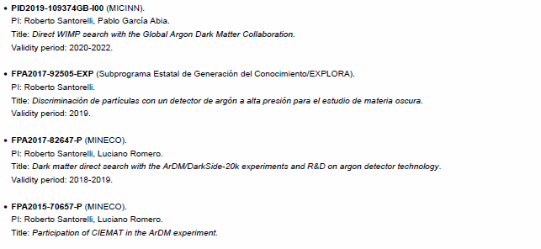
History
http://darkmatter.ciemat.es/funded-projects
PID2019-109374GB: 200 k€ C. directos / 0 becas
PN-DM 19/09/22 3

Slide 4
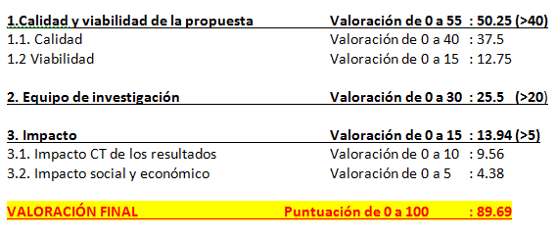
Evaluation
PN-DM 19/09/22 4

Slide 5
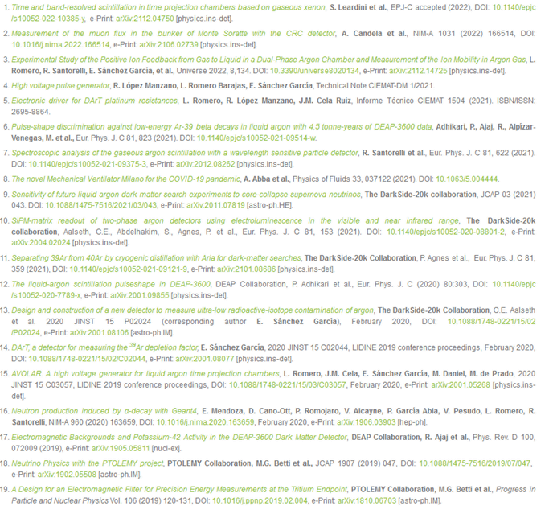
Scientific production (2019-2022)
http://darkmatter.ciemat.es/publications

Slide 6
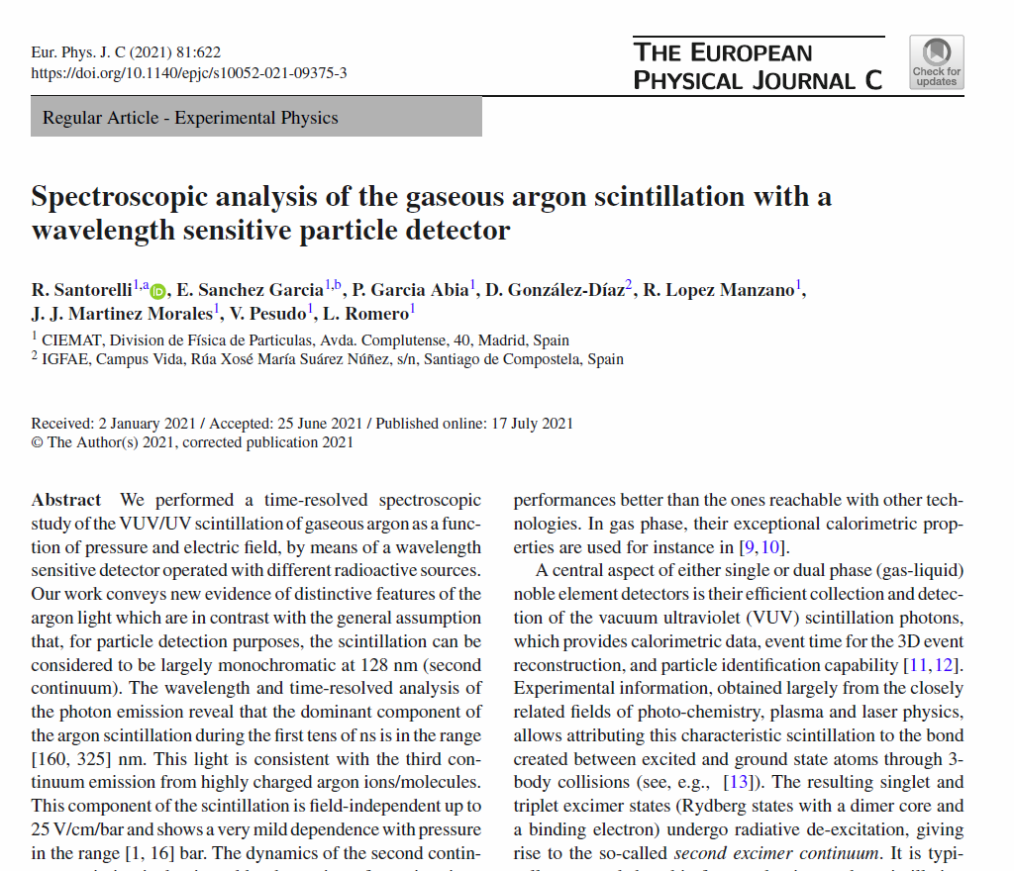
Eur. Phys. J. C 81, 622 (2021).
PN-DM 19/09/22 6

Slide 7
Scientific production (2019-2022)
http://darkmatter.ciemat.es/master-and-phd
1 PhD thesis
8 Master thesis
28 talks (TAUP, La Thuile, DM, PANIC, CPAN..)
1 EXPLORA
Step 2 for an ERC starting grant
2 Workshops organized
2 collaboration meetings
1 conference next year
PN-DM 19/09/22 7

Slide 8
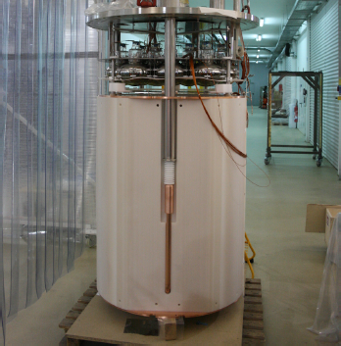
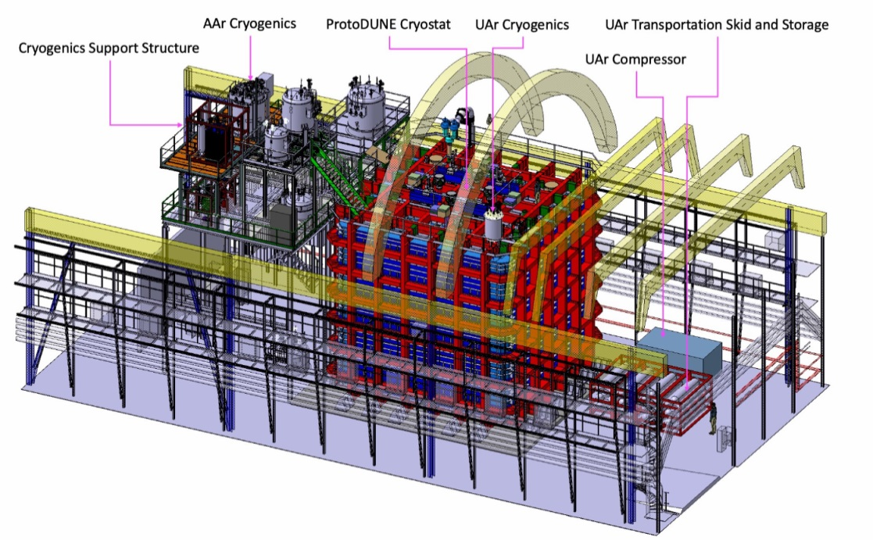
A successful technology
’00s ∼Kg-scale
’10s ∼ton-scale
’20s ∼tens of ton
PN-DM 19/09/22 8

Slide 9
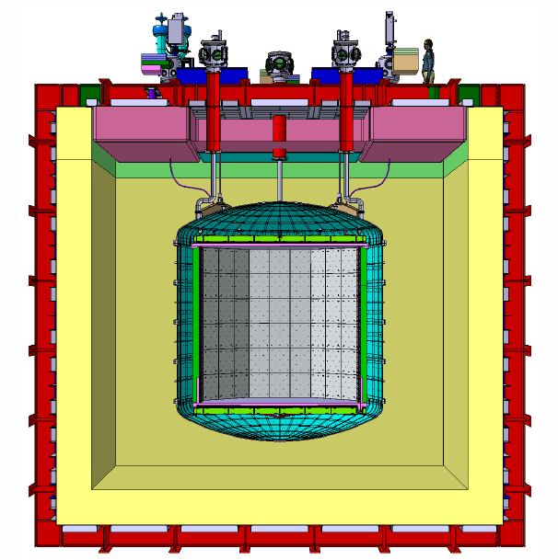
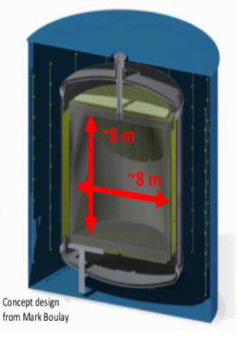
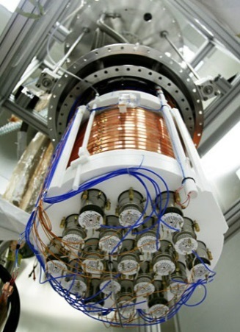
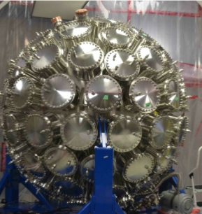
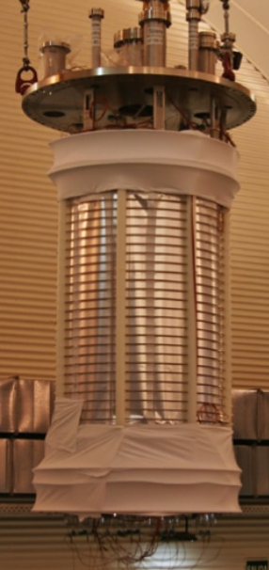
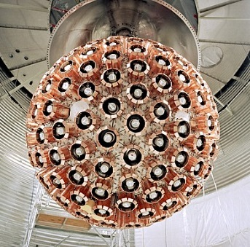
GADMC: towards 200 t⋅yr
There is a remarkable and unique opportunity for large exposures (∼200 t⋅yr) in background-free mode with a massive argon TPC
The dual-phase LAr-TPC is able to exceed the current experimental limits, reaching the neutrino floor
GADMC: Collaboration with groups from DS-50, ArDM, DEAP-3600 and MiniCLEAN (major expertise in Argon based detectors) ∼500 people, about 100 Institutions
DarkSide-20k@LNGS
DarkSide-50@LNGS Mini Clean@SNOLAB
ARGO@SNOLAB
3,5 m
Data taking from 2025
51 t total mass
20 t × 10 yr
Conceptual studies in progress
3 kt x 10 yr
DEAP-3600@SNOLAB ArDM@LSC

Slide 10
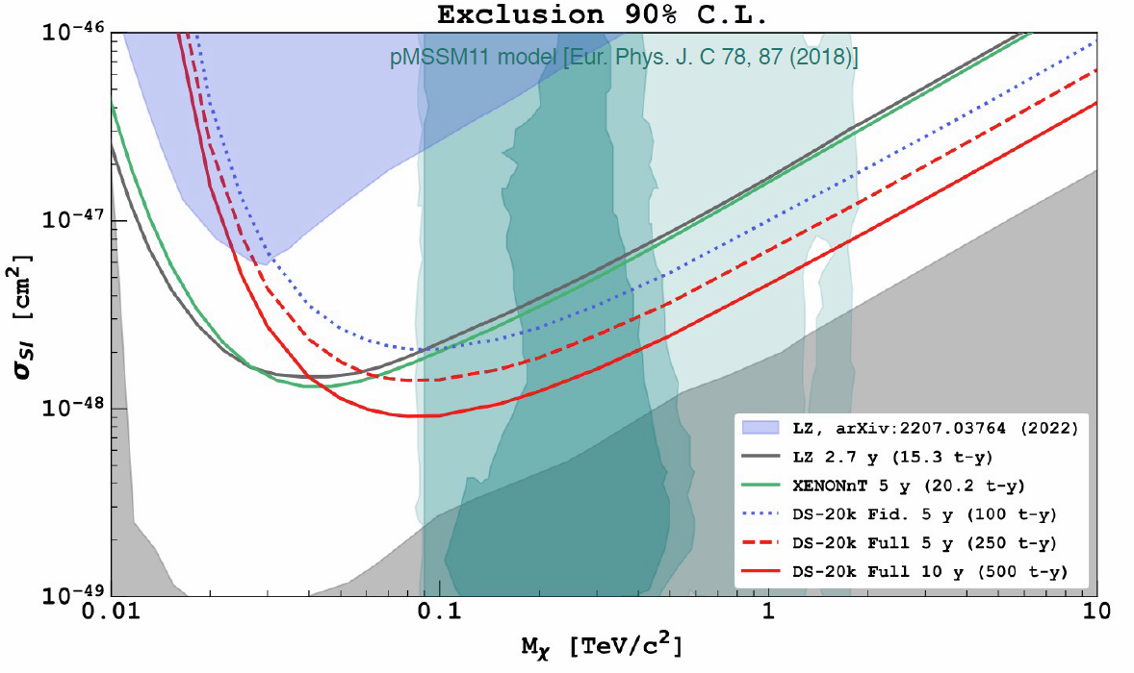
Sensitivity (SI)
Excluded region
Neutrino floor
6.3 × 10⁻⁴⁸ cm² for 1 TeV/c² WIMP (90% C.L.)
2.1 × 10⁻⁴⁷ cm² (5σ) discovery
nominal exposure: (20×10) t⋅yr
background: 0.1 events
Turquoise filled contours are from pMSSM11 model, E. Bagnaschi et al., Eur. Phys. J. C 78, 87 (2018).
PN-DM 19/09/22 10

Slide 11
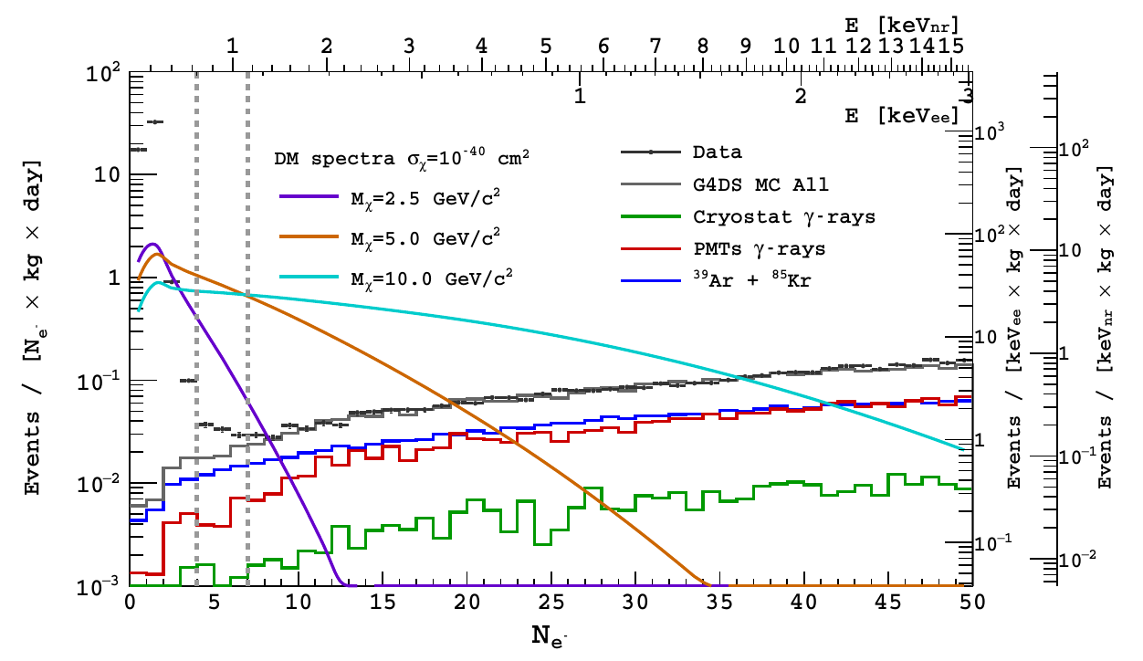
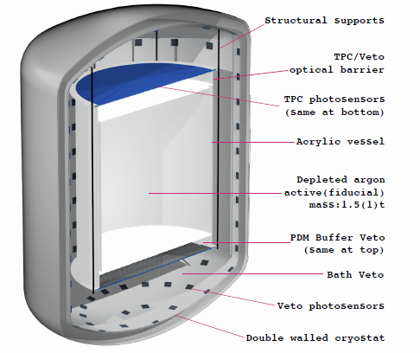
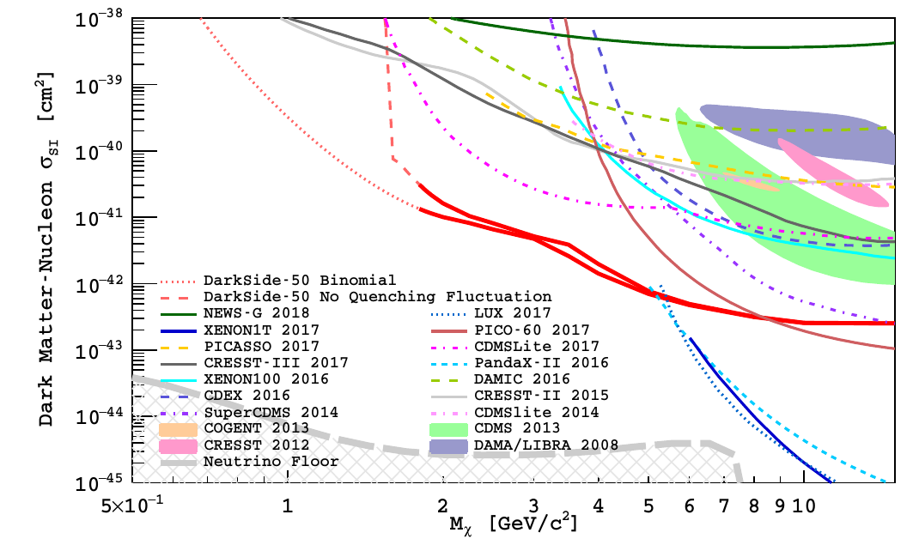
Low-mass, SN…
1.5 t dual-phase Ar-TPC
acrylic vessel
10 cm buffer vetoes
UAr bath veto
arXiv:2209.01177
Physics program beyond WIMPs:
Exotic DM searches
Low mass DM searches (DS-LowMass)
Solar axions
SuperNova neutrinos
…. And more
DarkSide-50@LNGS
Phys.Rev.Lett. 121 (2018)
PN-DM 19/09/22 11

Slide 12
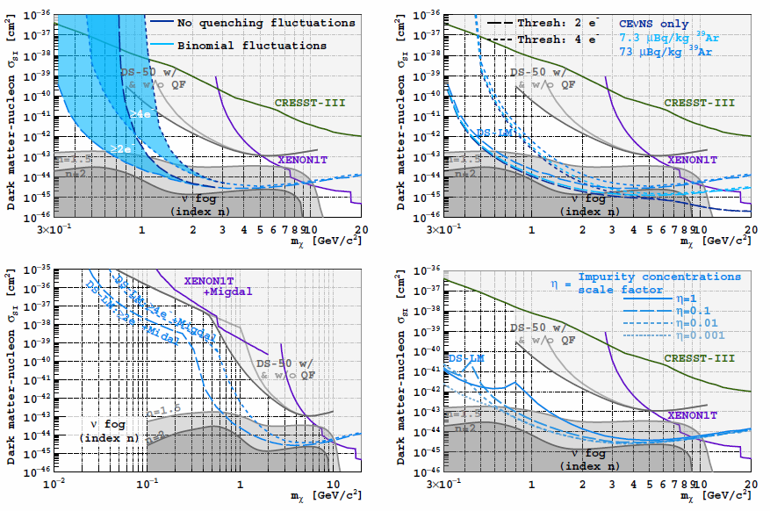
PN-DM 19/09/22 12

Slide 13
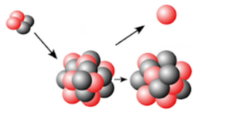
Technology breakthrough: Radiopurity
Very demanding background requirements (< 0.1 in 10 yr exposure):
PSD alone is not sufficient
Strategy:
Assay all materials of the detector
Worldwide effort Canada, Italy, France, Poland, Russia, Spain, UK, US…
Counting facilities in four Underground laboratories involved (Boulby, LNGS, LSC, SNOLAB)
3 different techniques employed: ICPMS, HPGe, Po extraction for Upper, Middle and Lower ²³⁸U chain
Hundreds of assays carried-out
Platform to store and manage the results of the material assay campaign
Full characterization and calculation of the
materials background
Control of the cosmogenic activation of materials
Control of the surface contamination
Evaluation of the radioactive budget of the experiment including activation UG
Evaluation of the systematic uncertainty from the material composition
New MC tools for (𝛼, 𝑛) calculations
25x25 cm²
DarkSide is the first experiment with the (a,n) neutron background fully calculated with Geant4
Simple and versatile tool provided to the community SaG4n (http://win.ciemat.es/SaG4n/)
“Neutron production induced by α-decay with Geant4”,
Nucl. Instrum. Methods A 960, 163659 (2020)
5x5 cm²
PN-DM 19/09/22 13

Slide 14
PN-DM 19/09/22 14

Slide 15
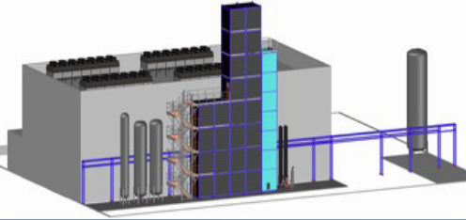
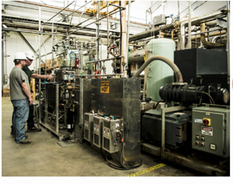
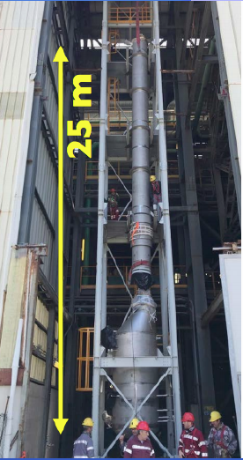
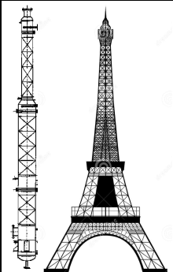
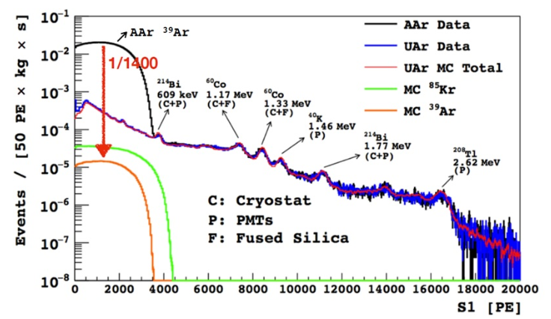
Technology breakthrough: radiopure Ar
URANIA project:
Procurement of 50 ton of UAr extracted from the CO₂ wells at Cortez mine, Colorado (∼330 kg/d, 99.99% purity)
ARIA project:
Seruci 1: chemical purification of
the UAr by cryogenic distillation
(reduction factor 1000 per pass, 1 t/d)
Seruci 2: Active Ar-39 depletion via isotope distillation
28 modules,
360 m in total

Slide 16
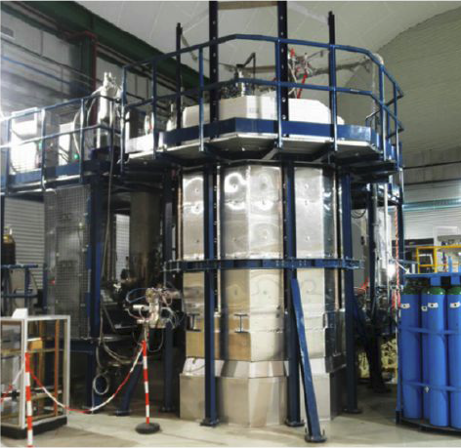
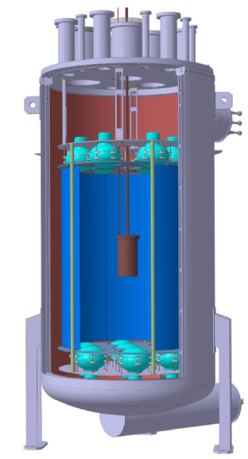
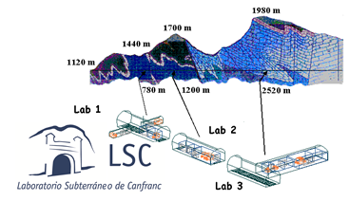
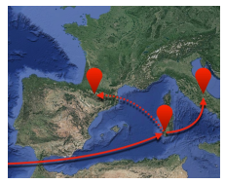
UAr radiopurity measurement: DArT in ArDM
LSC in Spain
Main Lab under mount Tobazo
~850 m rock
~2400 mwe
1400 m²
ArDM
Double-phase EL-TPC
850 kg active volume (≈2 t total)
Cryogenic low rad. PMT arrays (R5912 2×12)
50 cm passive neutron shield (Poly, 20 ton)
Data taken 2014-2018
PN-DM 19/09/22 16

Slide 17
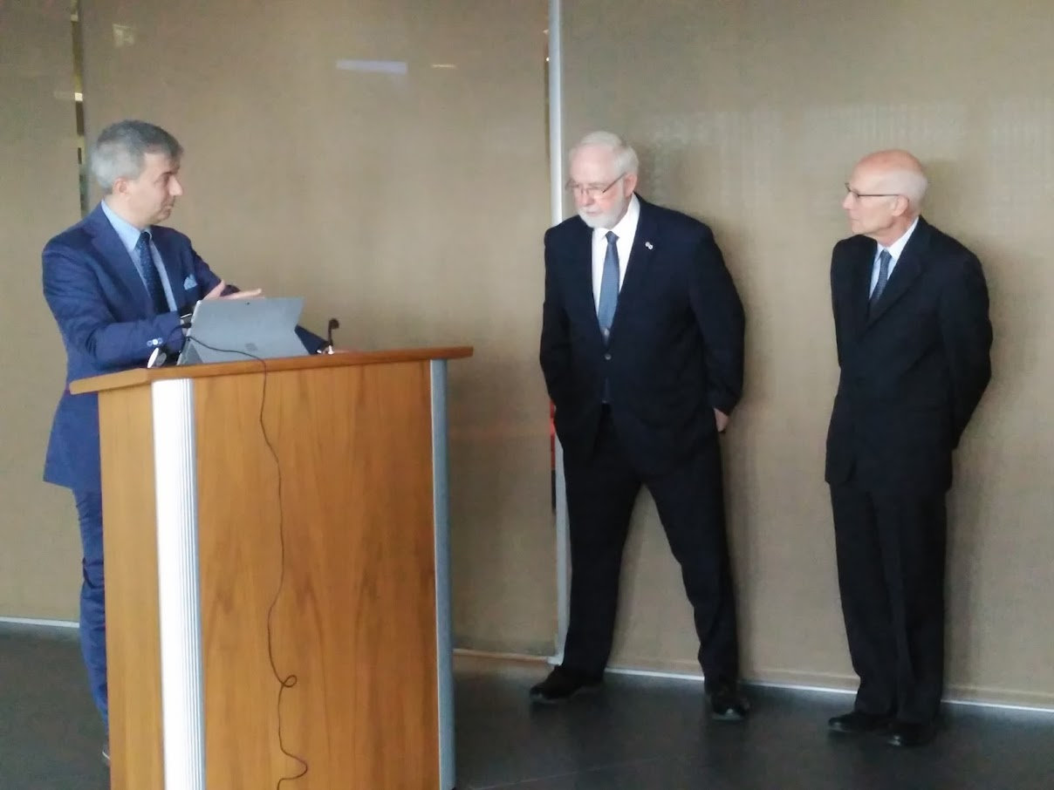
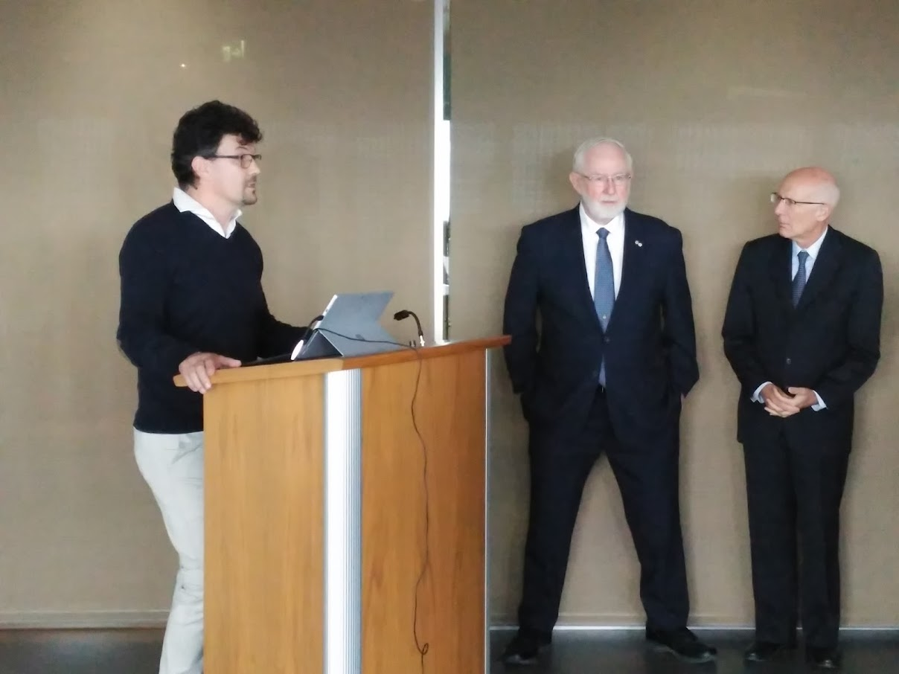
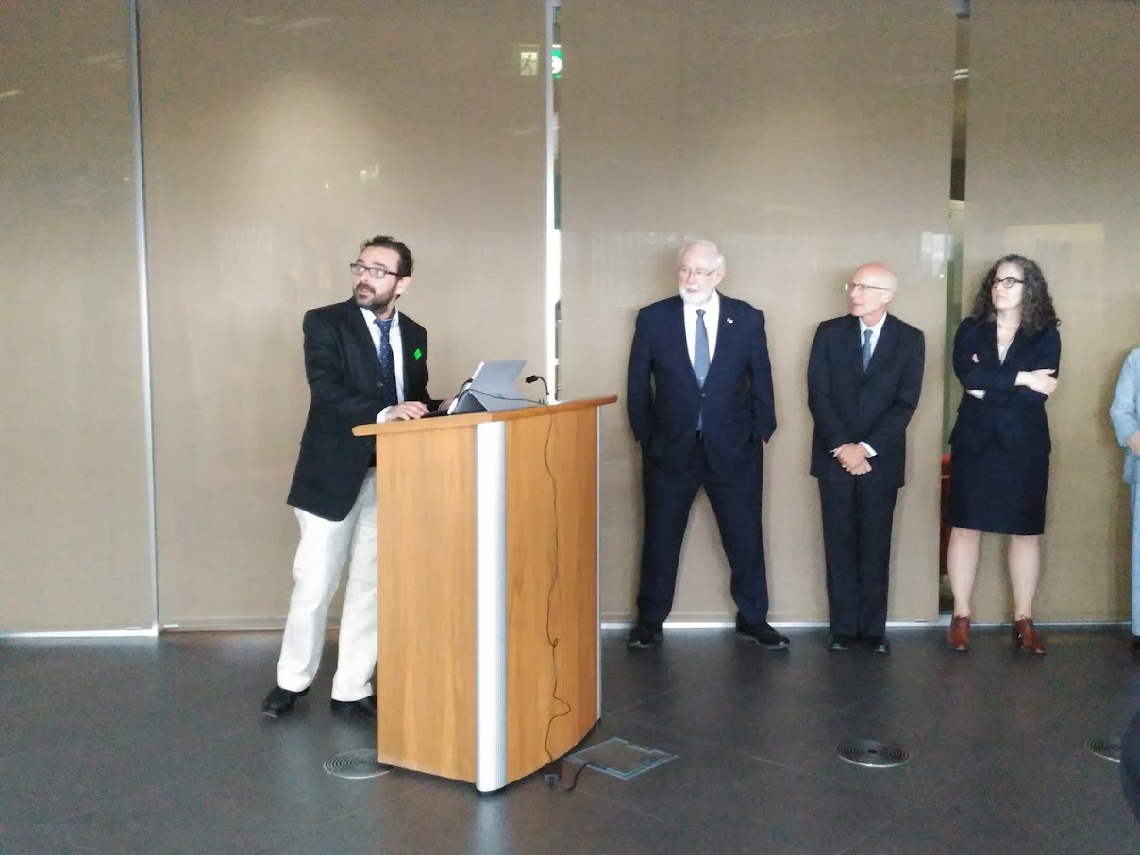
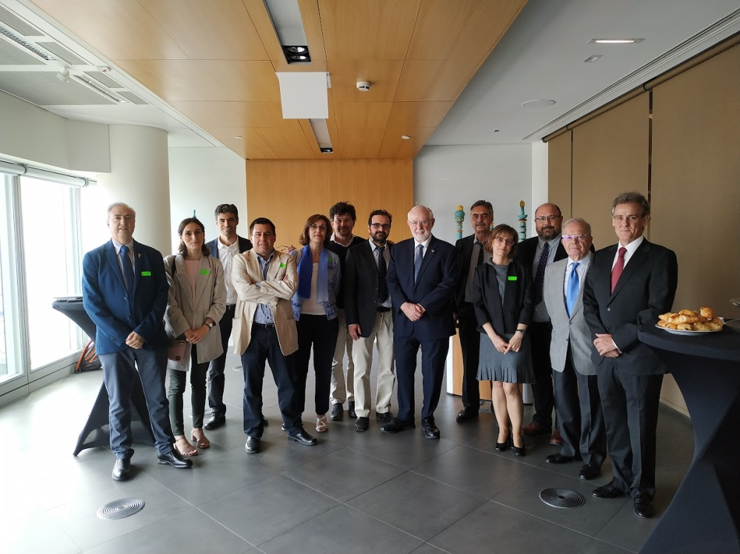
PN-DM 19/09/22 17

Slide 18
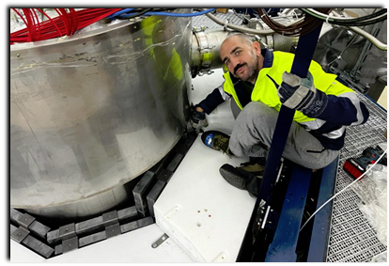
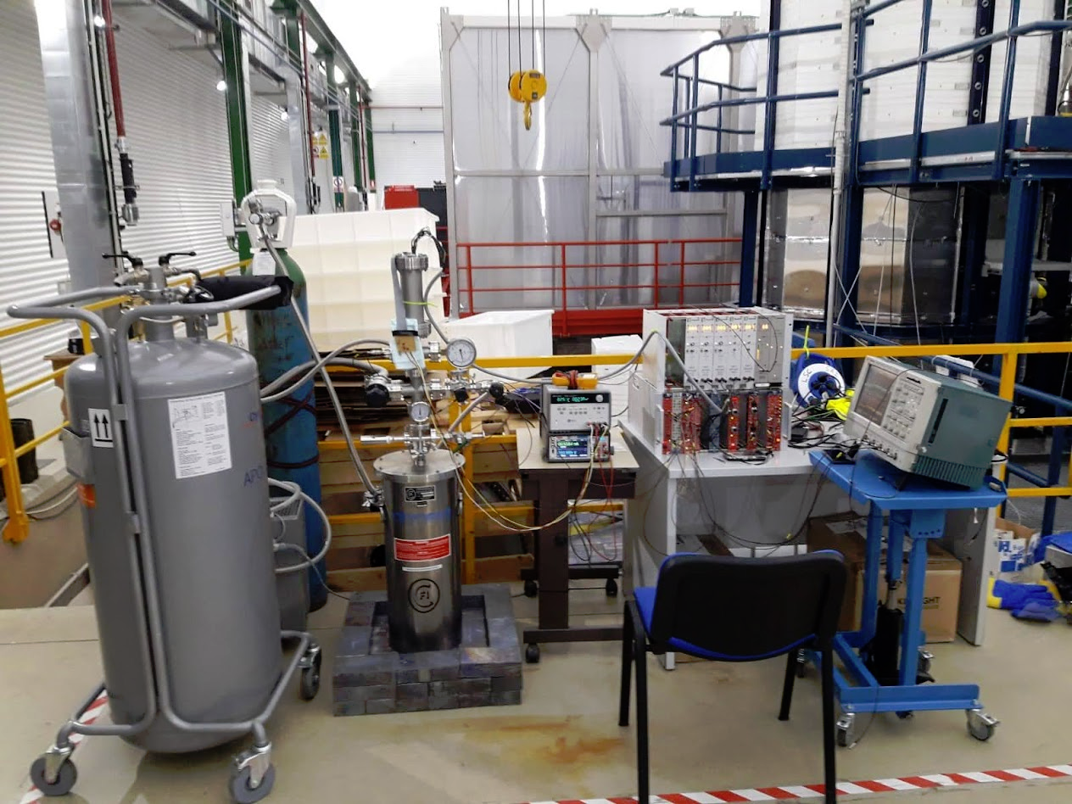
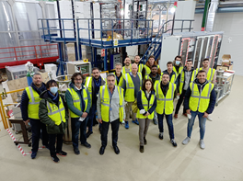
UAr radiopurity measurement: DArT in ArDM
PN-DM 19/09/22 18

Slide 19
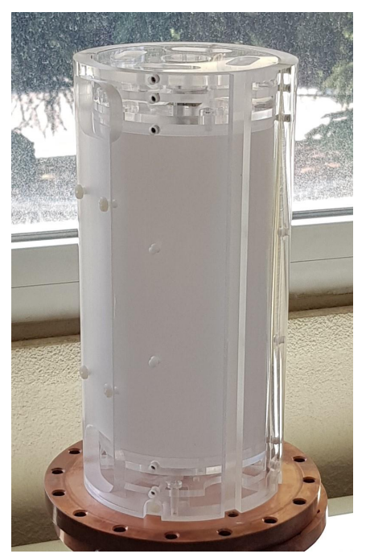
PN-DM 19/09/22 19

Slide 20
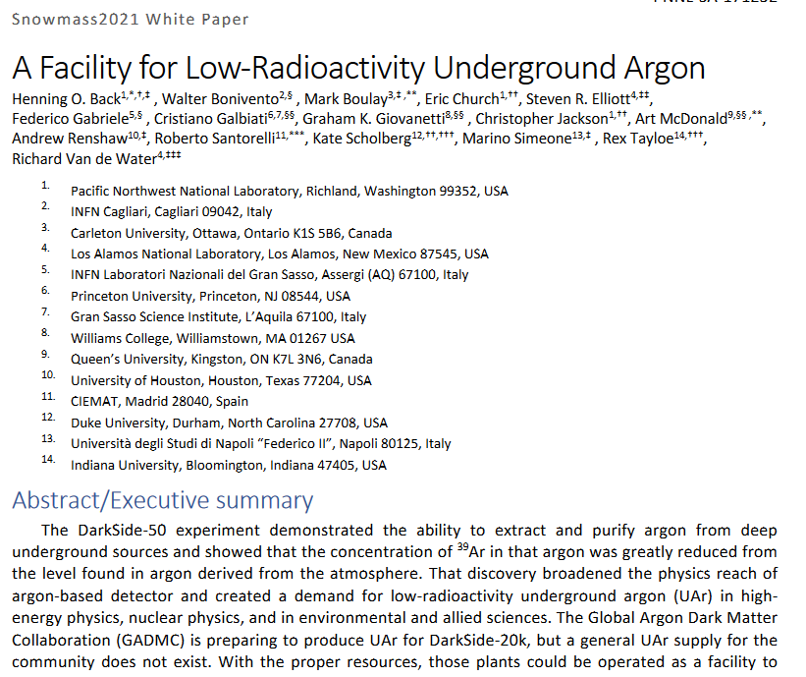
PN-DM 19/09/22 20

Slide 21
Recent management positions
In the GADM collaboration:
Spanish representative in the Global Argon Dark Matter Collaboration, 2017-present
Level-1 manager of the DarkSide-20k project (responsible for the background of the experiment), 2016-present
DS-Mat/Bkg WG convener
Member of the rules committee 2017-2019
Member of the DarkSide-20k executive board / management board, 2018-present
Chair of the DarkSide-20k advisory committee (elected position), 2017-2021
Run coordinator in DEAP-3600
Technical coordinator of DArT
PN-DM 19/09/22 21

Slide 22
Goals of our proposal
Darkside-20k | Material analysis/Radiopurity Construction MC/Bkg calculation DEAP-3600 analysis
DArT in ArDM | Construction Operations Data taking / analysis
R&D | Charge (AVOLAr/ArIon) Light (LArDis/PILSNER)
PN-DM 19/09/22 22

Slide 23
Funds request
With the current funds our participation in GADMC is not viable
Travels: constant presence @ LSC (2 people)
Trips to LNGS for the next 3 y
DS-20k construction funds (81 k€)
Assay campaign (∼ 50 k€)
DArT construction/operation (∼ 100 k€)
R&D Charge/light (∼ 100 k€)
Personnel: student+postdoc for data analysis
Common funds (∼ 100 k€)
∼250 k€
PN-DM 19/09/22 23

Slide 24
Conclusions / remarks
Our group already demonstrated to be able to take a leading role in a huge international collaboration thanks to the specific expertise
This expertise cannot be lost!
We have a clear scientific plan with strong connection at international/national level
Fundamental connection with an important Spanish ICTS
Outstanding synergies at national level
PN-DM 19/09/22 24

Slide 25
Conclusions / remarks
We are still pretty much in survival mode
PID2019-109374GB only for travels
Very limited budget for the R&D (Only Consumables?)
No predoc contract (we need two)
Coordinated project with Zaragoza (ANAIS group)
Resource board representative
PN-DM 19/09/22 25

Slide 26
 | 2022 | 2023 | 2024 | 2025 | 2026 | 2027
DArT
DS-20k
R&D
PN-DM 19/09/22 26

Slide 27
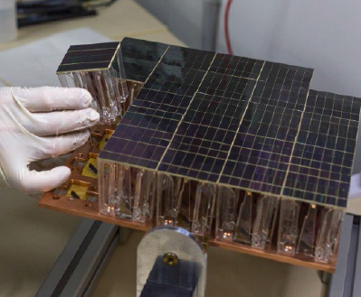
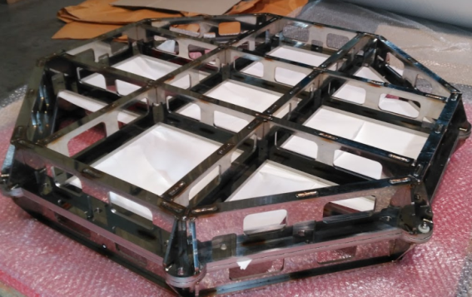
PN-DM 19/09/22 27

Slide 28
Backup

Slide 29
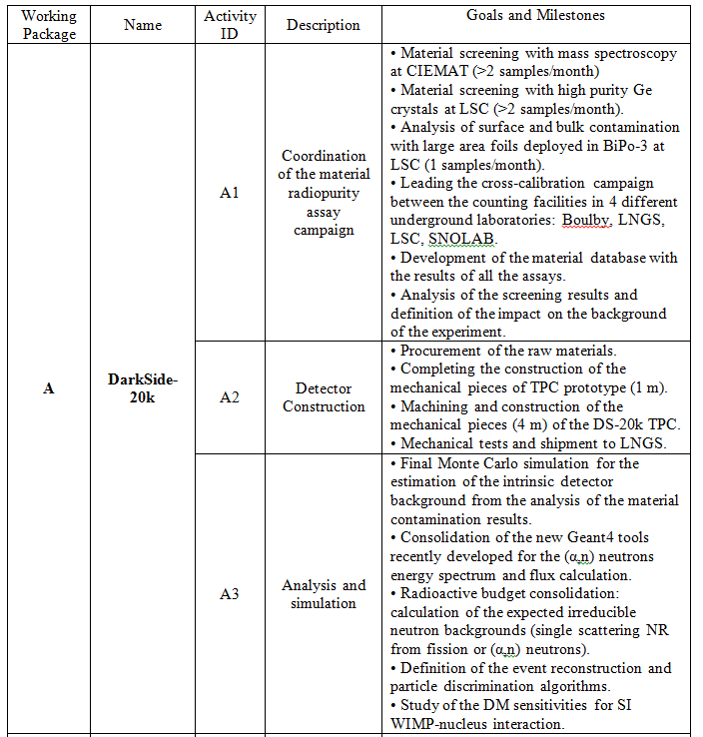
Goals of this proposal: A

Slide 30
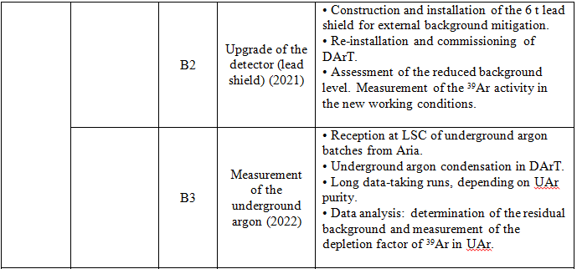
Goals of this proposal: B

Slide 31
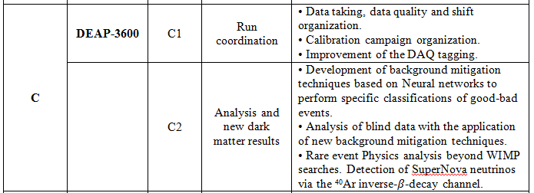
Goals of this proposal: C

Slide 32
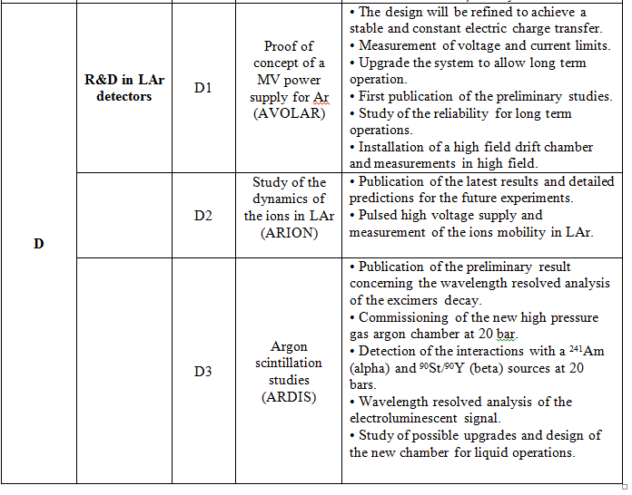
Goals of this proposal: D

