Slide 1

IA en el CIEMAT
Sala B (Ramón y Cajal)
3 de julio de 2023

Slide 2
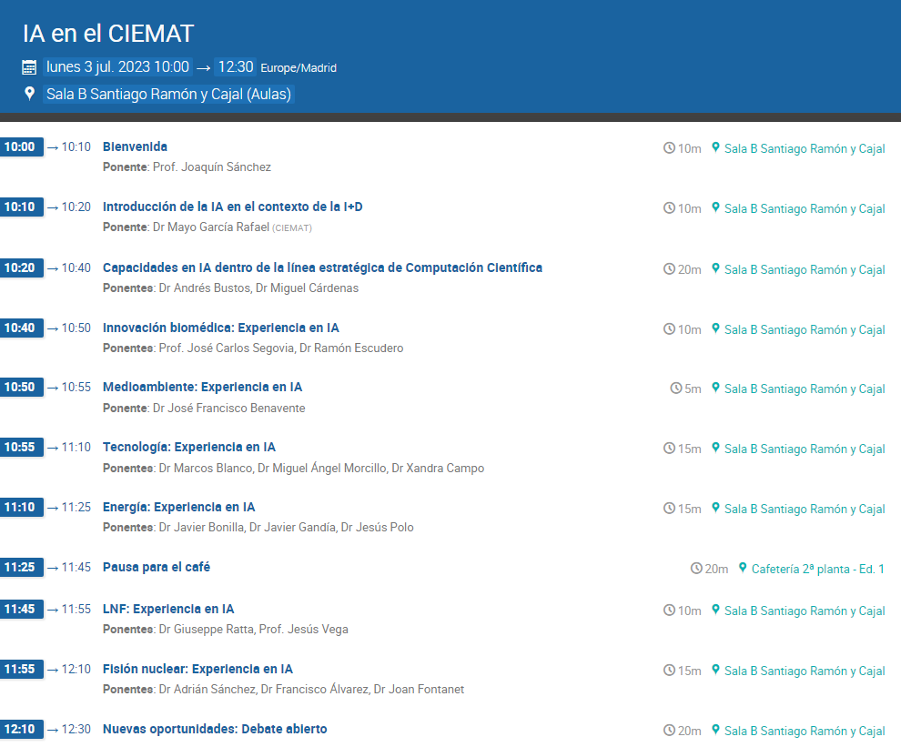

Slide 3
Bienvenida

Slide 4
Introducción de la IA en el contexto de la I+D

Slide 5


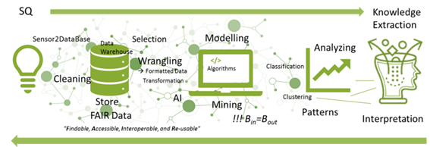


Slide 6
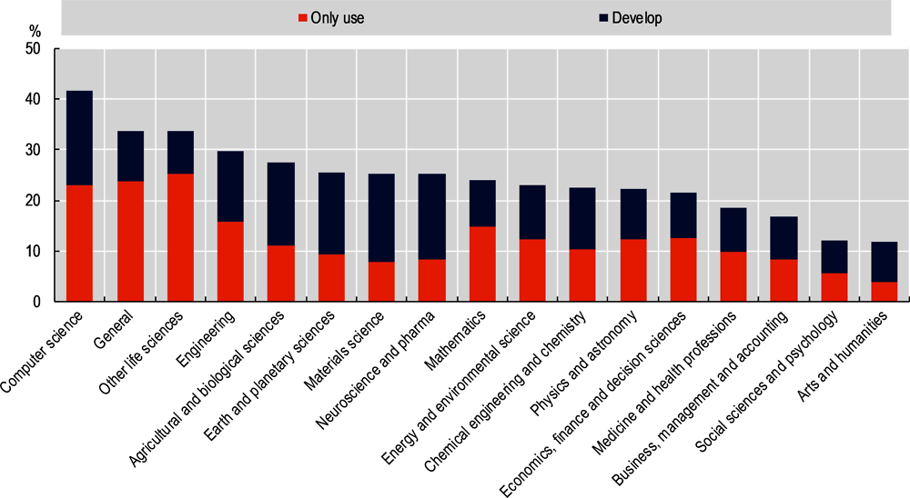
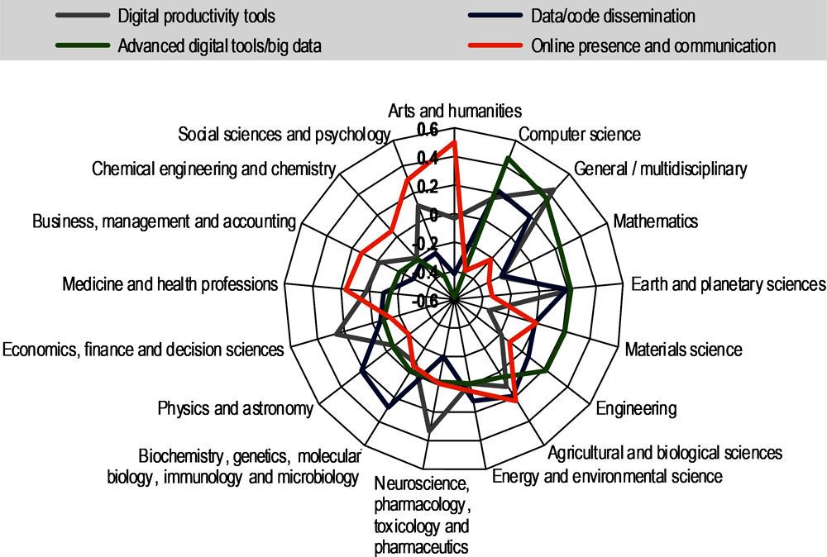
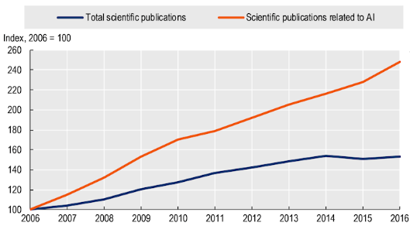

Measuring the Digital Transformation
A Roadmap for the Future (2019)

Slide 7
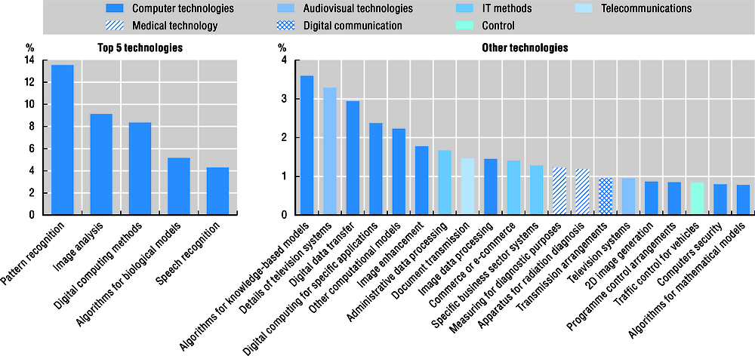
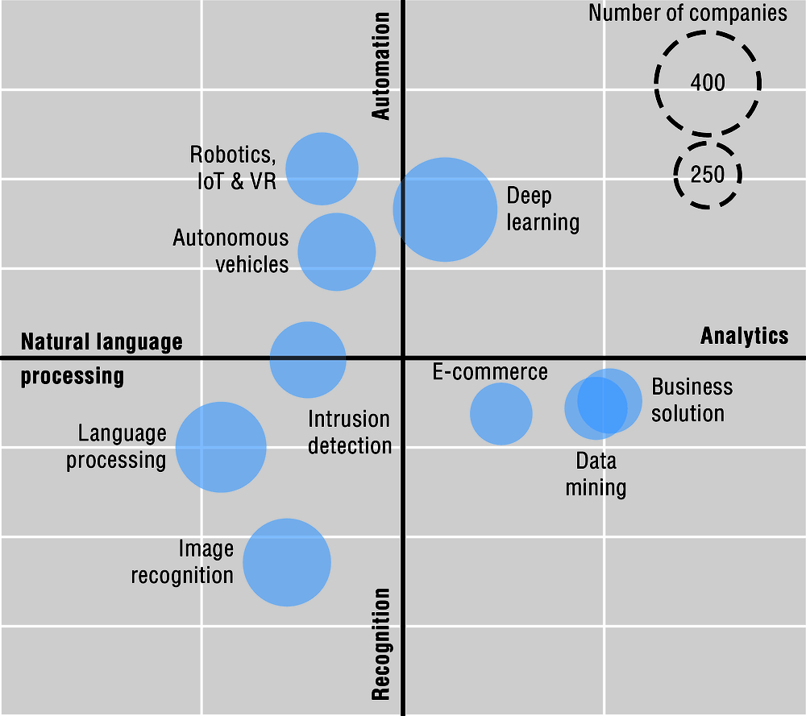
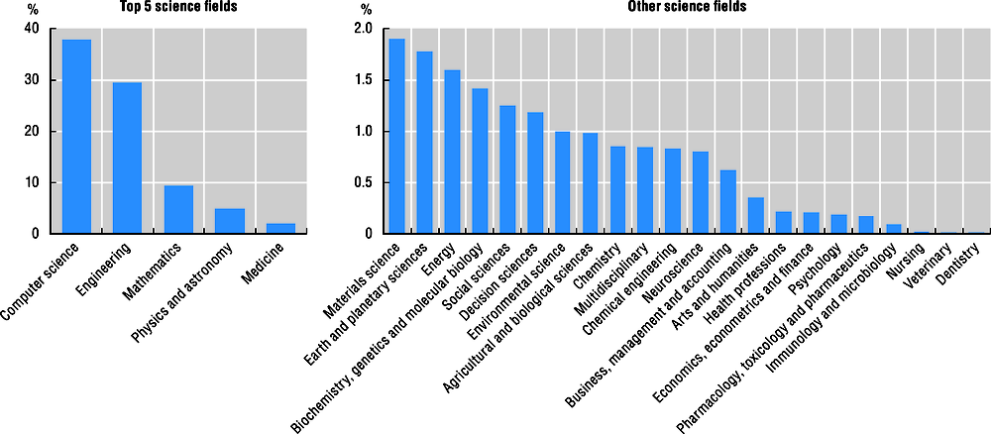
Measuring the Digital Transformation
A Roadmap for the Future (2019)

Slide 8
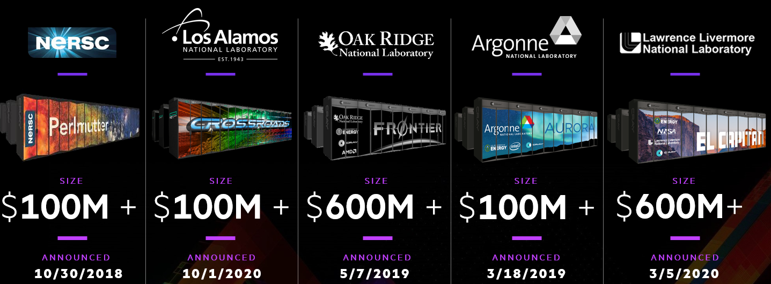

Slide 9
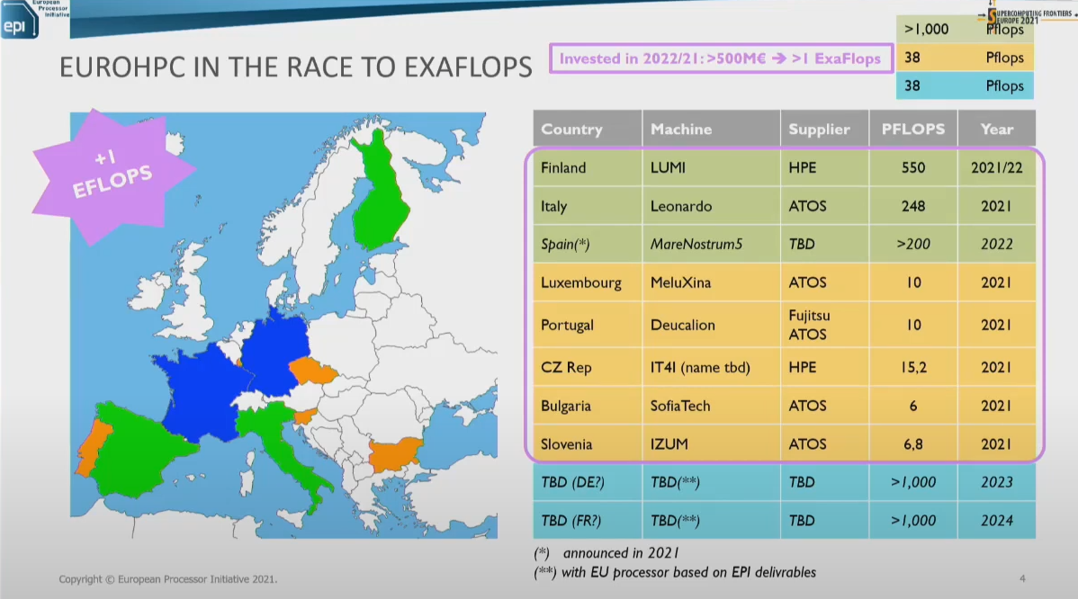
‘Alps’ en el CSCS: ~5000 Grace Hopper Superchips (Arm-based Nvidia Grace CPU + Nvidia Hopper GPU) + 1024 nodos AMD

Slide 10

2023-P1 | Actividades solicitadas | Recursos solicitados | Actividades con horas A | Actividades con horas B | Horas A concedidas Exaflops (Mhoras) | Horas B concedidas Exaflops (Mhoras)
 |  | Exaflops (Mhoras)
Astronomy, Space and | 27 | 25.089 (88,25) | 22 | 2 | 18.575 (68,46) | 159 (0,64)
Earth Sciences
Life and Health Sciences | 22 | 23.276 (41,81) | 17 | 3 | 8.179 (30,33) | 1.109 (3,15)
Engineering and | 23 | 20.132 (52,81) | 19 | 1 | 10.864 (37,47) | 250 (0,18)
Mathematics
Physics | 38 | 50.223 (127,55) | 35 | 3 | 27.205 (106,39) | 791 (2,12)
Homogeneous Chemistry | 11 | 7.015 (23,96) | 11 | 1 | 6.650 (23,49) | 128 (0,50)
Heterogeneous Chemistry and Solids | 34 | 12.245 (51,66) | 33 | 1 | 9815 (43,75) | 98 (0,10)
Total | 155 | 137.980 (386,04) | 137 | 11 | 81.289 (309,89) | 2.536 (6,25)
¡¡Pero la demanda de nodos acelerados ha superado en 7 veces la oferta!!
Nueva convocatoria para problemas con IA con recursos específicos

Slide 11
CPD | Clúster | Nodos | Procesador | Frec (GHz) | Cores | RAM/nodo (GB) | IB | Alm/Nodo (GB) | Tarjeta | nº
Madrid | Xula1 | 44 | Intel 6148 | 2,4 | 1760 | 192 | EDR100 | 240
 | Xula2 | 56 | Intel 6254 | 3,1 | 2016 | 192 | FDR100 | 240
 | Xula3 | 90 | Intel 6342 | 2,8 | 4320 | 256 | HDR200 | 320
 | Xula4 | 24 | SPR P8480+ | 2 | 2688 | 1024 | HDR200 | 960 |  |  | Pdte
 | HEP | 1 | AMD 7763 | 2.4 | 128 | 1024
 | HEP | 28 | Intel 5318Y | 2.1 | 1344 | 256 |  | 3.8
 | HEP | 8 | Intel 5218 | 2.3 | 256 | 128
 | HEP | 6 | Intel 6130 | 2.1 | 192 | 128
 | HEP | 20 | Intel E5-2650 | 2.2 | 480 | 128
 | HEP | 16 | Intel E5-2670 | 2.2 | 384 | 128
Trujillo | TurgaliumCPU | 40 | Intel 6254 | 3,1 | 1440 | 192 | EDR100 | 240
 | TurgaliumGPU | 16 | Intel 6240 | 2,6 | 288 | 192 | EDR100 | 240 | V100 | 24
 | TurgaliumCPU | 10 | SPR P8480+ | 2 | 1120 | 1024 | HDR200 | 960 |  |  | Pdte
 | TurgaliumGPU | 2 | SPR P8480+ | 2 | 224 | 1024 | HDR200 | 960 | H100 | 8 | Pdte
PIC | PIC | 2 | AMD 7662 | 2 | 256 | 1024
 | PIC | 24 | AMD 7452 | 2,35 | 1536 | 512
 | PIC | 60 | E5-2680v4 | 2,4 | 1680 | 128
 | PIC | 36 | E5-2640v3 | 2,6 | 576 | 64
 | PIC | 24 | AMD 7502

