Slide 1

Colaboración
Unidad de Computación Científica
Unidad de Innovación Biomédica – División de Tecnología Celular

Slide 2
Objetives
Development of a pipeline to identify clonal cell diversity in gene therapy protocols by DNA barcoding
Development of a tool to stratify renal damage from tissue sections

Slide 3
Objetives
Development of a pipeline to identify clonal cell diversity in gene therapy protocols by DNA barcoding
Development of a tool to stratify renal damage from tissue sections

Slide 4
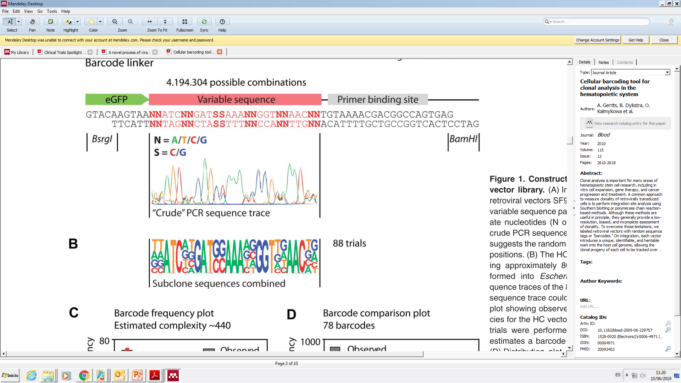



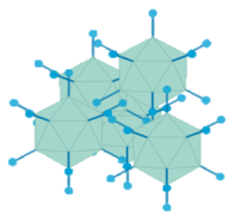



Our strategy for studying clonality of gene edited cells
LHA
CoRPK
RHA
pA
Non variable seq
Variable sequence
Non variable seq
TCAATTGTAANNATCNNGATSSAAANNGGTNNAACNNTGTAAAACGA
AGTTAACATTNNTAGNNCTASSTTTNNCCANNTTGNNACATTTTGCT
27bp
17bp
4.194.304 possible combination
Plasmid
Library
AAV Library
Next Generation Sequencing
In house bioinformatic pipeline

Slide 5
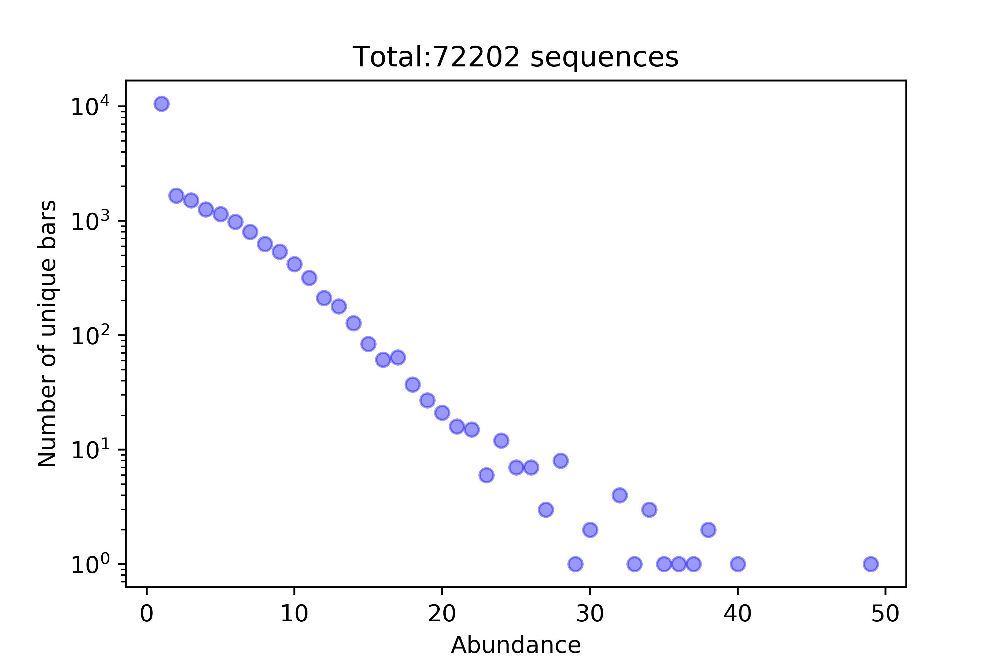
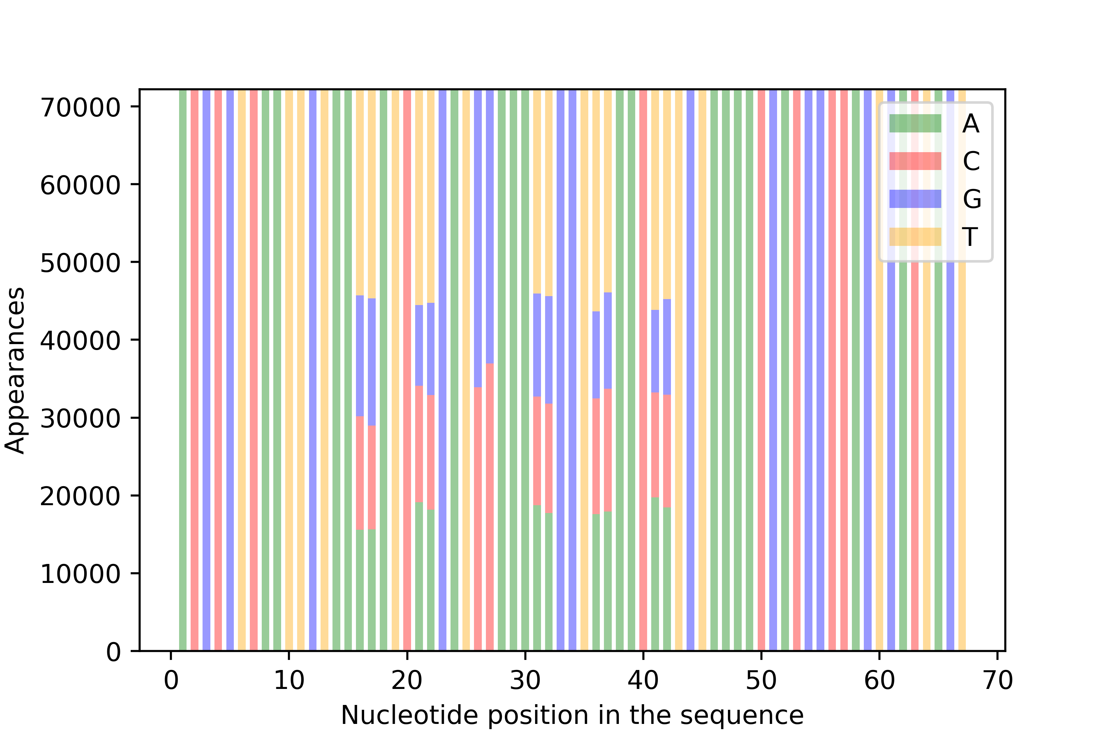
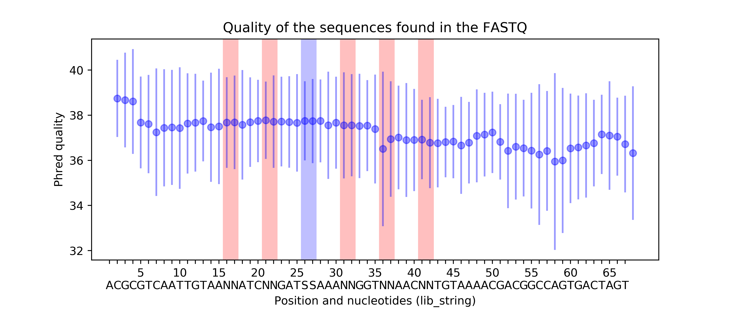
BCS Workflow
FASTQ
Input file
SEARCH
‘lib’
Abundance Filter
‘BCS_threshold’
Repetitions
SEARCH_DATA.TXT
sequence_counts.csv
Composition
Quality

Slide 6
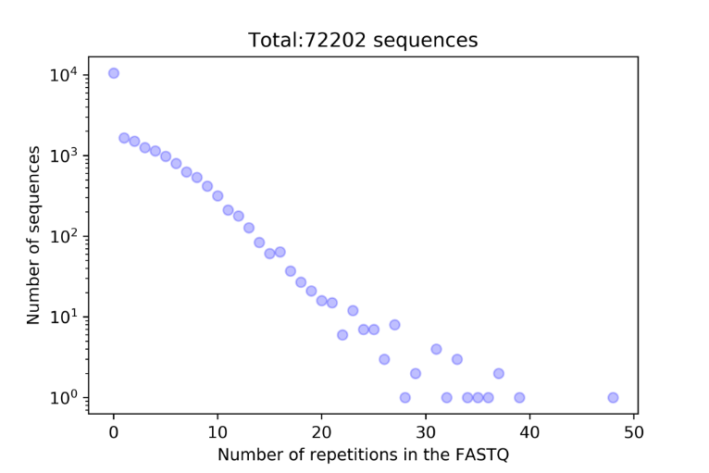
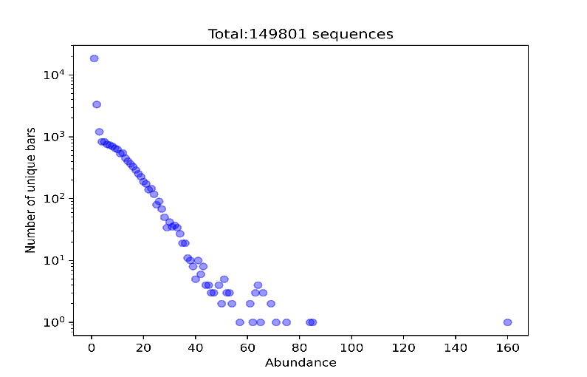
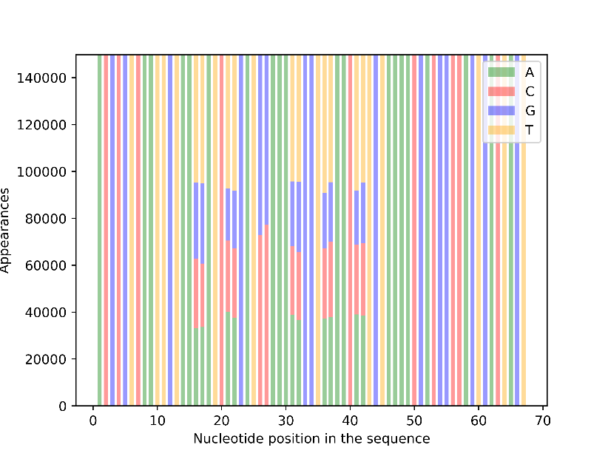
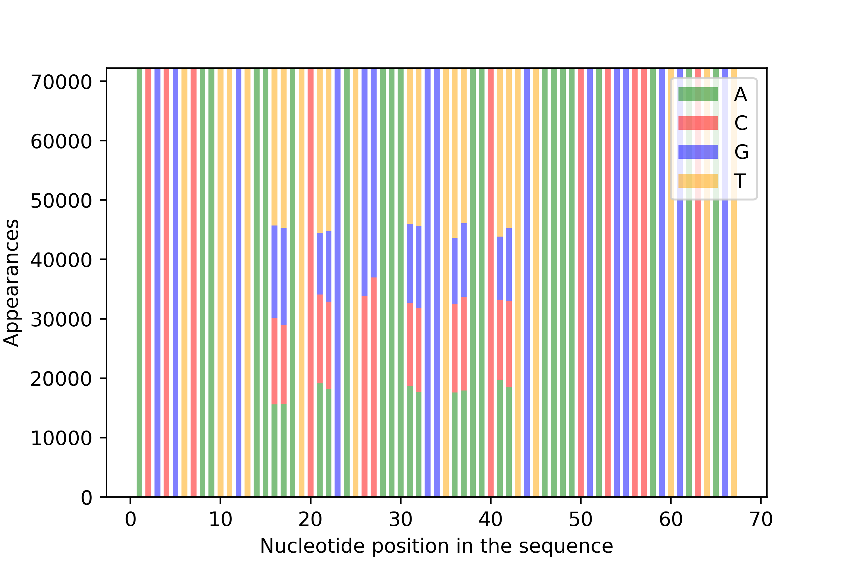
Diversity of barcode
Plasmid
AAV6 particles
Number of sequences
Number of sequences
Abundance
Abundance
Non-Variable
Variable
Non-Variable
Non-Variable
Variable
Non-Variable
Nucleotide abundance
Nucleotide abundance
Nucleotide position
Nucleotide position
Notes:
.

Slide 7
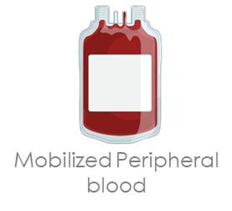

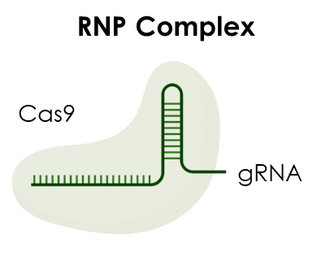
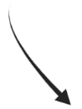
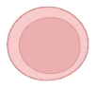

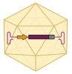
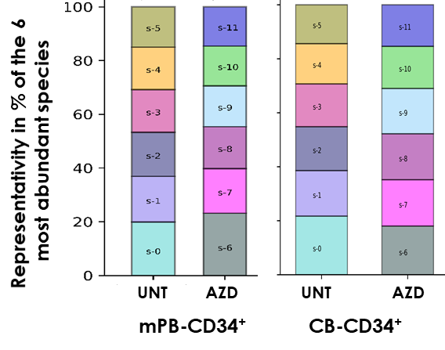
Use of barcode to study the addition of AZD in vitro
or
+/- AZD
72h
48/72h
ddPCR analysis
Barcode analysis
CD34+
Edited CD34+
ASGCT(Washington) – 2022 - comunicación oral ,
SETGyC (Sevilla) - 2022- comunicación oral y premio a la mejor comunicación oral
ESGCT (Edimburgo)- 2022 - poster

Slide 8
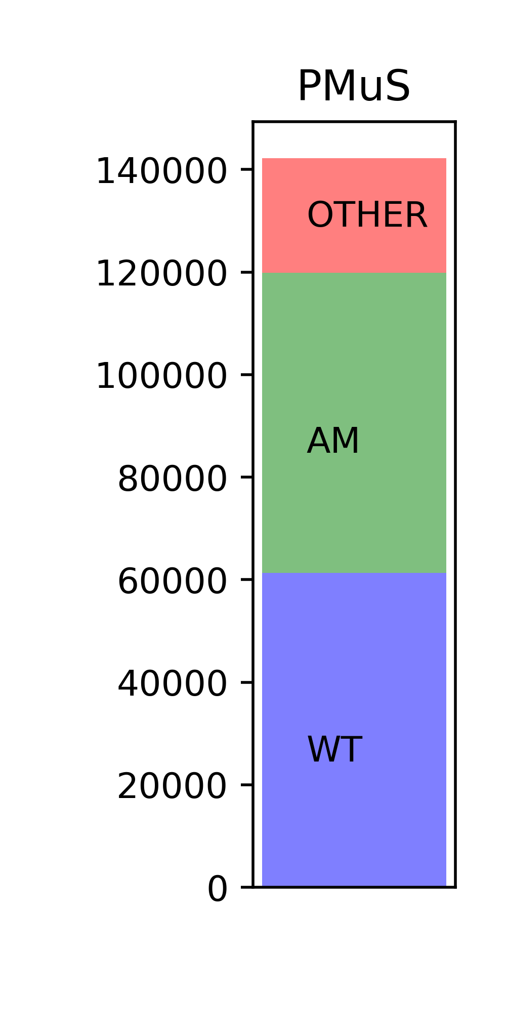
PMuS Workflow
FASTQ
Input file
Mutation Search
PMuS.csv
PMuS.log
most_common_sequences.csv
OTHER_abundancies.csv
Representativity Filter
‘PMuS_percentage’

Slide 9
Objetives
Development of a pipeline to identify clonal cell diversity in gene therapy protocols by DNA barcoding
Development of a tool to stratify renal damage from tissue sections

Slide 10

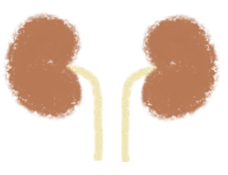
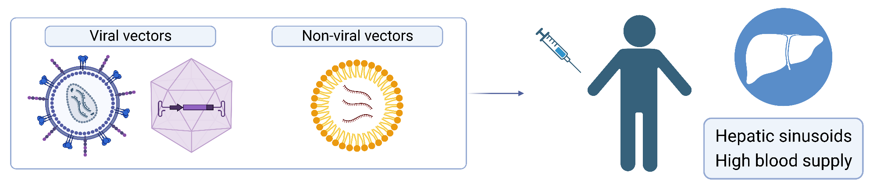
In vivo gene therapy for Primary Hyperoxaluria Type 1
  PH1: CELL-AUTONOMOUS DISEASE
No kidney damage
Oxalate
Oxalate
In vivo gene therapy targeting the liver
Notes:
Our lab is expert in the development of gene therapy for hereditary genetic diseases. This strategy consists of the addition of a correct versión of the mutated gene or it’s correction by genetic modifications. Gene therapies approaches targeting the liver are mainly in vivo approaches, which consists of the introduction of different gene delivery tools into the organism. Liver structure of hepatic sinusoids together with the high blood supply of this tissue makes it a favorable target for in vivo approaches.
As it has being explained before this morning PH1 affected tissue is the liver, which makes it a Good target for this kind of therapies. In particular, we propose to develop an in vivo lentiviral vector based gene therapy approach.
More tan 150 mutations has been reported in AGXT gene and 30% of patients shows an infantile onset. Lentiviral vectors are integrative vectors that Will introduce a correct version of the mutated gene into the target cells. So, the treatment would be independent on the mutation, being universal, and also it’s integrative capacity Will make this stategy permanent.
An important characteristic of the disease that needs to be overcome to achieve curative efficacy in this strategy is the cell-autonomous character of the disease. Non-corrected cells Will continue producing oxalate if not corrected, so we need to achieve an enough percentage correction to reduce oxalate production by the liver to a levels that can be eliminated by kidneys without producing renal damage.

Slide 11
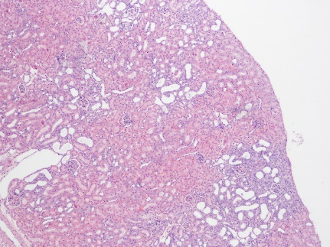
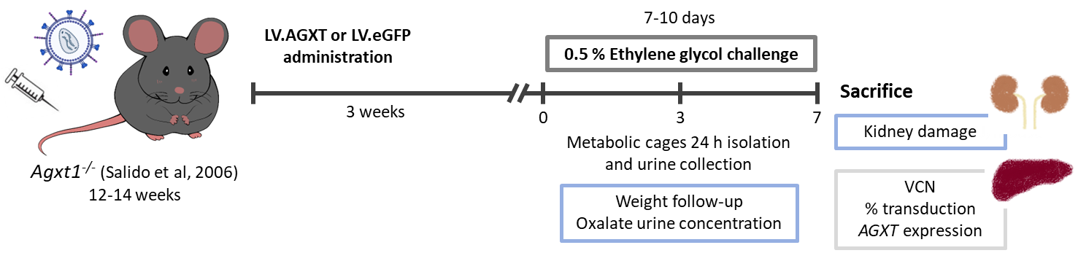

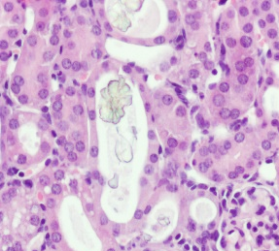
Studies of nephrocalcinosis
Score 0
Score 3
Collaboration with Rodriguez-Madoz’s group
Notes:
Finally, the last PH1 end-point analysed was the kidney damage. To measure this parameter we developed a kidney damage score that allows us to classify the histological samples from no damage to a nephrocalcinosis stage in which calcium oxalate crystals appears. As you can see in this figure, in the case of non-treated Agxt1 KO mice between one third and half of the animals developed kidney damage, whereas in the case of mice treated with the intermediate dose this percentage was reduced and none of them developed nephrocalcinosis.
The PH1 end-points analysis suggest that increasing LV dose doesn’t improve the therapeutic efficacy. So, it is necessary to improve the percentage of transduction to achieve a complete pathological phenotype reversion.

Slide 12
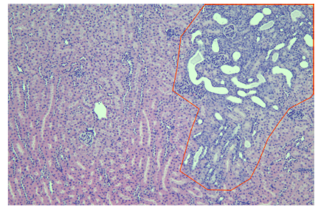
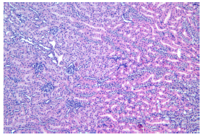
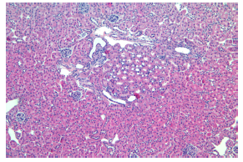
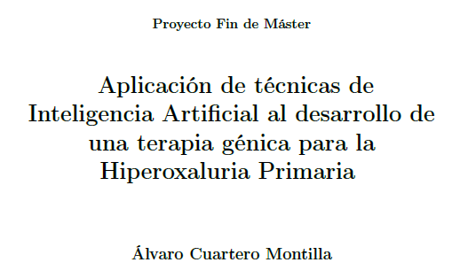
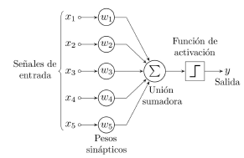
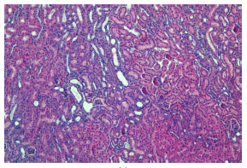
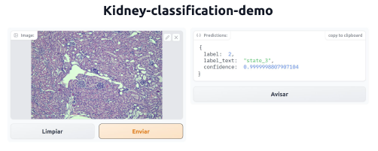

Collaboration with “Informática Científica” at CIEMAT
Andrea Molinos Vicente

Slide 13
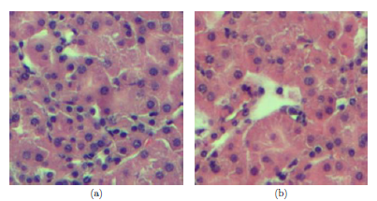
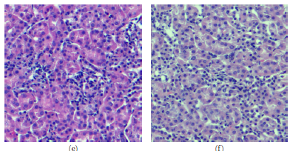
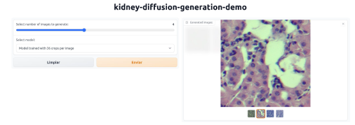
Collaboration with “Informática Científica” at CIEMAT
Generation of images by a patch trained model
Andrea Molinos Vicente

