Slide 1
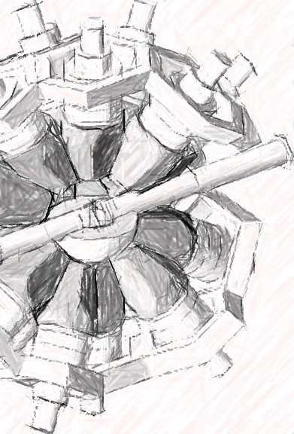
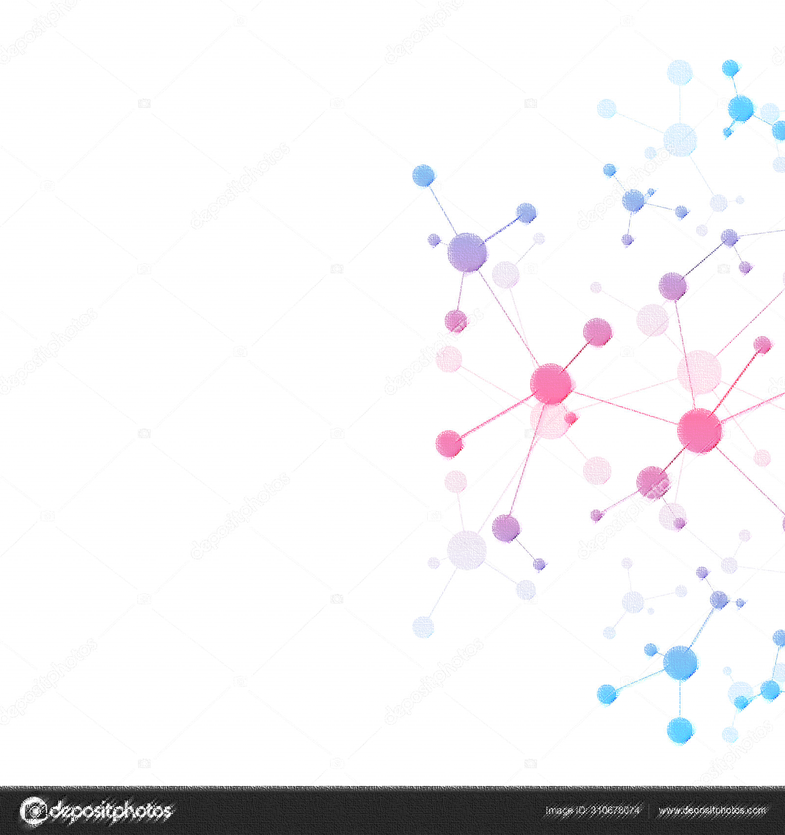




Deep Learning applied to Capture Cross Section Data Analysis
Speaker: A. Sánchez-Caballero
A. Sánchez-Caballero, V. Alcayne, D. Cano-Ott, E. Mendoza, A. Pérez de Rada
CIEMAT– Unidad de Innovación Nuclear
Taller aplicaciones IA para proyectos CIEMAT

Slide 2
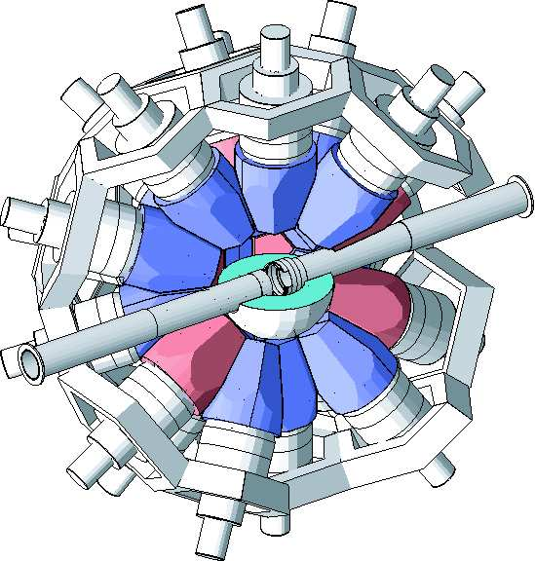
DL and nuclear data: neutron capture classification
Problem definition
The Total Absorption Calorimeter (TAC) at nTOF provides the deposited energy of gamma rays in 40 BaF₂ crystals. For each registered event, we have the number of activated crystals (m_{cr}) and the sum of the deposited energy (E_{sum}).
neutron

Slide 3
DL and nuclear data: neutron capture classification
Problem definition
The Total Absorption Calorimeter (TAC) at nTOF provides the deposited energy of gamma rays in 40 BaF₂ crystals. For each registered event, we have the number of activated crystals (m_{cr}) and the sum of the deposited energy (E_{sum}).
Nuclear reaction

Slide 4
DL and nuclear data: neutron capture classification
Problem definition
The Total Absorption Calorimeter (TAC) at nTOF provides the deposited energy of gamma rays in 40 BaF₂ crystals. For each registered event, we have the number of activated crystals (m_{cr}) and the sum of the deposited energy (E_{sum}).
Absorbed γ-rays

Slide 5
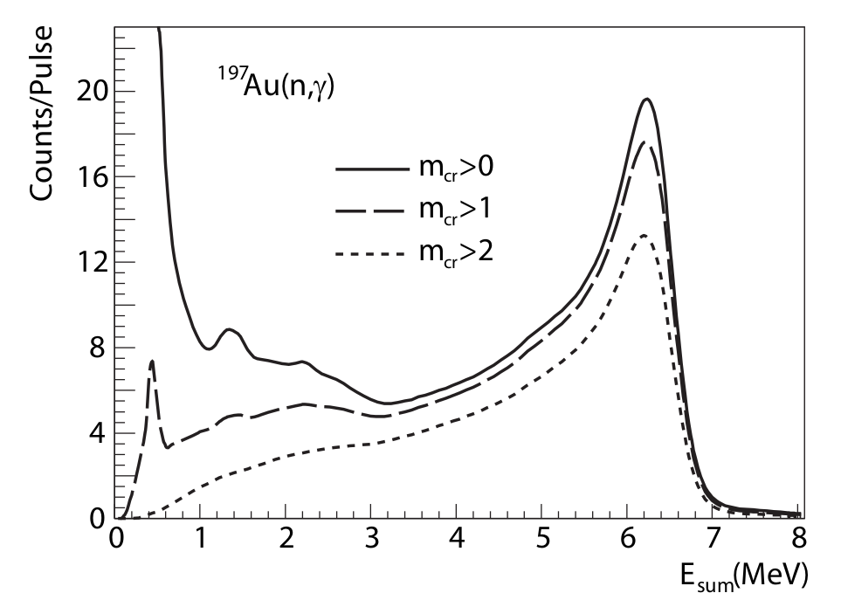
DL and nuclear data: neutron capture classification
Problem definition
Current method: specific cuts or constraints on E_{sum} and m_{cr} values of each event to improve the signal-to-background ratio.
For ¹⁹⁷Au(n,γ):
Objective: to build a DL model for classification of capture/non-capture events from TAC signals and compare with current method.
m_{cr}>2
2.5<E_{sum}<7 MeV
Deposited energy distribution of the 197Au(n,γ) measurement under different constraints in crystal multiplicity.
Image source: Carlos G. Guerrero Ph.D. thesis “Measurements of the 237Np and 240Pu neutron capture cross sections at the CERN nTOF facility” (2008)

Slide 6
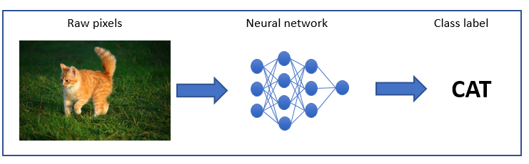
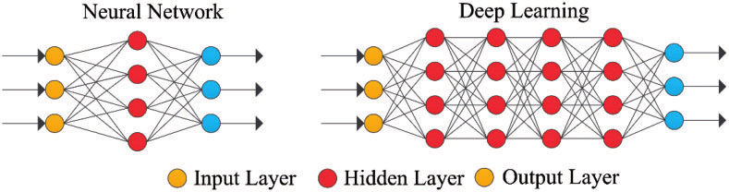
DL and nuclear data: neutron capture classification
Deep Learning
Deep Learning models have proved to be good classifiers of text, audio, image, and video samples.
In our case, we have high dimensionality data (40 signals from the TAC crystals) and we can generate a big dataset with Monte Carlo simulations. Appropriate conditions to try neural networks as discriminator of capture events.

Slide 7
DL and nuclear data: neutron capture classification
Methodology
Input: 40-sized arrays of deposited energy in each crystal from Monte Carlo simulations of a ¹⁹⁷Au measurement experiment.
1 cm
n (10⁻² – 10⁵ eV)
Capsule of Al,
Ø 2.5 cm
¹⁹⁷Au sample
100 µm width
Ø 2.0 cm
Neutron source
TAC@nTOF
Neural Network classifier: a model with 5 dense layers, 18K trainable parameters, binary cross-entropy loss function, and Adam optimizer, using the Keras API for Python. The NN classifies between capture (0) and non-capture (1).
E_{dep,1}
E_{dep,2}
E_{dep,40}
Neural Network
Prediction
{0…1}

Slide 8
DL and nuclear data: neutron capture classification
BN+LR = Batch Normalization + Leaky ReLU activation
Methodology. Network architecture
200
neurons
100
100
50
1
y=1
BN+LR
BN+LR
BN+LR
BN+LR
y=0
Input
layer
Dense
(or Fully Connected)
Dense
Dense
Dense
Dense
Sigmoid activation
Combinations of DL with different cuts on E_{sum} and m_{cr} are studied.
The performance of all methods are evaluated through the values of:
  ε_{γ,rel} = capture detection efficiency. Set to 1 for the dataset without any cut.
  R_{i} = signal-to-background ratio in the i-th interval of the incident neutron energy spectrum. Calculated as true capture events divided by non-capture events.

Slide 9
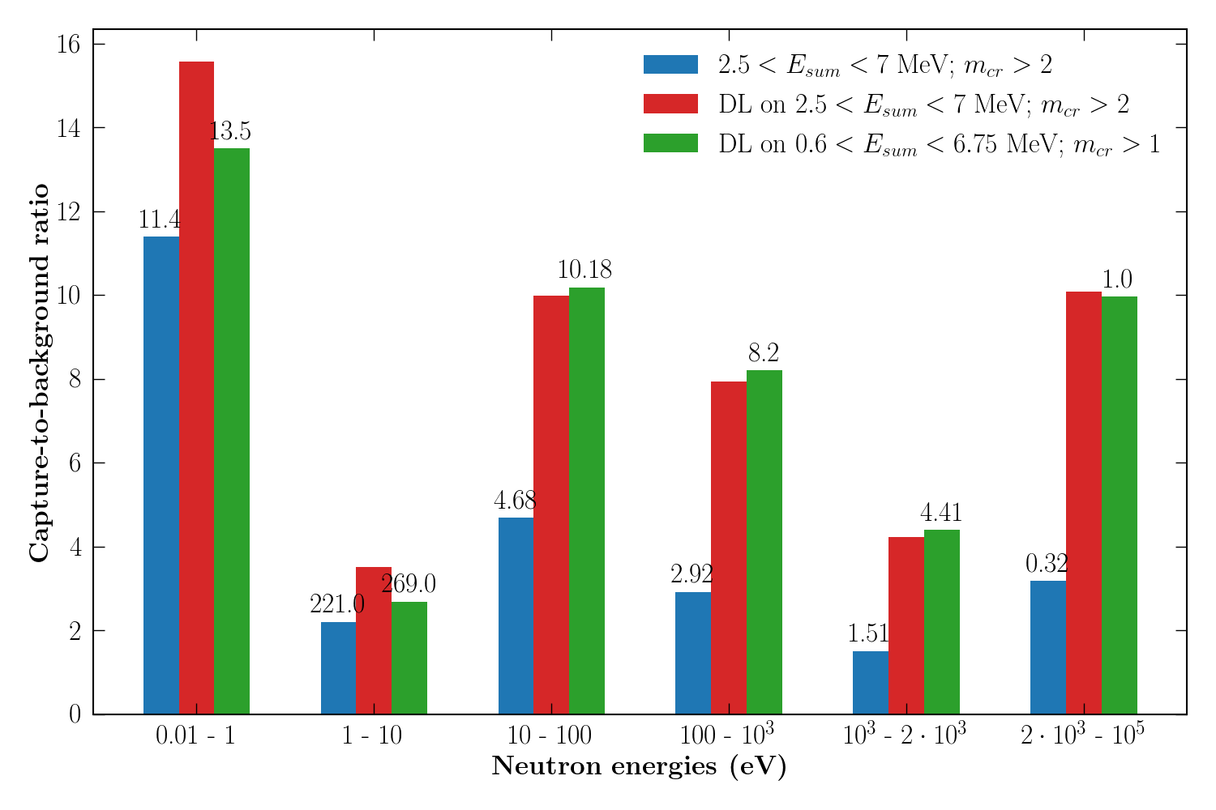
Results and comparison with traditional method
Applying more precise and relaxed cuts allow us to obtain similar results but also with higher relative capture efficiency.
Capture efficiencies, ε_{γ,rel} :
Std. cuts = 55%
Std. cuts + DL = 43%
New cuts + DL = 62%
¹⁹⁷Au with aluminum canning
Scaled up
X10
Scaled down
X0.01

Slide 10
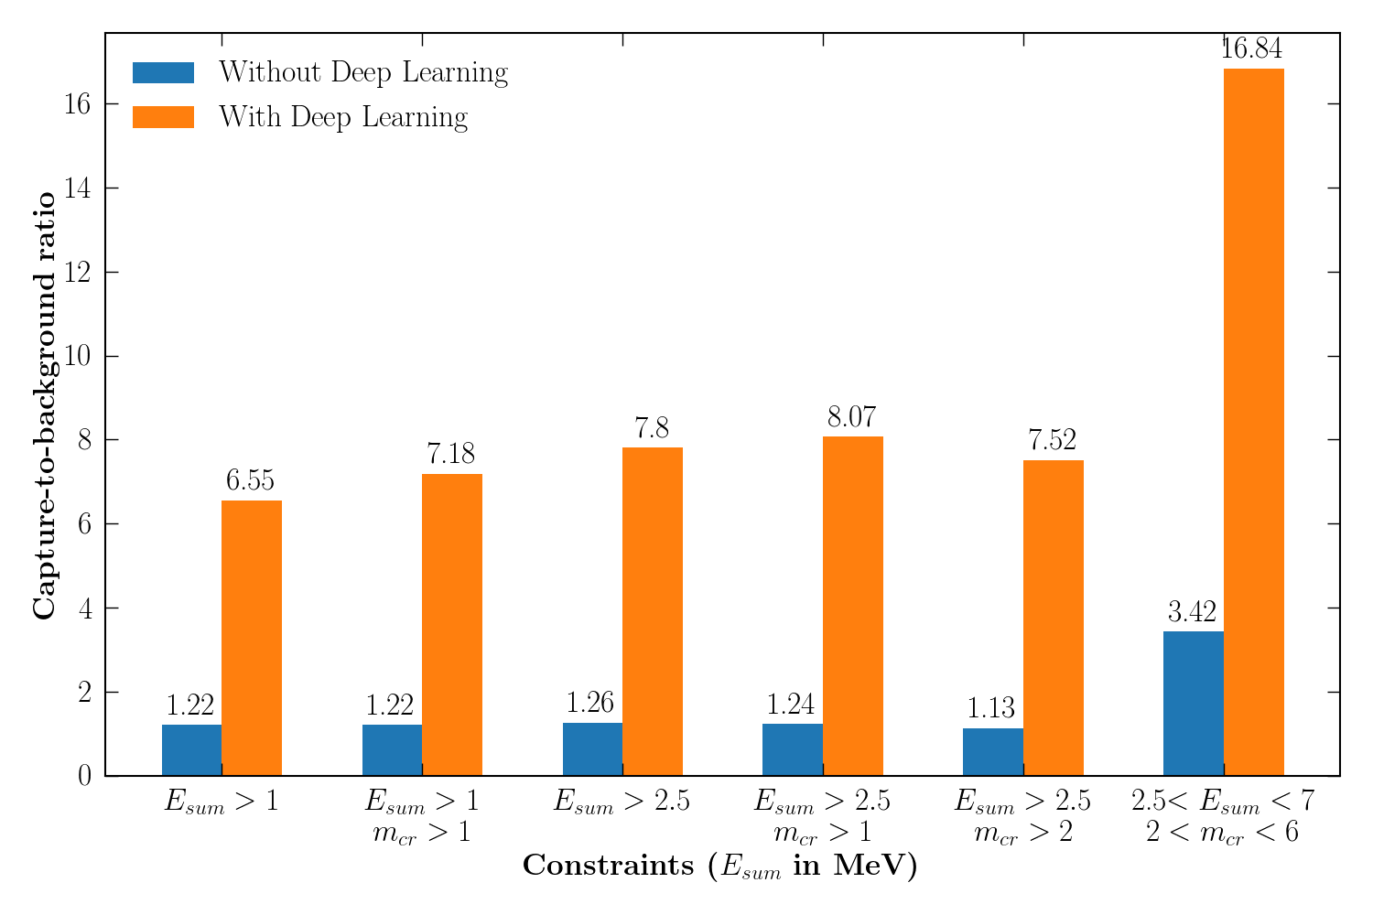
Results and comparison with traditional method
Case of a fissile sample: ²³⁹Pu
Example of using traditional cuts with or without DL for data including fission events.
Figure shows the full-spectrum capture-to-background ratio.
Capture-to-fission rate in original data (no cuts): ~0.5
Some capture efficiencies, ε_{γ,rel} :
2.5<E_{sum}<7;2<m_{cr}<6 = 73%
Std. cuts + DL = 63%
E_{sum}>2.5;m_{cr}>1 + DL= 77%
*
(*): ratios calculated adding the E_{sum}<7 MeV constraint to the indicated cut (X axis).

Slide 11
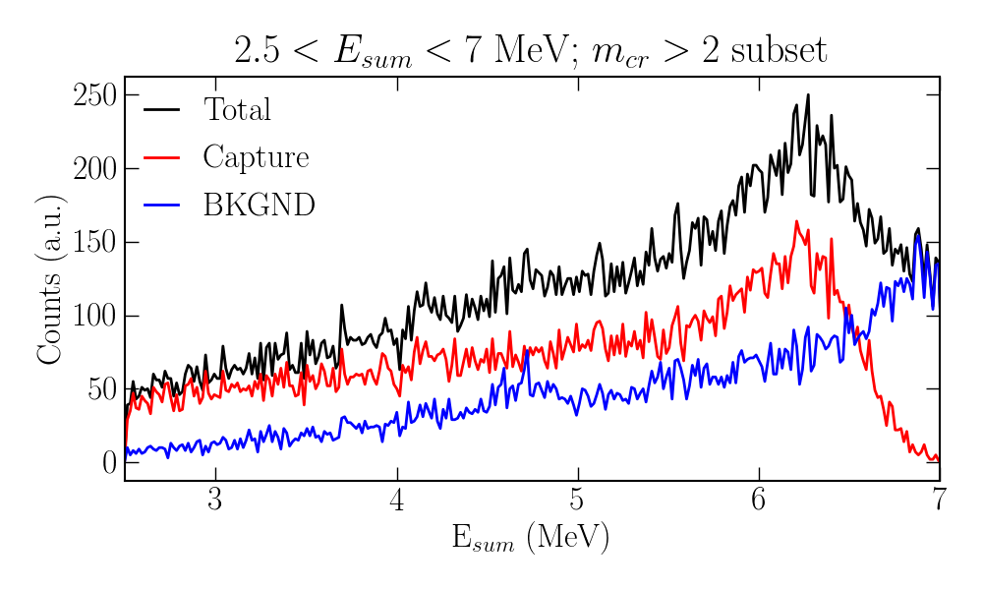
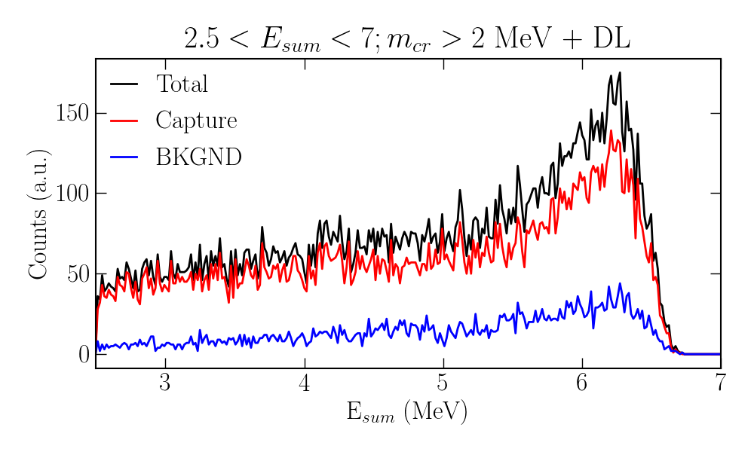
Results and comparison with traditional method
Deposited energy spectrum: ¹⁹⁷Au simulation
For neutron energies between 1 keV and 2 keV
Without Deep Learning
With Deep Learning

Slide 12
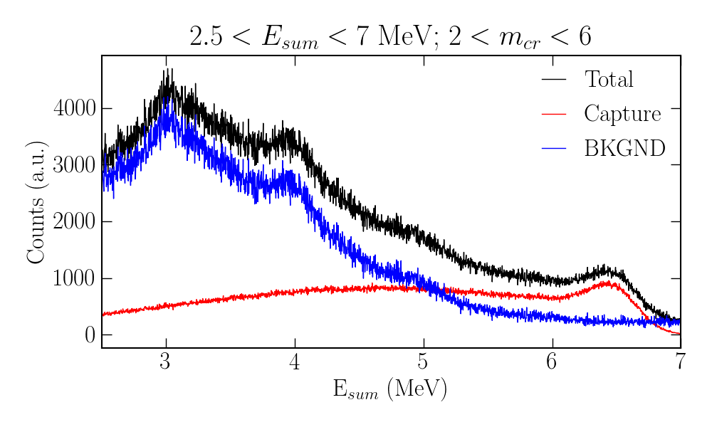
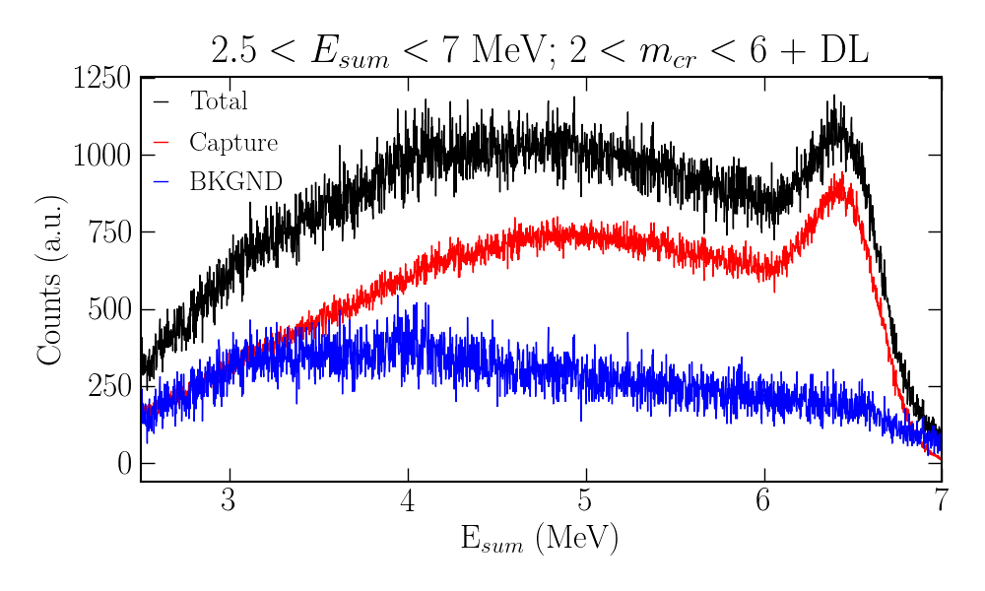
Results and comparison with traditional method
Deposited energy spectrum: ²³⁹Pu simulation
Without Deep Learning
With Deep Learning

Slide 13
Additional results
Simulating a faulty detector in the TAC
We set E_{dep} of Detector#1 to a fixed value of 0.001 MeV for all events.

Slide 14
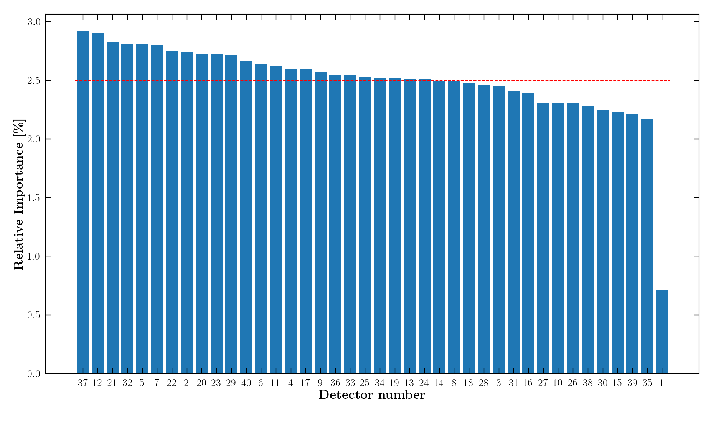
Additional results
Simulating a faulty detector in the TAC
We set E_{dep} of Detector#1 to a fixed value of 0.001 MeV for all events.
The algorithm successfully identifies the defective crystal.

