Slide 1
Evolutionary algorithm applied to nuclear fuel cycle optimization
F. Álvarez-Velarde, P. Martínez Moreno
(francisco.alvarez@ciemat.es)
Original work by A. V. Skarbeli
Presented in the 46th Annual Meeting of the SNE, “Uncertainty and optimization: a coupled problem for scenario analyses”, Granada, 6-8 October 2021
CIEMAT – Avda. Complutense, 40. Ed. 17, 28040 Madrid

Slide 2
Introduction
Nuclear fuel cycle simulators are very powerful tools for the study and analysis of the different nuclear fuel cycles.
Each facility is modelled according to a series of input parameters, so when the simulation is completed, results in terms of mass, isotopic content, radiotoxicity, costs... can be obtained.
Nevertheless from the strategic point of view the inverse problem is presented:
  The results of the cycle are set (cost minimization, inventories stabilization, …)
  But it is not clear which configuration will fulfil the requirements
Optimization problem!

Slide 3
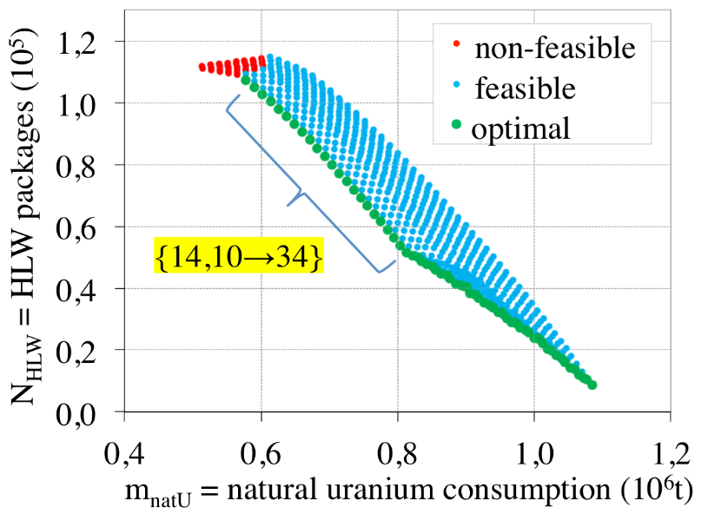
Introduction
Nuclear fuel cycle optimization is a multiobjective problem
  There are unlimited criteria for the optimization
    Volume of TRU inventories
    U_{nat} requirements
    Fuel cycle costs
    Proliferation risk
    ….
  And in general, no scenario will optimize all of them
  simultaneously
    Trade-off between improving one objective and degrading the others: Pareto Front
It also usually contains constrains or restrictions (e.g., the demanded fabrication mass cannot exceed the stocks)
Freynet, D. et al. “Multiobjective optimization for nuclear fleet evolution scenarios using COSI”. In: EPJ Nuclear Sciences & Technologies 2 (2016), p. 9. doi:10.1051/epjn/e2015-50066-7

Slide 4
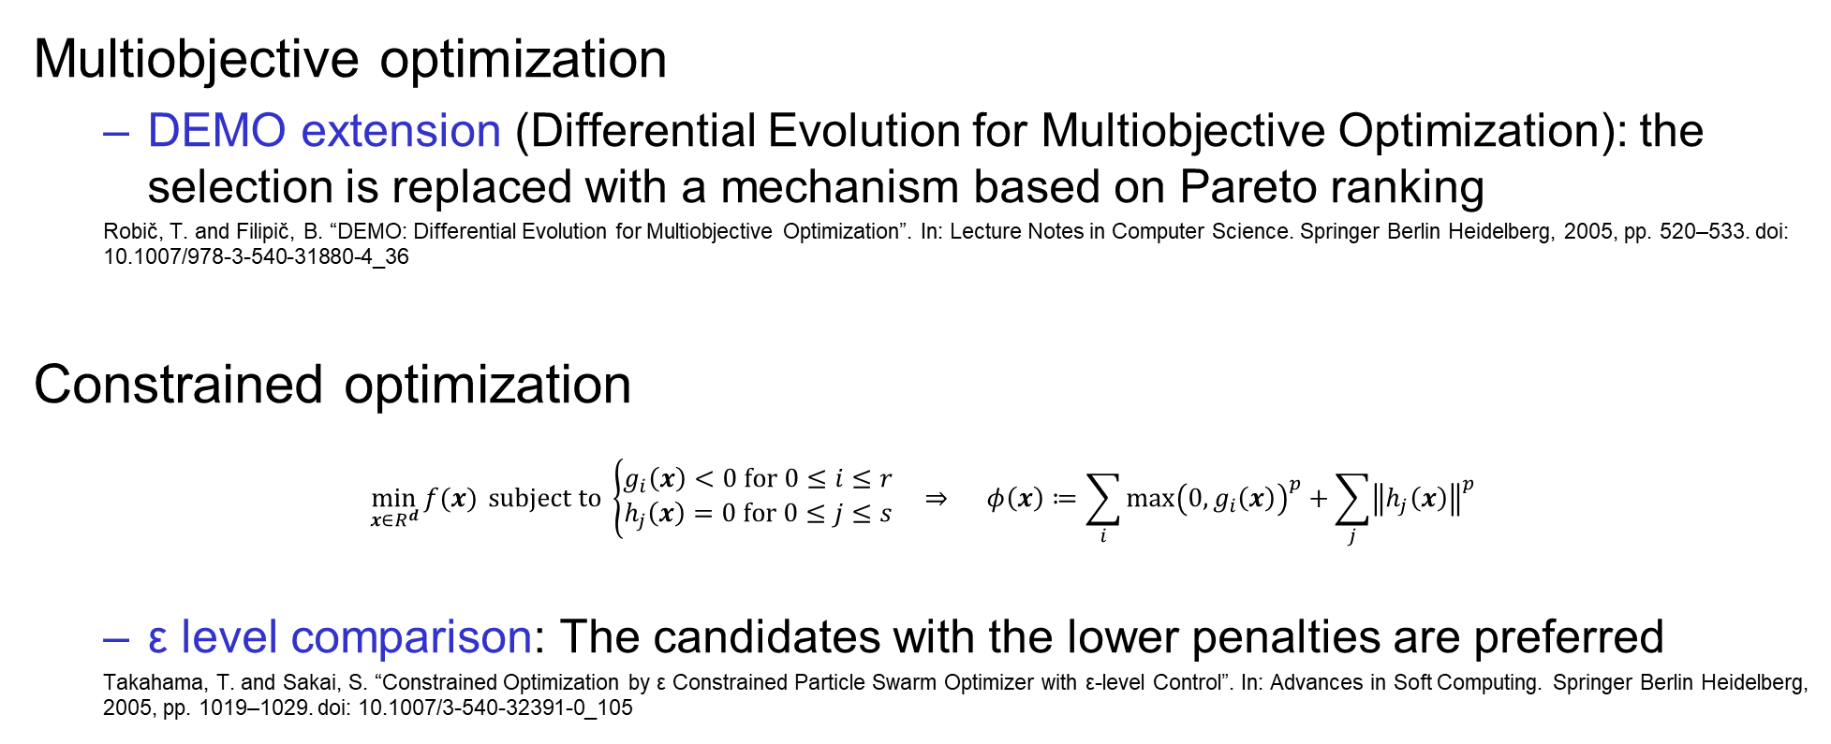
Multiobjective optimization
Multiobjective optimization
  DEMO extension (Differential Evolution for Multiobjective Optimization): the selection is replaced with a mechanism based on Pareto ranking
  Robič, T. and Filipič, B. “DEMO: Differential Evolution for Multiobjective Optimization”. In: Lecture Notes in Computer Science. Springer Berlin Heidelberg, 2005, pp. 520–533. doi: 10.1007/978-3-540-31880-4_36
Constrained optimization
$$\min_{x∈R^{d}}{f(x)} subject to \left\{\begin{aligned}g_{i}\left(x\right)<0 for 0≤i≤r \\ h_{j}\left(x\right)=0 for 0≤j≤s\end{aligned}\right. ⇒ φ\left(x\right)≔\sum_{i}{\max{{\left(0,g_{i}\left(x\right)\right)}^{p}}}+\sum_{j}{{\left\|h_{j}\left(x\right)\right\|}^{p}}$$
  ε level comparison: The candidates with the lower penalties are preferred
  Takahama, T. and Sakai, S. “Constrained Optimization by ε Constrained Particle Swarm Optimizer with ε-level Control”. In: Advances in Soft Computing. Springer Berlin Heidelberg, 2005, pp. 1019–1029. doi: 10.1007/3-540-32391-0_105

Slide 5
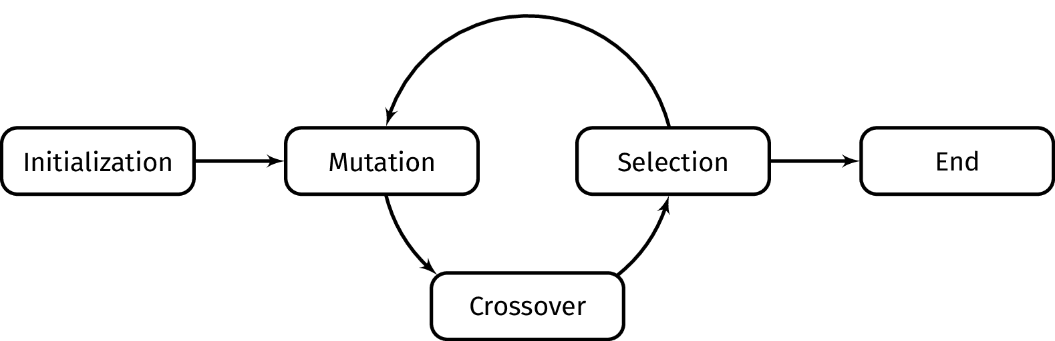
Evolutionary strategies: Differential evolution
These families of algorithms are based on generating a set of candidate solutions which are iteratively updated until convergence criterion is met
Differential Evolution (DE)
  Extremely simple algorithm
  Three key operations: Mutation, Crossover/Recombination and Selection
    For every generation, the Mutation and Crossover operators produce a new set of candidate solutions (agents) applying linear combination and permutations to the best ones
    These candidate solutions are only accepted if they improve the existing ones
Storn, R. and Price, K. Differential Evolution - A simple and efficient adaptive scheme for global optimization over continuous spaces. Tech. rep. TR-95-012. Berlekey: International Computer Science Institute, 1995
Storn, R. and Price, K. “Differential Evolution – A Simple and Efficient Heuristic for global Optimization over Continuous Spaces”. In: Journal of Global Optimization 11.4 (1997), pp. 341–359. doi: 10.1023/a:1008202821328

Slide 6
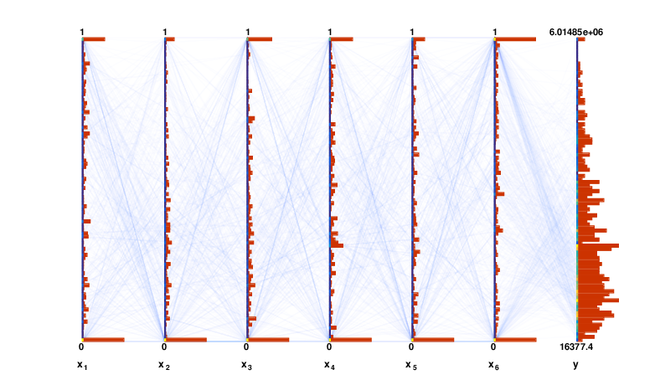
Evolutionary strategies: Differential evolution
Test function $y=f(x_{1},x_{2},x_{3},x_{4},x_{5},x_{6})$
10 generations

Slide 7
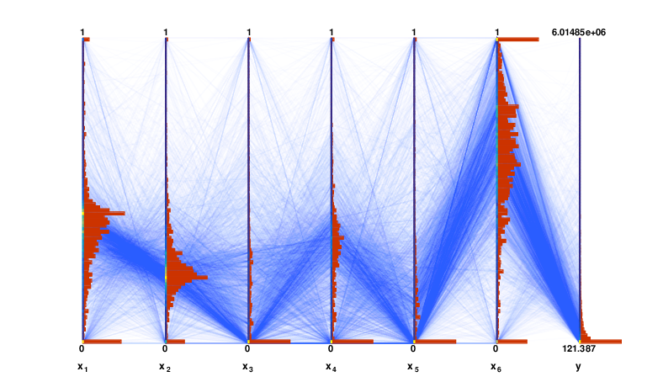
Evolutionary strategies: Differential evolution
100 generations

Slide 8
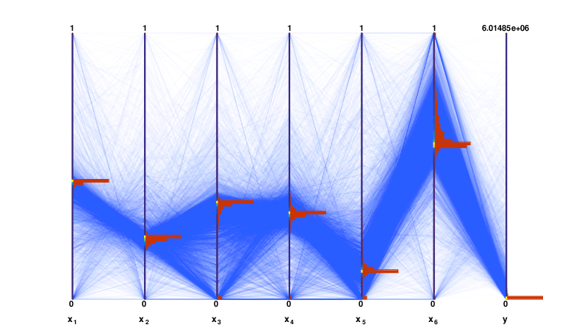
Evolutionary strategies: Differential evolution
Final convergence

Slide 9
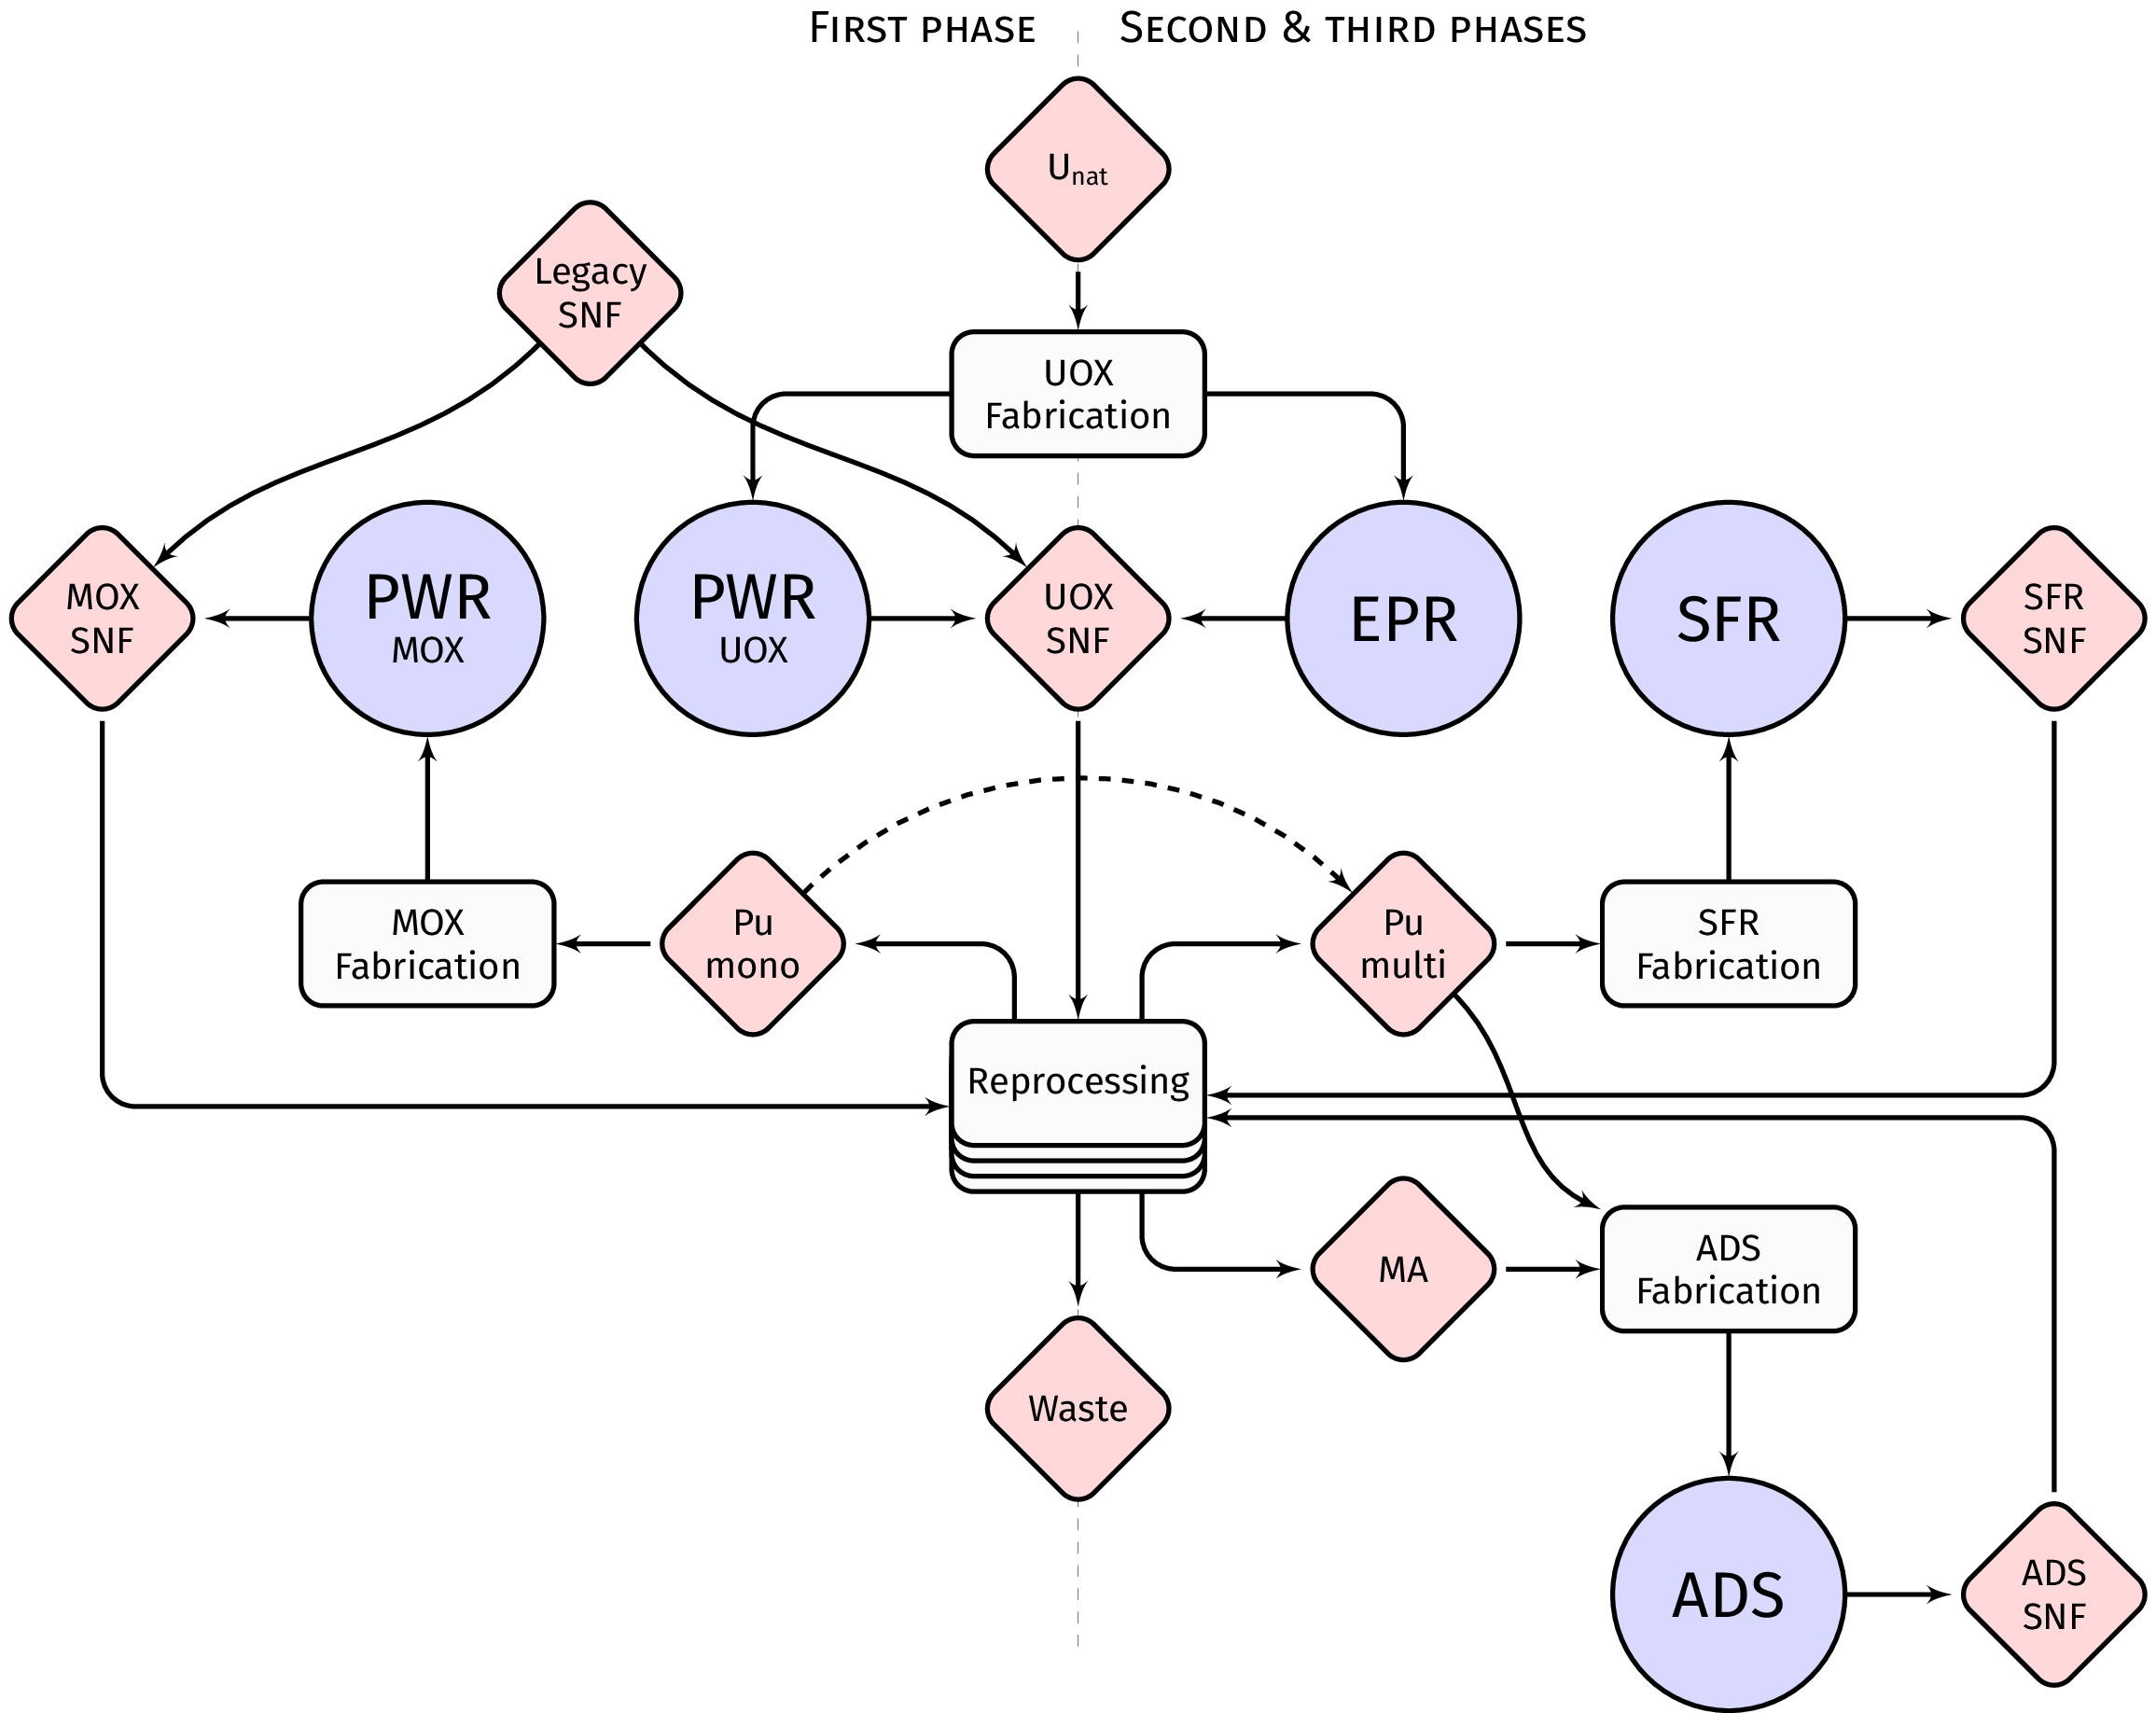
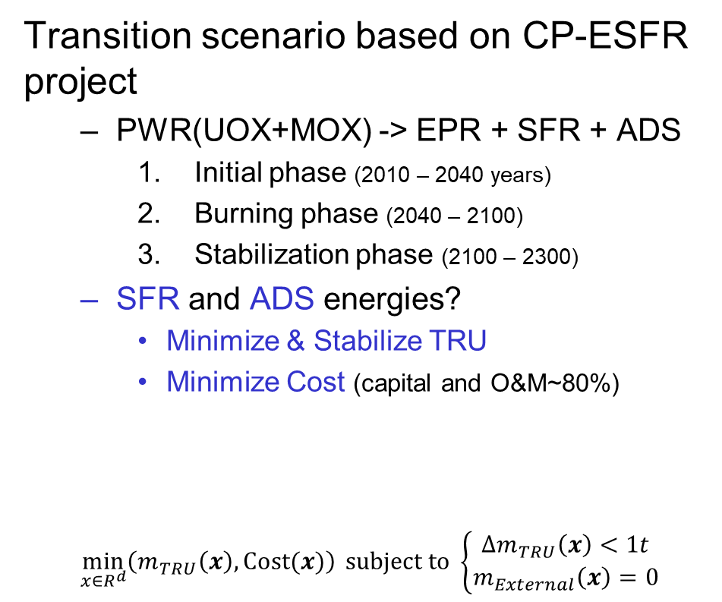
Scenario description
Transition scenario based on CP-ESFR project
  PWR(UOX+MOX) -> EPR + SFR + ADS
    Initial phase (2010 – 2040 years)
    Burning phase (2040 – 2100)
    Stabilization phase (2100 – 2300)
  SFR and ADS energies?
    Minimize & Stabilize TRU
    Minimize Cost (capital and O&M~80%)
  $$\min_{x∈R^{d}}\left(m_{TRU}\left(x\right), Cost(x)\right) subject to \left\{\begin{aligned}Δm_{TRU}\left(x\right)<1t \\ m_{External}\left(x\right)=0\end{aligned}\right.$$
Rodríguez, I. M., et al. “Analysis of advanced European nuclear fuel cycle scenarios including transmutation and economic estimates”. In: Annals of Nuclear Energy 70 (Aug. 2014), pp. 240–247. 10.1016/j.anucene.2014.03.015.
Energy fixed at 800 TWhe/year
Reprocessing capacity 2000+800 t_{HM}/year (UOX + MOX)
Uncertainties ±10%
(no additional mass)

Slide 10
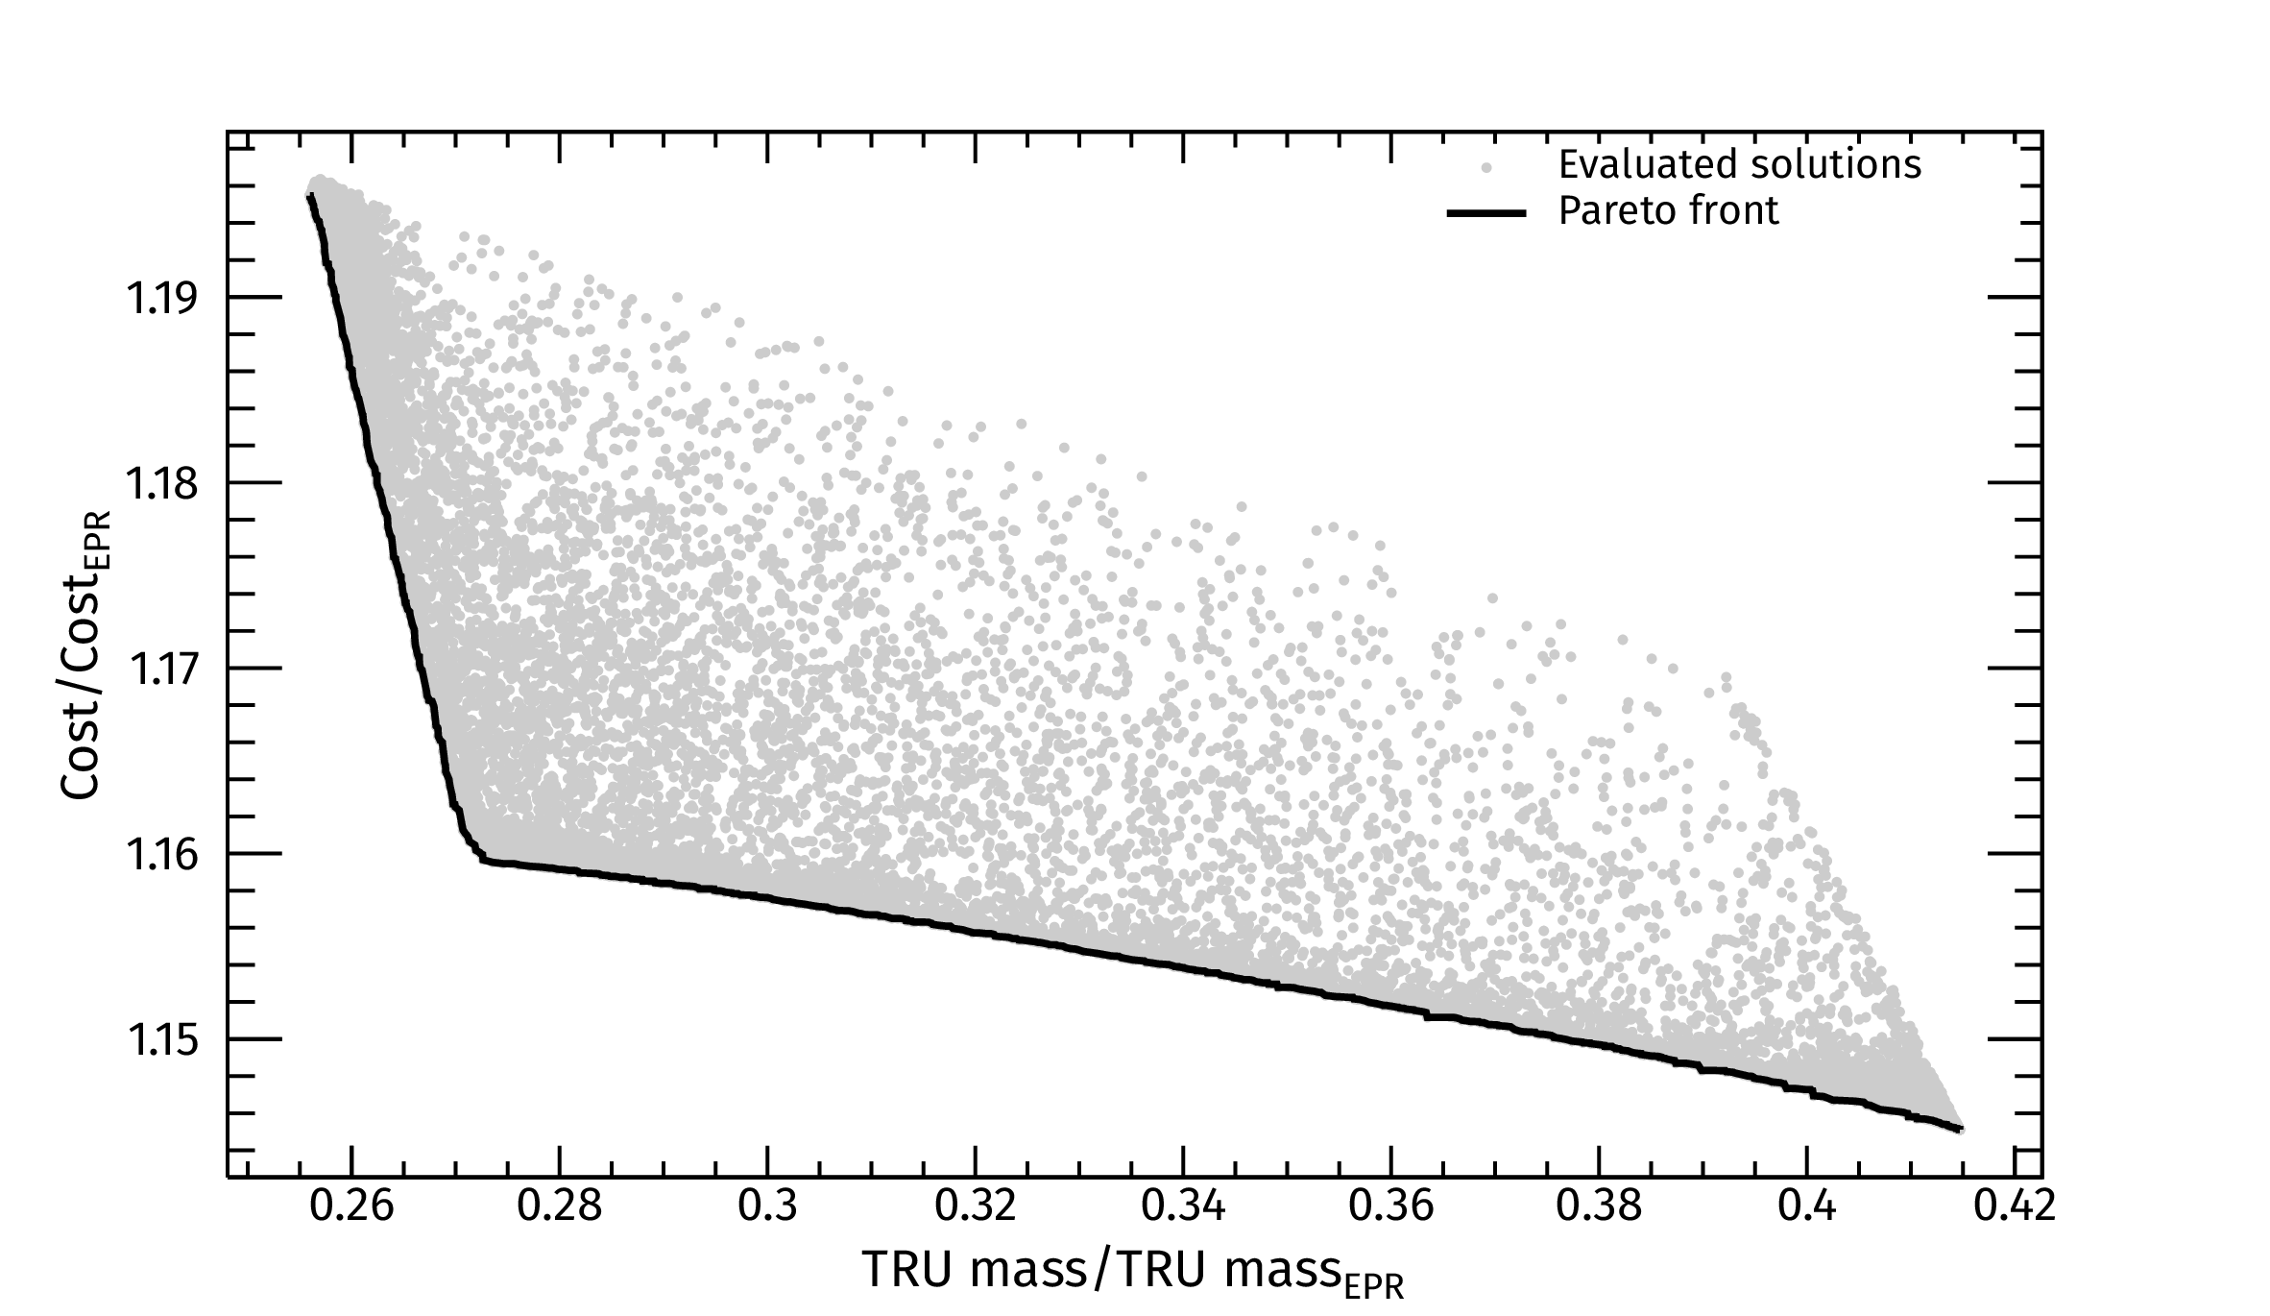
Results
Solutions space: TRU reduction 60-75% with an overcost 15-20%

Slide 11
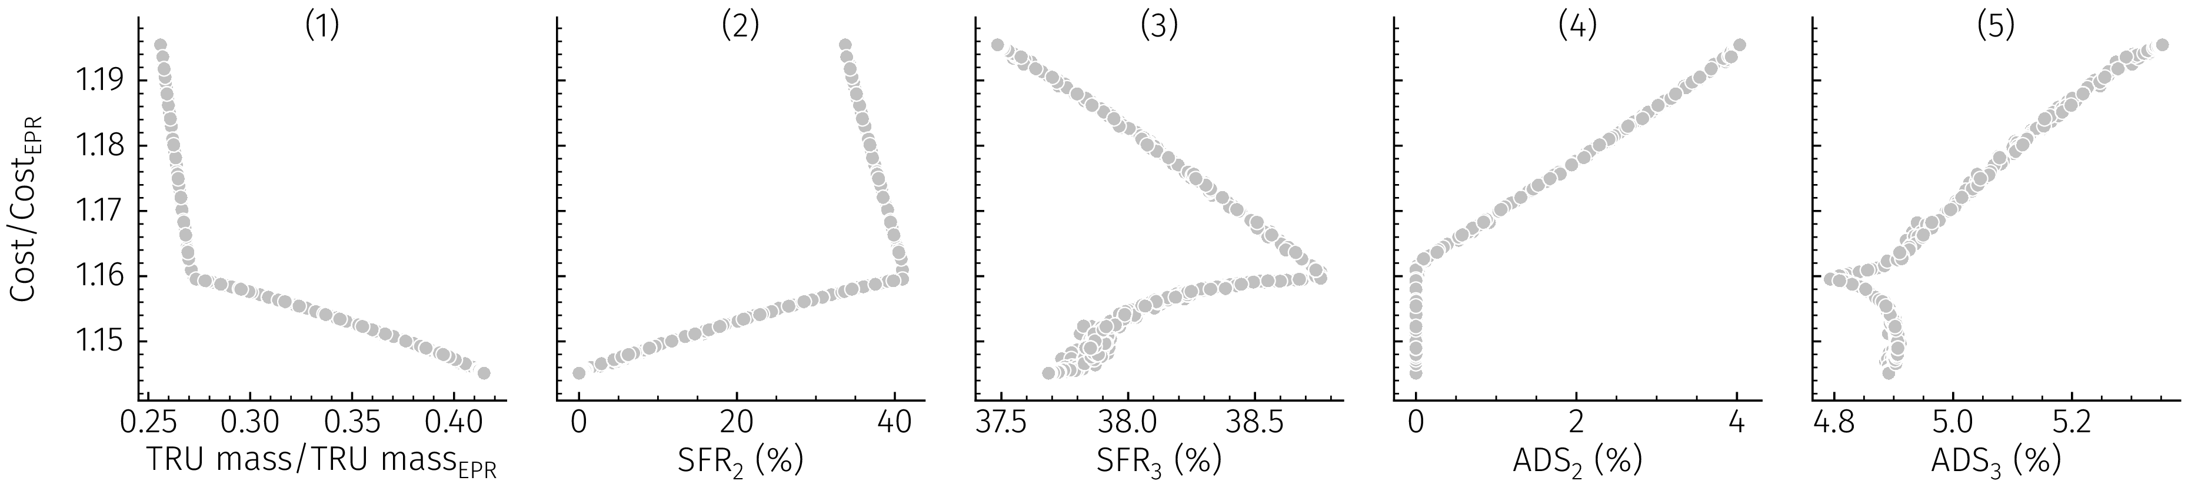
Results
Input space
  The energy shares during the stabilization phase are quite insensitive to the burning phase.
    SFR ~37.5 – 39% (compared to 0-40% during burning phase)
    ADS ~4.8 – 5.3% (compared to 0-4%)

Slide 12
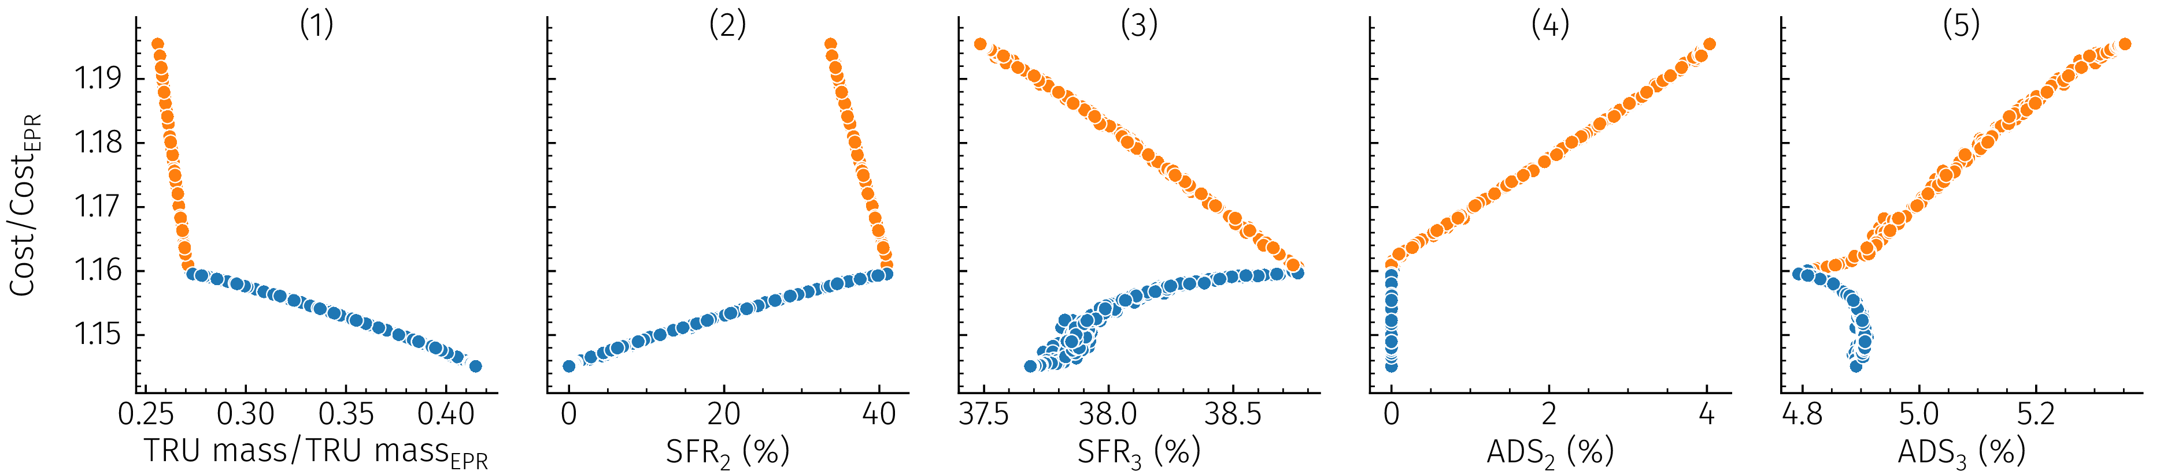
Results
Input space
  The solutions are separable in two branches
Orange < 0.272 TRU mass/TRU mass_{EPR} < Blue
  The introduction of ADS during the burning produces the cost increase

Slide 13
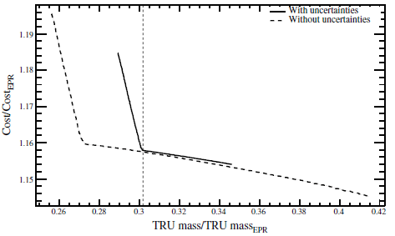
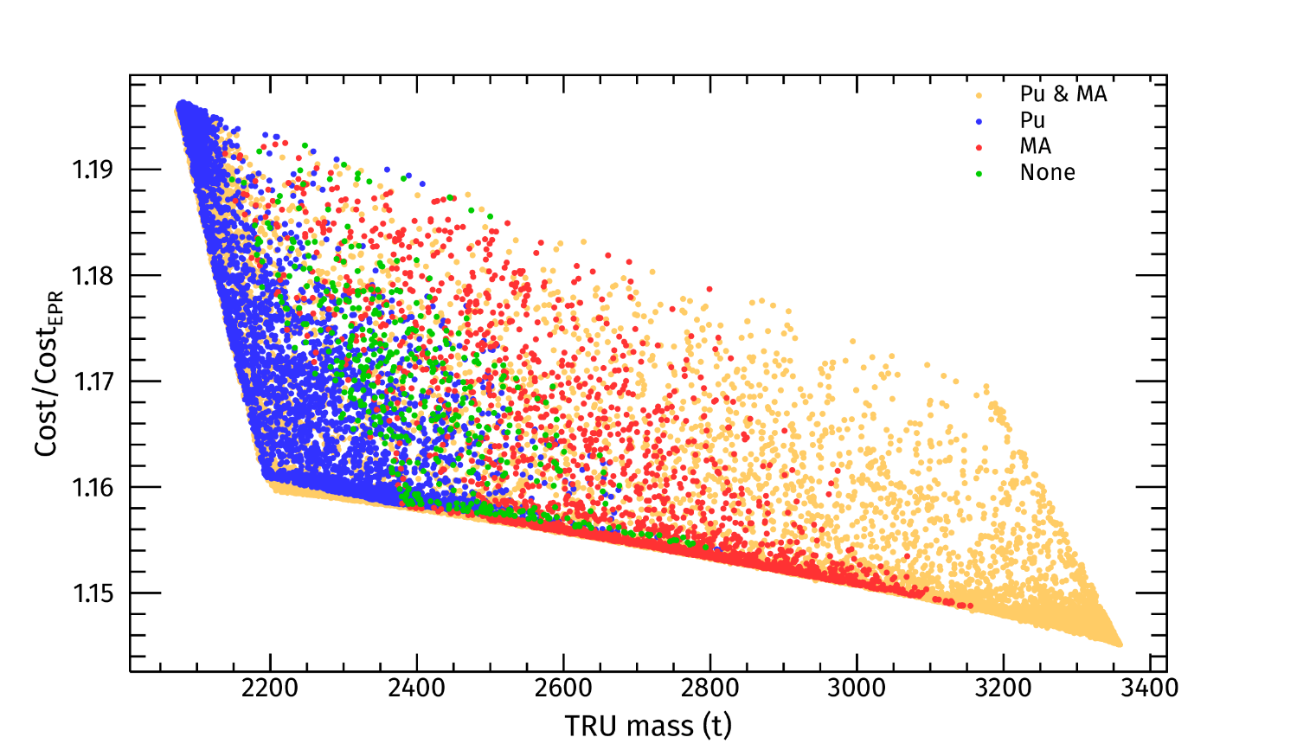
Uncertainties
The introduction of the uncertainties (parametric variations) in the Pareto’s front scenarios, shows that none of the solutions was robust
  All violates the stabilization constraint
  And a small subset requires an external mass
  (those achieving the lower TRU)
Uncertainties should be taken into account during the optimization process!

Slide 14
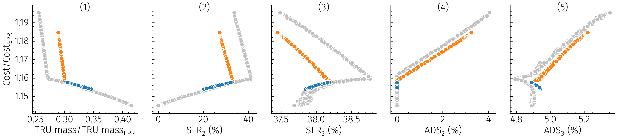
Uncertainties
Input space
Orange < 0.301 TRU mass/TRU mass_{EPR} < Blue
Uncertainties constraint the decision space (TRU reduction 65-71% with an overcost 16-18.5%)
Blue solutions except for ADS energy in stabilization phase almost coincide with reference case -> possibility of readaptation of the scenarios

Slide 15
Conclusions
Optimization is an essential problem in fuel cycle studies for scenario planning
Uncertainties play a decisive role in the validity of the solutions
  The decision space can be highly affected as a consequence of the lack of robustness
  And for extreme cases, no feasible solution may exist
DEMO evolutive algorithm can be easily extended to handle uncertainties
  Although the computational cost can be prohibitively large

Slide 16
Authors would like to thank ENRESA (through the CIEMAT-ENRESA agreement on “Transmutación de residuos radiactivos de alta actividad”) and the Spanish “Programa Estatal de I + D + I Orientada a los Retos de la Sociedad” project SYTRAD2 (ENE2017-89280-R), for the financial support of this work.

