Slide 1
Inteligencia Artificial en el Área
de la Seguridad Nuclear
Presented by: Joan Fontanet
Joan.fontanet@ciemat.es
Unit of Nuclear Safety Research
Department of Nuclear Fission
CIEMAT
Taller IA en el CIEMAT
CIEMAT, 3 julio 2023

Slide 2


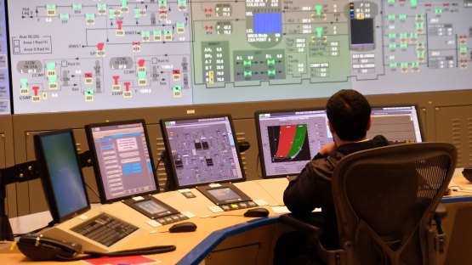
EURATOM-ASSAS Project
Artificial intelligence for the Simulation of Severe AccidentS
Objective:
Developing a proof-of-concept for a severe accident simulator based on Artificial Intelligence
Period: 2022 - 2026
Budget: 3 700 349,35 €
Coordination: IRSN (France)

Slide 3
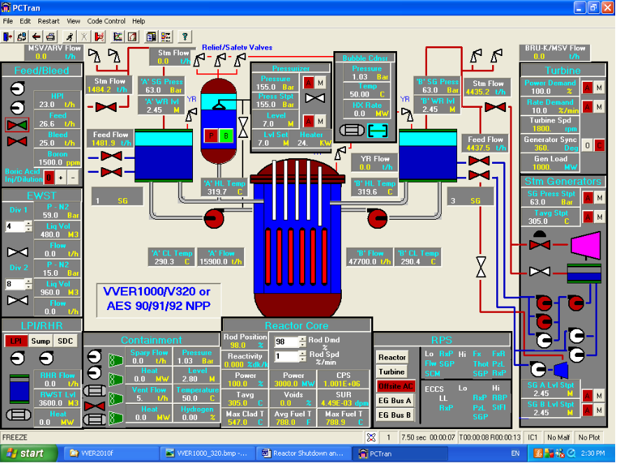
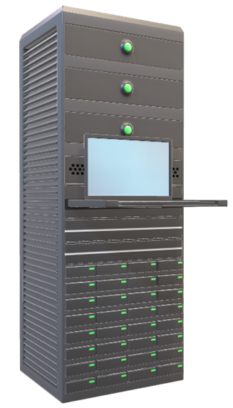
Simulator & numerical code
Integral Sereve Accident Code (ASTEC)
Simulator screen
Server

Slide 4
Simulator & numerical code
Integral Sereve Accident Code (ASTEC)
Simulator screen
Server
ASSAS project
Replacing modules and/or routines by surrogate models based on Artificial Intelligence

Slide 5
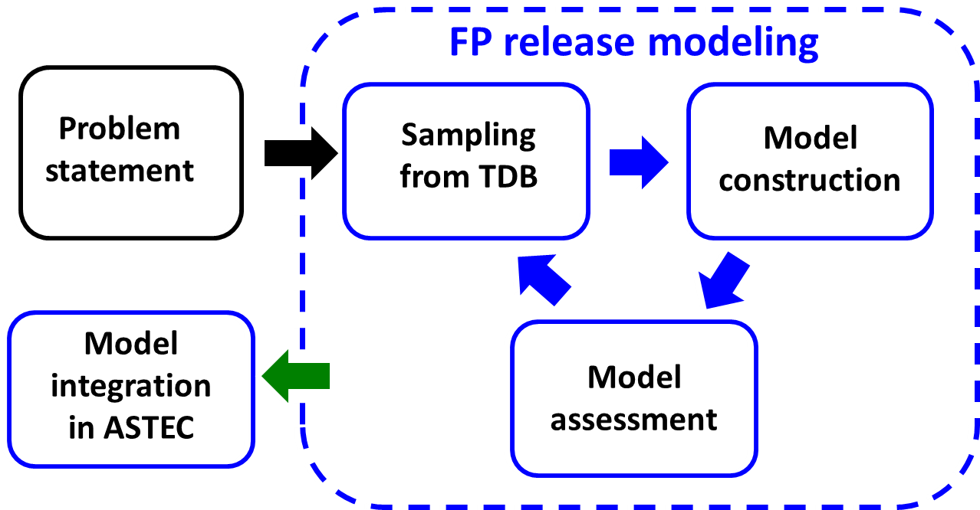
CIEMAT’s contribution to ASSAS
Definition of strategies for surrogate models development
Contribution to the Training Database generation
Surrogate model for fission products release
Acceptance test of the simulator

Slide 6
IA in the Unit of Nuclear Safety Reseach
Present projects
ASSAS: Severe accident simulator
    Surrogate model for Fission Products release
OperaHPC: Advanced fuel performance modelling Analysis of computation time reduction methods based on ML
Potential areas for application of AI
Surrogate model development
Emergency Preparedness & Response

Slide 7
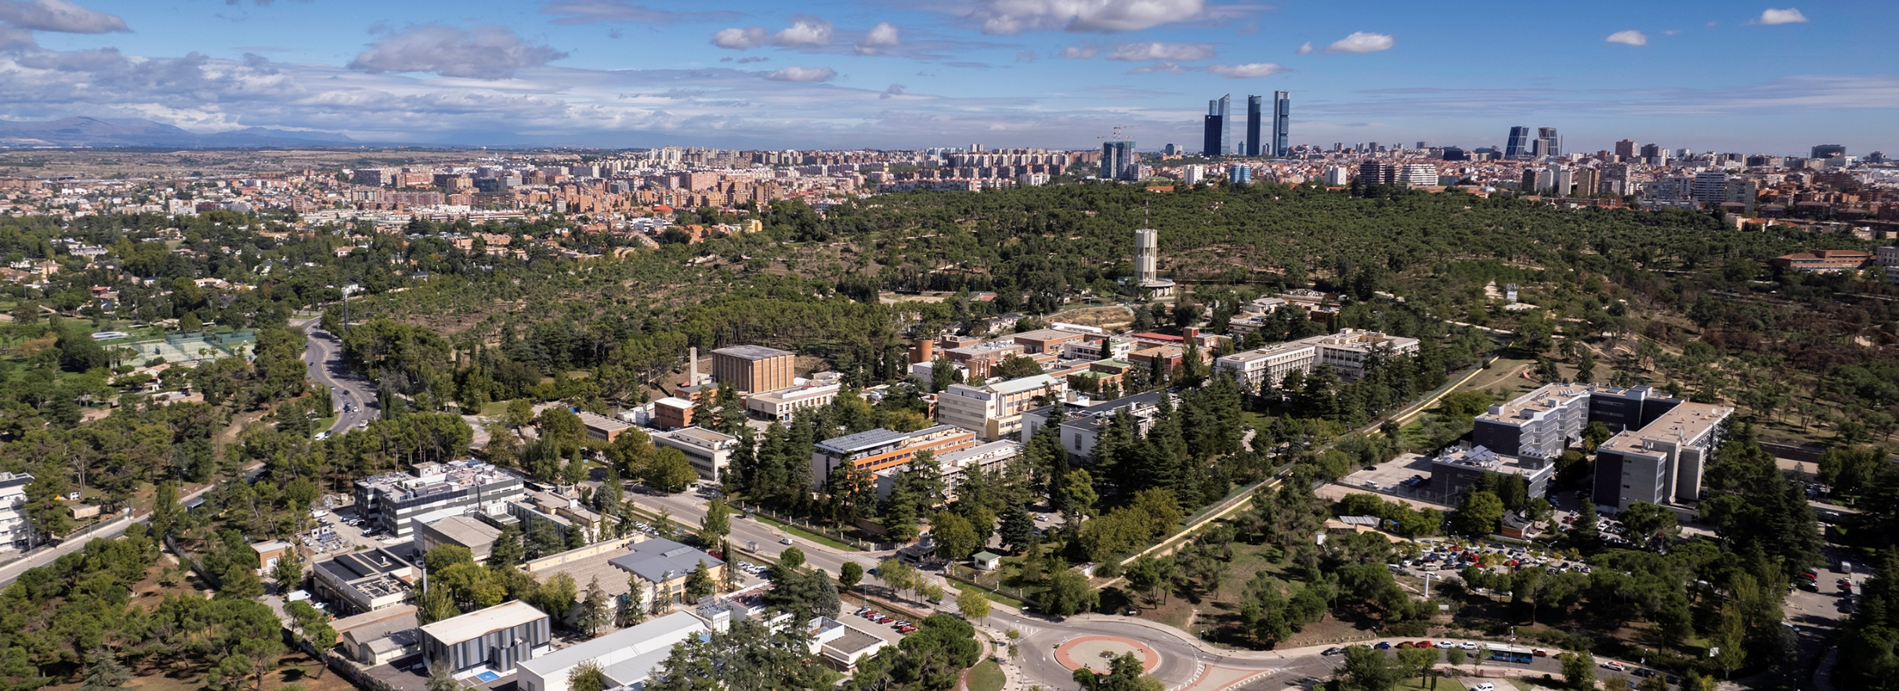
Thank you for your attention!
Unit of Nuclear Safety Research
Department of Nuclear Fission
CIEMAT
joan.fontanet@ciemat.es

