Slide 1
New equipment and infrastructures
Heikki Penttilä
EURATOM proposal preparation meeting, evaluation of Letters of Interest, Madrid, 10.7.2023

Slide 2
Evaluation criteria
Primary criterion: New and/or improved nuclear data production potential
The ranking is based on my view how large potential the projects have to support producing new nuclear data. This view is bound to be subjective and I see myself that I probably see more potential on those LoI’s that myself understand better and underestimate the less familiar. Ranking is based
motivation
novelty
technical feasibility.

Slide 3
Rejected LoIs
TERRIFIC: Development of Terbium based cancer theranostics
no nuclear data aspect
NEDEGARA: Development of an in-beam neutron detector for total cross section measurements in presence of gamma radiation
requests 550k out of total 300k for equipment and infra
If this was a realistic budget, reducing it with any reasonable factor results in totally handicapped project

Slide 4
Budget distribution proposal
No general ”cheese cutter” principle
Higher rank LoI’s were reduced less
Small requests were reduced less
Very small funding does not necessarily produce a viable project
PM requests were reduced less than travel and equipment
Possibility to move the travel expenses to the TAA part of the project proposal was happily assumed
Depends on the structure of the TAA
Travel support needs to be applied again
United Kingdom not EU any more
Have a funding system of their own if supported
UK proposals included intact and uncut

Slide 5
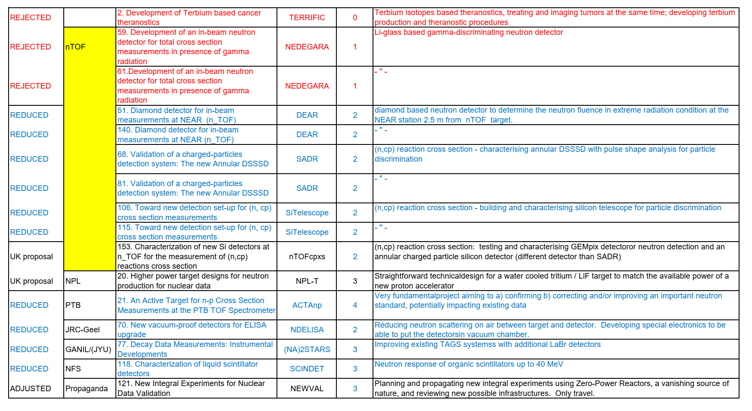
Overview

Slide 6
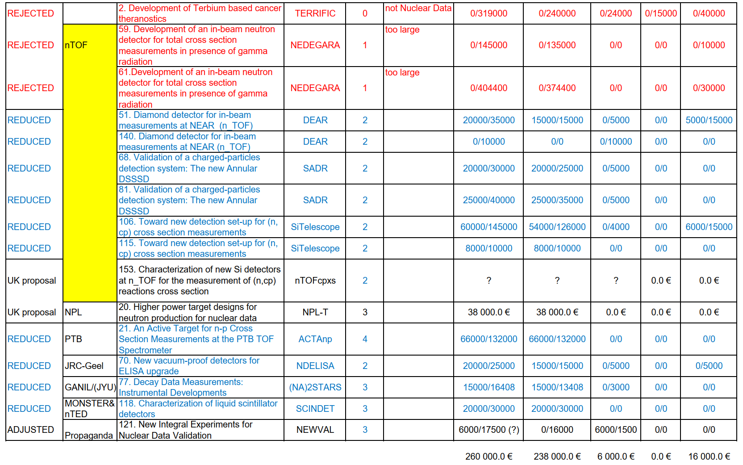
Overview funding suggestion
A second thought:

Slide 7
Combining projects: ”Detectors for nTOF (DenTOF)”? 🤔
Even after reduction half of the funding goes to detector development for nTOF
Detector far and detector NEAR, detectors hanging both of the EARs…
Coherence of the proposed projects? Looks very scattered at the moment
How about combining these to one collaborative task to provide nTOF with necessary detectors, with a common motivation and complementary subtasks? Instead of the each institution commissioning their favorite toy?

