Slide 1
New Nuclear data project core meeting
10/07/2023, Madrid, CIEMAT
Maëlle Kerveno

Slide 2
At the beginning : « new ewperiments »
General features :
~ 62 LoIs
39 meas. ; projects some LoIs included modeling, or evaluation tasks
By topics :
11 (n, g)
7 (n, n’g)
23 (n,f) XS; FFY
13 (n, X), (lcp, X)
8 DD
For SANDA, we had 55 proposals for WP1 & 2
We kept 35 proposals in WP2 (1 M€)

Slide 3
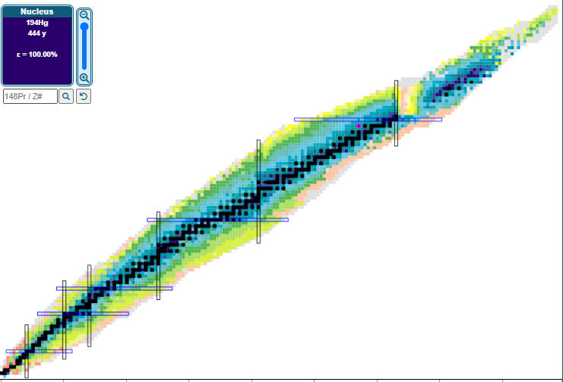
Which nuclei is the community interested in?
35Cl
(n,p); (n, a) | 35ClXs MORE (n,p)
90,92Zr
(n, n’g) | NNNXNXS
9Be
(a,n) | MANY
6,7Li
(d,x)t,Be | H3Be7@DONES
Li7(n, n’) | DEFROST
56Fe
(n,g) | Fe56_NG_Meas
(n, n’g) | DEFROST
(n, el) | NNNXNXS
59Co
(n,g) SACS | M2NM
Cr
(n,lcp) | LIPS
54Fe
(n,a); (n,2n) | NPL-D
(n, el) | NNNXNXS
63,65Cu
(n,g) | RAMEN
(n, n’g) | RAMEN, NNNXNXS
(n, el) | NNNXNXS
27Al
(a,n) | MANY

Slide 4
186W
(n,g) SACS | M2NM
Which nuclei is the community interested in?
209Bi
(n,g) & 209Bi/209mBi | BINGO
166,167Er
(n,g) | ErCapture
197Au
Assymetriy & (n, f) XS | FlowZ
206,208Pb
(n, el) | NNNXNXS
natCe
Assymetriy & (n, f) XS | FlowZ
194Hg
Half life | DREH
103Rh
(n,g) aver. XS | AOSTA-2
92Rb, 96Y
Electron spectra | E-shape
109Ag
(n,g) SACS | M2NM
99Tc
(n,g) aver. XS | AOSTA-2
98,99,98mY,90Br, 84As, 104gsNb,104mNb
Beta decay | TAGS
89Y
(n,xn) x=2-4 | HINEAR

Slide 5
Which nuclei is the community interested in?
239Pu
G-ray & neutron mult. & energies in correlation with FY | NeGaFis
(n,f) RRR | Pu239
Tot RRR | Pu239
Prompt n mult (nubar) | REMUS
FY fast & epithermal | SENFY
238U
(n,f) standard 0-40 MeV | FISHES
G-ray & neutron mult. & energies in correlation with FY | NeGaFis
(n,g) | U238_NG_Meas
(n, 2-3n g) | NNNXNXS
235U
(n,f) standard 0-40 MeV | FISHES
FY fast neutron | AFFY
FY thermal & fast neutron | VERDI
Barrier height, capture proba | ISS,d,pf
Fission Mass Y nth | LOHENGRIN
G-ray & neutron mult. & energies in correlation with FY | NeGaFis
(n,f) standard 2.5 -100 keV | STAR
240Pu
(n,f) (0,5 -5 MeV) | EPIC
(n,f) 1 -3 MeV | PuF
233U
FY fast & epithermal | SENFY
241Pu
(n,f) aver. XS | AOSTA-2
(n,f), (n,g) | Cap-Fis-Pu241
232Th
(n,g) SACS | M2NM
242Pu
(n,f) (0,2 -20 MeV) | EPIC
243Am
(n,f) thermal- x 100 MeV | SOFIA
241Am
(n,f) aver. XS | AOSTA-2

Slide 6
Evaluation work?
Criteria for assessment
Priority for evaluation (0-3) (doc Arjan, HPRL, other documents listed in publication)
Risk (2 (no) – 0 (high)) that the experiment could not be perform (depend on det dev not yet validated, on accelerator availability, …)
Sample (0 -2) not there, in contact, already exist
PhD or Post doc involved (E&T criteria) (0-2)
General quality of the proposal (0-2)
Data in EXFOR promised (0 -2)
Financial support well justified (0 – 3)
Link with an evaluation work in this project (0 – 1)
General mark over 4.
Check if the work was already supported in SANDA
Obvious NB: I have not assessed the LoIs I am part of

Slide 7
Removed LoI
LoI (n ,f) & FFY | Mark | comments
FISHES (2/2) | 1 | I didn’t find request for the improvement of the standard in the energy region proposed in the LoI (and no reference given, only general consideration). They claim to re-measure standard but no target accuracy is given.
FlowZ | 1 | Proposal too far from application and evaluation needs. The funding of all the experiment is required to EC
ISS d,pf | 1 | Justification is very vague. Interesting for modeling and fission study but too far from the goal of the ND project.
NeGaFis | 1 | 2 outcomes/ the first was already supported in SANDA and the second is for experiment design. Should be evaluated in “New equipment and infrastructures” ?
NONIII (2/2) | 1 | The proposal concerns the development and commissioning of a new installation for FY measurement. Should be evaluated in “New equipment and infrastructures” ?
PuF (1/2) CEA/DES | 1 | Should be in “evaluation “ tracks
AFFY (1/3) CEA/DES | 1 | The work performed by CEA/DES is not described.

Slide 8
Removed LoI
LoI (n ,X) and (ch.p., X) | Mark | Comments
HINEAR (2/2) | 1 | Project more related to « facility development » via validated neutron spectra for integral measurement. Financial request not justified (travel cost 25 k€). Contradictory information for sample and PhD Should it be moved to “New equipment and infrastructures”?
XS10BAN (1/2) | 1 | A part of the proposal (UKAEA) should have been submitted in « evaluation »
LoI DD | Mark | comments
NA(2)STAR | 1 | Commissioning of a new detector, should be in “New equipment and infrastructures”?
E-shape (2/2) | 2 | Taking into account the competition in the project, TAGS data will produced more data. May be, e-shape project could be removed despite its interest.
SPAS | 1 | Too far from the ND project objectives
FIDEGASP | 2 | Don’t know about the precise results (what isotopes?). Don’t know the added value compared to TAGS measurement for example.

Slide 9
Removed LoI
LoI (n ,g) | Mark | comments
AOASTA-2 | 2 | This measurement should not be in « validation »? No justification is given for the chosen isotopes.
BINGO | 2 | Measurement already support in SANDA for JRC-Geel. This work is not mentioned in the proposal (only n,tot meas.). So don’t know what will be the added value of this measurement.
238U_NG_Meas | 2 | As mentioned in the LoI, should it be first interesting to revisit the n-TOF data to see if correction could be applied and then proposed an experiment if it is necessary. (to safe money of the project?)
LoI (n , n’g) | Mark | comments
DEFROST (2/2) | 1 | This proposal focuses on methodology development. This subject was already supported in WP1 SANDA. It seems they are not yet ready to produce accurate data. Should be evaluated in “New equipment and infrastructures” .

Slide 10
Budget reduction for supported LoI
Criteria for reduction
After removing some LoIs (-20 LoIs), the total amount was still 3 M€.
So a factor 3 could be applied on all LoI?
BUT
* If the LoI request < 30 k€ don’t touch
* for LoI > or = 100 k€ factor 3 up to 4 (with modulation on the type of costs)
* Between 30 k€ and 100 k€, modular reduction.
* Sum of LoIs for same project < 175 k€
* reduced travel cost to 5 k€ max
* When funds are requests for PhD or Post Doc PMs, try to moderate the cut. But not so easy because it is high cost!
Result (failed!)
did not manage to reach 1.05 M€ … only 1.28 M€
Maximum for one LoI 40 000 €.
A solution, removed others LoIs or reduced to 30 000 € the max support

Slide 11
Budget reduction for supported LoI
- Per topics

Slide 12
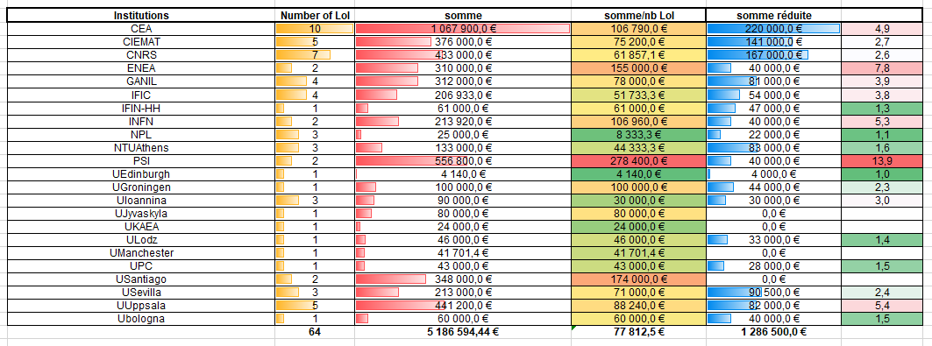
Budget reduction for supported LoI
- Per institution
UK contribution : 26 k€
PSI contribution: 40 k€

