Slide 1
Budget for the TAA & ET of HORIZON-EURATOM-2023-NRT-01-06: Improved nuclear data for the safety of energy and non-energy applications of ionising radiation
Chosen limit 350 kEUR (100 % support) for TAA, E&T and schools
Scientific motivation similar to ARIEL: E & T for early stage researchers (+ technicians + experts) TAA facility support and user support for experiments pooling scheme with PAC evaluation of proposals
Strongly reduced budget ➔ only partial facility support available (ca. 50 hours per experiment)
Opportunities through ENEN2+ and OFFERR for user mobility and facility support.

Slide 2
ARIEL Budget and Experience:
TAA (user support (4 users/7days) 203 kEUR + facility support 583 kEUR ca. 3000 hours )
E&T (30 scientific visits of typically 8 weeks: 264 kEUR)
Travel budget for PAC meetings ca. 3000 EUR/PAC meeting
Schools and dissemination: (4 summer schools and 4 scientific workshops) Typical cost of one school: 35 kEUR 24 participants with travel support, 1 week Typical cost for one workshop: 25 kEUR with travel support for ca. 25 partners
Committed budget from all PAC meetings: TAA: user support: 162 kEUR facility support: 590 kEUR (3369 approved beam time hours, 35 experiments) E&T: 267 kEUR ( 30 scientific visits)
TAA user support not fully used, can be reduced to 3 users per experiment PAC meetings virtual (only first and last in person)
Open access publication fee support very little requests (Publications come late, or arXiv („green“ open access))

Slide 3
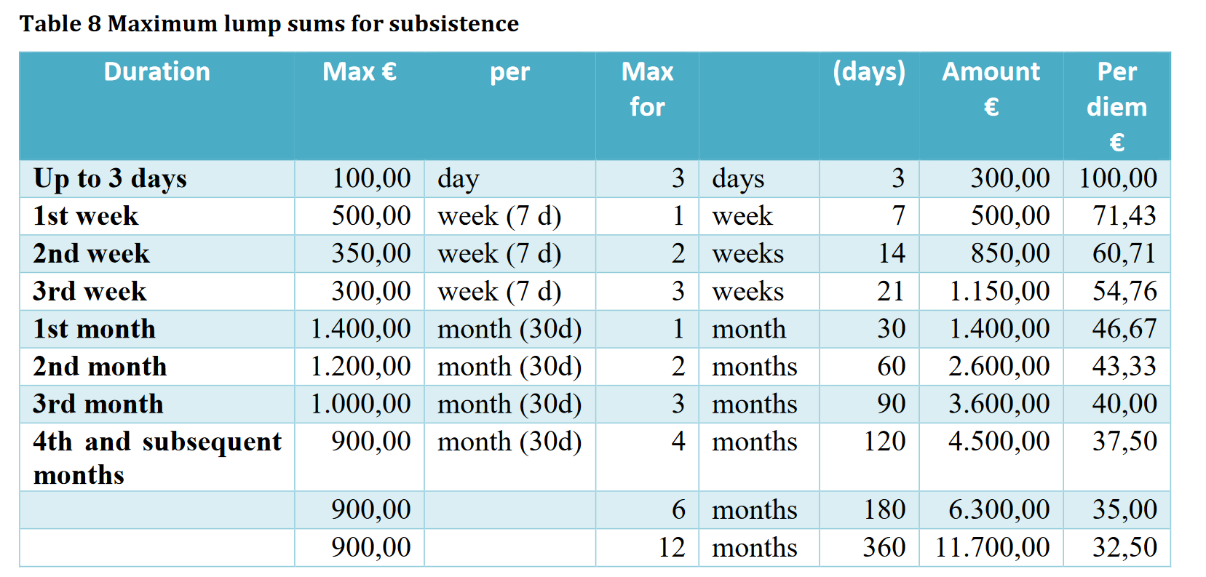
ENEN2+ support until 31.07.2025
Transnational mobility for experiments E &T activities, individual and group applications possible
Postdoc, PhD MSc Bsc students eligible + Early career professionals
Long and short projects are possible mostly for single students could be a partial substitution for user support.
Travel support: lump sum 500 EUR,
Per diem as given by the table
ENEN2+ support is expected
Decision 4 months after submission deadline, payment 5 months after deadline
ARIEL per diem was
150 EUR /day 400 EUR typical travel support

Slide 4
OFFERR facility support until 30.09.2025
“fast-track project” to perform studies of limited scope which are to be completed in less than 6 months of access to the infrastructure. Financial support up to 50 kEUR (consult the catalogue of fast-track activities) Facility beam time support and travel support for senior researchers (young researchers ➔ ENEN2+)
The proposals shall aim at strengthening the leadership of the European union in the field of civil nuclear fission research, development and innovation.
1) Light Water Reactor sustainability,
2) Advanced fission reactor concepts,
3) Waste and decommissioning,
4) Nuclear science applications,
5) Advanced nuclear fuels,
6) Innovation in nuclear instrumentation,
7) Radioprotection and nuclear medicine
Two independent expert reviewers for evaluation process ( Who ?)

Slide 5
OFFERR application process
OFFERR guidline for applicants:
3) An applicant shall contact the contact person of the chosen infrastructure and agree on the content and timing of the experimental campaign.
4.) An applicant shall prepare a project proposal that includes the commitment of the infrastructure provider on availability and costs. (decision 6 weeks after call deadline)
7) After the end of the evaluation process, applicant will receive a notification of application acceptance or rejection.
10) The users should write and submit the User report. Infrastructure contact person should write and submit the Infrastructure report (within 2 months after the end of the experiment)
11) The users declare the costs and get refunded.
Requirements: Signed Intellectual property agreement to be submitted with proposal Experimental results to be uploaded for open data access before final rate of reimbursement
Facility cost: 20 % prefinancing 80 % after completion (infrastructure report + data module)
Facility beam time support through financial support for third parties (FSTP). Maximum amount of 300000 EUR per party, expected 70 short track projects with 10 % nuclear science applications.

Slide 6
Proposal for a reduced TAA and E&T scheme
Assume up to 7 activities (E&T) and 7 experiments can be covered by ENEN2+ and OFFERR fast track activities. OFFERR has legal and open data access requirements .
Reduced new budget for 15 E&T visits and 15 experiments (750 hours): 15 Education and Training activities up to 8 weeks (8800 EUR): 132 kEUR User support (2 users (5 d) per experiment 1150 EUR/user): 35 kEUR Facility support (15 Experiments 50 hours per exp.): 150 kEUR
Support of two schools: 2 * 35 kEUR
PAC meeting travel support
Open access fee support

Slide 7
49/55 | HISPANOS Hands-On school on the production, detection and use of neutron beams | (NA)2STARS: Decay Data Measurements: Instrumental Developments
Carlos Guerrero, University of Seville, CNA
Schools has two parts (lectures, seminars on fundamental+applied aspects) and hands-on session at CNA with neutron beams. 24 participants supported, 10 days, best poster price Experiments in small groups include: ToF experiment, PSD discrimination, neutron capture by activation (MACS), Thermal neutron radiography, fission neutrons, particla transport simulations. |  |  | Upgrade of existing Total Absorption Spectrometers (TAS) that will be employed in beta decay studies of relevance for the calculation of reactor decay heat and the reactor antineutrino spectra. Building a TAS of second generation, allying efficiency with higher segmentation and energy resolution thanks to 16 LaBr3 crystals to be added to the existing segmented TAS in Europe i.e. the DTAS detector (18 NaI crystals [DTAS]) and the Rocinante detector (12 BaF2 crystals [Rocinante])
Comments by evaluator: HISPANOS school has already been realized once in ARIEL. (Well requested by students) Well written and complete proposal. Clear value for E &T should be supported in full.
Total |  | Personnel | Travel support | Other direct cost
44500 € |  | 10000 € | 29000 € | 5500 €

Slide 8
92/126 | E&T in Nuclear Data Life Cycle | (NA)2STARS: Decay Data Measurements: Instrumental Developments
Oscar Cabellos, Technical University of Madrid (UPM)
Continuing the Education&Training on “nuclear data life cycle” activities from GRE@T-PIONEeR – GRaduate Education Alliance for Teaching the PhysIcs and safety Of NuclEar Reactors – (https://great-pioneer.eu/ ) 50 participants (20 % = 10 in person on site) pre-class online (40 hours /1 month) Support for two schools requested ! |  |  | Upgrade of existing Total Absorption Spectrometers (TAS) that will be employed in beta decay studies of relevance for the calculation of reactor decay heat and the reactor antineutrino spectra. Building a TAS of second generation, allying efficiency with higher segmentation and energy resolution thanks to 16 LaBr3 crystals to be added to the existing segmented TAS in Europe i.e. the DTAS detector (18 NaI crystals [DTAS]) and the Rocinante detector (12 BaF2 crystals [Rocinante])
Comments by evaluator: School has already been realized in a previous project. Strong “online” component (extensive material already developed through Gre@T-PIONEeR) Reduced “in person” classes. Contents not detailed in the proposals Could be merged e.g. with the CIEMAT course Are two courses required ?
Total |  | Personnel | Travel support | Other direct cost
31409 € |  | 11409 € | 20000 € | 0 €

Slide 9
135/181 | European Summer School on Thermal Neutron Scattering Data | (NA)2STARS: Decay Data Measurements: Instrumental Developments
Jose Ignacio Marquez Damian, European Spallation Source ERIC
Neutron interactions with condensed matter: Generation, processing, validation and utilization of thermal scattering nuclear data using open source tools based on “HighNESS International School on Thermal Neutron Scattering Kernel Generation” Teach the use of nCrystal code to serve the broader nuclear data community and contribute to the growth of the thermal scattering sublibrary of JEFF, and train the broader nuclear data community in thermal scattering law. |  |  | Upgrade of existing Total Absorption Spectrometers (TAS) that will be employed in beta decay studies of relevance for the calculation of reactor decay heat and the reactor antineutrino spectra. Building a TAS of second generation, allying efficiency with higher segmentation and energy resolution thanks to 16 LaBr3 crystals to be added to the existing segmented TAS in Europe i.e. the DTAS detector (18 NaI crystals [DTAS]) and the Rocinante detector (12 BaF2 crystals [Rocinante])
Comments by evaluator: School has already been realized in a previous project. Thermal neutron scattering law for material research at ESS, not in line with our project; number students not given 20-30 ? 4 PM request only in the LoI, added travel support for students (40000 EUR) not of high priority for nuclear data Are two schools required ?
Total |  | Personnel | Travel support | Other direct cost
80000 € |  | 40000 € | 40000 € | 0 €

