Slide 1
The Role of Natural and Social Sciences for Transdisciplinary Research and Implementation in the Energy Transition
Sept. 23. 2024
Madrid, Spain
Ortwin Renn
Research Institute for Sustainability Helmholtz Center, Potsdam

Slide 2
Four Major Global Transformations (intended)
Continuous Economic Growth (De-growth)
Globalization/Re-nationalization
Digitalization/AI
Sustainabilization/Climate Protection
Energy transition
Agriculture and Food
Housing and consumption

Slide 3
Unintended Side Effects
Global environmental changes (climate, biodiversity, pollution, environmental health)
Increase of vulnerability with respect to the interactions between the technological, social and natural risks
Urbanization, demographic changes, migration, land-use planning
Governance deficits (corruption, re-nationalization, authoritative leaderships, neo-imperialism)
Severe equity problems with respect to opportunities, income and vulnerabilities

Slide 4
Crucial Question:
What do these trends imply for the relationship between science and society?

Slide 5
Challenges
Major increase in scientific studies and analyses without major impact on the success of sustainability, climate protection and energy transition
Plurality of knowledge claims: science is not the only knowledge provider that counts
Missing bridges between knowledge and action
Lack of convincing concepts for transformative and transdisciplinary research

Slide 6
Transdisciplinary Concept of Science
Classic Research (curiosity driven, methodological rigor, open questions)
Goal Oriented Investigations (coherent strategies to reach a predefined objective or set of objectives, including assessment of unintended consequences
Catalytic Expertise (analyzing, designing and facilitating processes to initiate constructive and productive learning among and between different knowledge camps, interest groups and value orientations)

Slide 7
Social Science Instruments and Methods I
Classic research
Observation (participatory and non-participatory)
Experiments (Quasi-experiential)
Surveys (quantitative and qualitative)
Case Studies
Goal oriented research
Simulation (Game theory)
Scenario Construction
Foresight
Gaming
Delphi methods (traditional and Group Delphi)

Slide 8
Social Science Instruments and Methods II
Catalytic Research
Diagnostics
Conflict analysis
Network analysis
Discourse analysis
Solution-Oriented (participatory)
Multi-attribute utility method (rational actor model)
Communicative action model (Habermas)
Models of deliberative co-creation (Dryzek; Barber)
Search for mutually agreed arrangements (postmodern)
Combination: analytic-deliberative discourse (US Academy)

Slide 9
Analytic-Deliberative Approach
Characteristics of analytic component
Legitimate plurality of evidence
Need for joint fact finding
Multi-criteria assessment of benefits and risks
Transparency about inevitable trade-offs
Characteristics of deliberative component
Based on arguments not on positions or interests
Common Good Orientation: effectiveness, efficiency, sustainability, fairness, resilience and economic viability
Crucial factor: inclusiveness and consensus on rules for how to make decisions

Slide 10
Components of transdisciplinary approaches
« Civil society »
Actors
Transdisciplin.. Experts
Transdisciplin. Experts
Affected stakeholders
Affected stakeholders
Interdisciplinary
Scientists/ Researchers
Interdisciplinary Researchers
Interdisciplinary Researchers
Experts (disciplinary)
Agency Staff
Agency Staff
Experts (disciplinary)
Experts (disciplinary)
Experts (disciplinary)
Agency Staff
Type of participation
Instrumental
Build on past experience and state-of-the-art knowledge
Epistemic
Use experts to find valid, reliable and relevant models about the problem
Reflective
Involve all affected stakeholders to collectively decide best way forward
Participatory
Include all actors so as to expose, accept, discuss and resolve differences
Dominant problem characteristic
Simple
Complexity
Uncertainty
Ambiguity
As the level of knowledge changes, so
will the type of participation need to change

Slide 11
Case Study 1
Climate Protection Plan
for the State of Baden-Württemberg 2015

Slide 12
Transdisciplinary Approach
Climate Protection Goals defined by State Government (net-zero for 2050)
Scientific experts were asked to provide roadmaps with strategies and measures to reach this goal
Seven Round Tables were established for stakeholders to select, comment and prioritize measures
Four citizen forums (random selection) were asked to select, comment and prioritize measures
One virtual citizen forum (volunteers) was asked to select, comment and prioritize measures
One joint forum was formed from all bodies to reach conclusive recommendations
)

Slide 13
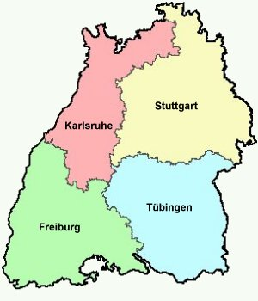
The deliberative components of the Climate Protection Plan
Ministry
Stakeholder
Citizen Forums
UM-6
Electricity
Online-Participation
UM-6
Private Consumption
UM-6, MFW
Industrial Applications
UM-6, MFW
Heat Production
MVI
Mobility
UM-2, MFW, IM, MVI
Public Sector
MLR
Agriculture and Food

Slide 14
Results
Overall, 110 recommendations for climate protection
Interaction between science (goal-oriented), stakeholders (Round Tables), randomly selected citizens, and virtual volunteers
Integration board released: 46 consensual recommendation, 28 partly supported recommendations (advocated by some and tolerated by the others), 12 contested and 25 highly contested recommendations
Validation by expert group with respect to effectiveness and efficiency
State Government released protection plan including most of the recommendations

Slide 15
Case Study 2
The German National Citizen Assembly 2022

Slide 16
Division in analytic and deliberative component
Characteristics of analytic component
Expert Assessment on the effects of different policies and measures
Establishment of a scientific committee to monitor the process and to provide analytic input
Establishment of a core groups of scientists to assist citizens in making evidence-based judgements
Characteristics of deliberative component
Based on a random selection of 168 citizens of Germany (corrected for age, education and region)
Four major topics: mobility, heating system, consumption and food(nutrition
Due to Corona: online over a period of six weeks

Slide 17
Process of Deliberation
Plenary sessions
Input by expert(s)
Question and Answers period
Small groups that were facilitated by professional moderators
Small groups without moderation
Results were reported to plenary and documented
Evaluation sessions
Policies and measures were discussed with respect to advantages and disadvantages
Experts assessed the effectiveness of each suggested policy and measure
Small groups made suggestions for final discussion
In the end, vote of all citizens (threshold 75% approval)

Slide 18
Results of Deliberation
Preferences
Clear decision (98%) to keep the Paris agreement
Phase-out of coal before 2035
Exchange of home heating/cooling system to accommodate green energy sources
More emphasis on public transportation and bicycle routes
Conflicts
Additional costs should be taken up by tax-money
Rich people should pay more for the transformations
Preference for economic incentives, subsidies and governmental role models, but not prohibitions

Slide 19
Implementation of Recommendations
Resonance
Government and parliament felt supported
Most stakeholder groups endorsed the recommendations
But many skeptical views about acceptance in the broader population
Mixed media evaluation (positive and negative)
Impacts
Strong emphasis on justice and fairness (but programs do not convince the skeptical public)
Law for exchanging heating systems failed due to public protest
Polarization with respect to green energy plans increased over the last two years

Slide 20
Case Study 3
EU Real-Deal Project

Slide 21
1st Main Question
Potential solution: analytic-deliberative discourse (US Academies 2008)
input by scientists
Deliberative balancing of options by democratic bodies and/or participatory formats
b) Operationalization in REAL DEAL:
Delphi-Workshops with experts and stakeholders
Round Tables with organized stakeholders with input from Group-Delphi
Combination of Group Delphi with Citizen Assemblies
How can we overcome and resolve the potential conflict between respecting the planetary boundaries for reaching a sustainable future and preserving openness and democratic sovereignty in our governance institutions and processes?

Slide 22
2nd Main Question
a) Potential solution: combination of focus groups and citizen assemblies
First component: citizen assemblies
Second component: Focus groups with marginalized groups
Integration: Feeding of focus group results into the citizen assemblies
b)Operationalization in REAL DEAL:
Focus groups with selected marginalized groups
Feeding the results of focus groups into the citizen assemblies
How can we assure that representatives of marginalized or disadvantaged groups of society are an integral part of participatory processes and how can a fair and adequate integration of different and sometimes conflicting positions be accomplished?

Slide 23
3rd Main Question
Potential solution: vertical integration of participatory formats
Organization of participatory formats on each vertical governance level Integration:
Organization of integration boards
Operationalization in REAL DEAL:
Not empirically tested
Integration of different participatory formats have been partly simulated in a European Group Delphi and the European Semester Program
What is the appropriate vertical governance level (community, region, province, country, EU, UN) for what kind of policy issues and measure and how can outcomes of different vertical governance levels be integrated for a common EU policy process?

Slide 24
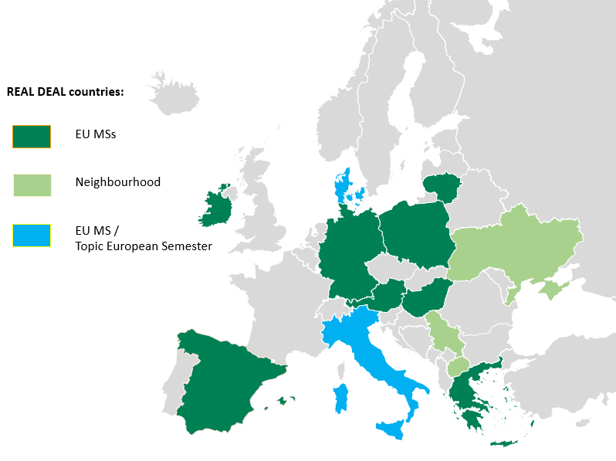
REAL DEAL Pilots
REAL DEAL tested different formats in 11 countries, 2 on the EU semester process and 3 at EU level
EU level

Slide 25
REAL DEAL Formats and Test Results
Combination of Delphi and Citizen Assemblies (Hybrid)
Goal: Specifically targeted to test the interaction between scientists, stakeholders and members of the general public
Countries: Germany, Greece, Hungary, and North Macedonia
Topics: Energy, Food, Financing
Products: Experts provide state-of-the-art knowledge and range of legitimate judgments
Results
Delphi: consent on dissent(s): exclusion of illusions, absurd claims and misperceptions (true range of knowledge camps)
Citizen Assembly: positive appreciation of Delphi results, little resistance, but the results need translation into convincing narratives and visual images
Delphi results improved understanding of citizens and had a positive effect on motivation to act

Slide 26
Conclusions
Focus on three major scientific concepts
Curiosity driven, classic concept
Goal oriented, strategic and instrumental concept
Process-oriented, catalytic concept
Transdisciplinary approach includes methods and instruments from all three concepts; classic, strategic and catalytic
The most challenging part is the catalytic process:
Combination of expertise, interests and values
Design of formats for a successful integration
Convincing answers to inclusion, closure and transfer
The empirical case studies show that analytic-deliberative processes have the potential to improve understanding of complex relationships and enhance motivation to act

Slide 27
Final Note Deliberative processes for involving stakeholders and the general public are instruments of art and science: They require a solid theoretical knowledge, a personal propensity to engage in group interactions, and lots of practical experience

Slide 28
Many thanks
Contact: orenn1951@gmail.com

Slide 29
Extra Slides for Discussion

Slide 30
Distinction:
Disciplinary
Multi-disciplinary
Inter-disciplinary
Trans-disciplinary
Multi-disciplinarity combines different disciplines in an additive way, Inter-disciplinarity provides a cooperative approach to developing a joint research design
A transdisciplinary approach integrates (a) theory and practice (b) includes different types of knowledge and (c) provides targeted information to users
Notes:
Input BF

Slide 31
Features of Transdisciplinary Sciences I
Integration of theory and practical application
Scientific and systematic analysis
Solution-oriented practicable orientation
Prepared for implementation
Integration of different types of knowledge
Academic, systematic insights
Experiential knowledge (learned by actions)
Tacit knowledge (indigenous, local)
Intuition

Slide 32
Features of Transdisciplinary Sciences II
Participatory Research Design
Experts and knowledgeable persons
Politicians and administrators
Stakeholder (corporations, economy, civil society)
Ordinary citizens (random selection)
Design for multi-actor dissemination
Based on needs and interests of participating actors
Framed in a language that is well understood by each actor
Linked to direct implementation

Slide 33
Two questions for co-production of knowledge
Inclusion
Who: stakeholders, scientists, public(s)
What: options, policies, scenarios, frames, preferences
Scope: multi-level governance (vertical and horizontal)
Scale: space, time period, future generations
Closure
What counts: acceptable evidence
What is more convincing: competition of arguments
What option is selected: decision making rule (consensus, compromise, voting)

Slide 34
Who should be involved?
Vertical governance
Political bodies ranging from communities via regions, states, countries, to international level
Other agencies or ministries
Subordinate administrations
Horizontal governance
Stakeholders (organized groups with an interest in the issue including private sector and NGOs)
Experts (groups with specific knowledge)
Multipliers (Media, opinion leaders)
Affected and general public

Slide 35
Candidates for Participatory Models
Organized stakeholders
Hearing
Round Tables (Forum, Dialogue Processes)
Negotiated Rulemaking
Mediation and Alternate Conflict Resolution
General public
Ombudsperson
Public Hearings
Citizen Advisory Committees
Citizen Forum, Planning Cells, Citizen Juries
Consensus Conferences (Danish Model)
Notes:
Models of involvement

