Slide 1
Sustainability for European Synchrotron Light Sources
Francis Pérez
25/09/2024
15’ + 5’

Slide 2
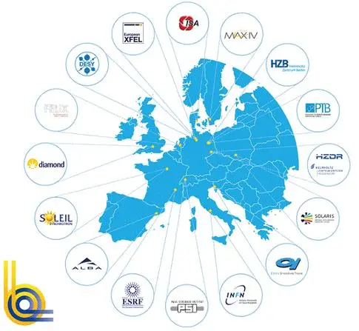
European Synchrotron Light Sources
Thanks to all that have shared info with me:
Emanuel Karantzoulis
Jorgen S. Nielsen
Richard Walker
Rainer Wazenberg
Harald Reichert
Andreas Jankowiak
Pedro Tavares
Jean-Luc Revol

Slide 3

European Synchrotron Light Sources
https://leaps-initiative.eu/
24.000 direct users and
a wider network
of 35.000 researchers

Slide 4
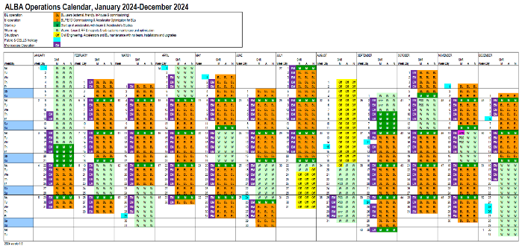
Synchrotron Light Sources
How we operate?
Normally 24/24h - 7/7d
2000 – 7000 hours / year
On several runs along the year:
Synchrotron users require stability, since experiments can take hours/days.
Accelerators and Beamline components shall be thermalized after each start-up.

Slide 5
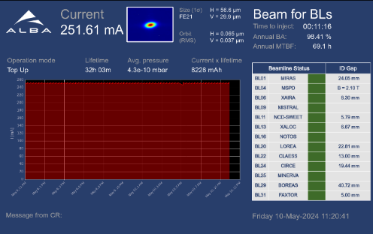
Synchrotron Light Sources
How we operate?
We operate on “top-up” for stability.
Injector is operational
or
warm (in stand-by).
→ Normally, we over-dimension the systems to ensure reliability and stability.

Slide 6
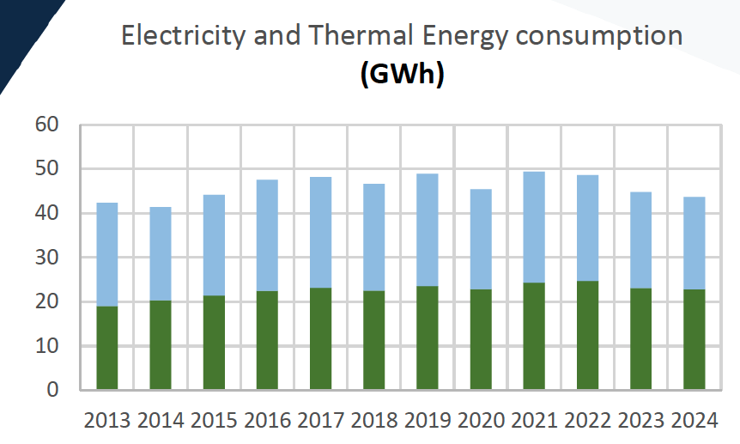

Synchrotron Light Sources
How much we consume?
from
few GWh/y small labs
up to
240 GWh/y large ones
with more than one accelerator
∼50% thermal
∼50% electricity
Medium ligth sources,
with single accelerator like
ALBA around 50 GWh/y

Slide 7
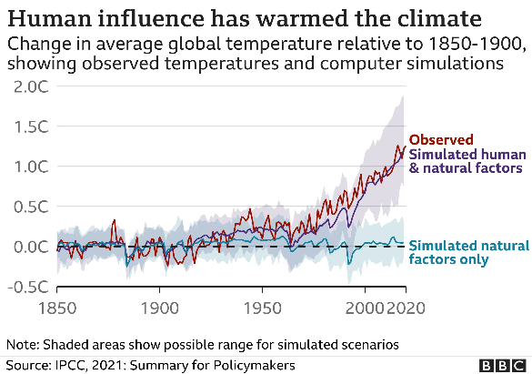
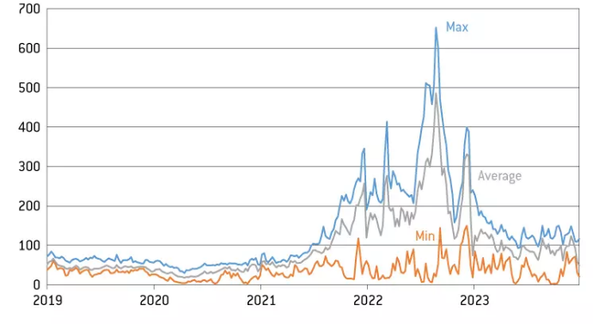
Synchrotron Light Sources
Sustainability motivation
Motivation
European wholesale electricity prices, €/MWh
https://www.bbc.com/news/science-environment-58130705
https://www.bruegel.org/policy-brief/europes-under-radar-industrial-policy-intervention-electricity-pricing

Slide 8
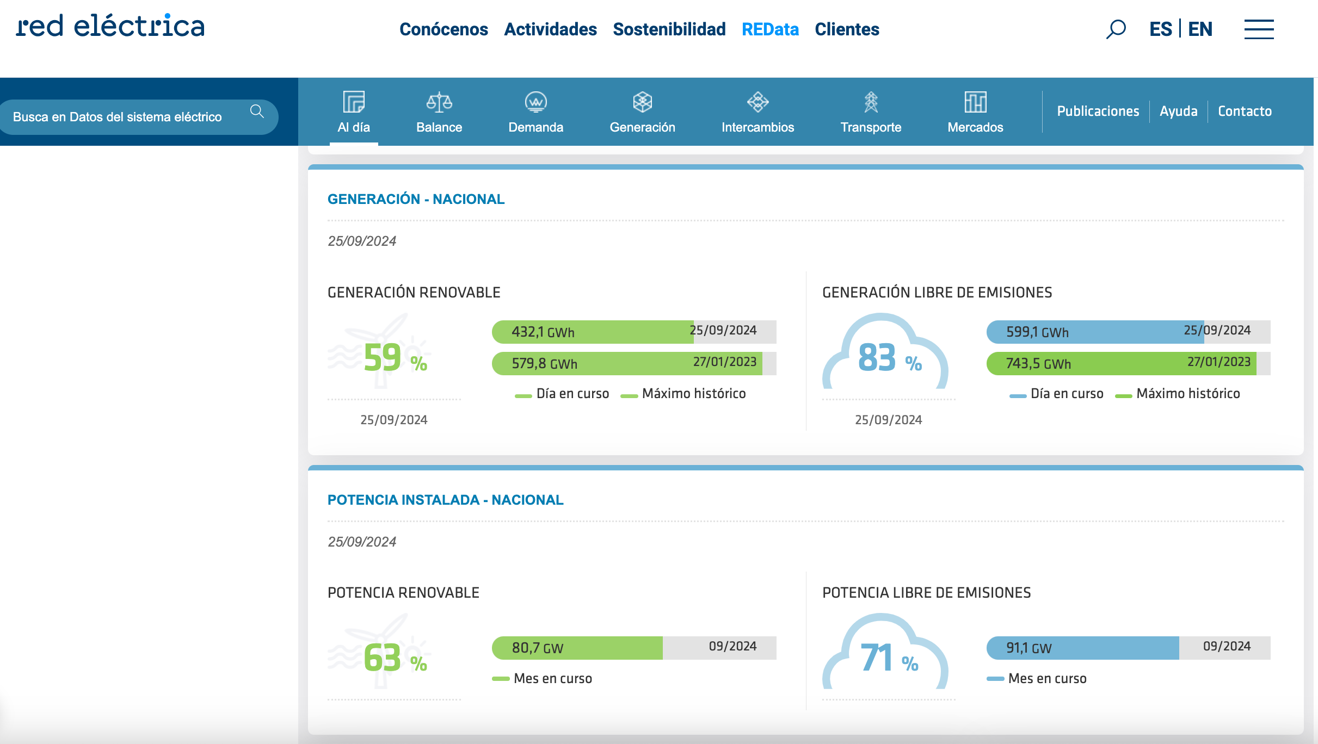
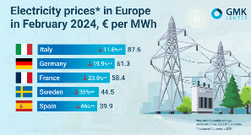
Synchrotron Light Sources
Sustainability motivation
Motivation
European wholesale electricity prices, €/MWh
https://www.ree.es/es/datos/aldia
x2
https://gmk.center/en/posts/electricity-prices-in-europe-fell-significantly-in-february/
Spanish CO2 free production

Slide 9
What we do about sustainability
Components
Permanent Magnets
RF system
…
Operation
Operational hours
Remote operation
Standby optimization
…
Infrastructure
Solar plants
Cooling/heat system
He recovery
…
Others
Led ligthing
Trips constraints
…

Slide 10

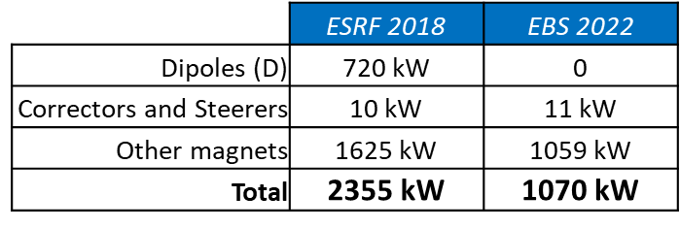
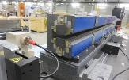

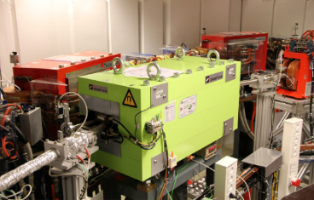
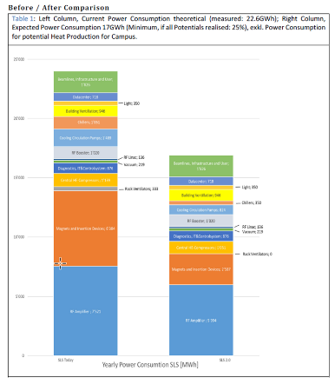

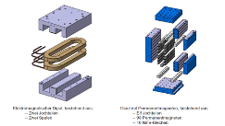
Permanent magnets
Since 2013 – ISA - Aarhus
30° “green magnet” with permanent in transfer line between ASTRID and ASTRID2. This permanent magnet has now been in operation for ~10 years, absolutely no problems with it, and no change on magnetization.
Since 2022 – EBS – ESRF
Longitudinal dipoles,
without buil-in correction
: 2,3
Jean-Luc Revol, LER 2024
From 2025 – SLS 2.0 – PSI
Dipoles & reverse bend quadrupoles
: 2,5
Next projects with PM: Petra IV, SOLEIL 2.0, ALBA II …
David Reinhard, ESSRI 2022

Slide 11
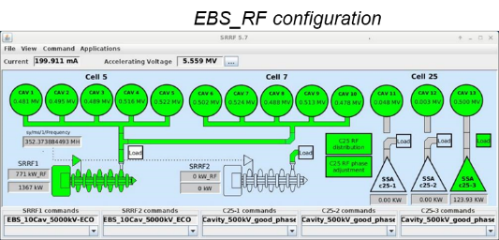


RF Operation
Optimization of the RF transmitter operation,
maintaining the total RF voltage: 11% power reduction
6.0 MV → 5.5 MV
Running at a
lower RF voltage
19 MV → 16 MV
Petra III
EBS
And many others

Slide 12
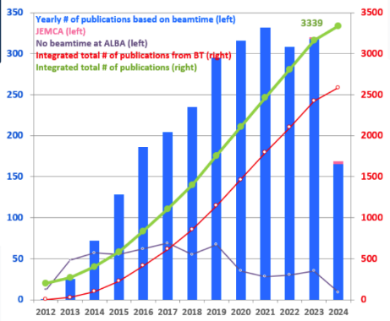

Operation
Some labs had been forced (2022-23) by budgetary or political reasons to reduce the operational hours, but this is not a sustainable solution, just economics, since not operating means not science performed.
The goal should be to operate for users as usual but in a more energy efficiency way.
Some actions:
- Switch off subsystems when not really needed:
Relax air conditioning on week-ends and shutdowns.
Switch off water pumps on stand-by periods.
Optimize injector operation.
- Reduce trips:
Implement remote users operation.
Implementation of remote access to control room.
Implement videoconference tools.
At DESY the trips have been reduced by 1/3.
Publications
COVID
COVID
And many others

Slide 13

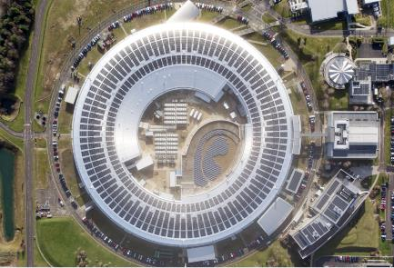
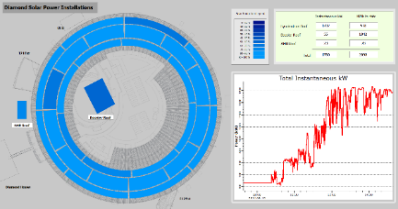

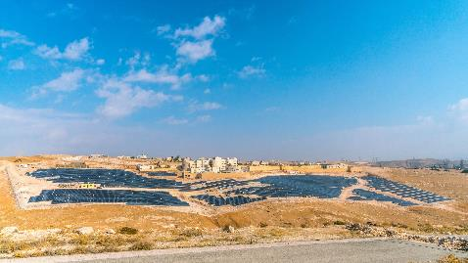
Solar Panels
DIAMOND
New Storage Ring Building roof photovoltaic power plant now fully operational
  - Phase 1: 1 MW peak (June 2023)
  - Phase 2: 1.7 MW peak (June 2024)
Expected total output ~ 2.3 GWh/y, ~ 5% of total annual consumption.
At current cost, £540k/year savings
SESAME, Jordan
1.8MW
≈100% energy for operation produced by a EU financed
solar plant
ALBA, SLS and others will follow.

Slide 14

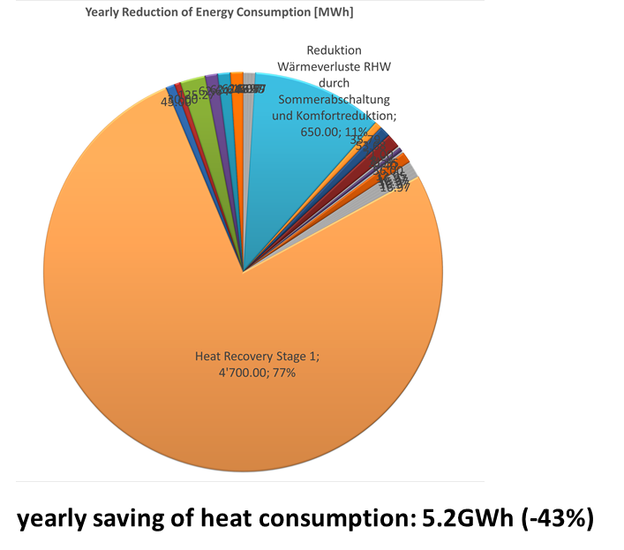
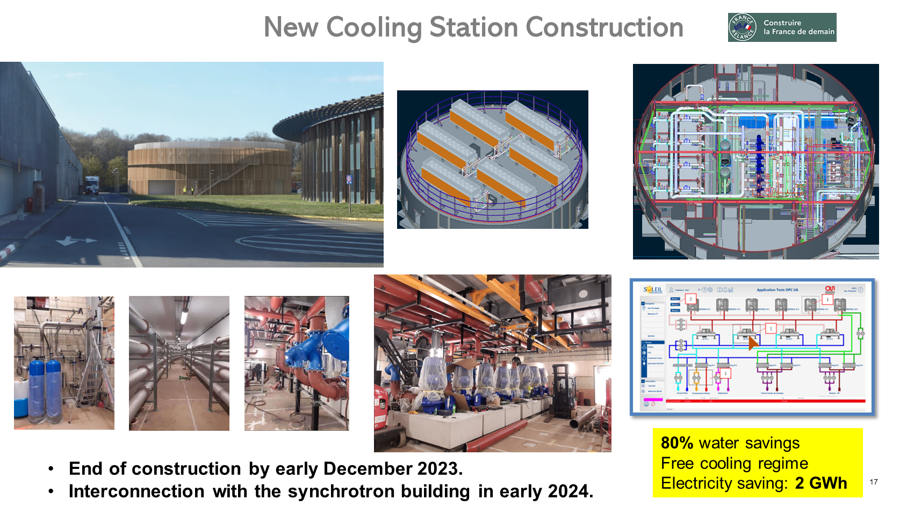
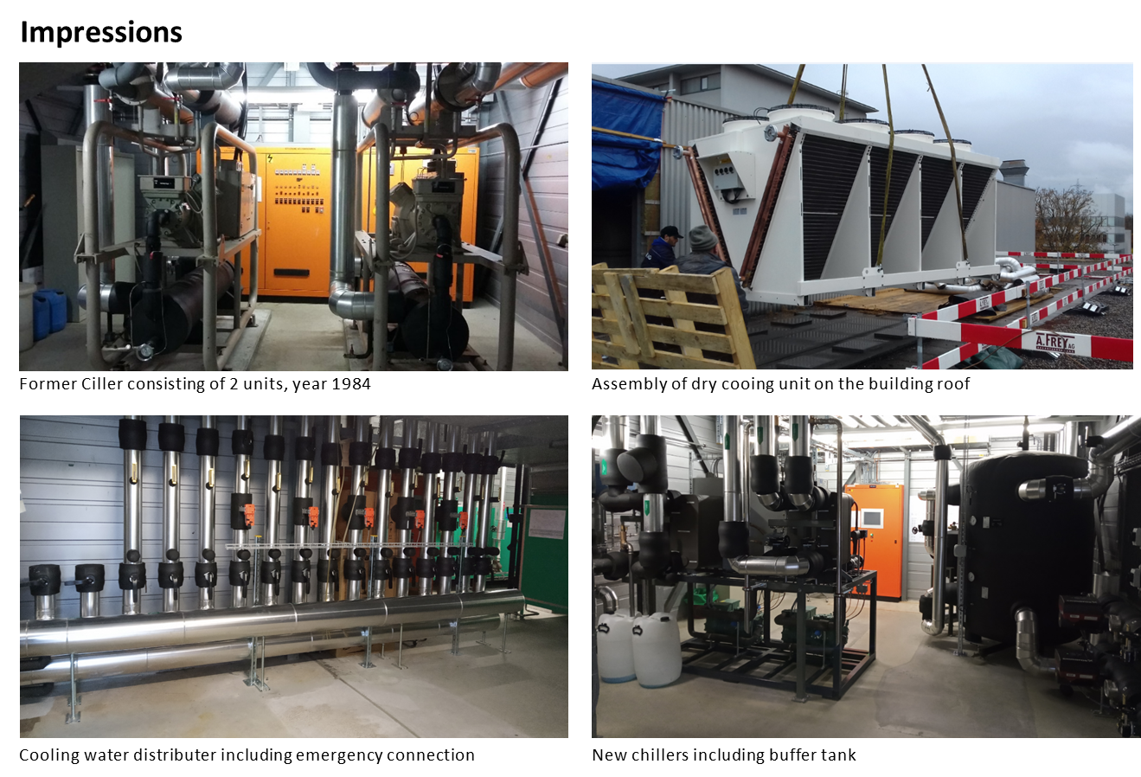
Cooling / heat system
J.L. Revol, ESLS Workshop 2023
Investments are required to become more energy efficient!
David Reinhard, ESSRI 2022

Slide 15
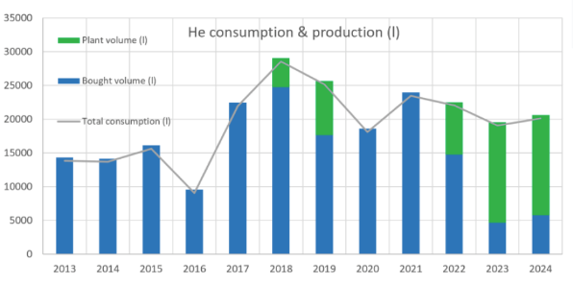
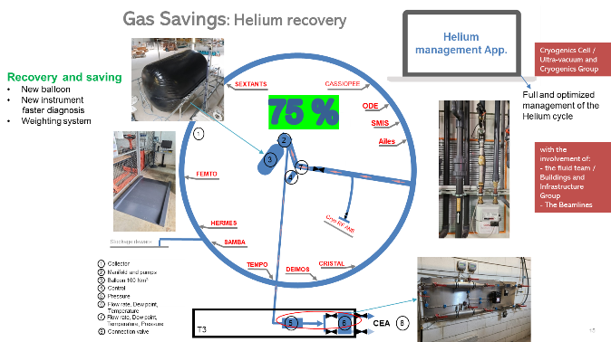
He recovery plant
75%
recovered
ALBA
SOLEIL
DIAMOND
  - total usage ~ 25,000 LHe per year
  - recovery systems in place for 6 beamlines.
  - fraction of use from recovered gas ~ 50% maximum so far, but aiming for 80 %.

Slide 16
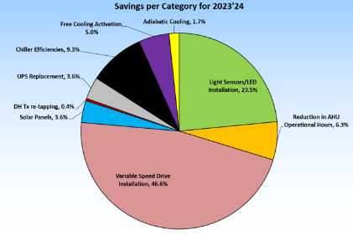
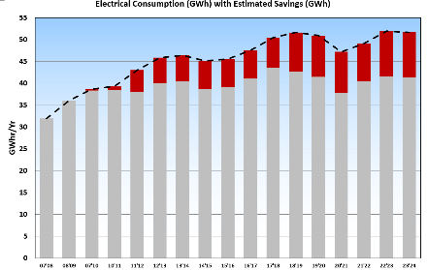
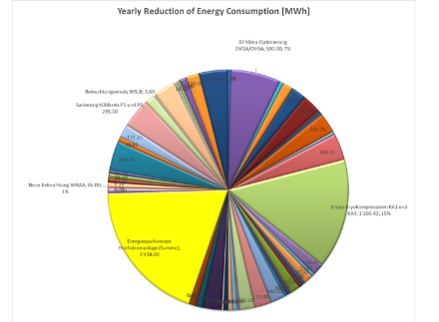
Other actions
DIAMOND
20% yearly
savings
PSI
AHU reduction operational hours.
Equipment replacement.
Ligth sensors.
LEDs installation.
Heat recovery.
Stand-by operation.
Energy monitoring.
…
6% yearly
savings
from 143 GWh
(7,4GWh)
David Reinhard
ESSRI 2022

Slide 17
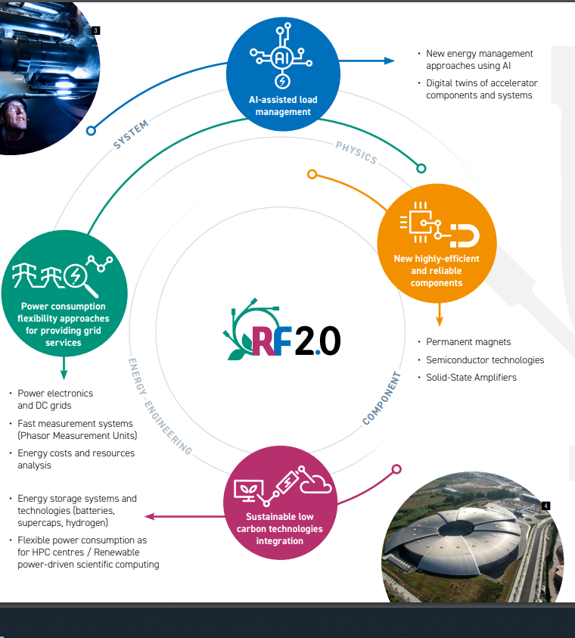
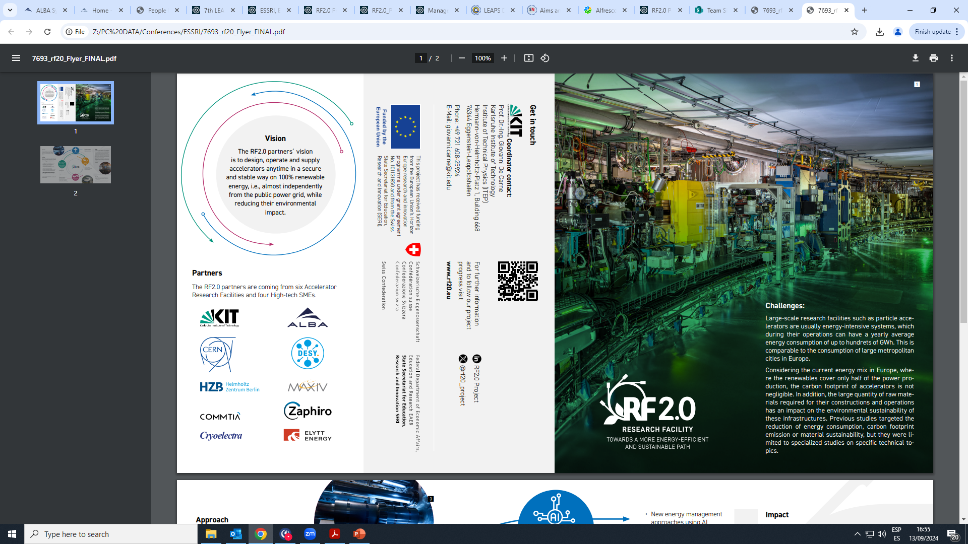

Research Facilities 2.0
EU project

Slide 18
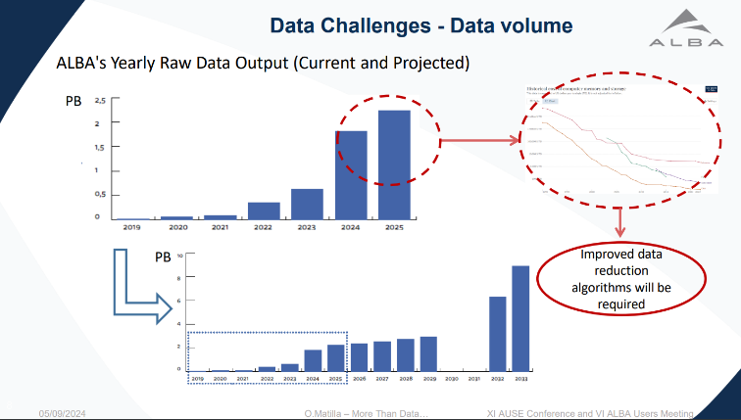
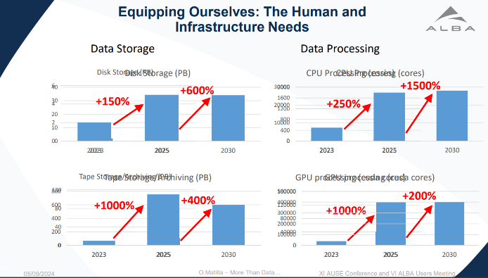
Final remark:
Experimental data
Oscar Matilla, ALBA User’s meeting 2024
Huge increase of experimental data!

Slide 19
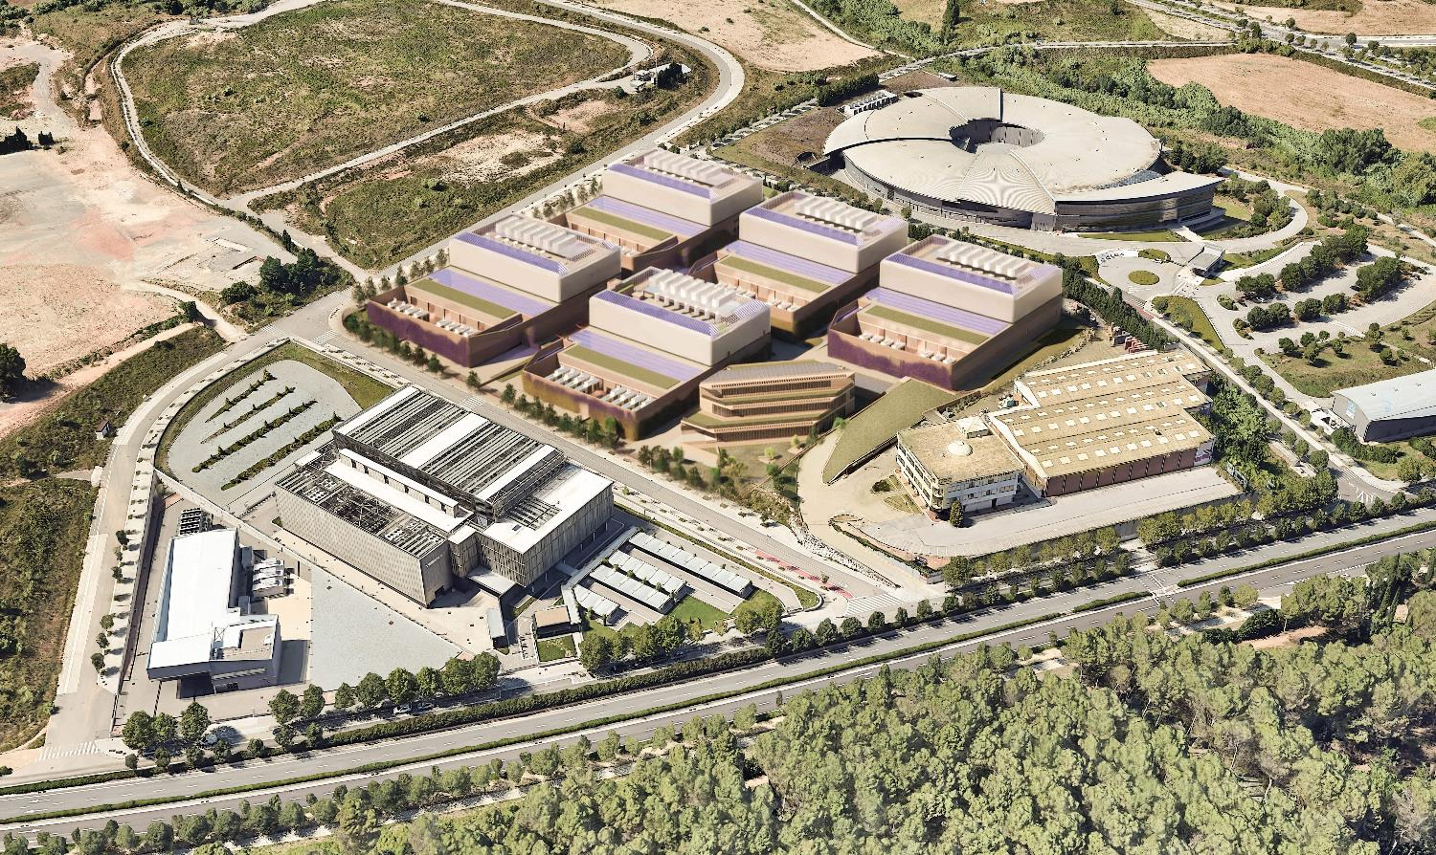
Final remark
…around 2026
Synchrotron
4 MW
Data Center
60 MW
Maqueta del data de center d'AQ Compute. Imatge: AQ Compute
https://www.elnacional.cat/oneconomia/ca/empreses/aq-duplica-seva-inversio-en-centre-dades-cerdanyola-fins-600-milions_1243164_102.html

Slide 20
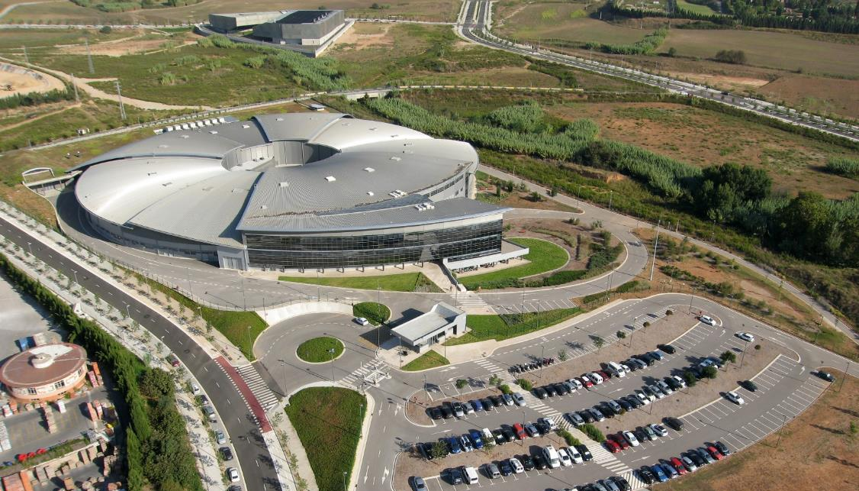
THANKS! for your attention

