Slide 1
Development of a new large gas cell with electric field guidance for IGISOL (Task 1.1.2.)
Heikki Penttilä [& IGISOL group]
University of Jyväskylä, Accelerator laboratory

Slide 2
Development of a new large gas cell with electric field guidance for IGISOL
Description of the work:
The JYU will improve the quality of the neutron induced fission product collection at IGISOL by the design of a new gas cell with electric field guidance. This new device will allow better efficiency which is expected to be of the order of 100 compared to what exist today. This improvement will benefit greatly for the fission products studies.
What has been done:
The capability of the means of faster ion extraction studied utilising simulations
The site specific constraint at IGISOL (space, radiation, high voltage) surveyed
Suitable means for IGISOL adopted
Detailed technical drawings will be produced
D.1.2 “Report on the design of the large gas cell for IGISOL”, due M24 – delayed, delivered 1.11.2023, M51
Gao, Z., et al., (2023). "New design and simulation of the ion guide for neutron-induced fission products at the IGISOL facility", proceedings of the 15th International Conference on Nuclear Data for Science and Technology (ND2022), 21-29 July 2022, online. EPJ Web of Conferences, 284, Article ID 04011.

Slide 3
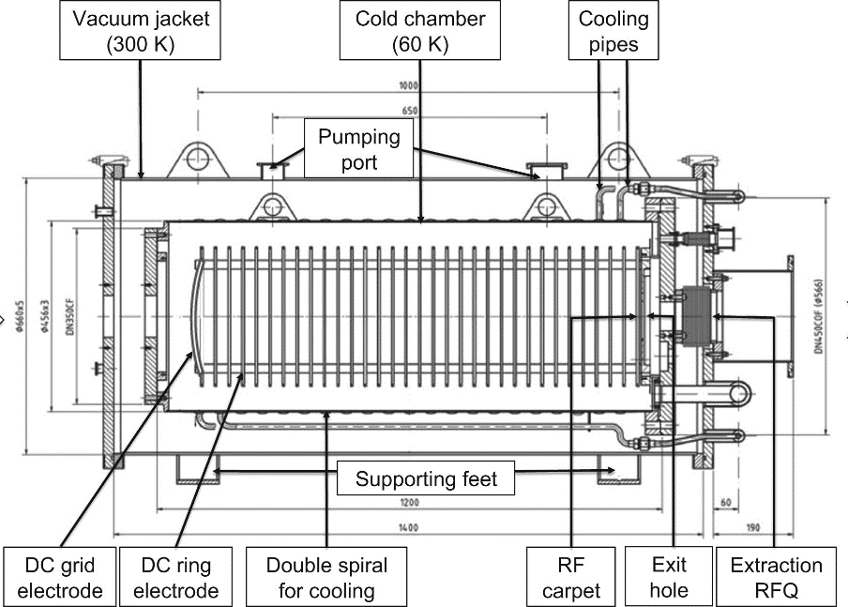
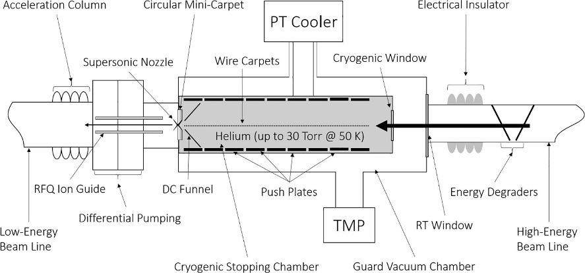
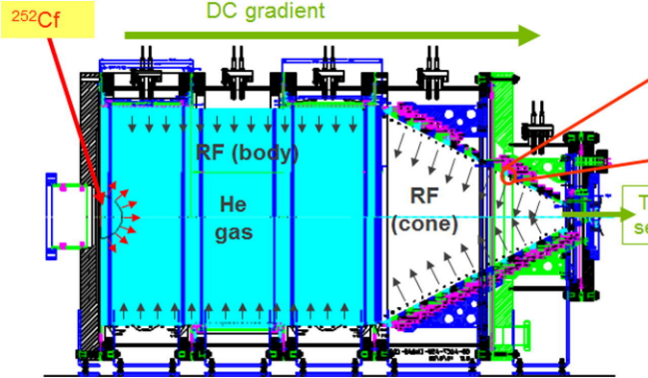
Development of a new large gas cell with electric field guidance for IGISOL
In the ion guide technique, reaction products are stopped in helium as ions and transported as ions to further analysis.
Target
At the IGISOL the ions are transported with the gas flow alone. This limits the size of gas cell: bigger gas cell is not better, since the ion survival time is limited.
Stopping efficiency for the fission products in the current fission ion guide is ≈ 0.75 %, and their mean extraction time is ≈ 100 ms.
Needed:
higher stopping efficiency
faster extraction.
SPIG electrode
Extractor
Beam
Possible solution: large stopping gas cell with electric field guidance
GSI cryogenic gas cell
ANL CARIBU
ACGS (Advanced Cryogenic Gas Stopper) at NSCL
NIMA 770 (2015) 87
NIMB 376, (2016) 246
NIMB 463 (2020) 378

Slide 4
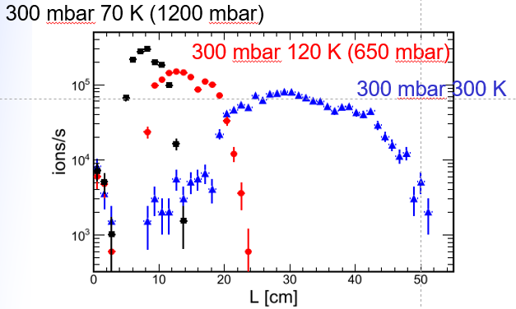
Development of a new large gas cell with electric field guidance for IGISOL
Cryogenity? …eventually, no.
Benefit:
higher gas density, so better stopping efficiency
Freesing of impurities
Operation of RF carpets easier in lower pressure
Challenge:
Technically complicated, space consuming
Combining with neutron production target (heat and cryo dont mix well)
Denser space charge
It is not only stopping, extraction matters as well:
Ion mobility $∝T,$ while density $∝1/T$ so extraction time
NIMB 397, (2016) 1

Slide 5
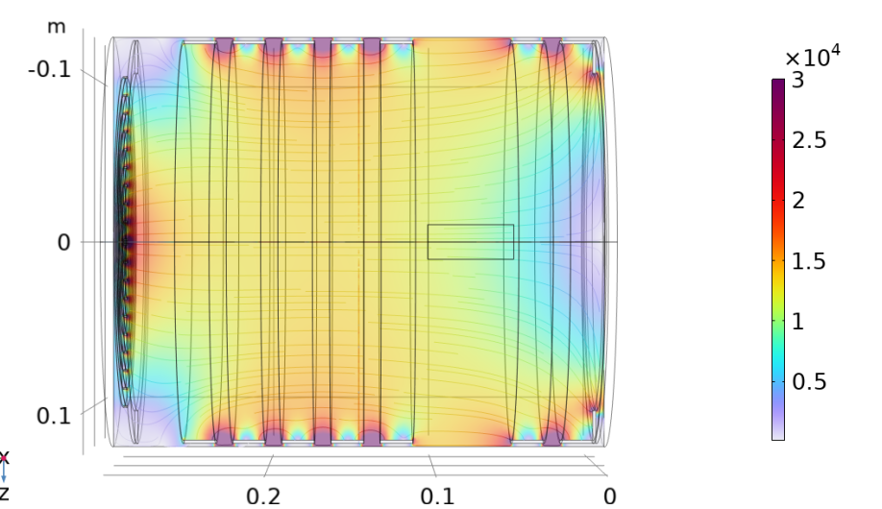
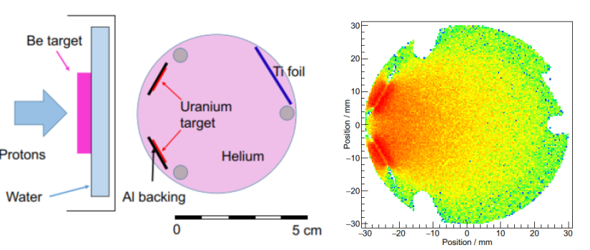
Development of a new large gas cell with electric field guidance for IGISOL
Electric field simulations:
25 by 30-40 cm cylinder ring electrodes to generate DC field;
RF-carpet on the end of the cylinder; RF-field about 6 MHz; 10 concentrig rings to enhance the electric field towards the exit nozzle
here n-induced fission similar as performed with modified current fission ion guide (see below).
EPJ Web of Conferences 284 (2023) 04011

Slide 6
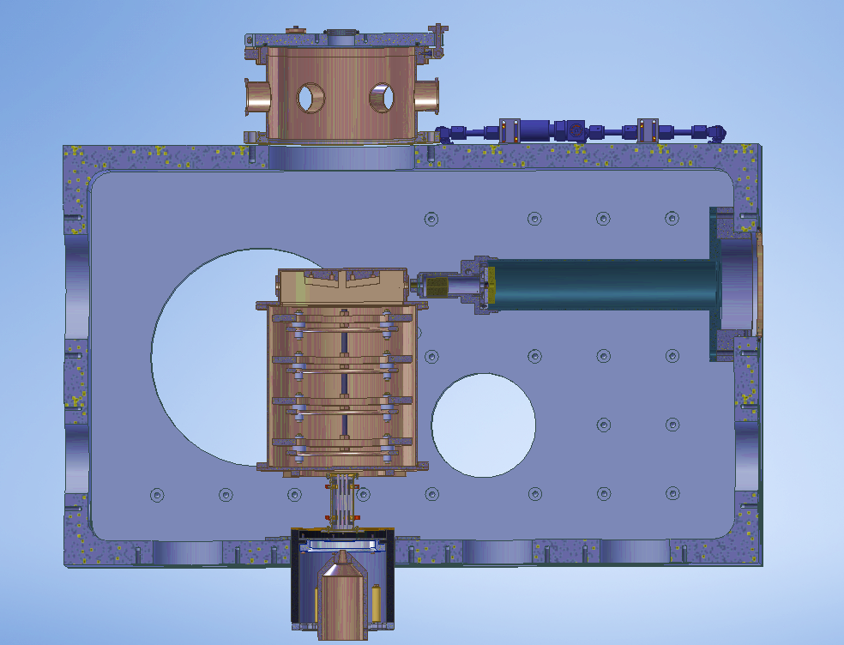
Development of a new large gas cell with electric field guidance for IGISOL
Proton induced fission
CURRENT GAS CELL
NEW GAS CELL
SPIG
SPIG
EXTRACTOR
EXTRACTOR

Slide 7
Development of a new large gas cell with electric field guidance for IGISOL
BEAM

Slide 8
Development of a new large gas cell with electric field guidance for IGISOL
What has been done:
The capability of the means of faster ion extraction studied utilising simulations
The site specific constraint at IGISOL (space, radiation, high voltage) surveyed
Suitable means for IGISOL adopted
Detailed technical drawings will be produced
D.1.2 “Report on the design of the large gas cell for IGISOL”, due M24 – delayed, delivered 1.11.2023, M51
Gao, Z., et al., (2023). "New design and simulation of the ion guide for neutron-induced fission products at the IGISOL facility", proceedings of the 15th International Conference on Nuclear Data for Science and Technology (ND2022), 21-29 July 2022, online. EPJ Web of Conferences, 284, Article ID 04011.

