Slide 1




Pb and Bi transmission measurements at GELINA
P. Romojaro, C. Paradela, S. Panizo, G. de la Fuente et al.
SANDA Final Workshop. General Meeting – 3-5 July 2024 | Ciemat (Spain)

Slide 2
Task 2.3
“JRC will perform high accuracy measurements of the branching ratio for ²⁰⁹Bi, ²⁰⁸Pb(n,tot)…”
Response to specific requests based on the output of sensitivity studies of k_{eff} performed in CHANDA
SCK CEN contribution in kind (Bismuth_MYRRHA & Lead-GELINA)
  MYRRHA
  SMR-LFR

Slide 3
Bi branching ratio measurement
Performed @ J-PARC MLF facility in 2019
JAEA provided raw data to SCK CEN
  Needed support for data analysis
  Visit from S. Endo postponed until 2023 due to COVID-19
In the meantime:
  2020-2021 Bi transmission measurements @ GELINA
  2022-2023 Bi capture measurements @ GELINA
  2024 Collaboration with IFIC-Valencia (ongoing)

Slide 4
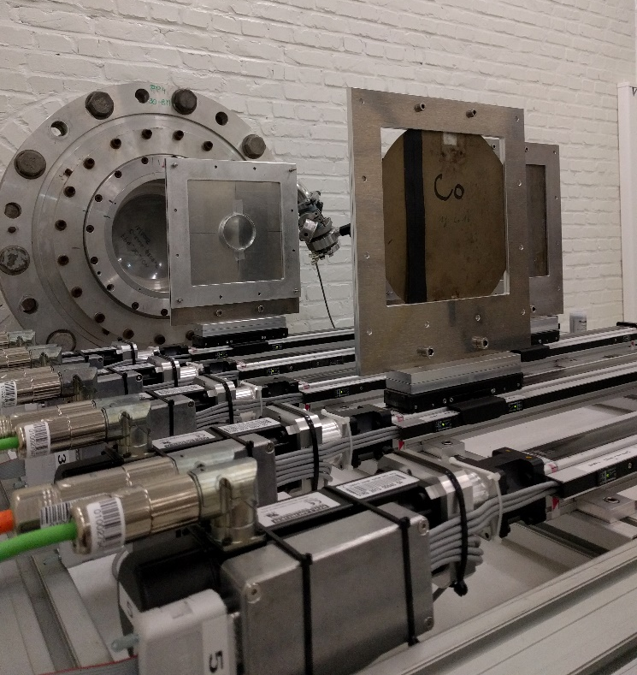
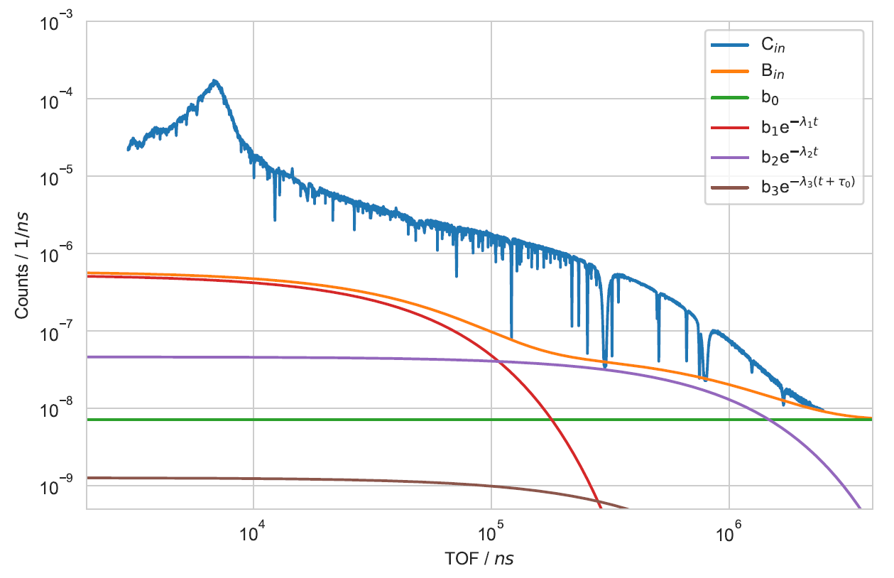
Bi transmission measurements
Transmission measurements carried out at FP4 of GELINA (detector at 47 m)
Two Bi discs of 1.255 mm (0.0035 at/b) and 4 mm (0.011 at/b) thickness
Detection efficiency cancels
Incoming neutron flux cancels
No calibration or reference to standard required
Absolute measurement

Slide 5
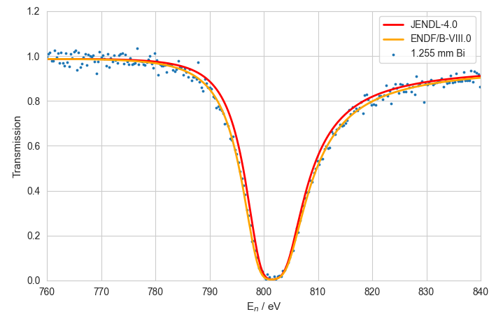
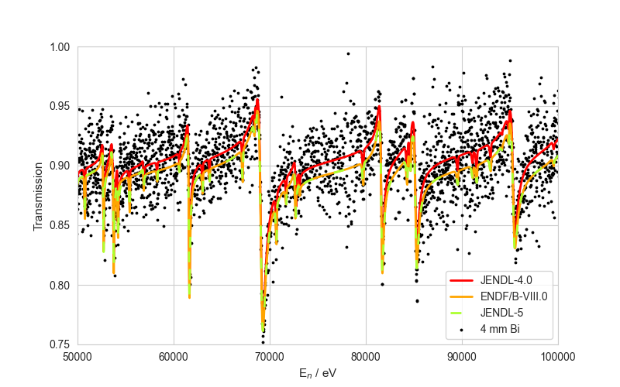
Bi transmission measurements
High-resolution results up to 150 keV
Validation of ENDF/B-VIII.0 (Mughabghab) RP for 1st resonance
Results published in a JRC report and submitted to EXFOR
https://publications.jrc.ec.europa.eu/repository/handle/JRC136373

Slide 6
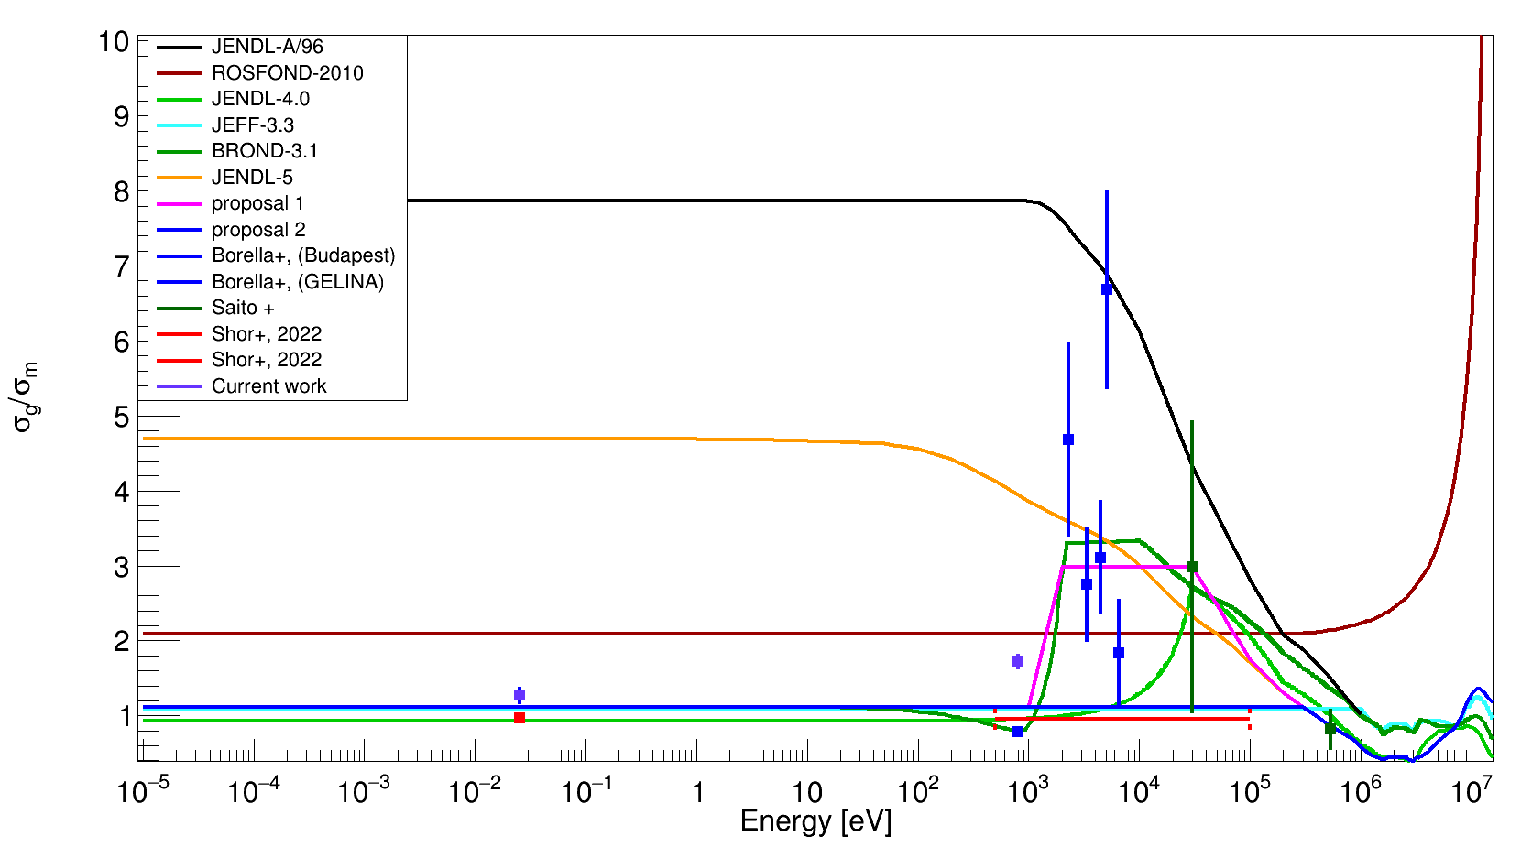
Bi branching ratio preliminary
Analysis of J-PARC data by IFIC-Valencia
Planned contribution to JEFF-4
Notes:
Neutron scattering contribution at the 1st resonance? Multiple scattering correction+neutron capture in detector?

Slide 7
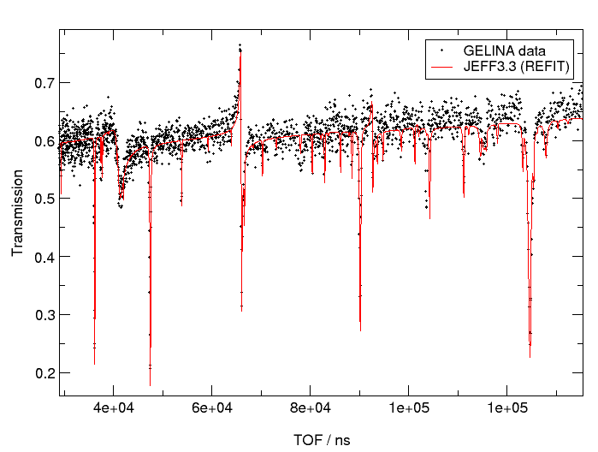
Pb transmission measurements
2022-2023 ^{nat}Pb and ²⁰⁶Pb transmission measurements @ GELINA
²⁰⁶Pb data analysis completed by CIEMAT
^{nat}Pb data analysis ongoing
Lack of suitable samples for ²⁰⁸Pb transmission measurements

Slide 8
Deliverables and associated datasets
D2.5 Report on the measurements of the branching ratio for ²⁰⁹Bi, ²⁰⁸Pb(n,tot) and ²³⁸U(n,inel) cross sections at GELINA
  Completed in April 2024
Bi transmission data submitted to EXFOR
  Not published yet, but can be included as part of the deliverable
²⁰⁶Pb transmission dataset in preparation to be attached to D2.5
  Before end of July 2024

Slide 9
Acknowledgements
This work has received funding from the Horizon 2020 Euratom research and training programme under grant agreement No 847552 (SANDA)

Slide 10
Copyright © SCK CEN
PLEASE NOTE!
This presentation contains data, information and formats for dedicated use only and may not be communicated, copied, reproduced, distributed or cited without the explicit written permission of SCK CEN.
If this explicit written permission has been obtained, please reference the author, followed by ‘by courtesy of SCK CEN’.
Any infringement to this rule is illegal and entitles to claim damages from the infringer, without prejudice to any other right in case of granting a patent or registration in the field of intellectual property.
SCK CEN
Belgian Nuclear Research Centre
Foundation of Public Utility
Registered Office: Avenue Herrmann-Debrouxlaan 40 – BE-1160 BRUSSELS
Operational Office: Boeretang 200 – BE-2400 MOL

