Slide 1
SANDA D5.1: Sensitivity analysis methods
Vicente Bécares Palacios
vicente.becares@ciemat.es
Unidad de Innovación Nuclear
Departamento de Fisión Nuclear
CIEMAT
Avda. Complutense 40, 28040 Madrid – España

Slide 2
SANDA D5.1: Introduction
Subtask 5.1.1: Impact studies and sensitivity analyses:
“Methods of sensitivity analysis: CIEMAT, LSPC, UPM and CEA/DEN will compare their methods of sensitivity studies”.
Deliverable D5.1: Report on sensitivity analysis methods (CIEMAT, UPM, IRSN); M24
Authors: V. Bécares (CIEMAT), S. Panizo (CIEMAT), N. Leclaire (IRSN), A. Jiménez-Carrascosa (UPM), N. García-Herranz (UPM), P. Romojaro (SCK CEN), F. Álvarez-Velarde (CIEMAT), O. Cabellos (UPM)
Cross-comparison of S/U analysis methodologies:
UPM: SCALE TSUNAMI-3D
CIEMAT: MCNP KSEN + SUMMON
IRSN + CIEMAT: MORET + SUMMON
Issued on 14/10/2021.
2019 |  |  |  | 2020 |  |  |  |  |  |  |  |  |  |  |  | 2021 |  |  |  |  |  |  |  |  |  |  |  | 2022 |  |  |  |  |  |  |  |  |  |  |  | 2023
S | O | N | D | E | F | M | A | M | J | J | A | S | O | N | D | E | F | M | A | M | J | J | A | S | O | N | D | E | F | M | A | M | J | J | A | S | O | N | D | E | F | M | A | M | J | J | A
1 | 2 | 3 | 4 | 5 | 6 | 7 | 8 | 9 | 10 | 11 | 12 | 13 | 14 | 15 | 16 | 17 | 18 | 19 | 20 | 21 | 22 | 23 | 24 | 25 | 26 | 27 | 28 | 29 | 30 | 31 | 32 | 33 | 34 | 35 | 36 | 37 | 38 | 39 | 40 | 41 | 42 | 43 | 44 | 45 | 46 | 47 | 48
 |  |  |  |  |  |  |  |  |  |  |  |  |  |  |  |  |  |  |  |  |  |  | D

Slide 3
SANDA D5.1: Reference system
Reference system:
ESFR RZ model at End-of-Cycle.
Developed by UPM within H2020 ESFR-SMART project.
Used by OECD-NEA WPEC/SG46.
Reference library:
JEFF-3.3 library, covariance matrices processed in 33 energy groups.
S/U analyses for:
Criticality constant k_{eff}.
Sodium void reactivity worth.
Sensitivity profiles provided.
The main objective of this work was guaranteeing the equivalence of the S/U analyses methodologies implemented with all three codes.
S. Panizo et al., Comparison of Sensitivity/Uncertainty analysis methodologies in the European Sodium Fast Reactor. 46th Annual Meeting SNE, Granada (Spain) 6-8 October 2021

Slide 4
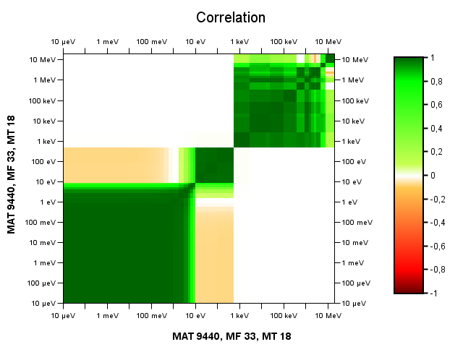
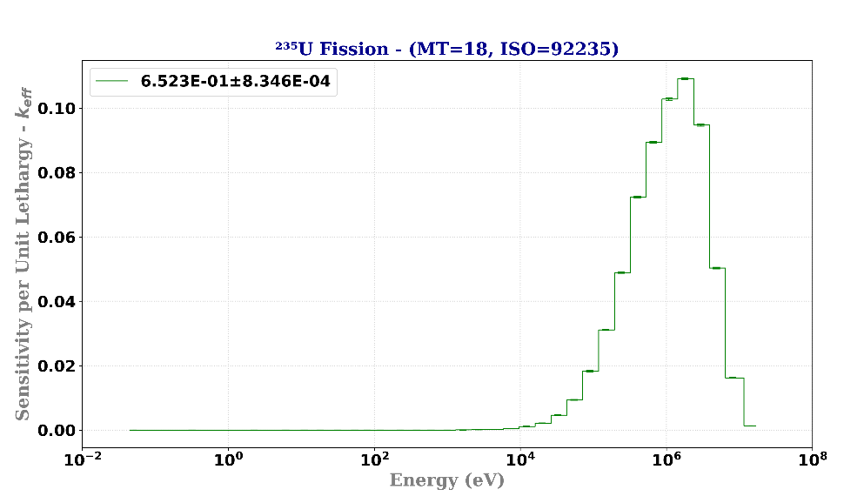
SANDA D5.1: Methodology
Uncertainty quantification (1st order approximation, “sandwich rule”)
$$Var\left(f\right)=\sum_{i}{{\left(\frac{∂f}{∂α_{i}}\right)}^{2}Var\left(α_{i}\right)}+\sum_{i,j}{\frac{∂f}{∂α_{i}}\frac{∂f}{∂α_{j}}Cov\left(α_{i},α_{j}\right)}=S_{α}V_{α}S_{α}^{T}$$
$$\sim df\left(α\right)=\frac{∂f}{∂α}dα$$
Sensitivity profiles$S_{α}$
Neutron transport codes
MORET: differential operator + adjoint-flux weighted perturbation technique
MCNP+TSUNAMI: adjoint-flux-weigthed perturbation technique
Covariance matrices $V_{α}$
Nuclear data libraries
This methodology is used by SCALE TSUNAMI-3D module and CIEMAT’s SUMMON code (coupled with sensitivity profiles from a neutron transport code)

Slide 5
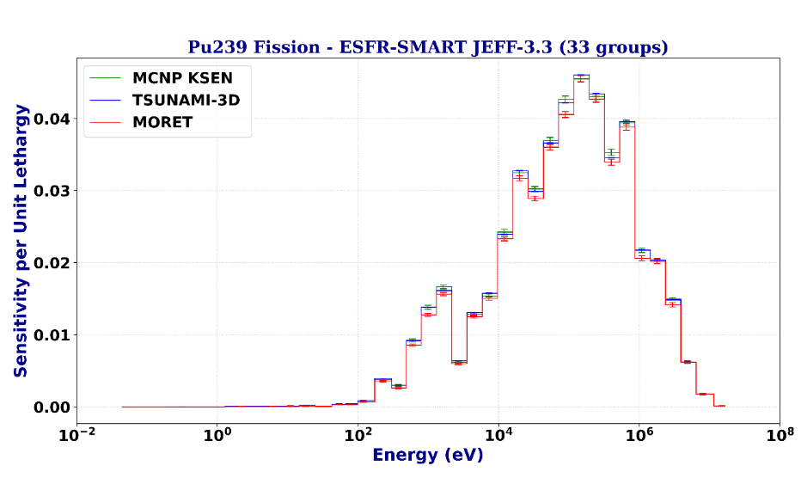
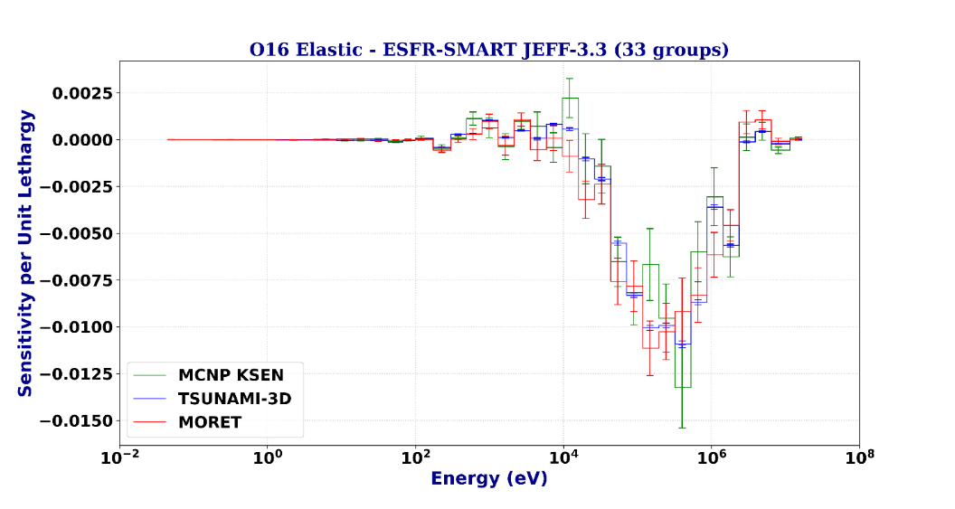
SANDA D5.1: Results: k_{eff}
k_{eff} S/U results:
MCNP and TSUNAMI-3D ISC & uncertainty results typically within ~1%.
MORET ISC & uncertainty results within ~10% (lower statistics).
Worst agreement for scattering reactions (elastic & inelastic) → slow convergence in MC calculations.
Quantity |  | Δk_{eff}/k_{eff} (%)
 |  | TSUNAMI-3D + SAMS | MCNP + SUMMON |  | MORET + SUMMON
 |  |  | Result | Ratio | Result | Ratio
²⁴⁰Pu (n,f) | ²⁴⁰Pu (n,f) | 0.582 ± 8.40E-05 | 0.577 ± 5.93E-04 | 0.992 ± 1.03E-03 | 0.572 ± 9.25E-04 | 0.983 ± 1.60E-03
²³⁸U (n,n') | ²³⁸U (n,n') | 0.476 ± 1.79E-04 | 0.464 ± 4.23E-03 | 0.975 ± 8.90E-03 | 0.449 ± 2.60E-03 | 0.944 ± 5.47E-03
²⁴⁰Pu (n,f) | ²⁴⁰Pu (n,γ) | -0.437 ± 2.02E-05 | -0.438 ± 1.09E-04 | 1.002 ± 2.53E-04 | -0.435 ± 1.60E-04 | 0.996 ± 3.69E-04
²³⁹Pu χ | ²³⁹Pu χ | 0.427 ± 4.17E-04 | 0.426 ± 1.96E-03 | 0.997 ± 4.70E-03 | --- | ---
²³⁸U (n,n’) | ²³⁸U (n,f) | -0.341 ± 5.51E-05 | -0.345 ± 9.23E-04 | 1.014 ± 2.71E-03 | -0.331 ± 5.75E-04 | 0.971 ± 1.70E-03
²³⁹Pu (n,f) | ²³⁹Pu (n,f) | 0.313 ± 1.21E-05 | 0.313 ± 2.42E-04 | 0.999 ± 7.73E-04 | 0.300 ± 1.42E-04 | 0.959 ± 4.56E-04
²³⁹Pu nubar | ²³⁹Pu nubar | 0.296 ± 3.93E-06 | 0.296 ± 3.11E-05 | 0.998 ± 1.06E-03 | --- | ---
NOTE: negative uncertainties mean negative variance

Slide 6
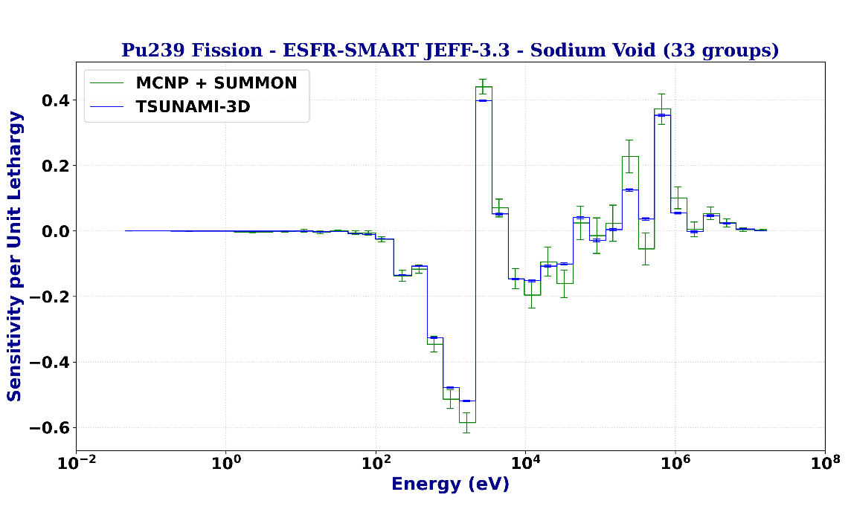
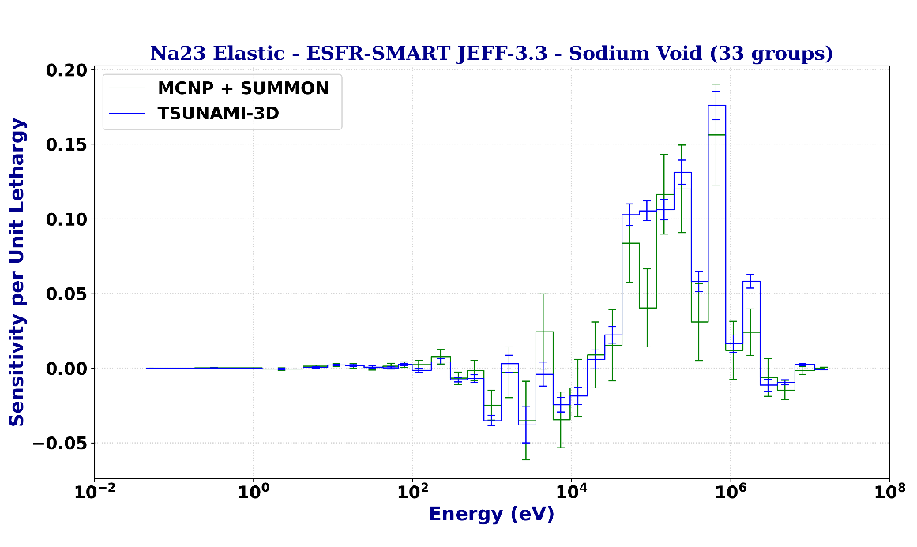
SANDA D5.1: Results: sodium void worth
Reaction |  | Δρ_{Void}/ρ_{Void} (%)
 |  | TSUNAMI-3D + TSAR | MCNP + SUMMON
 |  |  | Result | Ratio
²³⁹Pu (n,f) | ²³⁹Pu (n,f) | 5.086 ± 5.32E-03 | 5.489 ± 2.06E-05 | 1.0793 ± 0.0011
²³⁹Pu (n,γ) | ²³⁹Pu (n,γ) | 2.406 ± 6.02E-04 | 2.443 ± 2.70E-06 | 1.0156 ± 0.0003
²³⁸U (n,n’) | ²³⁸U (n,n’) | 1.911 ± 1.19E-02 | 1.802 ± 6.35E-04 | 0.9431 ± 0.0059
²³Na (n,n) | ²³Na (n,n) | 1.843 ± 9.12E-03 | 1.535 ± 1.24E-05 | 0.8329 ± 0.0041
²³⁹Pu (n,f) | ²³⁹Pu (n,γ) | -1.781 ± 5.31E-04 | -1.857 ± 2.32E-06 | 1.0430 ± 0.0003
²³⁸U (n,γ) | ²³⁸U (n,γ) | 1.721 ± 4.13E-04 | 1.762 ± 7.64E-06 | 1.0241 ± 0.0002
²³⁸U (n,n') | ²³⁸U (n,γ) | -1.623 ± 6.78E-03 | -1.886 ± 1.11E-04 | 1.1620 ± 0.0049
²³⁸U (n,n) | ²³⁸U (n,n') | -1.547 ± 1.37E-02 | -1.051 ± 4.30E-04 | 0.6792 ± 0.0060
ρ_{Void} S/U results:
MCNP and TSUNAMI-3D ISC & uncertainty results within ~10% (small difference between large numbers).
Large discrepancies for scattering reactions → slow convergence in MC calculations.
Accurate propagation of MC statistical uncertainties in S/U calculations required.
NOTE: negative uncertainties mean negative variance

Slide 7
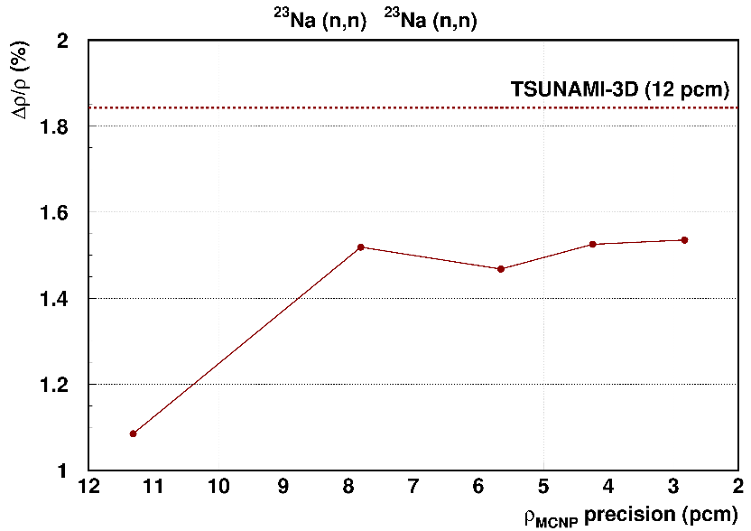
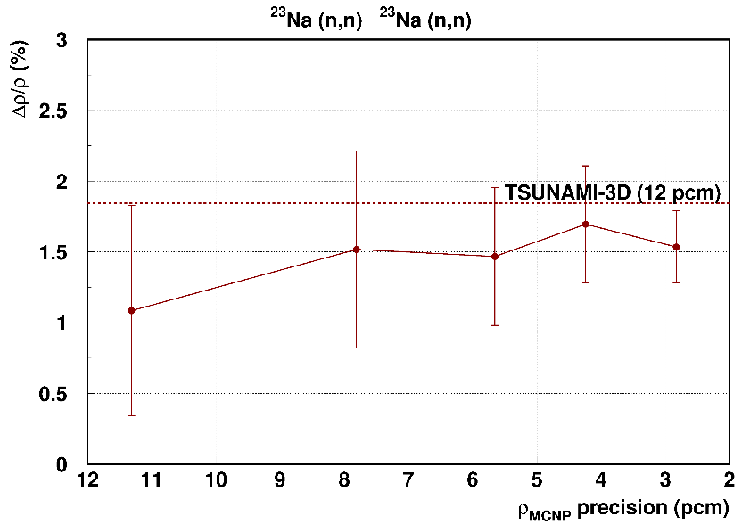
MC error propagation in SUMMON
Propagation of statistical uncertainties implemented in SUMMON:
$$σ^{2}(var\left(k\right))=\sum_{k;γ}{{\left(\frac{∂(\sum_{i,j;αβ}{s_{i,α}^{T}C_{ij;αβ}s_{j,β}})}{∂s_{k,γ}}ds_{k,γ}\right)}^{2}}$$
$$s.d.\left(k\right)=\frac{σ(var\left(k\right))}{2\sqrt{var(k)}}= \frac{\sqrt{\sum_{β}{{\left(\sum_{α}{s_{i,α}^{T}C_{ij;αβ}ds_{j,β}}\right)}^{2}}}}{\sqrt{\sum_{α,β}{s_{i,α}^{T}C_{ij;αβ}s_{j,β}}}}$$
Validated it by performing random variations in the SPs calculated with MCNP.
Most of the observed discrepancies in D5.1 can be explained by MC statistics.
But: correlations between energy ranges in the sensitivity profiles do exist → up to a factor ~3 discrepancy with results calculated with different random sequences in MCNP, specially for the uncertainty contribution of individual reactions.
S. Panizo et al., Impact of statistical error and sensitivity coefficient correlations on the sandwich rule. JEFFDOC-2258 (November 2023).

Slide 8
Cross-comparison SUMMON/SANDY
Cross comparison of SUMMON (CIEMAT, deterministic methodology) with SANDY (SCK-CEN, MC methodology).
Godiva & Jezebel
 | GODIVA |  | JEZEBEL
 | k_{eff} | unc (pcm) | k_{eff} | unc (pcm)
SUMMON | 1.00013 ± 1pcm | 1204 ± 1 | 0.99929 ± 1pcm | 221.2 ±0.4
SANDY |  | 1238 ± 90 |  | 228.0 ± 22
diff (pcm) | 24 | -34 | -5 | 7
Good agreement
in all cases
MYRRHA
Perturbation | SUMMON | SANDY | diff (pcm)
 | unc (pcm) | unc (pcm)
²⁴⁰Pu | 406.9 ± 0.9 | 415.5 ± 23.0 | -8.6
²³⁹Pu | 362.4 ± 0.3 | 349.1 ± 14.7 | 13.3
²³⁸U | 258.2 ± 0.5 | 247.5 ± 11.8 | 10.6
⁵⁶Fe | 110.8 ± 2.4 | 74.2 ± 4.7 | 36.6
Good agreement except for ⁵⁶Fe
S. Panizo et al., Propagation of uncertainty due to nuclear data: stochastic methodology vs. first-order approach. M&C 2023, Niagara Falls (Canada) 13-17 August 2023.

Slide 9
Conclusions
D5.1 conclusions:
ESFR k_{eff}: good agreement in ISC’s and calculated uncertainties between TSUNAMI-3D, MCNP (KSEN) + SUMMON (<1%) and MORET +SUMMON (<10%, lower statistics).
EFR void worth: good agreement in ISC’s and calculated uncertainties between TSUNAMI-3D and MCNP (KSEN) + SUMMON (<10%).
Slow convergence in sensitivity calculations of scattering reactions (both elastic and inelastic) → accurate propagation of MC statistical uncertainties to S/U results.
Further work:
Propagation of MC statistical errors implemented in SUMMON and validated.
Correlations between energy groups in sensitivity profiles are present and affect this propagation → discrepancies up to a factor of 3.
Cross-comparison SUMMON/SANDY also carried out → good agreement, with a few exceptions (⁵⁶Fe in MYRRHA).

