Slide 1
SUPLYING ACCURATE NUCLEAR DATA FOR ENERGY AND NON-ENERGY APPLICATIONS
D5.7. Report on reactor and shielding C/E validation and nuclear data trends
Linked to WP5/Task 5.2/Subtask 5.2.2 – C/E validation and trends
Contributors:
UPM: N. García-Herranz, O. Cabellos, A. Jiménez-Carrascosa (currently at PSI)
JSI/UKAEA: I. Kodeli, G. Žerovnik
CEA/DES: D. Bernard
NRG: S. van der Marck
SANDA Final workshop, General Meeting, 3-5 July 2024
Notes:
1

Slide 2

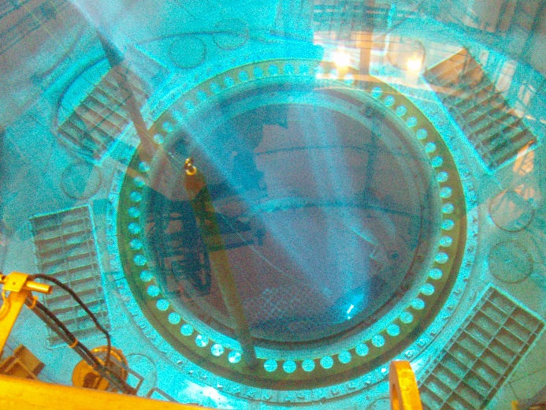
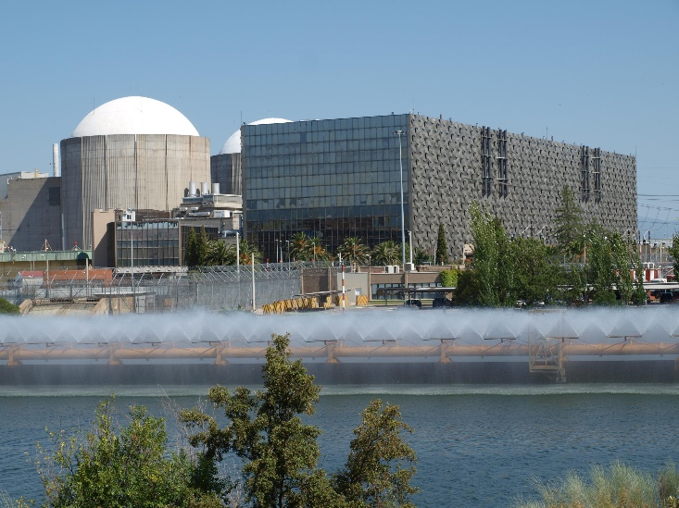
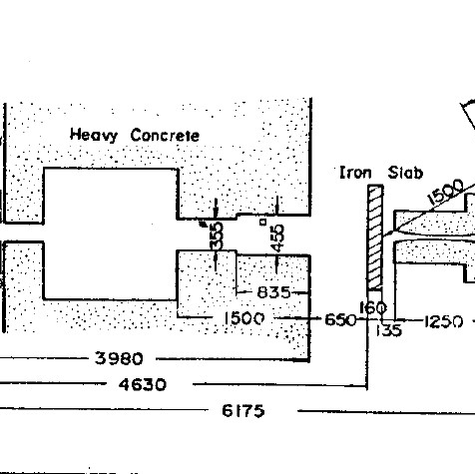



D5.7 | Objective
C/E validation using reactor physics experiments and shielding benchmarks
to contribute to the improvement of JEFF nuclear data files (including JEFF-4T3)
        IRPhEP
        Partner’s own databases: CEA/DES - LWR
        Other legacy experiments: SEFOR, Almaraz NPP (IAEA)
        SINBAD
        ICSBEP

Slide 3
D5.7 | Status
    Work completed. No deviations from the GA
    Deliverable D5.7 submitted on 18 June 2024

Slide 4
D5.7 | Contents
Table of Contents
1. Introduction
2. Methodologies for Nuclear Data Validation
3. Advanced Fast Reactors
4. Thermal Reactors
5. Commercial Light Water Reactors
6. Shielding benchmarks
7. Summary and conclusions

Slide 5
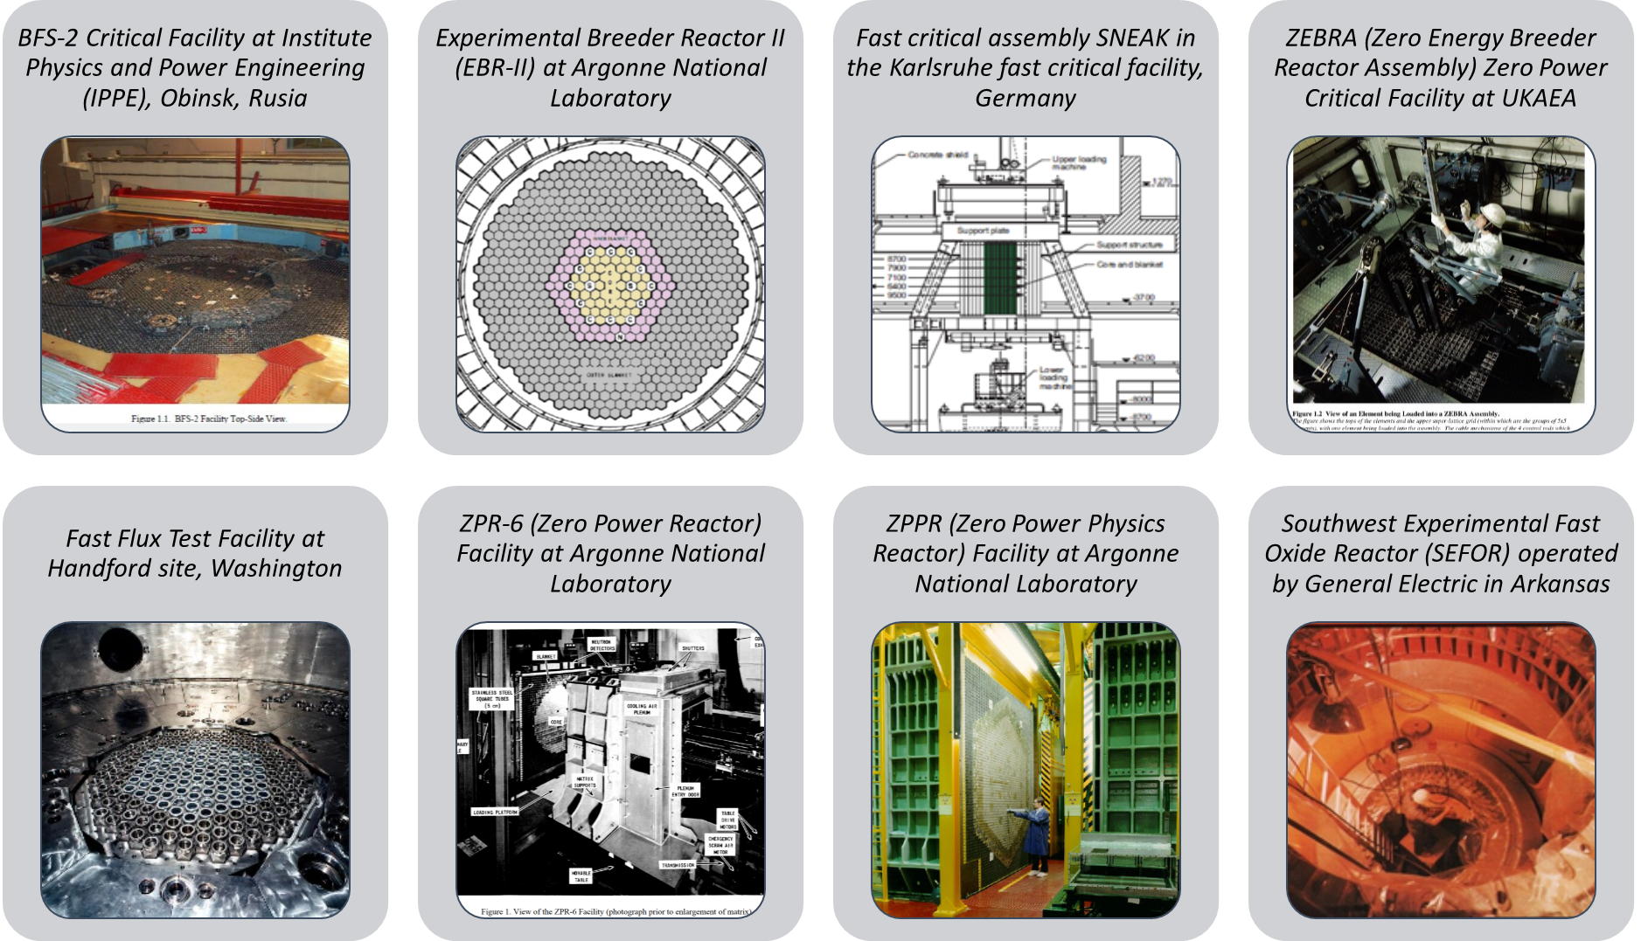
D5.7 | Results: Advanced Fast Reactors C/E validation
    16 IRPhEP integral experiments for k-eff
    7 IRPhEP experiments for sodium void worth
    5 IRPHEP experiments for control rod worth
    SEFOR experiments for Doppler
    Calculations with Monte Carlo CE codes: MCNP6, KENO-VI/SCALE6.2.3
    Sensitivities computed with KSEN/MCNP or TSUNAMI/SCALE6.2.3 in 33g : available in .sdf format
Notes:
16 experiments for multiplication factors (EALF ranging from 0.11 MeV to 0.36 MeV)

Slide 6
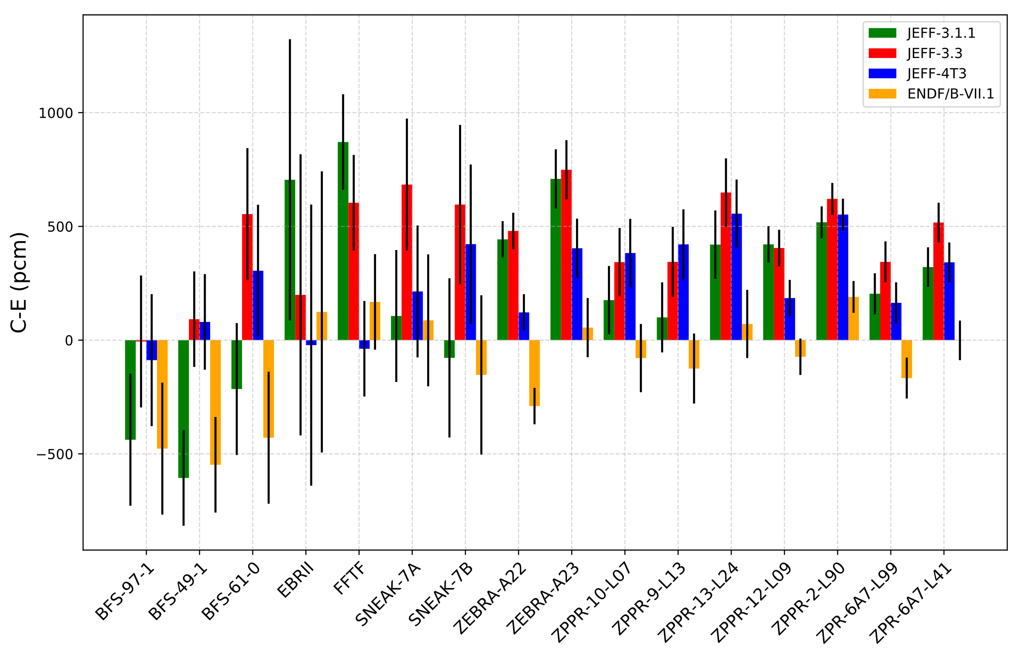
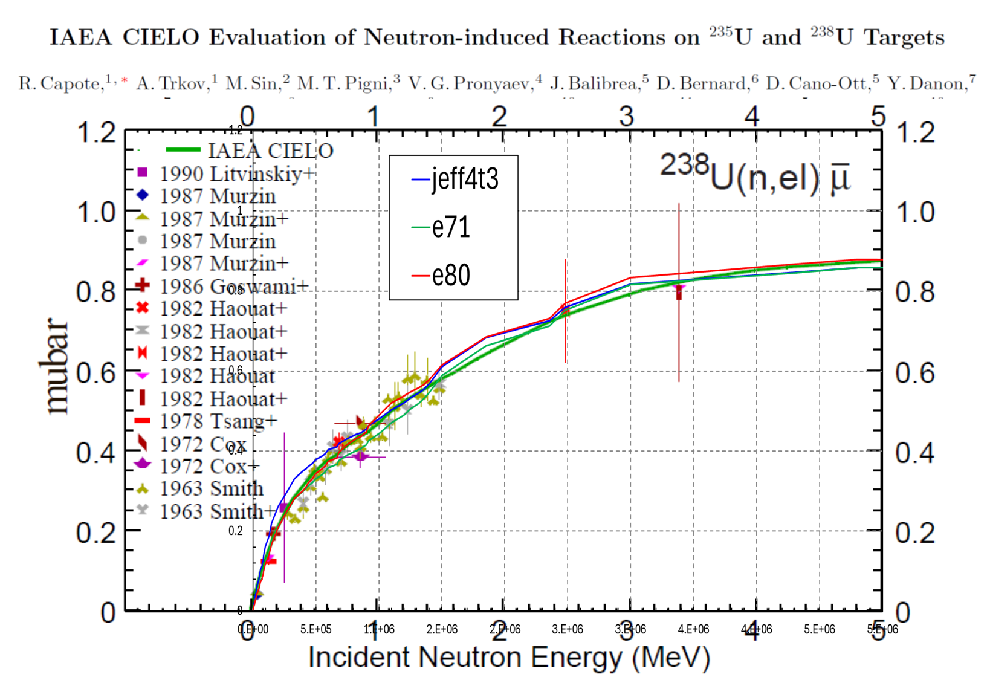
D5.7 | Results: Advanced Fast Reactors C/E validation
575 pcm J4T3 vs. E71
493 pcm J4T3 vs. E80
 |  | C- E (pcm)
 |  | JEFF-4T3 | ENDF/B-VII.1 | ENDF/B-VIII.0
SNEAK-7A |  | 214 | 87 | 9
SNEAK-7B |  | 422 | -153 | -71
FLATTOP-Pu |  | 18 | 103 | -28
FLATTOP-U235 |  | -116 | 151 | -37
FLATTOP-U233 |  | -112 | -119 | -2
J4T3 improves biases with respect to J33 for almost all benchmarks, but E71 performs better
Perturbation analysis to identify biases
For SNEAK cases (very sensitive to ²³⁸U elastic xs and angular distribution): large impact of J4T3-E71 differences in ²³⁸U elastic angular distribution between 0.1 and 1 MeV that appears to be compensated by differences in ²³⁸U elastic cross-section (confirmed with FLATTOP benchmarks)

Slide 7
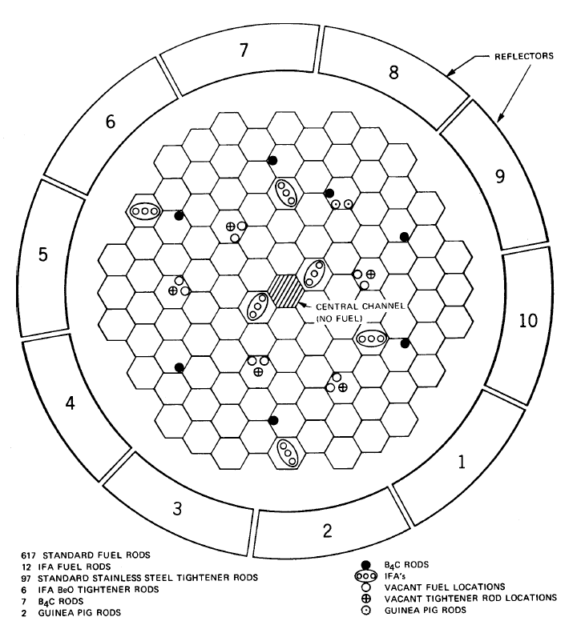
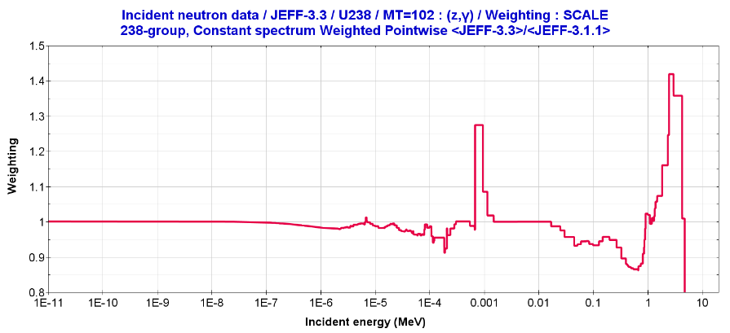
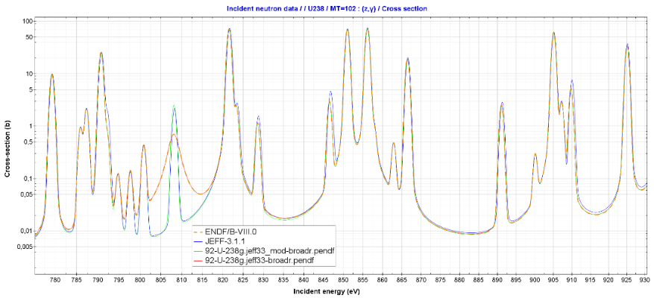
D5.7 | Results: Advanced Fast Reactors C/E validation
  SEFOR experiments (SFR-UAM) for validation of Doppler reactivity effect and reflector worth (potential of calibration curves for ND validation of ²³⁹Pu, ⁵⁶Fe, ⁵⁸Ni)
 | Calculated at UPM SCALE-6.2.3 (R-Z model)
 | JEFF-3.1.1 | JEFF-3.3 | Corrected JEFF-3.3
Doppler constant | -676.6 | -708.9 | -688.7
Core II C/E | 1.010 | 1.058 | 1.028
SEFOR Core II
U-238 (n,γ) ratio JEFF-3.3/JEFF-3.1.1
This allowed to identify a typo for the 808 eV p-wave Γ_{γ} parameter

Slide 8
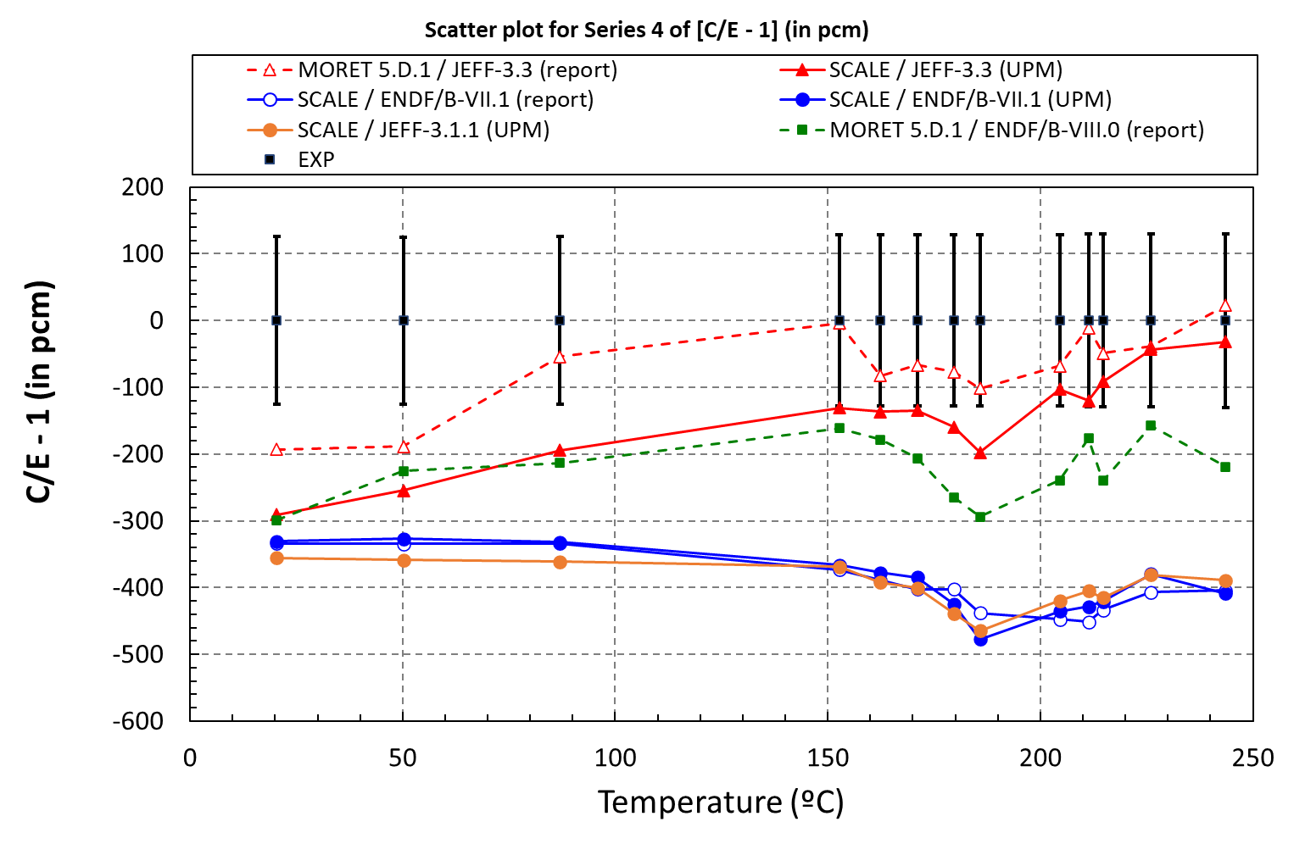
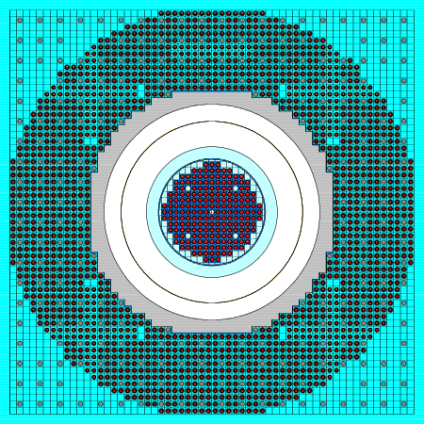
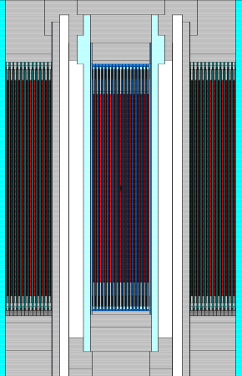
D5.7 | Results: Thermal Reactors C/E validation
CREOLE and KRITZ (LWR lattices at KRITZ reactor in Studsvik) benchmarks
CREOLE benchmark
C/E for KRITZ4/Series4
Calculations with MCNP6
JEFF-3.3 exhibits a strong trend with temperature for KRITZ/Series 4
Perturbation analysis showed that trend is dominated by ²³⁵U(n,fission) in the energy range ~ 0.01 eV –1eV

Slide 9
D5.7 | Results: Commercial LWR C/E validation
  Analysis of Post-Irradiation Experiments (PIE) of PWR UO₂ pellets
  JEFF-4T3 C/E isotopic prediction consistent with experimental uncertainties, but trends with burnup were observed
  APOLLO calculations: a perturbation analysis suggested that some capture cross sections in specific thermal regions should still be revised:
JEFF-4T3/²³⁹Pu(n_{[0.10-0.53]eV},γ) should be increased by (+5.3±1.4)% (prior uncertainty was ±3%)
JEFF-4T3/²⁴⁰Pu(n_{[0.53-4.00]eV},γ) should be increased by (+1.5±2.2)% (prior uncertainty was ±3%)

Slide 10
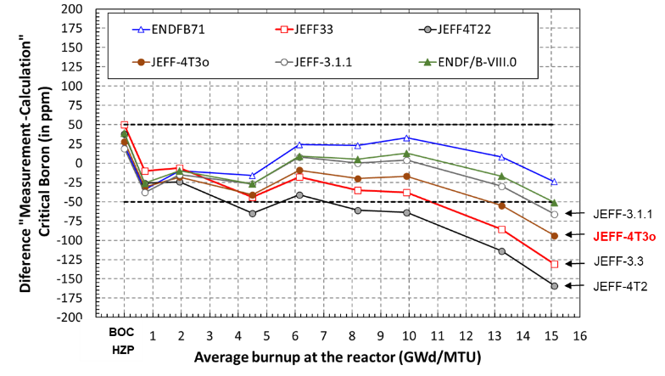
D5.7 | Results: Commercial LWR C/E validation
  Critical Boron Letdown Curve of a 3-loop Westinghouse-type PWR (Almaraz II, IAEA-TECDOC-815, 1995)
Calculations with SEANAP core simulator
Larger reactivity loss along burnup for JEFF-4T3 compared to E71, E80
The most influential nuclides are ²³⁹Pu, ²⁴⁰Pu, ²⁴¹Pu, ²³⁵U and ²³⁸U, as well as the fission yields and capture xs of a few critical fission products
Such wrong prediction severely limits the use of JEFF-4.x evaluations for LWR analysis: additional studies needed

Slide 11
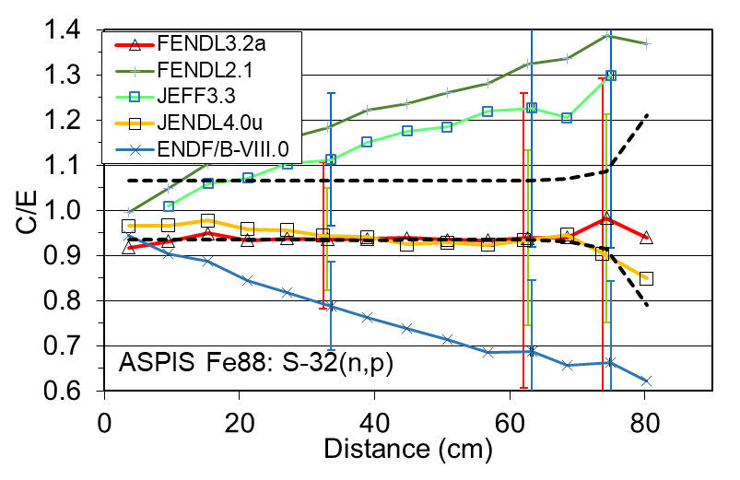
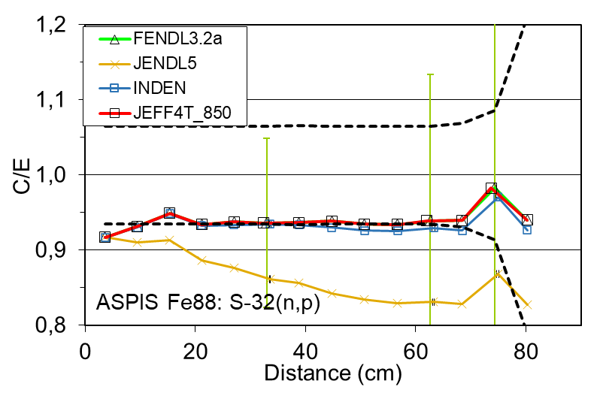
D5.7 | Results: Shielding benchmarks
Identification of a set of shielding benchmarks from SINBAD
Benchmark / quality
ASPIS Iron-88 ~ ♦♦♦
ORNL PCA Pool Critical Assembly - PV Benchmark (1980)
ASPIS PCA REPLICA - Winfrith Water/Steel ♦♦♦
CIAE Iron slab 14 MeV benchmark
KFK Iron spheres neutron and gamma spectra
Especially useful for testing scattering (elastic and inelastic) cross sections and angular distributions
For ASPIS and PCA, large improvements with JEFF-4T compared to JEFF-3.3
CIAE analysis pinpoints possible inconsistencies in angular distributions (backward scattering)
KFK high experimental uncertainties: measurements to be repeated using modern techniques
Biases C/E in S(n,p) for ASPIS Fe-88

Slide 12
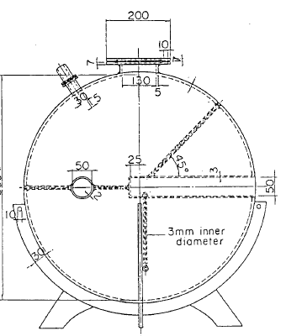
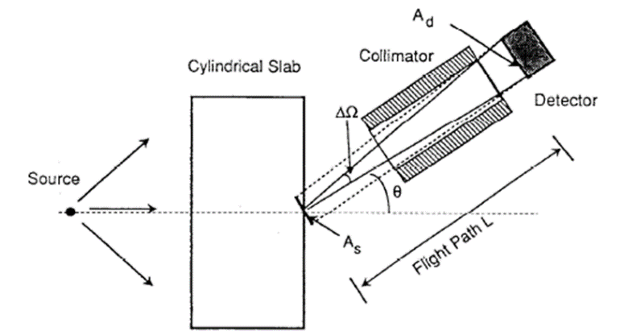
D5.7 | Results: Shielding benchmarks
FNS/TOF
Oktavian pulsed sphere
Time-of-flight (TOF) Shielding and Transmission experiments
JAEA Fusion Neutron Source (FNS) – TOF (17 cases x 5 angles)
OKTAVIAN/TOF spheres (15 cases)
ICSBEP/FUND-JINR-1/E-MULT-TRANS-001 neutron transmission
FNS/TOF results
Oktavian results

Slide 13

D5.7 | Concluding remarks
Calculations performed for a significant number of sets of reactor physics & shielding benchmarks, as planned
Extensive use of JEFF-3.3 and each JEFF-4Tx test release
Contribution to JEFF-4Tx improvements: identification of trends; typo; highlight of possible inconsistencies

Slide 14
SUPLYING ACCURATE NUCLEAR DATA FOR ENERGY AND NON-ENERGY APPLICATIONS
D5.9. Synthesis report on C/E validation and nuclear data trends
Linked to WP5/Task 5.2
Contributors:
UPM: N. García-Herranz, O. Cabellos, A. Jiménez-Carrascosa (currently at PSI)
JSI/UKAEA: I. Kodeli, G. Žerovnik
CEA/DES: D. Bernard
NRG: S. van der Marck
IRSN: N. Leclaire
CIEMAT: V. Bécares
SANDA Final workshop, General Meeting, 3-5 July 2024
Notes:
14

Slide 15
D5.9 | Objective
  Synthesize findings from D5.7, D5.8 and validation of FP data against MINERVE/CERES
  Present other relevant experimental data to be included in the validation domain

Slide 16
D5.9 | Status
    Work completed. No deviations from the GA
    Draft under revision (already sent to contributors)
    Deliverable pending submission

Slide 17
D5.9 | Contents
Table of Contents
1. Introduction
2. Nuclear data trends in JEFF evaluations
Reactor physics and shielding experiments (D5.7)
Criticality experiments (D5.8)
MINERVE/CERES pile oscillation experiments
3. Need of C/E validation in other areas of interest
4. Summary and conclusions
5. Derived publications

Slide 18
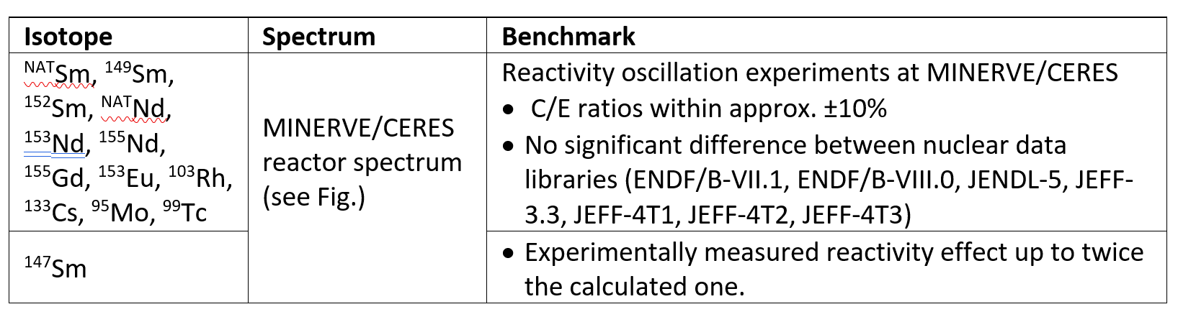
D5.9 | Concluding remarks
Main findings presented in Tables, identifying isotope/reaction/energy spectrum/benchmark where relevant
Needs of C/E validation in other areas that are gaining significance: spent fuel casks, RPV neutron fluence, proton-therapy centers, depletion calculations using SFCOMPO

Slide 19
D5.9 | Dissemination
    1 Doctoral thesis: A. Jiménez-Carrascosa “Methodologies for enhancing the Neutronic Assessment of Sodium-Cooled Fast Reactors: From Nuclear Data to transient Analysis”, UPM, February 2023 https://oa.upm.es/72803/1/ANTONIO_JIMENEZ_CARRASCOSA.pdf
1 International conference: Nuclear Data 2022 https://doi.org/10.1051/epjconf/202328414009
19 JEFDOC
All those documents will be public together with the deliverable

Slide 20
Backup slides

Slide 21
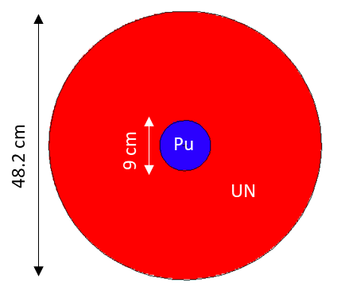
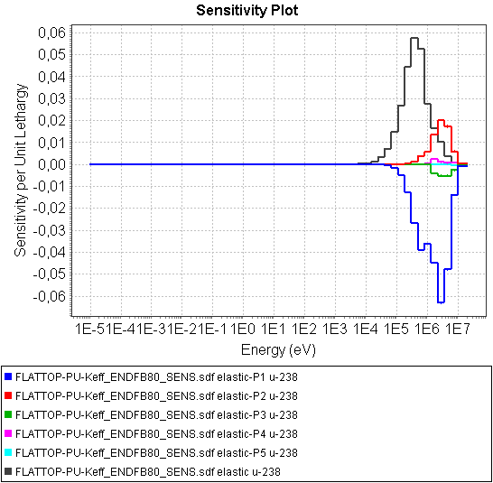
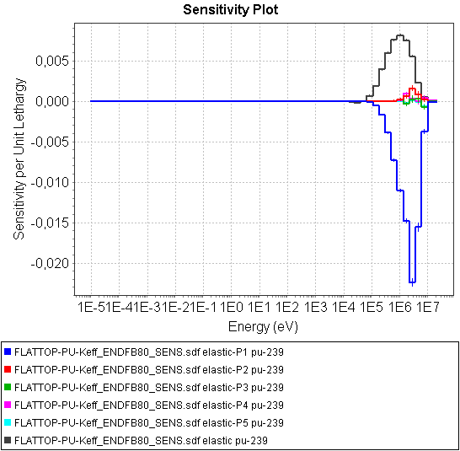
FLATTOP-Pu (POPSY) (PMF006)
 | POPSY
Diff. J4T3 vs. E80 (pcm) | 46
Perturbation with NDaST: impact of (J4T3-E80)/E80 (MCNP S)
U-238 elastic | 858
U-238 n,n’ | -534
U-238 fission | 80
U-238 n,g | 83
U-238 nubar | 48
U-238 chi | -
Pu-239 elastic | 66
Pu-239 n,n’ | -262
Pu-239 fission | 414
Pu-239 n,g | -186
Pu-239 nubar | -77
Pu-239 chi | -
Sum of NDaST effects | 490
Perturbation replacing data in MCNP
J4T3 U²³⁸ elastic angular distribution | -570
J4T3 U²³⁸ inelastic angular distribution | 72
J4T3 Pu²³⁹ elastic angular distribution | 246
J4T3 Pu²³⁹ inelastic angular distribution | 15
J4T3 Pu²³⁹ fission spectrum | -187
Sum of replacement data effects | -424
Global NDaST effect + other effects | 66
U238 elastic:
Sensitivities to P1, P2 significant
Sensitivities to P3, P4, P5 negligible
Pu239 elastic:
Sensitivities to P1significant
Sensitivities to P2, … P5 negligible

