Slide 1
Uncertainty and parameter optimisation in high-energy models
Jean-Christophe David
Work done by J. Hirtz (Post-doc)
SANDA Final workshop. General Meeting
Madrid - 3–5 Jul 2024

Slide 2
Plan
Introduction
Method
Results
Conclusions
SANDA Final workshop. General Meeting
Madrid - 3–5 Jul 2024
Uncertainty and parameter optimisation in high-energy models

Slide 3
Introduction
The main project Error assessment and model improvement + associated uncertainty
Tool bayesian statistics(inference)
Information experimental data
Done within CHANDA
Building a method to assess error
Done within SANDA
Building a method to improve the model (INCL) via parameter optimisation
Next steps (project funded by ANR for 4 years, 2024 → 2027)
Combining both
Applying to specific cases
SANDA Final workshop. General Meeting
Madrid - 3–5 Jul 2024
Uncertainty and parameter optimisation in high-energy models

Slide 4
Introduction
The main project Error assessment and model improvement + associated uncertainty
Tool bayesian statistics(inference)
Information experimental data
Done within CHANDA
Building a method to assess error
Done within SANDA
Building a method to improve the model (INCL) via parameter optimisation
Next steps (project funded by ANR for 4 years, 2024 → 2027)
Combining both
Applying to specific cases
SANDA Final workshop. General Meeting
Madrid - 3–5 Jul 2024
Uncertainty and parameter optimisation in high-energy models

Slide 5
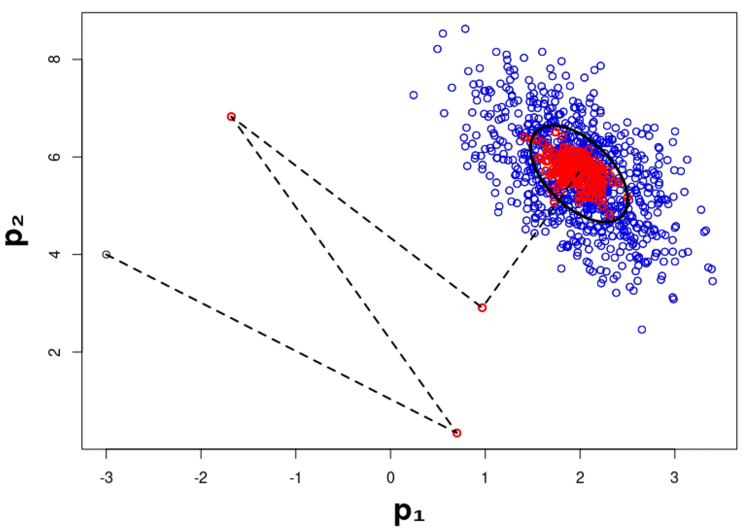
Method
Parameter optimisation
Two steps
GLS (Generalized Least Square method) → Optimized parameters
Gibbs-sampling-like method → Uncertainties of the values
X
More details…
SANDA Final workshop. General Meeting
Madrid - 3–5 Jul 2024
Uncertainty and parameter optimisation in high-energy models

Slide 6
Method
Parameter optimisation
GLS
GLS gives the new values of the parameters and related covariance matrices
SANDA Final workshop. General Meeting
Madrid - 3–5 Jul 2024
Uncertainty and parameter optimisation in high-energy models

Slide 7
Method
Parameter optimisation
GLS
GLS gives the new values of the parameters and related covariance matrices
reference
link between
parameter and
model
weight of the information
information
SANDA Final workshop. General Meeting
Madrid - 3–5 Jul 2024
Uncertainty and parameter optimisation in high-energy models

Slide 8
Method
Parameter optimisation
GLS
GLS gives the new values of the parameters and related covariance matrices
But
1- Right for linear model → Approximation: →
2- So, Covariance matrix not the right one to get uncertainties
Jacobian
SANDA Final workshop. General Meeting
Madrid - 3–5 Jul 2024
Uncertainty and parameter optimisation in high-energy models

Slide 9
Method
Parameter optimisation
GLS
GLS gives the new values of the parameters and related covariance matrices
Steps
(INCL is not linear, so p_{op} from iterations)
with
T_{i}
i+1
SANDA Final workshop. General Meeting
Madrid - 3–5 Jul 2024
Uncertainty and parameter optimisation in high-energy models

Slide 10
Method
Parameter optimisation
Gibbs-sampling-like
Similar process as GLS, But…
No more from
But from (break the linear approximation)
and with
T_{i}
i+1
i+1
SANDA Final workshop. General Meeting
Madrid - 3–5 Jul 2024
Uncertainty and parameter optimisation in high-energy models

Slide 11
Results
Two examples - two cases
Model needs improvement Subthreshold production of K⁺
Model already not bad Double differential neutron cross section
SANDA Final workshop. General Meeting
Madrid - 3–5 Jul 2024
Uncertainty and parameter optimisation in high-energy models

Slide 12
Results
Subthreshold production of K+
Description
K⁺ production from p+A (E~1GeV)
A few parameters involved 🙂
Very rare event (σ ~nb) + experimental data for each set (target, E) ☹️
→ long calculations
Parameters:
σ(NN → K⁺ + X) → a_{NN} x σ(NN → K⁺ + X)
σ(πN → K⁺ + X) → a_{πN} x σ(πN → K⁺ + X)
σ(ΔN → K⁺ + X) → a_{ΔN} x σ(ΔN → K⁺ + X)
Fermi momentum (270 MeV/c) → Fm
Time: 7 days with 20 cores
SANDA Final workshop. General Meeting
Madrid - 3–5 Jul 2024
Uncertainty and parameter optimisation in high-energy models

Slide 13
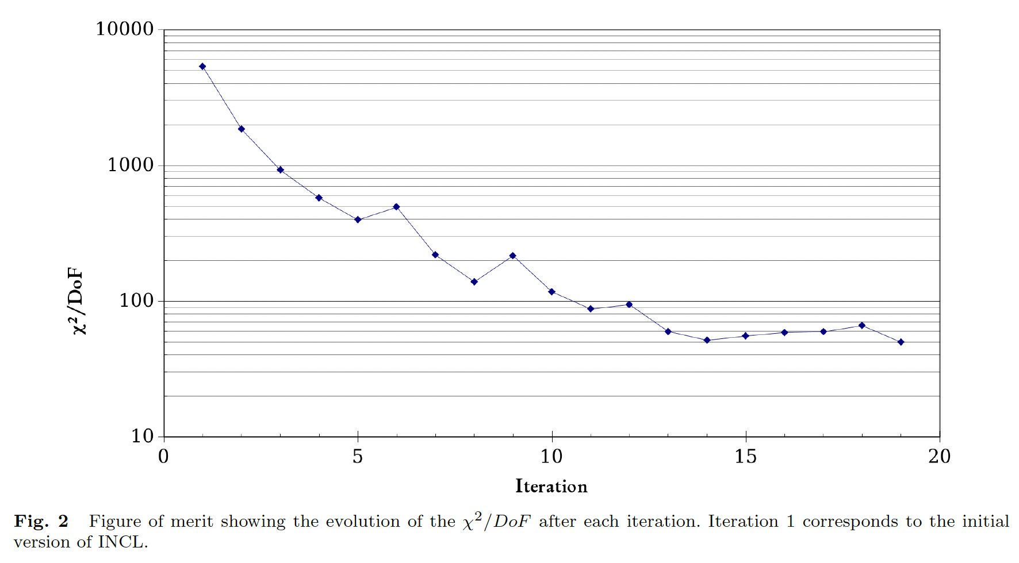
Results
Subthreshold production of K+
Results
Name | old | new
a_{NN} | 1.0 +/- 0.1 | 1.5
a_{πN} | 1.0 +/- 0.1 | 0.26
a_{ΔN} | 1.0 +/- 0.1 | 0.43
Fm | 270. +/- 5. | 232.
⚠️ Exercice! ⚠️
New values, acceptable?
consequences on other quantities?
A complete study must go beyond!
χ² was bad
. delicate mechanisms;
. only 3% for exp. uncertainties…
And now…
. not « wonderful »,
. but falls rapidly!
~5000
~50
SANDA Final workshop. General Meeting
Madrid - 3–5 Jul 2024
Uncertainty and parameter optimisation in high-energy models

Slide 14
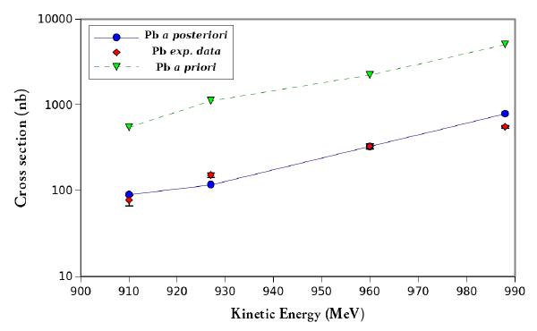
Results
Subthreshold production of K+
Results
Name | old | new
a_{NN} | 1.0 +/- 0.1 | 1.5
a_{πN} | 1.0 +/- 0.1 | 0.26
a_{ΔN} | 1.0 +/- 0.1 | 0.43
Fm | 270. +/- 5. | 232.
⚠️ Exercice! ⚠️
New values, acceptable?
consequences on other quantities?
A complete study must go beyond!
χ² was bad
. delicate mechanisms;
. only 3% for exp. uncertainties…
And now…
. not « wonderful »,
. but falls rapidly!
And great improvement for Pb target
SANDA Final workshop. General Meeting
Madrid - 3–5 Jul 2024
Uncertainty and parameter optimisation in high-energy models

Slide 15
Results
Double differential neutron cross section
Description
Neutron DDXS from p+A A < Aluminum; E_{p} < 200 MeV
Toxic data (error bar: 0.45%!!!) → exp. data must be studied before
Are we able to do better, for an already not too bad DDXS? 🤔
Parameters:
σ(NΔ → NN) $∝$ 3 σ(NN → NΔ) → σ(NΔ → NN) $∝$ DB x σ(NN → NΔ)
t_{stop} = 29.8 x A^{0.16} fm/c → t_{stop} = a x A^{b} fm/c
Fermi momentum (270 MeV/c) → Fm
Time: 60 hours with 20 cores
☹️
SANDA Final workshop. General Meeting
Madrid - 3–5 Jul 2024
Uncertainty and parameter optimisation in high-energy models

Slide 16
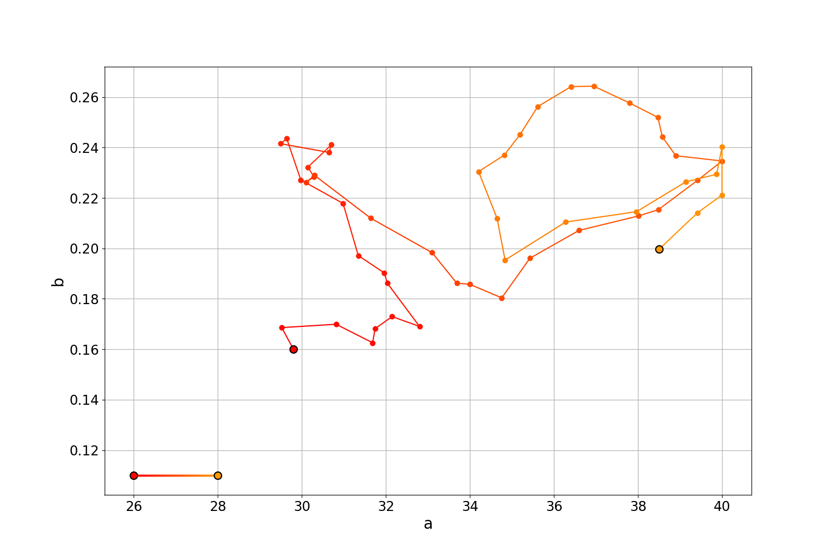
Results
Double differential neutron cross section
Results
Name | old | new
DB | 3.0 +/- 0.1 | 4.406 +/- 0.131
a | 29.8 +/- 0.5 | 37.13 +/- 0.59
b | 0.16 +/- 0.05 | 0.226 +/- 0.005
Fm | 270. +/- 3. | 266.4 +/- 0.97
χ2/DoF 7.805 → 7.34
(6% better)
GLS gives the values
… and uncertainties, but not really usable (linearity)
GLS
SANDA Final workshop. General Meeting
Madrid - 3–5 Jul 2024
Uncertainty and parameter optimisation in high-energy models

Slide 17
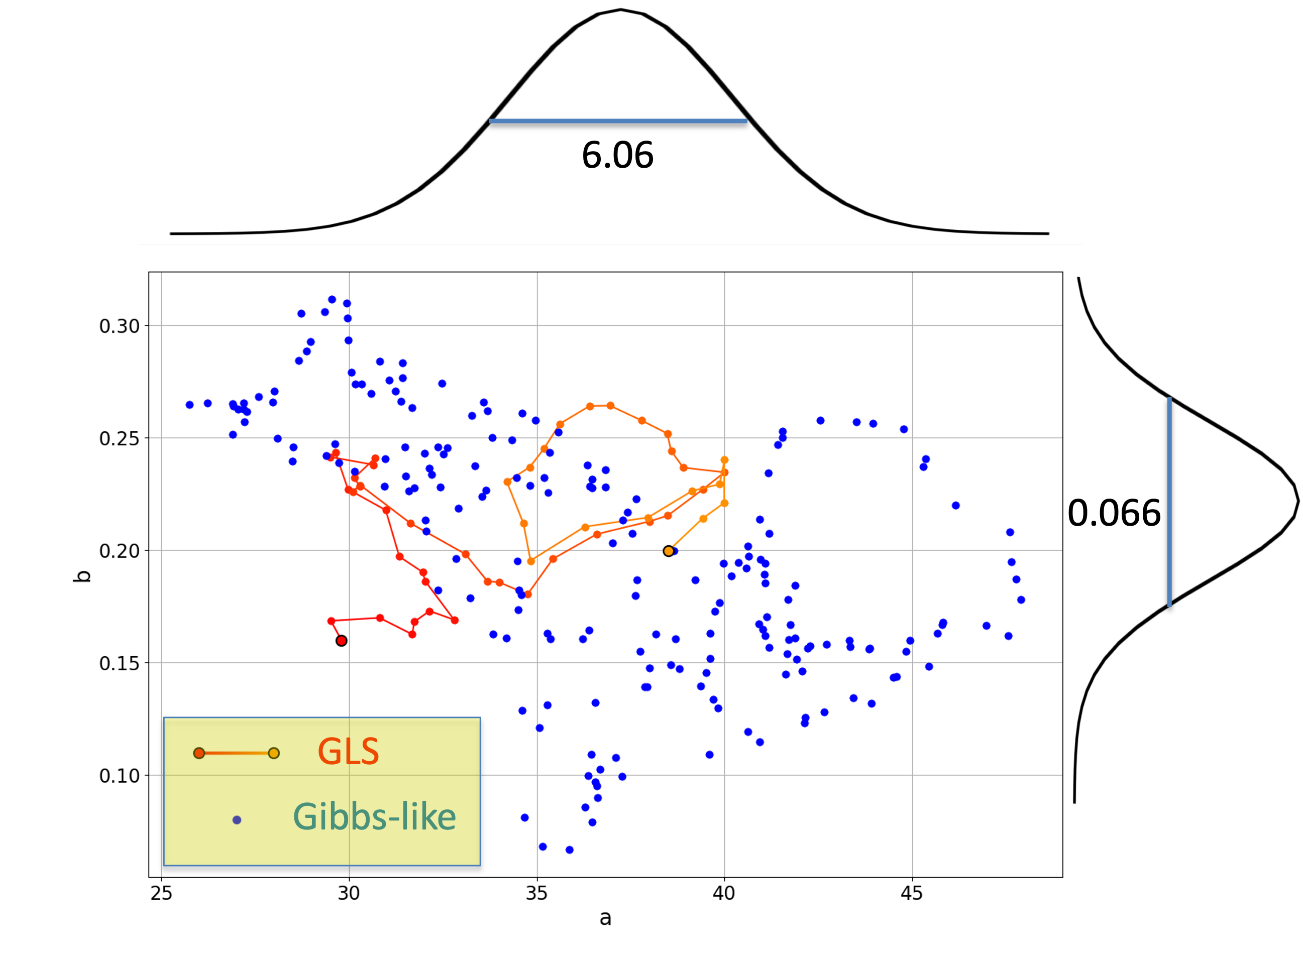
Results
Double differential neutron cross section
Results
Name | old | new
DB | 3.0 +/- 0.1 | 4.406 +/- 0.131 +/- 0.986
a | 29.8 +/- 0.5 | 37.13 +/- 0.59 +/- 6.06
b | 0.16 +/- 0.05 | 0.226 +/- 0.005 +/- 0.066
Fm | 270. +/- 3. | 266.4 +/- 0.97 +/- 8.82
GLS gives the values
… and uncertainties, but not really usable (linearity)
Gibbs-like, distributions of the possible values
Fit by a gaussian → uncertainties
SANDA Final workshop. General Meeting
Madrid - 3–5 Jul 2024
Uncertainty and parameter optimisation in high-energy models

Slide 18
Conclusions
The method to optimize parameters of Monte Carlo nuclear reaction models like INCL is built (with associated uncertainty).
The report has been delivered.
An article has been accepted in EPJA and will be published soon.
SANDA Final workshop. General Meeting
Madrid - 3–5 Jul 2024
Uncertainty and parameter optimisation in high-energy models

Slide 19
Thanks for your attention!
And thanks to
J. Hirtz
who did the work
in collaboration with
G. Schnabel
SANDA Final workshop. General Meeting
Madrid - 3–5 Jul 2024
Uncertainty and parameter optimisation in high-energy models

