Slide 1



ADDRESSING PRIORITIES OF EVALUATED NUCLEAR DATA IN EUROPE
APRENDE
Daniel Cano Ott
On behalf of the APRENDE Euratom Research and Training Programme project
Grant agreement 101164596
CIEMAT, Atomki, CEA, CERN, CVREZ, ENEA, ESS, GANIL, HZDR, CSIC, IFIN-HH, INFN, IRSN, JSI, KIT, LGI, NRG, NTUA, PTB, SCK CEN, STUBA, TUW, UBU, RUG, UION, JYU, ULODZ, UMAR, UPC, UPM, USE, USOF, UU, ENEN, CNRS, (AE) UNANTES, (AE) IMT, (AE) INPG, JRC, EPFL, PSI, UKAEA, NPL, UEDIN.

Slide 2
Red WiFi: Visitor
User: N00Visitor
password: Ap486973

Slide 3
APRENDE kick off meeting
Goals of today’s meetings:
Review and clarify the APRENDE project, including:
  Activities foreseen and milestones
  Compromised results and deliverables
  Implications for the different partners
  Resources to be committed
Review the procedures and obligations for the execution of the project
Hold the first General Assembly meeting and complete the administrative definition of the project

Slide 4
Today’s agenda
09:00 → 09:15 Welcome and introduction Daniel Cano Ott (CIEMAT)
09:15 → 09:35 Information from the EC Project Officer Katerina Peckova (EC)
09:35 → 09:50 Introduction of the LGI team Clara Demange (LGI)
09:50 → 10:20 WP1 - Development of new equipment and infrastructures Carlos Guerrero (U. Sevilla)
10:20 → 10:50 WP2 - New nuclear data measurements Maëlle Kerveno (CNRS/IPHC)
10:50 → 11:20 Coffee break
11:20 → 11:50 WP3 - Isotope and target supply Dimitri Rochman (PSI), Goedele Sibbens (EC JRC Geel), Dr Rugard Dressler (PSI)
11:50 → 12:20 WP4 - Nuclear data evaluation Dimitri Rochman (PSI)
12:20 → 13:00 WP5 - Nuclear data validation, sensitivity analyses and impact studies
12:20 Nuclear data validation Robert Jacqmin (CEA)
12:40 Sensitivity analyses and impact studies Oscar Cabellos (UPM)
13:00 → 14:15 Lunch
14:15 → 15:20 WP6 - Communication, transnational access, education & training, dissemination & exploitation
  14:15 Communication plan Johan Díaz (LGI)
  14:30 Transnational access, access to facilities and scientific visits Arnd JUNGHANS (HZDR)
  14:50 Organisation of schools Carlos Guerrero (U. Sevilla)
  15:05 Dissemination and exploitation Daniel Cano Ott (CIEMAT)
15:20 → 16:10 WP7 Project management
  15:20 Project management Daniel Cano Ott (CIEMAT)
  15:35 Scientific exchange between project partners and coordination with external agencies Daniel Cano Ott (CIEMAT)
  15:45 APRENDE and JEFF Arjan Plompen (JRC-Geel)
  15:55 Data management Clara Demange (LGI)
16:10 → 16:40 Coffee break
16:40 → 18:00 General assembly
20:30 → 22:30 Dinner at Panamera (all details can be found on the Indico agenda)

Slide 5
APRENDE data
Grant agreement: 101164596
Call: HORIZON-EURATOM-2023-NRT-01
Project start date: 01/10/2024
Duration: 48 months
Requested EC contribution: 3,999,900 €
Contributions from non-member states: 982,500 €
43 Institutions: CIEMAT, Atomki, CEA, CERN, CVREZ, ENEA, ESS, GANIL, HZDR, CSIC, IFIN-HH, INFN, IRSN, JSI, KIT, LGI, NRG, NTUA, PTB, SCK CEN, STUBA, TUW, UBU, RUG, UION, JYU, ULODZ, UMAR, UPC, UPM, USE, USOF, UU, ENEN, CNRS, (AE) UNANTES, (AE) IMT, (AE) INPG, JRC, EPFL, PSI, UKAEA, NPL, UEDIN.
from 19 different European countries (2 non-member states): AU, BE, BU, CH, CZ, FI, FR, GE, GR, HU, IT, NE, PL, RO, SE, SK, SL, SP, UK.
Coordinator: CIEMAT (Spain)
38 deliverables + 18 milestones

Slide 6
Objectives of APRENDE
Conducting experiments to obtain new and improved nuclear data
Developing and improving detectors, experimental techniques, infrastructures, and data analysis methodologies.
Evaluating available experimental nuclear data relevant for energy and non-energy applications, producing evaluated nuclear data files for the end-users and stakeholders.
Developing new infrastructures to produce isotopically enriched materials for high quality nuclear data measurements.
Validating evaluated nuclear data files and performing new integral experiments.
Identifying new nuclear data priorities in various fields.
Supporting access to key experimental infrastructures for preserving the know-how in experimental techniques, computer applications, nuclear data evaluation, validation of data and models, and to improve education & training and knowledge sharing.
Assessing the status of nuclear data competences, libraries, and computer simulation tools available in Europe
Recommending strategic actions for the preservation and improvement of the Euratom capacities.

Slide 7
Priorities of APRENDE
The activities in APRENDE are driven by priorities:
All aspects of spent nuclear fuel (SNF),
Reactor operational characteristics such as reactivity versus burnup, transients, and margins,
Advanced reactor and fuel cycle development including small modular reactors (SMR) and GenIV systems based on lead and sodium coolants, molten salts, or an accelerator like MYRRHA,
Criticality safety and shielding for safety assessments and safety assessment methodologies,
Non-Energy applications, radiation protection.

Slide 8
The nuclear data cycle
Experiment on ^{A}Z
New needs and priorities
EXFOR – data base with the ^{A}Z data
ICSBEP + … integral experiment databases
Validation with integral data
Users
Evaluation
Theoretical models tuned with experimental data
Evaluated nuclear data libraries
JEFF, ENDF/B, JENDL, CENDL, BROND

Slide 9
The nuclear data cycle
Experiment on ^{A}Z
New measurements on key isotopes and reactions.
Improved or new detectors, facilities and methodologies.
Better quality & rare targets.
New needs and priorities
EXFOR – data base with the ^{A}Z data
ICSBEP + … integral experiment databases
Validation with integral data
Users
Evaluation
Theoretical models tuned with experimental data
Evaluated nuclear data libraries
JEFF, ENDF/B, JENDL, CENDL, BROND

Slide 10
The nuclear data cycle
Experiment on ^{A}Z
New needs and priorities
EXFOR – data base with the ^{A}Z data
ICSBEP + … integral experiment databases
New experimental data for the evaluators.
Validation with integral data
Users
Evaluation
Theoretical models tuned with experimental data
Evaluated nuclear data libraries
JEFF, ENDF/B, JENDL, CENDL, BROND

Slide 11
The nuclear data cycle
Experiment on ^{A}Z
New needs and priorities
EXFOR – data base with the ^{A}Z data
ICSBEP + … integral experiment databases
Validation with integral data
Improved uncertainty assessment.
Improved codes.
Users
Evaluation
Theoretical models tuned with experimental data
Evaluated nuclear data libraries
JEFF, ENDF/B, JENDL, CENDL, BROND

Slide 12
The nuclear data cycle
Experiment on ^{A}Z
New needs and priorities
EXFOR – data base with the ^{A}Z data
ICSBEP + … integral experiment databases
Validation with integral data
Users
Validation with high quality integral experiments.
New integral experiments.
Improved understanding of microscopic phenomena.
Evaluation
Theoretical models tuned with experimental data
Evaluated nuclear data libraries
JEFF, ENDF/B, JENDL, CENDL, BROND

Slide 13
The nuclear data cycle
Experiment on ^{A}Z
New needs and priorities
EXFOR – data base with the ^{A}Z data
ICSBEP + … integral experiment databases
Dissemination, coordinated with different international agencies NEA, IAEA.
Coordination with the European JEFF evaluation.
Validation with integral data
Users
Evaluation
Theoretical models tuned with experimental data
Evaluated nuclear data libraries
JEFF, ENDF/B, JENDL, CENDL, BROND

Slide 14
The nuclear data cycle
Experiment on ^{A}Z
New needs and priorities
EXFOR – data base with the ^{A}Z data
ICSBEP + … integral experiment databases
Identification of new nuclear data needs.
Coordination with end users and stakeholders.
Coordination with the European JEFF evaluation.
Validation with integral data
Users
Evaluation
Theoretical models tuned with experimental data
Evaluated nuclear data libraries
JEFF, ENDF/B, JENDL, CENDL, BROND

Slide 15
The nuclear data cycle
Experiment on ^{A}Z
New needs and priorities
EXFOR – data base with the ^{A}Z data
ICSBEP + … integral experiment databases
Education and training of young researchers (evaluators and experimentalists).
Strategic & SWOT analysis of the European nuclear data activities (capabilities, resources, know-how…).
Glue the European ND community.
Validation with integral data
Users
Evaluation
Theoretical models tuned with experimental data
Evaluated nuclear data libraries
JEFF, ENDF/B, JENDL, CENDL, BROND

Slide 16
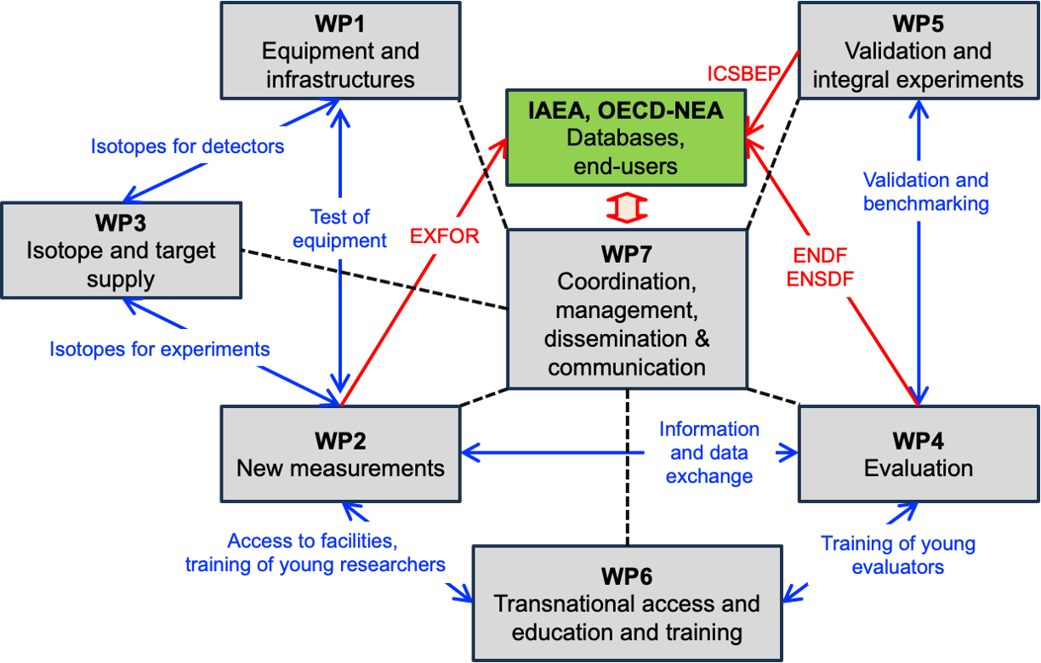
Structure of APRENDE

Slide 17
WP1 – Development of new equipment and infrastructures
Coordinator: Carlos Guerrero – Universidad de Sevilla
Objectives: upgrades of facilities and systems. R&D of detectors.
Task 1.1 Detector and facility upgrades (CNRS)
1.1.1 Enabling experiments in vacuum with ELISA at JRC-Geel.
1.1.2 Enhancement with LaBr3 detectors of the TAS capabilities for decay data
1.1.3 Higher power target designs for neutron production for nuclear data
1.1.4 Neutron-induced independent and isomeric fission yield studies at the IGISOL
Task 1.2 Neutron detectors with new experimental capabilities (PTB)
1.2.1 An active target for n-p cross section measurements at PTB
1.2.3 Diamond detectors for in-beam measurements at n_TOF-NEAR
1.2.4 Characterization of liquid scintillator detectors up to 40 MeV
Task 1.3 Developments of silicon-based devices for (n,chp) cross sections (UION)
1.3.1 Silicon telescope for (n,chp) cross section measurements at n_TOF towards the measurement of ³⁹K(n, chp)
1.3.2 New annular DSSSD for (n,chp) cross section measurements at n_TOF

Slide 18
WP2 – New nuclear data measurements
Coordinator: Maëlle Kerveno – CNRS
Objectives: perform new and prioritary nuclear data measurements
Task 2.1 Decay data (CSIC)
Task 2.2 (n,f) cross section measurements and fission yields (CEA)
  2.2.1 Fission yields measurements
  2.2.2 Neutron induced fission cross section measurements
  2.2.3 ²³⁹Pu fission studies in the resonance range
Task 2.3 (n,𝛄) cross section measurements (CIEMAT)
  2.3.1 Capture reaction measurements on structural materials
  2.3.2 Capture reaction measurements on actinides
  2.3.3 Capture reaction measurements for neutron metrology
Task 2.4 Neutron elastic and inelastic scattering cross section measurements (IFIN-HH)
  2.4.1 (n,xn𝛄) cross section measurement
  2.4.2 Elastic and inelastic scattering measurement
Task 2.5 (n ,X) and (ch.p., X) reactions (NPL)
  2.5.1 ³⁵Cl(n, lcp) cross section measurement for advanced reactor concepts
  2.5.2 Cross section measurement for fusion applications
  2.5.3 Cross section measurement for dosimetry.

Slide 19
WP3 – Isotope and target supply
Coordinator: Rugard Dressler – PSI (important contribution of JRC – Geel)
Objectives:
Ensure the in-time and high-quality delivery of the targets needed in WP2.
Foster the target maker network in Europe and world-wide.
Build-up of a dedicated isotope separator.
Contribute to the strategic analysis of EURATOM nuclear data capacities.
Task 3.1 Target supply (PSI)
Task 3.2 Fostering the target maker network (PSI)
Task 3.3 Implementation of an isotope separator at PSI (M1-M48), Task leader: PSI

Slide 20
WP4 – Nuclear data evaluation
Coordinator: Dimitri Rochman – PSI
Objectives:
Producing new evaluations for decay data, thermal scattering data, fission yields and cross sections of important isotopes and reactions. JEFF project
Development and preservation of the knowledge needed for evaluation work
Addressing deficiencies from the past and existing nuclear data libraries
Ensure the quality of the delivered evaluations (collaboration with WP5)
Task 4.1 Decay data evaluation and education (USOF)
Task 4.2 Thermal Scattering Data (ESS)
4.2.1 Code development
4.2.2 Evaluation
Task 4.3 Fission yield evaluation (CEA)
4.3.1 Fission yield investigations
4.3.2 Fission yield benchmarking
Task 4.4 Cross section evaluation (CEA)
4.4.2 File processing and cross section benchmarking
4.4.3 Cross section evaluation tools

Slide 21
WP5 – Nuclear data validation, sensitivity analyses and impact studies
Coordinator: Robert Jacqmin – CEA & Óscar Cabellos – UPM
Objectives:
Producing sensitivity profiles and impact studies
Identifying nuclear data trends from the analyses of integral experiments and data assimilation studies
New integral experiments and needs
Task 5.1. Sensitivity analyses, uncertainty quantification, impact studies (CIEMAT)
  5.1.1. Sensitivity analyses and priorities for nuclear data improvements
  5.1.2. Nuclear data uncertainty propagation in reactor and shielding applications
  5.1.3. Nuclear data uncertainty propagation in advanced fuel cycles
Task 5.2: Analysis of experiments, validation, and data assimilation (UPM)
  5.2.1 Analyses of integral measurements, reactor data
  5.2.2. Correlations between integral data
  5.2.3. Assimilation using group-averaged data, derivation of JEFF4 trends
  5.2.4. Direct inclusion of EXFOR data in a global assimilation process
Task 5.3: New integral experiments and validation data (CEA)
  5.3.1. Experiments in LR-0 and other reactors
  5.3.2. Source-detector experiments
  5.3.3. Future experiments for nuclear data validation

Slide 22
WP6 – Communication, transnational access, education & training,
dissemination & exploitation
Coordinator: Arnd Junghans – HZDR
Objectives:
Training activities of early-stage researchers and scientific visitors
Provide beam time at the consortium facilities and support experiments there.
Organize 2 summer schools.
Task 6.1 Public Communication (LGI)
Task 6.2 Proposals for Transnational Access and Education and Training (HZDR)
Task 6.3 Access to neutron beam facilities (HZDR)
Task 6.4 Training of early-stage researchers and scientific visits (HZDR)
Task 6.5 Organisation of two summer schools (USE)
Task 6.6 Dissemination and exploitation (CIEMAT)

Slide 23
WP7 – Project management
Coordinator: Daniel Cano-Ott – CIEMAT
Objectives:
Set up an appropriate governance structure and internal communication methods.
Closely monitor the project implementation to meet the objectives in time, scope and budget.
Define and maintain the decisional and operational framework, including risk management.
Ensure high-quality deliverables.
Monitor the project’s resources in line with the financial guidelines.
Drive the interactions with the project and end-users.
Enforce gender equality and mitigate the carbon footprint of the project.
Foster the scientific exchange between the projects partners and coordinate the activities with JEFF, IAEA, and OECD-NEA.
Task 7.1 Project management (CIEMAT)
Task 7.2 Scientific exchange between project partners and coordination with external agencies (CIEMAT)
Task 7.3 Data management (CIEMAT)

Slide 24
AOB
APRENDE logo. LGI is preparing some proposals.
Access to common documents, via LGI Teams and web server (LGI)

