Slide 1


APRENDE (Addressing PRiorities of Evaluated Nuclear Data in Europe)
WP1: Development of new equipment and infrastructures
This project has received funding from the European Union’s Horizon Europe Euratom Research and Training Programme (EURATOM) under Grant Agreement No: 101164596-APRENDE
Carlos GUERRERO
Universidad de Sevilla
Centro Nacional de Aceleradores (CNA)
cguerrero4@us.es
APRENDE kick-off meeting, Madrid (16/10/2024)

Slide 2
Objectives in this Kick-Off meeting related to WP1
Objectives in this Kick-Off meeting related to WP1:
Present WP in teh context of the overall APRENDE Project
Summarize the scientific objectives of WP1 and their distribution in 3 tasks
Milestones and deliverables:
  Summarize and confirm ítems
  Propose and confirm responsables for comunicating Miestones and preparing Deliverables

Slide 3
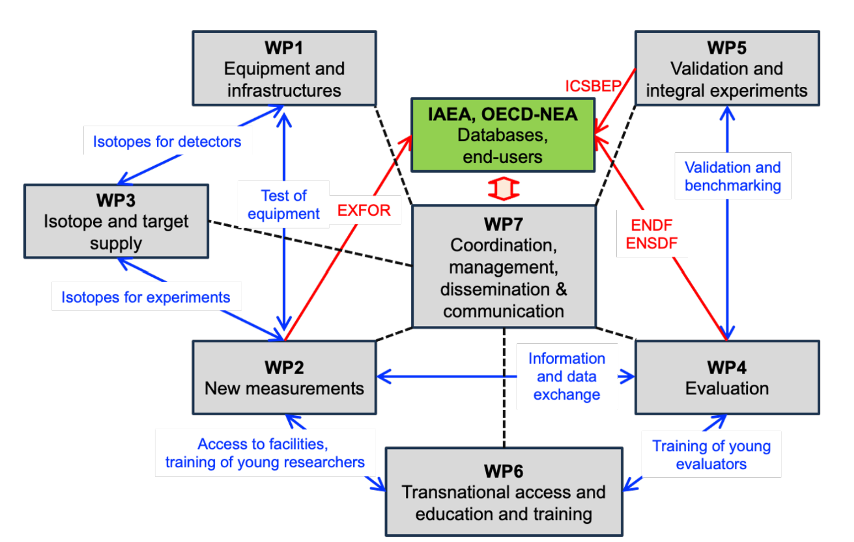
APRENDE-WP1 in context

Slide 4
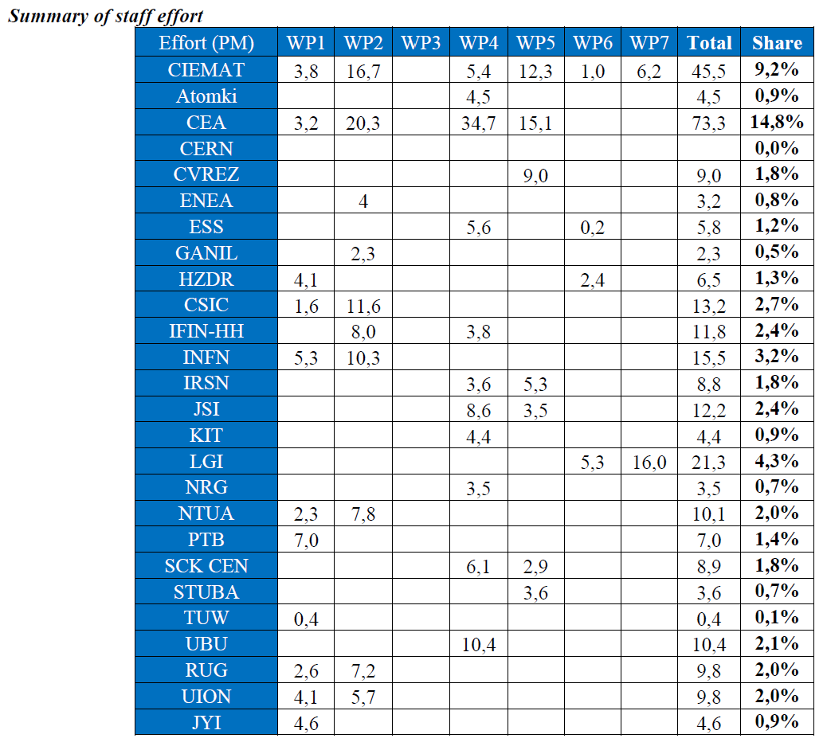
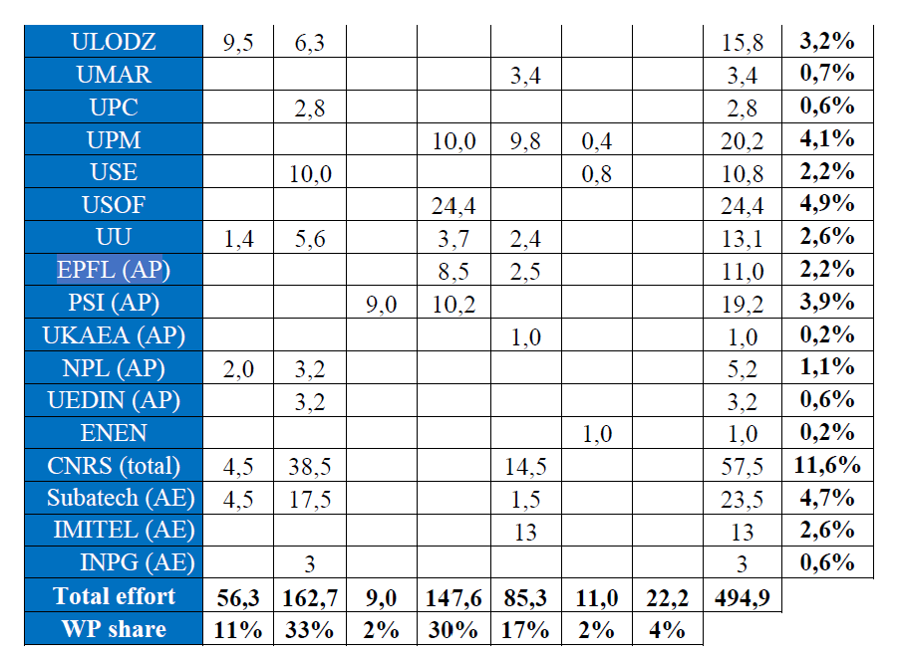
Summary of Staff effort
16 institutions
56.3 PM
11% share of overall staff effort
10% share of overall budget
Some indicators

Slide 5
WP1: Development of new equipment and infrastructures
WP1 Objectives:
Upgrading currently existing facilities and detecting systems to allow for more accurate means of studying nuclear reactions leading to nuclear data considered as priority.
Development and tests of detectors that enable access to new observables in already existing neutron beam facilities.
Contributing to the strategic analysis of EURATOM nuclear data capacities

Slide 6
WP1: Development of new equipment and infrastructures: TASK 1.1
TASK 1.1 Detector and facility upgrades [CNRS, RUG, JRC, IFIC, NPL, UU, JYI]
Task Leader: Muriel Fallot, CNRS/IN2P3
The current experimental capabilities of the participants in this project are excellent and allow for a very ambitious program of measurements addressing the priorities identified, which is the aim of W2. However, new challenges lay ahead and some of the existing infrastructures (IGISOL the target systems at NPL) and detectors (ELISA at JRC and the DTAS and Rocinante spectrometers) will benefit greatly by the upgrades proposed in this task, allowing for more accurate and complete experiments in the future.
Subtask 1.1.1 Enabling experiments in vacuum with ELISA at JRC-Geel…………………………… [NDELISA => RUG & JRC]
Subtask 1.1.2 Enhancement with LaBr₃ detectors of TAS capabilities for decay data…… [TAGS => IFIC & CNRS]
Subtask 1.1.3 Higher power target designs for neutron production for nuclear data…… [NPL-T => NPL]
Subtask 1.1.4 N-induced independent and isomeric fission yield studies at the IGISOL…. [NONIIII => JYI & UU]

Slide 7
WP1: Development of new equipment and infrastructures: TASK 1.2
TASK 1.2 Neutron detectors with new experimental capabilities [PTB, HZDR, CEA, NTUA, TUW, CIEMAT]
Task Leader: Elisa Pirovano, PTB
Neutrons are the main radiation of interest when it comes to fission, Hence, neutron detection is at the core of every neutron facility and neutron induced reaction measurement. Measuring neutrons is the means for both characterizing neutron beams and measuring specific reactions such as total or eleastic/inelastic cross sections. The following substasks contribute in different and complementary ways to establish new experimental capabilities to address future needs.
Subtask 1.2.1 An active target for n-p cross section measurements at PTB………………….. [ACTAnp => PTB]
Subtask 1.2.2 Enabling transmission measurements at nELBE and n_TOF……………………… [NEDEGARA => CEA & HZDR]
Subtask 1.2.3 Diamond detectors for in-beam measurements at n_TOF-NEAR……………… [DEAR => NTUA & TUW]
Subtask 1.2.4 Characterization of liquid scintillator detectors up to 40 MeV………………… [SCINDET => CIEMAT

Slide 8
WP1: Development of new equipment and infrastructures: TASK 1.3
TASK 1.3 Developments of Si-based devices for σ(n,chp), (UOI. INFN-LNS, ULODZ, CIEMAT, NPL)
Task Leader: Nikolas Patronis, UOI
Neutron induced reactions resulting in light charged particle production (n,lcp) are responsible for neutron absorption, gas production and residual nuclides (activation products). Inhibited by a Coulomb barrier or a reaction threshold their importance in nuclear devices is higher when fast neutron fluxes are considered, for instance in innovative devices. Several reactions emitting protons, tritium or alphas appear on the NEA HPRL given their interest in nuclear technology. The n_TOF facility at CERN is currently not capable of addressing the necessary measurements and thus two approaches will be followed to develop Si based detector systems allowing (n,lcp) measurements in the fast energy range, even beyond 10 MeV.
Subtask 1.3.1 Si-telescope for σ(n,chp) at n_TOF towards measuring ³⁹K(n, cp)…[Si-telescope => ULodz & CIEMAT]
Subtask 1.3.2 New annular DSSSD for σ(n,chp) at n_TOF……………………………………...[SADR => UOI & INFN]

Slide 9
APRENDE WP1 Milestones and Deliverables
ID | Milestone | Responsible |  | Month
1.1 | Acceptance by the CERN INTC of the n_TOF LOIs by CERN => Note: related to NEDEGARA, DEAR, Si-Telescope and SADR) | Nikolas Patronis, UOI? | Approval by the CERN INTC | 18 (3/2025)
1.2 | Realization of the test experiments related to ACTAnp | Elisa Pirovano, PTB? | Report to the WP lead | 24 (9/2026)
1.3 | Realization of the test experiments related to (NA)2STARS | Muriel Fallot, CNRS? | Report to the WP lead | 24 (9/2026)
1.4 | Realization of the test experiments related to NPL-T | Michael Bunce, NPL? | Report to the WP lead | 24 (9/2026)
ID | Deliverable | Lead | Type | Month
1.1 | Technical report on the facility upgrades at NPL and Jyväskylä => Note; related to NPL-T and NONIIII | PTB: Michael Bunce? | Report | 36 (9/2027)
1.2 | Performance of innovative neutron detectors => Note: related ACTAnp, NEDEGARA, DEAR and SCINDET | PTB: Elisa Pirovano? | Report | 36 (9/2027)
1.3 | Outlook of (n,chp.) measurements with fast neutrons at n_TOF => Note: related to both Si-telescope and SADR | INFN: Luigi Cosentino? | Report | 36 (9/2027)
1.4 | Enhanced capabilities of the LaBr₃ upgraded TAS detectors | CNRS: Muriel Fallot? | Report | 47 (8/2028)

Slide 10
APRENDE-WP1 conclusions
WP1: Development of new equipment and infrastructures
Participants: 16 institutions comitting 56.3 PM
In context: 11% share of staff effort with 10% share of overall Budget
Scientific case: very interestesting developments that shpudl lead to renewed capabilities of the ND community
Let’s hope for a
Collaborative and productive project

