Slide 1

APRENDE – WP2
New nuclear data measurements
Maëlle Kerveno,
IPHC, CNRS, Université de Strasbourg
Kick-Off Meeting
October, 16-17 2024, CIEMAT, Madrid

Slide 2
OUTLINE
Objectives
Partners & Structure
Description of Work
Commitments
Summary

Slide 3
OUTLINE
Objectives
Partners & Structure
Description of Work
Commitments
Summary

Slide 4
Objectives
Provide new and accurate experimental nuclear data to be used for improving the accuracy of the evaluated nuclear data relevant to project priorities:
A. All aspects of spent nuclear fuel (SNF),
B. Reactor operational characteristics such as reactivity versus burnup, transients, and margins,
C. Advanced reactor and fuel cycle development including small modular reactors (SMR) and GenIV systems based on lead and sodium coolants, molten salts, or an accelerator like MYRRHA,
D. Criticality safety and shielding for safety assessments and safety assessment methodologies,
E. Non-Energy applications, radiation protection.
Use state-of-the-art detectors and facilities available mainly in Europe to study various neutron induced reactions (fission, capture, elastic and inelastic scattering, charged particles emission and decay data)
Tackle challenging measurements listed in HPRL
Enhance exchanges between experimentalists (WP2) and evaluators (WP4)

Slide 5
OUTLINE
Objectives
Partners & Structure
Description of Work
Commitments
Summary

Slide 6










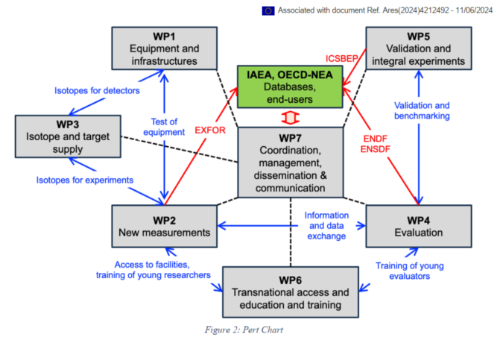
Partners & Structure
18 Partners for 186.2 PM & ~1.1 M€
CIEMAT (16.7) , CEA (20.3), ENEA (4), GANIL (2.3), CSIC (11.6), IFIN-HH (8), INFN (10.3), NTUA (7.8), RUG (7.2), UION (5.7), ULODZ (3), UPC (2.8), USE (10), UU (5.6), CNRS (32.5), JRC (26), NPL (AP-3.2), UEDIN (AP-3.2)
WP strongly linked to other WPs
5 tasks organized around the type of studied reactions

Slide 7
Partners & Structure
Structure
TASK 2.1 : Decay data,
Task leader : CSIC, Alejandro Algora
Other participants : CNRS
TASK 2.2 : (n, f) cross section measurements and fission yields,
Task leader : CEA, Abdelaziz Chebboubi
Other participants : CIEMAT, CNRS, JRC-Geel, UU, GANIL, NTUA, UION, ULODZ
TASK 2.3 : (n, γ) cross section measurements,
Task leader : CIEMAT, Emilio Mendoza
Other participants : CSIC, INFN, JRC-Geel, ENEA, CEA, USE
TASK 2.4 : Elastic and inelastic scattering cross section measurements,
Task leader : IFIN-HH, Adina Coman
Other participants : JRC-Geel, RUG, CNRS, NTUA
TASK 2.5 : (n, X) and (ch.p., X) reactions,
Task leader : NPL, Michael Bunce
Other participants : UEDIN, USE, CIEMAT, UPC, CSIC, UKAEA, JRC-Geel

Slide 8
Partners & Structure
Structure
TASK 2.1 : Decay data, CSIC, Alejandro Algora
TASK 2.2 : (n, f) cross section measurements and fission yields, CEA, Abdelaziz Chebboubi
2.2.1 Fission yields measurement
2.2.2 Neutron induced fission cross section measurements
2.2.3 ²³⁹Pu fission studies in the resonance range
TASK 2.3 : (n, γ) cross section measurements, CIEMAT, Emilio Mendoza
2.3.1 Capture reaction measurements on structural materials
2.3.2 Capture reaction measurements on actinides
2.3.3 Capture reaction measurements for neutron metrology
TASK 2.4 : Elastic and inelastic scattering cross section measurements, IFIN-HH, Adina Coman
2.4.1 (n, xnγ) cross section measurement
2.4.2 Elastic and inelastic scattering measurement
TASK 2.5 : (n, X) and (ch.p., X) reactions, NPL, Michael Bunce
2.5.1 ³⁵Cl(n, lcp) cross section measurement for advanced reactor concept
2.5.2 Cross section measurements for fusion applications

Slide 9
OUTLINE
Objectives
Partners & Structure
Description of Work
Commitments
Summary

Slide 10
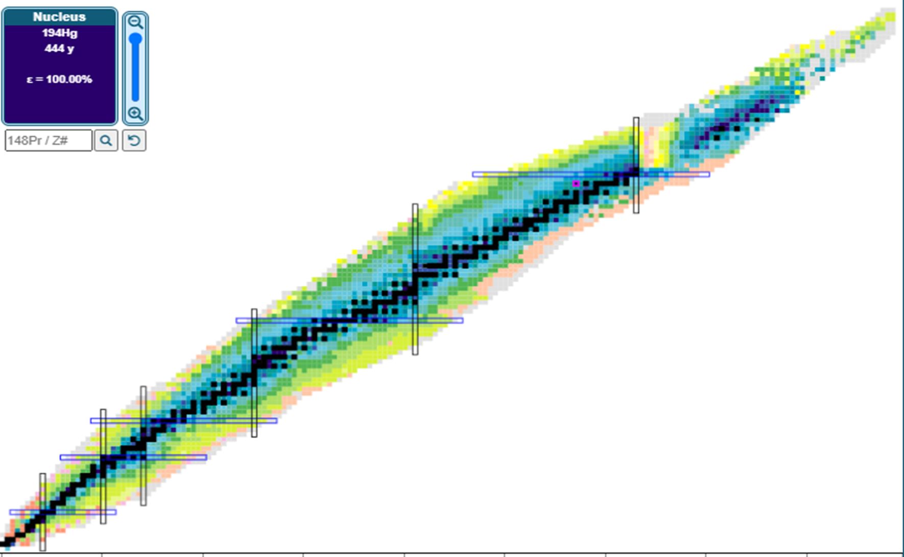
Description of Work
²⁵²Cf
²⁴²Pu
²⁴³Cm
²⁴¹Pu
²⁴³Am
²⁴⁰Pu
25 measurement projects (LoI)
37 nuclei under study from ⁷Li to ²⁵²Cf
Expected results :
completion of 40 experiments and production of 51 new data sets
19 data sets relative to HPRL request
²³⁸U
²³⁹Pu
²³⁵U
²³³U
²³²Th
²⁰⁹Bi
²⁰⁶Pb
²⁰⁸Pb
¹⁸⁶W
⁹⁶Y
⁹⁹Nb
⁹¹Kr
¹⁶⁶Er
⁹¹Br
⁹²Rb
¹⁶⁷Er
¹⁰⁹Ag
⁹⁰Zr
⁹²Zr
²⁷Al
³⁵Cl
⁶⁵Cu
⁶³Cu
¹⁰B
⁵⁴Fe
⁵⁶Fe
⁵⁹Co
⁹Be
^{6,7}Li

Slide 11
Description of Work
25 measurement projects (LoI) : 37 nuclei under study from ⁷Li to ²⁵²Cf
nucleus | reaction
6Li | 6Li(d,n)7Be
7Li | 7Li(d,2n)7Be
9Be | 9Be(α,n)
10B | 10B(α,n)13N
27Al | 27Al(α,n)
35Cl | 35Cl(n,p)
35Cl | 35Cl(n,a)
54Fe | 54Fe(n,α)51Cr
54Fe | 54Fe(n,2n)53Fe
54Fe | 54Fe(n,n)
54Fe | 54Fe(n,n')
56Fe | 56Fe(n,n)
56Fe | 56Fe(n,n')
nucleus | reaction
59Co | 59Co(n,γ)
63Cu | 63Cu(n,g)
65Cu | 65Cu(n,γ)
91Br | decay data
91Kr | decay data
92Rb | decay data
96Y | decay data
90Zr | 90Zr(n,n'γ)
92Zr | 92Zr(n,n'γ)
99Nb | decay data
109Ag | 109Ag(n,γ)
167Er | 167Er(n,γ)
166Er | 166Er(n,γ)
186W | 186W(n,γ)
nucleus | reaction
206Pb | 206Pb(n,n)
206Pb | 206Pb(n,n')
208Pb | 208Pb(n,n)
208Pb | 208Pb(n,n')
209Bi | 209Bi(n,γ)
232Th | 232Th(n,γ)
235U | FY
238U | 238U(n,γ)
238U | 238U(n,2nγ)
238U | 238U(n,3nγ)
233U | FY
nucleus | reaction
239Pu | 239pu(n,f)
239Pu | FY
239Pu | Pn
239Pu | 239pu(n,tot)
240Pu | 240pu(n,f)
241Pu | 241Pu(n,f)
241Pu | 241Pu(n,γ)
242Pu | 242Pu(n,f)
243Am | 243Am(n,f)
243Cm | FY
252Cf | FY
252Cf | Pn

Slide 12
Description of Work
51 new data sets for APRENDE priorities
WP2 new measurements | A. SNF | B. Burnup, Transients, Margins | C. Advanced reactors and fuel cyles | D.Criticality sfatey and shielding | E. Non-energy and radioprotection
 | TAS of 91Kr, 91Br and 99Nb | 166,167Er(n,γ) | Fast fission yields of 239Pu, 243Cm, 233U, 235U | 63Cu,65Cu (n,γ) cross sections | 59Co, 109Ag, 186W and 232Th (n,γ) MACS
 | beta-shape of 92Rb and 96Y decays |  | 240Pu and 242Pu (n,f) cross section
 | 231Am(n,f) cross section |  | 209Bi(n,γ) cross section |  | 27Al,9Be(α,n)
 | 241Pu(n,f)and (n,γ) |  | 231Am(n,f) cross section
 | 239Pu(n,tot) and 238U(n,γ) |  | 35Cl(n,p) (n,α) cross section |  | 10B(α,n)13N
 | 239Pu(n,f), nu_bar and spectrum |  | 90,92Zr(n,n’γ) and 238U(n,2-3nγ) cross section
 | Thermal fission yields of 235U |  | 206,208Pb and 54,56Fe(n,n) and (n,inel) cross section |  | 6,7Li(d,x)7Be
 |  |  | 54Fe activation in 252Cf spectrum

Slide 13
Description of Work
TASK 2.1 : Decay data
LoI : e-shape Measurement of the shape of beta transitions relevant for reactor applications (priority A) | Submitters : CNRS/SUBATECH : Magali Estienne CSIC : Alejandro Algora
Reaction | Energy range | Method/detector | Facility | HPRL | Exp. status | Link with other LoI | Delive-rable
β-Decay of fission product : ⁹²Rb, ⁹⁶Y | - | Shape of e⁻ spectrum with e-shape detector | JYFLTRAP @Jyväskylä | NO | - | TAGS (WP2) | D2.14 M45
LoI : TAGS Total absorption measurements for reactor applications (priority A) | Submitters : CNRS/SUBATECH : Muriel Fallot CSIC : Alejandro Algora
Reaction | Energy range | Method/detector | Facility | HPRL | Exp. status | Link with other LoI | Delive-rable
β-Decay of fission product : ⁹¹Kr, ⁹⁹Nb, ⁹¹Br | - | β-decay with DTAS or ROCINANTES TAS detector | JYFLTRAP @Jyväskylä | NO | To be submitted | (NA)2STARS (WP1) | D2.14 M45

Slide 14
Description of Work
TASK 2.2 : (n, f) cross section measurements and fission yields
2.2.1 Fission yields measurement (4)
LoI : AFFY Actinide Fission Fragments Yields (priority C) | Submitters : CEA/DRF: Diane Doré GANIL : Jean Eric Ducret CEA/DES : Olivier Litaize
Sample JRC Geel
Reaction | Energy range | Method/detector | Facility | HPRL | Exp. status | Link with other LoI | Delive-rable
²³⁵U(n,f) | 0.5 - 40 MeV | FY (mass) & neutron mult., kinetic en. distr. with FALSTAFF (2-arms) | NFS@SPIRAL2 | NO | MS5 M18 PAC GANIL | - | D2.6 M45
LoI : LOHENGRIN Fission mass yield measurement with the LOHENGRIN spectrometer (priority A & B) | Submitters : CNRS/LPSC : Christophe Sage CEA/DES : Abdelaziz Chebboubi
Reaction | Energy range | Method/detector | Facility | HPRL | Exp. status | Link with other LoI | Delive-rable
²³⁵U(n_{th},f) | thermal | LOHENGRIN + ToF | ILL | NO | Accepted | COREL (WP4) | D2.6 M45

Slide 15
Description of Work
TASK 2.2 : (n, f) cross section measurements and fission yields
2.2.1 Fission yields measurement (4)
LoI : VERDI The 2E-2v fragment spectrometer VERDI - High precision experiments on fission yields and nubar (priority A) | Submitters : UUppsala: Ali Al-Adili JRC-Geel : Stephan Oberstedt
Reaction | Energy range | Method/detector | Facility | HPRL | Exp. status | Link with other LoI | Delive-rable
²³⁵U(n_{th},f) ²⁵²Cf(sf) | thermal | mass and energy FY (pre-post neutron), nubar as a function of mass and total kinetic energy with VERDI spectrometer | ILL | NO | To be submitted | - | D2.6 M45
LoI : SENFY Fission Yields measurements (priority C) | Submitters : GANIL : Diego Ramos
Reaction | Energy range | Method/detector | Facility | HPRL | Exp. status | Link with other LoI | Delive-rable
²³³U,²³⁹Pu, ²⁴³Cm(n,f) | fast & epithermal neutron | isotopic FY in inverse kinematics with VAMOS PISTA | GANIL | NO | - | SENFY (WP4) | D2.7 M45

Slide 16
Description of Work
TASK 2.2 : (n, f) cross section measurements and fission yields
2.2.2 Neutron induced fission cross section measurements (3)
LoI : EPIC Fission cross section measurements of ^{242,240}Pu(n,f) (priority C) | Submitters : CEA/DAM : Audrey Chatillon JRC-Geel : Goedele Sibbens
Sample JRC Geel
Reaction | Energy range | Method/detector | Facility | HPRL | Exp. status | Link with other LoI | Delive-rable
^{240,242}Pu(n,f) | 0.7- 100 MeV | XS meas. (rel. to ^{235U} & ²³⁸U) with Fission chamber | WNR @LANL | YES | To be submitted | - | D2.8 M45
LoI : PuF ²⁴⁰Pu Fission cross section (priority C) | Submitters : CNRS/LP2i : Ludovic Mathieu
Sample JRC Geel
Reaction | Energy range | Method/detector | Facility | HPRL | Exp. status | Link with other LoI | Delive-rable
²⁴⁰Pu(n,f) | 1 – 3 MeV | XS meas. (rel. to H(n,p)) with Solar cells | MONNET @JRC-Geel | YES | To be submitted | - | D2.8 M45

Slide 17
Description of Work
TASK 2.2 : (n, f) cross section measurements and fission yields
2.2.2 Neutron induced fission cross section measurements (3)
LoI : SOFIA Study Of FΙssion cross section on 243-Am (SOFIA) (priority C) | Submitters : NTUAthens : Roza Vlastou Uioannina : Nikolaos Patronis
Sample JRC Geel
Reaction | Energy range | Method/detector | Facility | HPRL | Exp. status | Link with other LoI | Delive-rable
²⁴³Am(n,f) | thermal -hundred of MeV | XS meas. (rel. to ²³⁵U(n,f), ²³⁸U(n,f) and ¹⁰B(n,α) ) with micromegas det. | EAR1 & EAR2 @n_TOF | YES | - | - | D2.10 M45

Slide 18
Description of Work
TASK 2.2 : (n, f) cross section measurements and fission yields
2.2.3 ²³⁹Pu fission studies in the resonance range (2)
LoI : Pu239 Toward new measurements and evaluation of the Pu239 resonance parameters (priority A & B) (priority C) | Submitters : CIEMAT : Emilio Mendoza Ulodz : Jaroslaw Perkowski
Sample JRC Geel
Reaction | Energy range | Method/detector | Facility | HPRL | Exp. status | Link with other LoI | Delive-rable
²³⁹Pu(n,f) | low energy region resonance range | XS meas. with Fission chamber (used at n-TOF in the TAC) | GELINA @JRC-Geel | YES | To be submitted MS6 M24 | Pu239 (WP4) | D2.9 M45
LoI : REMUS Resonance Prompt Neutron Multiplicity in Pu239 Fission (priority A & B) | Submitters : Uuppsala : Andreas Solders JRC-Geel : Stephan Oberstedt CEA/DES : Olivier Litaize
Sample JRC Geel
Reaction | Energy range | Method/detector | Facility | HPRL | Exp. status | Link with other LoI | Delive-rable
²³⁹Pu(n,f) | 0.3 - 100 eV (RRR) | nubar % 252Cf(sf) nubar & PNS with SCINTIA, LaBr3 and IC | GELINA @JRC-Geel | YES | To be submitted MS6 M24 |  | D2.9 M45

Slide 19
Description of Work
TASK 2.3 : (n, γ) cross section measurements
2.3.1 Capture reaction measurements on structural materials (3)
LoI : BINGO ²⁰⁹Bi(n,γ) cross section measurement at n_TOF (priority C) | Submitters : IFIC : Javier Balibrea Correa
Reaction | Energy range | Method/detector | Facility | HPRL | Exp. status | Link with other LoI | Delive-rable
²⁰⁹Bi(n,γ) ²⁰⁹Bi(n,γ)/^{209m}Bi(n,γ) BR | thermal - 300 keV neutron resonance | TOF & Pulse height weighting method, Activation (XS & BR) | EAR2@n_TOF HISPANOS@CNA | YES | Accepted @n-TOF | - | D2.11 M45
LoI : ErCapture Measurement and analysis of the capture cross section of Er-166 and Er-167 (priority B) | Submitters : CIEMAT : Victor Alcayne Aicu INFN : Cristian Massimi
Reaction | Energy range | Method/detector | Facility | HPRL | Exp. status | Link with other LoI | Delive-rable
^{166,167}Er(n,γ) | 0,02 - 100 keV | TAC & C6D6 | EAR1 & EAR2@n_TOF | YES | - | - | D2.11 M45

Slide 20
Description of Work
TASK 2.3 : (n, γ) cross section measurements
2.3.1 Capture reaction measurements on structural materials (3)
LoI : RAMEN Neutron cross sections for ⁶³Cu and ⁶⁵Cu (priority D) | Submitters : INFN : Cristian Massimi ENEA : Donato Maurizio Castelluccio
Reaction | Energy range | Method/detector | Facility | HPRL | Exp. status | Link with other LoI | Delive-rable
^{63,65}Cu(n,γ) | thermal - 300 keV | XS with C6D6 | EAR @n_TOF | YES/NO | To be submitted ? MS7 M24 | - | D2.11 M45

Slide 21
Description of Work
TASK 2.3 : (n, γ) cross section measurements
2.3.2 Capture reaction measurements on actinides (3)
LoI : Cap-Fiss-Pu241 Measurements of the ²⁴¹Pu fission and capture cross sections at GELINA and n_TOF (priority A) | Submitters : CEA/DRF : Emmeric DUPONT CEA/DES : Olivier Serot
Sample JRC Geel
Reaction | Energy range | Method/detector | Facility | HPRL | Exp. status | Link with other LoI | Delive-rable
²⁴¹Pu(n,f) ²⁴¹Pu(n,γ) | En < 1 MeV En < 100 keV | Fission XS and fission to capture ratio with TAC & FC | GELINA@JRC-Geel EAR1@n_TOF | YES | Accepted | - | D2.12 M45
LoI : Pu239 Toward new measurements and evaluation of the Pu239 resonance parameters (priority A & B) | Submitters : CEA/DES : Gilles Noguere JRC-Geel : Carlos Paradela
Sample JRC Geel
Reaction | Energy range | Method/detector | Facility | HPRL | Exp. status | Link with other LoI | Deliverable
²³⁹Pu(n,tot) | Resonance range | Transmission | GELINA @JRC-Geel | YES | To be submitted MS6 M24 | Pu239 (WP4) | D2.9 M45

Slide 22
Description of Work
TASK 2.3 : (n, γ) cross section measurements
2.3.2 Capture reaction measurements on actinides (3)
LoI : U238_NG_Meas Measurement of the U-238 neutron capture cross section at the n_TOF facility (priority A) | Submitters : CIEMAT : Emilio Mendoza
Reaction | Energy range | Method/detector | Facility | HPRL | Exp. status | Link with other LoI | Delive-rable
²³⁸U(n,γ) | thermal - 20 keV | C6D6 | EAR1@n_TOF | YES | Accepted | - | D2.12 M45

Slide 23
Description of Work
TASK 2.3 : (n, γ) cross section measurements
2.3.3 Capture reaction measurements for neutron metrology
LoI : M2nM MACS Measurements for Neutron Metrology (priority E) | Submitters : Usevilla/CNA : Carlos Guerrero
Reaction | Energy range | Method/detector | Facility | HPRL | Exp. status | Link with other LoI | Delive-rable
⁵⁹Co(n,γ), ¹⁰⁹Ag(n,γ), ¹⁸⁶W(n,γ), ²³²Th(n,γ) | kt=30 keV | SACS_{30keV} with activation | HISPANOS@CNA | NO | accepted | - | D2.2 M36

Slide 24
Description of Work
TASK 2.4 : Elastic and inelastic scattering cross section measurements
2.4.1 (n, xnγ) cross section measurement
LoI : NNNXNXS (n,n) and (n,xnγ) cross section measurements (priority C & D) | Submitters : IFIN-HH : Adina Coman CNRS/IPHC : Maëlle Kerveno JRC-Geel : Carlos Paradela
Reaction | Energy range | Method /detector | Facility | HPRL | Exp. status | Link with other LoI | Delive-rable
⁹²Zr(n,n’γ), ⁹⁰Zr(n,n’γ), ²³⁸U(n,2-3nγ) | <20 MeV <20 MeV 6-40 MeV | GAINS GRAPhEME MAELS | GELINA@JRC-Geel GELINA@JRC-Geel NFS@SPIRAL2 | NO | to be submitted MS6 M24 - In progress | ZEN (WP4) ZEN (WP4) | D2.13 M45

Slide 25
Description of Work
TASK 2.4 : Elastic and inelastic scattering cross section measurements
2.4.2 Elastic and inelastic scattering measurement
LoI : NNNXNXS (n,n) and (n,xnγ) cross section measurements (priority C & D) | Submitters : Ugroningen : Myroslav Kavatsyu NTUAthens : Maria Diakaki JRC-Geel : Carlos Paradela
Reaction | Energy range | Method /detector | Facility | HPRL | Exp. status | Link with other LoI | Delive-rable
^{54,56}Fe(n,n’),(n,n) ^{206,208}Pb(n,n’), (n,n) | <20 MeV <20 MeV | ELISA | GELINA@JRC-Geel | NO/YES YES/NO | - To be sub. MS6 M24 | NNNXNXS (WP4) NDELISA (WP1) | D2.13 M45

Slide 26
Description of Work
TASK 2.5 : (n, X) and (ch.p., X) reactions
2.5.1 ³⁵Cl(n, lcp) cross section measurement for advanced reactor concept (2)
LoI : 35clxs ³⁵Cl(n,p;α)³⁵S cross section measurement in the energy range En=0.5-5 MeV (priority C) | Submitters : NPL : Giuseppe Lorusso
Reaction | Energy range | Method/detector | Facility | HPRL | Exp. status | Link with other LoI | Delive-rable
³⁵Cl(n,p) ³⁵Cl(n,α) | 0.1-5 MeV | XS by activation | NPL | YES NO | To be submitted | - | D2.1 M36
LoI : More Measurement of the ³⁵Cl(n,p)³⁵S cross section relevant for fast chloride molten salt reactor design (priority C) | Submitters : Uedinburgh : Claudia Lederer-Woods JRC-Geel : Cristiano Fontana
Reaction | Energy range | Method/detector | Facility | HPRL | Exp. status | Link with other LoI | Delive-rable
³⁵Cl(n,p) | 1.4 MeV - 3 MeV | XS with double sided silicon strip detectors | MONNET@JRC-Geel | YES | To be submitted | - | D2.1 M45

Slide 27
Description of Work
TASK 2.5 : (n, X) and (ch.p., X) reactions
2.5.2 Cross section measurements for fusion applications (3)
LoI : He3Be7@DONES Assessing the NEA-HPRL request for measuring the deuteron-induced production of ³H and ⁷Be in ^{6,7}Li up to 40 MeV (priority E) | Submitters : Usevilla/CNA : Carlos Guerrero
Reaction | Energy range | Method/detector | Facility | HPRL | Exp. status | Link with other LoI | Delive-rable
⁶Li(d,n)⁷Be ⁷Li(d,2n)⁷Be | 5 - 40 MeV | differential cross sections for ⁷Be production via activation | HISPANOS@CNA NFS@SPIRAL2 | YES YES | To be submitted MS5 M24 | - | D2.5 M45
LoI : XS10BAN ¹⁰B(a,n)¹³N cross section measurement and evaluation for plasma diagnostics applications (priority E) | Submitters : UKAEA : Ivan Kodeli NPL : Giuseppe Lorusso
Reaction | Energy range | Method/detector | Facility | HPRL | Exp. status | Link with other LoI | Delive-rable
¹⁰B(α,n)¹³N | 1 – 6 MeV | XS with moderated 3He detector ELIGANT-TN | IFIN-HH | NO | To be submitted | - | D2.4 M45

Slide 28
Description of Work
TASK 2.5 : (n, X) and (ch.p., X) reactions
2.5.2 Cross section measurements for fusion applications (3)
LoI : MANY Measurement of (α,xn) reactions yields (priority E) | Submitters : CIEMAT : Trino Martinez Perez UPC : Guillem Cortes Rossell CSIC : Ariel Tarifeño Usevilla/CNA : Carlos Guerrero
Reaction | Energy range | Method/detector | Facility | HPRL | Exp. status | Link with other LoI | Delive-rable
²⁷Al(α,n) ²⁷Al(α,n) ⁹Be(α,n) ⁹Be(α,n) | up to 9 MeV 2 - 10 MeV 2 - 10 MeV up to 9 MeV | activation & MONSTER detector (time fo flight) miniBELEN | HISPANOS@CNA CMAM | NO | To be submitted | - | D2.4 M45

Slide 29
Description of Work
TASK 2.5 : (n, X) and (ch.p., X) reactions
2.5.3 Cross section measurements for dosimetry
LoI : NPL_D Iron reaction cross-section measurements for dosimetry at the National Physical Laboratory (priority E) | Submitters : NPL : Michael Bunce
Reaction | Energy range | Method/detector | Facility | HPRL | Exp. status | Link with other LoI | Delive-rable
⁵⁴Fe(n,α)⁵¹Cr ⁵⁴Fe(n,2n)⁵³Fe | 15,5 - 19 MeV & ²⁵²Cf | activation | NPL | YES | - | - | D2.3 M36

Slide 30
OUTLINE
Objectives
Partners & Structure
Description of Work
Commitments
Summary

Slide 31
Commitments
Milestones
Only 3 milestones to verify that the experiments performed at neutron facility with competitive beam time request have been accepted before the half of the project
MS5 | Experiments accepted at NFS | WP2 | 3 - CEA | Report to the WP lead | M18
MS6 | Experiments accepted at JRC-Geel | WP2 | 35 - CNRS | Report to the WP lead | M24
MS7 | Experiments accepted at n_TOF | WP2 | 6 - ENEA | Report to the WP lead | M24

Slide 32
Commitments
Deliverables
14 reports have to be prepared.
If possible (ready) produced data have to be send to EXFOR before the end of the project.
(NB: the last deliverable date is M45 and not M48!)
# | Deliverable Title | Lead | name | Type | Diss. level | due date in Months |  | tasks | LoI involved | institutions
D2.1 | Report on measurement results for 35Cl(n, lcp) reaction Cross section | UEdinburg | C. Lederer-Woods | Report | public | M36 |  | 5 : (n,X) & (lcp, X) reaction studies | 35ClXS, More | NPL, UEdinburgh
D2.2 | report on measurements for SACS measurements on 59Co, 109Ag, 186W, 232Th | USevilla | C. Guerrero | Report | public | M36 |  | 3 : (n,g) cross section measurements | M2NM | USevilla
D2.3 | Report on the alpha and neutron yield in neutron induced reactions on 54Fe | NPL | M. Bunce | Report | public | M36 |  | 5 : (n,X) & (lcp, X) reaction studies | NPL-D | NPL
D2.4 | Report on measurement results for 27Al, 9Be, 10B(α,n) cross section | UPC | G. Cortes Rossell | Report | public | M45 |  | 5 : (n,X) & (lcp, X) reaction studies | MANY, XS10BAN | CIEMAT, UPC, IFIC, USevilla, NPL, UKAEA
D2.5 | Report on the Be production in deuteron induced reaction on Li | USevilla | C. Guerrero | Report | public | M45 |  | 5 : (n,X) & (lcp, X) reaction studies | H3Be7@DONES | USevilla

Slide 33
Commitments
Deliverables
14 reports have to be prepared.
If possible (ready) produced data have to be send to EXFOR before the end of the project.
(NB: the last deliverable date is M45 and not M48!)
# | Deliverable Title | Lead | name | Type | Diss. level | due date in Months |  | tasks | LoI involved | institutions
D2.6 | Report on thermal and fast fission yields and nu-bar in 235U(n,f) | CEA | A. Chebboubi | Report | public | M45 |  | 2: (n,f) cross section measurements and fission yields | AFFY, LOHENGRIN, VERDI | CEA, CNRS, UUppsala
D2.7 | Report on measurement results for fission yields of 239Pu, 243Cm, 233U | GANIL | D. Ramos | Report | public | M45 |  | 2: (n,f) cross section measurements and fission yields | SENFY | GANIL
D2.8 | Report on measurements for 242Pu and 240Pu(n,f) cross section | CNRS | L. Mathieu | Report | public | M45 |  | 2: (n,f) cross section measurements and fission yields | EPIC, PuF | CEA,CNRS
D2.9 | Report on 239Pu(n,f) and (n,tot) measurements | CEA | G. Noguere | Report | public | M45 |  | 2: (n,f) cross section measurements and fission yields | Pu239, REMUS | CEA, CIEMAT, Ulodz, UUppsala
D2.10 | Report on measurements for 243Am(n,f) cross section | NTUAthens | R. Vlastou | Report | public | M45 |  | 2: (n,f) cross section measurements and fission yields | SOFIA | NTUAthens, Uioannina

Slide 34
Commitments
Deliverables
14 reports have to be prepared.
If possible (ready) produced data have to be send to EXFOR before the end of the project.
(NB: the last deliverable date is M45 and not M48!)
# | Deliverable Title | Lead | name | Type | Diss. level | due date in Months |  | tasks | LoI involved | institutions
D2.11 | Report on (n, γ) cross section on 209Bi, 166,167Er and 63,65Cu | INFN | C. Massimi | Report | public | M45 |  | 3 : (n,g) cross section measurements | BINGO, ERCapture, RAMEN | IFIC, CIEMAT, INFN
D2.12 | Report on (n, g) measurements on actinides (238U, 241Pu) | CIEMAT | E. Mendoza | Report | public | M45 |  | 3 : (n,g) cross section measurements | CAP-FISS-Pu241, U238_NG_Meas, | CEA, CIEMAT, Ulodz, UUppsala
D2.13 | Report on (n, el) and (n, inel) data of 54,56Fe, 90,92Zr, 206,208Pb, 238U | IFIN-HH | A. Olacel | Report | public | M45 |  | 4 : elastic and inelastic scattering cross section measurements | NNNXNXS | IFIN-HH, CNRS, Ugroningen, NTUAthens
D2.14 | report on β-decay studies : 92Rb, 96Y, 91Br, 91Kr, 99Nb | IFIC | A. Algora | Report | public | M45 |  | 1 : Decay data | e-shape, TAGS | IFIC, CNRS

Slide 35
OUTLINE
Objectives
Partners & Structure
Description of Work
Commitments
Summary

Slide 36
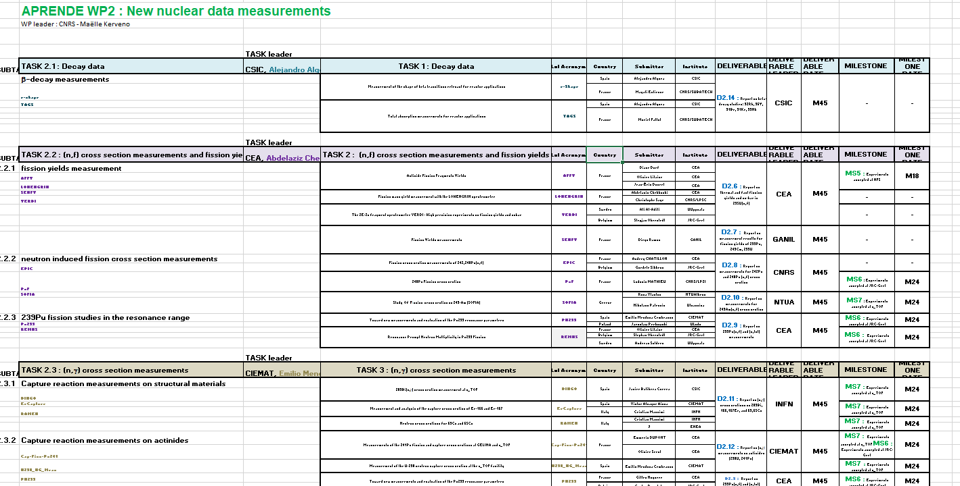
Summary
Very ambitious WP which must produce a significative amount of accurate new experimental data
WP management
Tables with all the information (WP structure, milestones, deliverables, contacts) have been already sent to all LoI’s submitters. Consider it as a “summary map” of all WP2 works. KEEP IT! (also on indico)

Slide 37
Summary
Very ambitious WP which must produce a significative amount of accurate new experimental data
WP management
Tables with all the information (WP structure, milestones, deliverables, contacts) have been already sent to all LoI’s submitters. Consider it as a “summary map” of all WP2 works. KEEP IT! (also on indico)
Task leaders will be key people for efficient management.

Slide 38
Summary
Very ambitious WP which must produce a significative amount of accurate new experimental data
WP management
Tables with all the information (WP structure, milestones, deliverables, contacts) have been already sent to all LoI’s submitters. Consider it as a “summary map” of all WP2 works. KEEP IT! (also on indico)
Task leaders will be key people for efficient management.
Remote meetings, between WP leader and task leaders (and/or LoI’s submitters) will be organized every 6 months to follow and monitor the progress of each task. First in January 2025!

Slide 39
Summary
Very ambitious WP which must produce a significative amount of accurate new experimental data
WP management
Tables with all the information (WP structure, milestones, deliverables, contacts) have been already sent to all LoI’s submitters. Consider it as a “summary map” of all WP2 works. KEEP IT! (also on indico)
Task leaders will be key people for efficient management.
Remote meetings, between WP leader and task leaders (and/or LoI’s submitters) will be organized every 6 months to follow and monitor the progress of each task. First in January 2025!
In case of major difficulties during the execution of the project, inform as soon as possible.

Slide 40
Summary
Very ambitious WP which must produce a significative amount of accurate new experimental data
WP management
Tables with all the information (WP structure, milestones, deliverables, contacts) have been already sent to all LoI’s submitters. Consider it as a “summary map” of all WP2 works. KEEP IT! (also on indico)
Task leaders will be key people for efficient management.
Remote meetings, between WP leader and task leaders (and/or LoI’s submitters) will be organized every 6 months to follow and monitor the progress of each task.
In case of major difficulties during the execution of the project, inform as soon as possible.
A desire to strengthen exchanges between experimentalists and evaluators to streamline and improve the overall evaluation process
Organization of common WP2-WP4 workshops during the APRENDE project :
exchanges on “good practices”, on common studied (meas. & eval.) nuclei, …

Slide 41
Summary
SUMMARY per PARTNERS
L = Lead beneficiary
Partner | CNRS | JRC | CEA | CIEMAT | CSIC | INFN | USE | IFIN-HH
PM | 32.5 | 26 | 20.3 | 16.7 | 11.6 | 10.3 | 10 | 8
Task/sub-task | 2.1- 2.2.1- 2.2.2- 2.4.1 | 2.2.2- 2.2.3- 2.3.2- 2.4.1- 2.4.2 | 2.2.1- 2.2.2- 2.2.3- 2.3.2 | 2.2.3- 2.3.1- 2.3.2- 2.5.2 | 2.1- 2.3.1- 2.5.2 | 2.3.1 | 2.3.3- 2.5.2 | 2.4.1
Respons-ibilities | WP Leader; D2.8 L; MS6 L |  | T leader 2.2; D2.9 & D2.6 L; MS5 L | T leader 2.3; D2.12 L; | T leader 2.1; D2.14 L | D2.11 L; | D2.2 & D2.5 L; | T leader 2.4; D2.13 L
Contri-bution to Delivera-ble | D2.6 D2.8 D2.13 | D2.8 D2.9 D2.13 | D2.6 D2.8 D2.9 D2.12 | D2.4 D2.9 D2.11 D2.12 | D2.4 D2.11 D2.14 | D2.11 | D2.2 D2.4 D2.5 | D2.13

Slide 42
Summary
SUMMARY per PARTNERS
L = Lead beneficiary
Partner | NTUA | RUG | UION | UU | ENEA | NPL | UEDIN | ULODZ | UPC | GANIL
PM | 7.8 | 7.2 | 5.7 | 5.6 | 4 | 3.2 | 3.2 | 3 | 2.8 | 2.3
Task/sub-task | 2.2.2- 2.4.2 | 2.4.2 | 2.2.2 | 2.2.1 2.2.3 | 2.3.1 | 2.5.1- 2.5.3 | 2.5.1 | 2.2.3 | 2.5.2 | 2.2.1
Respons-ibilities | D2.10 L |  |  |  | MS7 L | T Leader 2.5; D2.3 L | D2.1 L |  | D2.4 L | D2.7 L
Contri-bution to Delivera-ble | D2.10 D2.13 | D2.13 | D2.10 | D2.6 D2.9 | D2.11 | D2.1 D2.3 | D2.1 | D2.9 | D2.4 | D.7

Slide 43

THANK YOU
WISH list
A fruitful collaboration,
Efficient cooperation for reporting,
Nice and significant results !!!

