Slide 1


APRENDE (Addressing PRiorities of Evaluated Nuclear Data in Europe)
Task 6.5: Organization of Schools
This project has received funding from the European Union’s Horizon Europe Euratom Research and Training Programme (EURATOM) under Grant Agreement No: 101164596-APRENDE
Carlos GUERRERO
Universidad de Sevilla
Centro Nacional de Aceleradores (CNA)
cguerrero4@us.es
APRENDE kick-off meeting, Madrid (16/10/2024)

Slide 2
Summary
Task 6.5 Organisation of two summer schools (M1-M48),
Task leader: USE
Other participants: USE, UPM, ESS, HZDR, CIEMAT
Budget; 56 k€ (1.4% share of budget)
“HISPANOS Hands-on school on the production, detection and use of neutrons” (USE, D6.6)
Director of the school: Carlos Guerrero (USE)
“Nuclear data: The path from the detector to the reactor calculation” (UPM, D6.7)
Director of the school: Oscar Cabellos (UPM)
- The target groups are young European scientists or engineers.
- The schools cover theoretical lectures and practical hands-on laboratory exercises.
- The courses address all aspects of nuclear data from experiment to the end-use by consortium laboratories (USE, UPM) with an excellent educational reputation for forming earlystage researchers.
- Cooperation with ENEN will allow us to reach out to a wider research community.

Slide 3
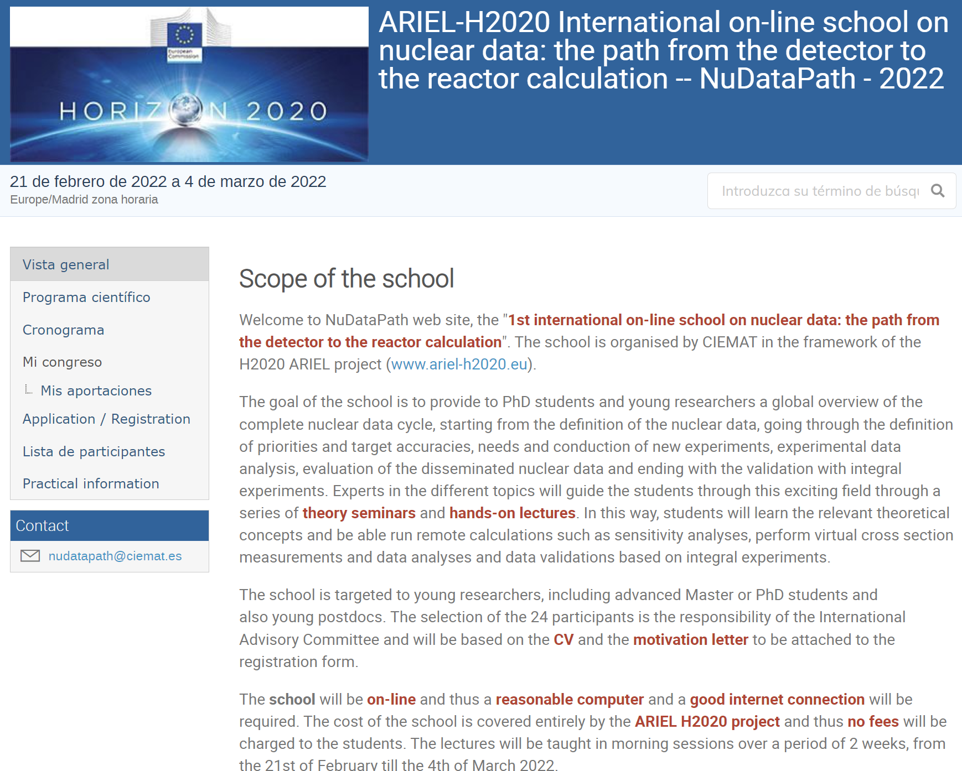
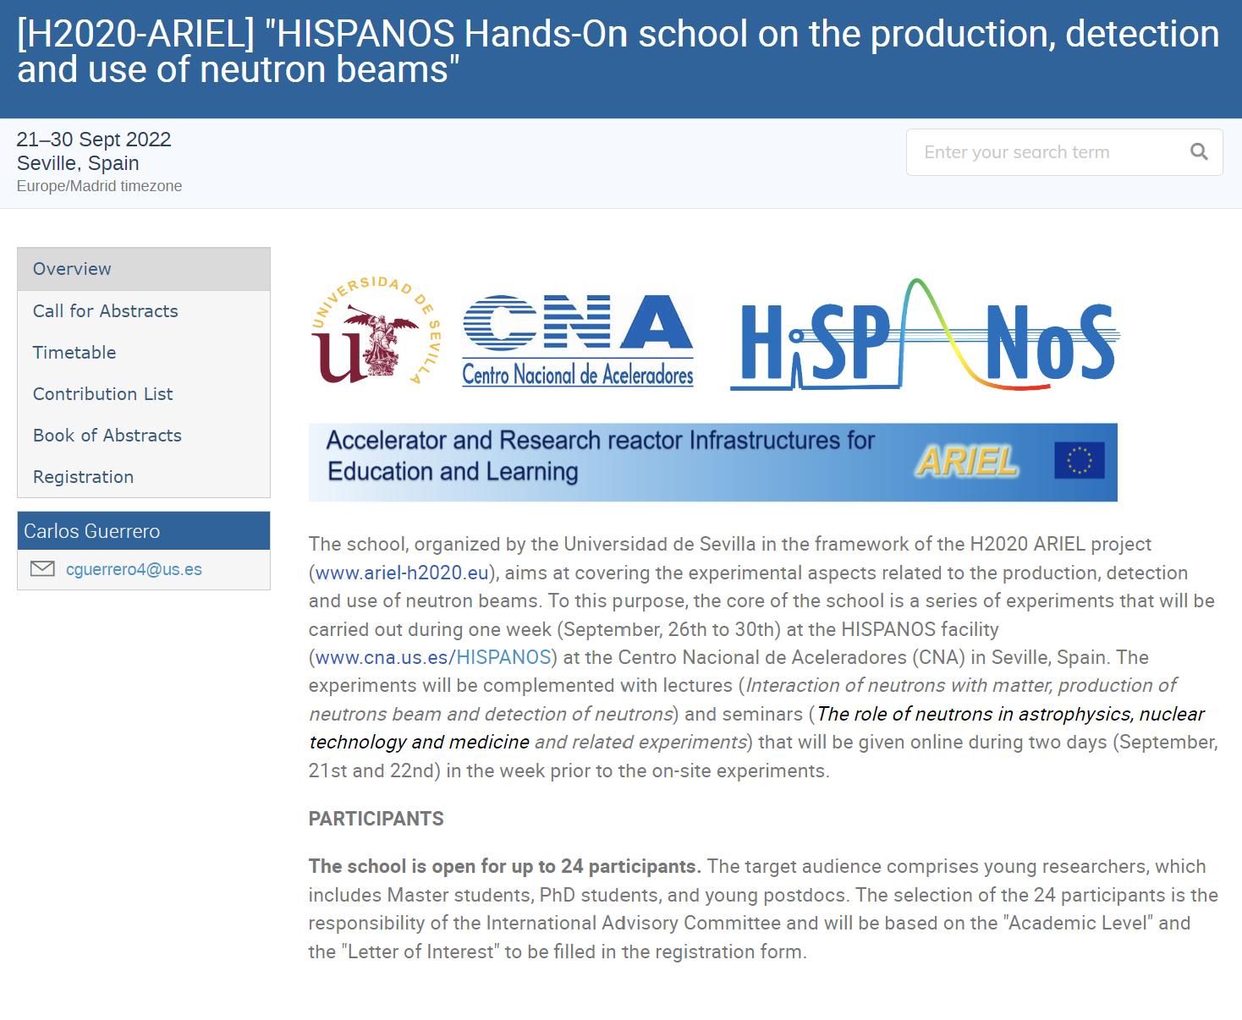
2nd edition of two H2020-ARIEL schools
https://agenda.ciemat.es/event/3201/
https://indico.cern.ch/event/865322/

Slide 4
General aspects and differences with previous editions
“HISPANOS Hands-on school on the production, detection and use of neutrons” (USE, D6.6)
Expected in September 2025 [M12] (3 years after prev. edition)
~24 participants
Only minor changes with respect to previous editions
“Nuclear data: The path from the detector to the reactor calculation” (UPM, D6.7)
Expected in ~June 2026 [M21] (3 years after prev. edition)
~40 participants
Presential (@UPM) in 2026 instead of online @CIEMAT in 2022
In both cases:
School during the first half of the Project, so that APRENDE’s young researchers fully profit
One week of presence
Seminars during the previous week(s) to introcuce concepts and exercises
International Advisory Committee (IAC) for bllind selection of the participants

