Slide 1


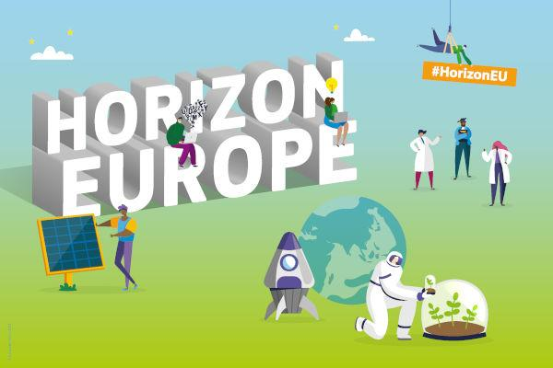
ADDRESSING PRIORITIES OF EVALUATED NUCLEAR DATA IN EUROPE
APRENDE
Grant agreement 101164596
WP6 – T6.6 Dissemination and exploitation
Daniel Cano Ott

Slide 2
APRENDE kick off meeting
The goal of task 6.6 is to
Coordinate and follow-up of the dissemination and communication activities all over the project.
Assess the state of (European) nuclear data libraries, computer simulation tools, and research infrastructures for nuclear data measurements to advise on strategic actions for preserving and developing Euratom capacities. The strategic analysis will be made with the collaboration of the different WP leaders and will be the content of D6.8 “Strategic analysis of nuclear data activities and resources in Europe”.
Enhance the visibility of how nuclear data play an important role in several fields (energy, health, space, environment, industry…) and that its improvement is of great benefit for science, end-users and society.

Slide 3
Target groups
APRENDE will engage with a series of target groups, media, public, and research communities to effectively disseminate the results:
Nuclear scientists and engineers
  performing simulations of nuclear reactors or fuel cycles facilities
  performing simulations of nuclear treatments or diagnostics for medical applications.
  performing simulations to optimize isotope production for medical therapy or diagnosis.
  developing radiation detectors, nuclear facilities, and various methods to measure, evaluate, or validate basic nuclear data.
  in environmental or other industries designing or analysing results from radiative tools.
• Students and people in training period.
• Research organizations, public organizations, technological platforms, and industry using nuclear technologies.
• International organizations like OECD-NEA and IAEA, responsible for the storage and dissemination of nuclear data.
• Governments, European Commission, and funding agencies, as receivers of the strategic analysis on nuclear data in Europe.

Slide 4
Dissemination & exploitation mechanisms
Dissemination of data via international organizations
  Regular exchange of information with the IAEA and NEA-OCDE.
  Liaison with the Joint European Fission and Fusion nuclear data library – JEFF project (OECD-NEA) to make sure that the APRENDE results (in the form of ENDF–formatted files) receive a priority consideration for inclusion in the future releases of the JEFF library.
  Experimental data and evaluated nuclear data data produced in the project will be disseminated via open international libraries and international nuclear data centres coordinated by the IAEA (https://wwwnds.iaea.org/) and by the OECD-NEA Data bank (https://www.oecd-nea.org/databank/). This mechanism will preserve the data beyond the end of the project and guarantees its broad availability.
Dissemination via articles in (peer-reviewed) scientific journals, PhD, and master's theses.
Dissemination via conferences, workshops, and technical meetings.
E&T activities.
Participation in generic events with partners of the technological platforms and associations (SNETP, ENEN, SMR Industrial Alliance…)
Governments, European Commission, and funding agencies, as receivers of the strategic analysis on nuclear data in Europe.

Slide 5


Basic rules to be followed
All the results of the work (partially) funded by APRENDE will have to:
Be public. This includes both the data, publications (papers, reports, conference proceedings, presentations) and codes. They will have to be available at a public site (EXFOR, ENDF repositories, as Open Access publications in journals, open access archives (arXiv…) APRENDE web site…).
Acknowledge the funding received by APRENDE / EC. Use of adequate acknowledgement sentence, EC logos, APRENDE logo…
Report to the PMO & Coordinator every dissemination activity and submit the material. A public file will be available for adding the details.
All project partners have committed (GA) to actively contribute to the dissemination.

