Slide 1



ADDRESSING PRIORITIES OF EVALUATED NUCLEAR DATA IN EUROPE
APRENDE
Grant agreement 101164596
WP7 – Management
Daniel Cano Ott

Slide 2
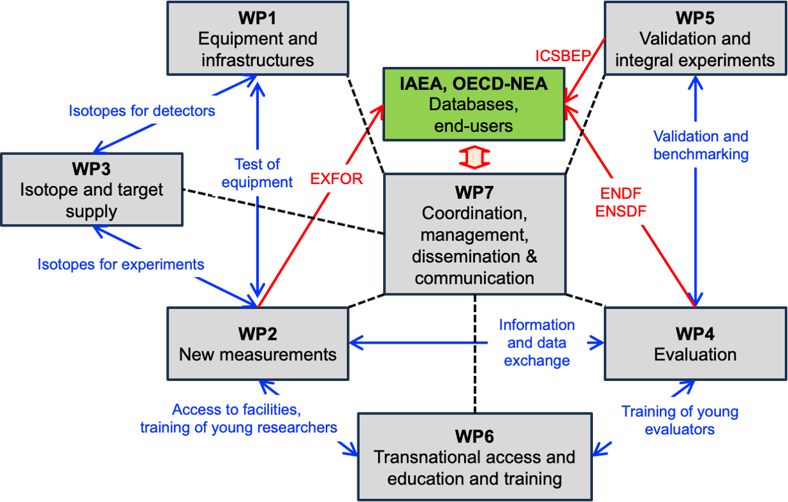
Task 7.2 Scientific exchange and coordination with external agencies

Slide 3
Task 7.2 Scientific exchange and coordination with external agencies
Project meetings
Involving a few researchers. For example, experimentalists responsible for a data set and evaluators using it in their evaluation.
Involving entire WPs. For example, WP2 and WP6; WP1 and WP2…
General project meetings, on a ~yearly frequency.
Having joint meeting with other ND activities. For example, the NEA nuclear data week…
Workshops
Participation in workshops in Europe, USA, Asia…
Participation of APRENDE researchers in NEA and IAEA working groups (large previous experience).
Participation of APRENDE researchers in the JEFF project (evaluators, validators…)
Incorporating external advisors to the ExCom
Strategic meetings
With NEA, IAEA, NuPECC, SNETP, SMR Industrial alliance, nuclear data program managers overseas (USA, Japan, China, Korea…)

Slide 4
Task 7.2 Scientific exchange and coordination with external agencies
Meetings with stakeholders
Inviting stakeholders to APRENDE General meetings.
Attending meetings with stakeholders organised by other agencies
Information exchange with other EURATOM projects
Several of the APRENDE participants are participating in other EURATOM projects like EUROLABS, OFFERR, EURAD-II, TRANSPARANT, LESTO…

