Slide 1
KateŘina PtÁČkovÁ
APRENDE KoM
16 October 2024

Slide 2
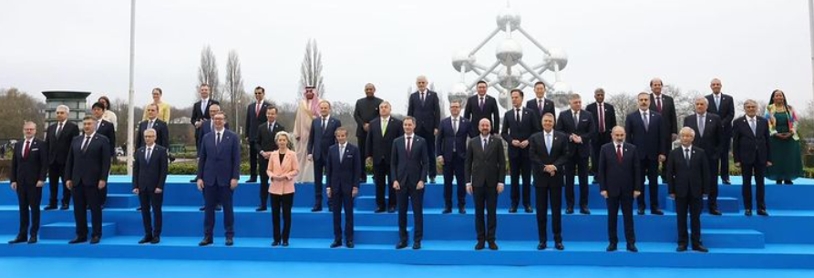
Nuclear comeback on policy agenda
  A world renewed pledge for nuclear by 20 nations at COP-28 in November 2023 (‘to triple nuclear energy capacity by 2050’)
  21 March 2024, Brussels - Nuclear Energy Summit: the world's first high-level meeting focused entirely on nuclear energy, attended by world leaders from more than 30 countries and the European Union

Slide 3
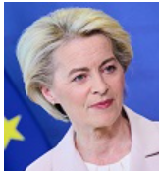
European policy developments
Nuclear Energy Summit, Brussels, 21 March 2024
“I am here because I believe that, in countries that are open to the technology, nuclear technologies can play an important role in clean energy transitions.”
GLOBSEC Forum 2024, Prague, 30 August 2024
“When we speak about our energy, we have to produce more of our own energy – more renewables, more nuclear, more efficiency.”
  European Grean Deal: climate neutrality by 2050
  EU Green taxonomy for sustainable investments: nuclear and gas included (in 2022) as environmentally sustainable economic activities
  Grean Deal Industrial Plan: enhances the competitiveness of Europe's net-zero industry and is accelerating the transition to climate neutrality (Feb 2023)
  Net Zero Industry Act: facilitates investments in net-zero technology manufacturing projects (May 2024)
Notes:
Grean Deal Industrial Plan enhances the competitiveness of Europe's net-zero industry and is accelerating the transition to climate neutrality. It does so by creating a more supportive environment for scaling up the EU's manufacturing capacity for the net-zero technologies and products required to meet Europe's ambitious climate targets
The Net-Zero Industry Act is part of the Green Deal Industrial Plan’s pillar for a predictable and simplified regulatory environment. NZIA creates the necessary conditions to facilitate investments in net-zero technology manufacturing projects and makes it easier for project promoters to build up net zero industrial manufacturing.

Slide 4
Nuclear initiatives – RTD context
  ‘Nuclear Alliance’ (half of EU Member States) aiming to provide 150 GW of nuclear electricity capacity by 2050
  Letter from 15 MS asking the Commission to work on nuclear skills
  Revamped SET-Plan: safety of SMRs, diversification of the supply chains, industrial hubs, centres of excellence, competencies and world class research infrastructures
  EU SMRs Industrial Alliance

Slide 5
SMR projects in EU27 (2022)
D
EcoSMR
D
SEALER LFR
B
NuScale PWR
BWRX-300 BWR
B
D
Seaborg MSR
Copenhagen Atomics MSR
NuScale PWR
BWRX-300 BWR
USNC HTGR
EUHTER HTGR
B
B
Rolls-Royce PWR
Thorizon MSR
U-Battery HTGR
D
D
D
Hydromine LFR
CVR molten salt cooled HTR
D
D
NUWARD PWR
JIMMY HTGR
CADOR SFR
General interest in SMR
B
NuScale PWR
B
NuScale PWR
B
Gen IV type
D = Development and Analysis
B = EoI to build
Thanks to Michael Fuetterer for this overview!
Notes:
In Europe, several countries are interested in LW SMR concepts from overseas, but a stronger domestic effort is developing, also in view of accelerating deployment of AMR, especially of HTGR for cogeneration purposes and MSR for closed fuel cycles in addition to research regarding LFR and SFR.

Slide 6

European Industrial Alliance on SMRs
The main objective of the European Industrial Alliance on SMRs is to facilitate and accelerate the development, demonstration, and deployment of the first SMRs projects in Europe in the early 2030s, by assisting emerging SMRs projects to reach the demonstration and deployment phase
Launch event held in March 2024
First general assembly in May 2024
European Industrial Alliance on Small Modular Reactors - European Commission (europa.eu)

Slide 7
HE & Euratom research and training programme

Slide 8
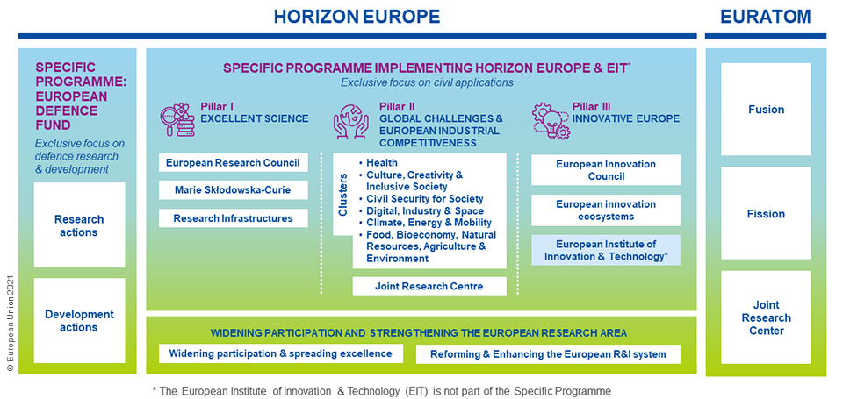
Horizon Europe & Euratom

Slide 9

Euratom research and training programme (2021-2025)
A complementary funding programme to Horizon Europe covering nuclear research and innovation
Uses the same instruments and rules for participation as Horizon Europe
The budget is €1.38 billion to implement the programme for the period 2021 -2025 (extension by 2 years is planned in 2025 to align with MFF)
€583 million for indirect actions in fusion research and development
€266 million for indirect actions in nuclear fission, safety and radiation protection
€532 million for direct actions undertaken by the Joint Research Centre

Slide 10

Euratom research and training programme (2021-2025)
Objective
Research and training activities to increase nuclear safety and security, development of safe nuclear technologies and optimal radiation protection.
Key novelties
  Simplification: Specific objectives from currently 13 to 4, covering both direct actions (implemented by JRC) and indirect actions
  Increased focus on non-power applications of radiation (medical, industrial, space)
  New categories of Prizes
  Opening mobility opportunities for nuclear researchers through inclusion in Marie Skłodowska-Curie fellowships
Notes:
The Euratom Treaty provides for a 5-year programme (i.e. 2021-2025), but the Commission proposal for the Union long-term budget already sets out the budget for 2021-2027.
In the past an additional 2-year programme was adopted to cover the whole 7-year period.

Slide 11
Main objectives of the Euratom Programme
Improve and support nuclear safety, security, safeguards, radiation protection, safe spent fuel and radioactive waste management, decommissioning, including the safe and secure use of nuclear power and non-power applications of ionizing radiation,
Maintain and further develop expertise and competence in the nuclear field within the Community
Foster the development of fusion energy as potential future energy source for electricity production and contribute to the implementation of the European fusion roadmap,
Support the policy of the Union and its MS on continuous improvement of nuclear safety, safeguards and security.

Slide 12
APRENDE in Euratom programme

Slide 13
HORIZON-EURATOM-2023-NRT-01- 06: Improved nuclear data for the safety of energy and non-energy applications of ionising radiation
Expected outcomes:
• Assess the state of nuclear data libraries and computer simulation tools to advise on strategic actions in order to preserve and develop Euratom capacities;
• Provide reliable nuclear data for neutron or charged particles induced reactions crosssections, decay and structure data, and computer simulation tools for different nuclear energy and non-energy applications, mainly applied to the fields of fission and fusion safety, radiation protection, waste management, innovative nuclear systems and sustainable fuel cycles;
• Support access to key experimental infrastructures that address specific measurement capabilities and methodologies to preserve know-how in computer applications, nuclear data evaluation, validation of data and models, and to improve education & training and knowledge sharing.

Slide 14
Overview
Project management
IPR, Communication & Dissemination

Slide 15
Reporting and payment schedule (art. 21, 22)
Points 4.1 & 4.2 of Data Sheet in GA
Deliverables have to be submitted on time
Periodic report submission – 60 days after end of the period
90 days for analysis and payment
EC may query for clarification and additional information (90 days clock will be stopped)
Please, fill all the parts of the Periodic Report, including Part A – Structured Forms

Slide 16
Certificates, audits, reviews (art. 24, 25)
Certificates on the financial statements: at final payment, if requested EU contribution to costs ≥ 430 k€ threshold is reached (cumulative, art. 24 of GA, Data Sheet)
The granting authority may — during the action or afterwards — check the proper implementation of the action (internal checks, art. 25 of GA).
The granting authority may carry out reviews on the proper implementation of the action. (art. 25 of GA, Data Sheet).
The granting authority may carry out audits during the implementation of the action and until 2 years after end of the project, using its own audit service or use external audit firms (art. 25 of GA, Data Sheet).

Slide 17
Amendments to GA (art. 39 of GA)
If there are any changes to:
GA terms & conditions (e.g. data or options specific to that agreement)
GA annexes
GA amendment is needed
Amended provisions become an integral part of the agreement.
For policy on amendments, see Funding and Tender portal Online Manual

Slide 18
Intellectual Property Rights (art. 16 and Annex 5)
Beneficiaries must give access to the background identified as needed for implementing the action, under fair and reasonable conditions.
Results are owned by the beneficiaries that generate them, including joint ownership. The beneficiaries must indicate the owner(s) of the results (results ownership list) in the final periodic report. Beneficiaries may transfer or license results, in accordance with the GA.
Beneficiaries must — up to four years after the end of the action — use their best efforts to exploit their results, including adequate protection of the results — for an appropriate period and with appropriate territorial coverage — if protection is possible and justified. If the results are not exploited within one year after the end of the action, the beneficiaries must use the Horizon Results Platform to find interested parties to exploit the results.

Slide 19
Communication, Dissemination & Visibility (art. 17 and Annex 5)
The beneficiaries must ensure open access to peer-reviewed scientific publications. At the time of publication, a copy of the manuscript is deposited in a trusted repository for scientific publications.
The beneficiaries must establish a data management plan and deposit the data in a trusted repository. The beneficiaries must ensure open access following the principle ‘as open as possible as closed as necessary’.
The beneficiaries must provide and regularly update a plan for the exploitation and dissemination of results including communication activities.
Any communication or dissemination activity related to the action must use factually accurate information. It must include EU flag and indicate the following disclaimer (translated into local languages where appropriate): “Funded by the European Union…”

Slide 20

Open Science across the programme
Mainstreaming of open science practices for improved quality and efficiency of R&I, and active engagement
of society
Open
Science
Mandatory immediate Open Access to publications: beneficiaries must retain sufficient IPRs to comply with open access requirements;
Data sharing as ‘open as possible, as closed as necessary‘: mandatory Data Management Plan for FAIR (Findable, Accessible, Interoperable, Reusable) research data
Work Programmes may incentivize or oblige to adhere to open science practices such as involvement of citizens
Development and implementation of the European Open Science Cloud
Open Research Europe (ORE) publishing platform

Slide 21

Open Research Europe
Why Open Research Europe?
Support our open access policy and beneficiary capacity to adhere to it and also enables publishing post-grant
Leading by example in operationalising open science principles within scientific publishing and enabling the European Research Area
Contribute to transparency and cost-effectiveness and explore sustainable open access publishing business models
What is Open Research Europe?
A peer-reviewed publishing platform. Not a repository. Post-publication peer-review model. First you publish, then review takes place. Publication and review reports open access under CC BY licenses

Slide 22
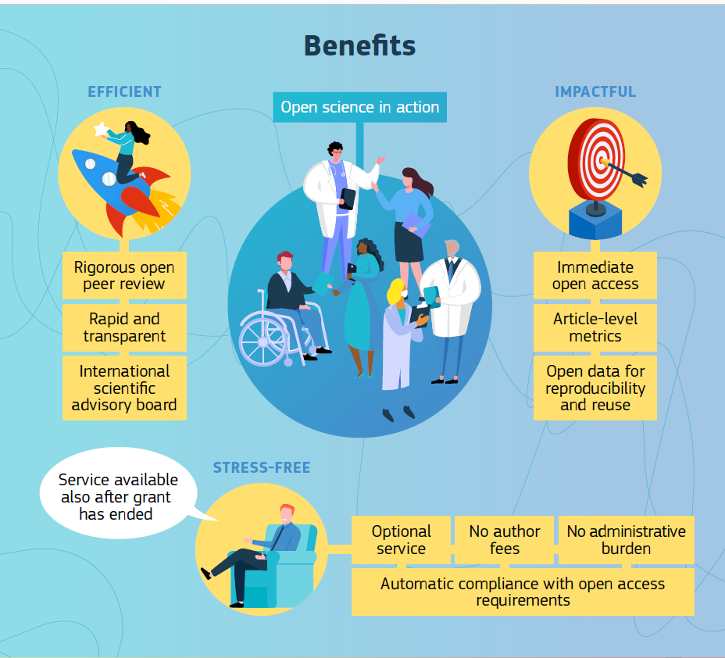
ORE resources
https://open-research-europe.ec.europa.eu/
Open Research Europe infographic
Open Research Europe playlist in DG R& I Youtube channel
@OpenResearch_EU Twitter

Slide 23
Main references for HE/Euratom 2021-2025
Annotated Grand Agreement
Funding and tender opportunities – Online Manual
Horizon Europe
Euratom Research and Training Programme

