Slide 1
JEFF & APRENDE
Arjan Plompen
APRENDE kick-off meeting
16 October 2024

Slide 2
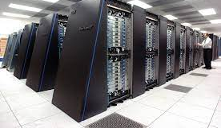
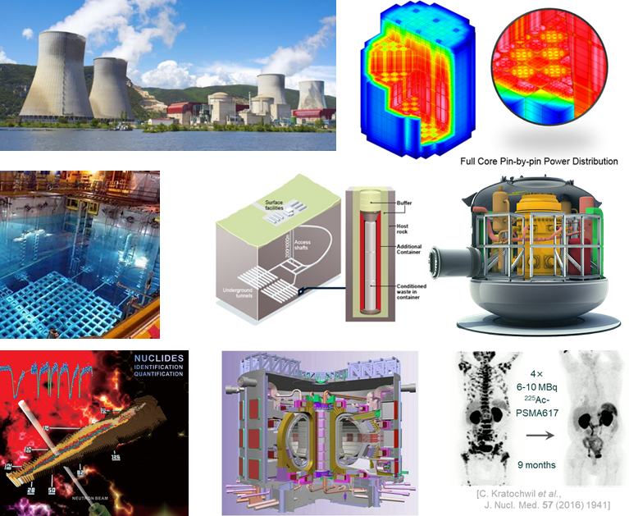

JEFF-4: nuclear data for tomorrow’s solutions
Modelling is needed at every step of nuclear development
Scoping, design, testing, operation, safety analyses, waste and spent fuel management
Good modelling allows savings and shortening of development
Good data are essential to good modelling

Slide 3
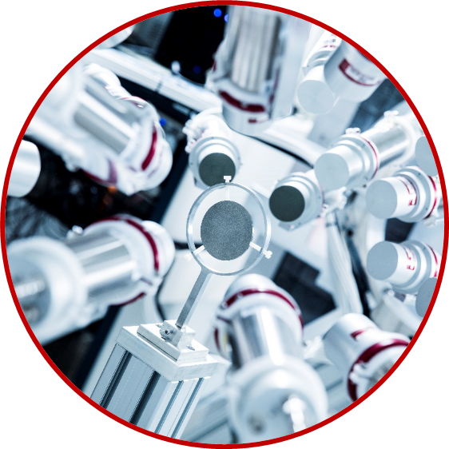
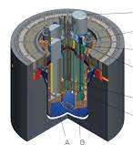
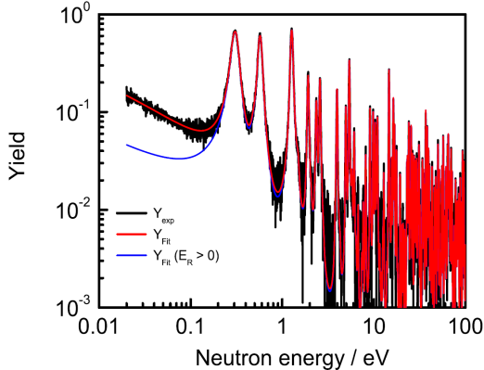
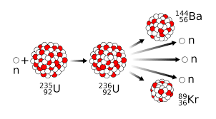
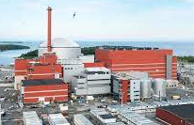
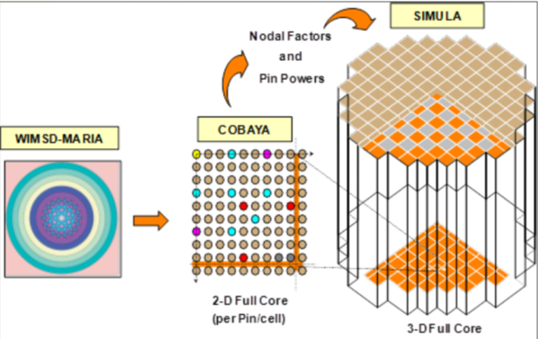


From measurement to application
Measured data
Research & Development
Theory
Database
JEFF
Industry
Benchmarks
Regulatory bodies
New questions
Collect new data

Slide 4
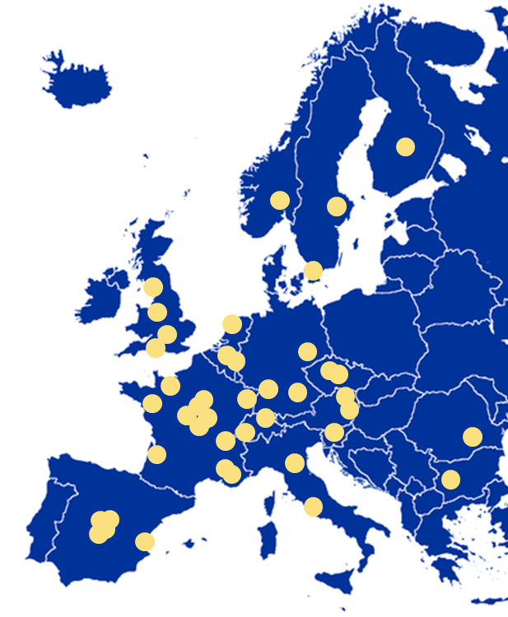





Working with our partners through collaborative projects
Structured collaboration with member states
European Research and Innovation programs
Collaborations
Organisation for Economic Cooperation & Development
International Atomic Energy Agency

Slide 5
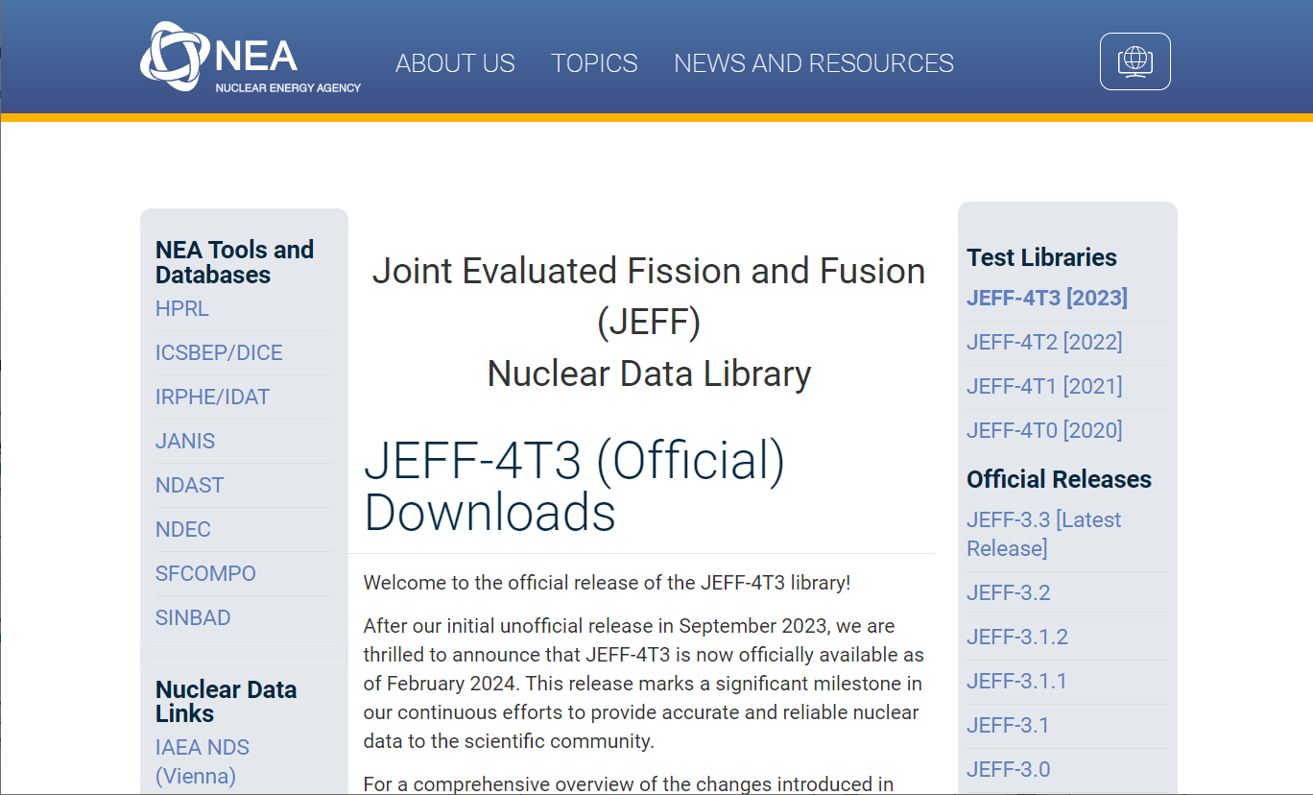

Slide 6
JEFF Development – for whom
Stakeholder meetings 2019, 2023.
  General purpose – wide range of applications
  Uncertainty quantification (covariances)
  Industrial applications (reactivity, depletion, inventory, power map)
  Technical support organisations of regulators
  Reprocessing and waste management organisations
  Innovative design
  Science and technology (energy, dosimetry, ESS, exploration)
Developers’ interests (about 30 European organisations)
  Evolutionary reactors (LTO, Gen-III+, SMR)
  Spent nuclear fuel and radioactive waste management up to final disposal
  Advanced reactors (AMR, Gen-IV)
  Fusion
  Accelerator applications
  medicine, space, astrophysics

Slide 7
JEFF-4
Target date: December 2024
Status: JEFF-4T4 (yesterday)
Goals
  True general purpose
    Broad range of application
  Best available science for users
  Improved focus on stakeholders
  Improved production methods
  Improved uncertainty estimation
  Unadjusted vs adjusted library
  Preserve and improve performance

Slide 8
Content
Neutron library
  3 Major actinides (cs+fy)
  Minor actinides
  Completeness: Tendl-2023(.1)
  Fission products
  Structural materials (INDEN,++)
  Standards + IRDFF
Set of transport files (~500)
Full set of for heating and activation (TENDL-approach)
Expanded and improved set of thermal scattering files
New thermal FY for U-235, Pu-239
TENDL-2023 for g, p, d, a induced
  Selected p-induced from JENDL-5
No new RDD file (JEFF-4.1)
No adjusted file in 2024 (in progress)

Slide 9
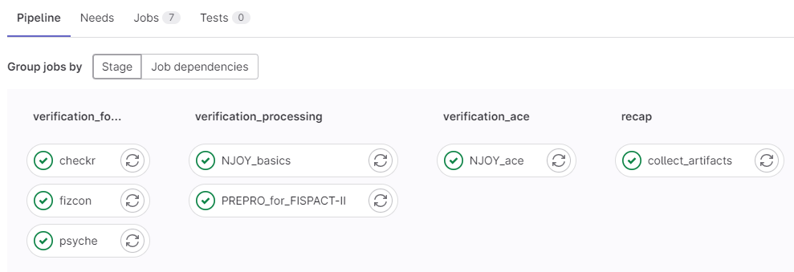
NEA Pipeline
The NEA Pipeline was used since JEFF-4T2
Daniela Foligno
NEA / Data Bank / Nuclear Data Services

Slide 10
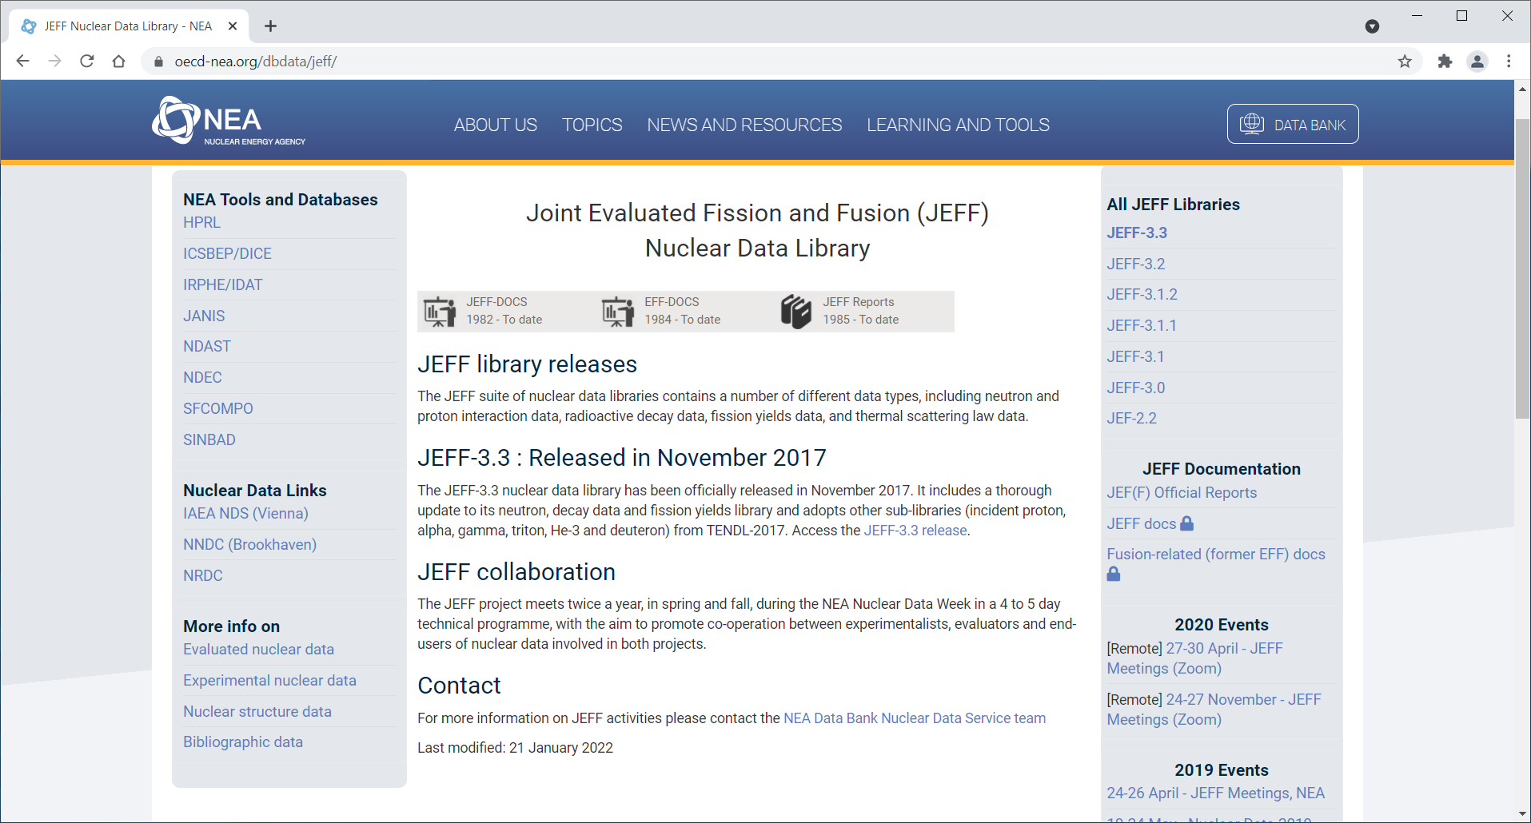
Summary
JEFF is a collaborative project involving many organisations
JEFF wants to cater to stakeholder interests and engage stakeholders better
All aspects of fission, fusion, and many other applications
There is considerable emphasis on benchmarking and validation
Close interaction with TENDL development community with immediate benefits
Collaboration with INDEN
Working groups: Big-3, Activation, Fission Yield, Random files, Processing, Benchmarking and validation, Experiments, Theory and models, Fusion, Machine learning
JEFF-4.0 early 2025.
Promising outlooks: Big-3, DD, FY, …, range and scope of benchmarking

Slide 11
Outlook
JEFF-4.1 in 2028/9
Input from APRENDE will be part of the mandate
Needs a new emphasis on fostering new nuclear data evaluators
Integrate evaluation in both experimental and application programs
Help us stimulate the interaction between the two communities
Help bridge the gap between science and application (data and modelling)

Slide 12
Questions?

Slide 13
Actinides: the Big-3, ^{235,238}U & ²³⁹Pu
Revisiting all aspects of the major actinides
Thermal, resonance and fast ranges
Cross sections
Neutron multiplicity and spectra
Fission yields

Slide 14
Minor actinides ²³⁶U, ²³⁷Np, ^{238,240,242}Pu, ^{241,242m,g,243}Am, ^{251,252}Cf
²⁴⁰Pu
JENDL-4

Slide 15
Fission yields
Kessedjian et al.
New ²³⁵U(n_{th},fy) evals
²³⁹Pu(n_{th},fy) to follow soon
Other FY evaluations
Fission physics w Fifrelin
Need for fast range energy dependence

Slide 16
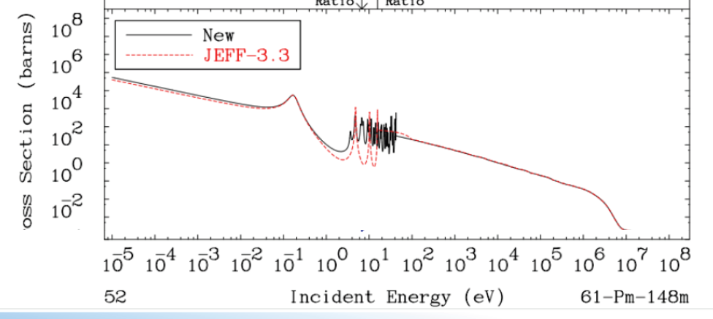
Fission products and many structural materials
^{148m}Pm
¹³⁵Xe

