Slide 1




ADDRESSING PRIORITIES OF EVALUATED NUCLEAR DATA IN EUROPE
General Assembly meeting
Daniel Cano Ott

Slide 2
Agenda
Constitution of the General Assembly
Identification of participants, delegations and quorum
Chairing the General Assembly
Distribution of the 1st EC payment
Consortium Agreement finalization
Partner requests
Distribution and modification of the revised version
Signature process
Election of the WP6 PAC
AOB

Slide 3
Attendance, representations and quorum

Slide 4
Chairing the General Assembly
Text as it is right now in the new DESCA version (with associated partners) in 6.2.2.8
“The Coordinator shall chair the meetings of the General Assembly (GA), unless decided otherwise by a majority of two-thirds of those present and represented during the kick-off meeting (provided that the quorum established in Section 6.2.3.1 is satisfied). If that case, the chair of the General Assembly will be elected by the same majority of two-thirds of those present and represented.”
Summary of the roles of the chairperson of the GA (Consortium Body):
Call for the GA meetings, prepare the agendas, write the draft minutes (supported by the PMO) and incorporate the changes from the beneficiaries, prepare notifications on the decision to the GA and coordinator, monitor the implementation of the decisions adopted in the GA...
Decision: keep it like that or look for a different chairperson.

Slide 5
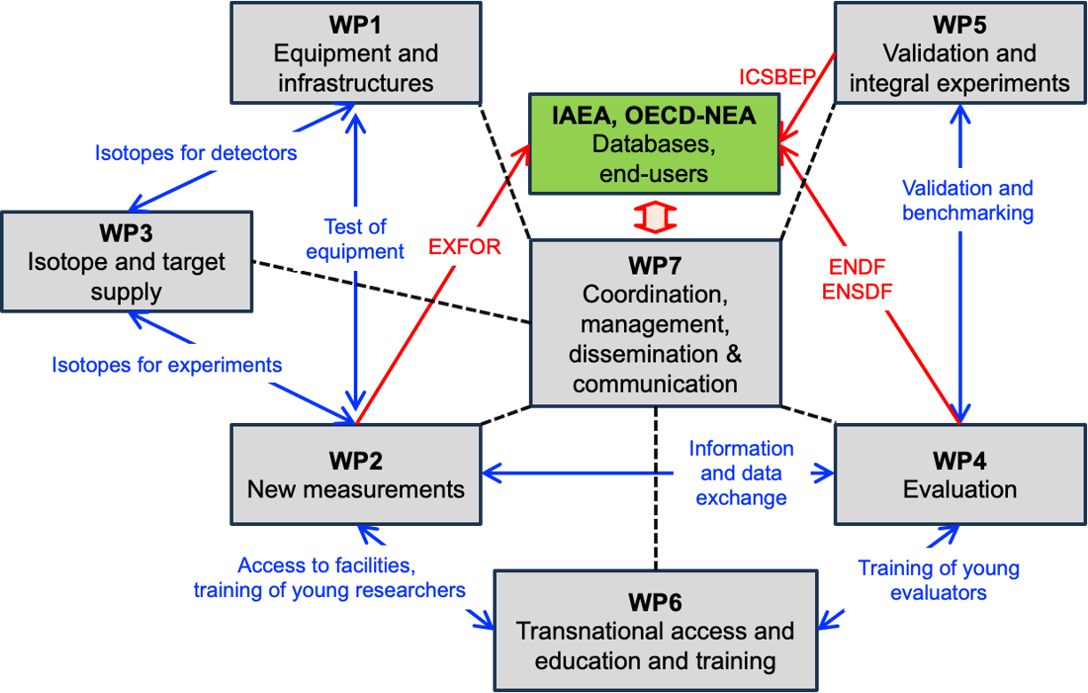
Structure of APRENDE

Slide 6
WP1 – Development of new equipment and infrastructures
Coordinator: Carlos Guerrero – Universidad de Sevilla
Objectives: upgrades of facilities and systems. R&D of detectors.
Task 1.1 Detector and facility upgrades (CNRS)
1.1.1 Enabling experiments in vacuum with ELISA at JRC-Geel.
1.1.2 Enhancement with LaBr3 detectors of the TAS capabilities for decay data
1.1.3 Higher power target designs for neutron production for nuclear data
1.1.4 Neutron-induced independent and isomeric fission yield studies at the IGISOL
Task 1.2 Neutron detectors with new experimental capabilities (PTB)
1.2.1 An active target for n-p cross section measurements at PTB
1.2.3 Diamond detectors for in-beam measurements at n_TOF-NEAR
1.2.4 Characterization of liquid scintillator detectors up to 40 MeV
Task 1.3 Developments of silicon-based devices for (n,chp) cross sections (UION)
1.3.1 Silicon telescope for (n,chp) cross section measurements at n_TOF towards the measurement of ³⁹K(n, chp)
1.3.2 New annular DSSSD for (n,chp) cross section measurements at n_TOF

Slide 7
WP2 – New nuclear data measurements
Coordinator: Maëlle Kerveno – CNRS
Objectives: perform new and prioritary nuclear data measurements
Task 2.1 Decay data (CNRS)
Task 2.2 (n,f) cross section measurements and fission yields (CEA)
  2.2.1 Fission yields measurements
  2.2.2 Neutron induced fission cross section measurements
  2.2.3 ²³⁹Pu fission studies in the resonance range
Task 2.3 (n,𝛄) cross section measurements (CIEMAT)
  2.3.1 Capture reaction measurements on structural materials
  2.3.2 Capture reaction measurements on actinides
  2.3.3 Capture reaction measurements for neutron metrology
Task 2.4 Neutron elastic and inelastic scattering cross section measurements (IFIN-HH)
  2.4.1 (n,xn𝛄) cross section measurement
  2.4.2 Elastic and inelastic scattering measurement
Task 2.5 (n ,X) and (ch.p., X) reactions (NPL)
  2.5.1 ³⁵Cl(n, lcp) cross section measurement for advanced reactor concepts
  2.5.2 Cross section measurement for fusion applications
  2.5.3 Cross section measurement for dosimetry.

Slide 8
WP3 – Isotope and target supply
Coordinator: Rugard Dressler – PSI (important contribution of JRC – Geel)
Objectives:
Ensure the in-time and high-quality delivery of the targets needed in WP2.
Foster the target maker network in Europe and world-wide.
Build-up of a dedicated isotope separator.
Contribute to the strategic analysis of EURATOM nuclear data capacities.
Task 3.1 Target supply (PSI)
Task 3.2 Fostering the target maker network (PSI)
Task 3.3 Implementation of an isotope separator at PSI (M1-M48), Task leader: PSI

Slide 9
WP4 – Nuclear data evaluation
Coordinator: Dimitri Rochman – PSI
Objectives:
Producing new evaluations for decay data, thermal scattering data, fission yields and cross sections of important isotopes and reactions. JEFF project
Development and preservation of the knowledge needed for evaluation work
Addressing deficiencies from the past and existing nuclear data libraries
Ensure the quality of the delivered evaluations (collaboration with WP5)
Task 4.1 Decay data evaluation and education (USOF)
Task 4.2 Thermal Scattering Data (ESS)
4.2.1 Code development
4.2.2 Evaluation
Task 4.3 Fission yield evaluation (CEA)
4.3.1 Fission yield investigations
4.3.2 Fission yield benchmarking
Task 4.4 Cross section evaluation (CEA)
4.4.2 File processing and cross section benchmarking
4.4.3 Cross section evaluation tools

Slide 10
WP5 – Nuclear data validation, sensitivity analyses and impact studies
Coordinator: Robert Jacqmin – CEA & Óscar Cabellos – UPM
Objectives:
Producing sensitivity profiles and impact studies
Identifying nuclear data trends from the analyses of integral experiments and data assimilation studies
New integral experiments and needs
Task 5.1. Sensitivity analyses, uncertainty quantification, impact studies (CIEMAT)
  5.1.1. Sensitivity analyses and priorities for nuclear data improvements
  5.1.2. Nuclear data uncertainty propagation in reactor and shielding applications
  5.1.3. Nuclear data uncertainty propagation in advanced fuel cycles
Task 5.2: Analysis of experiments, validation, and data assimilation (UPM)
  5.2.1 Analyses of integral measurements, reactor data
  5.2.2. Correlations between integral data
  5.2.3. Assimilation using group-averaged data, derivation of JEFF4 trends
  5.2.4. Direct inclusion of EXFOR data in a global assimilation process
Task 5.3: New integral experiments and validation data (CEA)
  5.3.1. Experiments in LR-0 and other reactors
  5.3.2. Source-detector experiments
  5.3.3. Future experiments for nuclear data validation

Slide 11
WP6 – Communication, transnational access, education & training,
dissemination & exploitation
Coordinator: Arnd Junghans – HZDR
Objectives:
Training activities of early-stage researchers and scientific visitors
Provide beam time at the consortium facilities and support experiments there.
Organize 2 summer schools.
Task 6.1 Public Communication (LGI)
Task 6.2 Proposals for Transnational Access and Education and Training (HZDR)
Task 6.3 Access to neutron beam facilities (HZDR)
Task 6.4 Training of early-stage researchers and scientific visits (HZDR)
Task 6.5 Organisation of two summer schools (USE)
Task 6.6 Dissemination and exploitation (CIEMAT)

Slide 12
WP7 – Project management
Coordinator: Daniel Cano-Ott – CIEMAT
Objectives:
Set up an appropriate governance structure and internal communication methods.
Closely monitor the project implementation to meet the objectives in time, scope and budget.
Define and maintain the decisional and operational framework, including risk management.
Ensure high-quality deliverables.
Monitor the project’s resources in line with the financial guidelines.
Drive the interactions with the project and end-users.
Enforce gender equality and mitigate the carbon footprint of the project.
Foster the scientific exchange between the projects partners and coordinate the activities with JEFF, IAEA, and OECD-NEA.
Task 7.1 Project management (CIEMAT)
Task 7.2 Scientific exchange between project partners and coordination with external agencies (CIEMAT)
Task 7.3 Data management (CIEMAT)

Slide 13
APRENDE budget table
Number | Country | Beneficiary | A.1 Employees (or equivalent), A.2 Natural persons under direct contract, A.3 Seconded persons | A.1 Employees (or equivalent), A.2 Natural persons under direct contract, A.3 Seconded persons | A.4 SME owners and natural person beneficiaries | Subcontracting | C.1 Travel and subsistence | C.2 Equipment | C.3 Other goods, works and services | D.1 Financial support to third parties | D.2 Internally invoiced goods and services | E. Indirect costs | Total costs | Maximum grant amount
1 | SP | CIEMAT | 227,600.00 € | 0.00 € | 0.00 € | 0.00 € | 29,600.00 € | 0.00 € | 8,000.00 € | 0.00 € | 0.00 € | 66,300.00 € | 331,500.00 € | 331,500.00 €
2 | HU | Atomki | 15,920.00 € | 0.00 € | 0.00 € | 0.00 € | 1,600.00 € | 0.00 € | 0.00 € | 0.00 € | 0.00 € | 4,380.00 € | 21,900.00 € | 21,900.00 €
3 | FR | CEA | 75,200.00 € | 621,200.00 € | 0.00 € | 0.00 € | 30,400.00 € | 0.00 € | 8,000.00 € | 0.00 € | 0.00 € | 183,700.00 € | 918,500.00 € | 918,500.00 €
4 | CH | CERN | 0.00 € | 0.00 € | 0.00 € | 0.00 € | 0.00 € | 0.00 € | 0.00 € | 0.00 € | 28,000.00 € | 0.00 € | 28,000.00 € | 28,000.00 €
5 | CZ | CVREZ | 42,800.00 € | 0.00 € | 0.00 € | 0.00 € | 4,800.00 € | 0.00 € | 0.00 € | 0.00 € | 0.00 € | 11,900.00 € | 59,500.00 € | 59,500.00 €
6 | IT | ENEA | 20,000.00 € | 0.00 € | 0.00 € | 0.00 € | 1,600.00 € | 0.00 € | 0.00 € | 0.00 € | 0.00 € | 5,400.00 € | 27,000.00 € | 22,000.00 €
7 | SE | ESS | 57,600.00 € | 0.00 € | 0.00 € | 0.00 € | 1,600.00 € | 0.00 € | 0.00 € | 0.00 € | 0.00 € | 14,800.00 € | 74,000.00 € | 74,000.00 €
8 | FR | GANIL | 16,000.00 € | 0.00 € | 0.00 € | 0.00 € | 1,600.00 € | 0.00 € | 0.00 € | 0.00 € | 12,250.00 € | 4,400.00 € | 34,250.00 € | 34,250.00 €
9 | GE | HZDR | 83,400.00 € | 0.00 € | 0.00 € | 0.00 € | 111,200.00 € | 0.00 € | 0.00 € | 34,750.00 € | 0.00 € | 48,650.00 € | 278,000.00 € | 278,000.00 €
10 | SP | CSIC | 66,000.00 € | 0.00 € | 0.00 € | 0.00 € | 8,000.00 € | 0.00 € | 0.00 € | 0.00 € | 0.00 € | 18,500.00 € | 92,500.00 € | 92,500.00 €
11 | RO | IFIN-HH | 47,280.00 € | 0.00 € | 0.00 € | 0.00 € | 3,200.00 € | 0.00 € | 0.00 € | 0.00 € | 7,000.00 € | 12,620.00 € | 70,100.00 € | 70,100.00 €
12 | IT | INFN | 54,400.00 € | 0.00 € | 0.00 € | 0.00 € | 4,800.00 € | 0.00 € | 0.00 € | 0.00 € | 0.00 € | 14,800.00 € | 74,000.00 € | 74,000.00 €
13 | FR | IRSN | 75,200.00 € | 0.00 € | 0.00 € | 0.00 € | 8,000.00 € | 0.00 € | 0.00 € | 0.00 € | 0.00 € | 20,800.00 € | 104,000.00 € | 104,000.00 €
14 | SL | JSI | 60,800.00 € | 0.00 € | 0.00 € | 0.00 € | 4,800.00 € | 0.00 € | 0.00 € | 0.00 € | 0.00 € | 16,400.00 € | 82,000.00 € | 82,000.00 €
15 | GE | KIT | 33,200.00 € | 0.00 € | 0.00 € | 0.00 € | 3,200.00 € | 0.00 € | 0.00 € | 0.00 € | 0.00 € | 9,100.00 € | 45,500.00 € | 45,500.00 €
16 | - | LGI | 153,000.00 € | 0.00 € | 0.00 € | 0.00 € | 7,000.00 € | 0.00 € | 4,000.00 € | 0.00 € | 0.00 € | 41,000.00 € | 205,000.00 € | 205,000.00 €
17 | NE | NRG | 36,000.00 € | 0.00 € | 0.00 € | 0.00 € | 1,600.00 € | 0.00 € | 0.00 € | 0.00 € | 0.00 € | 9,400.00 € | 47,000.00 € | 47,000.00 €
18 | GR | NTUA | 35,200.00 € | 0.00 € | 0.00 € | 0.00 € | 4,800.00 € | 0.00 € | 24,000.00 € | 0.00 € | 0.00 € | 16,000.00 € | 80,000.00 € | 80,000.00 €
19 | GE | PTB | 38,400.00 € | 0.00 € | 0.00 € | 0.00 € | 1,600.00 € | 0.00 € | 0.00 € | 0.00 € | 22,500.00 € | 10,000.00 € | 72,500.00 € | 72,500.00 €
20 | BE | SCK CEN | 147,200.00 € | 0.00 € | 0.00 € | 0.00 € | 8,000.00 € | 0.00 € | 0.00 € | 0.00 € | 0.00 € | 38,800.00 € | 194,000.00 € | 194,000.00 €
21 | SK | STUBA | 16,000.00 € | 0.00 € | 0.00 € | 0.00 € | 3,200.00 € | 0.00 € | 0.00 € | 0.00 € | 0.00 € | 4,800.00 € | 24,000.00 € | 24,000.00 €
22 | AT | TUW | 4,000.00 € | 0.00 € | 0.00 € | 0.00 € | 1,600.00 € | 0.00 € | 0.00 € | 0.00 € | 0.00 € | 1,400.00 € | 7,000.00 € | 7,000.00 €
23 | BU | UBU | 41,600.00 € | 0.00 € | 0.00 € | 0.00 € | 1,600.00 € | 0.00 € | 0.00 € | 0.00 € | 0.00 € | 10,800.00 € | 54,000.00 € | 54,000.00 €
24 | NE | RUG | 48,800.00 € | 0.00 € | 0.00 € | 0.00 € | 3,200.00 € | 0.00 € | 0.00 € | 0.00 € | 0.00 € | 13,000.00 € | 65,000.00 € | 65,000.00 €
25 | GR | UION | 34,400.00 € | 0.00 € | 0.00 € | 0.00 € | 3,200.00 € | 0.00 € | 0.00 € | 0.00 € | 0.00 € | 9,400.00 € | 47,000.00 € | 47,000.00 €
26 | FI | JYU | 23,200.00 € | 0.00 € | 0.00 € | 0.00 € | 1,600.00 € | 0.00 € | 0.00 € | 0.00 € | 15,750.00 € | 6,200.00 € | 46,750.00 € | 46,750.00 €
27 | PL | ULODZ | 45,000.00 € | 0.00 € | 0.00 € | 0.00 € | 3,200.00 € | 0.00 € | 15,000.00 € | 0.00 € | 0.00 € | 15,800.00 € | 79,000.00 € | 79,000.00 €
28 | SL | UMAR | 12,000.00 € | 0.00 € | 0.00 € | 0.00 € | 3,200.00 € | 0.00 € | 0.00 € | 0.00 € | 0.00 € | 3,800.00 € | 19,000.00 € | 19,000.00 €
29 | SP | UPC | 14,000.00 € | 0.00 € | 0.00 € | 0.00 € | 1,600.00 € | 0.00 € | 0.00 € | 0.00 € | 0.00 € | 3,900.00 € | 19,500.00 € | 19,500.00 €
30 | SP | UPM | 115,200.00 € | 0.00 € | 0.00 € | 0.00 € | 40,800.00 € | 0.00 € | 0.00 € | 0.00 € | 0.00 € | 39,000.00 € | 195,000.00 € | 195,000.00 €
31 | SP | USE | 54,000.00 € | 0.00 € | 0.00 € | 0.00 € | 32,800.00 € | 0.00 € | 0.00 € | 0.00 € | 8,750.00 € | 21,700.00 € | 117,250.00 € | 117,250.00 €
32 | BU | USOF | 48,800.00 € | 0.00 € | 0.00 € | 0.00 € | 1,600.00 € | 0.00 € | 0.00 € | 0.00 € | 0.00 € | 12,600.00 € | 63,000.00 € | 63,000.00 €
33 | SE | UU | 112,800.00 € | 0.00 € | 0.00 € | 0.00 € | 8,000.00 € | 0.00 € | 0.00 € | 0.00 € | 12,250.00 € | 30,200.00 € | 163,250.00 € | 163,250.00 €
34 | - | ENEN | 11,920.00 € | 0.00 € | 0.00 € | 0.00 € | 0.00 € | 0.00 € | 0.00 € | 0.00 € | 0.00 € | 2,980.00 € | 14,900.00 € | 14,900.00 €
35 | FR | CNRS | 256,350.00 € | 0.00 € | 0.00 € | 0.00 € | 27,800.00 € | 0.00 € | 42,000.00 € | 0.00 € | 0.00 € | 81,537.50 € | 407,687.50 € | 251,000.00 €
35.1 | FR | (AE) UNANTES | 15,000.00 € | 0.00 € | 0.00 € | 0.00 € | 0.00 € | 0.00 € | 0.00 € | 0.00 € | 0.00 € | 3,750.00 € | 18,750.00 € | 0.00 €
35.2 | FR | (AE) IMT | 30,000.00 € | 0.00 € | 0.00 € | 0.00 € | 0.00 € | 0.00 € | 0.00 € | 0.00 € | 0.00 € | 7,500.00 € | 37,500.00 € | 0.00 €
35.3 | FR | (AE) INPG | 22,500.00 € | 0.00 € | 0.00 € | 0.00 € | 0.00 € | 0.00 € | 0.00 € | 0.00 € | 0.00 € | 5,625.00 € | 28,125.00 € | 0.00 €
36 | BE | JRC | 430,009.00 € | 0.00 € | 0.00 € | 0.00 € | 9,600.00 € | 0.00 € | 0.00 € | 0.00 € | 0.00 € | 109,902.25 € | 549,511.25 € | 0.00 €

Slide 14
Payments
Payments from the EC
pre-financing payment;
one or more interim payments, on the basis of the request(s) for interim payment,
one payment of the balance
Pre-financing payment to CIEMAT. Net payment: 1,933,151.67 €
The pre-financing payment is 2,133,146.67 €, out of which 199,995.00 € have been reserved by the EC for the Mutual insurance mechanism.
Transfer of the funding from the coordinator to the beneficiaries:
The Consortium Agreement should be finalized and signed, except if a different agreement is reached in the GA.
Bank identification forms sent to Coordinator (Signed and with stamps). Missing: CEA, HZDR, JSI, KIT, NTUA, Sofia, UB, ULodz, UMainz, UManch, USC.
If any beneficiary would like to reduce the amount to be transferred, it should be reported formally via a signed letter to the Coordinator (with the PMO in cc:)

Slide 15
1st payment proposal
TOTAL EC grant | 3,999,900.00 €
1st EC Payment | 2,133,146.67 €
Mutual insurance mechanism | 199,995.00 €
To be distributed | 1,933,151.67 €
1st payment = (EC funding of the institution / Total EC funding) * EC funding received
Money_i = (EC funding of partner i / 3.999.900) * 1,933,151.67 €
CIEMAT will keep a pool of 64,762.20 €, to be transferred to the project beneficiaries with approved proposals in WP6.

Slide 16
1st payment proposal
Number | Beneficiary | Maximum grant amount | % of the total EC contribution | 1st payment |  | Number | Beneficiary | Maximum grant amount | % of the total EC contribution | 1st payment
1 | CIEMAT | 331,500.00 € | 8.29% | 160,213.95 € |  | 21 | STUBA | 24,000.00 € | 0.60% | 11,599.20 €
2 | Atomki | 21,900.00 € | 0.55% | 10,584.27 € |  | 22 | TUW | 7,000.00 € | 0.18% | 3,383.10 €
3 | CEA | 918,500.00 € | 22.96% | 443,911.05 € |  | 23 | UBU | 54,000.00 € | 1.35% | 26,098.20 €
4 | CERN | 28,000.00 € | 0.70% | 13,532.40 € |  | 24 | RUG | 65,000.00 € | 1.63% | 31,414.50 €
5 | CVREZ | 59,500.00 € | 1.49% | 28,756.35 € |  | 25 | UION | 47,000.00 € | 1.18% | 22,715.10 €
6 | ENEA | 22,000.00 € | 0.55% | 10,632.60 € |  | 26 | JYU | 46,750.00 € | 1.17% | 22,594.28 €
7 | ESS | 74,000.00 € | 1.85% | 35,764.20 € |  | 27 | ULODZ | 79,000.00 € | 1.98% | 38,180.70 €
8 | GANIL | 34,250.00 € | 0.86% | 16,553.03 € |  | 28 | UMAR | 19,000.00 € | 0.48% | 9,182.70 €
9 | HZDR | 278,000.00 € | 3.60% | 69,595.20 € |  | 29 | UPC | 19,500.00 € | 0.49% | 9,424.35 €
10 | CSIC | 92,500.00 € | 2.31% | 44,705.25 € |  | 30 | UPM | 195,000.00 € | 4.88% | 94,243.50 €
11 | IFIN-HH | 70,100.00 € | 1.75% | 33,879.33 € |  | 31 | USE | 117,250.00 € | 2.93% | 56,666.93 €
12 | INFN | 74,000.00 € | 1.85% | 35,764.20 € |  | 32 | USOF | 63,000.00 € | 1.58% | 30,447.90 €
13 | IRSN | 104,000.00 € | 2.60% | 50,263.20 € |  | 33 | UU | 163,250.00 € | 4.08% | 78,898.73 €
14 | JSI | 82,000.00 € | 2.05% | 39,630.60 € |  | 34 | ENEN | 14,900.00 € | 0.37% | 7,201.17 €
15 | KIT | 45,500.00 € | 1.14% | 21,990.15 € |  | 35 | CNRS | 251,000.00 € | 6.28% | 121,308.30 €
16 | LGI | 205,000.00 € | 5.13% | 99,076.50 € |  | 35.1 | (AE) UNANTES | 0.00 € | 0.00% | 0.00 €
17 | NRG | 47,000.00 € | 1.18% | 22,715.10 € |  | 35.2 | (AE) IMT | 0.00 € | 0.00% | 0.00 €
18 | NTUA | 80,000.00 € | 2.00% | 38,664.00 € |  | 35.3 | (AE) INPG | 0.00 € | 0.00% | 0.00 €
19 | PTB | 72,500.00 € | 1.81% | 35,039.25 € |  | 36 | JRC | 0.00 € | 0.00% | 0.00 €
20 | SCK CEN | 194,000.00 € | 4.85% | 93,760.20 € |  | 37 | EPFL | 158,000.00 €
 |  |  |  |  |  | 38 | PSI | 616,500.00 €
 |  |  |  |  |  | 39 | UKAEA | 16,000.00 €
 |  |  |  |  |  | 40 | NPL | 140,000.00 €
 |  |  |  |  |  | 41 | UEDIN | 52,000.00 €

Slide 17
Payments
Formal decisions of the GA:
Is the general rule for distributing the funding accepted?
Is there any beneficiary will to lower the amount of its 1st payment?
Is it accepted that the Coordinator keeps 64,762.20 € as a pool for the T&S funding of accepted proposals of beneficiaries approved in WP6?

Slide 18

Status of the consortium agreement
Based on DESCA version 1, December 2021, adapted for the participation of Associated Partners.

Slide 19
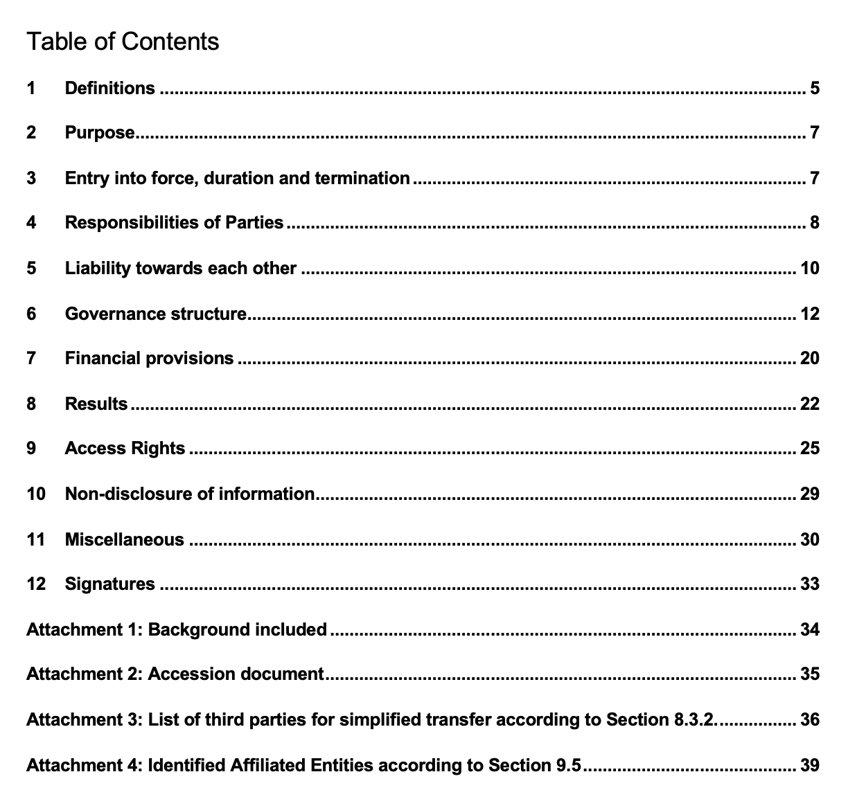
Status of the consortium agreement

Slide 20
Status of the consortium agreement
Comments received so far:
About the inclusion of Associated parties (done in the new version) and all relevant sections.
About the election of the chairperson of the GA.
Comments on the structure (ExCom)
About the non-use of the data for military applications.
About including the term funding agency (associated partners).
About replacing the term “Affiliated entities” by “Entities under the same control” (new DESCA version after we started to prepare the CA).
…
A new version of the CA including them is on the way and will be made available at the LGI Teams site. Every partner should add the comments / modifications and will be able to see what the others have written.
Please make the minimum number of comments. It is not easy to find an agreement among 43 different legal departments!
Deadline for submitting the comments: 15th of November.

Slide 21
Status of the consortium agreement
The organisational structure of the consortium shall comprise the following Consortium Bodies:
The General Assembly is the ultimate decision-making body of the consortium.
The Executive Committee as the supervisory body for the execution of the Project which shall report to and be accountable to the General Assembly; formed by the WPL, the coordinator and possibly some external experts.
The Coordinator is the legal entity acting as the intermediary between the Parties and the Granting Authority. The Coordinator shall, in addition to its responsibilities as a Party, perform the tasks assigned to it as described in the Grant Agreement and this Consortium Agreement.
The Project Management Office (PMO) assists the Coordinator.

Slide 22
WP6 PAC proposal
Selection criteria:
Expertise in different fields and in previous TNA projects (already in the ARIEL PAC).
Economy. Maximise the amount of funding allocated to experiments and visits. Involve beneficiaries or experts who can pay for their own travel expenses (international agencies)
Knowledge of the APRENDE priorities
Daniel Cano-Ott, CIEMAT / coord
Roberto Capote, IAEA Nuclear Data Section
Robert Jacqmin, CEA / WP5 leader (integral experiments)
Maëlle Kerveno, CNRS / WP2 leader (differential experiments)
Gert van den Eynde, SCK CEN applications
Decision:
do you accept the actual list for the APRENDE PAC or want to propose modifications?

Slide 23

AOB
Please add the PMO in cc: in all the communications related to the project management.
Please use the APRENDE logos in your future presentations, together with the EC / EURATOM logos.

