Slide 1
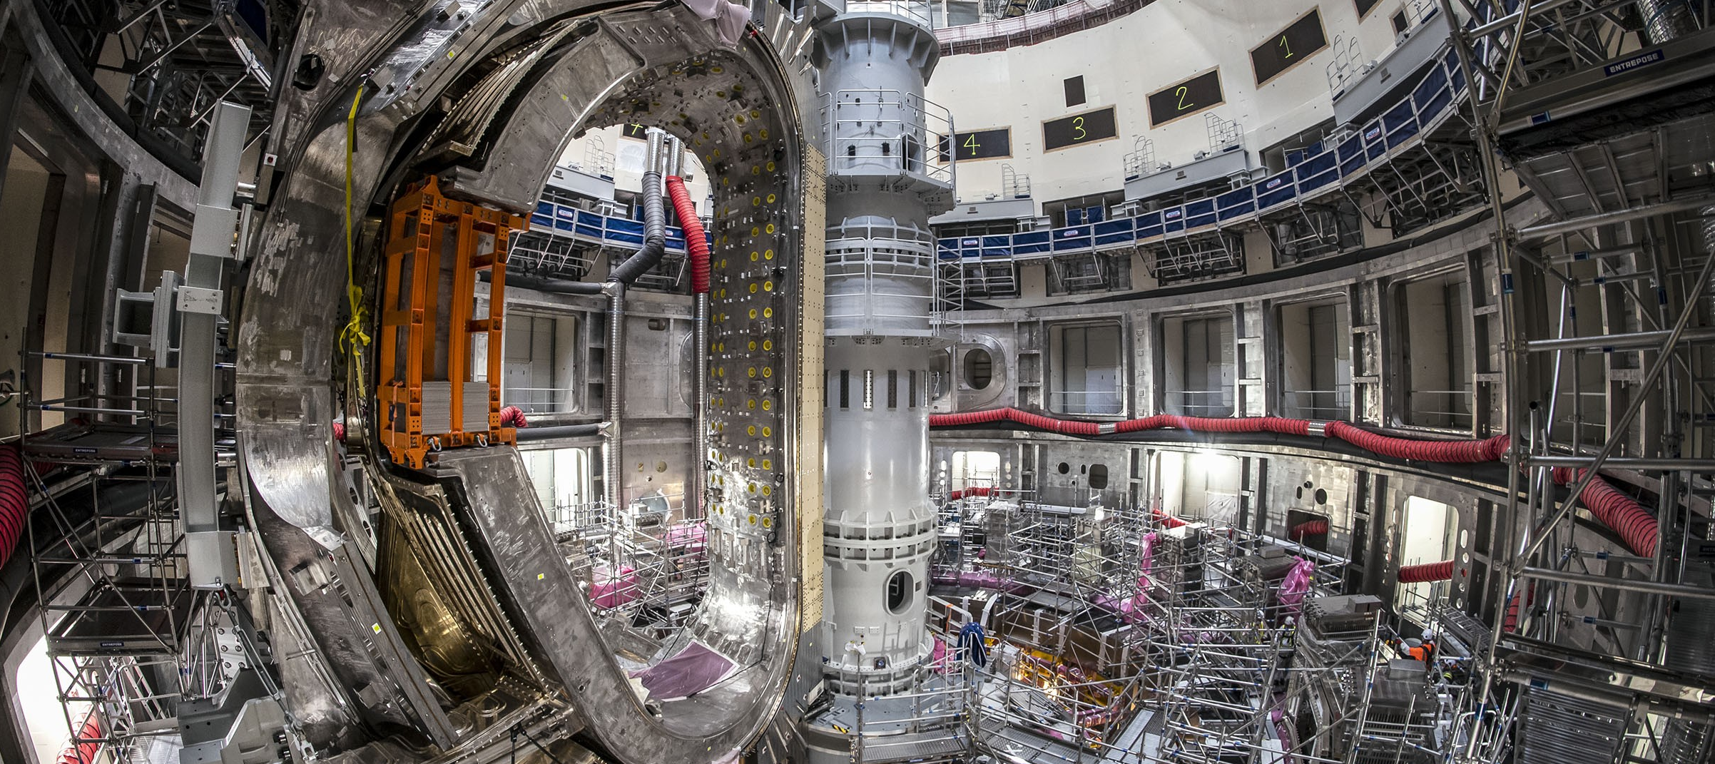

Data Analysis Strategy for the ITER Tokamak Systems Monitor
Daniel Iglesias¹, Victor Moncada², Joris Paret¹, Lana Abadie¹, Isabel Nunes¹, Daniel Sabio³, Sergey Sadakov¹, Nathaniel Saura¹
¹ ITER Organization, 13067 Saint Paul Lez Durance Cedex France
² CEA-IRFM, 13108 Saint-Paul-Lez-Durance, France
³ Automaticity Solutions SL, 08028 Barcelona, Spain
2nd VOLDA Workshop, November 18–20 2025, Madrid
The views and opinions expressed herein do not necessarily reflect those of the ITER Organization

Slide 2
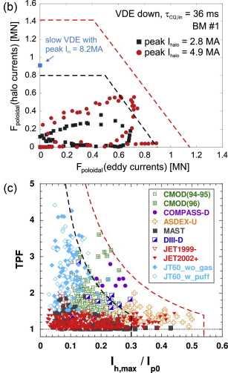
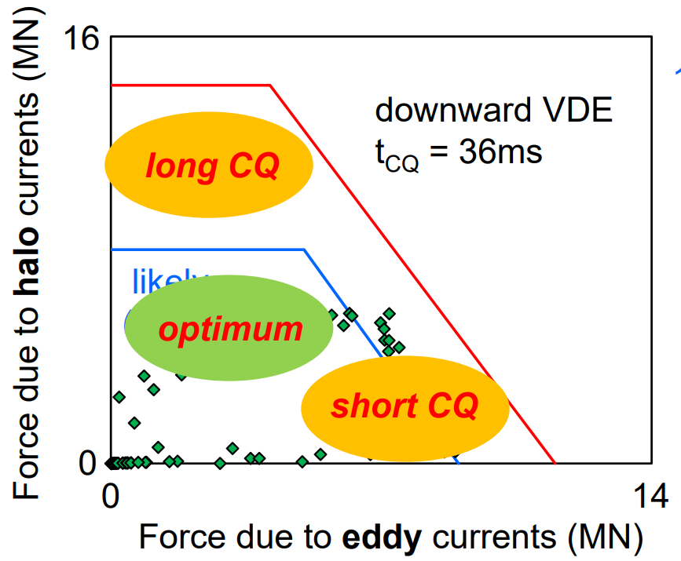
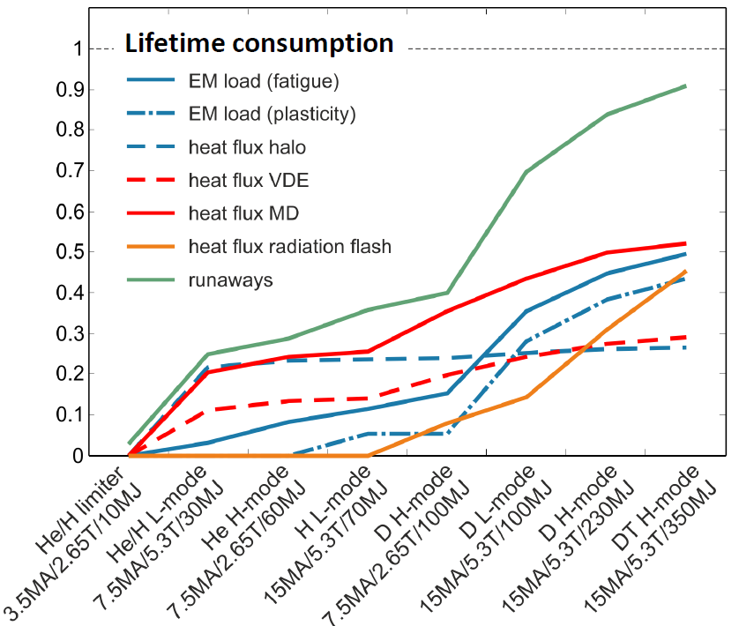
1. Introduction
PBS.55.GT, Tokamak Systems Monitor uses monitoring algorithms to determine actions and effects at the magnets, VV, blankets, divertor, port plugs, thermal shield and cryostat
These algorithms use the signals of the machine instrumentation as an input for determining the health of the tokamak systems
Main metrics cover forces, peaking factors [1], maximum deformation, heat loads, stress and lifetime effects
[1] Sadakov et al., “Practical Model for the Calculation of Lateral Electromagnetic Loads
in Tokamaks at Asymmetric Vertical Displacement Events (AVDEs)”, Plasma, 2024

Slide 3
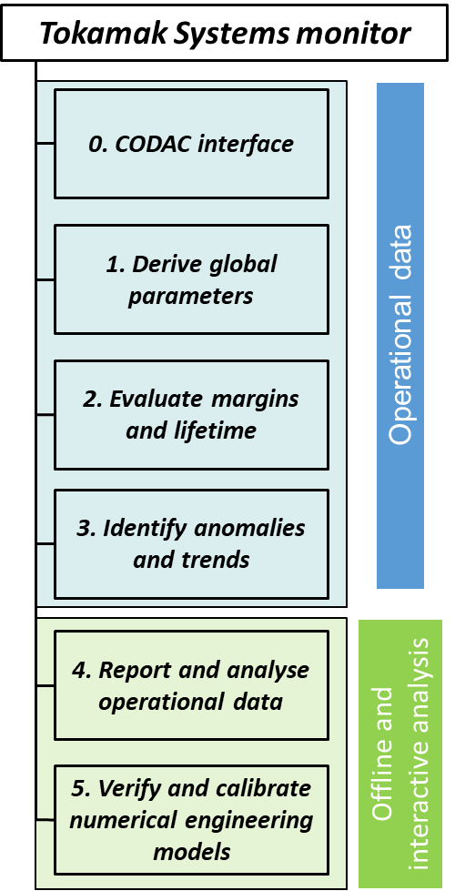
1. Introduction
TSM needs a tool for Data Analysis both during Operations and for offline detailed studies
The TSM algorithms produce large and heterogeneous amount of data for all tokamak systems
The health state of the machine will be derived from the following variables:
        Reconstruction algorithms values
        Limits and lifetime trends
        Anomaly detection triggers
The operator will need to check and validate the warnings
Early
Warnings

Slide 4
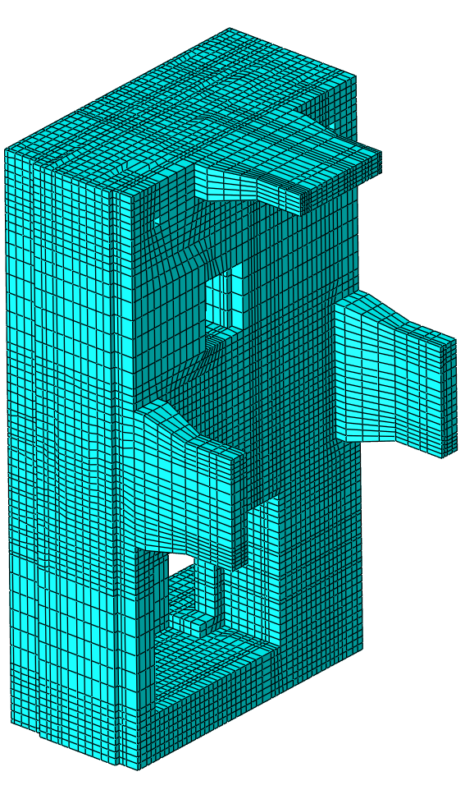
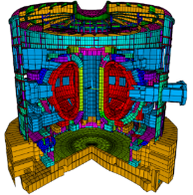
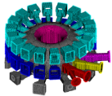
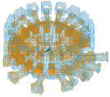
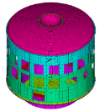


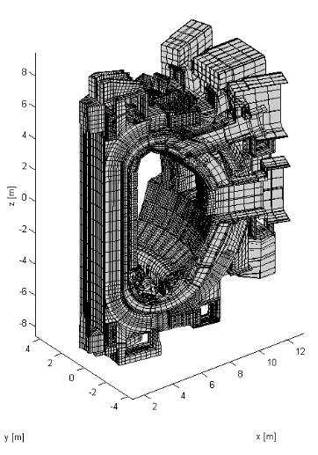
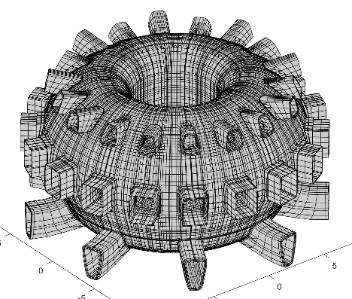
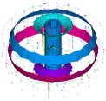
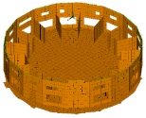
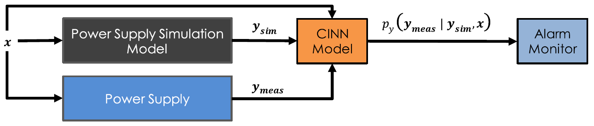
2. Monitoring models and data types
DFW Thermal
Global models
Structural
Vacuum Vessel and PPs:
shells and substructures
Grouped in disciplines [2]:
  Electromagnetic
  Structural
  Thermal* and
  thermomechanical
  Lifetime
  Anomalies**
Cryostat:
beams + shells
VVGS & TFGS:
40 degree
EM model
Electromagnetic
Magnets: beams + shells
TKC: shells
[2] Maqueda et al., “Feasibility evaluation and pre-conceptual design of the ITER TSM”, FED, 2023
* See N. Saura – Thermal Surrogate Modeling for the Monitoring of Actively Cooled First Wall Components in ITER
** See J. Paret – Design and Implementation of Machine Learning-Based Anomaly Detection in the ITER Tokamak Systems Monitor

Slide 5
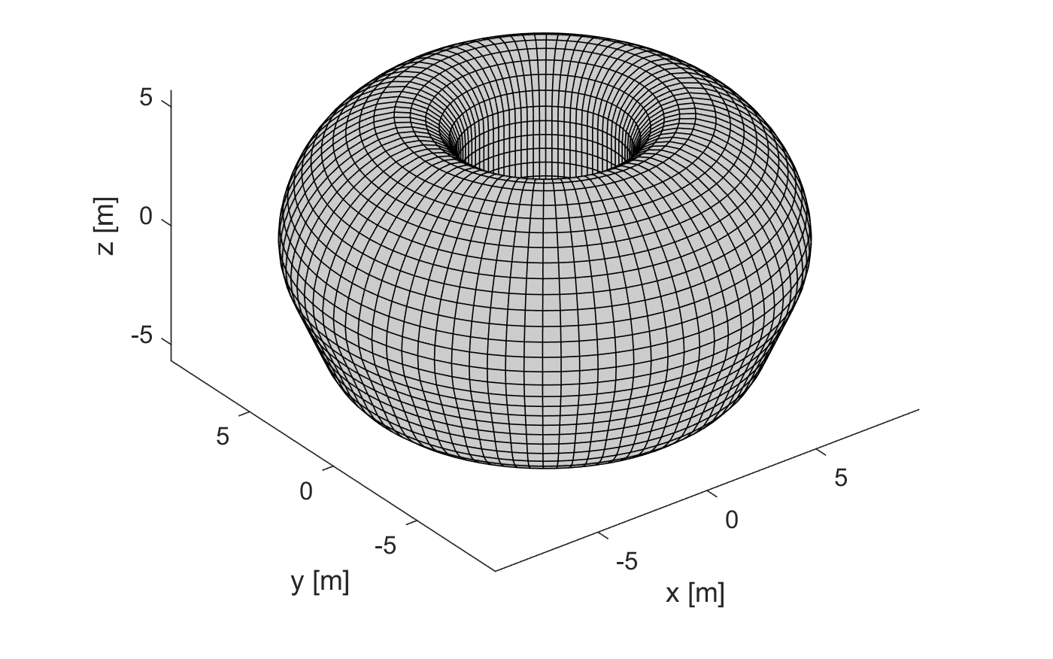
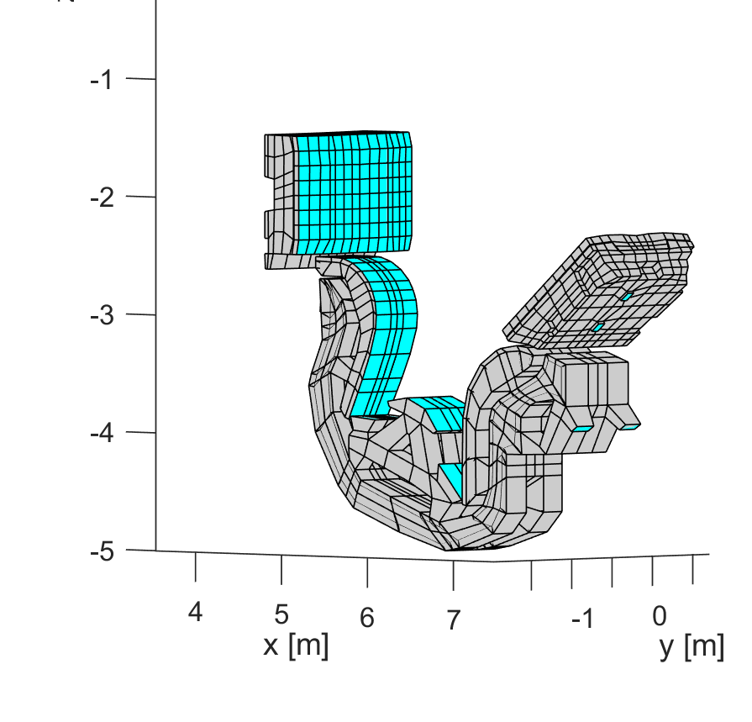
2. Monitoring models and data types
Electromagnetic monitoring outputs [3]:
  Vacuum Vessel currents
  Component forces
[3] Villone et al., “Reconstruction of Electromagnetic Loads during Disruptions in ITER”, NucFus, 2025

Slide 6
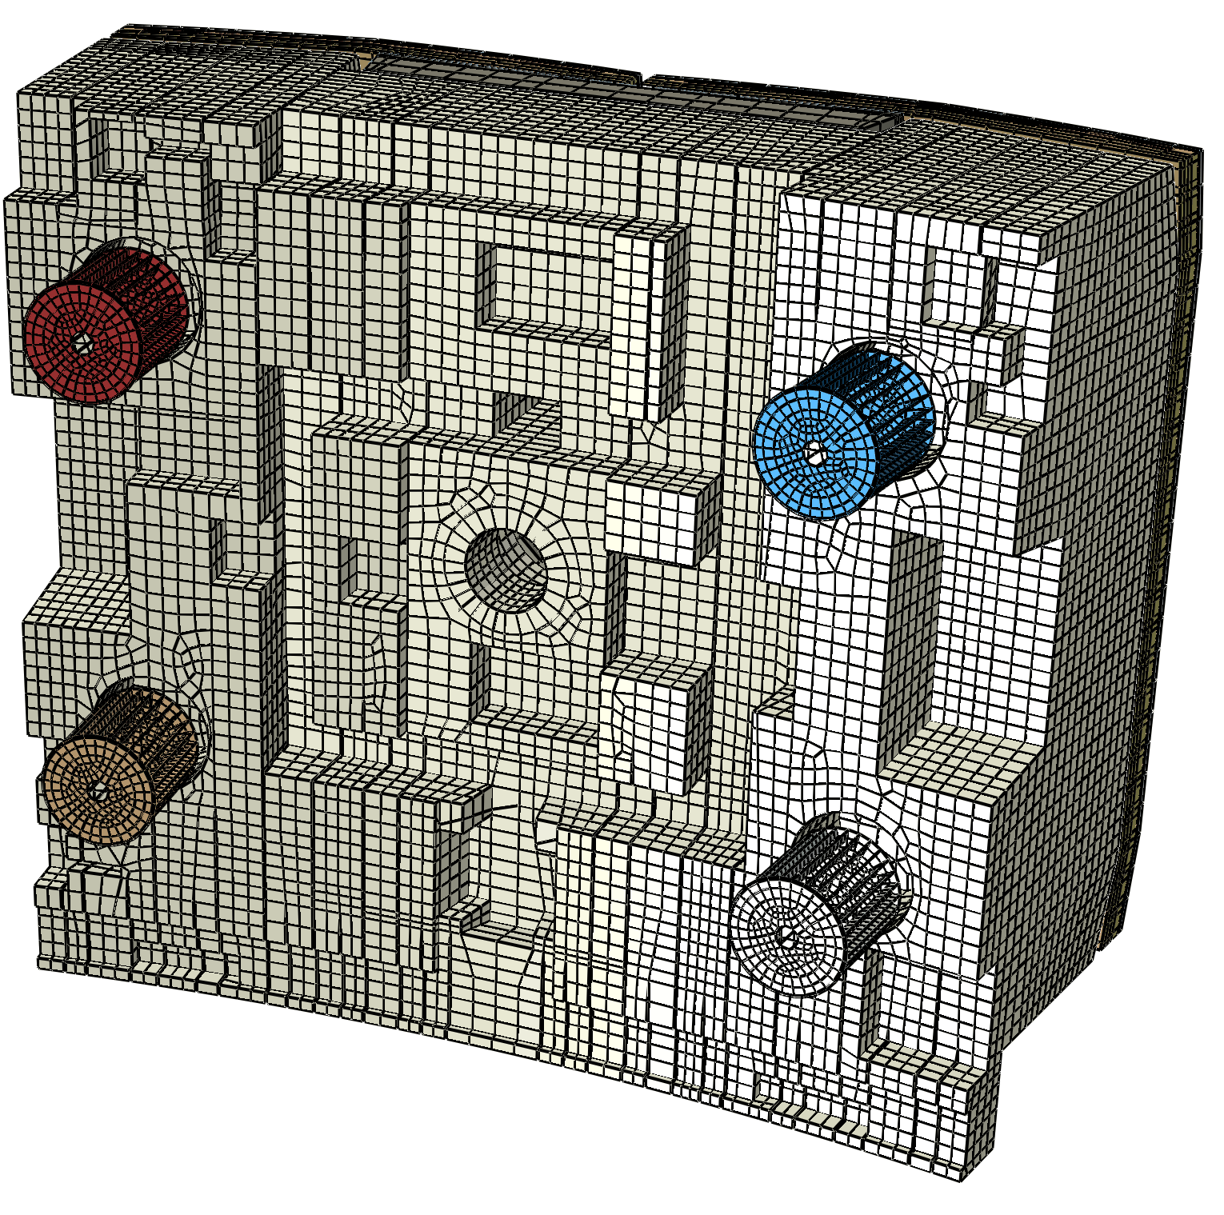
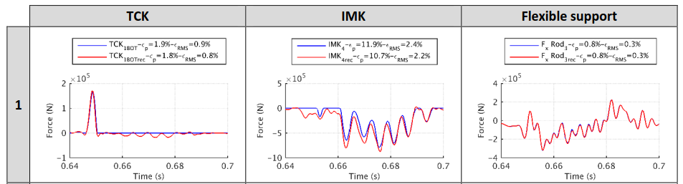
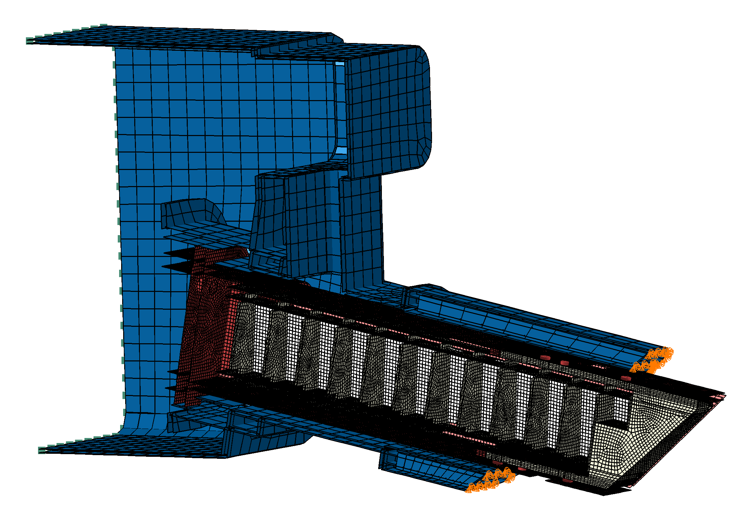
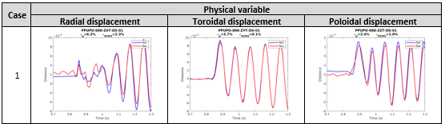
2. Monitoring models and data types
Structural monitoring outputs:
  System/component forces
  Component displacements
Blanket
Shield
Module
Upper
Port
Plug

Slide 7
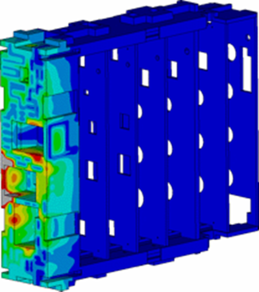

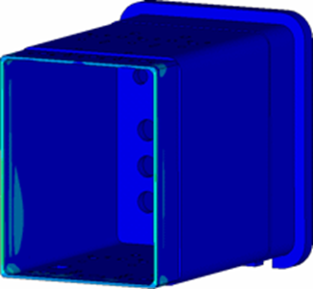
2. Monitoring models and data types
Thermal monitoring*:
  Online temperature tracking of relevant points
  Analysis allows calculating the complete thermal maps
Thermomechanical:
  Deformation
  Thermal stress
  Fatigue effects
* See N. Saura – Thermal Surrogate Modeling for the Monitoring of Actively Cooled First Wall Components in ITER

Slide 8
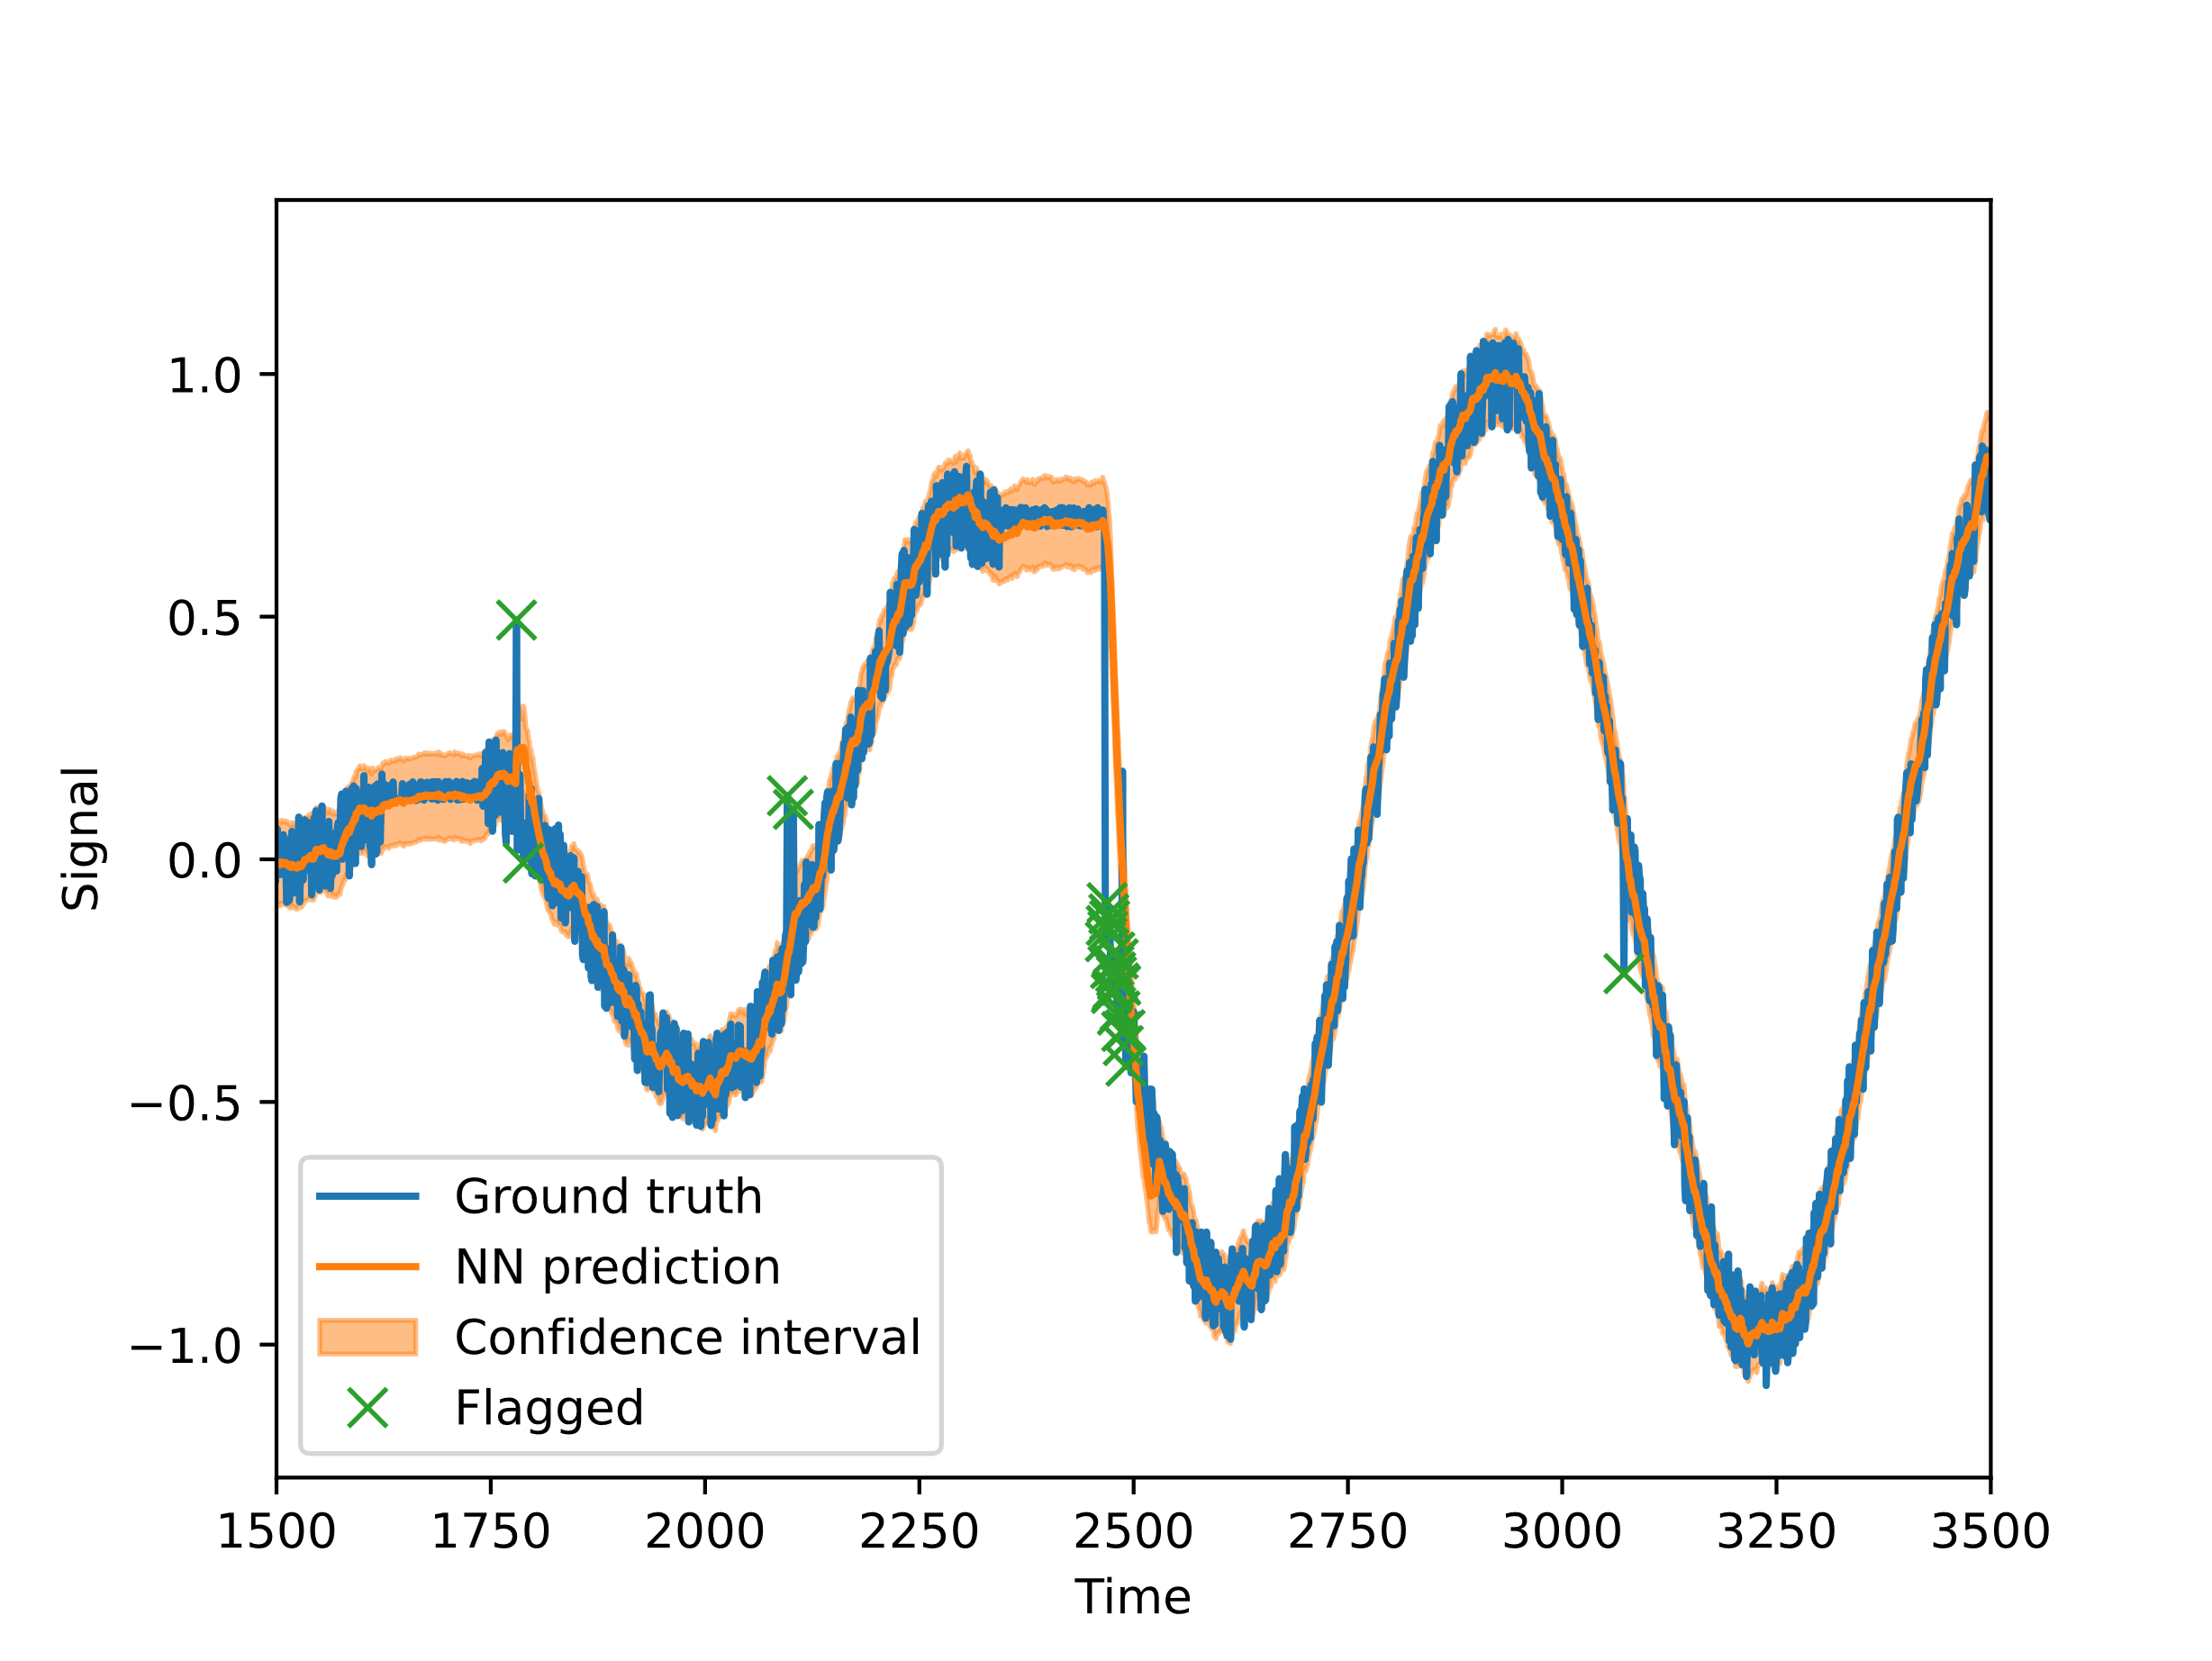
2. Monitoring models and data types
ML-based anomaly detection [4]:
  Output of these type of algorithms include flags or spikes in the case of time-dependant anomalies
  Interactivity needed with the plots to link an anomaly to a database (to keep a record), a 3D mesh (to trace it back to a physical location), etc.
  A second use case for the clustering algorithms is under study
Anomaly detection using a neural network on a toy dataset
[4] Paret et al., “ML-based anomaly detection for ITER’s TSM: a gyrotron case study”, TechRxiv, 2025

Slide 9
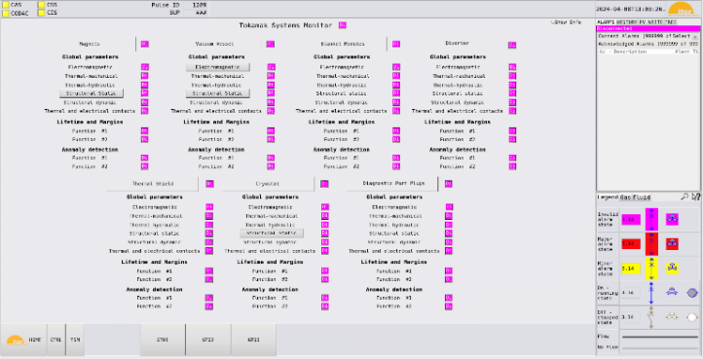
3. HMI high-level specification
Control HMI
TSM POZ currently contains all functionality of TSM for execution and control of the monitoring algorithms
TSM Data Analysis contains the rest, so that it reduces POZ complexity:
  Tokamak health indication
  Early warnings analysis and processing
  Operational data evaluation
  Offline data processing and calibration [5]
Data analysis HMI
Status
Annotations
Evaluation
Offline
[5] Paret et al., “Preliminary machine learning-based calibration strategy for the ITER Tokamak Systems Monitor”, FusEngDes, 2026

Slide 10
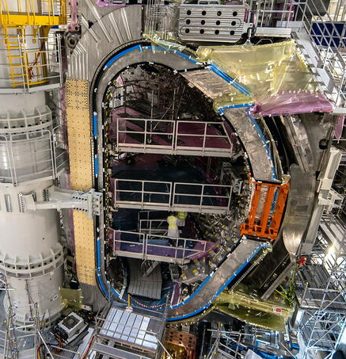
3. HMI high-level specification
HMI should allow to detect and process all inputs and outputs from TSM, both during plasma operations and offline detail analysis:
  Input sensors:
    Strain gauges ~1000
    Accelerometers ~100s
    Displacement sensors ~10s
    Temperature and flow sensors ~1000
    Electromagnetic diagnostics ~100s
  Output variables:
    Forces and stress ~1000
    Displacements ~100s
    Derived temperatures ~100s
    Heat flux and volume heat maps ~1E6
    Anomalies ~100s

Slide 11
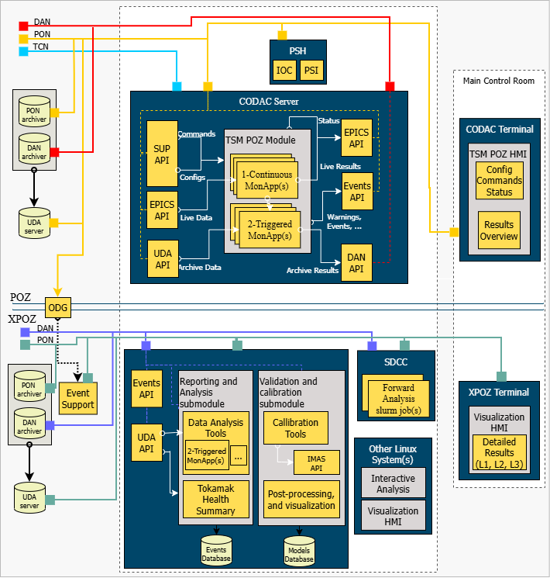
4. Architecture
Modular widget-based architecture.
Using technologies unavailable in POZ, hence the need to have a more complete deployment environment.
Linked to a “Events database” to report and label anomalies and other early warnings.

Slide 12
4. Architecture

Slide 13
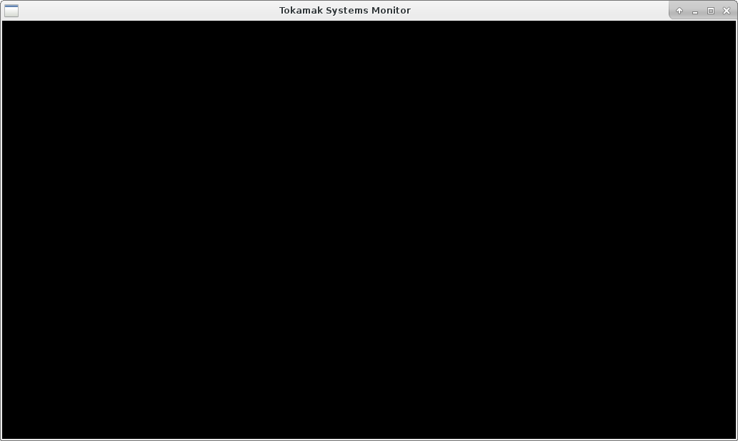
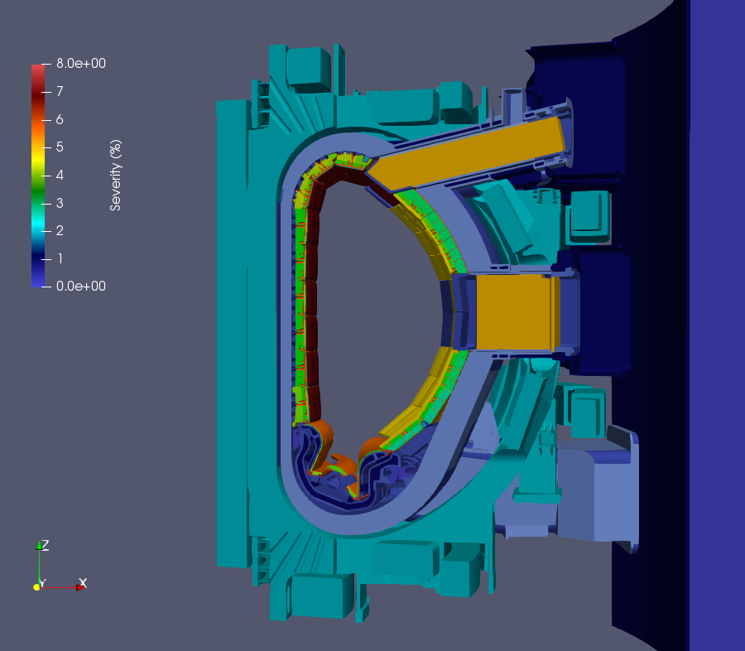
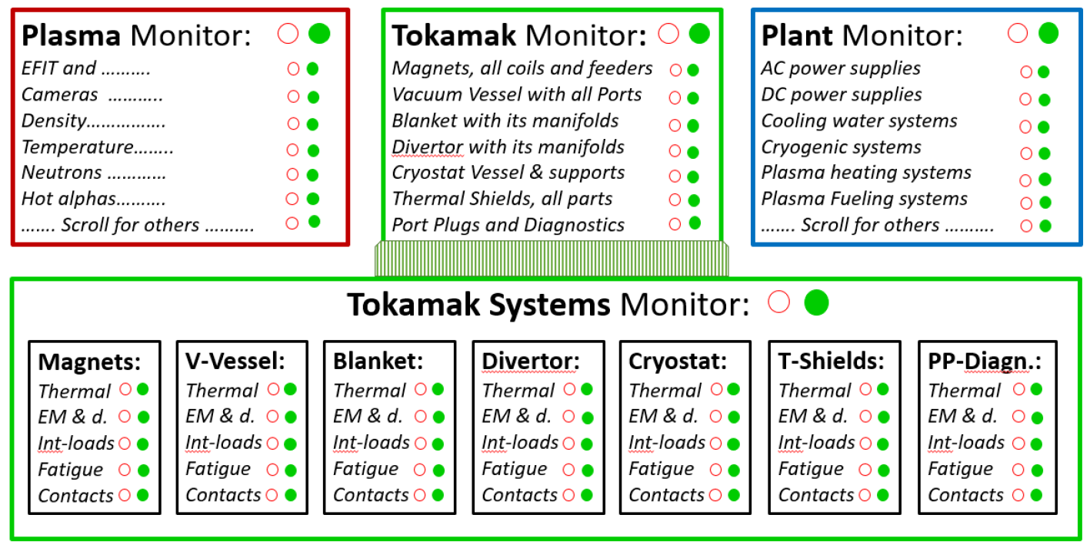
5. HMI layouts and workflows
Concept definition – Status
Event detected – Systems state live report [15h34’12”]
Scarce resources management
Warnings
No warnings
Based on
health limits
and anomalies
Based on
lifetime

Slide 14
5. HMI layouts and workflows
Concept definition – Status
Event detected – Systems state live report [15h34’12”]
Scarce resources management
Warnings
VV under evaluation
Based on
health limits
and anomalies
Based on
lifetime

Slide 15
5. HMI layouts and workflows
Concept definition – Status
Event detected – Systems state live report [15h34’12”]
Scarce resources management
Warnings
VV equatorial port displacement
Based on
health limits
and anomalies
Based on
lifetime

Slide 16
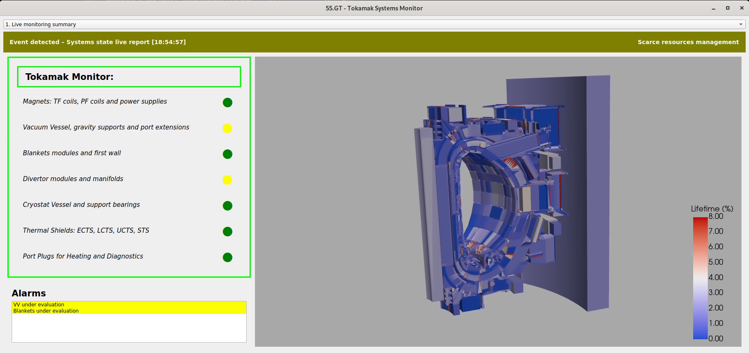
5. HMI layouts and workflows
Preliminary implementation – Status

Slide 17
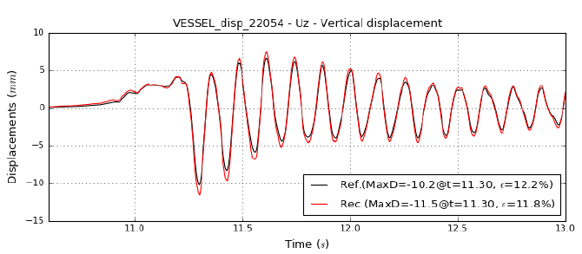
5. HMI layouts and workflows
Concept definition – Annotation
Event detected – Systems state live report [15h34’12”]
Warnings
102 Time 1 Signal A
103 Time 2 Signal B
System
Magnets
VV
Blanket
Divertor
Cryostat
Thermal Shield
Port plugs
ECH
NB
ICRH
…
S1 S2 S3 S4 S5 S6 S7 S8 S9
AI-enhanced
summary of the
warning
Warning 102 details
Triggered on time 1
By Signal A in VV : Sector 2
Normal level
Dismiss
Confirm issue
Postpone
More details

Slide 18
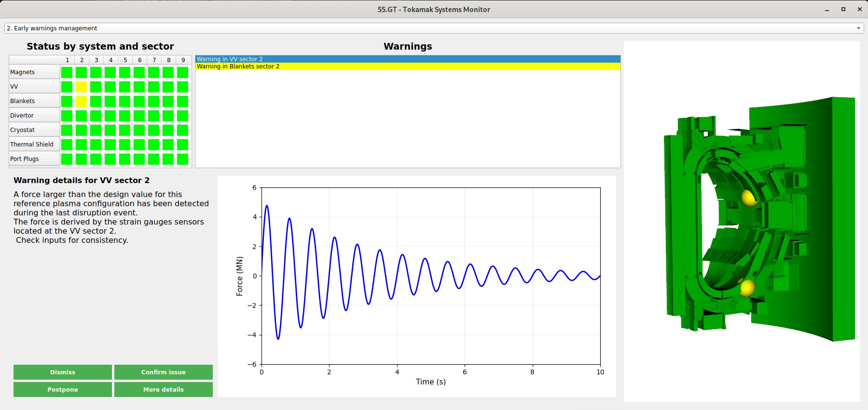
5. HMI layouts and workflows
Preliminary implementation – Annotation

Slide 19
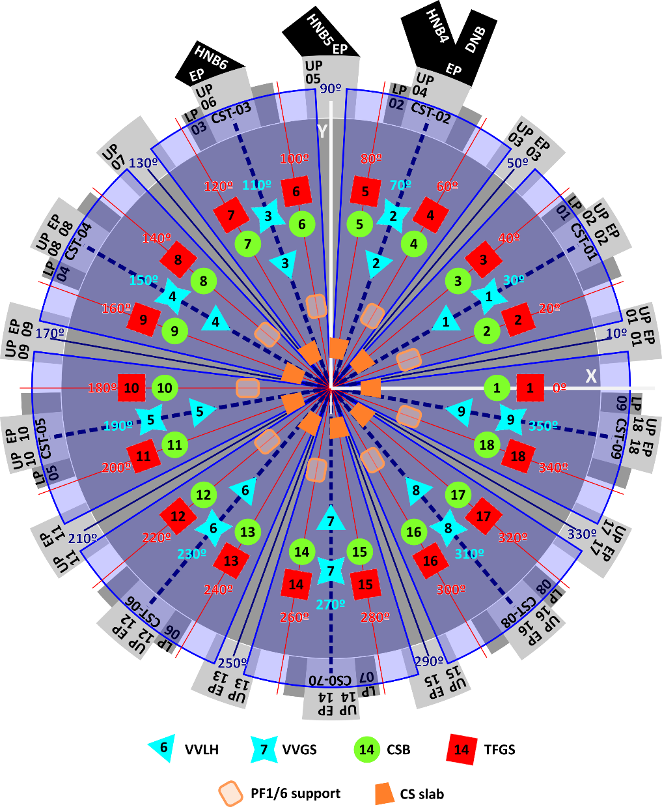
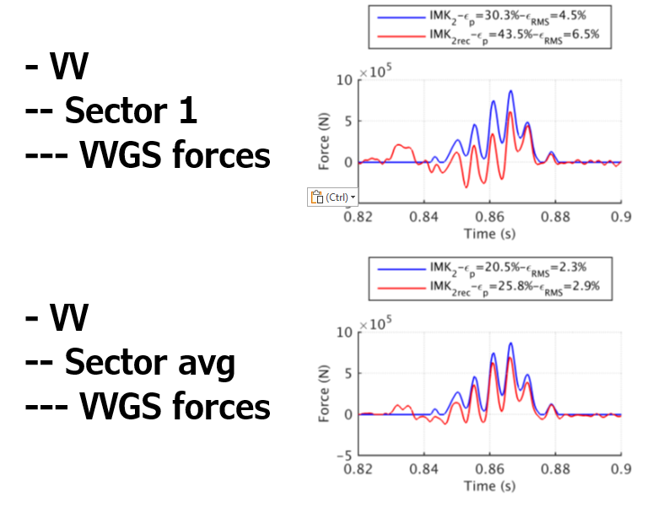
5. HMI layouts and workflows
Concept definition– Evaluation
Live monitoring of variables
Vacuum vessel sector 2 warning

Slide 20
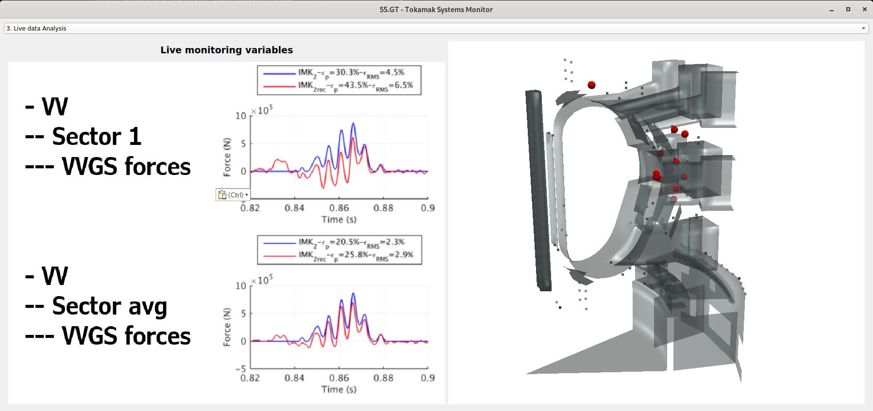
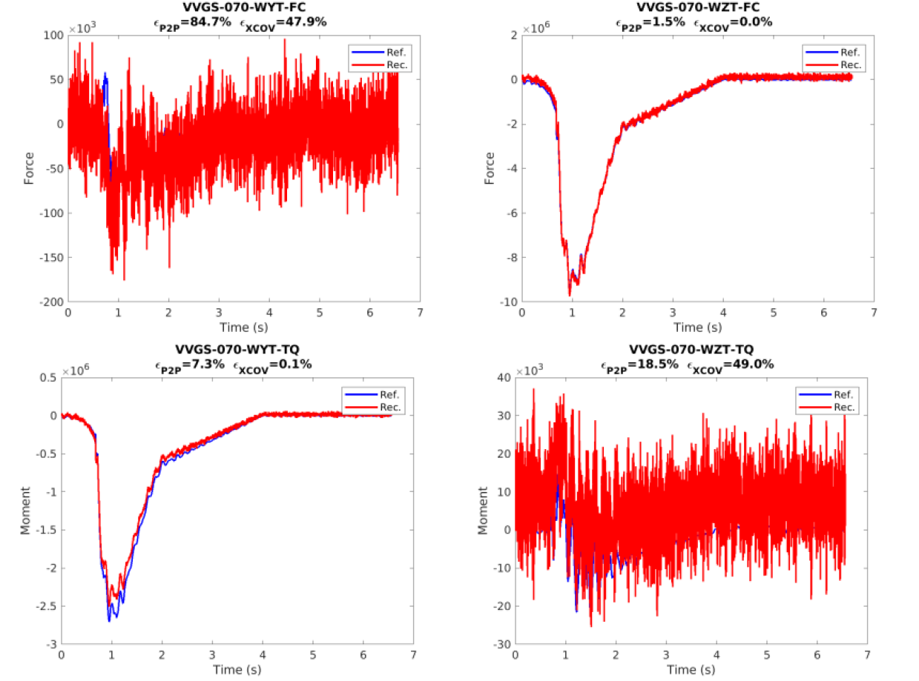
5. HMI layouts and workflows
Preliminary implementation – Evaluation

Slide 21
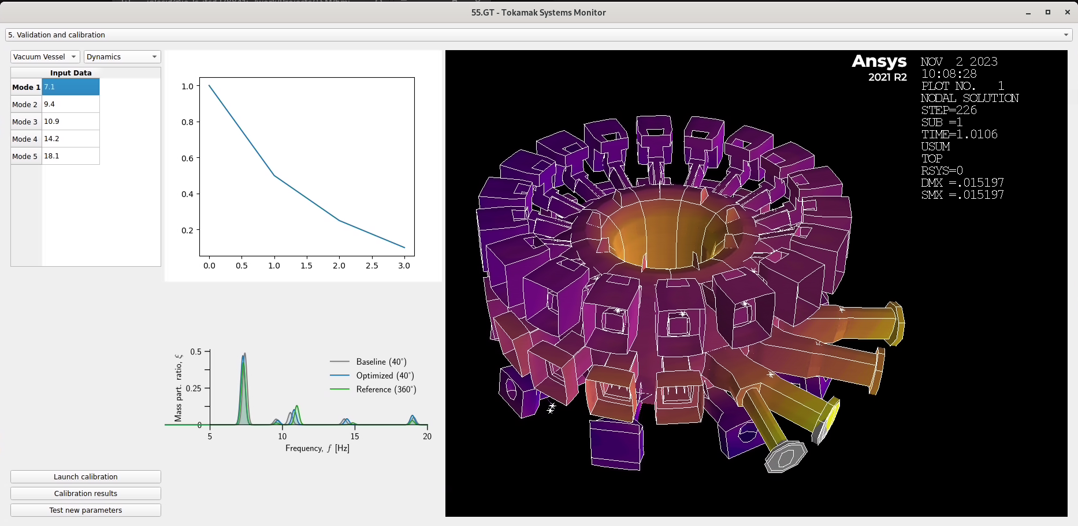
5. HMI layouts and workflows
Preliminary implementation – Offline processing

Slide 22
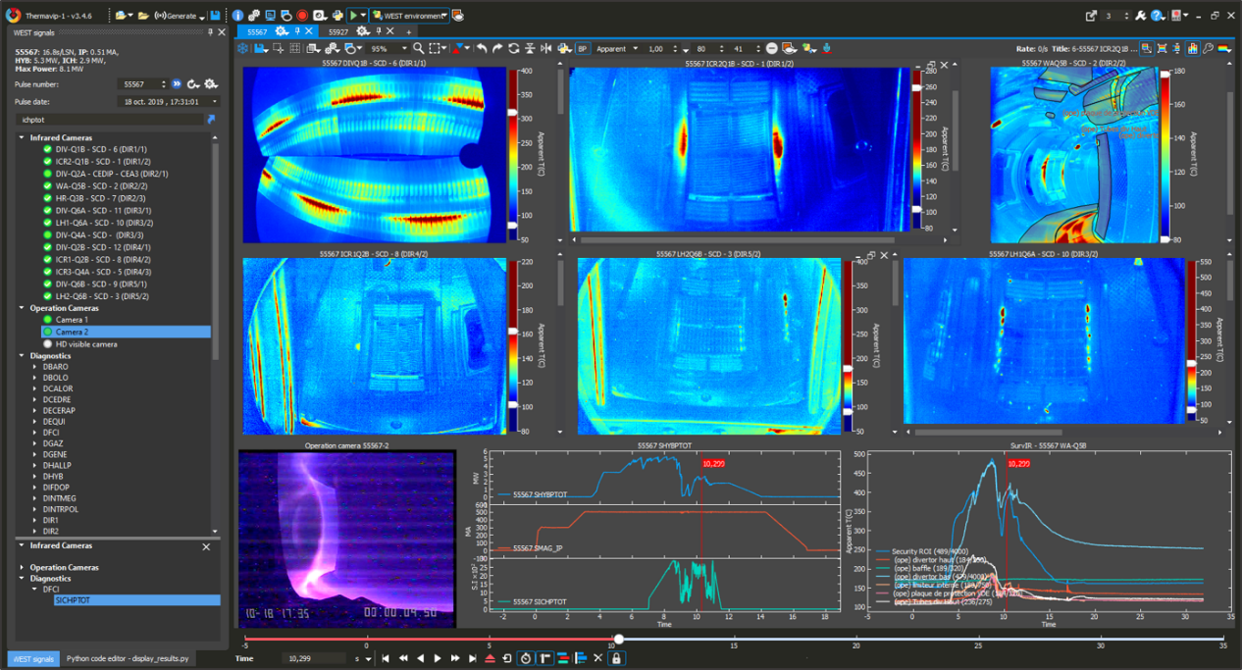
5. Ongoing final design
A thorough comparison was made during 2024 between 3 options:
Developing on top of Paraview
Adapting an existing monitoring tool
Continuing with a dedicated development from scratch
We decided to develop on top
of CEA’s ThermaVIP [6], with
the following key advantages:
Currently used for operation at
WEST, EAST and W7-X,
Known technologies: C++, Qt, etc.
Compatible with ITER UDA,
Open source.
[6] V. Moncada et Al., ”Software platform for imaging diagnostic exploitation
applied to edge plasma physics and real-time PFC monitoring”, FusEngDes, 2023

Slide 23
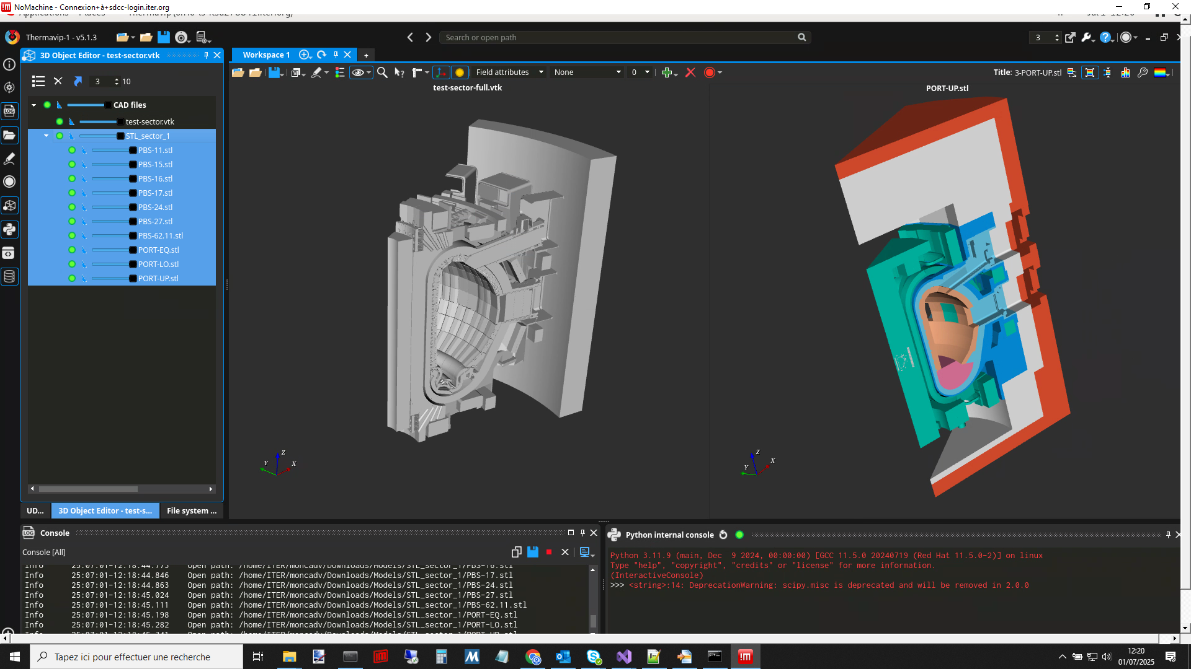
5. Ongoing final design
Current collaboration contract is ongoing, with the following features implemented:
Data archive read and live update through UDA
Fast data streamer subscription and plotting
VTK geometries and data plots allow analysis of 2D and 3D monitoring data
Filtering and representation of monitoring point data

Slide 24
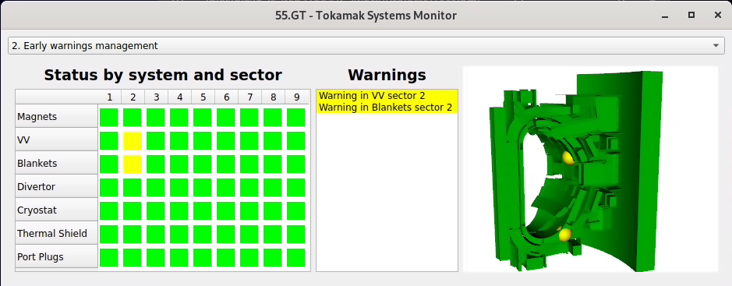
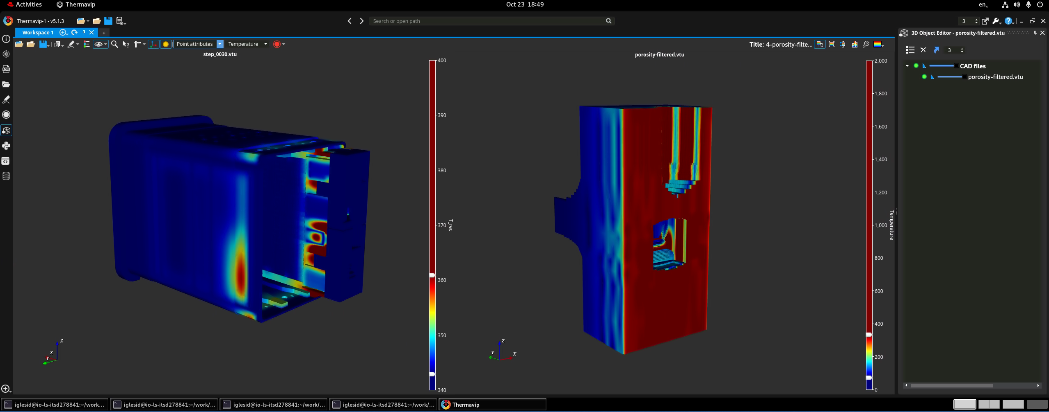
6. Conclusions
The ITER Tokamak Systems Monitor data analysis:
Requires treatment of thousands of input and output variables
Will have four main functionalities:
  Health status of the tokamak systems
  Annotations and management of early warnings
  Evaluation of the operational data
  Summaries, offline detail analysis, and calibration of models
Main workflows have been defined
Final design of the data analysis software is well underway

Slide 25
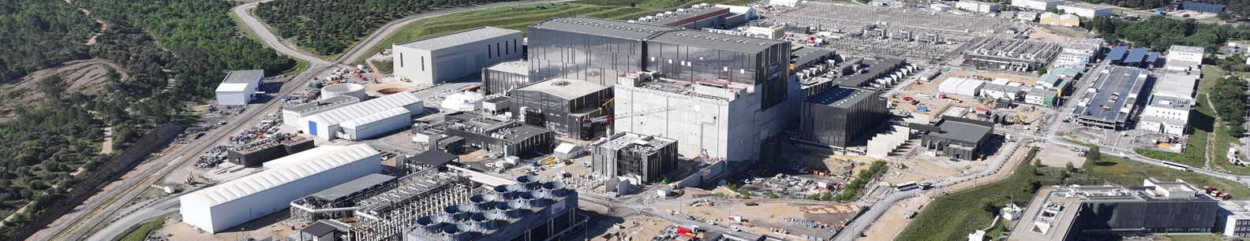
Thank you
Data Analysis Strategy for the ITER Tokamak Systems Monitor
Daniel Iglesias¹, Victor Moncada², Joris Paret¹, Lana Abadie¹, Isabel Nunes¹, Daniel Sabio³, Sergey Sadakov¹, Nathaniel Saura¹
¹ ITER Organization, 13067 Saint Paul Lez Durance Cedex France
² CEA-IRFM, 13108 Saint-Paul-Lez-Durance, France
³ Automaticity Solutions SL, 08028 Barcelona, Spain
2nd VOLDA Workshop, November 18–20 2025, Madrid

Slide 26
References
[1] Sadakov et al., “Practical Model for the Calculation of Lateral Electromagnetic Loads in Tokamaks at Asymmetric Vertical Displacement Events (AVDEs)”, Plasma, 2024
[2] Maqueda et al., “Feasibility evaluation and pre-conceptual design of the ITER TSM”, FED, 2023
[3] Villone et al., “Reconstruction of Electromagnetic Loads during Disruptions in ITER”, NucFus, 2025
[4] Paret et al., “ML-based anomaly detection for ITER’s TSM: a gyrotron case study”, TechRxiv, 2025
[5] Paret et al., “Preliminary machine learning-based calibration strategy for the ITER Tokamak Systems Monitor”, FusEngDes, 2026
[6] V. Moncada et Al., ”Software platform for imaging diagnostic exploitation applied to edge plasma physics and real-time PFC monitoring”, FusEngDes, 2023

