Slide 1

VOLDA 2025
Data Streaming with HDF5
John Readey
jreadey@hdfgroup.org

Slide 2
About me
Developer at The HDF Group for the last 10 years
The HDF Group is a non-profit company with a mission to support HDF5
My work has been focused on cloud enablement of HDF5 and HDF5 as a service
Live in Seattle, but frequently travel in Europe!

Slide 3
Outline
Introduction
Brief overview of HDF5
Data streaming with HDF5 (SWMR)
Overview of HSDS (HDF REST Service)
Data streaming with HSDS
Visualizing the results (with some help from Claude Code)
Conclusions/Questions

Slide 4
Introduction
Designing a system for live data streaming and visualization is quite complex, but to keep things simple, let’s assume:
  We have an arbitrary number of sensors producing a series of floating points values
  Each sensor has a frequency (number of sample per second)
  Update interval (how often a packet of samples are sent out)
  Various fixed metadata (e.g. min/max range, units, etc.)
Additional requirements:
  Be able to visualize the data in (near)real time
  Be able to store data in an archival file for later analysis
  Enable new sensors to come online at any time
  Allow access to archival file while sensor collection is in progress
We’ll use this as a framework to think about how we could design a streaming application using HDF5
the real-world will be a lot more complicated, but it’s a start!

Slide 5
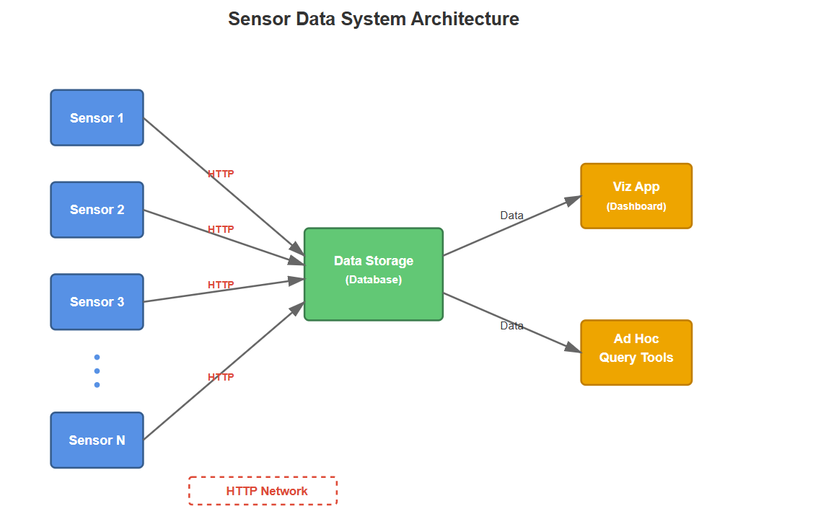

Slide 6
Overview of HDF5
HDF5 is a data format and library for storing scientific data
Multiple datasets (single or multiple dimension) datasets can be stored in a file
Datasets can be organized in groups
User defined metadata (attributes) can be attached to groups or datasets
Library supports partial reads and writers of dataset data
The HDF5 library is written in C, but Python (e.g. using the h5py package) and other languages are well supported

Slide 7
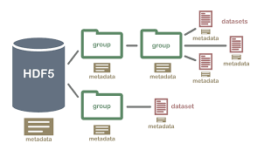
Example HDF5 Structure
Diagram courtesy of Neon Science: https://www.neonscience.org/resources/learning-hub/tutorials/about-hdf5

Slide 8
Using HDF5 our sensor data could be stored like this:
/sensors Group
/sensors/plasma_temp Dataset {100000}
attr: description Plasma temperature
attr: frequency 1000
attr: max_value 100
attr: min_value 0.0
attr: start_time 1763239815.2
attr: units keV
attr: update_interval 1
/sensors/plasma_pressure Dataset {100000}
attr: description Plasma Pressure
attr: frequency 1000
attr: max_value 800.0
attr: min_value 0.0
attr: start_time 1763239821.9
attr: units kPa
attr: update_interval 1

Slide 9
By using HDF5 as a storage format…
The good:
  You can put multiple data sets in one file
  You can use attributes to describe the data
  The data can optionally be compressed to save storage
  Data can be read using standard APIs and tools (e.g. h5dump)
The bad
  Only one writer can access a file at a time
  For simultaneous reading (SWMR) there are restrictions:
    No metadata changes allowed (new datasets, attributes, etc.)
    Storage must be POSIX (NFS not supported)
  Clients must directly access the file (no http requests)

Slide 10
Another approach: HSDS
HSDS – HDF5 Scalable Data Service
A REST-based service for working with HDF5 data (using sharded storage model)
Supports reading and writing to object-based storage (S3, Azure) in addition to Posix stores
Runs in Docker, Kubernetes, or directly on OS
Client libraries (h5pyd for Python, REST VOL for C/C++) enable applications to use existing HDF5 APIs to invoke requests to the service
MWMR (Multiple writer/multiple reader) is supported

Slide 11
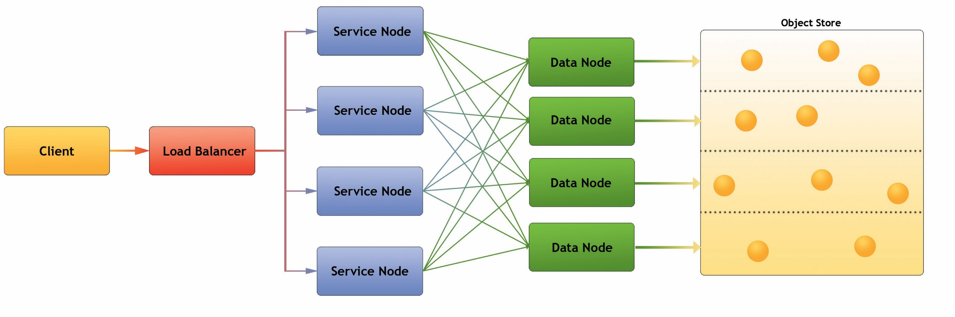
HSDS Architecture
Service Node (SN): Accepts client requests; delegates to Data Node
Data node (DN): Read & Write to storage for specific partition

Slide 12
Sharded format example
root_obj_id/
group.json
obj1_id/
group.json
obj2_id/
dataset.json
0_0
0_1
obj3_id/
dataset.json
0_0_2
0_0_3
In comparison with HDF5 file format, sharded storage enables read-write functionality on object-based storage
Observations:
Metadata is stored as JSON
Chunk data stored as binary blobs
Self-explanatory
One HDF5 file can translate to lots of objects
Flat hierarchy – supports HDF5 multilinking
Can limit maximum size of an object
Can be used with Posix or object storage
Schema is documented here: https://github.com/HDFGroup/hsds/blob/master/docs/design/obj_store_schema/obj_store_schema_v2.md

Slide 13
How does HSDS support concurrent writes?
The HSDS architecture along with the sharded data format ensures any object is updated exclusively by one “data node” (DN)
Multiple requests arriving at a DN to update a particular object will be handled serially
Example: client #1 could update “odd” rows of a table and client #2 could update even rows without a problem
However, no support for handling an arbitrary set of requests in a consistent way (i.e. the equivalent of a relational database “transaction”)

Slide 14
Visualization with HSDS
So HSDS appears to meet all the requirements for the sensor example from the introduction:
  Multiple sensors can be added
  Data transmitted over http
  All data stored in one “file” (the HSDS sharded collection)
What about the visualization aspect?
  One option would be to create a desktop app with (for example) Python, h5pyd, and matplotlib
  On the other hand, a webapp would be really nice – it wouldn’t require any special software to be installed for one thing
  But what if your developer has no knowledge of javascript, html, etc.?

Slide 15
App development with Claude Code
Claude had an easy time taking the following prompt and creating a functional webapp for a basic visualization of the sensor data. Total dev time: about 30 minutes!
Prompt: “Claude: create a web app to visualize dynamic data from a set of sensors. Each sensor will have data added periodically. New sensors maybe added at any time. Plot the data from all sensors together as a set of X-Y plots. Have a checkbox for the user to disable the display of any particular sensor and a edit box to select the refresh frequency. Use the HSDS REST API to read the data, here’s a Python notebook illustrating how to use the api for the sensor data example”
A couple of additional refinements were needed to get to the end result

Slide 16
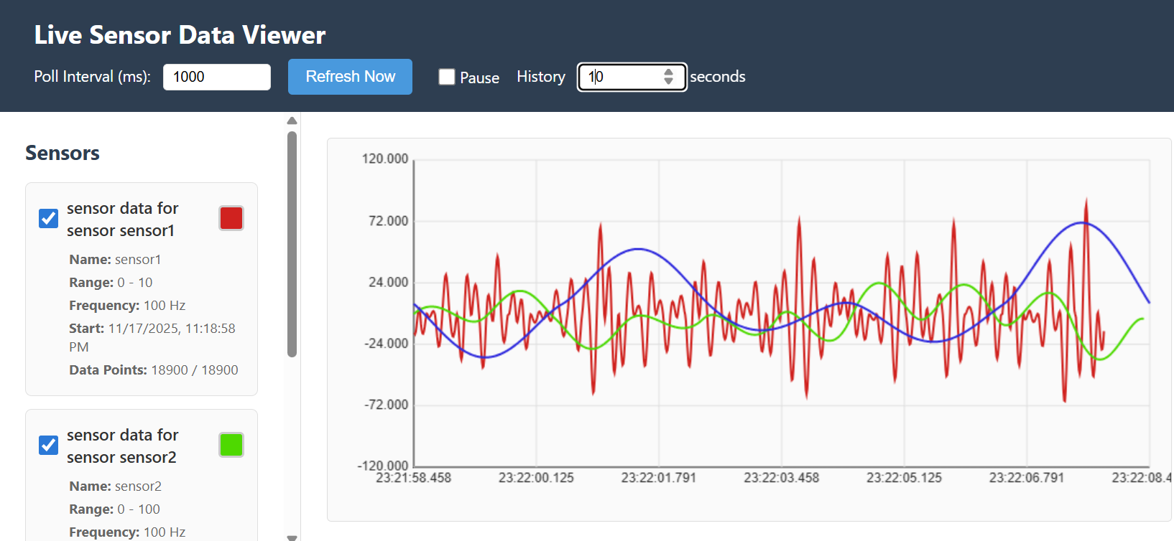
Screenshot of the Claude’s work…

Slide 17
Demo!
Source code for the demo can be found here: https://github.com/HDFGroup/hsds_examples/tree/master/live_data

Slide 18
Conclusions
If you like HDF5, but have run into some of its limitations, give HSDS a go
With HSDS you can have a web app without the need for running a backend to support it (in many cases, HSDS can provide all you need)
Coding Assistant AI’s (like Claude Code) can be a big productivity booster, esp in cases as with this demo where:
  I’m not familiar with the dev environment (javascript, html, svg, etc.)
  Claude is using common constructs (like a login dialog)
  Nothing terrible will happen (the Claude generated code is only reading) if it all goes wrong!

Slide 19
Questions?

Slide 20
Acknowledgement
Acknowledgment: “This material is based upon work supported by the U.S. Department of Energy, Office of Science, Office of Fusion Energy Sciences, under Award Number DE-SC0024442.”
Disclaimer: “This report was prepared as an account of work sponsored by an agency of the United States Government. Neither the United States Government nor any agency therefore, nor any of their employees, makes any warranty, expressed or implied, or assumes any legal liability or responsibility for the accuracy, completeness, or usefulness of any information, apparatus, product, or process disclosed, or represents that this use would not infringe privately owned rights. Reference herein to any specific commercial product, process, or service by trade name, trademark, manufacturer, or otherwise does not necessarily constitute or imply its endorsement, recommendation, or favoring by the United States Government or any agency thereof. The
views and opinions of authors expressed herein do not necessarily state or reflect those of the United States Government or any agency thereof."

