Slide 1
MDSplus WebScope
By Timothy Heidcamp
Notes:
Hello, and buenos dias! My name is Tim
I’m from the Plasma Science and Fusion Center at MIT
I’m one of the developers for MDSplus
Today, I’m going to tell you about visualizing data through our new WebScope
—----------------------------------------------------------------------
What is the point of this project
Moving mdsplus guis into the web age
There have been attempts before
Using websockets this time

Slide 2
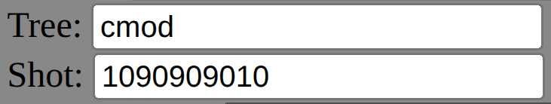
What is MDSplus?
MDSplus is a collection of tools and APIs for acquiring and analyzing data. It was developed primarily for fusion experiments as a collaboration between MIT and RFX. Both the acquired data and the settings are stored in a tree data structure and are organized into files by shot number. A shot refers to a single data capture of an experiment.
Notes:
So, what is MDSplus?
MDSplus is a collection of tools and APIs for acquiring and analyzing data.
It was developed as a collaboration between MIT and RFX, primarily for fusion experiments.
Fun fact: the history of MDSplus extends all the way back to the late 1980s!
Both the settings and the acquired data are stored in a tree data structure, and are organized into files by shot number.
A shot refers to a single data capture of an experiment.
A shot can be a single instance of a plasma.
The convention for storing a shot for CMOD is yyymmddexp
We preface years after 2000 with a 1 because of Y2K

Slide 3
What is a scope?
A data visualization tool
The word comes from ‘oscilloscope’
This allows viewing of multiple data signals side by side, zooming and aligning data, and updating the plots when new data is available
We need one because other data visualization tools don’t integrate with MDSplus.
Notes:
So, what is a scope?
A scope is a data visualization tool
Fun fact: the word comes from ‘oscilloscope’,
A digital scope allows viewing of multiple data signals—
side-by-side;
zooming and aligning data;
and updating the plots
…when new data is available.
Why do we need it?
Because other data visualization tools don’t integrate with MDSplus.

Slide 4
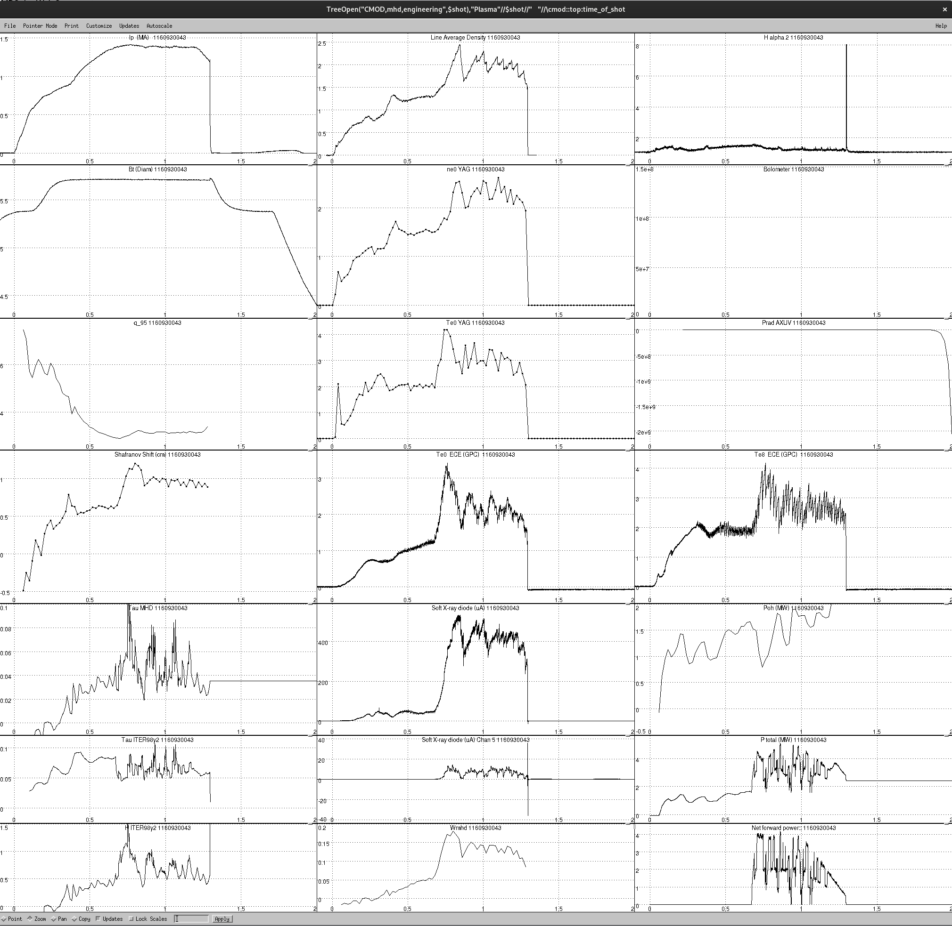
Existing MDSplus Scopes
Fun fact: DW refers to DECwindows
dwscope
Pros
Fast
Reliable
Cons
Difficult to maintain
Single line plots only
No colors
Missing modern creature comforts
Notes:
Now, we do have several existing that were developed over the years.
One of them is DW Scope
Fun fact: the DW stands for DECWindows, coming from the VMS XServer implementation
The pros of DW Scope are that it’s fast and reliable.
However:
It’s increasingly difficult to maintain as the foundational tools used to develop it lose support
It only has single line plots
There are no other colors available
And it doesn’t have some of the modern creature comforts. More on that later.
—------------------------------------
DW for DECwindows
Scope for oscilloscope bing a analog rotating magnetic drum.
X is a compositor
Takes a bunch of streams and combines them into one thing
However it uses really arcane dense C libraries that are too much for even Stephen to use
So you use an interface such as MOTIF to makes X easy to use
So how does X work?
There’s an XServer
And there are clients
…
DecWindows was the VMS XServer

Slide 5
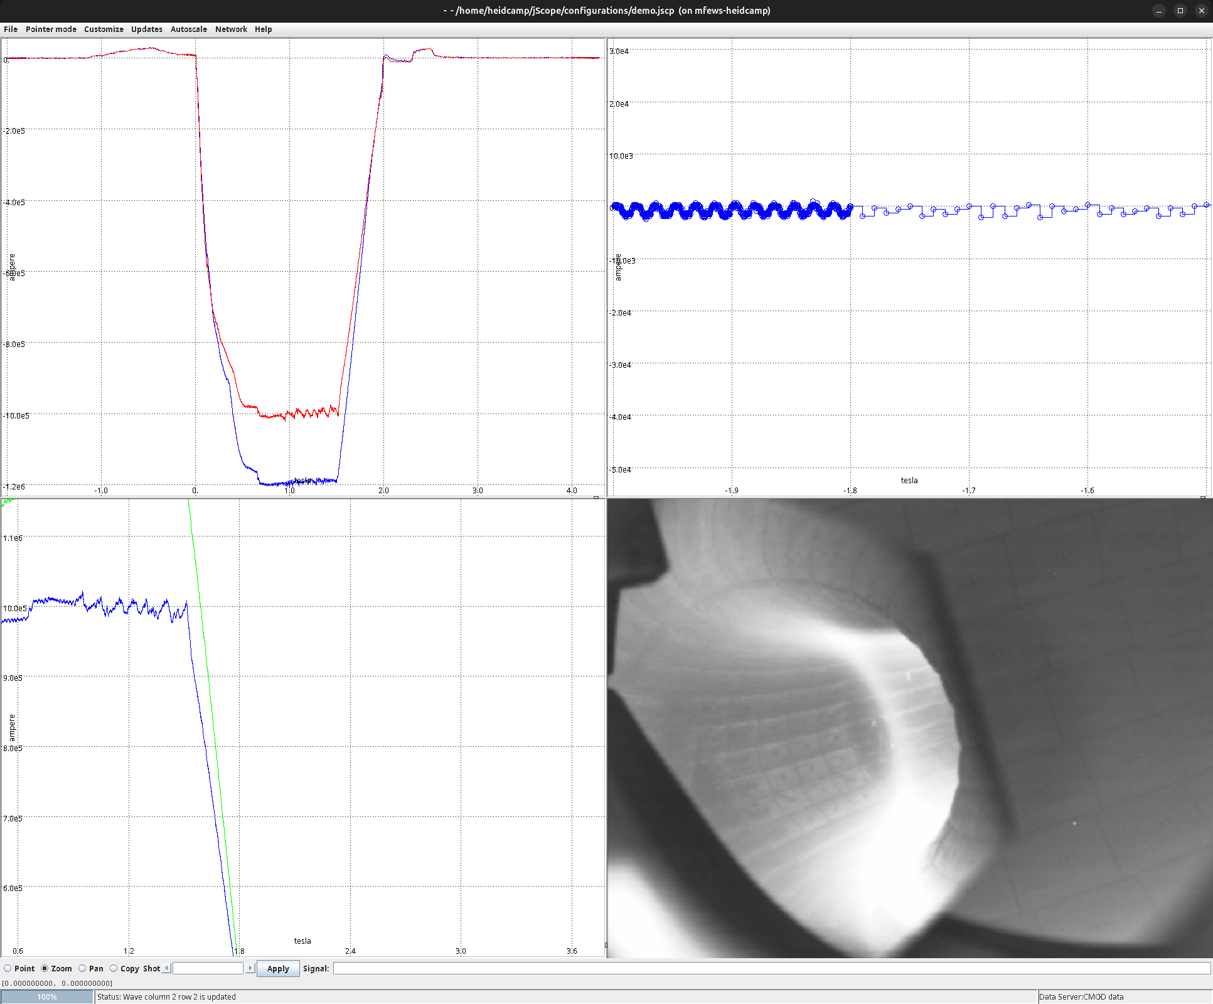
Existing MDSplus Scopes
jScope
Pros
Multi line traces
Different graph types/options
Supports video
Cons
Slow
Relies on outdated java windowing framework
Notes:
We also have jScope, which is written in Java.
It has multi-line traces
Different graph types and options
It even supports video
However:
It is slower…
…and it relies on an outdated Java windowing framework

Slide 6
Motivations
Limitations of the old scopes
Greater accessibility for more users with a smaller footprint
Modernize with web tools
Inspired by tools like Grafana
Notes:
What motivated us to start on this WebScope project?
Limitations of the old scopes (I just mentioned)
We wanted to provide a tool for users that doesn’t require installation
We wanted to modernize with web tools
We were inspired by tools like Grafana
Ultimately, we’re creating a platform to create new features in the future

Slide 7
Why not just
use Grafana?
Shot-based data,
not just time series data
Familiarity to existing users
Ability to import old scope files
Reduce dependence on external products
i.e., Why extend MDSplus instead?
Notes:
So why not just use Grafana?
In other words, why extend MDSplus instead?
Our data is shot-based, not just time-series, which is the only option for Grafana and many other tools on the market.
We wanted a scope that could feel familiar to existing users
We needed the ability to import old scope files
We wanted to reduce dependence on external products

Slide 8
WebScope
Features
Fast
Multi trace panels
Easily run on modern web browsers
Modern creature comforts
Colors
Import existing scope files
The goal is feature parity with dwscope and jScope
Notes:
Here are some great things about our new WebScope:
It’s fast
It can have multiple traces per panel
It easily runs on modern web browsers
There is better, more intuitive
We have colors
We’re not losing the ability to view old scope files
It’s a platform for new features: The goal is feature parity with dwscope and jScope.
—--------------------------------------------------------------------------------------------------------------------------------------------
The scope files exist as part of the existing data making it easy for new users to find channels and metadata
Scope files act as metadata
All same x auto y

Slide 9
Technologies Used
Vanilla Javascript
  Longevity
  Minimize dependency injection
D3
  SVG plot generation
  Interactive (zoom +/-)
Websockets
  Currently a simple python server
  MDSplus is not stateless (not well suited for REST)
  Designed around MDSplus’ getMany() API
  Only one Tree Open command
Notes:
What are some of the technologies we used?
We are currently using vanilla Javascript without frameworks
Longevity
Minimize dependency injection that could break our project
We’re using D3
For its SVG plot generation
And its tools like Interactive Zooming
You may have seen some previous iterations of the WebScope concept
But one major difference is this attempt is using websockets for our data
Websockets
Currently a simple python server
MDSplus is not stateless, so it’s not well suited for REST
Designed around MDSplus’ getMany() API
By maintaining our connection, we don’t need to rerun the costly tree open commands with every request
Ultimately, our new WebScope is faster and maintains its state better.
—----------------------------------
Vanilla JS with limited imports
D3 to view our data.
In order to ingest existing data we cannot break the panel’s dependency on other panels.

Slide 10
Demo
Notes:
Switch window to scope.psfc.mit.edu
Demo single panel
I’ll be using some CMOD data with a shot from 2009
(Drag to zoom) Easily to zoom in, can get quite granular
You can easy to reset it back to the original zoom
([ctrl] [+] zoom) You can also just make everything bigger using your web browser’s built in features
We can also add a second trace so we can see multiple data on the same plot.
\IP is plasma current. (I Current sub P plasma)
Demonstrate multitrace plots 1090909012
We’re using the plasma current for both
(Click Save)
Demo dragging in a existing scope
Everything is a tdi expression, which allows you to do some complicated things with the axes if you wanted to.
Panel 3 has an interesting y_axis
Show old DW scope panel

Slide 11
Future improvements
Styling
Configurable Dashboards
Exporting scope files
Additional graph types
Improve UI/UX
Incorporate useful features from projects such as piScope and Review+ (from D3D)
Dark Mode
Stack of Zoom operations
And much more!
Notes:
Here are some improvements we are planning future
Styling: want this to look nicer than it does currently
Add some more Configurable Dashboards
Exporting for the Web Scope so you can save new scope files
Additional graph types, like you saw in JScope
Improve UI/UX to more closely align with users are expecting to see
Incorporate useful features from other projects such as piScope and D3D’s Review+
Dark Mode
We also intend to add a stack of zoom operations so you can move back and forth between different zooms. This is a highly requested feature by users.
And much more!
—-------------------------------------
Vanilla JS with limited imports
D3 to view our data
Dashboards laid out like grafana
We are hoping to make the dashboards more interesting

Slide 12
Questions?
Notes:
And now we have a few minutes for questions
At the end:
Thank You for your time.

Slide 13
Demo Backup

Slide 14
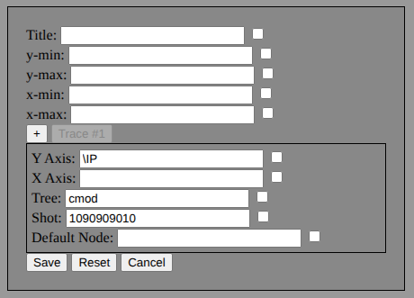
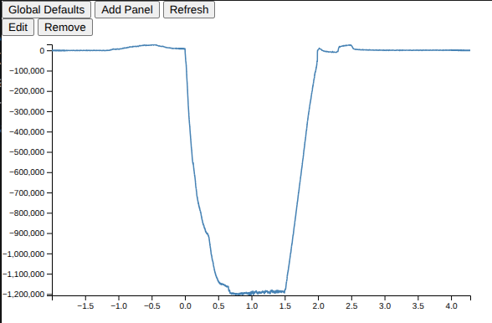

Slide 15
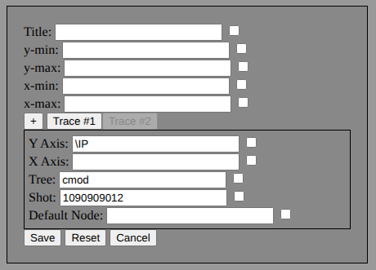
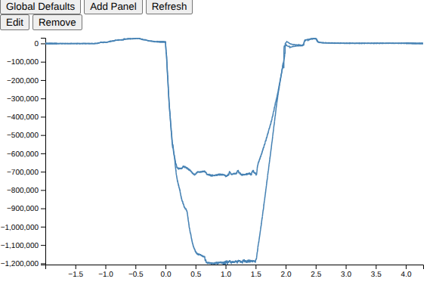

Slide 16

plasma.dat
Drag & Drop

Slide 17
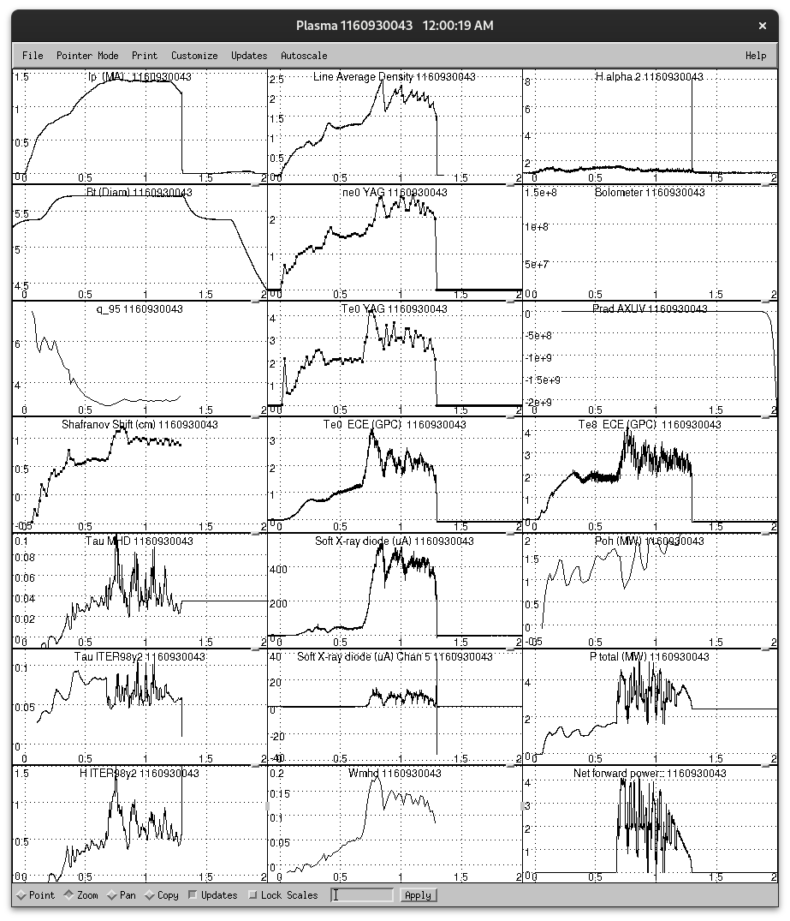
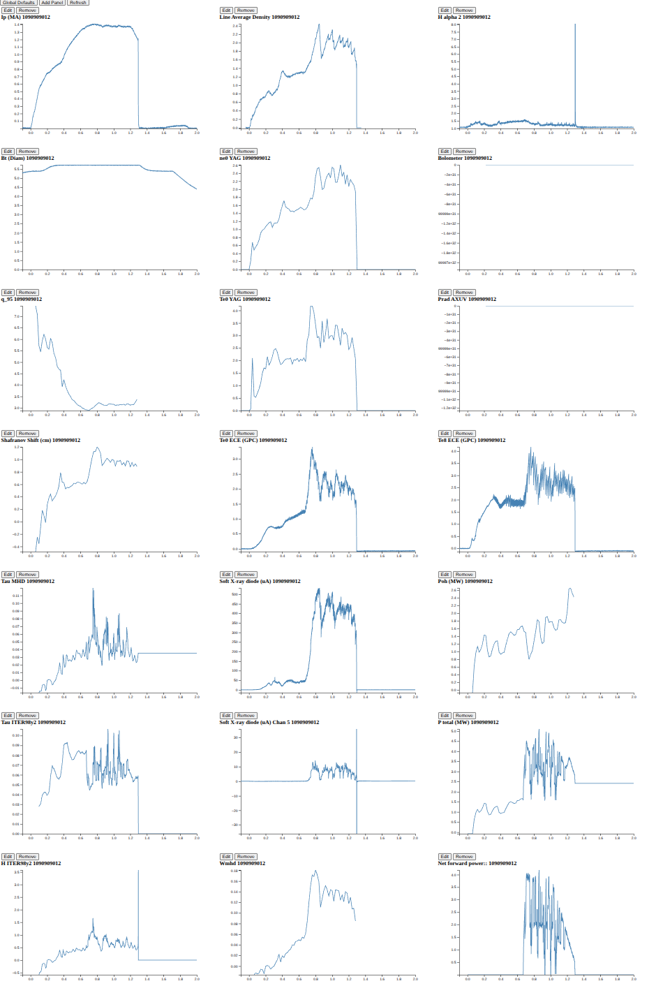

Slide 18
