Slide 1
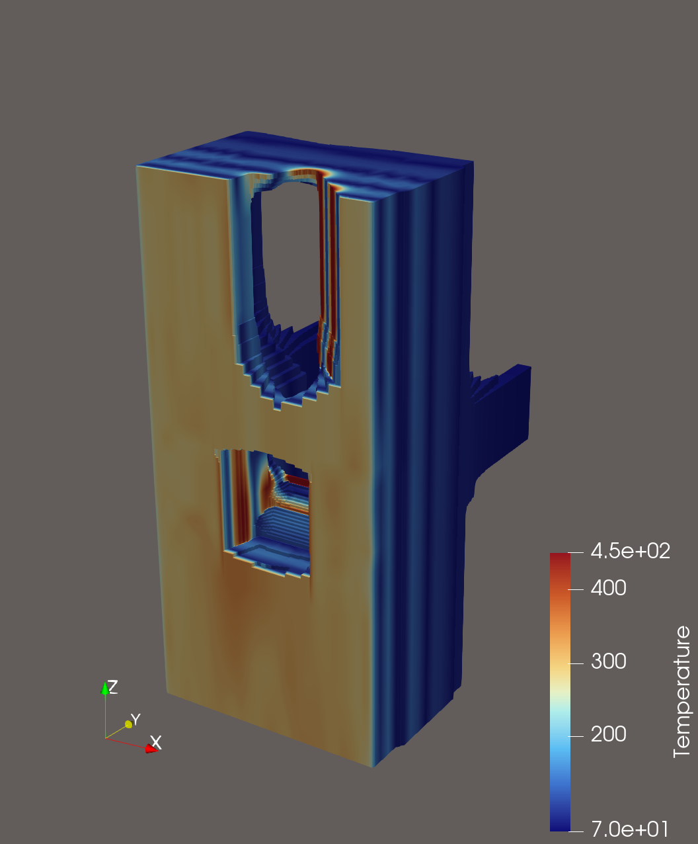
Thermal surrogate modeling for the monitoring of actively cooled first wall components in ITER
N. Saura, J. Paret, D. Iglesias
ITER Organization

Slide 2
Introduction and motivation
State of the art
  Existing models for continuous monitoring of tokamak first wall are limited to 2D formulations and typically assume limited cooling during the plasma discharge [1]
First wall components characteristics for ITER
  Passively cooled temporary first wall (TFW) for Start of Research Operations (SRO)
  Actively cooled diagnostics first wall (DFW), final blankets FW and divertor
Challenges
  While existing models are valid for TFW, accurate cooling is required for the rest
  3D geometries are relevant for defining the overall thermal state
  Models cannot afford to model the detailed geometry of cooling channels as the number of nodes would increase in numbers of magnitude
Scope of this contribution
  We present herein an evolution of the monitoring models which allow accounting for 3D geometries and cooling effects by combining 2D thermal models with linear interpolations
[1] Fusion Engineering and Design 125 (2017) 71-76

Slide 3
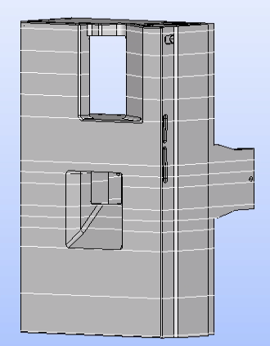
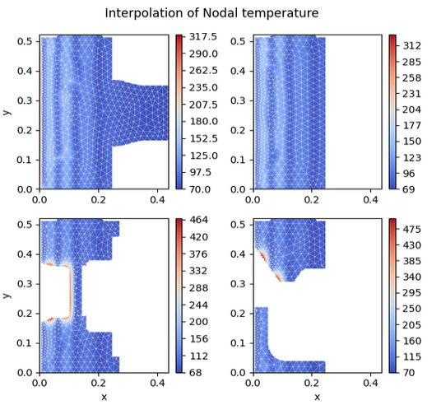
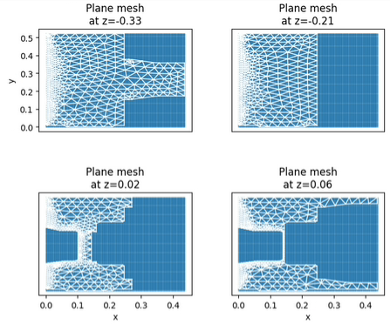
Global overview of the workflow
Defining 2D slices of existing CAD geometry
Surrogate modeling (porous approach) for temperature evolution through MKNIX
Interpolate intermediate plans to approximate the 3D solution

Slide 4
Overview of the presentation
I: Surrogate model of the thermal evolution of actively cooled DFW in ITER
  I-A: Surrogate modeling for monitoring
  I-B: Porous Media Approach (PMA) applied for ITER DFW
    Theoretical framework for the PMA
    Validation of the PMA implementation in MKNIX
    Porosity profiles and first results
II: 3D shape and temperature interpolation
  II-A: Signed Distance Function
    Mathematical description
    Example in shape morphing (valid-shape interpolation)
  II-B: Example of interpolation in real geometry: Equatorial Port Plug 12
    Setup of the numerical experiment: thermophysical quantities, orders of magnitude and assumptions
    Global reconstruction from solved planes
    Reconstruction errors for intermediate planes
III: Discussion and Conclusion

Slide 5
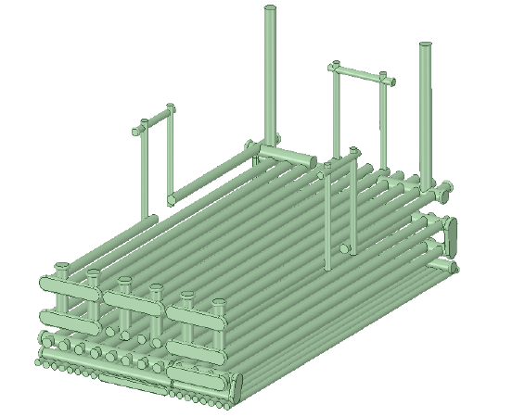

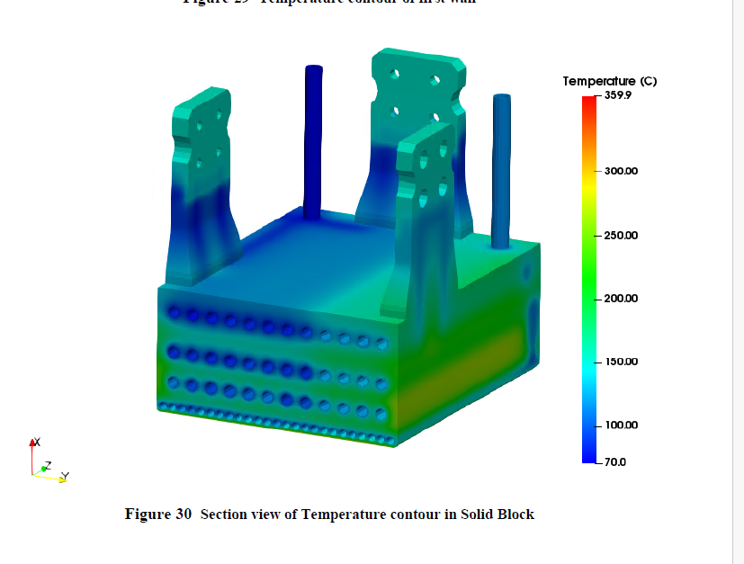
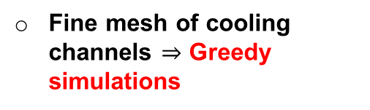
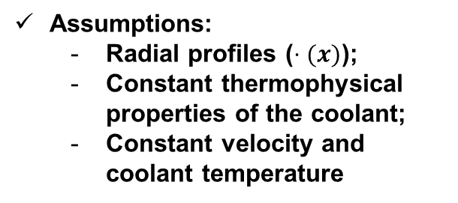
I-A: Incorporating cooling through added porosity
Cooling channels in the generic DFW
Fine mesh of cooling channels $⇒$ Greedy simulations
Assumptions:
  Radial profiles ($⋅(x)$);
  Constant thermophysical properties of the coolant;
  Constant velocity and coolant temperature
Porous media: energy extraction is modeled as a sink term in the Solid Temperature equation.
Model the added porosity resistance though coolant thermophysical properties

Slide 6

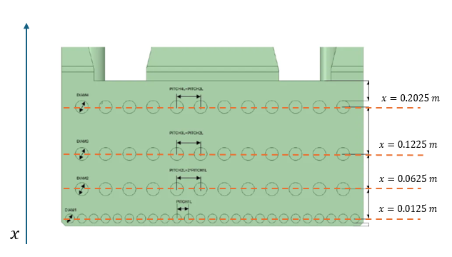



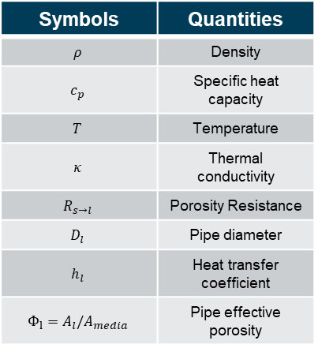
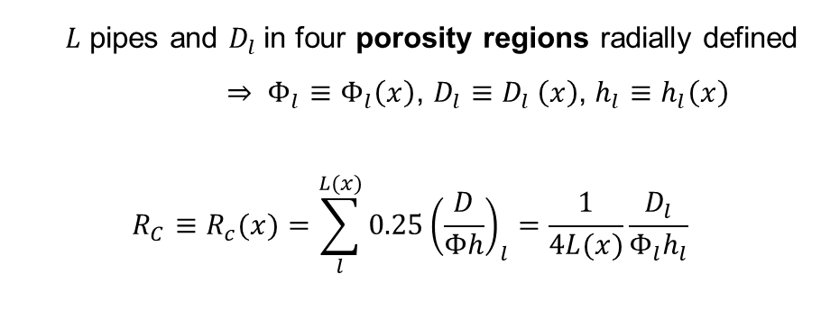

I-B: Theoretical framework for the PMA
Subscript: s solid, l coolant
Add local effect on the solid temperature evolution due to cooling channels [2]
With volumetric heat load and heat flux
Symbols | Quantities
$$ρ$$ | Density
$$c_{p}$$ | Specific heat capacity
$$T$$ | Temperature
$$κ$$ | Thermal conductivity
$$R_{s→l}$$ | Porosity Resistance
$$D_{l}$$ | Pipe diameter
$$h_{l}$$ | Heat transfer coefficient
$$Φ_{l}=A_{l}/A_{media}$$ | Pipe effective porosity
Total heat exchange to $L$ fluid streams
$$R_{s→l }=0.25{\left(\frac{D_{h}}{Φh}\right)}_{l}∼0.25{\left(\frac{D}{Φh}\right)}_{l}$$
$Φ_{l}=A_{l}/A_{media}$,
$h_{l }=$ ${Nu}_{l}κ_{l}/D_{l}$
(Dittus-Boelter correlation)
$L$ pipes and $D_{l}$in four porosity regions radially defined $⇒ Φ_{l}≡Φ_{l}\left(x\right)$, $D_{l}≡D_{l} \left(x\right)$, $h_{l}≡h_{l}\left(x\right)$
$$R_{C}≡R_{c}(x)=\sum_{l}^{L(x)}{0.25{\left(\frac{D}{Φh}\right)}_{l}}=\frac{1}{4L(x)}\frac{D_{l}}{Φ_{l}h_{l}}$$
Pipeline layout in the generic DFW $\left(y,x\right)$ from $[3]$
[2] Nuclear Engineering and Design 421 (2024) 113084
[3] IDM UID 2ABR92 (CFD analysis)

Slide 7
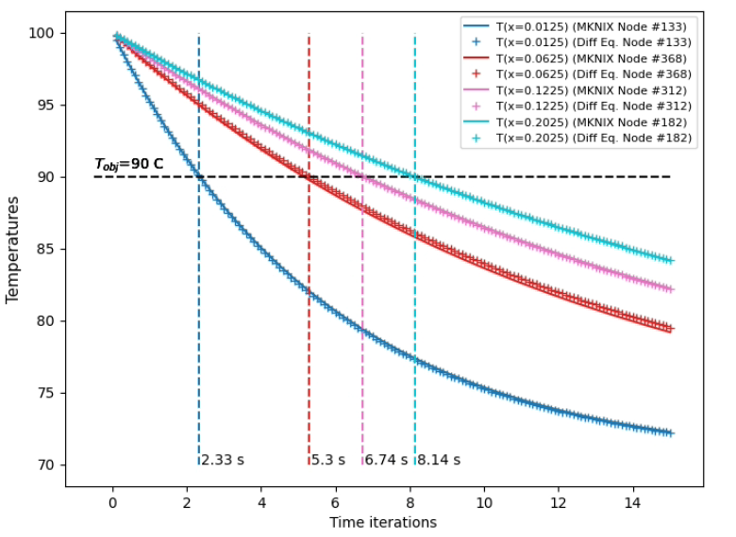
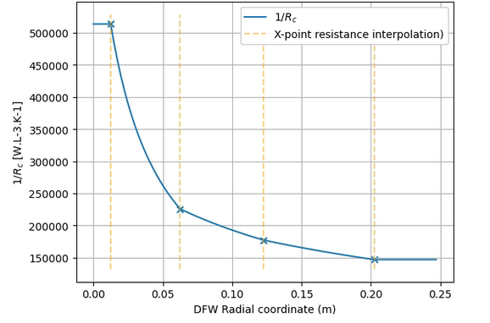
I-B: Validation of the PMA implementation in MKNIX
PMA implementation in local FEM solver: MKNIX
Take a simple case where analytical solution is known (differential equation)
Linear interpolation between porosity regions (simple case)
Time (s)

Slide 8
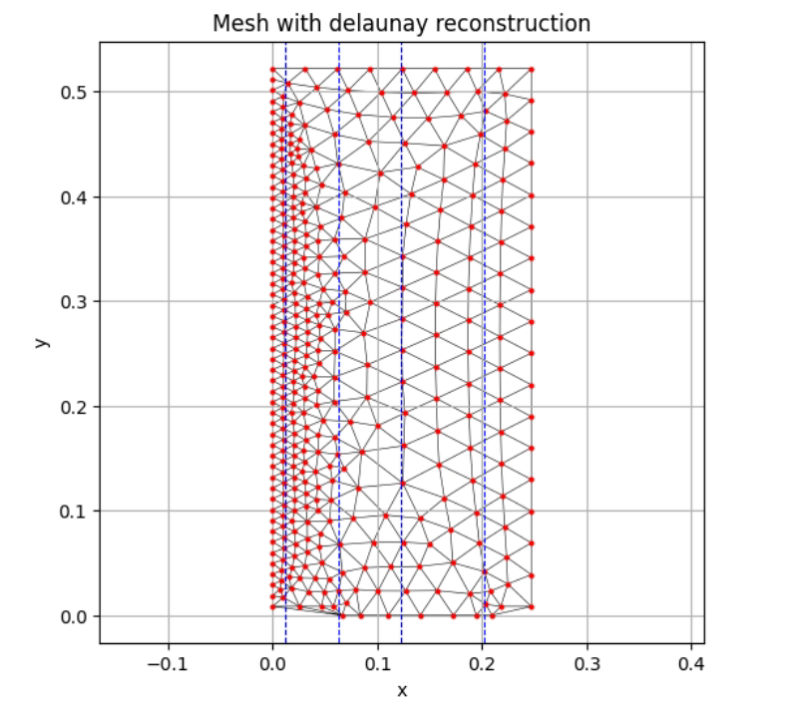
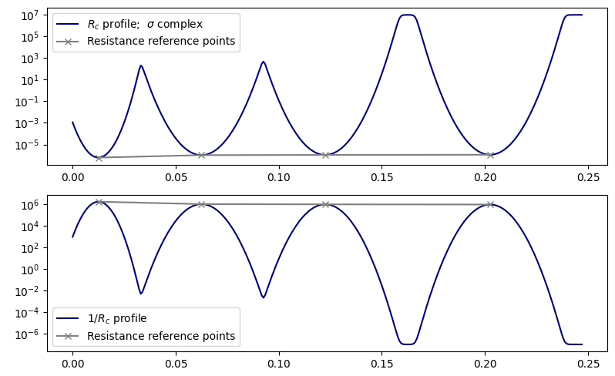


I-B: Porosity profiles and first results
Model the cooling effect by a gaussian which full width half maximum (FWMH) is the pipe radius
$$FWHM_{i}=r_{i}=\frac{d_{i}}{2}=2\sqrt{2 ln\left(2\right)} σ_{i}⇔σ_{i}=\frac{d_{i}}{4\sqrt{2 ln\left(2\right)}}$$
$R_{c}^{−1}\left(x\right)=\sum_{i}^{N_{layers}}{\frac{1}{R_{i}}\exp\left(−\frac{{\left(x−x_{i}\right)}^{2}}{2σ^{2} }\right) }$
Porosity profile: sum of the gaussians picked at the pipes center

Slide 9
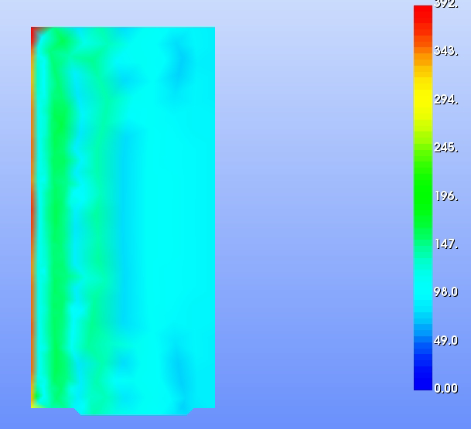

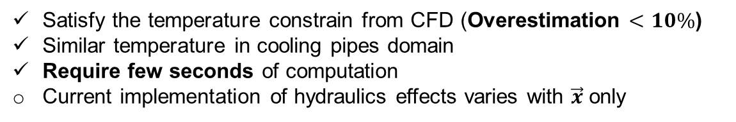

I-B: Porosity profiles and first results
We model the cooling effect by a gaussian which full width half maximum (FWMH) is the pipe radius
$$x$$
Reference results (CFD)
$$y$$
MKNIX-Porosity results (FEM/Surrogate)
Satisfy the temperature constrain from CFD (Overestimation $<10\%$)
Similar temperature in cooling pipes domain
Require few seconds of computation
Current implementation of hydraulics effects varies with $\vec{x}$ only

Slide 10
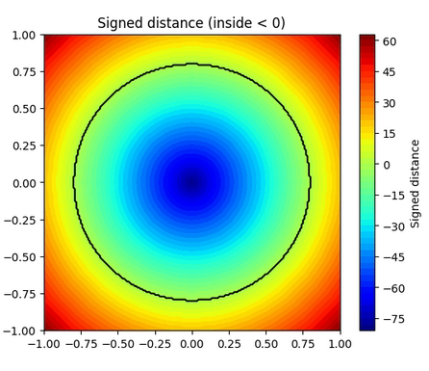
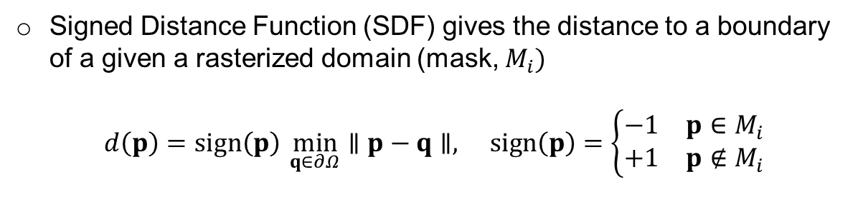
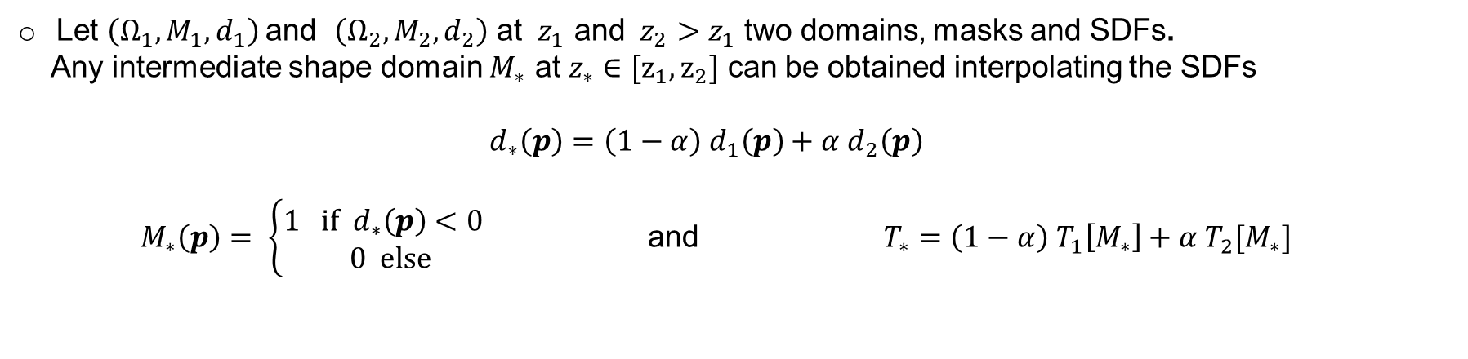
II-A: Signed Distance Function - Mathematical description
Signed Distance Function (SDF) gives the distance to a boundary of a given a rasterized domain (mask, $M_{i})$
$$d\left(p\right)=sign\left(p\right) \min_{q∈∂Ω}∥p−q∥, sign\left(p\right)=\left\{\begin{matrix}−1 & p∈M_{i} \\ +1 & p∉M_{i}\end{matrix}\right.$$
Let $\left(Ω_{1}, M_{1},d_{1}\right)$and $\left(Ω_{2}, M_{2},d_{2}\right)$ at ${ z}_{1}$ and ${ z}_{2}$ $>z_{1}$ two domains, masks and SDFs.
Any intermediate shape domain $M_{∗}$ at $z_{∗}∈[z_{1},z_{2}]$ can be obtained interpolating the SDFs
  $$d_{∗}\left(p\right)=\left(1−α\right){ d}_{1}\left(p\right)+α d_{2}\left(p\right)$$
  $M_{∗}\left(p\right)= \left\{\begin{aligned}1 if d_{∗}\left(p\right)<0 \\ 0 else\end{aligned}\right.$ and $T_{∗}=\left(1−α\right){ T}_{1}\left[M_{∗}\right]+α T_{2}[M_{∗}]$

Slide 11
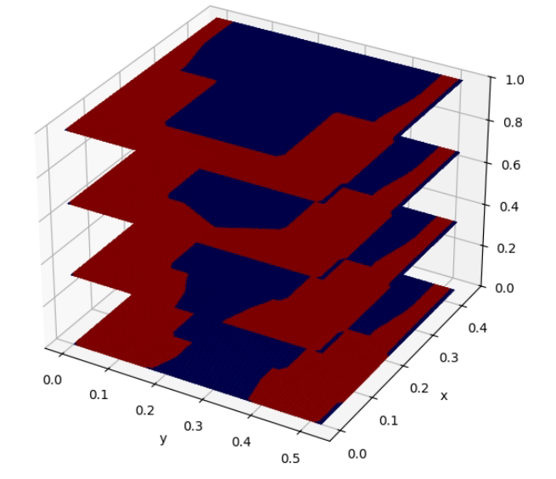
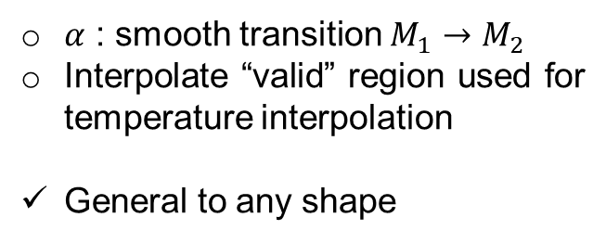

II-A: Example in shape morphing (valid-shape interpolation)
$$d_{∗}\left(p\right)=\left(1−α\right){ d}_{1}\left(p\right)+α d_{2}(p)$$
$${d_{∗}→M}_{∗}$$
$α$ : smooth transition $M_{1}→M_{2}$
Interpolate “valid” region used for temperature interpolation
General to any shape
Reference planes/masks
α
Evolving masks/shapes

Slide 12
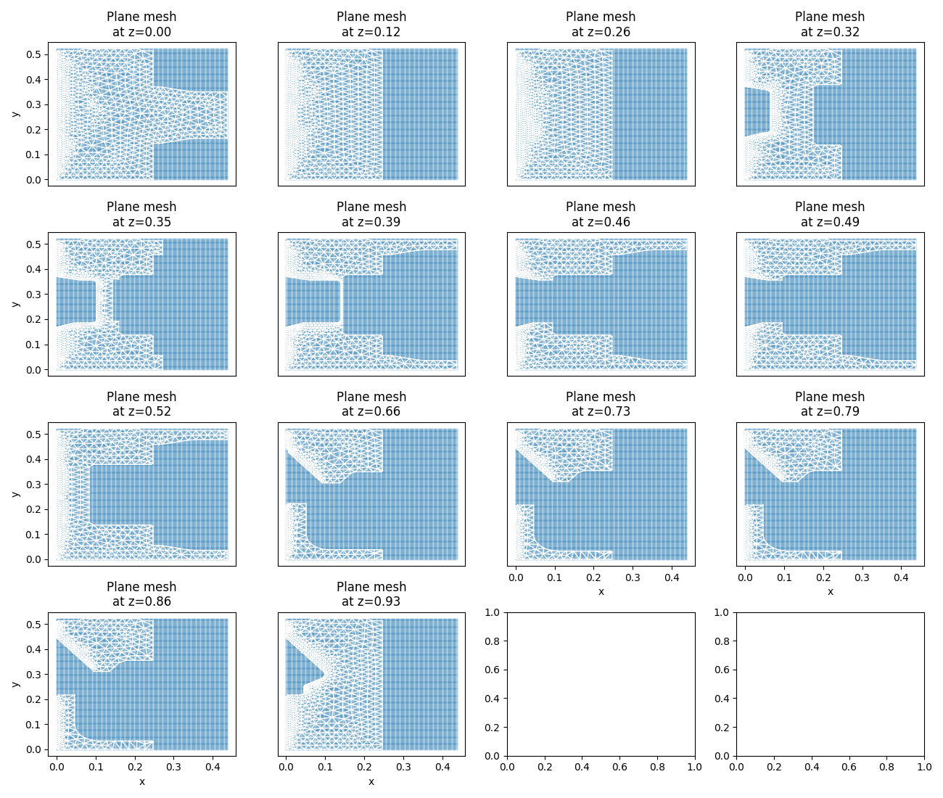
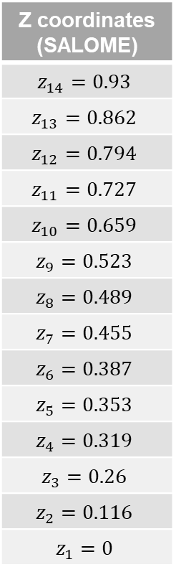
II-B: Setup of the numerical experiment
Z coordinates (SALOME)
$$z_{14}=0.93$$
$$z_{13}=0.862$$
$$z_{12}=0.794$$
$$z_{11}=0.727$$
$$z_{10}=0.659$$
$$z_{9}=0.523$$
$$z_{8}=0.489$$
$$z_{7}=0.455$$
$$z_{6}=0.387$$
$$z_{5}=0.353$$
$$z_{4}=0.319$$
$$z_{3}=0.26$$
$$z_{2}=0.116$$
$$z_{1}=0$$
~Fine mesh to account for high fluid velocity (see after)

Slide 13
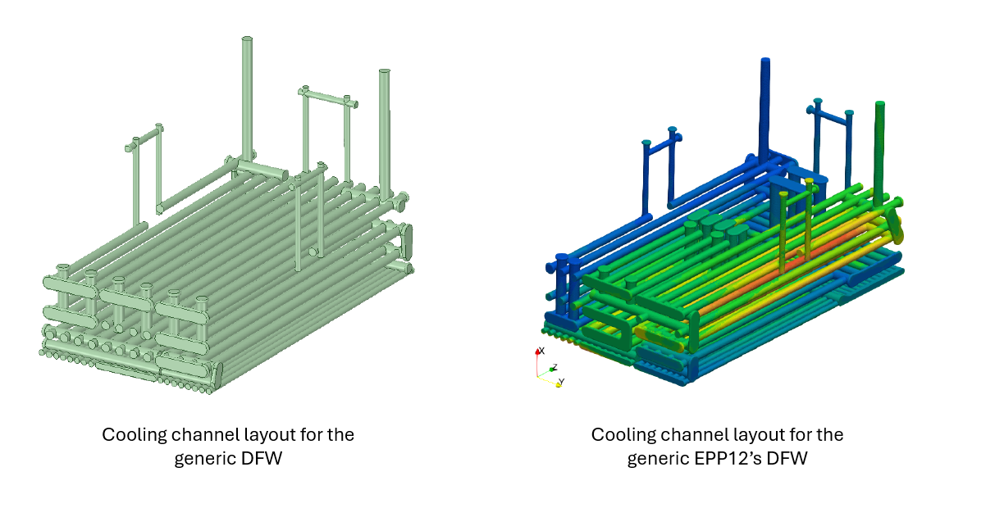
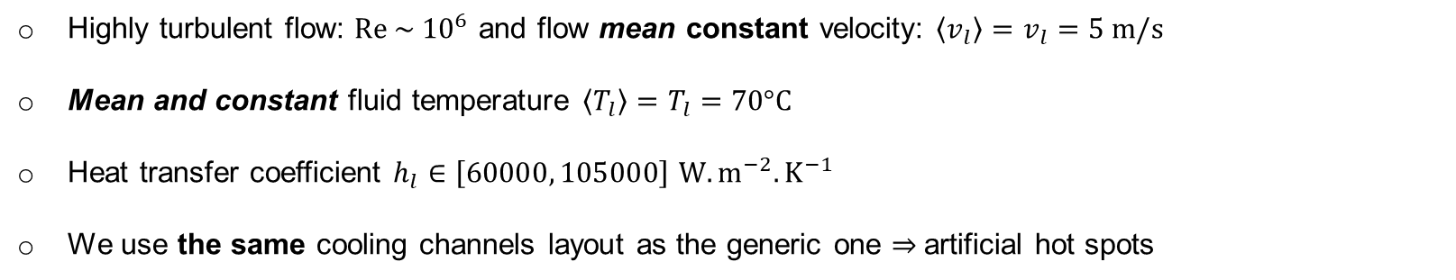
II-B: Setup of the numerical experiment: thermophysical quantities, orders of magnitude and assumptions
Highly turbulent flow: $Re \sim {10}^{6}$ and flow mean constant velocity: $\left\langle v_{l}\right\rangle =v_{l}=5 m/s$
Mean and constant fluid temperature $\left\langle T_{l}\right\rangle =T_{l}=70°C$
Heat transfer coefficient $h_{l}∈\left[60000, 105000\right]$ $W.m^{−2}.K^{−1}$
We use the same cooling channels layout as the generic one $⇒$artificial hot spots

Slide 14
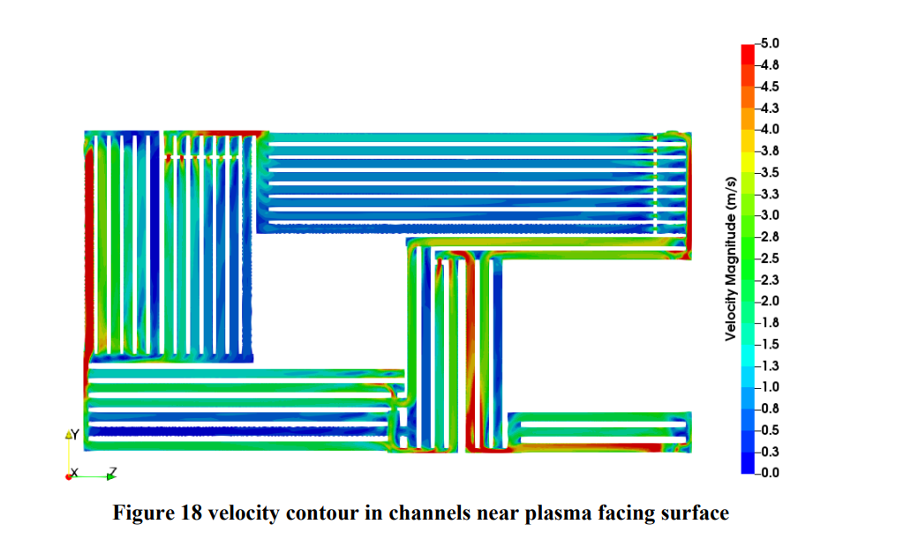
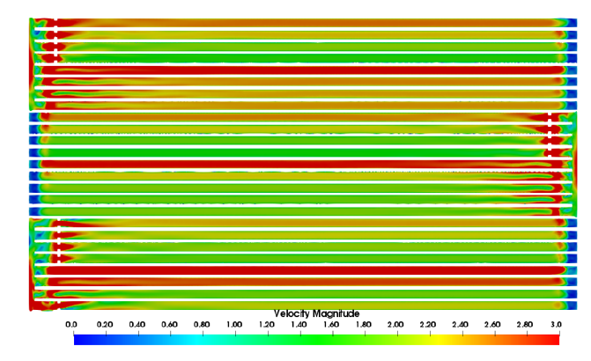
II-B: Setup of the numerical experiment: thermophysical quantities, orders of magnitude and assumptions
Cooling channels layout comparison
Velocity contour in first layer of cooling channels for generic DFW
Velocity contour in first layer of cooling channels for EPP12 DFW (bottom)

Slide 15
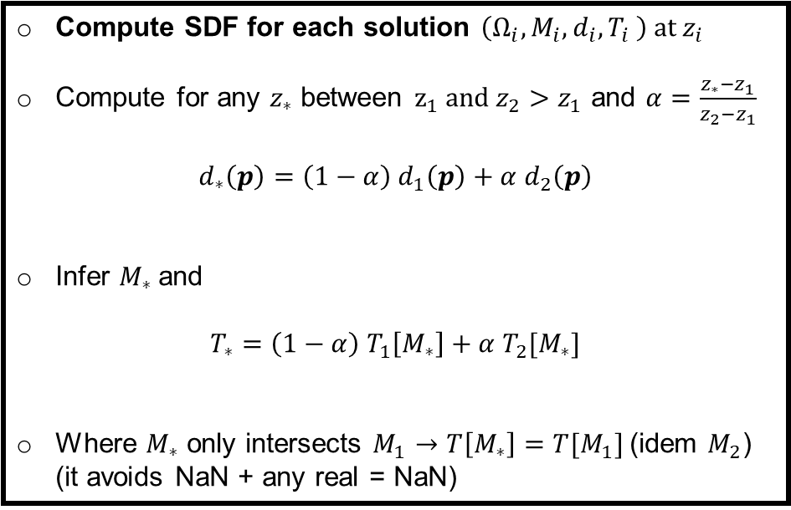

II-B: Global reconstruction from solved planes
First step:
Solve with MKNIX and
Interpolate nodal temperature (matplotlib.Tri)
Then
Compute SDF for each solution $\left(Ω_{i}, M_{i},d_{i},T_{i} \right)$at$z_{i}$
Compute for any $z_{∗}$ between $z_{1}$ and $z_{2}>z_{1}$ and $α=\frac{z_{∗}−z_{1}}{z_{2}−z_{1}}$
$$d_{∗}\left(p\right)=\left(1−α\right){ d}_{1}\left(p\right)+α d_{2}\left(p\right)$$
Infer $M_{∗}$and
$$T_{∗}=\left(1−α\right){ T}_{1}\left[M_{∗}\right]+α T_{2}[M_{∗}]$$
Where $M_{∗}$ only intersects $M_{1}$ $→$ $T\left[M_{∗}\right]={T[M}_{1}]$(idem $M_{2}$) (it avoids NaN + any real = NaN)
Takes ~ 2 seconds to compute 118 intermediate ($200×200$) solutions
At high velocity: requires ~20 seconds for all the slices (parallelizable)

Slide 16
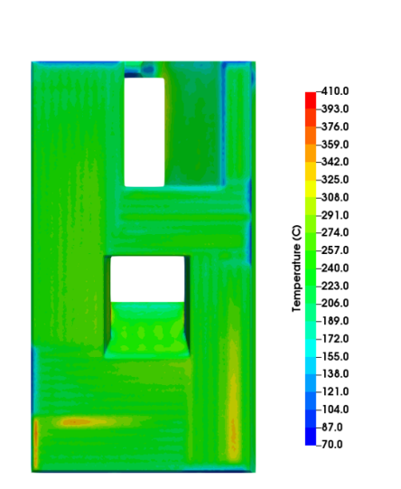
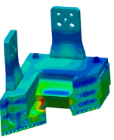



II-B: Global reconstruction from solved planes
~$\left[250,290\right]°C$
~$\left[270,300\right]°C$
Reconstructed 3D (TSM) few seconds in total
Reference results (CFD), computation time not specified (usually $𝓞(hours)$>> TSM)

Slide 17
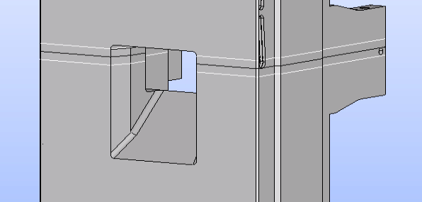
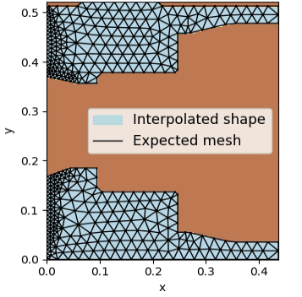
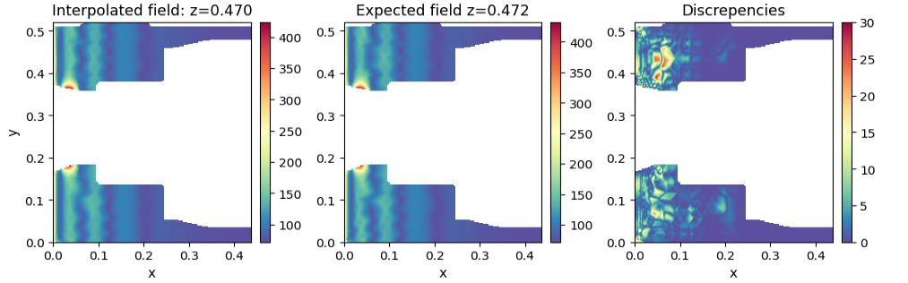

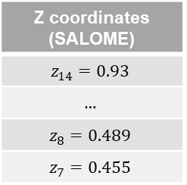
II-B: Reconstruction errors for intermediate planes
Z coordinates (SALOME)
$$z_{14}=0.93$$
$$…$$
$$z_{8}=0.489$$
$$z_{7}=0.455$$
$$z_{int}=0.470$$
Shape and temperature are well interpolated
Assuming similar heat load in the poloidal direction

Slide 18
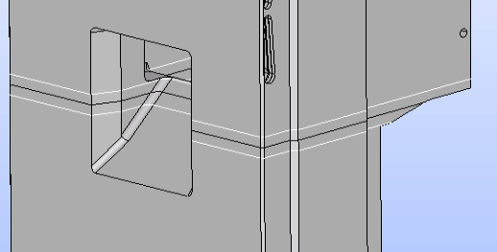
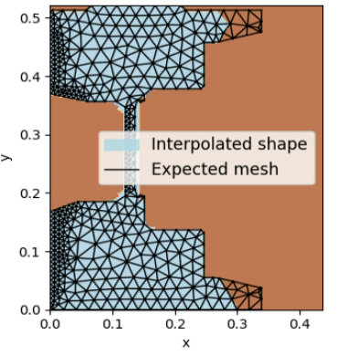
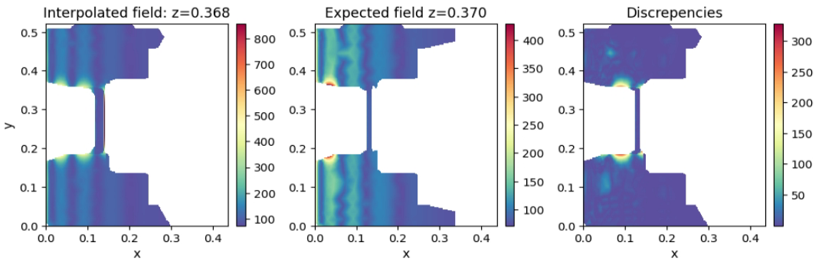

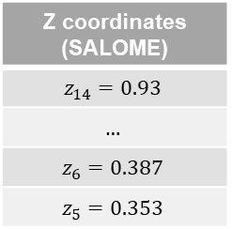
II-B: Reconstruction errors for intermediate planes
Z coordinates (SALOME)
$$z_{14}=0.93$$
$$…$$
$$z_{6}=0.387$$
$$z_{5}=0.353$$
$$z_{int}=0.470$$
Errors in the reconstruction of both shape and temperature
Interpolation is purely vertical: it expects that cooled domains remain the same
Modeling errors on the rightmost edge of the PP opening $→$ Needed to add heat diffusivity to DSM

Slide 19
II-B: Reconstruction errors for intermediate planes
Sharp variation of the shape
Error coming from next reference solution is corrupting the temperature reconstruction
Comes from the previous reference solution (wider exposed section)

Slide 20
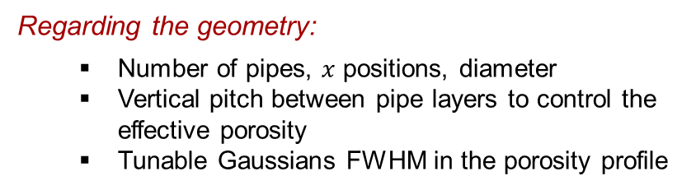
III: Discussion (PMA)
The PMA allows several tunable parameters (scenario exploration):
Regarding the cooling:
  Fluid velocity and temperature
  Regime flow
  Thermophysical properties
Regarding the geometry:
  Number of pipes, $x$ positions, diameter
  Vertical pitch between pipe layers to control the effective porosity
  Tunable Gaussians FWHM in the porosity profile
Results are still promising BUT limitations appear along with geometry complexity
Simulations are fast, cheaper and completely independent (one plan to another)
Flexible under the current constraints
The main limitations:
  Radial variations of porosity only (MKNIX)
  Constant heat load on the geometries (MKNIX)
  Constant velocity, temperature and thermophysical quantities for the modelled fluid (one way coupled)
  High velocity requires finer meshes

Slide 21
III: Discussion (2D$→$ 3D interpolation)
Current implementation shows promising results
  Fast 3D interpolations from reference plans
  Flat region are perfectly interpolated
  Global structure looks good but requires off-line selection of the reference planes
Improvements will be to induce global geometry awareness in the blending process to improve the plasma front temperature interpolation

Slide 22
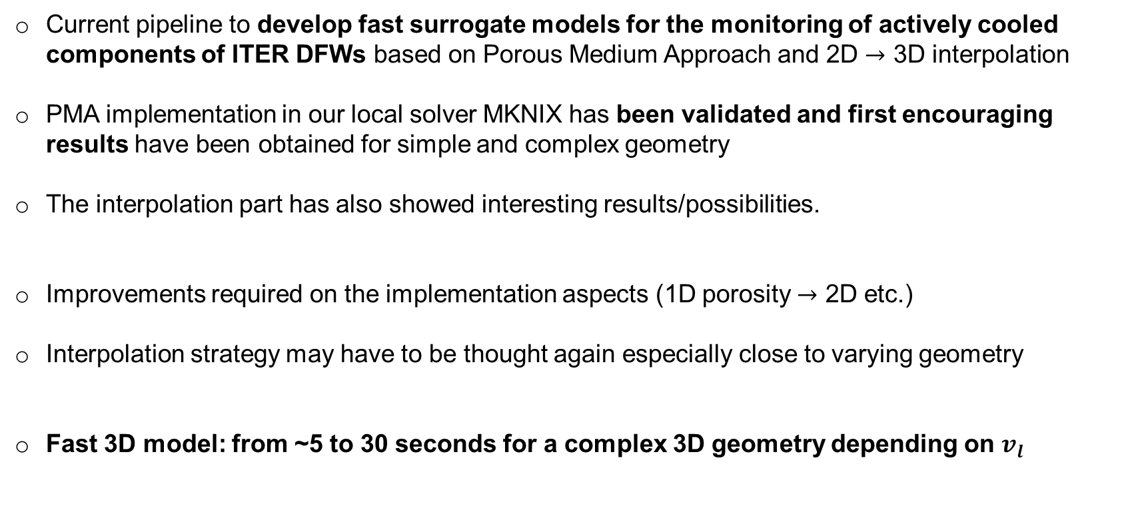
Conclusion
Current pipeline to develop fast surrogate models for the monitoring of actively cooled components of ITER DFWs based on Porous Medium Approach and 2D $→$ 3D interpolation
PMA implementation in our local solver MKNIX has been validated and first encouraging results have been obtained for simple and complex geometry
The interpolation part has also showed interesting results/possibilities.
Improvements required on the implementation aspects (1D porosity $→$ 2D etc.)
Interpolation strategy may have to be thought again especially close to varying geometry
Fast 3D model: from ~5 to 30 seconds for a complex 3D geometry depending on $v_{l}$

Slide 23
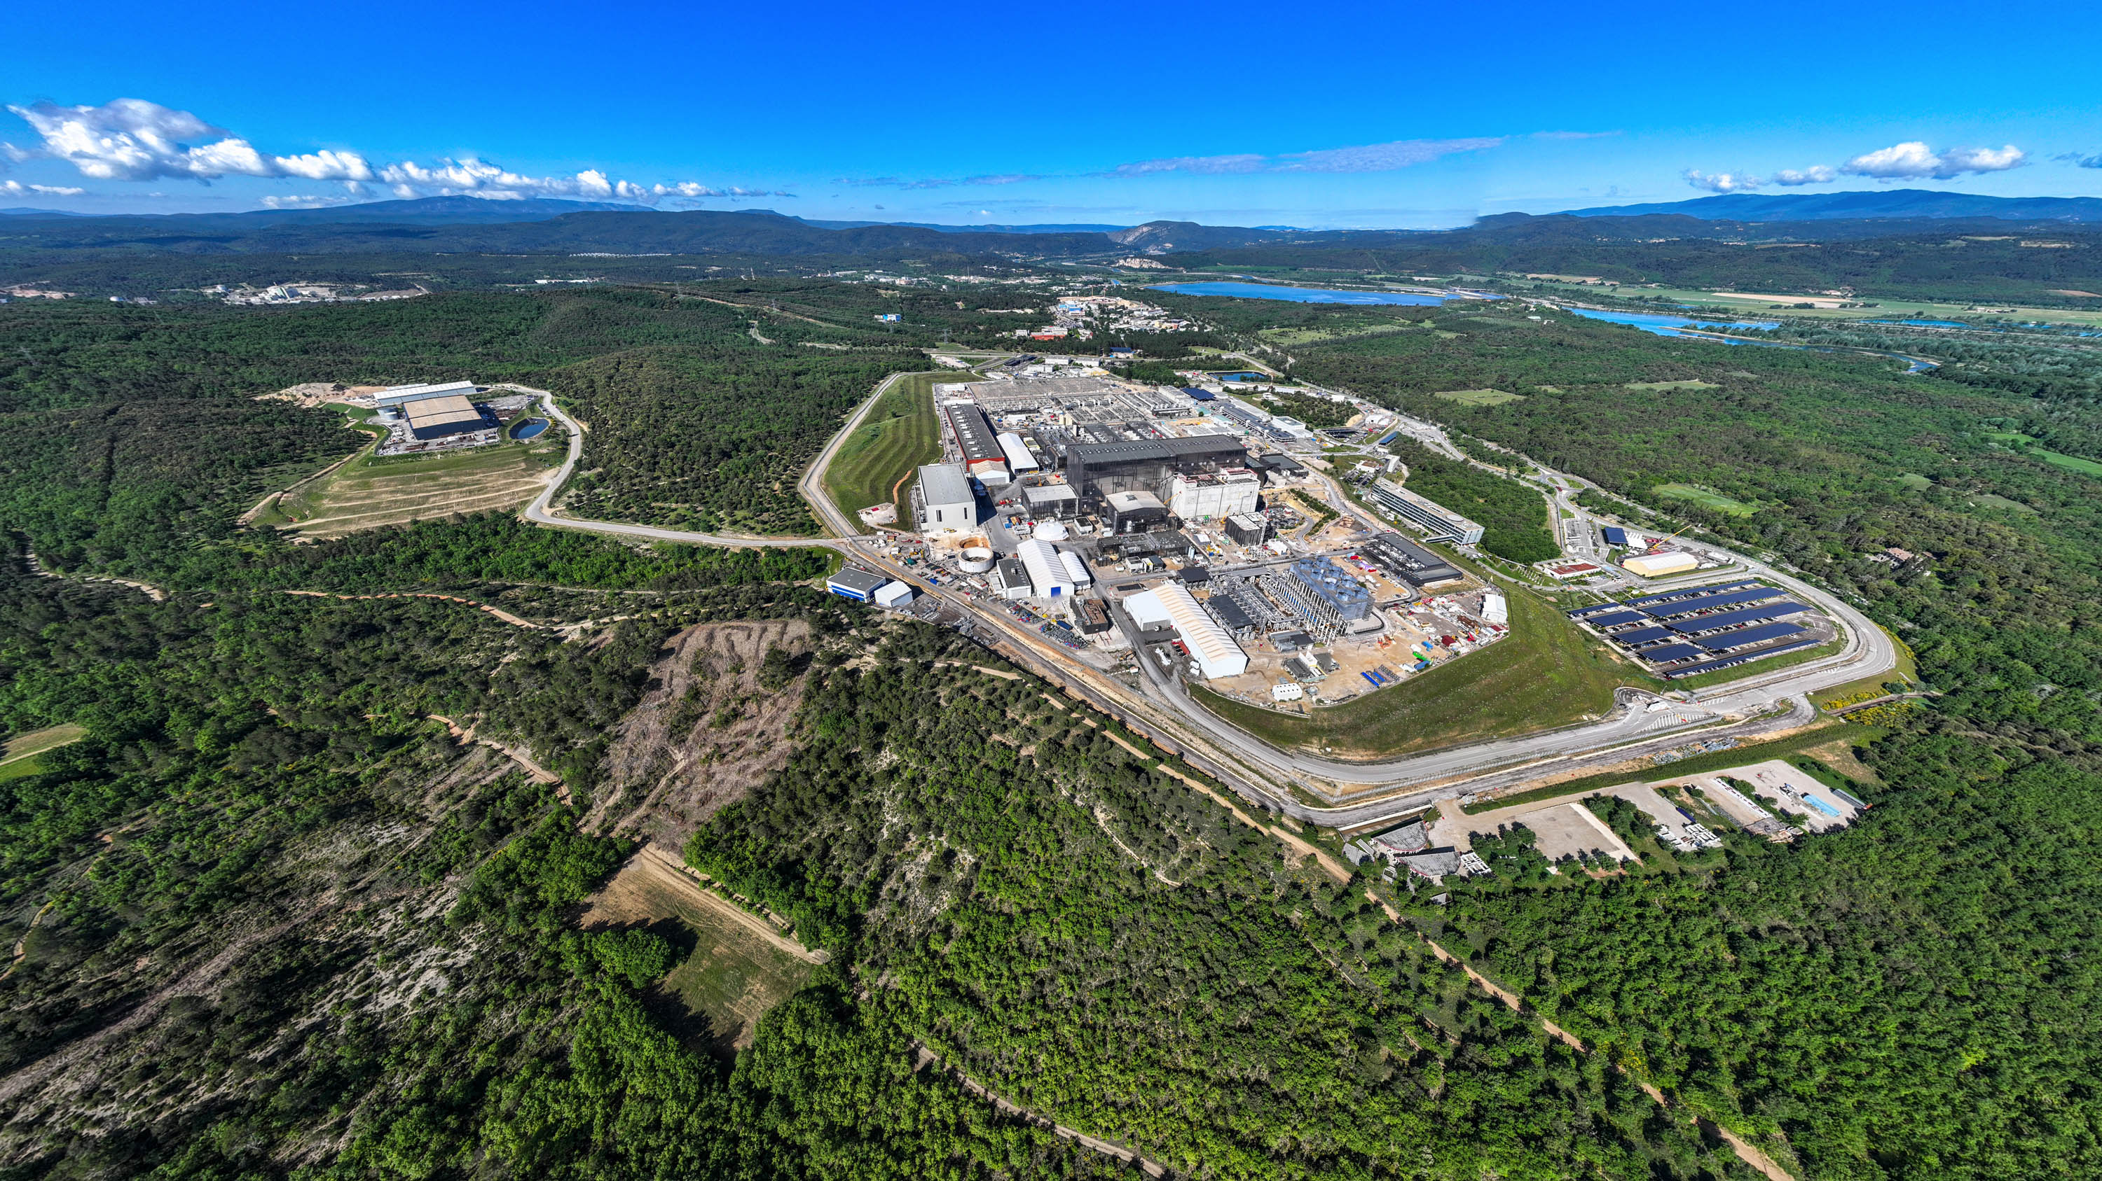

Thank you!
Nathaniel Saura
Second Visualizing Offline and Live Data with AI (VOLDA) Workshop

Slide 24

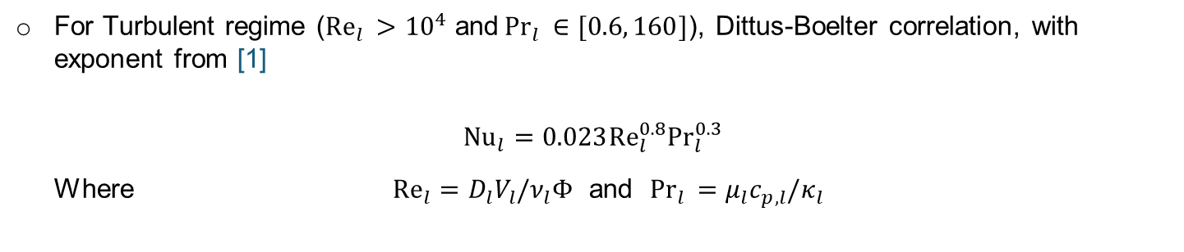
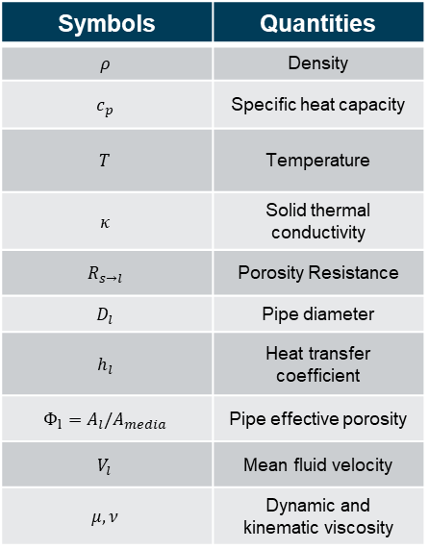

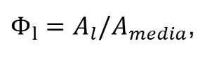
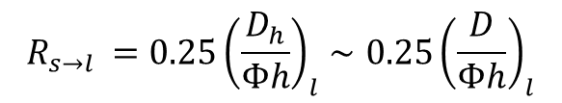
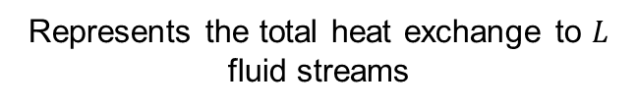
I-B: Incorporating cooling through added porosity
In the Solid temperature equation, we add the local effect due to the fluid in the cooling channels [1]
Subscript: s solid, l coolant
$$R_{s→l }=0.25{\left(\frac{D_{h}}{Φh}\right)}_{l}∼0.25{\left(\frac{D}{Φh}\right)}_{l}$$
Symbols | Quantities
$$ρ$$ | Density
$$c_{p}$$ | Specific heat capacity
$$T$$ | Temperature
$$κ$$ | Solid thermal conductivity
$$R_{s→l}$$ | Porosity Resistance
$$D_{l}$$ | Pipe diameter
$$h_{l}$$ | Heat transfer coefficient
$$Φ_{l}=A_{l}/A_{media}$$ | Pipe effective porosity
$$V_{l}$$ | Mean fluid velocity
$$μ, ν$$ | Dynamic and kinematic viscosity
$Φ_{l}=A_{l}/A_{media}$,
$$h_{l }= \frac{{Nu}_{l} κ_{l}}{D}$$
Represents the total heat exchange to $L$ fluid streams
For Turbulent regime (${Re}_{l }>{10}^{4}$ and${Pr}_{l }∈[0.6, 160]$), Dittus-Boelter correlation, with exponent from [1]
$${Nu}_{l}=0.023{Re}_{l}^{0.8}{Pr}_{l}^{0.3}$$
Where ${Re}_{l}=D_{l}V_{l}/ν_{l}Φ$ and ${Pr}_{l }=μ_{l}c_{p,l}/κ_{l}$
Coolant thermophysical quantities supposed constant
Porosity varies radially according to number of pipes and their diameters $⇒R_{s→l}≡R_{s→l}(x)$
[1] Nuclear Engineering and Design 421 (2024) 113084
[2] IDM UID 2ABR92 (CFD analysis)

Slide 25
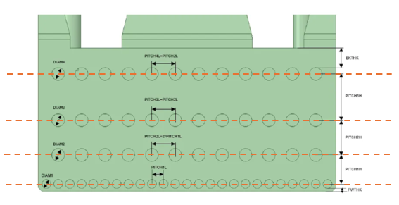




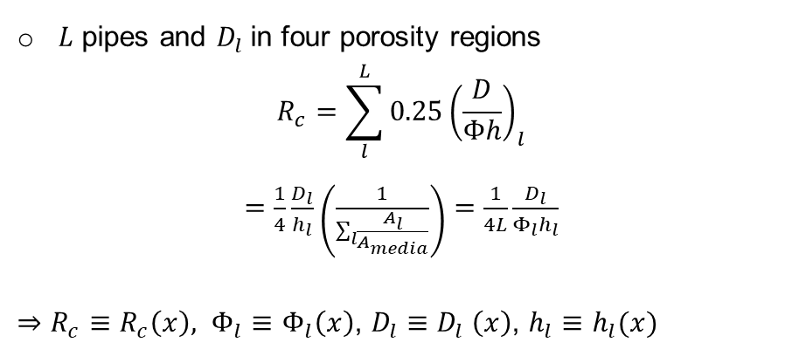
I-B: Incorporating cooling through added porosity
Subscript: s solid, l coolant
Add local effect on the solid temperature evolution due to cooling channels [2]
Symbols | Quantities
$$ρ$$ | Density
$$c_{p}$$ | Specific heat capacity
$$T$$ | Temperature
$$κ$$ | Thermal conductivity
$$R_{s→l}$$ | Porosity Resistance
$$D_{l}$$ | Pipe diameter
$$h_{l}$$ | Heat transfer coefficient
$$Φ_{l}=A_{l}/A_{media}$$ | Pipe effective porosity
$$R_{s→l }=0.25{\left(\frac{D_{h}}{Φh}\right)}_{l}∼0.25{\left(\frac{D}{Φh}\right)}_{l}$$
$Φ_{l}=A_{l}/A_{media}$,
$h_{l }=$ ${Nu}_{l}κ_{l}/D_{l}$
Total heat exchange to $L$ fluid streams
$L$ pipes and $D_{l}$in four porosity regions
$$R_{c}=\sum_{l}^{L}{0.25{\left(\frac{D}{Φh}\right)}_{l}}$$
$=$ $\frac{1}{4}\frac{D_{l}}{h_{l}}\left(\frac{1}{\sum_{l}{\frac{A_{l}}{A_{media}}}}\right)=\frac{1}{4L}\frac{D_{l}}{Φ_{l}h_{l}}$
$⇒$ $R_{c}≡R_{c}\left(x\right), Φ_{l}≡Φ_{l}\left(x\right)$, $D_{l}≡D_{l} \left(x\right)$, $h_{l}≡h_{l}(x)$
[2] Nuclear Engineering and Design 421 (2024) 113084
[3] IDM UID 2ABR92 (CFD analysis)

Slide 26
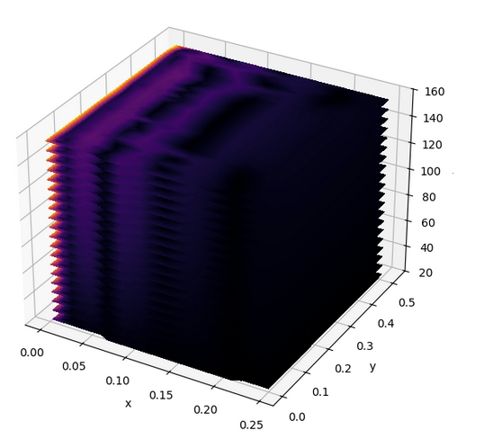


extrapolation
domain
$$t$$
Interpolation
domain

Slide 27


Slide 28

I-B: Incorporating cooling through added porosity
Cooling channels in the generic DFW
Fine mesh of cooling channels $⇒$ Greedy simulations
Porous media: energy extraction is modeled as a sink term in the enthalpy equation.
Model the added porosity resistance though coolant thermophysical properties
Assumptions:
  radial profiles
  constant properties
  gaussian profiles around center of pipes

