Slide 1
Prediction of NTM seed magnetic island trigger threshold in EAST based on supervised learning
Second Visualizing Offline and Live Data with AI (VOLDA) Workshop
Authors: Feifei Long¹, Yunjiao Zhang¹, Yian Zhao¹, Yang Zhang², Hailin Zhao², Tonghui Shi², Ting Lan², Zixi Liu¹, Ge Zhuang¹
1 University of Science and technology of China
2 Institute of plasma physics, Chinese Academy of Sciences, Hefei, Anhui
Email: lfeifei@ustc.edu.cn
18–20 Nov. 2025 CIEMAT Research Center, Madrid, Spain.
Notes:
Good morning. My name is Feifei long from university of science and technology of china in hefei. I am honored to talk about predicting when a neoclassical tearing mode, or NTM, will be triggered. Our goal is to spot the small “seed” island early and decide when and how to act with identification strategies.

Slide 2
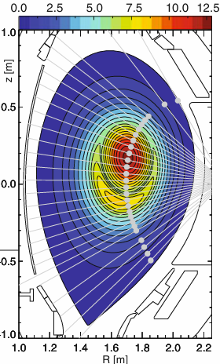
Importance of magnetic island recognition for accurate NTM control
Neoclassical tearing modes (NTMs) are a class of magnetohydrodynamic (MHD) instabilities that pose significant challenges to magnetic confinement fusion in tokamaks.
Unlike classical tearing modes driven by current gradients, NTMs are destabilized by neoclassical effects—collisional transport phenomena in toroidal plasmas—that alter the current profile.
These modes manifest as magnetic islands that degrade confinement and can trigger disruptions.
NTM recognition needs:
Rotation and mode-locking detection
phase inversion surface
Diagnostic check
Signal Position calibration
Mode numbers/ phase/frequency recognition
Magnetic Island position/width detection
Status
Healthy
No saturation
No bad point
SNR
Data Map
Comparable
Notes:
Firstly, I will answer Why island recognition matters in the NTM control. Magnetic islands degrade confinement and can even lead to disruptions. If we recognize the island early, we can align ECCD and suppress it with much less power. So precise detection and timing directly improve performance and safety. Therefore, the NTM recognition needs to develop a series of identification and detection point. First, diagnostic checks. We verify each signal is healthy: no saturation, acceptable SNR.
Second, measurement‑location calibration. We time‑align all channels, map measurements to radius or normalized ρ. This makes signals from different diagnostics comparable in space. Third, phase‑inversion surface identification. Tracking this inversion surface over time gives us a robust handle on where the island is. Fourth, mode number and frequency recognition. We determine m/n and compute rotation ω(t) from dφ/dt. Fifth, We estimate the island location and width. Once these modules are reliable, we can move from detection to action: align ECCD precisely, choose the start time, and keep the island width under control. In the next slide, I will introduce how to identify the phase inversion surface.

Slide 3
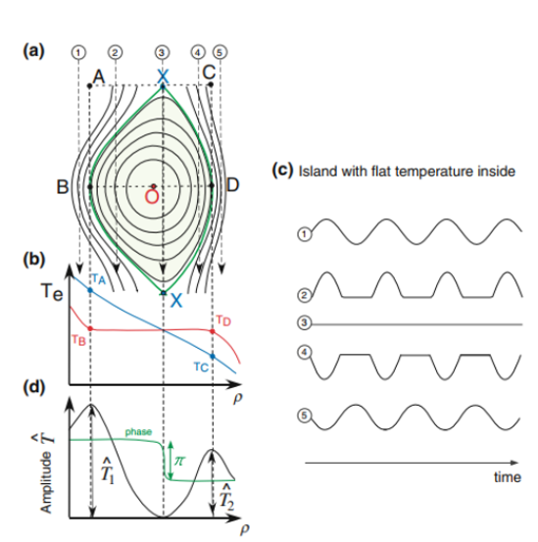
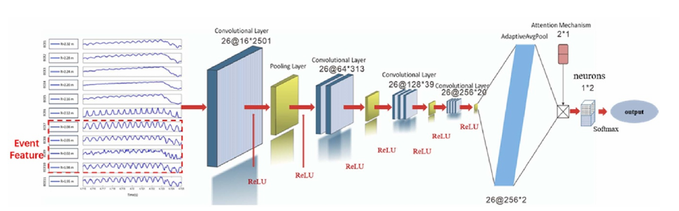
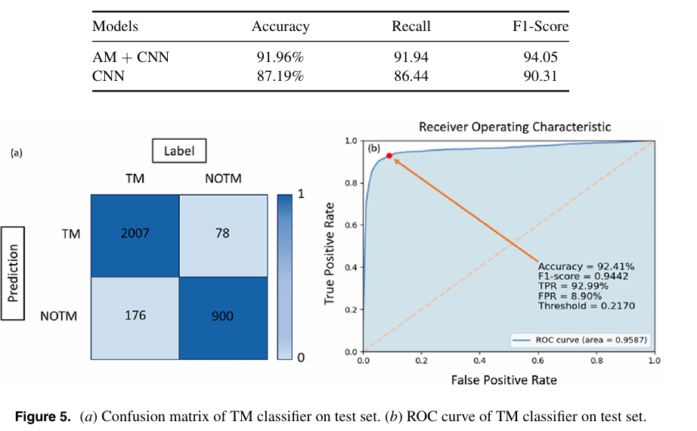
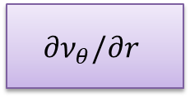
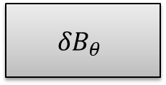
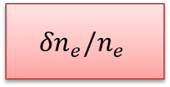
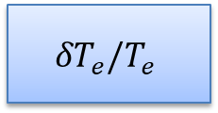
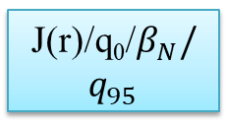
Detection of Phase inversion surface induced by Magnetic island
Diagnostic check
Signal Position calibration
Multi-channels convolutional neural networks with attention-aware
Islands Rotation detection
Mirnov probes
$${δB}_{θ}$$
Multi-channel ECE
$${δT}_{e}/T_{e}$$
Refl. / POINT
$${δn}_{e}/n_{e}$$
DBS
$${∂ν}_{θ}/∂r$$
Optimized EFIT
J(r)/q₀/$β_{N}/q_{95}$
Feifei Long et al 2025 Nucl. Fusion 65 056029
Notes:
A magnetic island rotation introduces a phase inversion across the resonant surface. Here I show how the phase flips and how we track that surface over time. The key point: the inversion surface is a robust physical signature we can use to localize the island.
Because our diagnostics are fixed in space, when the magnetic island rotates with the plasma, each fixed channel sees a changing perturbation and a changing phase. That means signals measured at different positions carry different phases. At the island O‑point, however, the phase is effectively stationary, while points on the two sides of the resonant surface are about 180 degrees out of phase. If a channel’s signal is rising you’re on one side; if it’s falling you’re on the other. By comparing these rise/fall trends across channels, we can pinpoint the phase‑inversion surface.
Based on this idea, we build a CNN that takes multi‑channel time series as input and adds an attention mechanism across channels. The attention focuses on relative phase shifts and amplitude trends, so the model can capture the phase‑inversion pattern and detect both the presence of the island and where it sits.

Slide 4
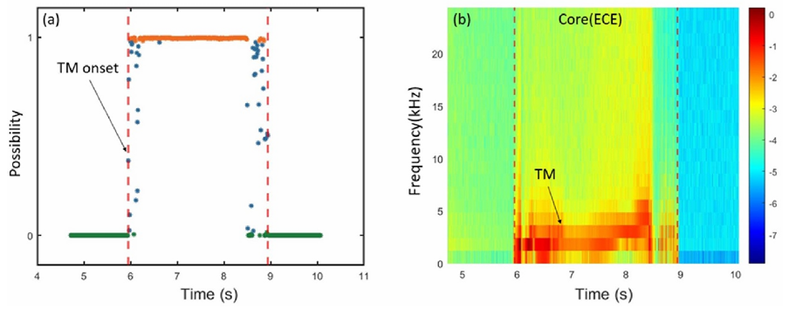
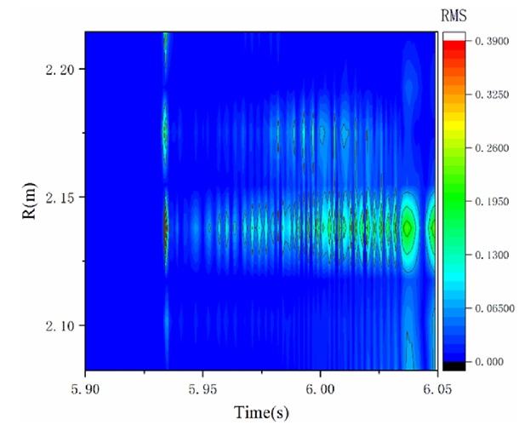
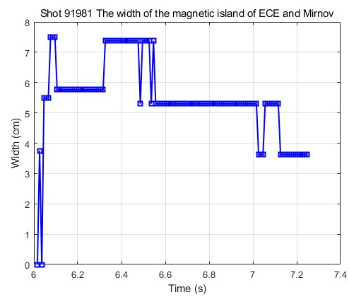
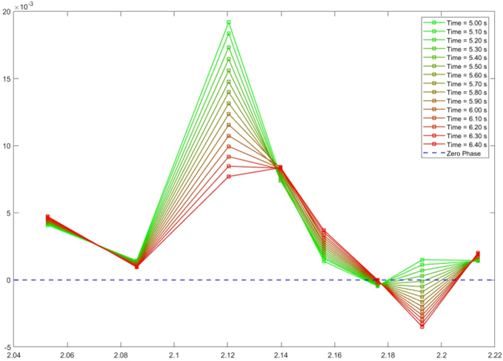
NTM mode numbers/ phase/frequency recognition
AACNN model randomly selects EAST discharge#86502
features | Tradition calculation | AI surrogate model
Mode numbers recognition | Phase tracing/compilated | 1D feature
Frequency recognition | FFT Spectrum/human assistance | 2 D feature
Phase recognition | FFT/simple | 0D feature
Physical prior + rule annotation → weakly supervised/semi-supervised → modular AI fusion
Feifei Long et al 2025 Nucl. Fusion 65 056029
Notes:
The upper left picture shows the prediction of time evolution of the inversion surface. We can clearly see the possibility close to 1. it means that the magnetic island is rotating and appears. Based on the AA_CNN model, we have plotted the normalized electron temperature perturbation distribution. And according to the inversion surface, the island width is confirmed. The frequency tells us whether the island is still rotating freely or approaching locking. We compare “traditional” pipelines with fast AI surrogates to get fast identification time. Therefore, use physics priors to write simple rules, use those rules to weakly label data, and then plug the pieces into a modular AI that fuses everything for the final decision.

Slide 5



Seed island detection from physical precursors (risk-weighted) evaluation
High risk
low risk
β onset by sawtooth
β onset by fishbone
β onset by ELM
β onset by triggerless
Untriggered/Without external inducement (spontaneous)
Real-time recognition sawtooth -AI models
Real-time feature FB-AI models
Real-time feature ELM-AI models
Difficult/ no apparent characteristic
√
√
√
Identification of MHD modes on EAST using a deep learning framework. PPCF, 2023(EXP)
O’Shea, Finn H., et al. "Automatic identification of edge localized modes in the DIII-D tokamak." APL Machine Learning 1.2 (2023).(EXP)
Matos, F., et al. "Classification of tokamak plasma confinement states with convolutional recurrent neural networks." Nuclear Fusion 60.3 (2020): 036022.(EXP)
Notes:
So a problem arises: seed magnetic islands refer to small magnetic islands that reach a threshold size. So, how can I determine whether seed magnetic islands will appear? Recent decades of research have found that the source that provides energy for small magnetic islands to grow must have a driving source. Then it was found that the instability properties such as sawtooth instability, fishbone mode instability and ELM provide a magnetic disturbance seed for the magnetic reconnection process, allowing it to grow rapidly to a certain size and become a seed magnetic island. Then, under the action of the bootscrape current and the pressure gradient, it increases rapidly. Therefore, the first thing that needs to be monitored is the occurrence of sawtooth instability events. At fudan's meeting in shanghai, Ouyang Hongjia from the HL-3 tokamak also reported on his work of using a deep learning framework to identify sawtooth instability in real time. In addition, there are many intelligent recognition and prediction methods for the instability of fishbone models and ELM prediction models. shea, Matos, and Guo Bihao, among others, have also utilized deep learning frameworks to predict these instabilities.

Slide 6
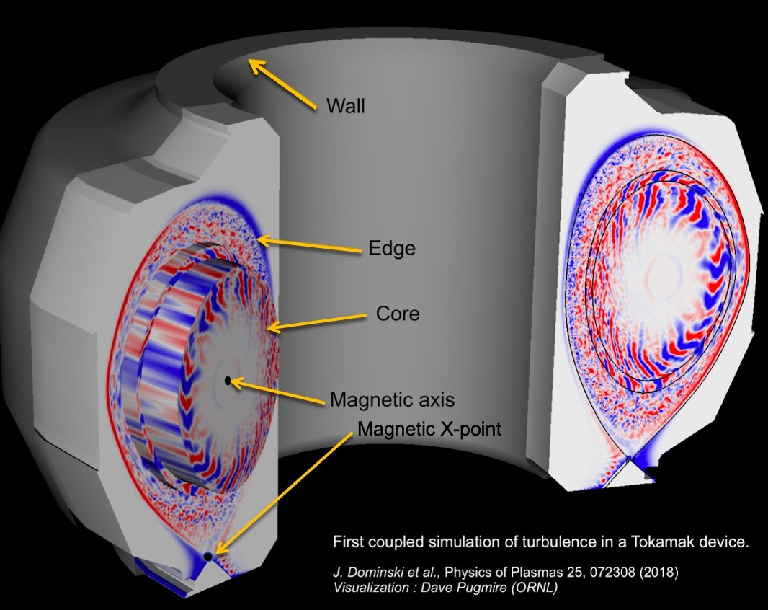
Seed island detection discriminant modular AI fusion
Physical mechanism of seed magnetic islands:
When small magnetic islands (non-seed islands) first form, the local temperature/density gradients begin to decrease but have not yet fully flattened.
This corresponds to a slow rise in the amplitude of the m/n mode observed by magnetic diagnostics, while the rotation frequency remains high.
discriminant modular AI fusion
Data rule/model: If F_flat is in its early rising phase and w_ECE < 0.5·w_crit and dA/dt > 0 and ω > ω_lock, then classify as Seed Stage
phase inversion surface model
yes
Possibility, Detection, position, quality
F_flat
Real-time recognition sawtooth -AI models
data_valid
Mode numbers/ phase/frequency recognition model
dA(t)/dt > 0
confidence : [0,1]
Multi Exp-signals
σ_φ、σ_f、σ_A
Real-time feature FB-AI models
Magnetic Island position/width detection model
w_ECE < 0.5 w_crit,γ(t) = (dw/dt)/w=0
width
sigma_r, sigma_w
confidence: [0,1]
Real-time feature ELM-AI models
Rotation and mode-locking detection model
State:[0,1]
ω > ω_lock
lock_index
Notes:
Seed island detection is not one thing—it’s a set of coordinated modulars AI fusion including physical mechanism discriminant, different Ai models constructed for different physical functions such as sawtooth, fishbone instabilities and so on. For the multiple diagnostic signals themselves, the phase inversion surface model, mode number/frequency recognition model/magnetic island position and width model and rotation and mode-locking detection model are necessary to be integrated into this detection framework. Therefore we design a discriminant modular AI fusion framework show below the figure. We also design the data rule model to determine the possible probability of the appearance of the seed magnetic island.

Slide 7
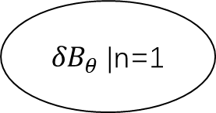
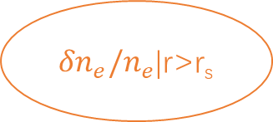



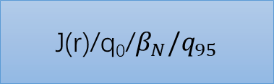
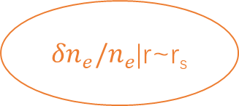
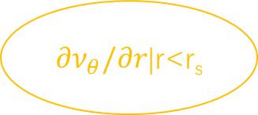
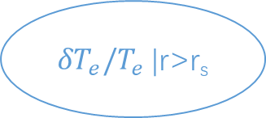
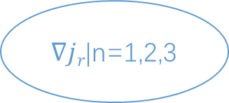

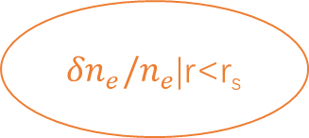

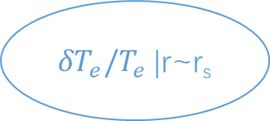
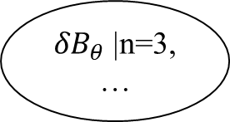
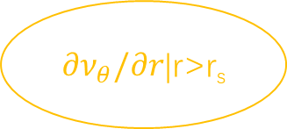

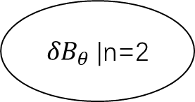
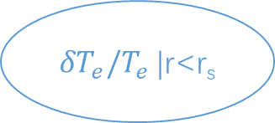

The seed triggers the time evolution associated with other parameters
Mirnov probes
$${δB}_{θ}$$
${δB}_{θ}$|n=1
${δB}_{θ}$|n=2
${δB}_{θ}$|n=3,…
Multi-channel ECE
$${δT}_{e}/T_{e}$$
${δT}_{e}/T_{e}$|r<r_{s}
${δT}_{e}/T_{e}$|r~r_{s}
${δT}_{e}/T_{e}$|r>r_{s}
Refl.
$${δn}_{e}/n_{e}$$
${δn}_{e}/n_{e}$|r<r_{s}
${δn}_{e}/n_{e}$|r~r_{s}
${δn}_{e}/n_{e}$|r>r_{s}
DBS
$${∂ν}_{θ}/∂r$$
${∂ν}_{θ}/∂r$|r<r_{s}
${∂ν}_{θ}/∂r$|r~r_{s}
${∂ν}_{θ}/∂r$|r>r_{s}
Optimized EFIT
J(r)/q₀/$β_{N}/q_{95}$
q_{x}|n=1,2,3
$∇jr$|n=1,2,3
$$β_{N}$$
$$q_{95}$$
Notes:
And when the seed island is triggered, the Mirnov probes, Multi-channels ECE , Reflectometer , DBS and EFIT code on EAST tokamak give the magnetic fluctuation, electron temperature perturbation, electron density perturbation, q profile and so on. So, we design different models for the different signals.

Slide 8
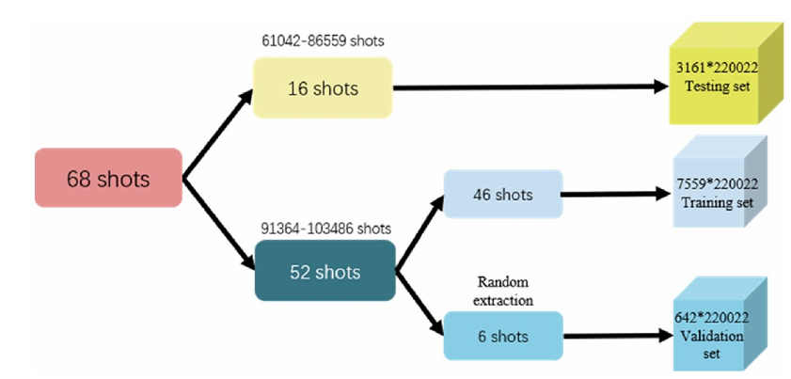
Dataset setting and screening
Data sources (typical 1–5 ms sampling or faster):
  Magnetic probes (Mirnov/saddle coils): mode phase φ_mn(t), amplitude A_mn(t), frequency ω = dφ/dt.
  ECE/ECEI: brightness temperature T_b(r,t), approximating T_e(r,t) when optically thick.
  Reflectometry (FMCW/O‑mode): density profile n_e(r,t), cut‑off layer displacement Δr_cut(t), echo amplitude/phase modulation (indicative of perturbation‑induced flux‑surface corrugation).
  Equilibrium reconstruction (EFIT): q(r,t), plasma geometry, resonant surface r_s(t) satisfying q = m/n.
  RF system logs: ECCD/LHCD launch frequency f, power P_RF, launcher mirror angles (θ, φ), predicted deposition radius r_dep(t) (via ray tracing).
  Others: NBI, fast‑particle diagnostics (neutron rate), soft X‑ray (SXR) tomography as auxiliary.
Dataset for pre-testing
Unified preprocessing steps:
  Time alignment: convert all streams to a common UTC or shot‑local t0; interpolate/resample to a common Δt (e.g., 1 ms).
  Radius/normalized‑ρ mapping: map spatial coordinates to ρ = r/a; ECE channel center frequency → ray‑trace to r; reflectometry cut‑off frequency → n_e(f) = f^2/(const·B) to invert r.
  Quality control: flag missing channels, saturation, and noise spikes (sliding‑window z‑score > 5); interpolate or set NaN.
  Storage format: HDF5 or Parquet (hierarchy: shot → signals → arrays), with metadata (sampling rate, units, processing version hash).
Notes:
After the discriminant modular AI fusion framework, the dataset setting and screening is important for the model. The definitions of many one-dimensional and 0-dimensional parameters need to be clearly stated in the database construction, for example the time evolution of mode phase and amplitude and so on. Beside all, we have to do the unified preprocessing steps including the time alignment, radius mapping, quality control and storage format.

Slide 9




Data-to-Actuator Diagnostic Fusion and Closed-Loop Control Framework
Data acquisition layer
Mirnov saddle coils
ECE w/dw/dt
Refl. ${δn}_{e}/n_{e}$
EFIT q/β
RF wave log
Auxiliary diagnosis_SXR …
Preprocessing and alignment
time-axis unification_resampling_ interpolation
spatial mapping of magnetic island position
quality control_missing data_saturation
noise removal
normalization and standardization
metadata logging_sampling rate_versioning
Feature engineering
mode features_phase noise
Temperature/density/pressure/ gradient
Density/temperature/magnetic perturbations
geometric profile
resonant surface position
power control parameters
final launcher (actuator) execution
Fusion and labeling
Early_mid-level _late fusion_ hybrid physics priors
multimodal early/mid/late fusion strategies
stage labels_regression targets
online updating_parameters_ thresholds
adaptation_real-time monitoring_feedback error
Models and decisions
classification model rules
sequence regression models
physics-constrained alignment model
control decisions
RF start_PF current adjustment_power adjustment
Notes:
And then we design a data to actuator diagnostic fusion and closed loop control framework. The framework is divided into six parts. The first part is the data acquisition layer including the diagnostic signals transition. The second one is the preprocessing and alignment including the time axis unification resampling interpolation and so on. The third one is the feature engineering including the mode features and temperature fluctuation distribution. The fourth layer is fusion and labeling including different fusion strategies. The fifth layer is the model and decision to decide whether the magnetic island appears. The last layer is the final Laucher actuator execution including the online updating parameter thresholds and adaptation real-time monitoring feedback error. Therefore I will show the details of the framework.

Slide 10
Feature engineering Construction
Feature engineering
mode features_phase noise
Temperature/density/pressure/ gradient
Density/temperature/magnetic perturbations
geometric profile
resonant surface position
power control parameters
Feature vector (at time t)
  X_{_t} = [A_{_mn}, dA/dt, ω, w_{_ECE}, F_{_flat}, F_{_flat_n}, Δr_{_cut}, d(Δr_{_cu}t)/dt, Δρ, steering_{_θ}, steering_{_φ}, P_{_RF}, dP_{_RF}/dt]
Labels
  Classification: y_{_class} = stage_label
  Regression (multi-head): y_{_reg} = [time_to_wcrit, w_{_future_max}, P_{_req_min}, Δθ_{_opt}, Δφ_{_opt}]
Models
  Classifier: XGBoost / LightGBM → stage_label
  Regressor: LSTM or Transformer (multi‑head) → y_reg
Joint loss (multi-task + physics)
  L = L_{_cls} + β·Σ L_{_reg_i} + γ·L_{_phys}
  L_{_phys}: physics constraints on w_{_pred} (monotonicity/smoothness), e.g., Σ|Δw_{_pred}| + λ·Σ|Δ²w_{_pred}|
Notes:
The first one is the feature engineering construction including the feature vector, labels, models name, joint loss。These are chosen for control relevance and real-time computability.

Slide 11
Signal Acquisition and Features
Feature engineering
mode features_phase noise
Temperature/density/pressure/ gradient
Density/temperature/magnetic perturbations
geometric profile
resonant surface position
power control parameters
(1)Magnetics: Mode Phase & Amplitude
  Phase: φ(t) = unwrap(φ_raw(t)); Amplitude: A_mn(t) via band‑pass + Hilbert envelope
  Features: rotation ω(t) = dφ/dt; growth d(ln A)/dt; phase noise σ_φ (short‑window variance)
(2)ECE Electron Temperature Gradients
  Inputs: channel temperatures T_{b,i}(t) at radii r_{i}
  Local gradient: G_{i}(t) = [T_{b,i}+1 − T_{b,i}−1] / [r_{{i+1}} − r_{{i−1}}]
  Flattening index: F_{flat}(t) = 1 − Var_{window}(T_{b}, in‑island) / Var_reference (→1 flatter)
  Island width (estimate): w_{ECE}(t) = width of contiguous radial region with G < G_{thr}
_{(3)Reflectometry Features}
  Cutoff‑layer radial shift: δr_{cut}(t) relative to mean density profile
  Density‑gradient flattening: F_{flat_n} = 1 − |dn_{_e}/dr|_{island} / |dn_{_e}/dr|_{ref}
  Echo phase spectrum: principal mode frequency f_{m} and amplitude ratio (aids resonant‑surface perturbation localization)
(4)Complementary / Control‑Relevant
  Normalized misalignment: Δρ(t) = ρ_{dep}(t) − ρ_{s}(t)
  ECCD power ramp: dP/dt; mirror angular rates: dθ/dt, dφ/dt (control predictability)
  Island phase: φ_{_island} ≈ φ_{mn} (tends to constant when locked)
Notes:
And the second one is the signal acquisition and features。 Magnetics give phase and rotation; ECE gives gradients and an island-width proxy; reflectometry provides cutoff displacement and spectral cues. Complementary features like Δρ and mirror rates connect perception to controllability.

Slide 12
Labels for Supervised Learning
Fusion and labeling
Early_mid-level _late fusion_ hybrid physics priors
multimodal early/mid/late fusion strategies
stage labels_regression targets
Stage Classification (Multi-class)
  Class 0 — No island: A_{_mn} < A_{_thr} and F_{_flat} < F_{_thr}
  Class 1 — Seeding: w_{_ECE} < 0.5·w_{_crit} and positive growth dA/dt > 0
  Class 2 — Intervenable window: 0.5·w_{_crit} ≤ w_{_ECE} < w_{_act_limit}
  Class 3 — Late/near locking: w_{_ECE} ≥ w_{_act_limit} or rotation ω < ω_{thr}
Regression Targets
  y1: Time-to-threshold Δt_{_to_wcrit} (remaining time to reach w_{_crit})
  y2: Max island width within horizon w_{_max}(Δt_{_horizon})
  y3: Minimum required aligned power P_{_req} (from model or empirical inversion)
Notes:
We use four classes: no island, seeding, intervenable, and late/near locking. For regression, we predict time to the critical width, expected max width in a horizon, and the minimum aligned power required.

Slide 13
Fusion Strategies with Physics Priors
Fusion and labeling
Early_mid-level _late fusion_ hybrid physics priors
multimodal early/mid/late fusion strategies
stage labels_regression targets
(1)Early Fusion Strategy
  Concatenate feature vector: X_{_t} = [A_{_mn}, ω, dA/dt, local stats of G_{_i}, F_{_flat}, F_{_flat_n}, δr_{_cut}, Δρ, …]
  Train classical models: Random Forest, XGBoost
  Pros: simple, fast; Cons: limited cross‑modal structure
(2)Mid-Level Fusion Strategy
  Separate encoders, then concatenate embeddings
    Magnetics: LSTM or 1D‑CNN (temporal)
    ECEI: 2D‑CNN (radial–poloidal) + temporal attention
    Reflectometry: spectral CNN on echo‑phase spectrum
  Pros: captures modality‑specific patterns; flexible downstream head
(3)Late Fusion Strategy
  Independent classifiers/regressors with voting or weighted averaging
  Robust to temporary diagnostic dropouts or missing channels
(4)Hybrid Physics Priors (Loss-Level Constraints) Strategy
  Add physics term to loss to enforce smooth, MRE‑consistent growth of island width w(t)
  Example total loss: L_{_total} = L_{_task} + λ · Σ |Δ² w_{_pred}|
    Δ² w_{_pred}: second difference penalty (discrete curvature) to suppress abrupt jumps
Notes:
And the third one is the fusion strategies with physics priors including the early fusion strategy, mid-level fusion ,late fusion strategy and the hybrid physics prior strategy. Early fusion is simple and fast; mid-level fusion learns per-modality encoders; late fusion is robust to missing channels. We also add physics-informed penalties so predicted width evolves smoothly and stays consistent with MRE trends.

Slide 14
Rule-Based Pseudo flow for Island Stage Classification
Models and decisions
classification model rules
sequence regression models
physics-constrained alignment model
control decisions
RF start_PF current adjustment_power adjustment
Step 1: Compute A_{_mn}(t). If A_{_mn} < A_{_noise} → Class 0 (No island).
Step 2: Else compute w_{_ECE} and F_{_flat}. If w_{_ECE} < 0.5·w_{_crit} and F_{_flat} shows an upward trend → Class 1 (Seeding).
Step 3: If 0.5·w_{_crit} ≤ w_{_ECE} < w_{_act_limit} (e.g., 0.8·w_{_crit}) and ω > ω_{_lock} → Class 2 (Intervenable).
Step 4: If w_{_ECE} ≥ w_{_act_limit} or ω ≤ ω_{_lock} → Class 3 (Late / near locking).
Critical width (source):
  From simplified MRE: w_{_crit} ≈ sqrt((χ_⊥ · L_{_q}) / (ε · β_{_p′} · C_{_bs})).
  In practice: use device-calibrated constant.
Anomaly-Detection Assist:
  Train an autoencoder on no-island history.
  If reconstruction error > threshold → flag “candidate seed,” then apply the above rule-based classification to reduce false positives.
Notes:
Here’s a simple rule chain for quick decisions: check amplitude against noise; then width and flattening; then rotation. We also use an anomaly detector trained on “no-island” data to flag candidate seeds and reduce false positives.

Slide 15
Challenges for Prediction of NTM seed magnetic island trigger threshold
Diagnostics and alignment
  Phase unwrap noise (magnetics); ECE/ECEI saturation and FoV gaps; reflectometry cutoff drift
  Time-axis sync, resampling, and latency mismatch; spatial registration (r → ρ, resonant surface) errors
Data quality and labels
  Rare/ambiguous seeding events; inter-annotator variance; label leakage
  Inconsistent definitions of w_{_ECE}, w_{_crit}, w_{_act_limit}; severe class imbalance
Feature and estimator uncertainty
  Island width from ECE/ECEI/reflectometry sensitive to noise and geometry
  Flattening indices and local gradients unstable at low SNR; rotation near locking hard to measure
Physics-model uncertainty
  MRE parameters (χ⊥, L_{_q}, ε, β′_{_p}, C_{_bs}) poorly calibrated and machine-dependent
  Equilibrium/q-profile reconstruction errors; scenario dependence (shape, β, heating/torque)
Decision coupling and real-time constraints
  Steering and power change the very features used for prediction; misalignment Δρ estimation error
  Control latency τ_sys and inference budget; missing channels at runtime
Distribution shift and generalization
  Cross-shot/cross-campaign drift; hardware upgrades; ramp-up vs flat-top regimes
Evaluation and risk
  Need time-to-event metrics (TTE MAE), early-warning PR curves, cost-sensitive errors
  Calibrated probabilities (UQ) to manage high FN cost; robust thresholds
Operationalization
  Online recalibration/drift detection; fallback rule-based logic; auditability and interpretability
Notes:
We aim to catch seed islands early and fire RF only when it helps and costs least energy. We sync magnetics, ECE/ECEI, and reflectometry, then compute a small, robust set of features: phase and amplitude stability from magnetics, flattening and width proxies from ECE, and cutoff shifts from reflectometry. A 4-stage classifier flags the intervention window; regressors estimate time-to-critical width, required RF power, and phase/angle offsets. We fuse rules and physics priors with compact ML encoders so it stays stable when some channels are missing. Finally, we choose the RF start time by minimizing energy under a required success probability, with simple triggers and retune/stop rules. The result is earlier, cheaper, and safer interventions, with clear metrics to track precision, false alarms, and energy savings. This concludes my talk—thank you for listening.

Slide 16
Thanks for your attention

