Slide 1
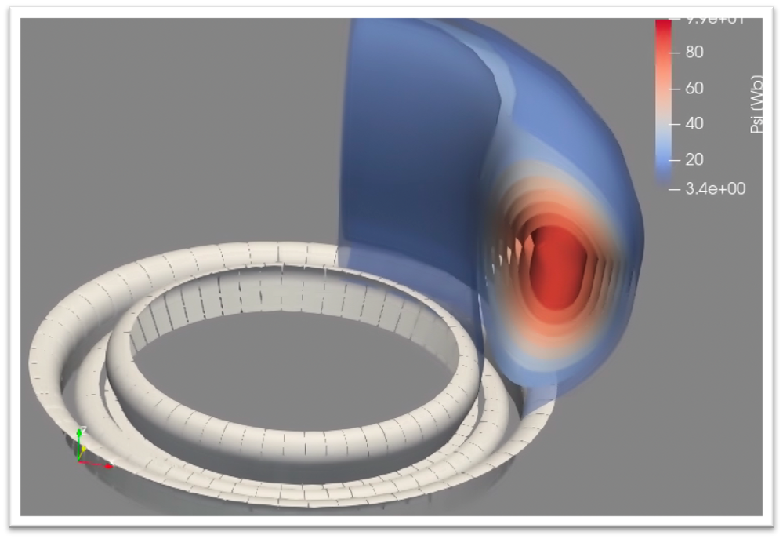
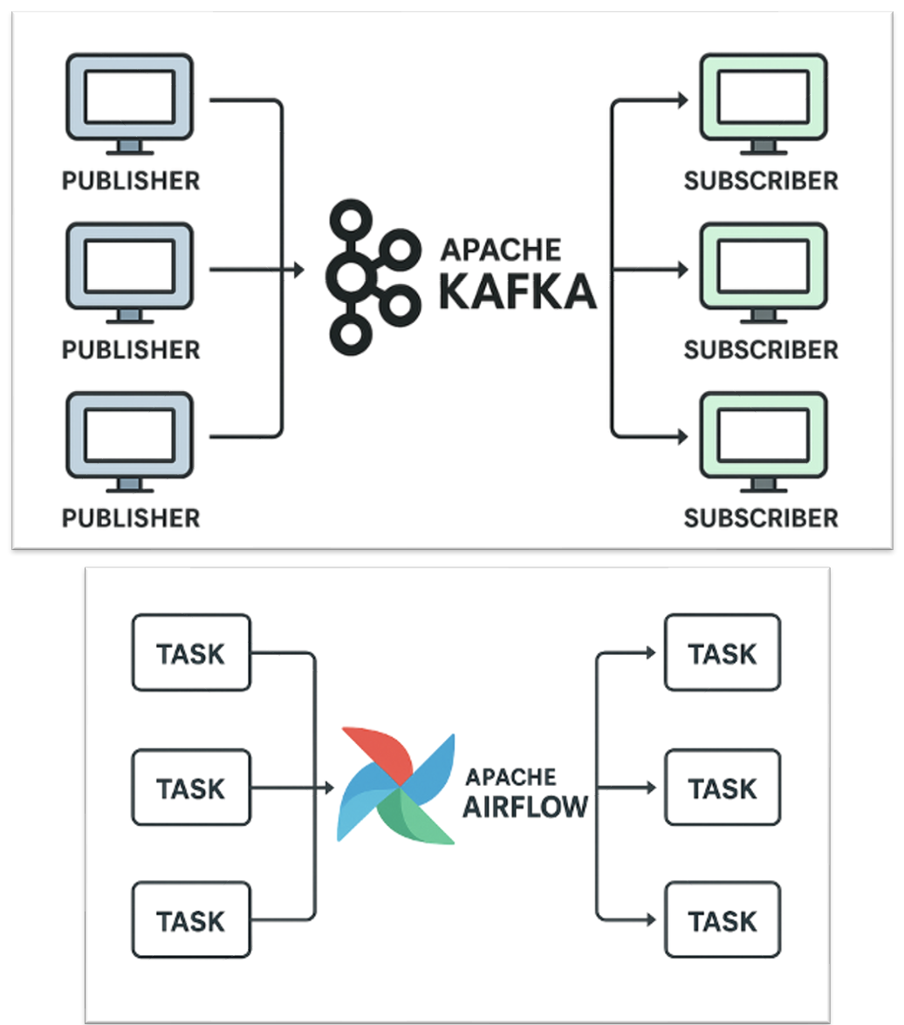

In-pulse analysis and 3D visualization at ITER:
workflow managers and 3D exploration tools
P Abreu (ITER Organization)
S. Rajesh (IO intership, Kalasalingam Academy of Research and Education, India)
S. Blockhuizen, M. Sebregts, D. van Vugt (Ignition Computing, Netherlands)
Disclaimer: The views and opinions expressed herein do not necessarily reflect those of the ITER Organization

Slide 2
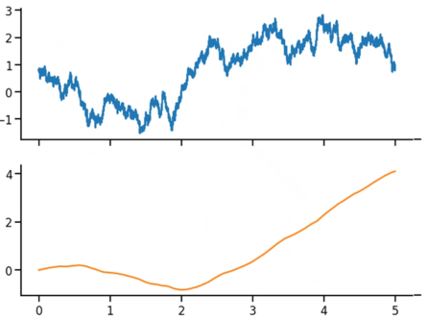

What is in-pulse data processing?
A set of interdependent programs/actors that calculate plasma parameters from measurements.
They use as input both the raw data from the diagnostics and processed data by other programs (hence the interdependence).
The complete workflow(s) can be represented by a directed acyclic graph (DAG).
The wider goal is to provide a consistent interpretation of the plasma state (with uncertainties) from the measurements during each pulse to guide the current experimental session.
More specifically to provide accurate measurement parameters (MP) in time to prepare the next pulse in the control room.
Workflow(s)
Workflow(s)
Workflow(s)
Trigger
Data providers
Orchestrator
Live display
partial if reprocessing
new pulse
or reprocessing
Kafka
Airflow
Orchestrator(s)
Workflow(s)
Orchestrator(s)
Workflow(s)
Orchestrator(s)
Workflow(s)
Motivation
Progress monitor

Slide 3
What is in-pulse data processing?
A set of interdependent programs/actors that calculate plasma parameters from measurements.
They use as input both the raw data from the diagnostics and processed data by other programs (hence the interdependence).
The complete workflow(s) can be represented by a directed acyclic graph (DAG).
The wider goal is to provide a consistent interpretation of the plasma state (with uncertainties) from the measurements during each pulse to guide the current experimental session.
More specifically to provide accurate measurement parameters (MP) in time to prepare the next pulse in the control room.
Today
Workflow(s)
Workflow(s)
Workflow(s)
Trigger
Data providers
Orchestrator
Live display
partial if reprocessing
new pulse
or reprocessing
Kafka
Airflow
Orchestrator(s)
Workflow(s)
Orchestrator(s)
Workflow(s)
Orchestrator(s)
Workflow(s)
Motivation
Progress monitor

Slide 4
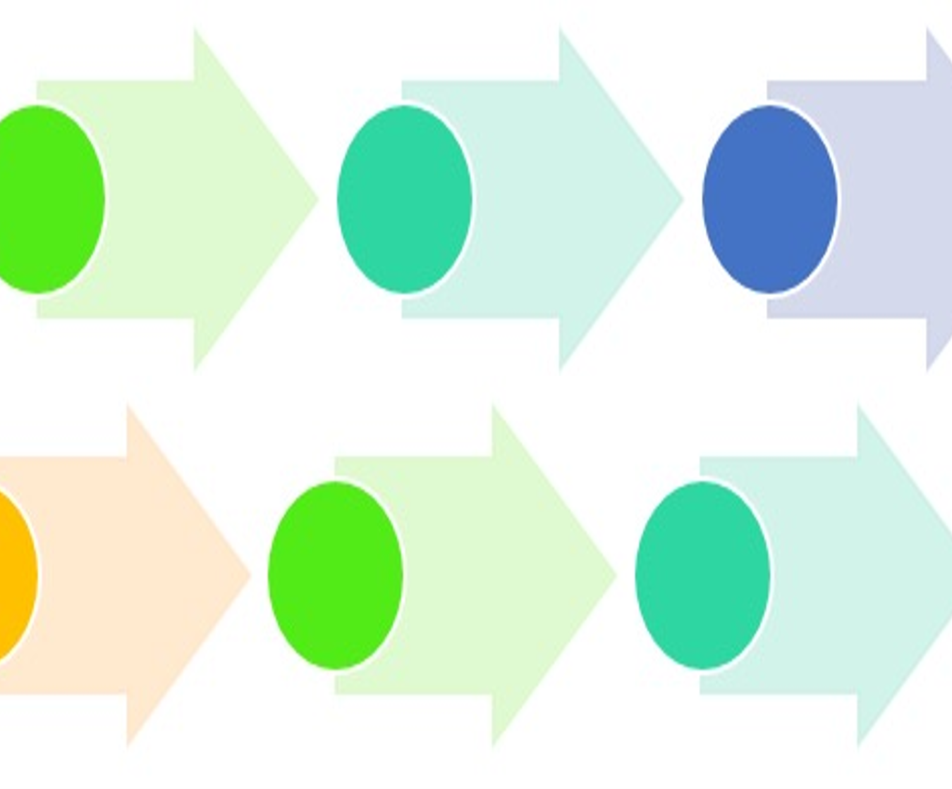
Contents
Motivation
Providers and consumers
  From DAN to SDCC
  Apache Kafka
Workflow manager
  Airflow
  First application: equilibrium reconstruction
  Workflow framework
3D visualization
Conclusions & future work

Slide 5
Contents
Motivation
Providers and consumers
  From DAN to SDCC
  Apache Kafka
Workflow manager
  Airflow
  First application: equilibrium reconstruction
  Workflow framework
3D visualization
Conclusions & future work

Slide 6
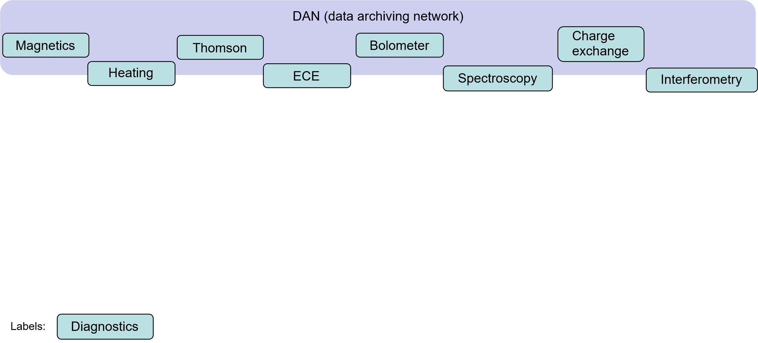
In-pulse analysis workflows: from diagnostics to physics
Motivation

Slide 7
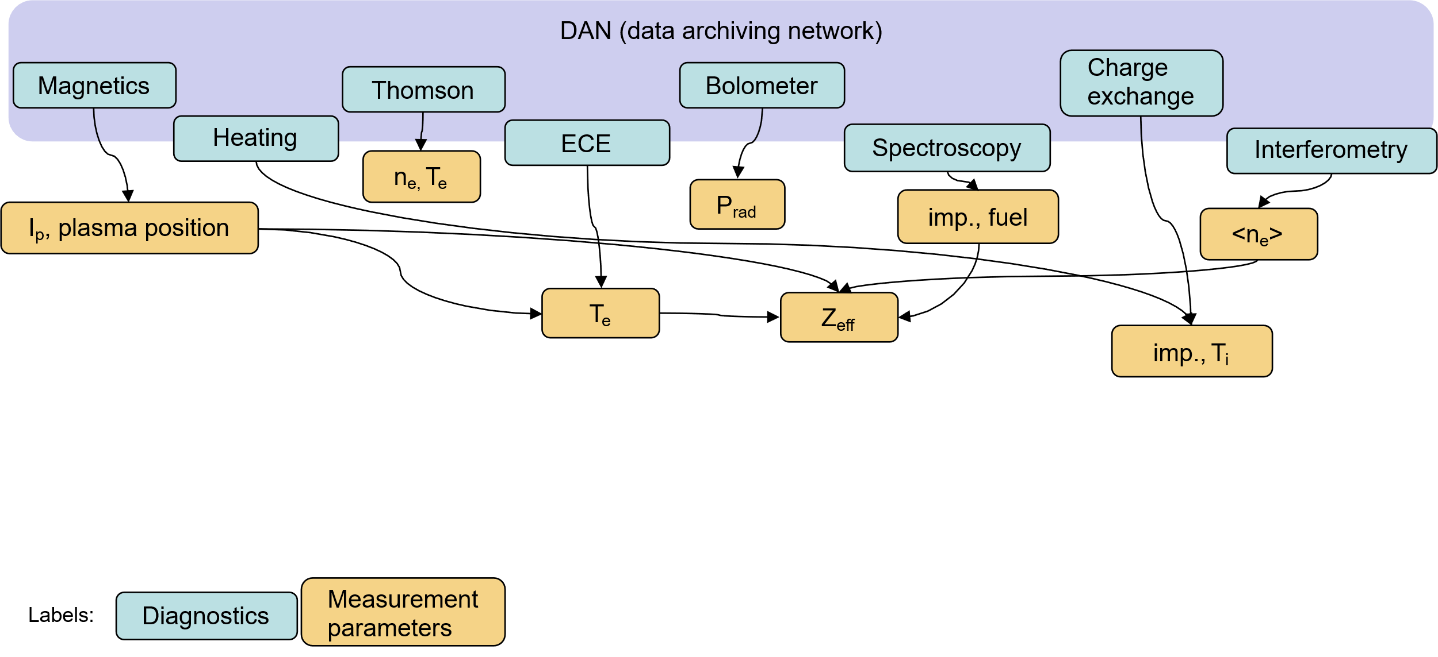
In-pulse analysis workflows: from diagnostics to physics
Motivation

Slide 8
In-pulse analysis workflows: from diagnostics to physics
Motivation

Slide 9
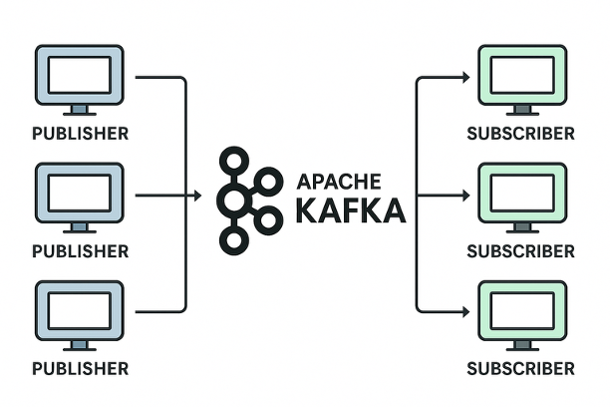
Contents
Motivation
Providers and consumers
  From DAN to SDCC
  Apache Kafka
Workflow manager
  Airflow
  First application: equilibrium reconstruction
  Workflow framework
3D visualization
Conclusions & future work

Slide 10
DAN high throughput data provider
From DAN (data archiving network)
Diagnostic 1
Raw data
Heating 1
Raw data
Diagnostic 2
Raw data
Heating 2
Raw data
Diagnostic N
Raw data
Heating 3
Raw data
How?
Data analysis clients (in-pulse, user codes, …)
From DAN to SDCC

Slide 11
DAN high throughput data provider
    Reads in the raw data (>1PB/day)
    Simple calibration ➨scaling,
    ➨ offset removal
    Decimation at different rates, eg
    ➨ 5 kHz
    ➨ 100 Hz
From DAN (data archiving network)
Diagnostic 1
Raw data
Heating 1
Raw data
Diagnostic 2
Raw data
Heating 2
Raw data
Diagnostic N
Raw data
Heating 3
Raw data
Calibration
Decimation
Calibration
Decimation
Data analysis clients (in-pulse, user codes, …)
From DAN to SDCC

Slide 12
DAN high throughput data provider
    Reads in the raw data (>1PB/day)
    Simple calibration ➨scaling,
    ➨ offset removal
    Decimation at different rates, eg
    ➨ 5 kHz
    ➨ 100 Hz
    IMAS compatible format
    ➨ Data mapping
    Creates data streams to be accessed by applications.
From DAN (data archiving network)
Diagnostic 1
Raw data
Heating 1
Raw data
Diagnostic 2
Raw data
Heating 2
Raw data
Diagnostic N
Raw data
Heating 3
Raw data
Calibration
Decimation
Calibration
Decimation
Diagnostic 1
Data stream
Heating 1
Data stream
Diagnostic 2
Data stream
Heating 2
Data stream
Diagnostic N
Data stream
Heating 3
Data stream
data streams
Data analysis clients (in-pulse, user codes, …)
Diagnostic 1 IDS
Heating 1 IDS
We need a data broker
Diagnostic 2 IDS
Heating 2 IDS
Diagnostic N IDS
Heating 3 IDS
From DAN to SDCC

Slide 13
Apache Kafka as the data broker
1. Publish–Subscribe Messaging System
  • Enables real-time communication between producers and consumers.
  • Decouples data streams for scalability and flexibility.
2. High Throughput & Low Latency
3. Scalability
  • Horizontally scalable by adding brokers and partitions.
4. Fault Tolerance & Durability
  • Data replication across brokers ensures resilience.
  • Messages persist on disk for guaranteed delivery.
From DAN to SDCC

Slide 14
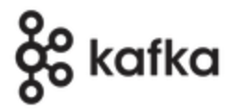
Kafka topics as workflow input
    Each data stream received from DAN is a Kafka topic.
    On SDCC, apps subscribe to Kafka topics
    While in-pulse you can subscribe to:
      latest time slice ➨ always up-to-date
      resume from last time slice ➨ no gaps
    Off-pulse: reprocess complete pulses
    Note: to partial reprocess a pulse, see later.
From DAN (data archiving network)
Diagnostic 1
Data stream
Heating 1
Data stream
Diagnostic 2
Data stream
Heating 2
Data stream
Diagnostic N
Data stream
Heating 3
Data stream
topics
= data streams
Data analysis clients (in-pulse, user codes, …)
Diagnostic 1 IDS
Heating 1 IDS
Diagnostic 2 IDS
Heating 2 IDS
Diagnostic N IDS
Heating 3 IDS
From DAN to SDCC

Slide 15
Kafka topics as workflow input
    Each data stream received from DAN is a Kafka topic.
    On SDCC, apps subscribe to Kafka topics
    While in-pulse you can subscribe to:
      latest time slice ➨ always up-to-date
      resume from last time slice ➨ no gaps
    Off-pulse: reprocess complete pulses
    Note: to partial reprocess a pulse, see later.
From DAN (data archiving network)
Diagnostic 1
Data stream
Heating 1
Data stream
Diagnostic 2
Data stream
Heating 2
Data stream
Diagnostic N
Data stream
Heating 3
Data stream
topics
= data streams
Data analysis clients (in-pulse, user codes, …)
Diagnostic 1 IDS
Heating 1 IDS
Diagnostic 2 IDS
Heating 2 IDS
Diagnostic N IDS
Heating 3 IDS
    Kafka event streaming allows:
      To publish (write) and subscribe to (read) streams of events, including continuous import/export of your data from other systems.
      To store streams of events durably and reliably for as long as you want.
      To process streams of events as they occur or retrospectively.
x
From DAN to SDCC

Slide 16

Kafka topics as workflow input
    Each data stream received from DAN is a Kafka topic.
    On SDCC, apps subscribe to Kafka topics
    While in-pulse you can subscribe to:
      latest time slice ➨ always up-to-date
      resume from last time slice ➨ no gaps
    Off-pulse: reprocess complete pulses
    Note: to partial reprocess a pulse, see later.
From DAN (data archiving network)
Diagnostic 1
Data stream
Heating 1
Data stream
Diagnostic 2
Data stream
Heating 2
Data stream
Diagnostic N
Data stream
Heating 3
Data stream
topics
= data streams
Data analysis clients (in-pulse, user codes, …)
Diagnostic 1 IDS
Heating 1 IDS
Diagnostic 2 IDS
Heating 2 IDS
Diagnostic N IDS
Heating 3 IDS
    Kafka event streaming allows:
      To publish (write) and subscribe to (read) streams of events, including continuous import/export of your data from other systems.
      To store streams of events durably and reliably for as long as you want.
      To process streams of events as they occur or retrospectively.
x
Check DAN2IMAS repo
From DAN to SDCC

Slide 17
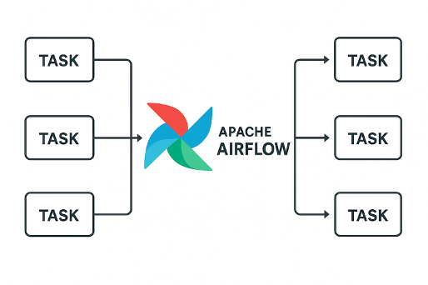
Contents
Motivation
Providers and consumers
  From DAN to SDCC
  Apache Kafka
Workflow manager
  Airflow
  First application: equilibrium reconstruction
  Workflow framework
3D visualization
Conclusions & future work

Slide 18
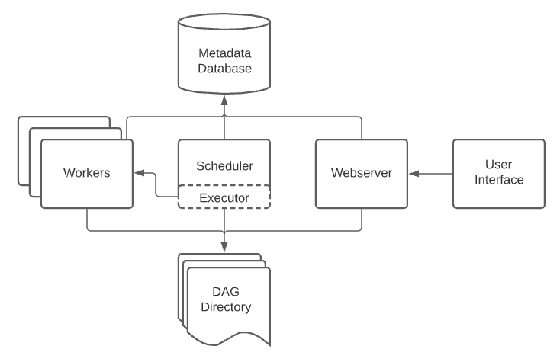
Apache Airflow as the workflow manager
    Open source
    Python
    DAG
    Web and CL interfaces
    Scalable (built-in task parallelism)
    Operators can have introspection
    into actors:
      Fault detection
      Restart
      Replace
Workflow manager: Airflow

Slide 19
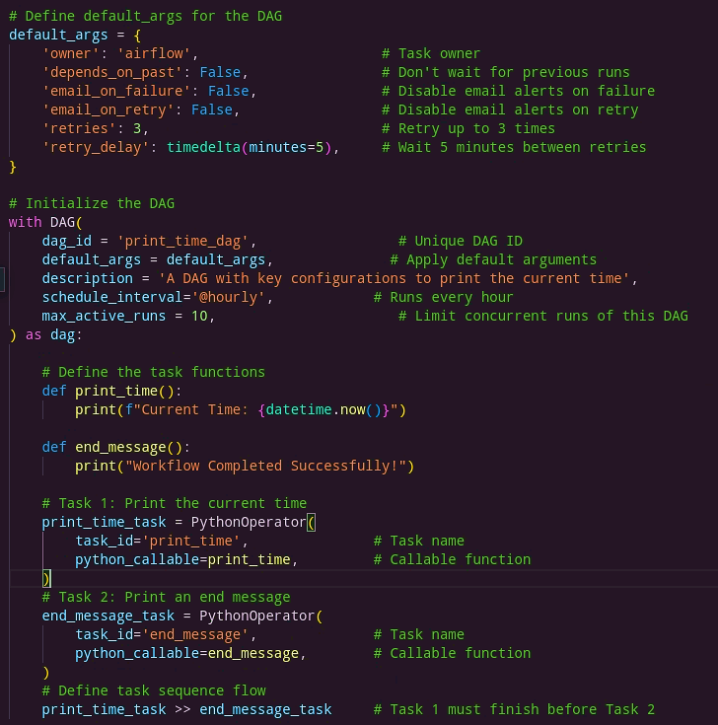
Airflow features at a glance
Retry Mechanism:
  Automatically retries failed tasks to enhance reliability.
Configuring Task Scheduling:
  Inbuild scheduling with Airflow.
  External scheduling.
Parallel Execution:
  Parallelism: Maximum number of tasks running across all DAGs.
  Concurrency: Maximum tasks allowed for a single DAG.
Task Dependencies:
  Specify execution order explicitly.
Workflow manager: Airflow

Slide 20
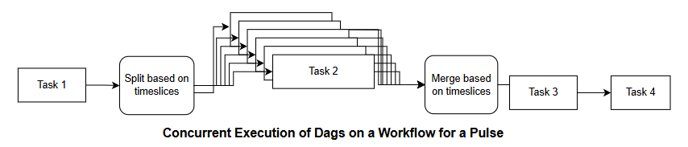
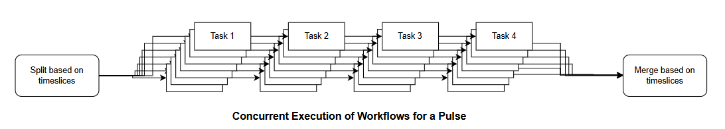
Simple parallelization per time slice
Most in-pulse actors process single time slices.
We can process time slcies in batches / ranges with simple parallelism
  Per actor / task:
  Or per workflow:
Workflow manager: Airflow

Slide 21
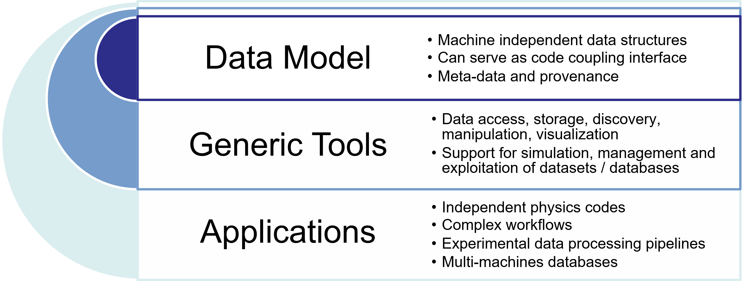
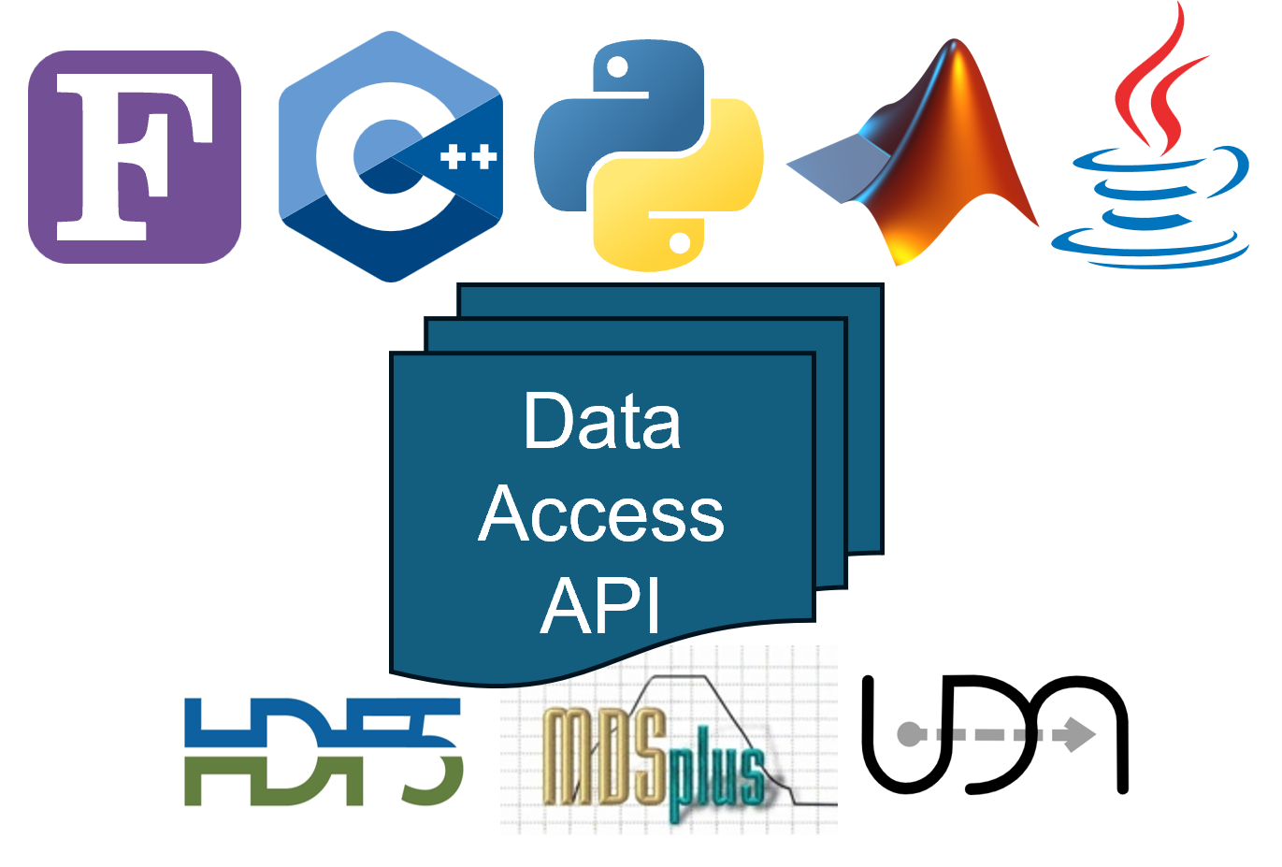
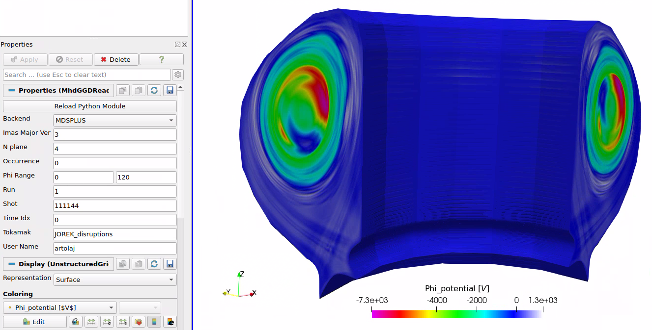

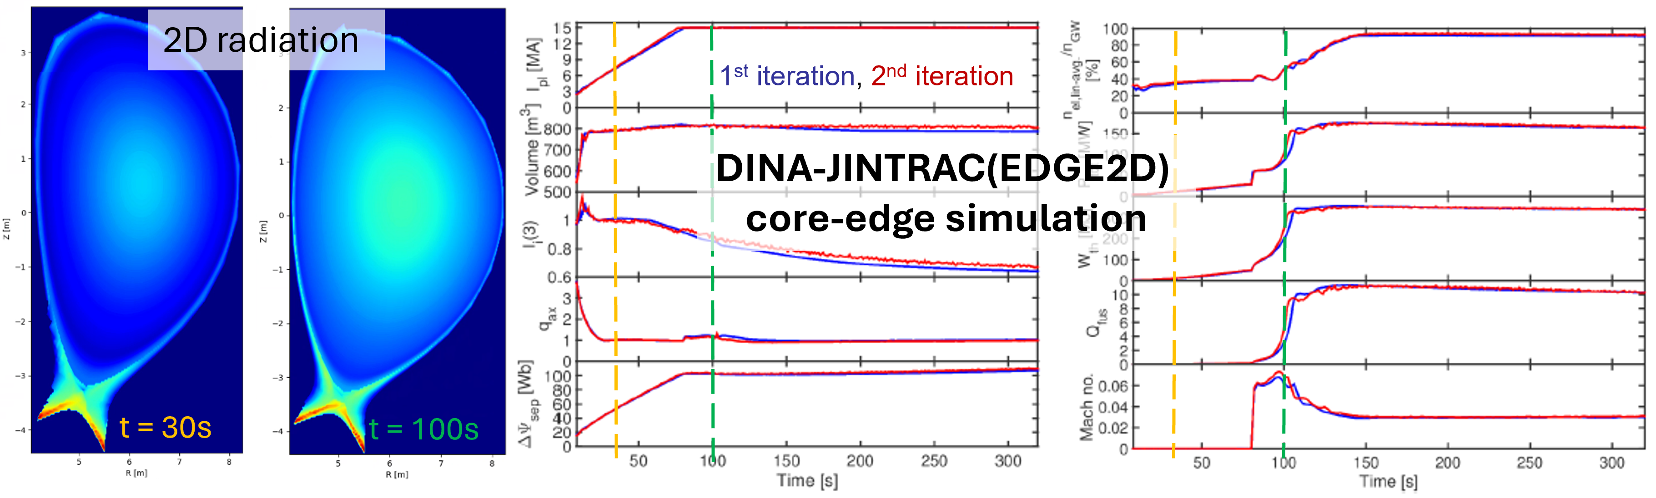
The Integrated Modelling and Analysis Suite (IMAS)
Data Dictionary
Implements the IMAS data model Interface Data Structures (IDS).
Abstracts the storage format
Both for simulation and experimental data.
Integrated Modelling & Analysis Suite is the collection of physics software that will be used to support ITER operations and research as defined in the ITER Integrated Modelling Programme.
Access Layer API
Visualization
IMAS integration

Slide 22
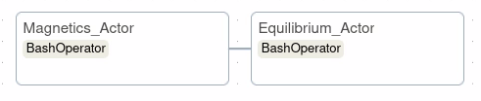
First application: equilibrium reconstruction with synthetic magnetics constraints
Magnetics Actor
  Magnetics_prep – Reads machine/diagnostic specific data.
  Magnetics – Synthetic diagnostic modelling for magnetics measurements.
Equilibrium Actor
  Equilibrium_prep – Reads machine/diagnostic specific data for the equilibrium reconstruction.
  Equilibrium –Actor used to reconstruct plasma equilibrium.
Machine agnostic: diagnostic/machine specificities are parameters to the actors.
Code agnostic: actors exchange data in IDS format, easily replaceable by other actors with the same inputs and outputs.
In this particular exercise:
  predictMagnetics (from the Minerva framework, L. Appel, UKAEA)
  EFIT++ (L. Appel, UKAEA)
Workflow manager: equilibrium reconstruction

Slide 23
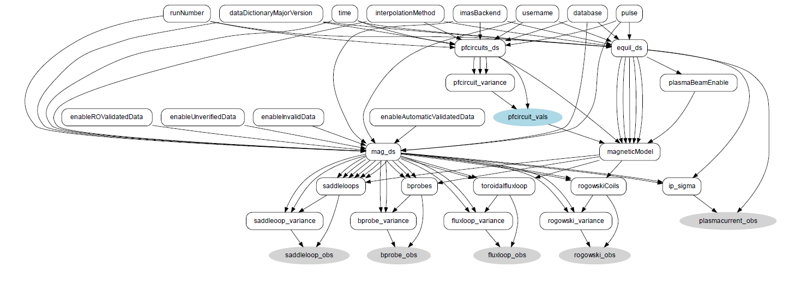
First application: equilibrium reconstruction with synthetic magnetics constraints
  55.A* magnetic diagnostics
  PredictMagnetics by L. Appel within the Minerva framework
  EFIT++ actor
Scenario
Machine Description
equilibrium
magnetics
pf_active
PredictMagnetics
magnetics
pf_active
magnetics
Machine Description
pf_active
pf_passive
wall
tf
EFIT++
equilibrium
M. Schneider @ ITPA TG Diag 2022
Workflow manager: equilibrium reconstruction

Slide 24
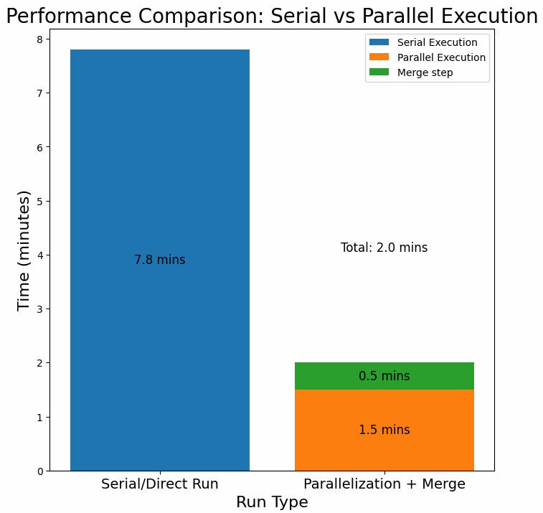
First application: simple parallelism
Workflow info: the Magnetics Actor for IMAS Pulse 105027, consisting of 614 timeslices.
Serial Execution:
  Total execution time: 7.8 minutes.
  Tasks were executed sequentially without concurrency.
Parallel Execution + Merge:
  Average execution time of 5 parallel runs : 1.5 minutes.
  Merge operation of the runs : 0.5 minutes.
  Total execution time reduced to 2.0 minutes (1.5 + 0.5 minutes).
Conclusion:
  Even with the overhead of the merge step, the average execution time of the parallel runs combined is significantly faster than the serial/direct run.
Workflow manager: equilibrium reconstruction

Slide 25
In-pulse Workflow Framework
  Developed a mock in-pulse processing workflow to simulate a complete plasma analysis workflow during a pulse.
  The workflow serves as a blueprint for future integration of real physics-based codes in ITER's real-time processing pipeline.
  All computational steps currently use placeholder actors, designed to be replaced with validated physics modules in future iterations.
  This framework establishes a baseline architecture for modular, scalable in-pulse workflows spanning multiple diagnostics and control loops.
Workflow manager: framework

Slide 26
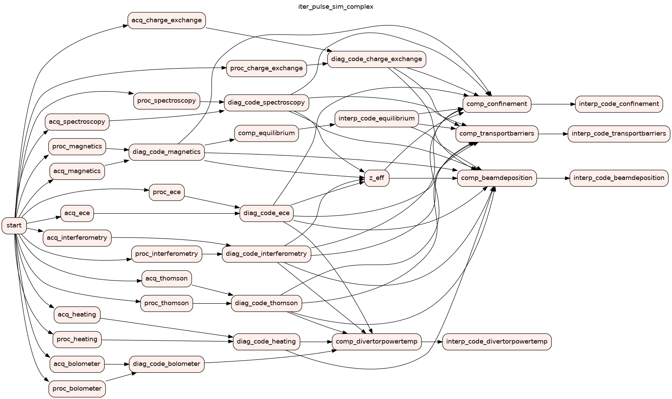
In-pulse Workflow Simulation
Subscribers
Workflow manager: framework

Slide 27
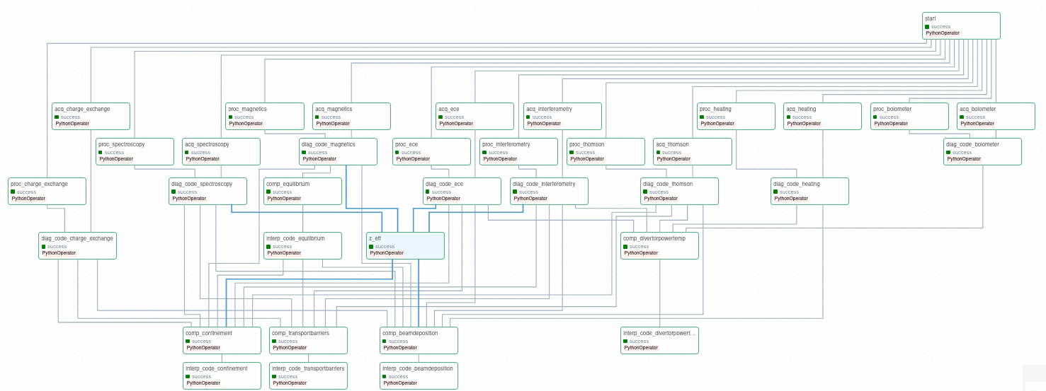
In-pulse Workflow Simulation in Airflow
:
Workflow manager: framework

Slide 28
In-pulse Workflow Simulation in Airflow
:
Failure detection: detects failures and supports resolution through retry logic, fallback paths, and execution monitoring.
Failure resolution: includes alternative placeholder codes that can be triggered dynamically if a primary actor fails enabling fault tolerance.
The architecture supports horizontal scaling, where multiple timeslices can be processed concurrently as they arrive.
It also enables vertical scaling, allowing additional dependent tasks (e.g., diagnostics, post-processing) to be added without disrupting existing workflows.
The orchestration setup is modular and extensible, allowing increased complexity and integration over time without changing the core design.
Workflow manager: framework

Slide 29
Workflow Simulation: in-pulse and reprocessing
  1. In-Pulse Workflow (Simulated):
    Mimics online timeslice-by-timeslice processing during an active pulse. Tasks triggered sequentially as new timeslices arrive.
  2. Reprocessing Workflow (Simulated):
  Executes after pulse completion using full data availability. Represents a traditional, serial processing pipeline.
  Both workflows use identical placeholder actors and input conditions, isolating orchestration behaviour for easier comparison.
  Each actor had randomized processing times, generated deterministically using the component's name as a seed
Check the source scripts of this example here:
https://git.iter.org/projects/WF/repos/orchestrators/browse
Workflow manager: framework

Slide 30
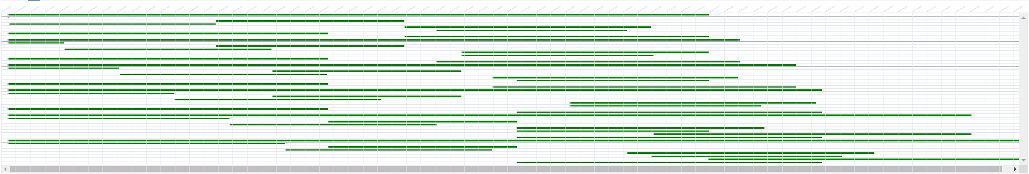
Workflow Simulation: in-pulse and reprocessing
In-pulse:
Airflow execution time
∆t₁
parallel processing
∆t_{n}
Reprocessing:
Workflow manager: framework

Slide 31
Contents
Motivation
Providers and consumers
  From DAN to SDCC
  Apache Kafka
Workflow manager
  Airflow
  First application: equilibrium reconstruction
  Workflow framework
3D visualization
Conclusions & future work

Slide 32
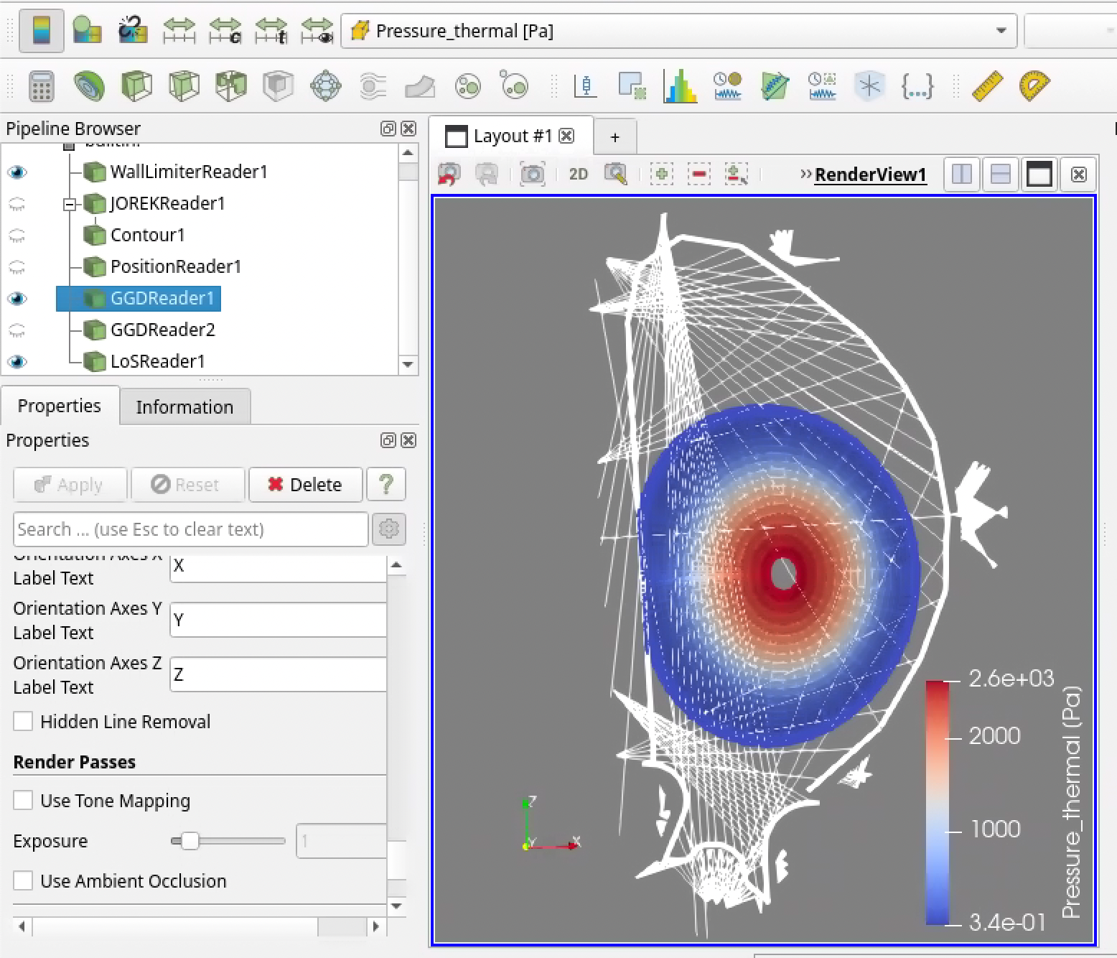
Data visualization and exploration
Data is useless without insight.
There is an ongoing development of ITER plotting library (L. Abadie):
  iplot ecosystem and MINT
  DAN, SDN, IMAS, …
  1D and 2D
  control room display and user desktop
3D scientific data exploration tool was missing:
    Kitware Paraview
    +
    IMAS plugin
SOLPS + Limiter + ECE LOS
3D Visualization

Slide 33
Data visualization and exploration
See IMAS-Paraview manual and example.
Open source on github
GUI and CLI (export to VTK)
GGD data (2D and 3D)
JOREK
1D profile data:
  Integrate 1D core with 2D edge
Machine/diagnostic description data:
  Divertor
  Wall
  LoS
  Magnetic sensors
  …
3D Visualization

Slide 34
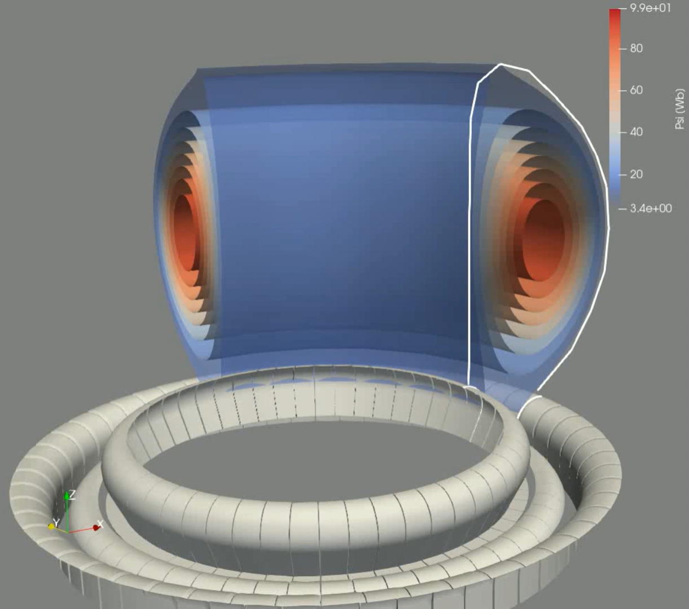
Example:
JOREK data (psi)
Divertor
Limiter
3D Visualization

Slide 35
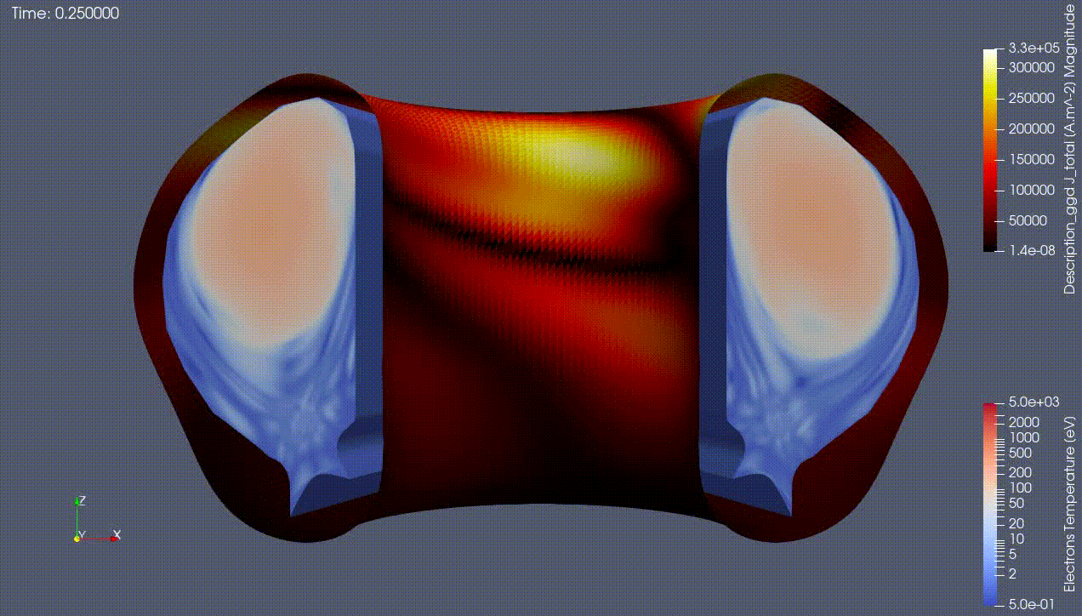
Example:
JOREK data
Animation of the electron temperature and wall currents.
Data provided by J. Artola.
3D Visualization

Slide 36
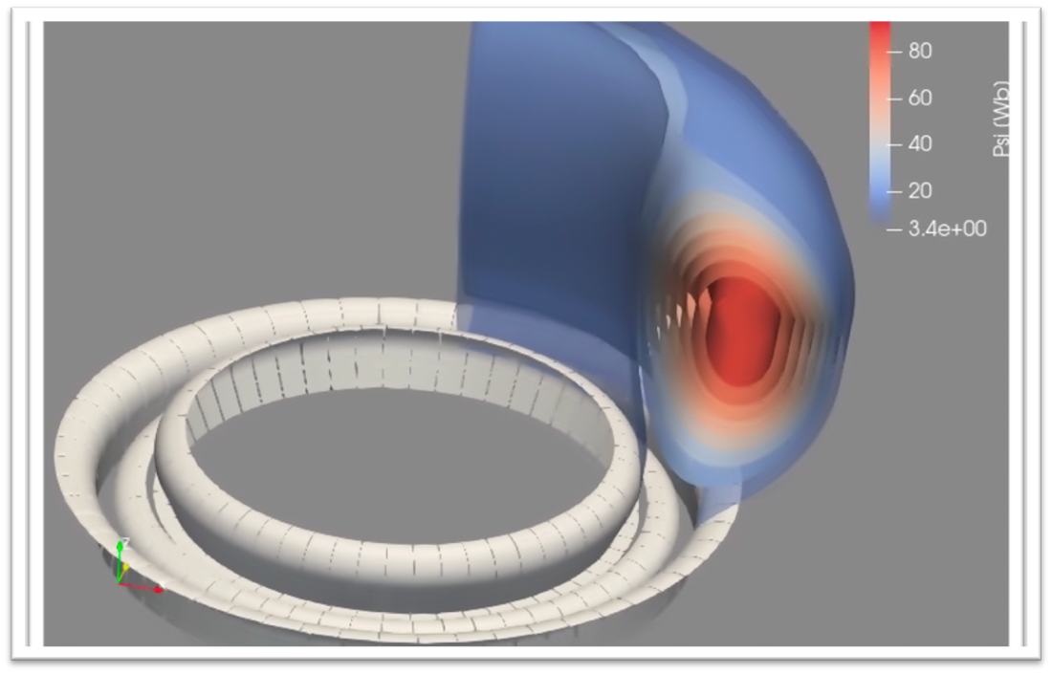
Contents
Motivation
Providers and consumers
  From DAN to SDCC
  Apache Kafka
Workflow manager
  Airflow
  First application: equilibrium reconstruction
  Workflow framework
3D visualization
Future work & discussion

Slide 37
Future work
  Realistic input data:
    Use synthetic diagnostic data as input
    Use mapped experimental data from other devices.
  Use real diagnostic programs as consumers for the data providers.
  Integrate with MUSCLE3 (persistent actor framework):
    HFPS workflow
    H&CD workflow
  3D visualization: further improvements based on user request
Topics for discussion
  What is being used by other devices?
  Does reprocessing integrate well with this architecture?
  Does high volume data (eg, IR/viz movies) need special treatment?
Future work & challenges

Slide 38
Thank you!

