Slide 1
Many big failures in big cloud providers
CloudFlare : 18 Nov. 2025 6 hours of unavailability: https://blog.cloudflare.com/18-november-2025-outage/
it was triggered by a change to one of our database systems' permissions which caused the database to output multiple entries into a “feature file” used by our Bot Management system. That feature file, in turn, doubled in size. The larger-than-expected feature file was then propagated to all the machines that make up our network
Amazon cloud outage on 20 Oct. 2025 (DNS issue, empty record)
https://health.aws.amazon.com/health/status?eventID=arn:aws:health:us-east-1::event/MULTIPLE_SERVICES/AWS_MULTIPLE_SERVICES_OPERATIONAL_ISSUE/AWS_MULTIPLE_SERVICES_OPERATIONAL_ISSUE_BA540_514A652BE1A
Microsoft Azure outage on 29th October :
https://petri.com/microsoft-azure-outage-disrupts-microsoft-365/
Big impact on many companies…

Slide 2
AI bubble?
OpenAI with current benefit of 13 billions sign (https://www.lefigaro.fr/secteur/high-tech/openai-achete-a-amazon-38-milliards-de-dollars-de-capacites-pour-developper-son-ia-20251103)
  38 billions with Amazon
  300 billions with Oracle
  250 billions with Microsoft
  1400 billions of infra (GPUs mainly)
The boss of Google Sundar Pichai (https://www.bbc.com/news/articles/cwy7vrd8k4eo)
  Asked whether Google would be immune to the impact of the AI bubble bursting, Mr Pichai said the tech giant could weather that potential storm, but also issued a warning.
  "I think no company is going to be immune, including us," he said.

Slide 3
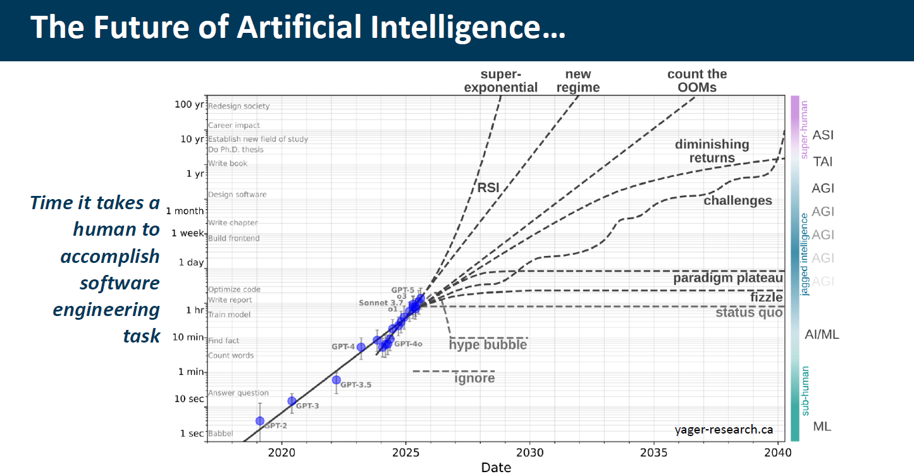
AI and cloud ecosystem for fusion data
Courtesy from Thorsten Hellert (BNL)

Slide 4
How to make use of cloud for AI and fusion data
Objective : put some recommendations on cloud usage for AI
The computing part is nice…especially training and inference of LLMs
Most big LLMs models are available on the cloud
But what about security and resilience? TIPPS?
Can we have AI/ML without cloud ? For ITER
  In the workshop, physics –based AI/ML were not using cloud and everything could be run on premises : no mention of cloud -> very good example from EAST
  Use different types of AI/ML
  For LLMs models : more complex
  Last year, PPL mentions a foundation model for ITER so usely trillions of parameters -> big computer needs
  Is the data space a concept which can help? A fusion data space?

