Slide 1
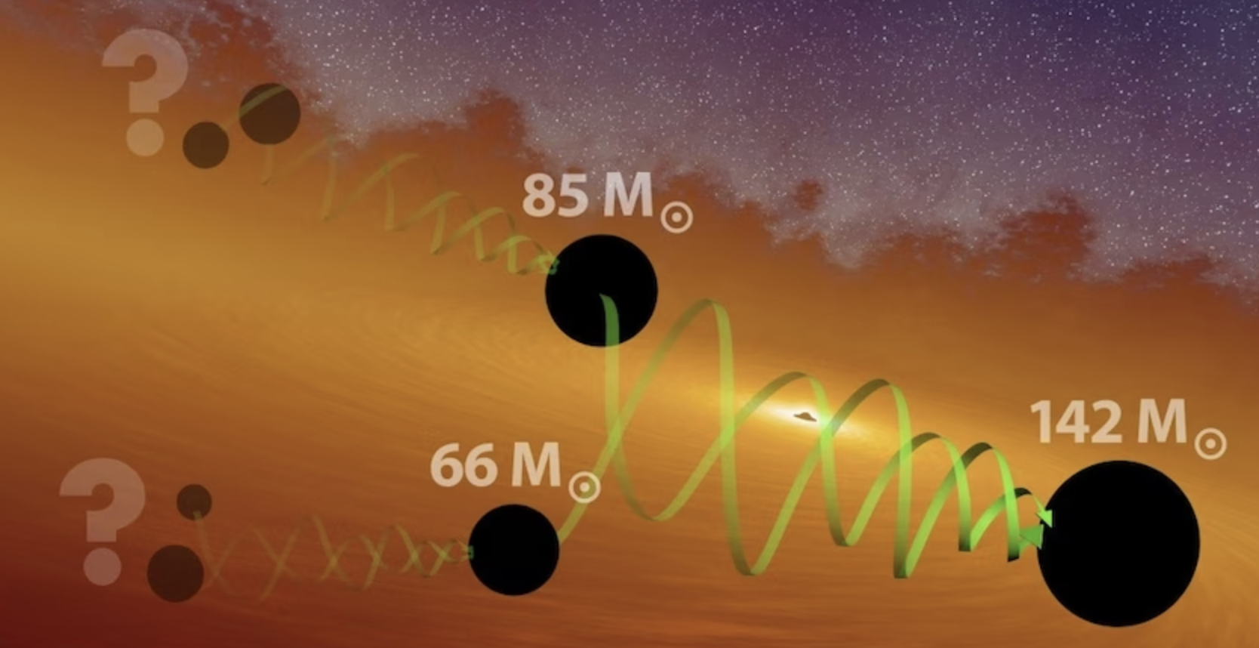



Finding the ancestors of LIGO-Virgo-KAGRA black holes and their host environments
Araujo-Alvarez+ ApJ 2025, Wong+ (in prep)
Juan Calderón Bustillo,
Henry W.Y. Wong & Carlos Araujo-Alvarez
IGFAE, University of Santiago de Compostela
Iberian Gravitational-wave Meeting,CIEMAT, Madrid, June 2025

Slide 2


Finding the ancestors of LIGO-Virgo-KAGRA black holes and their host environments
Fin
Araujo-Alvarez+ ApJ 2025, Wong+ (in prep)
Juan Calderón Bustillo,
Henry W.Y. Wong & Carlos Araujo-Alvarez
IGFAE, University of Santiago de Compostela
Iberian Gravitational-wave Meeting,CIEMAT, Madrid, June 2025

Slide 3
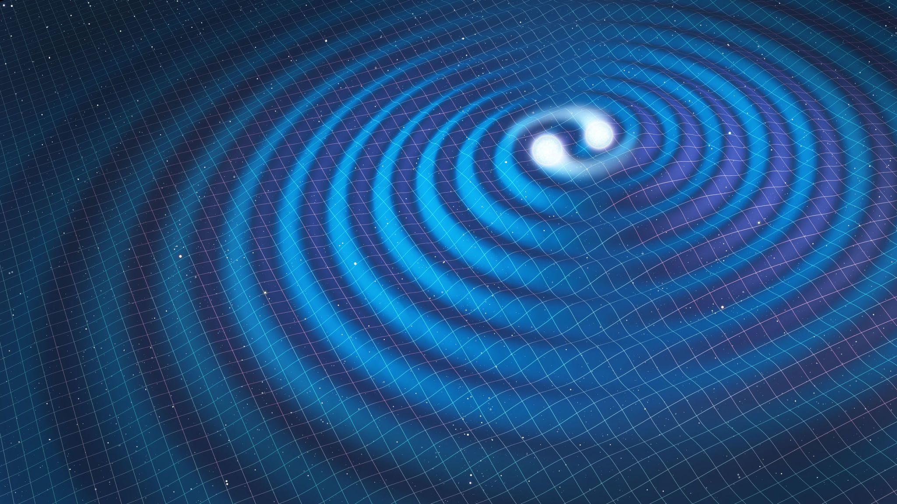
Summary
Black-holes in the pair-instability supernova gap & hierarchical formation channels
Environments
Black-hole recoil and final spin
Figuring out ancestors and environments: “backward method”
Figuring out ancestors and environments: “forward method” and environment selection
Conclusions

Slide 4
Pair-instability supernova gap and hierarchical black-hole mergers

Slide 5
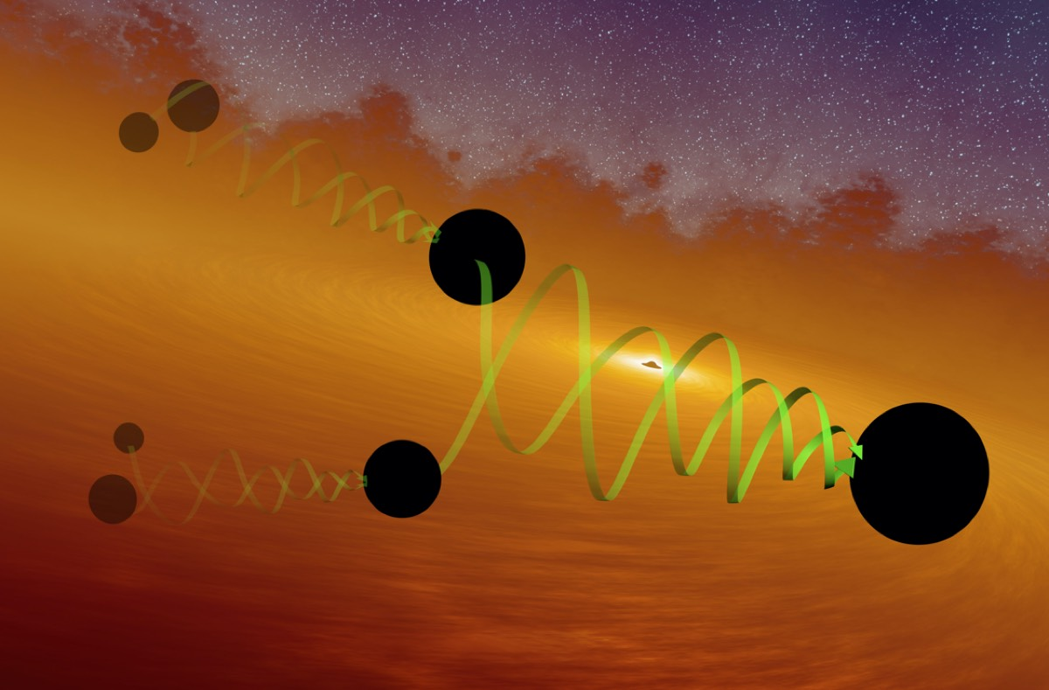


Black-hole recoil
  Up to 1000s km/s
(
(
(
(
(
(
JCB+’18 PRL, Varma+’22 PRL, JCB+’25 Nat.Astronomy.

Slide 6
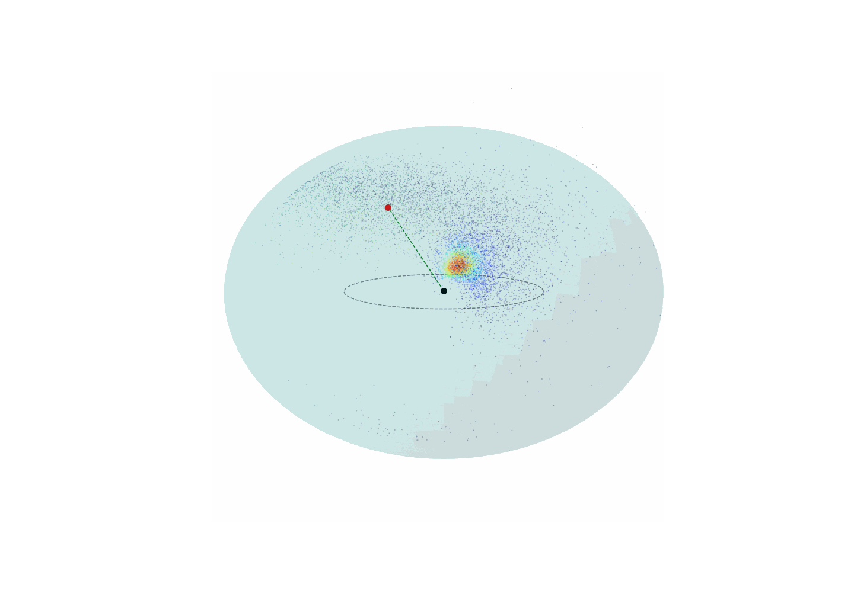
Black-hole recoil
GW190412
JCB, Leong & Chandra ’25 Nat.Astronomy.

Slide 7
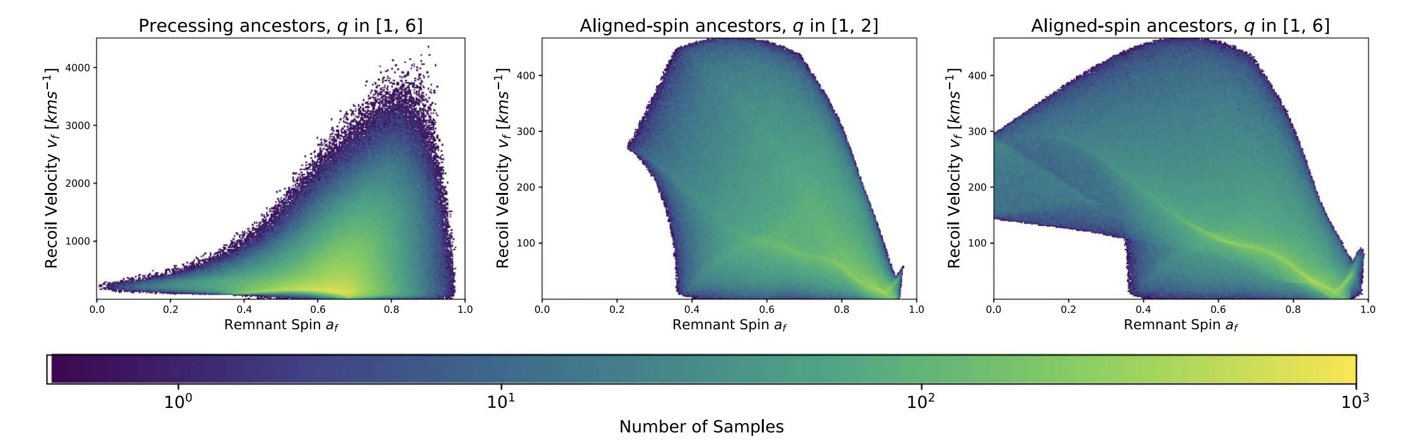
Black-hole recoil & implications for spin distributions
Tight relation between final kick and final spin
Can “infer” birth kick from final spin
Environment escape velocity determines the spin distribution of 2g black holes (See also Borchers+Fishbach ’25)

Slide 8
  Figuring out ancestors: “backwards method”
  Start from estimates for the putative “children”
Observed black-hole merger (LVK ’20 PRL)
  Key: respect the priors and posteriors for their parameter
GW190521
  They have ancestors
150Msun
  They “lived” in an environment
  Their “child” had to stay in the environment
85Msun
65Msun
Inference goes this way
  “Invert” relations between binary parameters and final mass, spin and kick
  Find ancestor properties and birth recoil
Araujo-Alvarez+ 2024 ApJ

Slide 9






  Figuring out ancestors: “backwards method”
  Start from estimates for the putative “children”
Observed black-hole merger (LVK ’20 PRL)
  Key: respect the priors and posteriors for their parameter
GW190521
  They have ancestors
150Msun
  They “lived” in an environment
  Their “child” had to stay in the environment
85Msun
65Msun
Inference goes this way
Kick > 1000km/s
Kick > 1000km/s
  “Invert” relations between binary parameters and final mass, spin and kick
  Find ancestor properties and birth recoil
Inferred Ancestors
Stellar-Born
Stellar-Born
Stellar-Born
Araujo-Alvarez+ 2024 ApJ
Araujo-Alvarez+ 2024 ApJ

Slide 10
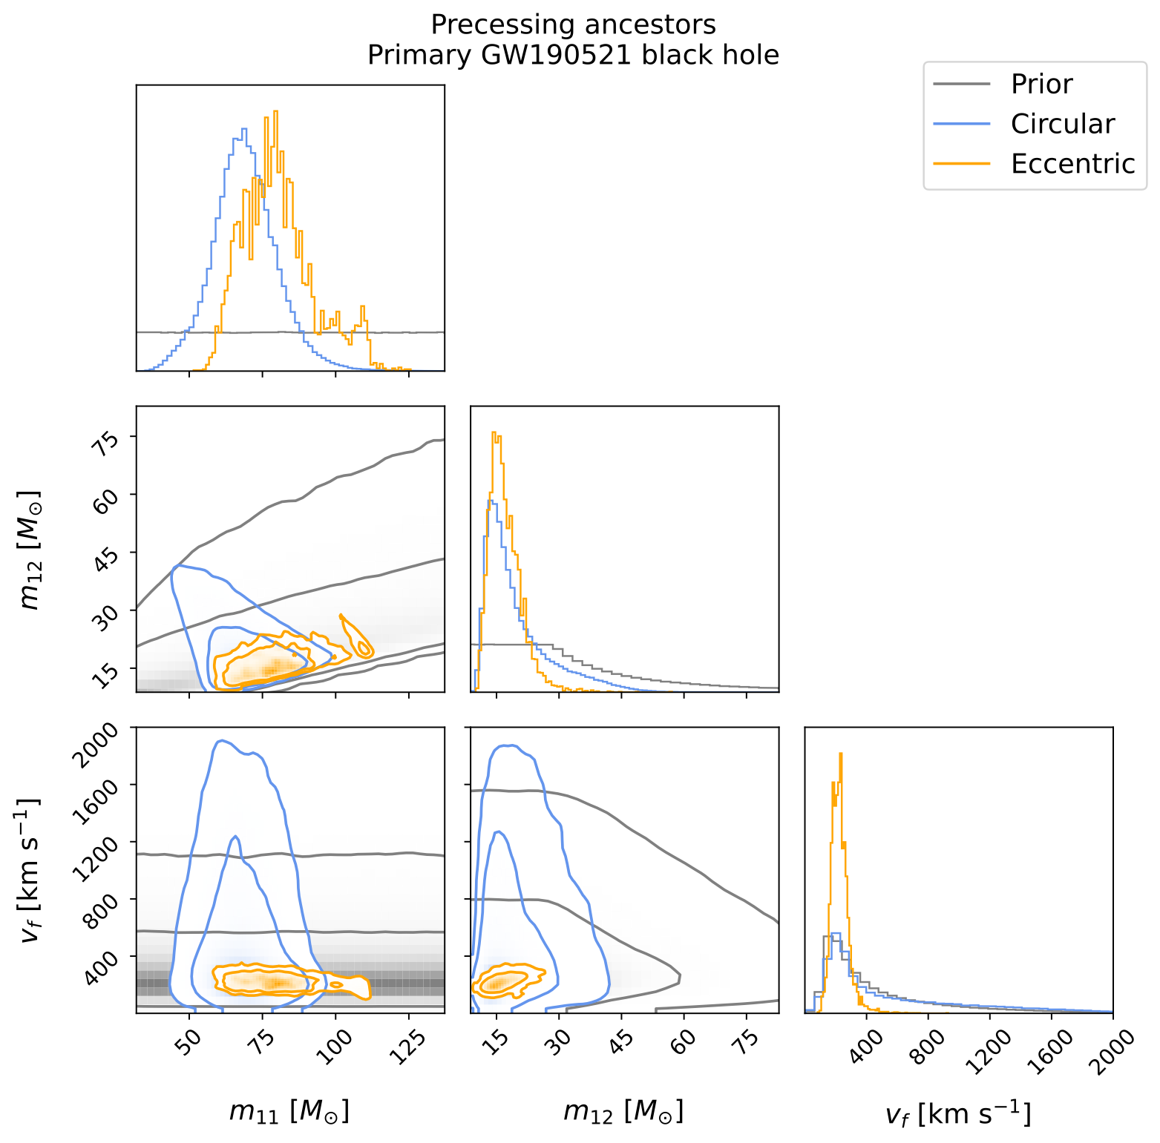
Figuring out “ancestors” and their environments: “backwards method”
Observed black-hole merger (LVK ’20 PRL)
GW190521
150Msun
85Msun
65Msun
Inference goes this way
Kick > 1000km/s
Kick > 1000km/s
Inferred Ancestors
Stellar-Born
Stellar-Born
Stellar-Born
Araujo-Alvarez+ 2024 ApJ

Slide 11
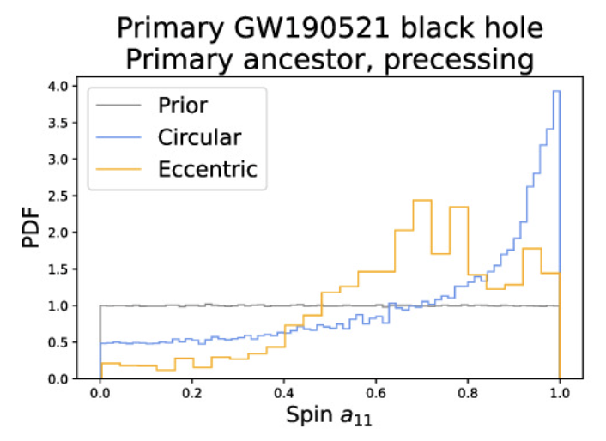
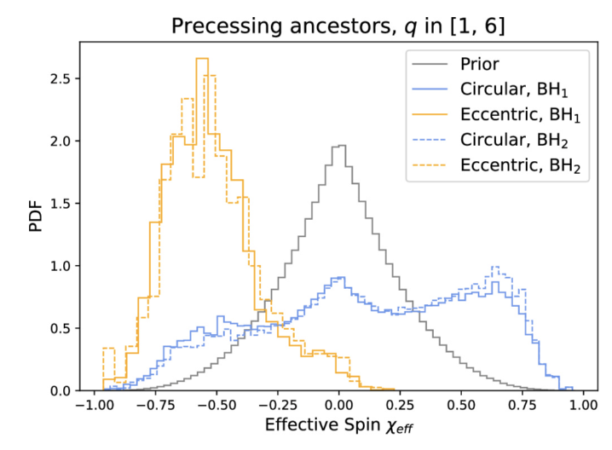
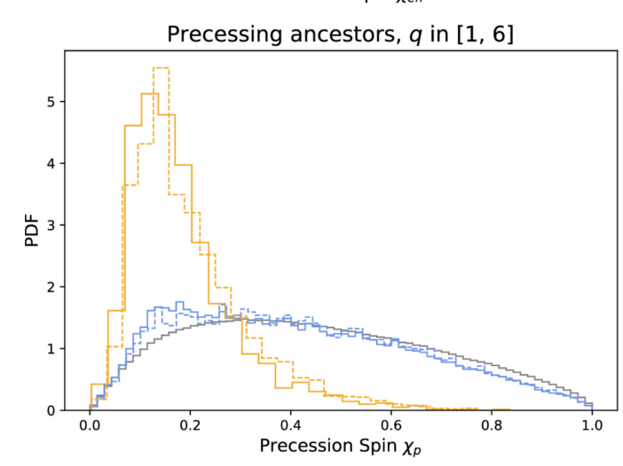
Figuring out “ancestors” and their environments: “backwards method”
Observed black-hole merger (LVK ’20 PRL)
GW190521
150Msun
85Msun
65Msun
Inference goes this way
Kick > 1000km/s
Kick > 1000km/s
Inferred Ancestors
Stellar-Born
Stellar-Born
Stellar-Born
Now used for O4 detections
Araujo-Alvarez+ 2024 ApJ

Slide 12
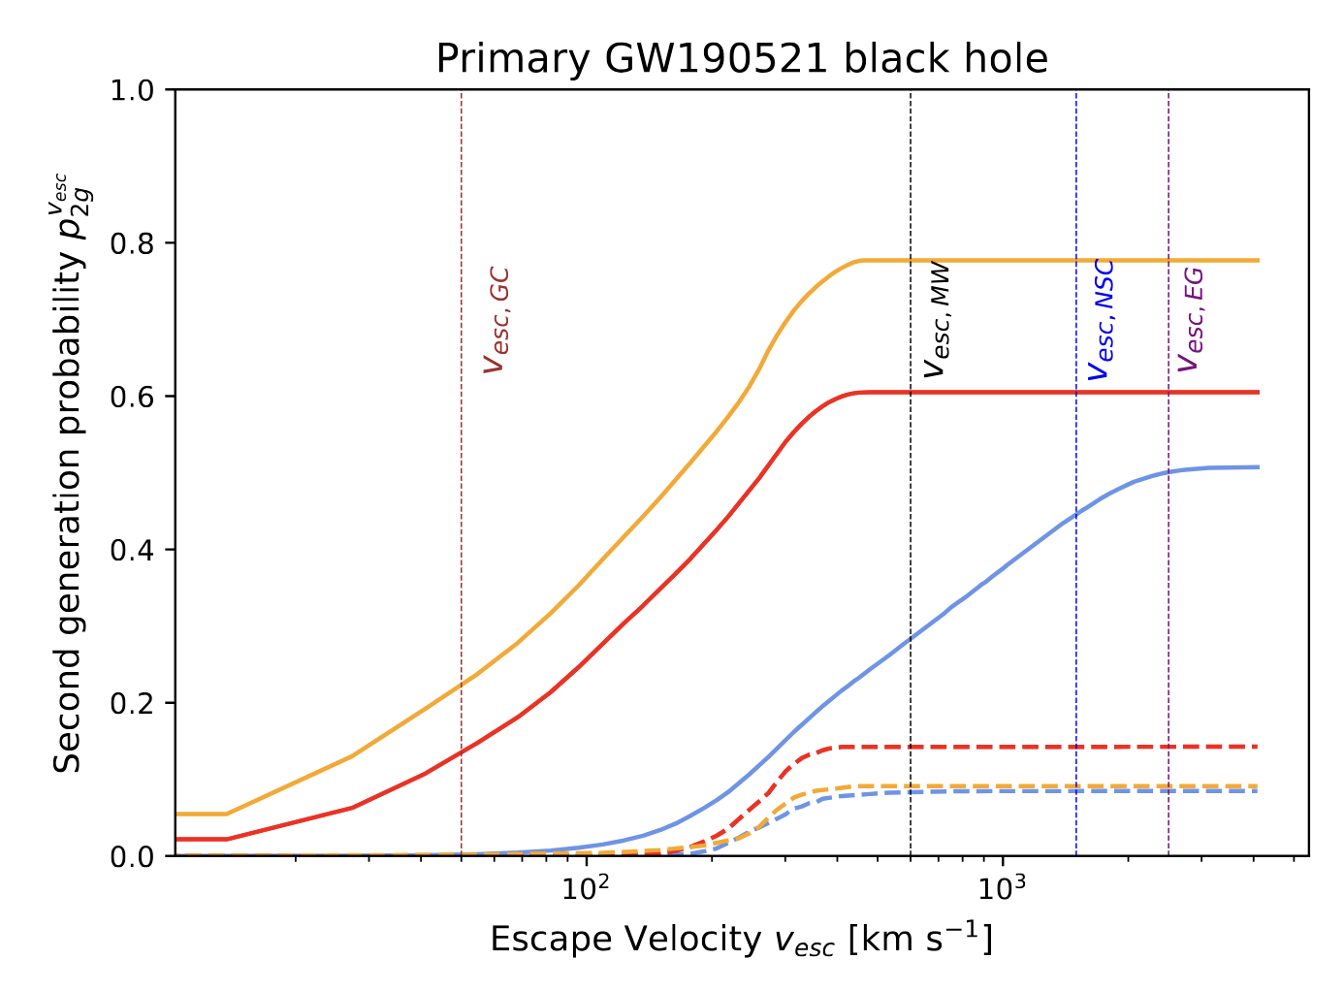
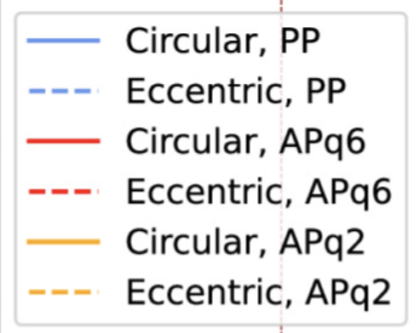
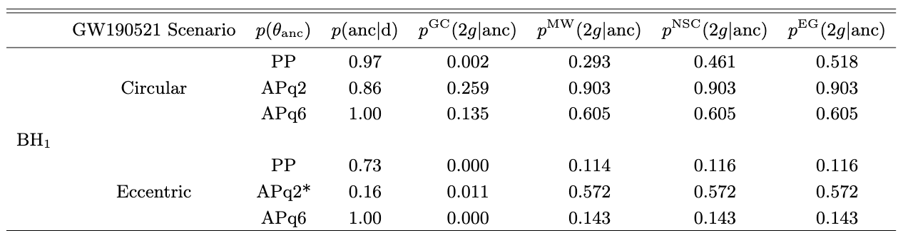
Birth Recoils and second-generation probabilities
Probability of both parents having masses < 65Msun and birth kick below escape velocity
Very tough to form the primary BH of GW190521 to form in a Globular Cluster
….. but wait for the next slides

Slide 13
  Figuring out ancestors: “forward method”
  Start from priors for the ancestors (parents, grandparents….)
  Compute the corresponding mass and spin priors induced on the
  BHs observed by LVK, for each v_esc
  “Obtain new” estimates for masses and spins
  Environment characeterised by escape velocity
  Read estimates for ancestral generations
Inference goes this way
  Not new: Mahapatra+ ’24.
  FOCUS here: obtain Bayesian Evidence!!
Inferred Ancestors
Now used for O4 detections
Wong & JCB (in prep)

Slide 14
  Figuring out ancestors: “forward method”
  Start from priors for the ancestors (parents, grandparents….)
  Compute the corresponding mass and spin priors induced on the
  BHs observed by LVK, for each v_esc
Observed black-hole merger (LVK ’20 PRL)
GW190521
  “Obtain new” estimates for masses and spins
  Environment characeterised by escape velocity
  Read estimates for ancestral generations
Inference goes this way
  Not new: Mahapatra+ ’24.
  FOCUS here: obtain Bayesian Evidence!!
Inferred Ancestors
Now used for O4 detections
Wong & JCB (in prep)

Slide 15
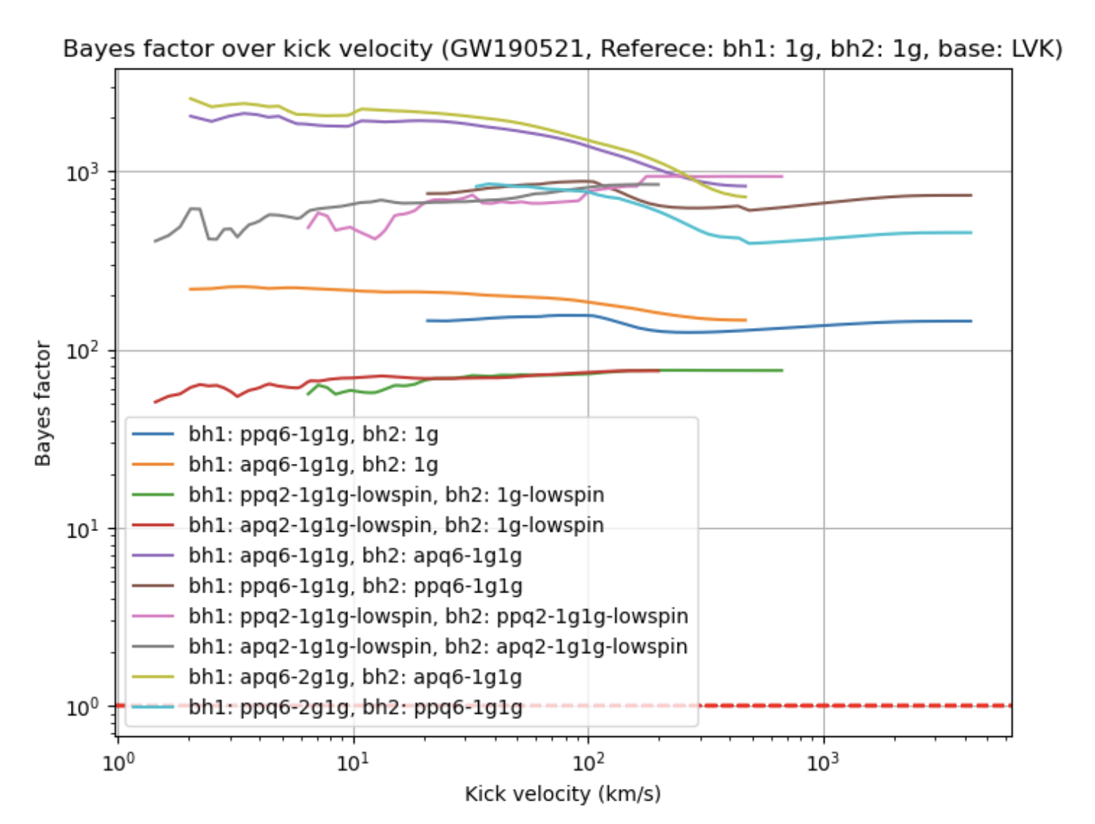
Indirect selection of host environments
  Environment characeterised by escape velocity
  Elliptical Galaxy
  AGN
  Globular cluster
  Globular Cluster is most favoured!
  Reason:
  GW190521 spins peak near 1
  Easier to form with large mass ratio ancestors
  These have low kicks
  Precisely what can be retained in a GC!
  Evidence as a function of host escape velocity for different “generations”
Wong & JCB (in prep)

Slide 16


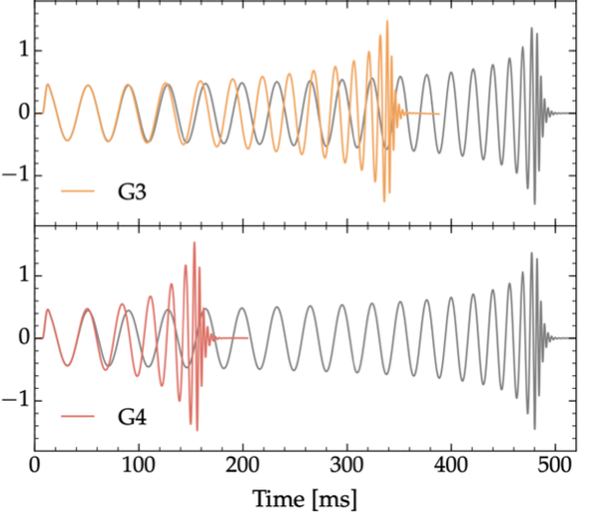
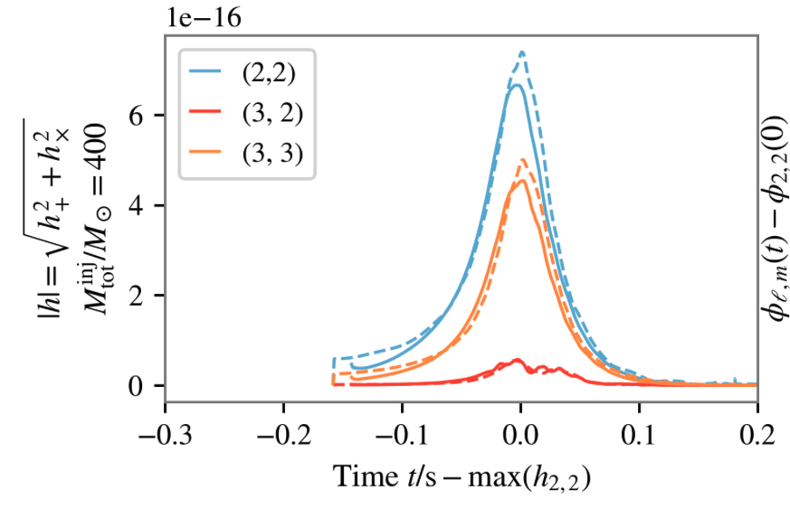
Direct selection of host environments
Vacuum Evolution
Environment impacts waveform morphology
Given quasi-normal mode
structure
Mass accretion —> alter signal frequency + “increased” final mass
Altered dynamics —> Altered ringdown mode structure
(Leong, JCB + ’23 PRD)
Initial BBH
with Scalar field
First searches for these effects in LVK data: effects too subtle to be detected (Caneva-Santoro+ PRL)
Different quasi-normal mode
structure
Fedrow+ PRL
Leong+ PRD

Slide 17
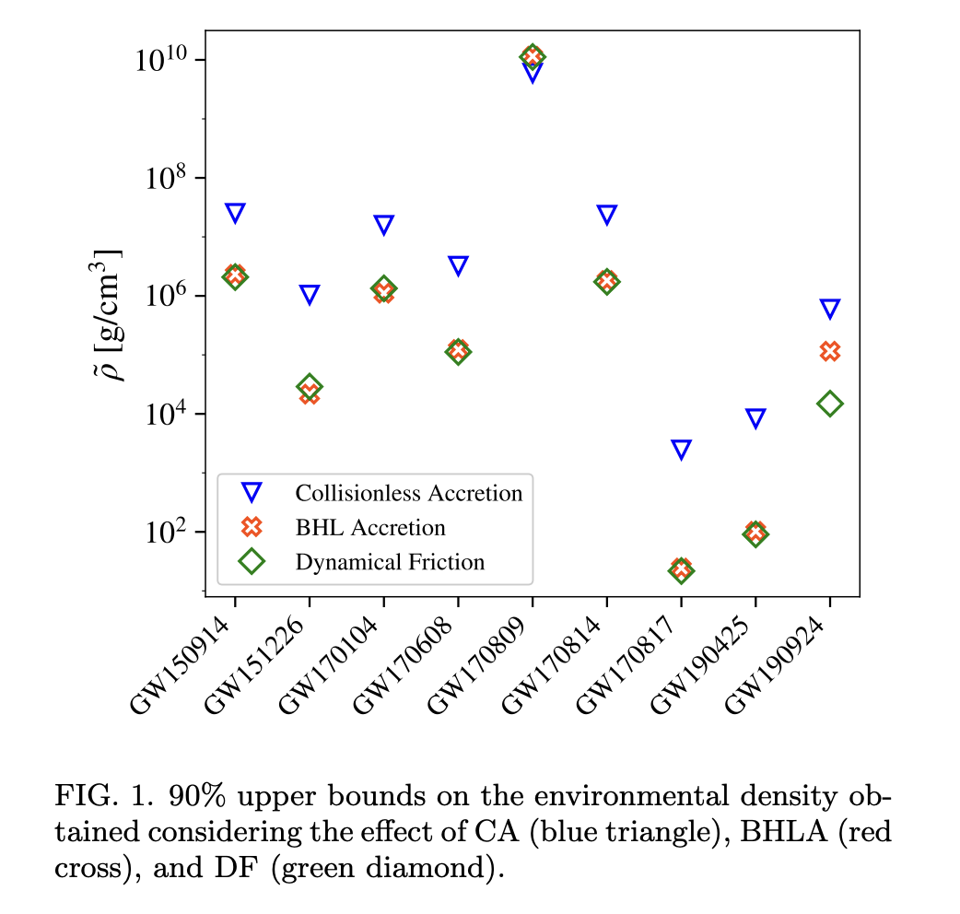
Direct selection of host environments
Vacuum Evolution
Environment impacts waveform morphology
Given quasi-normal mode
structure
Mass accretion —> alter signal frequency + “increased” final mass
Altered dynamics —> Altered ringdown mode structure
(Leong, JCB + ’23 PRD)
Initial BBH
with Scalar field
Different quasi-normal mode
structure
Caneva-Santoro+ PRL
First searches for these effects in LVK data: effects too subtle to be detected (Caneva-Santoro+ PRL)

Slide 18
Conclusions
Hierarchical channels are likely contributors to the observed BH population
Bayesian framework to estimate putative ancestors and constrain host environments
GW190521:
Globular cluster origin very slightly preferred
2g + 1g black-hole merger
Combining GW190521, GW200220 and GW190426:
No clear evidence for a fraction of events coming from globular cluster
Limitations:
Final parameter fits limited to quasi-circular mergers
Very naive priors on the mass and spins of the first generation black holes

