Slide 1

Molecular Dynamics simulations of NS crust breaking strain, and continuous GW.
D. Barba-González, C. Albertus & M.A. Pérez-García
Department of Fundamental Physics, University of Salamanca
Iberian GW Meeting, CIEMAT. 25th June 2025

Slide 2
Outline of the talk
Introduction: Neutron Stars.
Continuous gravitational waves from isolated Neutron Stars. Role of the crust.
Molecular Dynamics simulations. Stress and strain.
Results: breaking strain of the ionic crust.
Current work: elastic constants of the crust.
Conclusions.

Slide 3
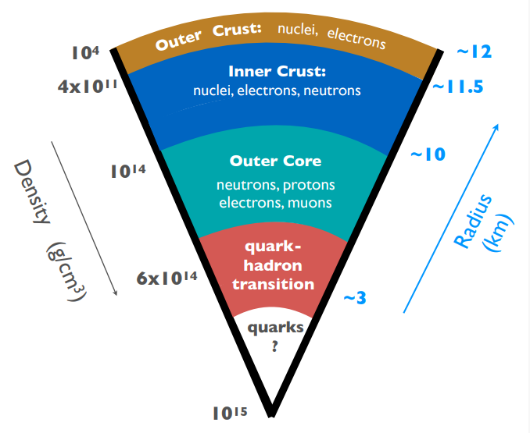
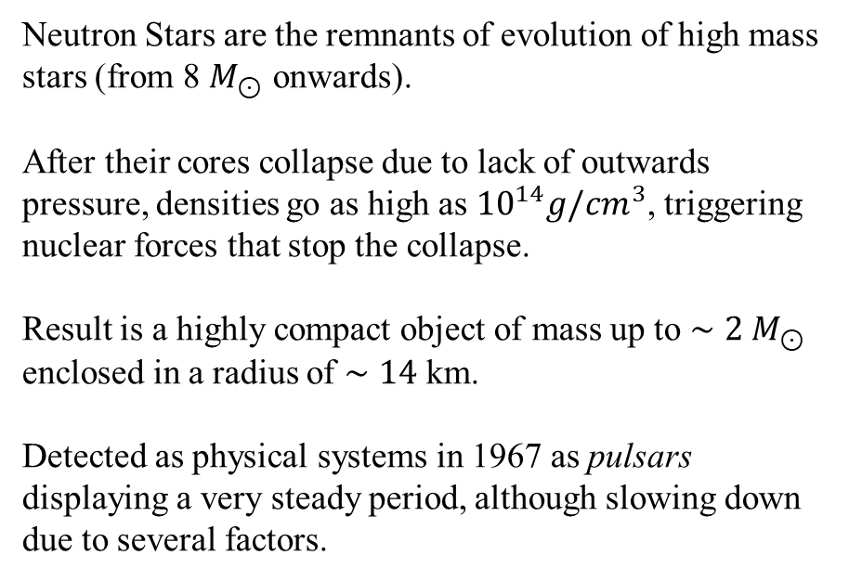
Neutron Stars in a nutshell
Neutron Stars are the remnants of evolution of high mass stars (from 8 $M_{⊙}$ onwards).
After their cores collapse due to lack of outwards pressure, densities go as high as ${10}^{14}g/cm^{3}$, triggering nuclear forces that stop the collapse.
Result is a highly compact object of mass up to $∼2 M_{⊙}$ enclosed in a radius of $∼14$ km.
Detected as physical systems in 1967 as pulsars displaying a very steady period, although slowing down due to several factors.
Credit: 3G Science White Paper
1/11

Slide 4
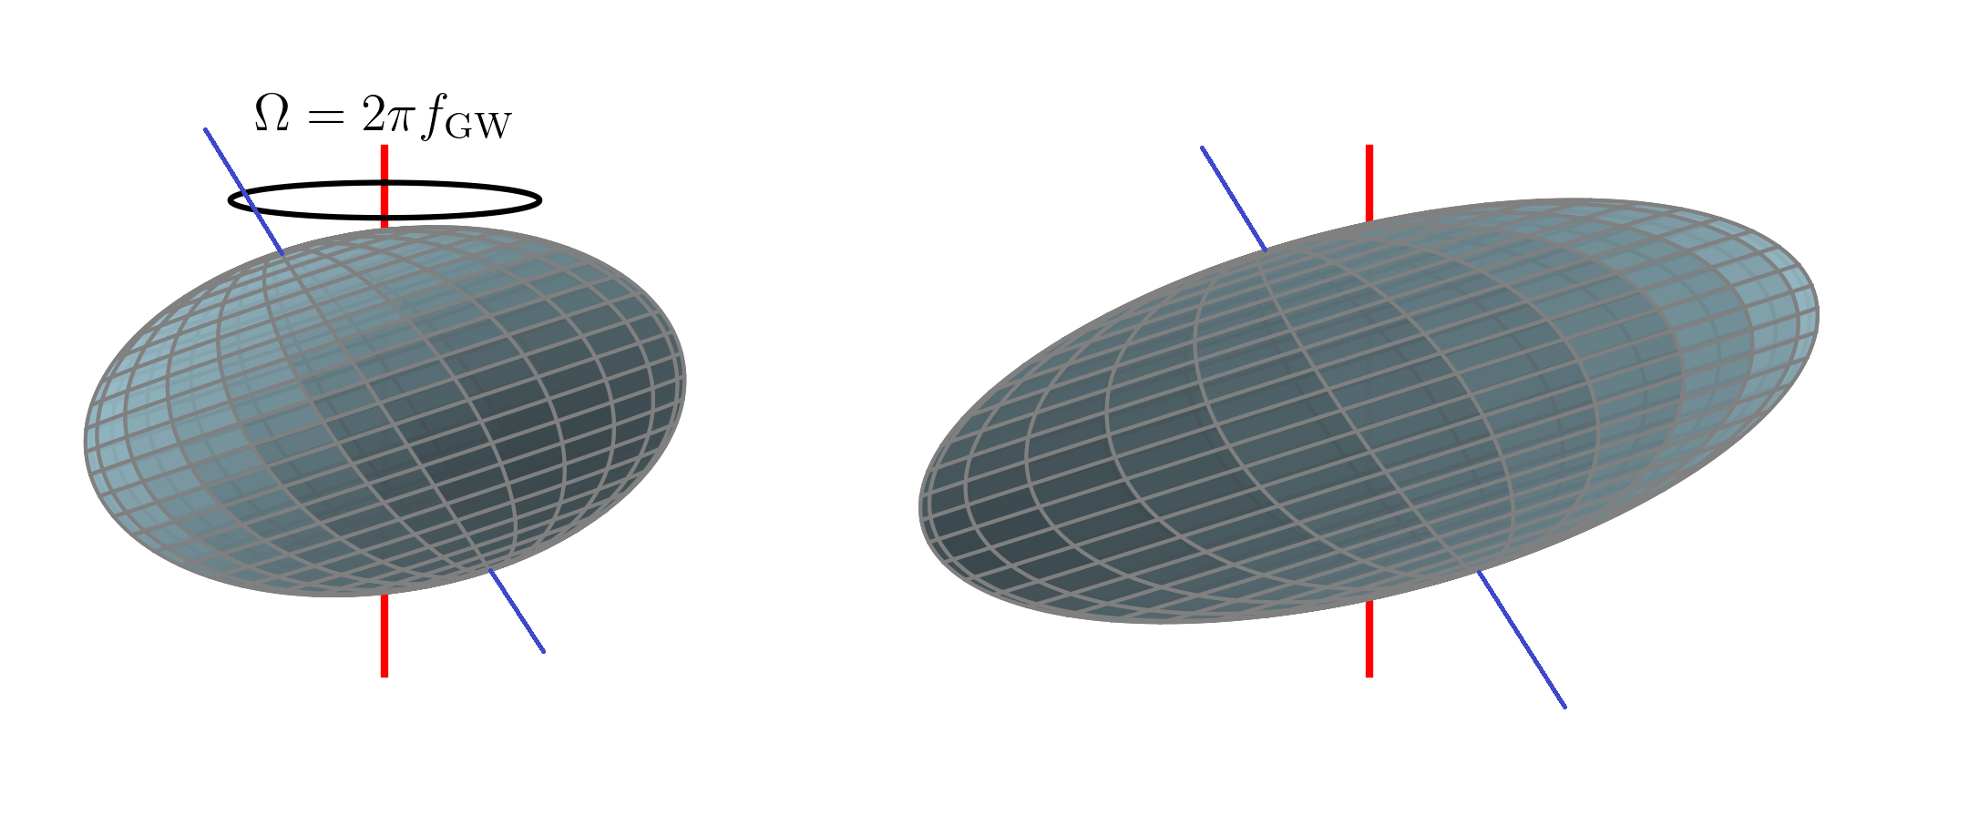
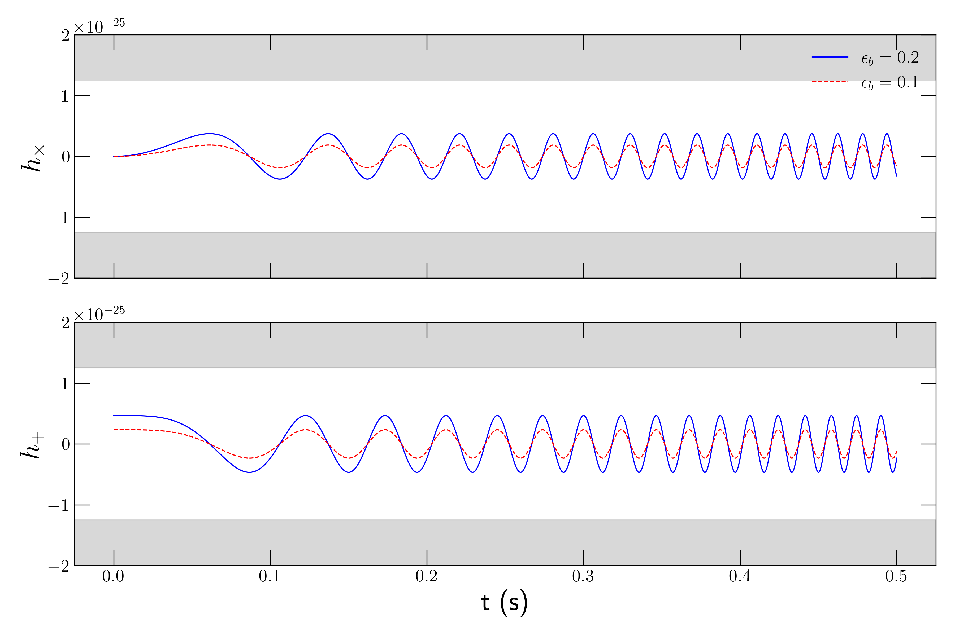

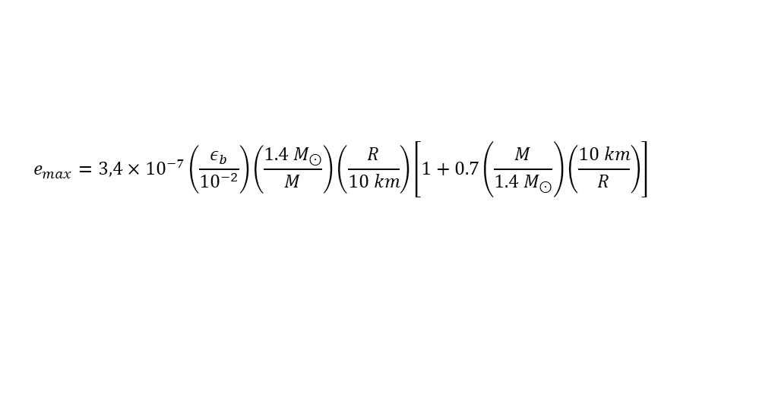

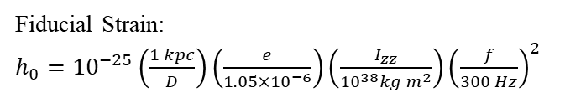
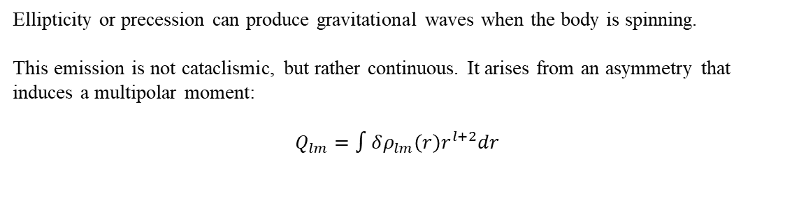
Motivation: NS mountains and Continuous gravitational waves.
Ushomirsky et al. 2000
Ellipticity or precession can produce gravitational waves when the body is spinning.
This emission is not cataclismic, but rather continuous. It arises from an asymmetry that induces a multipolar moment:
$$Q_{lm}=∫δρ_{lm}\left(r\right)r^{l+2}dr$$
A deformation (“mountain”) can produce this asymmetry, but the size of the mountain is constrained by how resistant is the crust.
If the lattice in the crust breaks, it is expected that the mountain would not be sustained.
$$e=\frac{I_{xx}−I_{yy}}{I_{zz}}$$
Ellipticity:
Sieniawska & Bejger 2019
Fiducial Strain:
$h_{0}={10}^{−25}\left(\frac{1 kpc}{D}\right)\left(\frac{e}{1.05×{10}^{−6}}\right)\left(\frac{I_{zz}}{{10}^{38}kg m^{2}}\right){\left(\frac{f}{300 Hz}\right)}^{2}$
Maximum ellipticity
$$e_{max}=3,4×{10}^{−7}\left.\left(\frac{ε_{b}}{{10}^{−2}}\right.\right)\left.\left(\frac{1.4 M_{⊙}}{M}\right.\right)\left.\left(\frac{R}{10 km}\right.\right)\left.\left[1+0.7\left.\left(\frac{M}{1.4 M_{⊙}}\right.\right)\left(\frac{10 km}{R}\right)\right.\right]$$
$ε_{b}$ is the breaking strain.
2/11

Slide 5
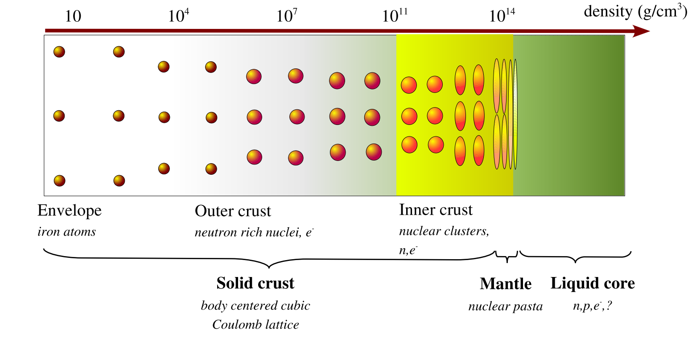
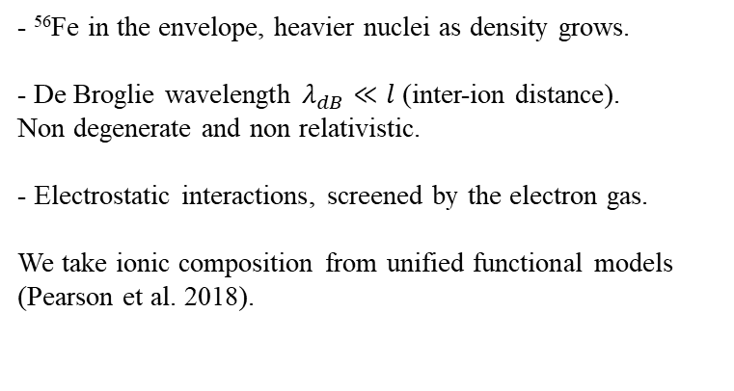
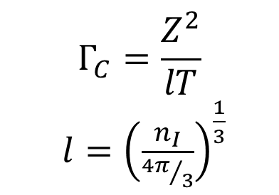
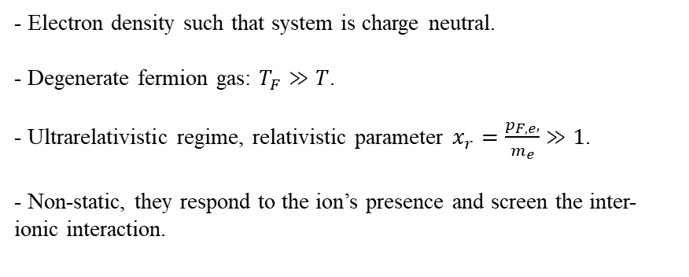
Neutron Star outer crust. Ionic plasmas.
Coulomb plasma parameter
$$Γ_{C}=\frac{Z^{2}}{lT}$$
$l={\left(\frac{n_{I}}{{4π}/3}\right)}^{\frac{1}{3}}$
Chamel & Haensel 2007
Ions
Electrons
- ⁵⁶Fe in the envelope, heavier nuclei as density grows.
- De Broglie wavelength $λ_{dB}≪l$ (inter-ion distance).
Non degenerate and non relativistic.
- Electrostatic interactions, screened by the electron gas.
We take ionic composition from unified functional models (Pearson et al. 2018).
- Electron density such that system is charge neutral.
- Degenerate fermion gas: $T_{F}≫T$.
- Ultrarelativistic regime, relativistic parameter $x_{r}=\frac{p_{F,e},}{m_{e}}≫1$.
- Non-static, they respond to the ion’s presence and screen the inter-ionic interaction.
3/11

Slide 6

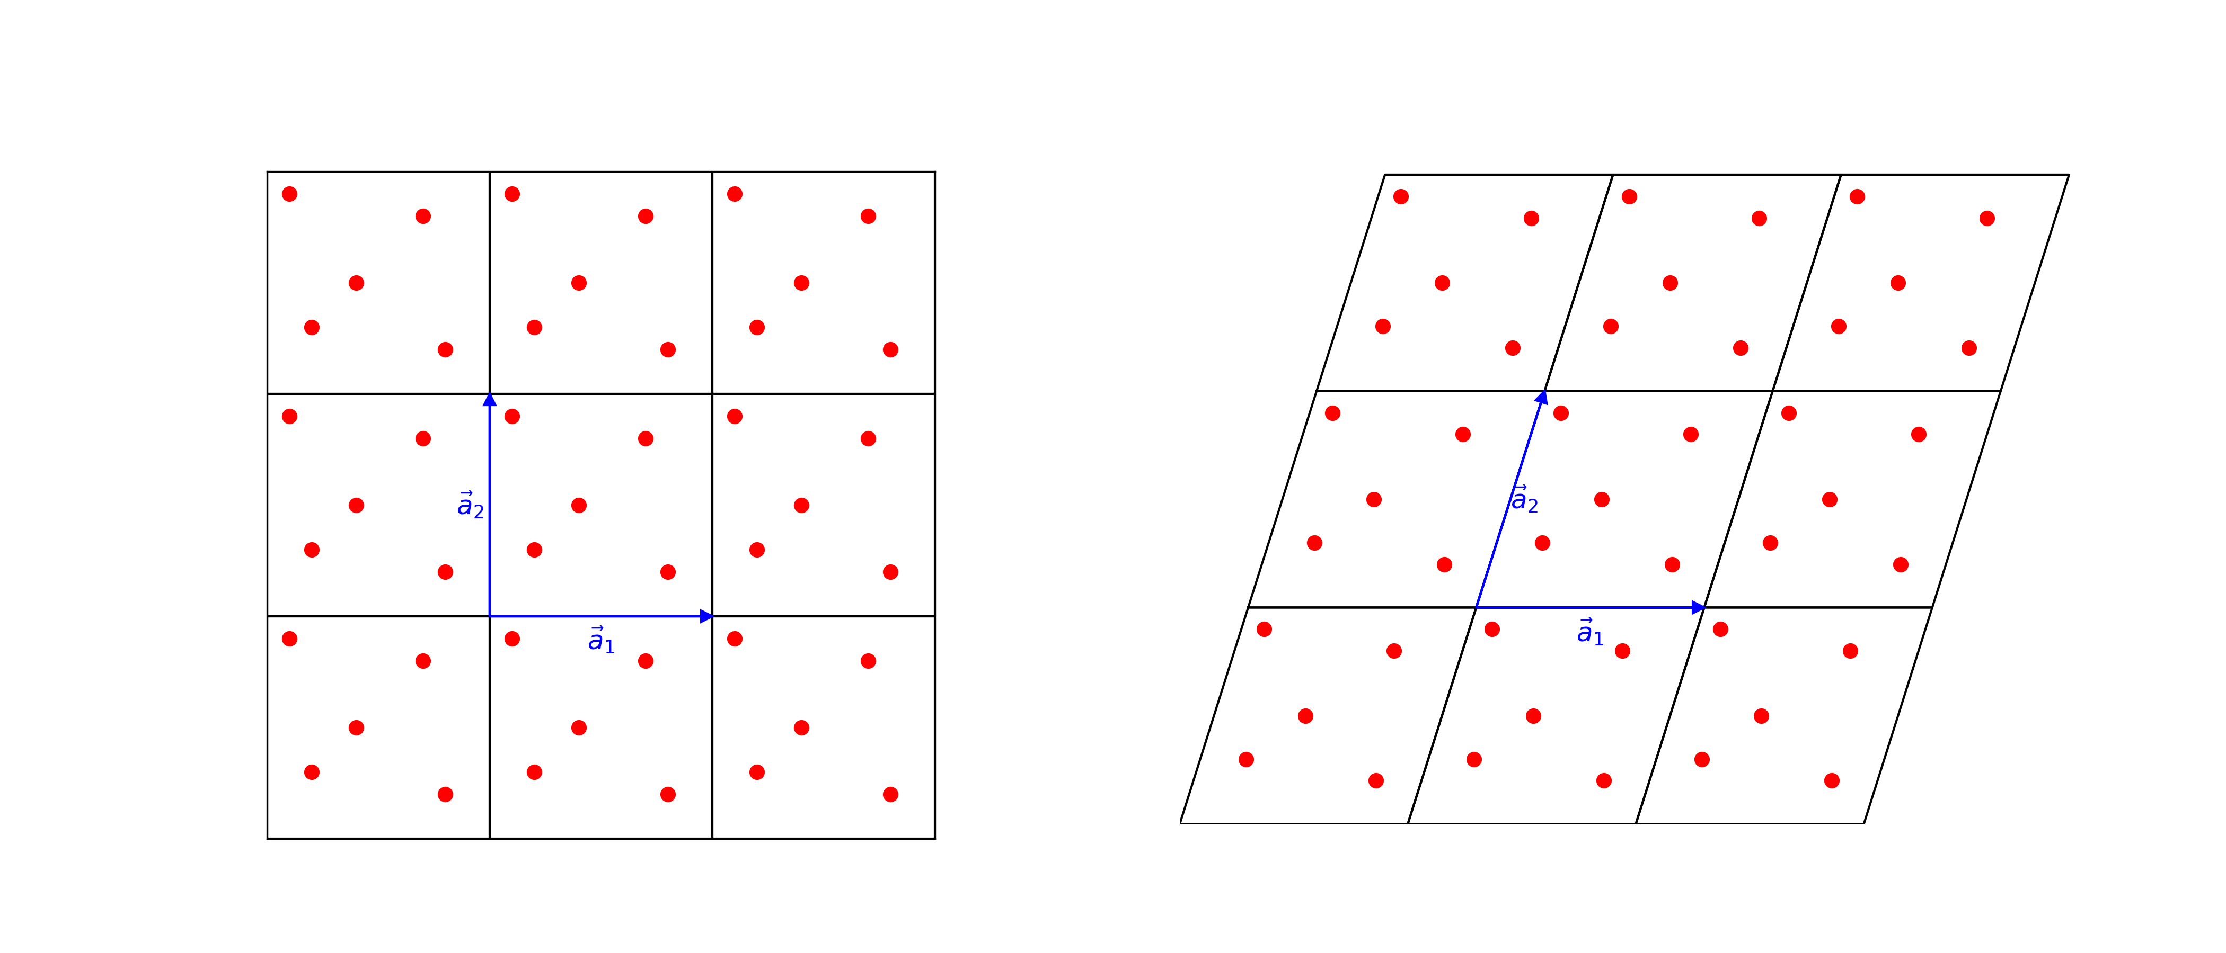
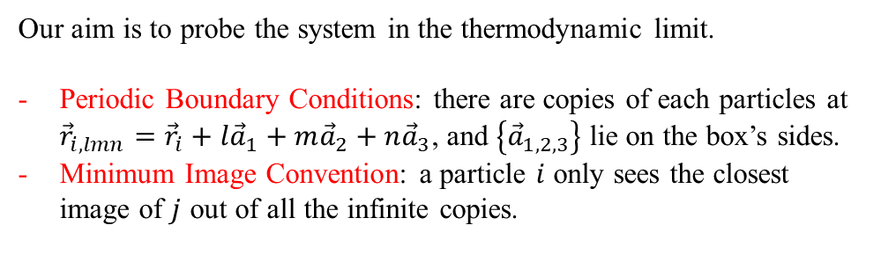
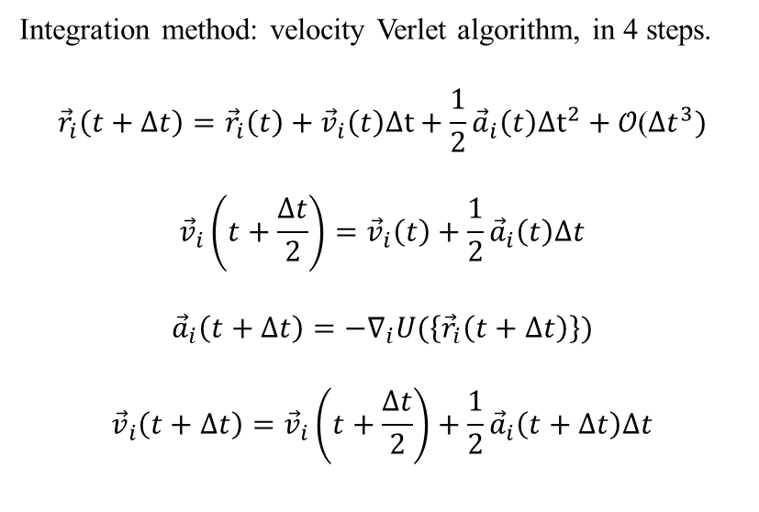
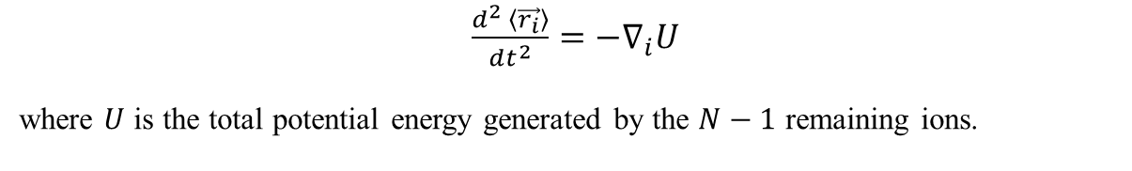
Molecular Dynamics in the NS outer crust.
Molecular Dynamics (MD) is a technique that computationally integrates the equations of motion of a set of N interacting particles.
$\frac{d^{2} \left\langle \vec{r_{i}}\right\rangle }{dt^{2}}=−∇_{i}U$
where $U$ is the total potential energy generated by the $N−1$ remaining ions.
MareNostrum5 @ BSC
Integration method: velocity Verlet algorithm, in 4 steps.
$${\vec{r}}_{i}\left(t+Δt\right)={\vec{r}}_{i}\left(t\right)+{\vec{v}}_{i}\left(t\right)Δt+\frac{1}{2}{\vec{a}}_{i}\left(t\right)Δt^{2}+\text{𝒪}\text{(}Δt^{3})$$
$${\vec{v}}_{i}\left(t+\frac{Δt}{2}\right)={\vec{v}}_{i}\left(t\right)+\frac{1}{2}{\vec{a}}_{i}\left(t\right)Δt$$
$${\vec{a}}_{i}\left(t+Δt\right)=−∇_{i}U(\left\{{\vec{r}}_{i}\left(t+Δt\right)\right\})$$
$${\vec{v}}_{i}\left(t+Δt\right)={\vec{v}}_{i}\left(t+\frac{Δt}{2}\right)+\frac{1}{2}{\vec{a}}_{i}\left(t+Δt\right)Δt$$
Our aim is to probe the system in the thermodynamic limit.
Periodic Boundary Conditions: there are copies of each particles at ${\vec{r}}_{i,lmn}={\vec{r}}_{i}+l{\vec{a}}_{1}+m{\vec{a}}_{2}+n{\vec{a}}_{3}$, and $\left\{{\vec{a}}_{1,2,3}\right\}$ lie on the box’s sides.
Minimum Image Convention: a particle $i$ only sees the closest image of $j$ out of all the infinite copies.
See Allen & Tildesley 2017
4/11

Slide 7


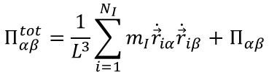
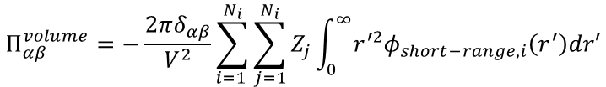

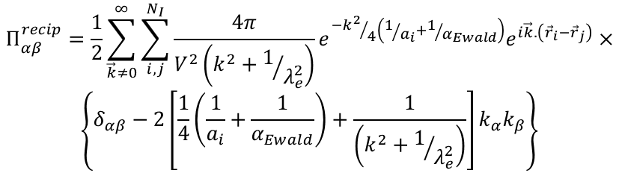
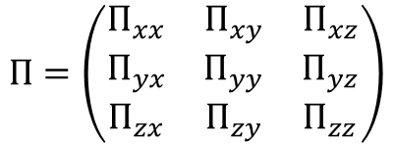
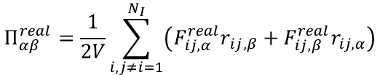

Molecular Dynamics in the NS outer crust.
$$Π_{αβ}^{tot}=\frac{1}{L^{3}}\sum_{i=1}^{N_{I}}{m_{I}{\dot{\vec{r}}}_{iα}{\dot{\vec{r}}}_{iβ}}+Π_{αβ}$$
$$Π_{αβ}=Π_{αβ}^{real}+Π_{αβ}^{recip}+Π_{αβ}^{volume}$$
Stress tensor (spacial 3x3 part of $T_{μν}$):
$$Π_{αβ}^{real}=\frac{1}{2V}\sum_{i,j≠i=1}^{N_{I}}{\left(F_{ij,α}^{real}r_{ij,β}+F_{ij,β}^{real}r_{ij,α}\right)}$$
$$Π=\left(\begin{matrix}Π_{xx} & Π_{xy} & Π_{xz} \\ Π_{yx} & Π_{yy} & Π_{yz} \\ Π_{zx} & Π_{zy} & Π_{zz}\end{matrix}\right)$$
Extraction of physical quantities must be done only after the system has been carried to equilibrium, and averaging over time steps.
We perform equilibration by rescaling the particles’ velocities during the 2nd step of velocity Verlet algorithm.
$$Π_{αβ}^{recip}=\frac{1}{2}\sum_{\vec{k}≠0}^{∞}{\sum_{i,j}^{N_{I}}{\frac{4π}{V^{2}\left(k^{2}+1/{λ_{e}^{2}}\right)}e^{{−k^{2}}/4\left(1/{a_{i}}+1/{α_{Ewald}}\right)}e^{i\vec{k}.\left({\vec{r}}_{i}−{\vec{r}}_{j}\right)}×}}$$
$$\left\{δ_{αβ}−2\left[\frac{1}{4}\left(\frac{1}{a_{i}}+\frac{1}{α_{Ewald}}\right)+\frac{1}{\left(k^{2}+1/{λ_{e}^{2}}\right)}\right]k_{α}k_{β}\right\}$$
$$Π_{αβ}^{volume}=−\frac{2πδ_{αβ}}{V^{2}}\sum_{i=1 }^{N_{i}}{\sum_{j=1}^{N_{i}}{Z_{j}\int_{0}^{∞}{r^{′2}φ_{short−range,i}\left(r^{′}\right)dr′}}}$$
Barba-González, Albertus and Pérez-García, PRC (2022) arXiv:2207.14323
Equation of State
Barba-González, Albertus and Pérez-García, MNRAS 528, 3498-3508 (2024).
arXiv:2312.16252
$$P=\frac{1}{3}Tr\left(Π\right)=P(u)$$
, $u≡$energy density
5/11

Slide 8
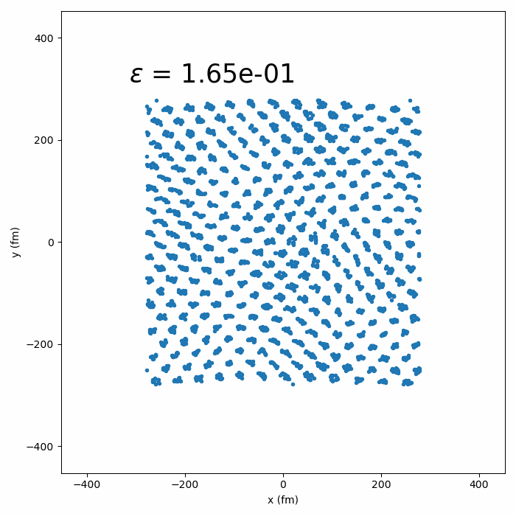

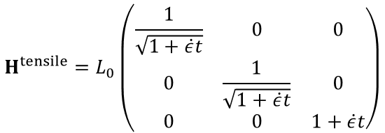
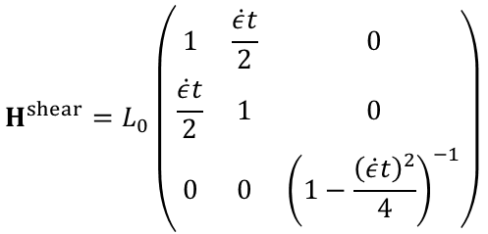


Calculating the breaking strain using MD simulations.
Deformations included in ${USAL}_{MDGE}$ via the so-called deformation matrix.
H$=[{\vec{a}}_{1},{\vec{a}}_{2}, {\vec{a}}_{3}]$
They enter the code in three ways:
Periodic Boundary Conditions
Minimum Image Convention
Ewald summation.
$$\vec{k}=2π{\left(H^{−1}\right)}^{T} (n_{x},n_{y},n_{z})$$
We consider two deformation matrices
$$\left.{H^{tensile}=L}_{0}\left(\begin{matrix}\frac{1}{\sqrt{1+\dot{ε}t}} & 0 & 0 \\ 0 & \frac{1}{\sqrt{1+\dot{ε}t}} & 0 \\ 0 & 0 & 1+\dot{ε}t\end{matrix}\right.\right)$$
Tensile deformation stretching the box in the z direction and compressing in the x and y directions.
$$\left.{H^{shear}=L}_{0}\left(\begin{matrix}1 & \frac{\dot{ε}t}{2} & 0 \\ \frac{\dot{ε}t}{2} & 1 & 0 \\ 0 & 0 & {\left(1−\frac{{\left(\dot{ε}t\right)}^{2}}{4}\right)}^{−1}\end{matrix}\right.\right)$$
Shear deformation
$\dot{ε}$ is the strain rate, deformation in relative units.
6/11

Slide 9
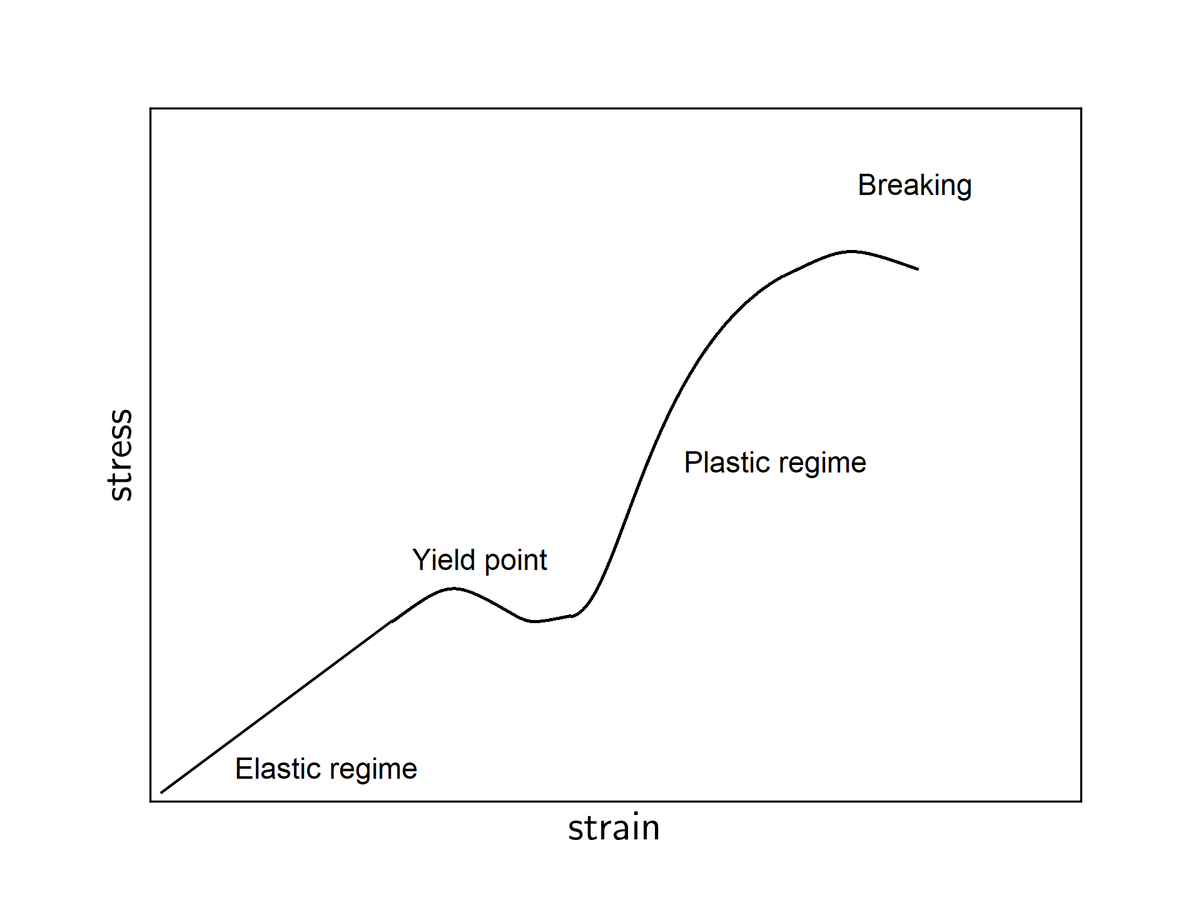
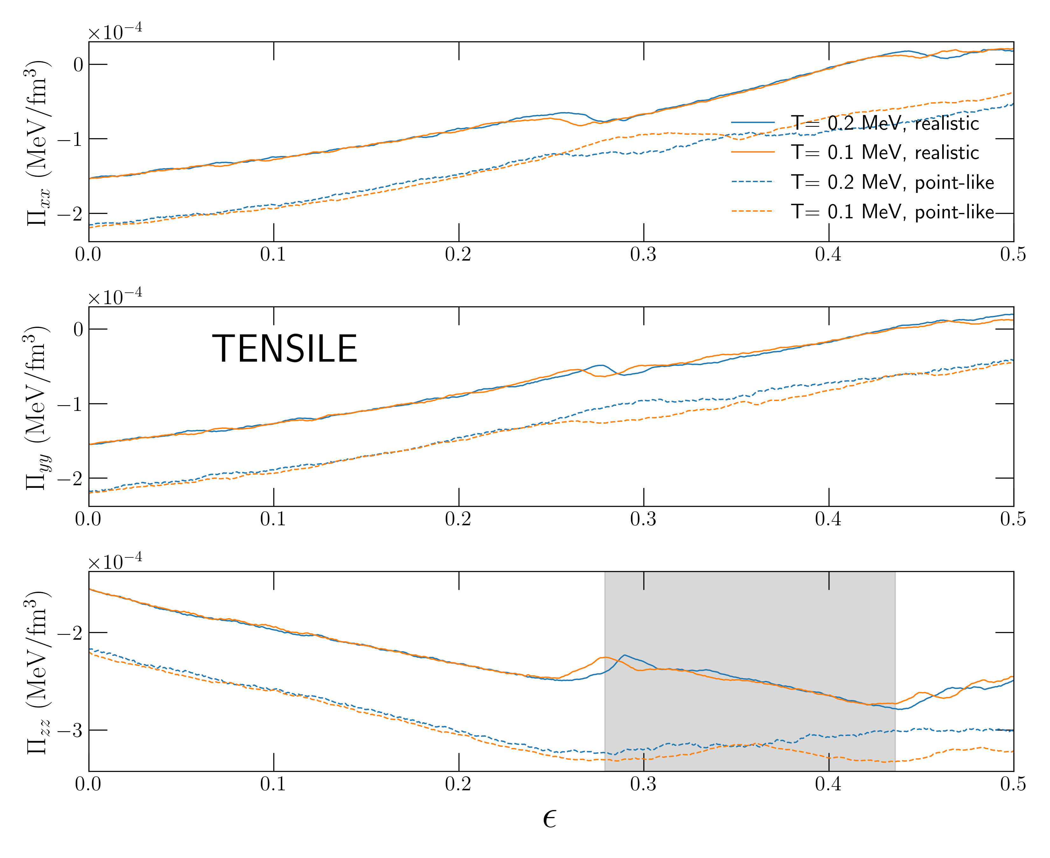
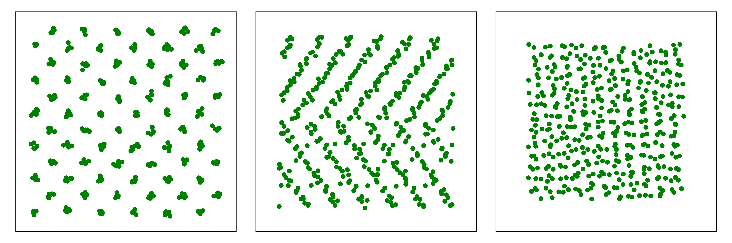

Breaking strain: results and interpretation.
Elastic regime means the deformation is still reversible.
$$Π_{αβ}=C_{αβμν}ε_{μν}$$
Linear stress-strain relation.
In realistic simulations the following sequence appears:
Elastic regime → Departure from linear behavior → Amorphous pase → Dissolution to liquid
As strain grows, the system first yields and then breaks. Depending on ion size these occur simultaneously or with delay.
7/11

Slide 10
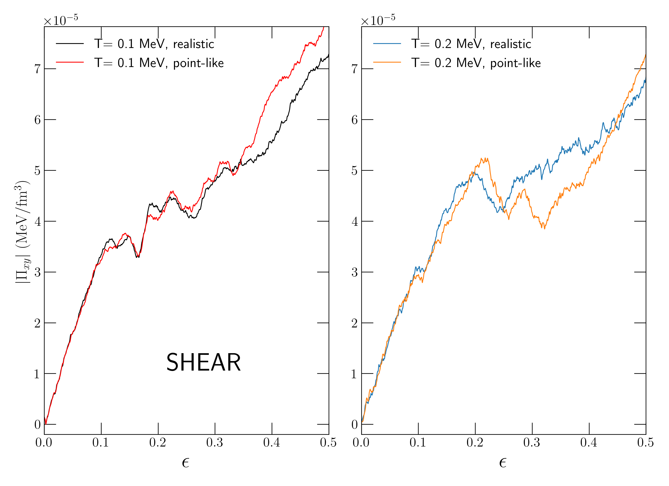
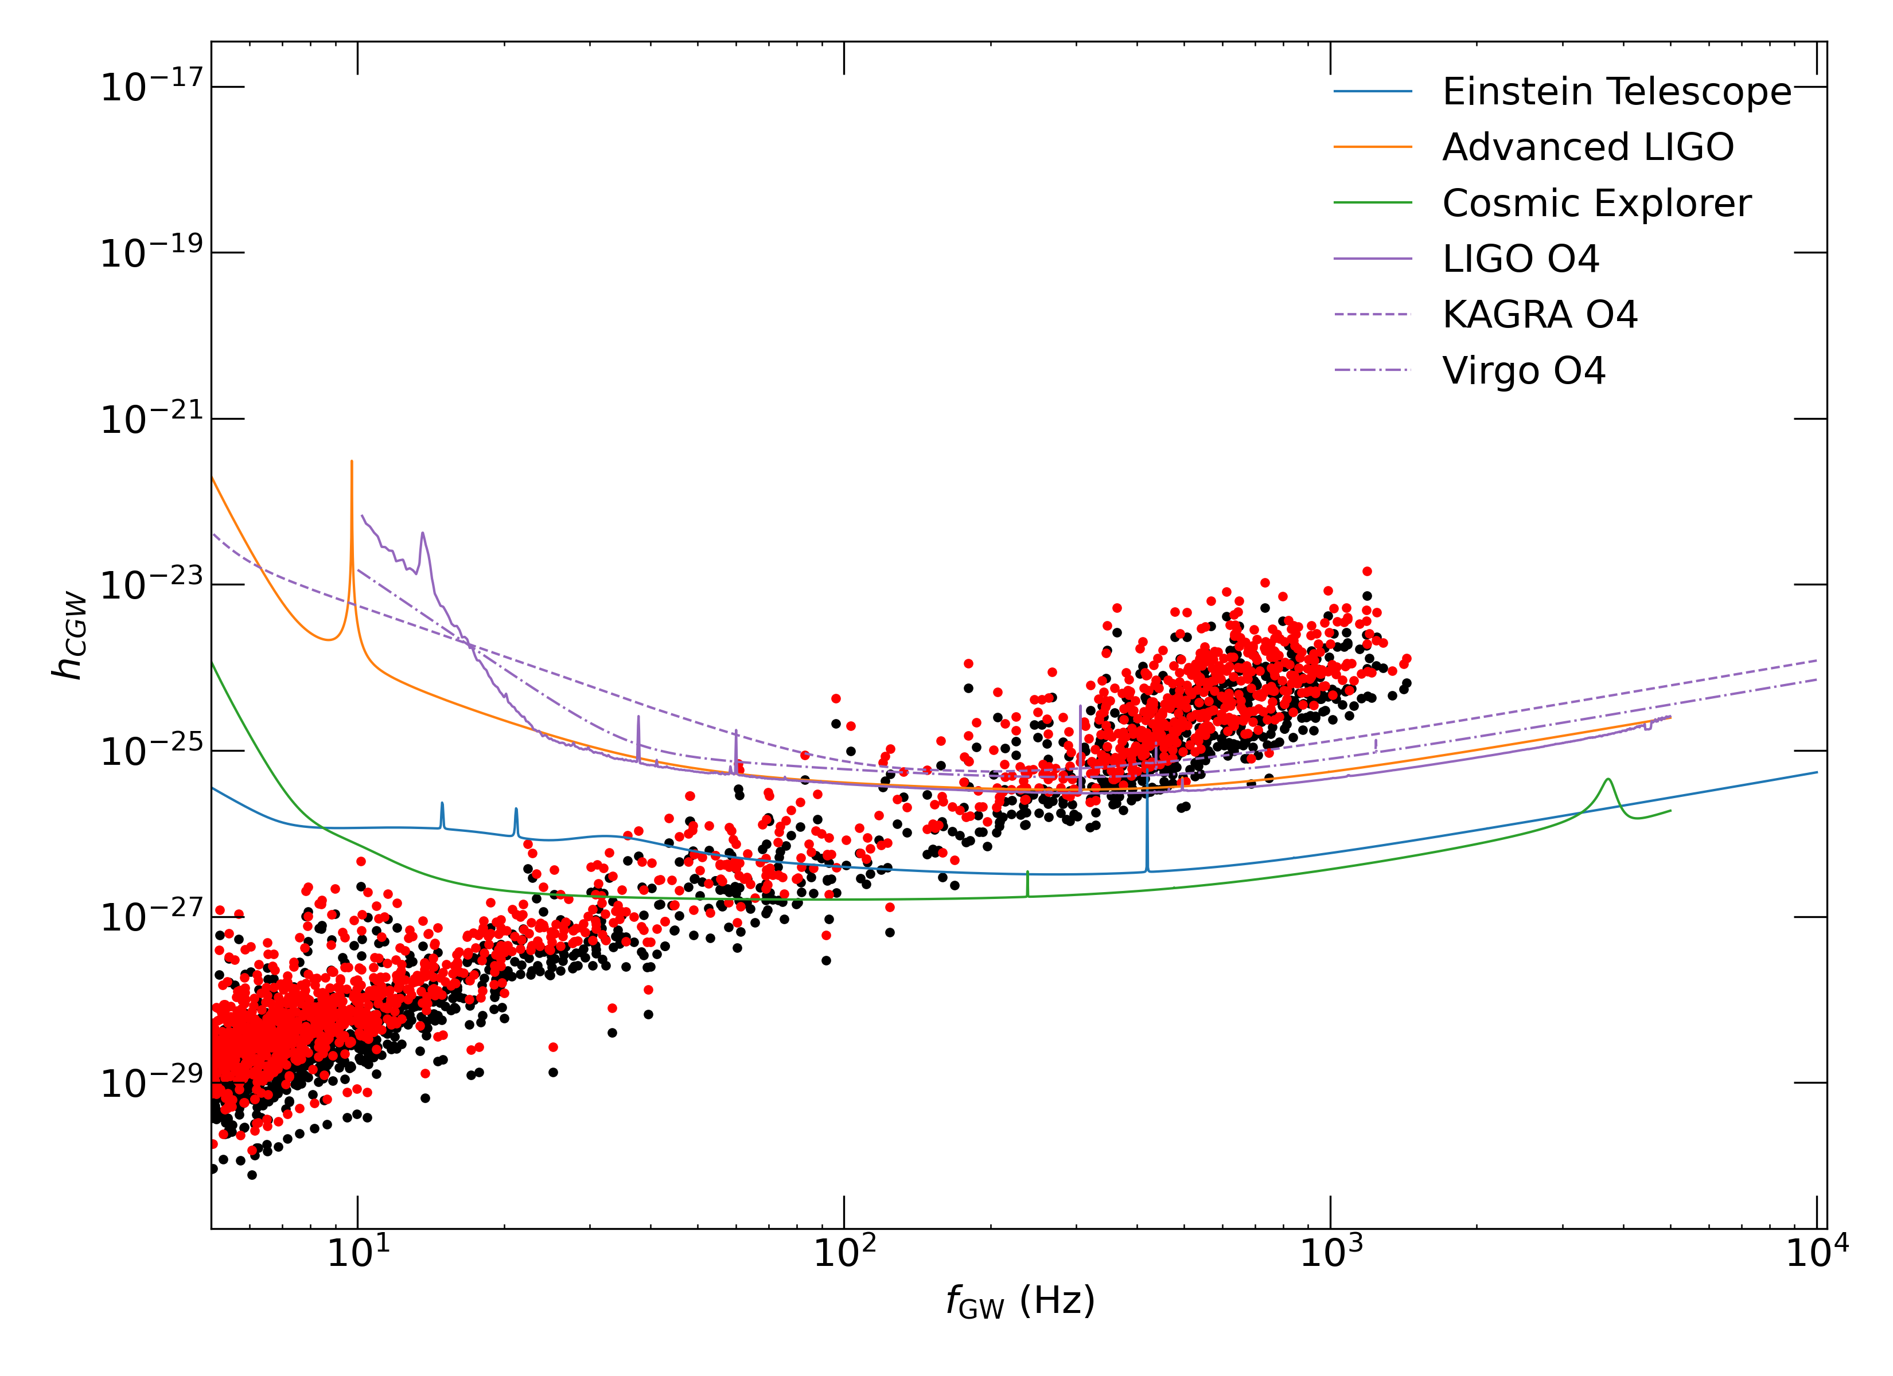
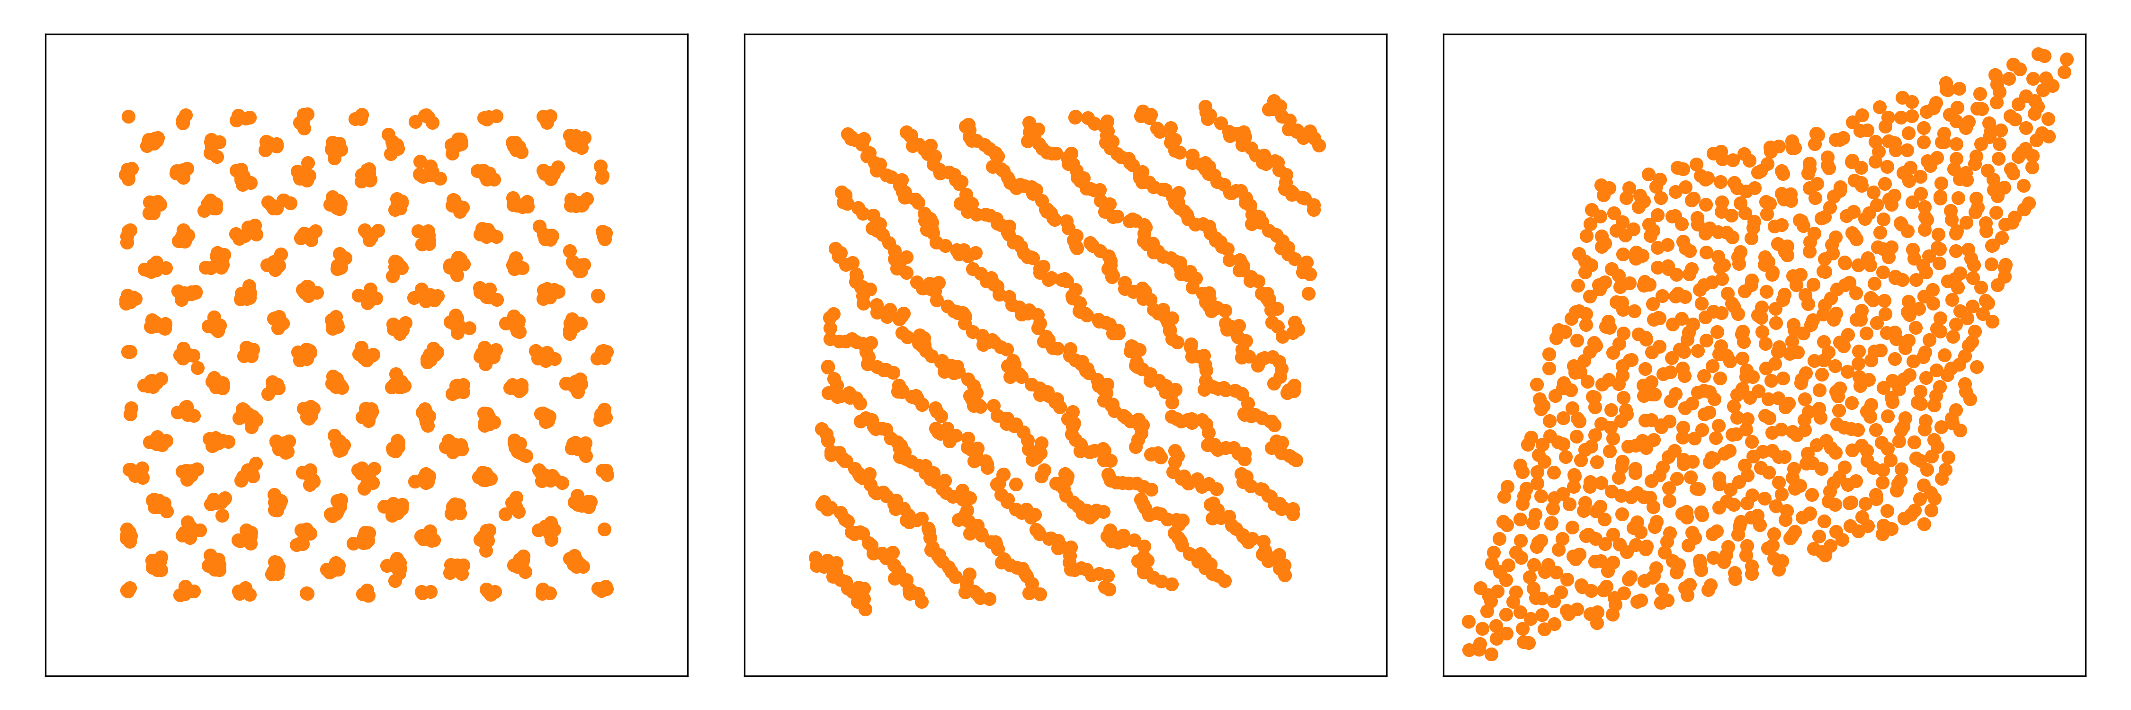
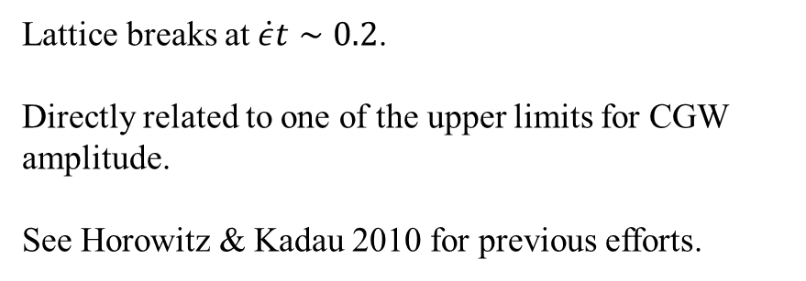
Shear deformations
Lattice breaks at $\dot{ε}t∼0.2$.
Directly related to one of the upper limits for CGW amplitude.
See Horowitz & Kadau 2010 for previous efforts.
8/11

Slide 11





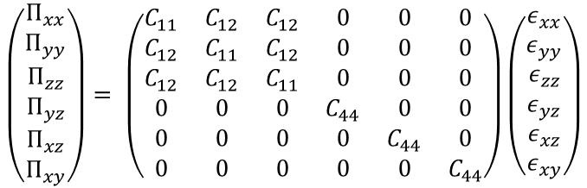

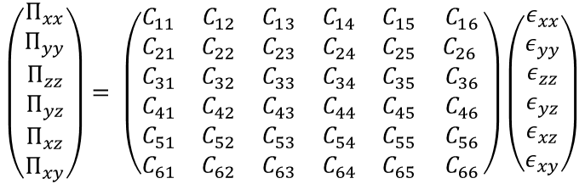

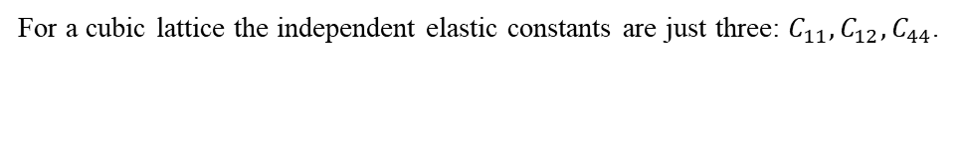

Elastic constants: current work
Elastic regime means the deformation is still reversible.
Voigt notation: $C_{αβμν}$ → $C_{ij}$
Symmetries reduce from 81 to 36 constants.
$$Π_{αβ}=C_{αβμν}ε_{μν}$$
Linear stress-strain relation.
For a cubic lattice the independent elastic constants are just three: $C_{11}, C_{12}, C_{44}$.
$$\left(\begin{matrix}Π_{xx} \\ Π_{yy} \\ Π_{zz} \\ Π_{yz} \\ Π_{xz} \\ Π_{xy}\end{matrix}\right)= \left(\begin{matrix}C_{11} & C_{12} & C_{13} & C_{14} & C_{15} & C_{16} \\ C_{21} & C_{22} & C_{23} & C_{24} & C_{25} & C_{26} \\ C_{31} & C_{32} & C_{33} & C_{34} & C_{35} & C_{36} \\ C_{41} & C_{42} & C_{43} & C_{44} & C_{45} & C_{46} \\ C_{51} & C_{52} & C_{53} & C_{54} & C_{55} & C_{56} \\ C_{61} & C_{62} & C_{63} & C_{64} & C_{65} & C_{66}\end{matrix}\right)\left(\begin{matrix}ε_{xx} \\ ε_{yy} \\ ε_{zz} \\ ε_{yz} \\ ε_{xz} \\ ε_{xy}\end{matrix}\right)$$
$$\left(\begin{matrix}Π_{xx} \\ Π_{yy} \\ Π_{zz} \\ Π_{yz} \\ Π_{xz} \\ Π_{xy}\end{matrix}\right)= \left(\begin{matrix}C_{11} & C_{12} & C_{12} & 0 & 0 & 0 \\ C_{12} & C_{11} & C_{12} & 0 & 0 & 0 \\ C_{12} & C_{12} & C_{11} & 0 & 0 & 0 \\ 0 & 0 & 0 & C_{44} & 0 & 0 \\ 0 & 0 & 0 & 0 & C_{44} & 0 \\ 0 & 0 & 0 & 0 & 0 & C_{44}\end{matrix}\right)\left(\begin{matrix}ε_{xx} \\ ε_{yy} \\ ε_{zz} \\ ε_{yz} \\ ε_{xz} \\ ε_{xy}\end{matrix}\right)$$
Tensile deformation
Shear deformation
Volumetric deformation
Bulk modulus
$$K=\frac{1}{3}\left(C_{11}+2C_{12}\right)$$
Shear modulus
$$G=\frac{1}{5}\left(C_{11}−C_{12}+3C_{44}\right)$$
Young’s modulus
$$E=\frac{9KG}{3K+G}$$
Poisson’s ratio
$$ν=\frac{3K−2G}{2\left(3K+G\right)}$$
$$C_{11}−C_{12}$$
$$C_{44}$$
9/11
$$C_{11}+2C_{12}$$

Slide 12
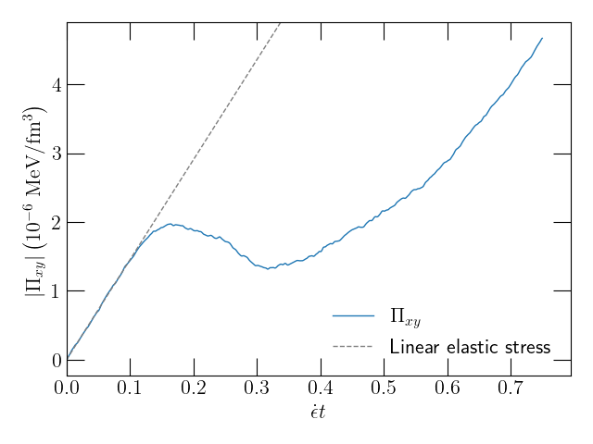
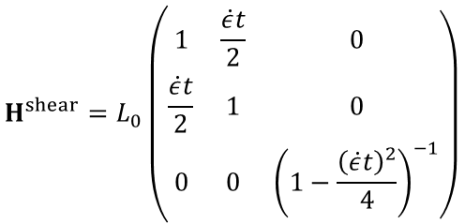
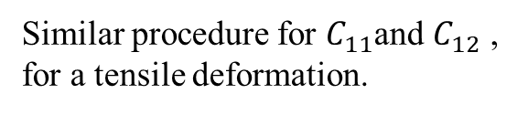

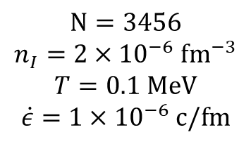
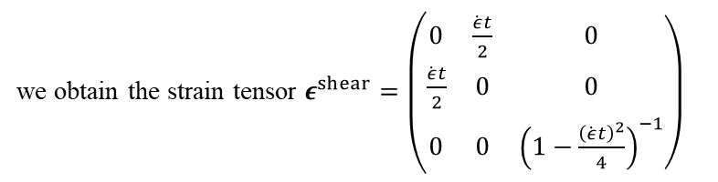
Elastic constants: procedure
$$\left.{H^{shear}=L}_{0}\left(\begin{matrix}1 & \frac{\dot{ε}t}{2} & 0 \\ \frac{\dot{ε}t}{2} & 1 & 0 \\ 0 & 0 & {\left(1−\frac{{\left(\dot{ε}t\right)}^{2}}{4}\right)}^{−1}\end{matrix}\right.\right)$$
we obtain the strain tensor $\left.ε^{shear}=\left(\begin{matrix}0 & \frac{\dot{ε}t}{2} & 0 \\ \frac{\dot{ε}t}{2} & 0 & 0 \\ 0 & 0 & {\left(1−\frac{{\left(\dot{ε}t\right)}^{2}}{4}\right)}^{−1}\end{matrix}\right.\right)$
Calculation: From
Thus from Hooke’s law: $Π_{xy}=C_{44}\frac{\dot{ε}t}{2}$
Similar procedure for $C_{11}$and $C_{12}$ , for a tensile deformation.
$$N=3456$$
$$n_{I}=2×{10}^{−6} {fm}^{−3}$$
$$T=0.1 MeV$$
$$\dot{ε}=1×{10}^{−6} c/fm$$
Barba-González, C. Albertus & M.A. Pérez-García 2025, in prep.
10/11

Slide 13
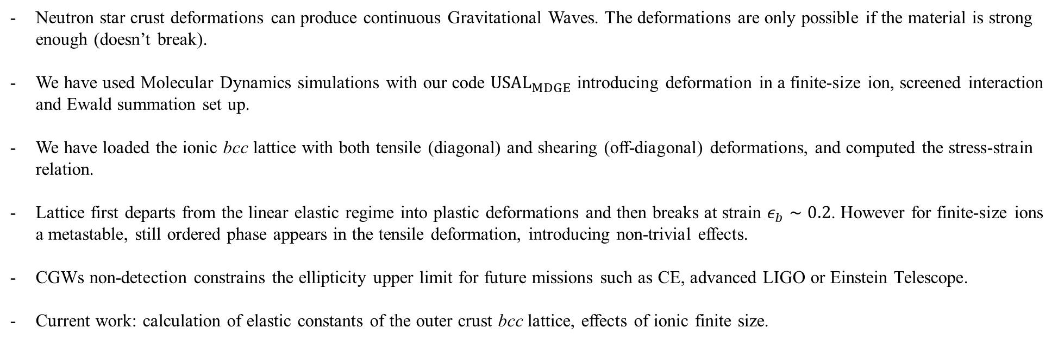
Conclusions
Neutron star crust deformations can produce continuous Gravitational Waves. The deformations are only possible if the material is strong enough (doesn’t break).
We have used Molecular Dynamics simulations with our code ${USAL}_{MDGE}$ introducing deformation in a finite-size ion, screened interaction and Ewald summation set up.
We have loaded the ionic bcc lattice with both tensile (diagonal) and shearing (off-diagonal) deformations, and computed the stress-strain relation.
Lattice first departs from the linear elastic regime into plastic deformations and then breaks at strain $ε_{b}∼0.2$. However for finite-size ions a metastable, still ordered phase appears in the tensile deformation, introducing non-trivial effects.
CGWs non-detection constrains the ellipticity upper limit for future missions such as CE, advanced LIGO or Einstein Telescope.
Current work: calculation of elastic constants of the outer crust bcc lattice, effects of ionic finite size.
11/11

