Slide 1
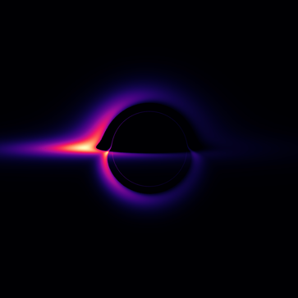
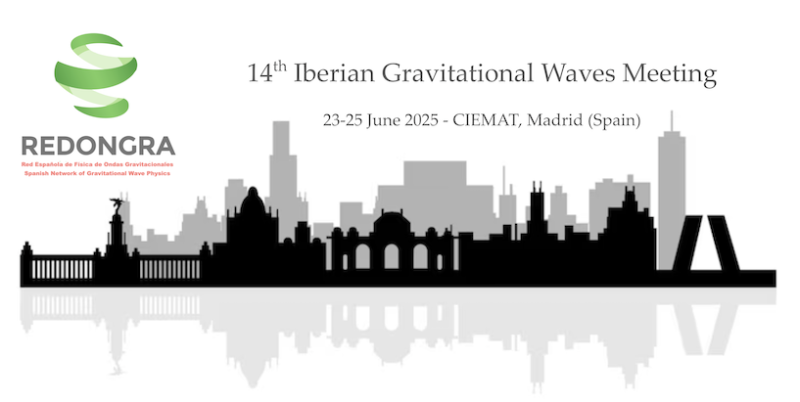
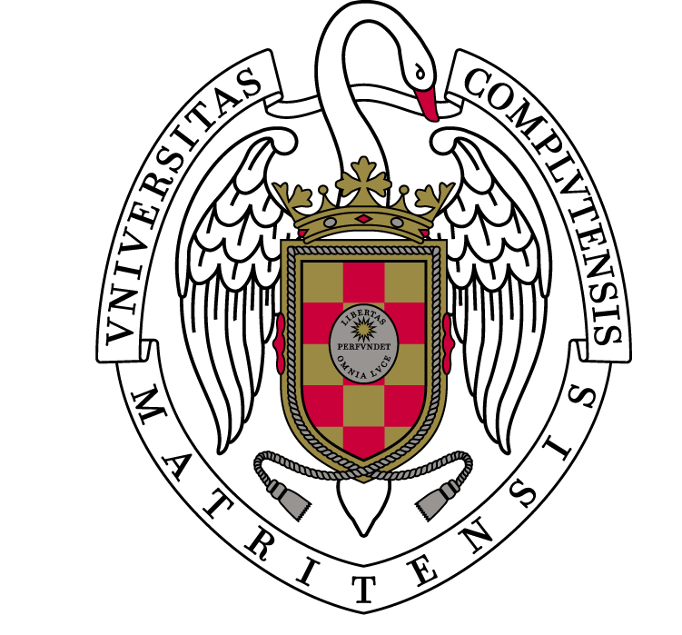
The QNM-Shadow correspondence in strong-gravity multimessenger astrophysics
David Díaz-Guerra,
Diego Rubiera-García
Universidad Complutense de Madrid

Slide 2
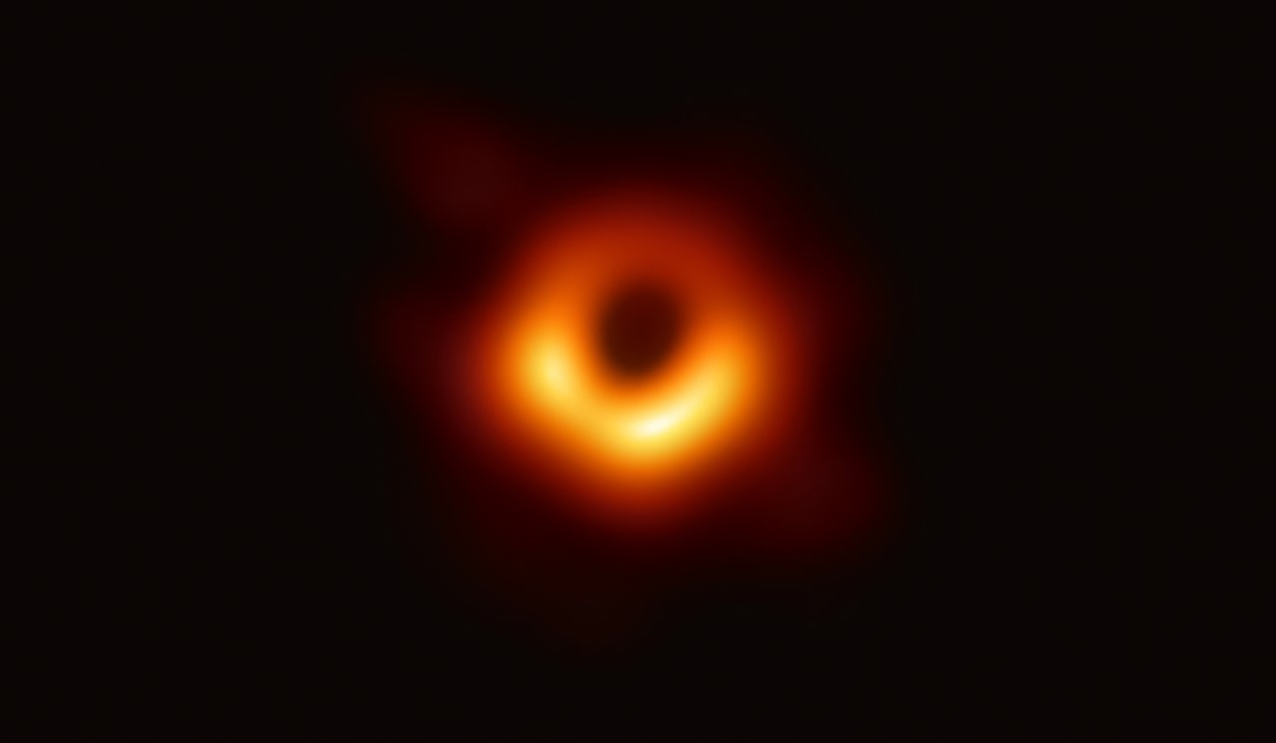
Imaging and gravitational waves – Testing strong gravity
Black hole shadows and gravitational waves explore the same aspects — the near-horizon regime — but from different angles.
Ringdown (from GWs): captures the dynamical response of spacetime after a merger.
Shadow (from imaging): reveals the stationary structure of spacetime through light bending.
Use both tools to test General Relativity and its extensions:
  Modified gravity: e.g., Gauss–Bonnet, f(R)f(R), Lovelock.
  Scalar–tensor theories: Brans–Dicke, dilaton, Horndeski.
  Metric-affine formulations and non-Riemannian geometries.
Search for exotic compact objects: boson stars, gravastars, fuzzballs…
Look for signatures of quantum gravity near the event horizon.
EHT Collaboration 2019

Slide 3
Some questions…
If both fields are measuring the spacetime at its extreme…
Is there any quantity from imaging that relates to one from gravitational waves?
Can we use it to check quantities between fields?
Can it show extra physics?

Slide 4
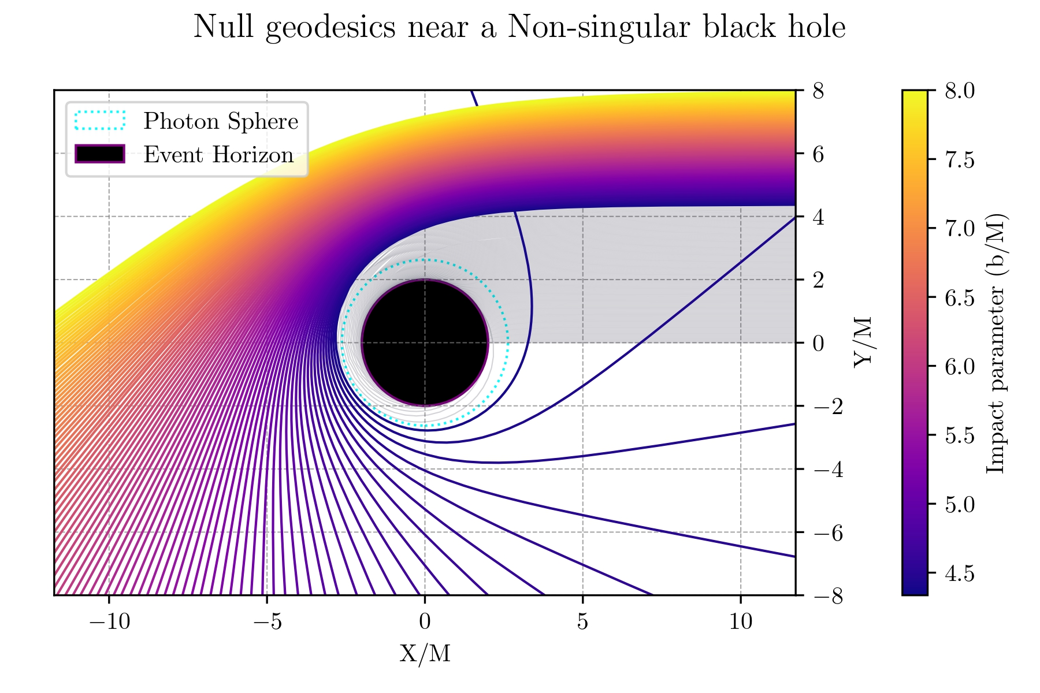
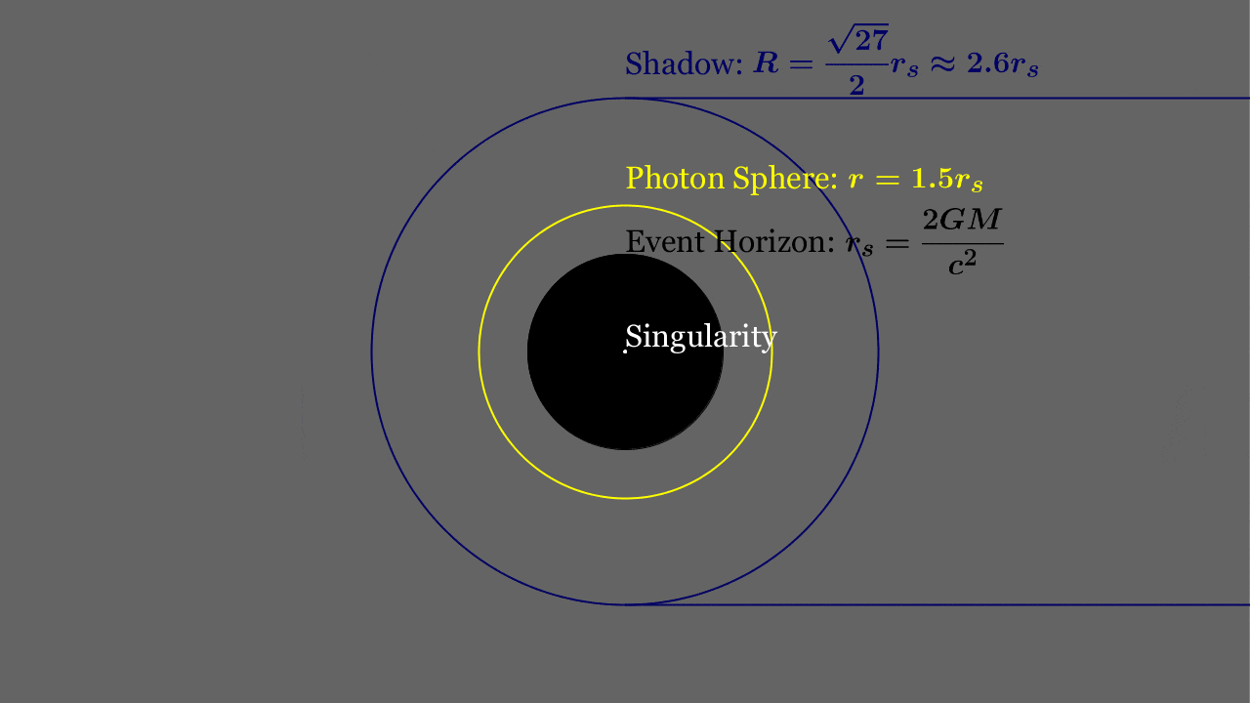
Null geodesics on curved spacetimes
  Extreme lensing effects:
  Strong bending near a particular region: the photon sphere.
  The photon sphere limits the region where:
    photons go back to infinity, and
    photons that are captured (by a horizon or a surface).
  The projected region (for the observer) from where no light comes from is the shadow.
  Near the photon sphere, photons can turn around the object multiple times: leading to multiple images: the photon rings.
Hugo Spinelli

Slide 5
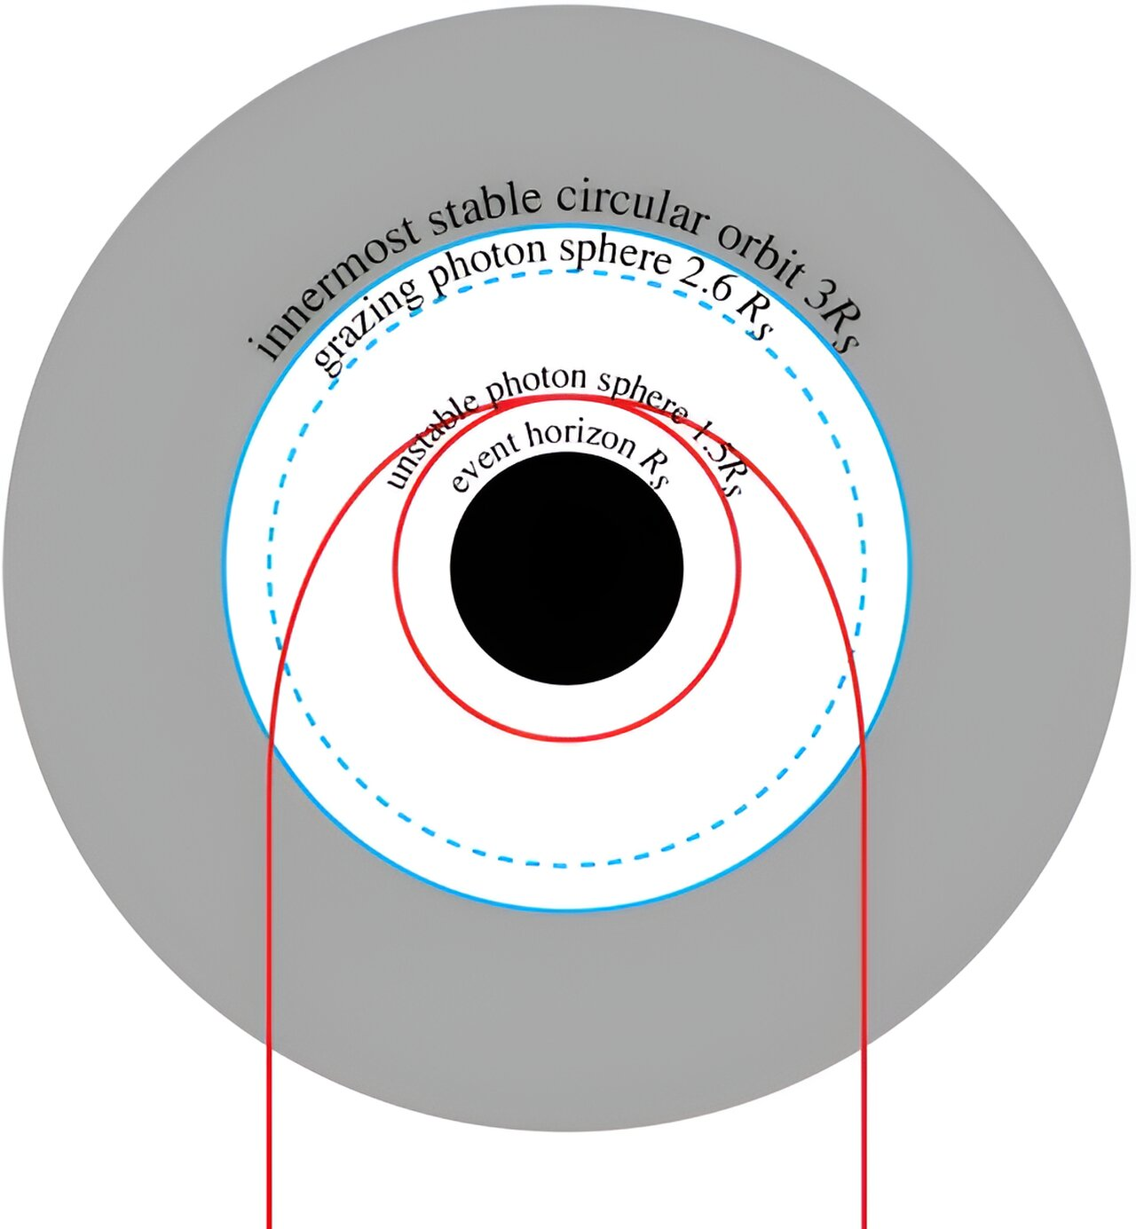
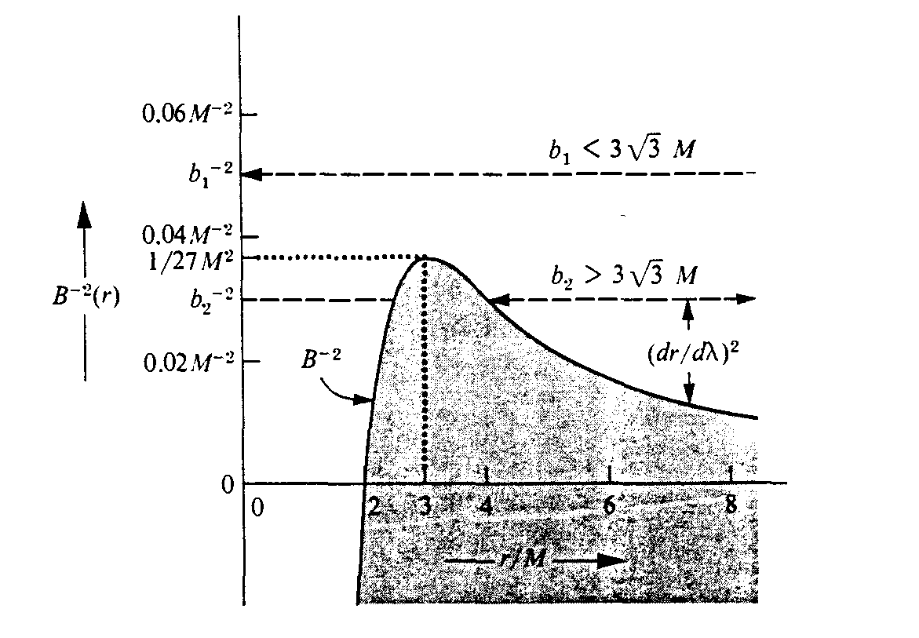
The instability of photon paths
These orbits around the photon sphere are not stable — they sit at a maximum of the effective null geodesic radial potential.
  A small inward or outward deviation causes the photon to be captured or escaping.
The Lyapunov exponent quantifies the exponential rate at which nearby trajectories diverge:
Photon sphere
$$δr_{n}∝e^{γ_{ps}n}$$
John F. Lindner
MTW

Slide 6
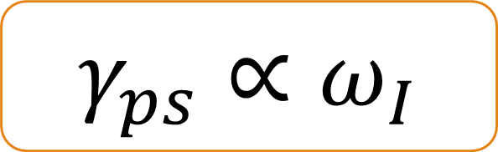
The QNM-Shadow correspondence
The instability of the photon paths near the photon sphere of the object is related to the instability of the gravitational radiation through the quasinormal modes of oscillation in the eikonal limit.
$$γ_{ps}∝ω_{I}$$
Lyapunov exponent
Imaginary
Freq. of QNM
V. Cardoso et.al. [0812.1806]
Is there any quantity from imaging that relates to one from gravitational waves?
Yes, but…

Slide 7
Simulating exotic objects
Null GEODESICS + EMISSION = BLACK HOLE IMAGE

Slide 8
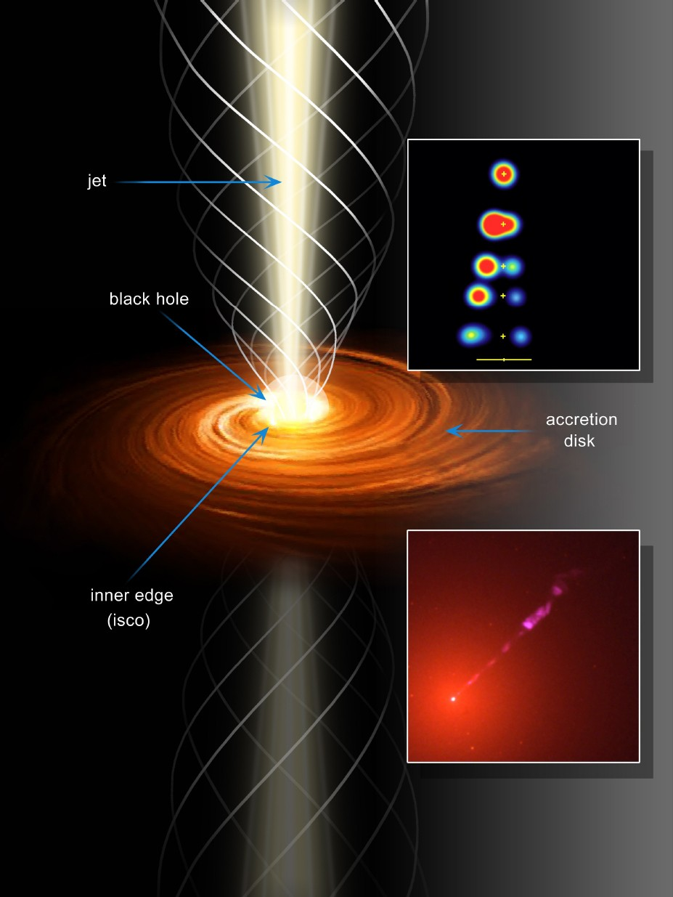
The emission
  The matter that accretes into the black hole emits EM radiation.
  The accretion disk (to deep into fluid dynamics, plasma physics, astrophysical observations)
  Geometrically thin
  Optically thin
  Semi-analytic profile based on GRMHD simulations.
  All together in a GPU-accelerated code (some metrics are expensive)
J.A. Biretta et al., Hubble Heritage Tea

Slide 9
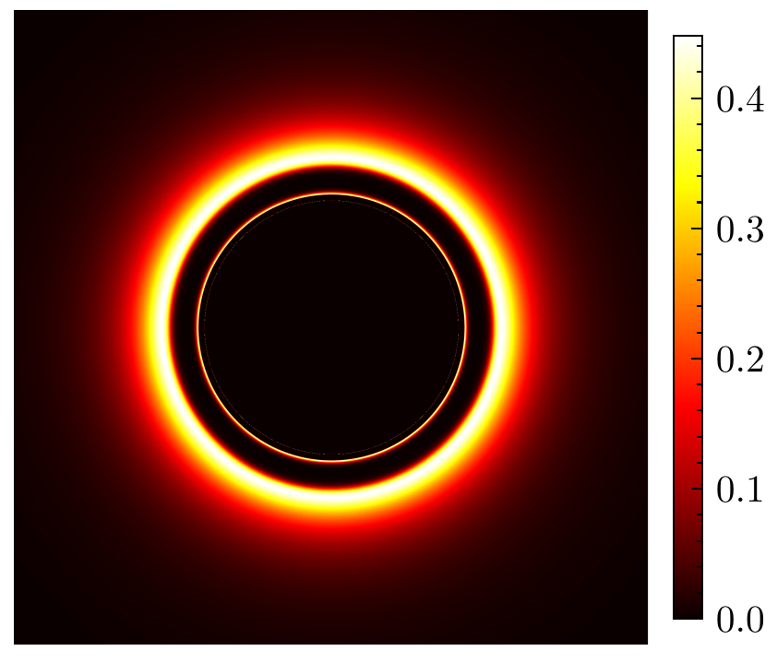
The black hole image
??
Photon rings
Shadow
Lensed disk
EHT

Slide 10
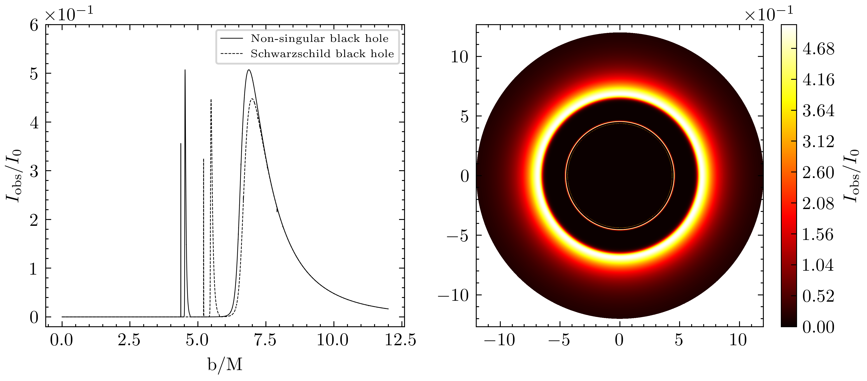
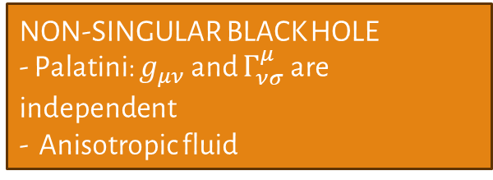
Testing GR with imaging
NON-SINGULAR BLACK HOLE
- Palatini: $g_{μν}$ and $Γ_{νσ}^{μ}$ are independent
- Anisotropic fluid
Quantitative Features:
Lensed disk
The shadow
The photon rings
Photon rings
Lensed disk
Shadow
D. Díaz-Guerra, D. Rubiera-García, [25xx.x]

Slide 11
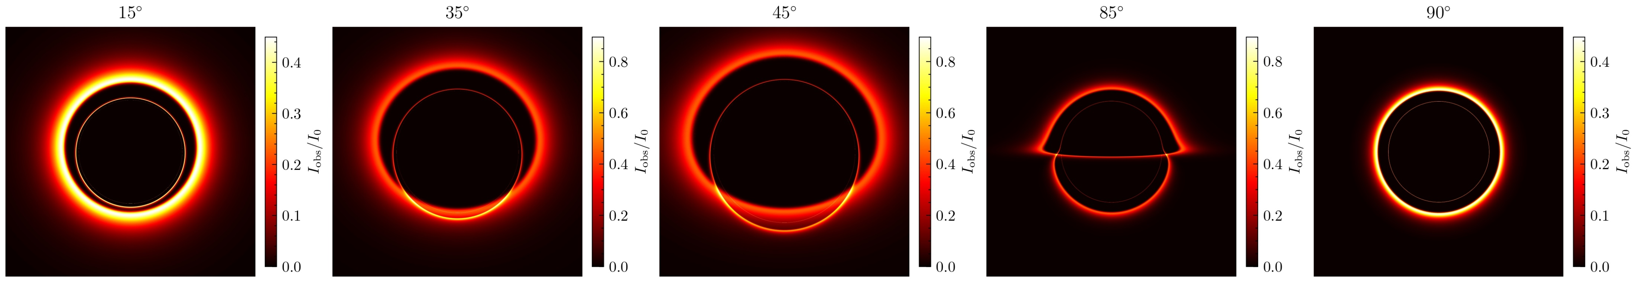
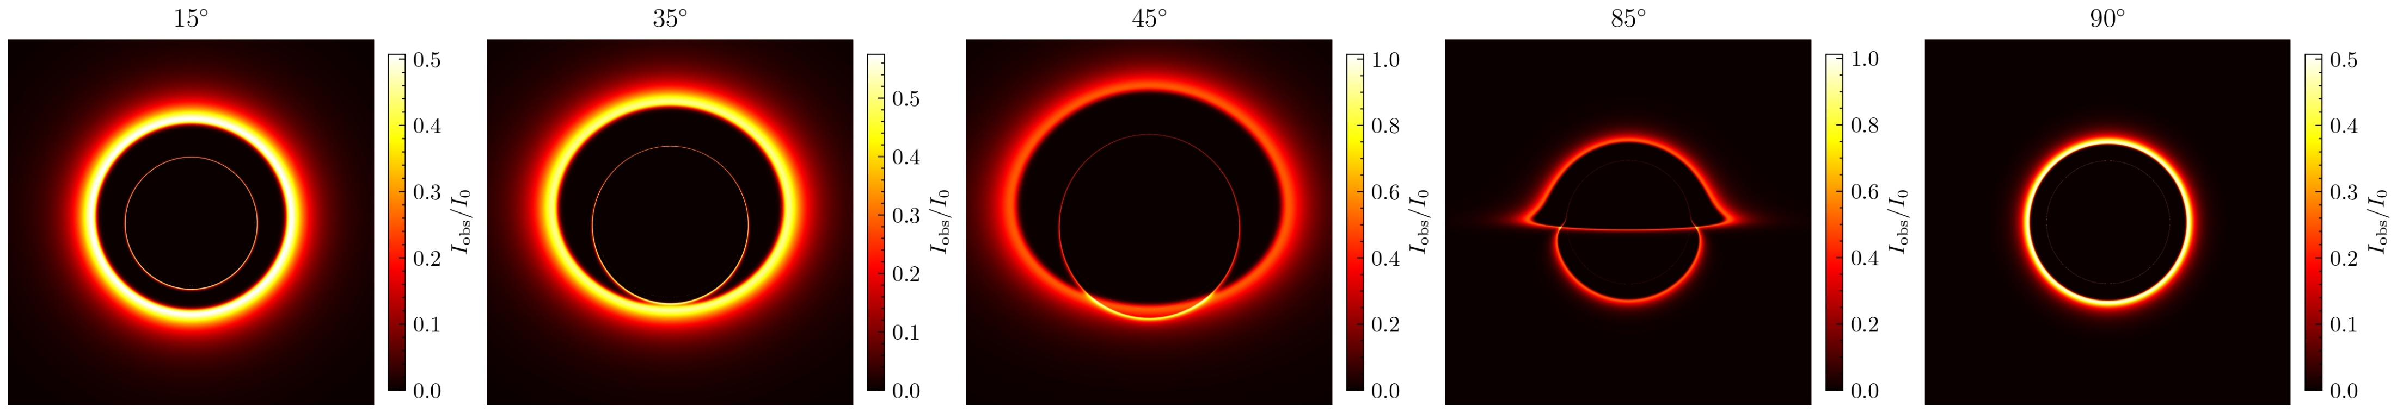
Schwarzschild black hole
Non-singular black hole

Slide 12
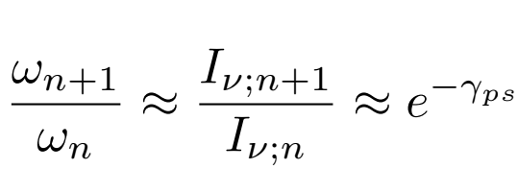
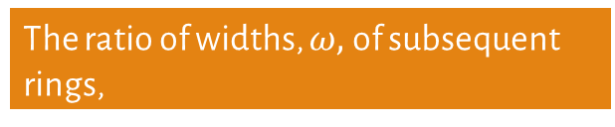
Measuring the Lyapunov
The exact value of the Lyapunov exponent needs the limit of $n→∞$, but…
From the rings obtained with the image, we can approximate the Lyapunov exponent,
The ratio of widths, $ω,$of subsequent rings,
The ratio of intensities of the peaks,
As we go beyond $n>1$, the rings do not depend on the physics of the accretion disk, yielding a pure spacetime measurement.

Slide 13
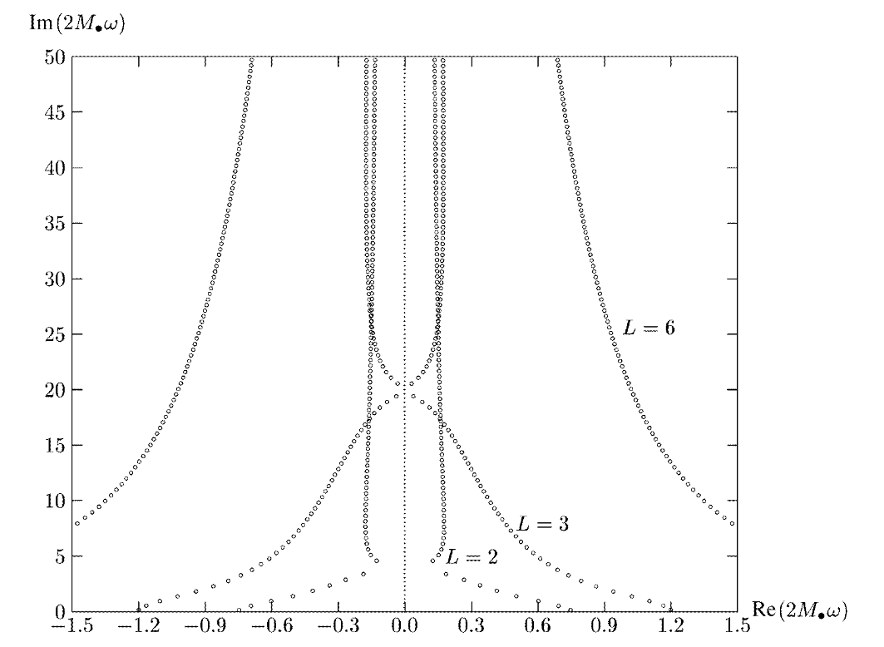

Using the QNM-Shadow correspondence
1. We measure the shadow, and photon ring's location on the image.
2. From the photon rings, we can approximate the Lyapunov exponent.
3. Use the correspondence
$$γ_{ps}∝ω_{I}$$
Can we use it to check quantities between fields?
Yes, approximately.
Nollert [CQG16.R159]
BH Shadows aren’t just still images — they encode the background spacetime where GWs propagate.
We might combine both to cross-check and constrain the black hole geometry.

Slide 14
Discussion and cautionary tale
AS OF TODAY, we can NOT resolve the rings.
  ngEHT and Black Hole explorer will resolve the first ring, hopefully also the second ring.
Even measuring the two photon rings, the Lyapunov exponent calculated is an approximation.
  Useful, but still an approximation!
Gravitational waves do NOT follow ray-optics. The Eikonal limit just yields an idealized high frequency wave of any spin on curved spacetime.
We need to keep study the theoretical implications of this correspondence, and new ways to exploit it. Such that, in the future, we can do strong-gravity multimessenger astrophysics.
Or do they show extra physics? We do not now, yet…

Slide 15
Conclusions
Black Hole Imaging offers a direct look at strong-field spacetime.
  Null geodesics + lensing → shadow, photon ring, Lyapunov
  In the inner photon ring, emission is secondary; geometry is the main aspect.
GWs and imaging are deeply complementary tools for strong gravity:
  The QNM-shadow correspondence is useful to compare and test results between the shadow and GW, or even test new physics.
  We can keep looking for new hints of deviations of the standard picture in strong-gravity.
  We are still taking the first steps for strong-gravity multimessenger astrophysics, but we there is a lot of work to do…

Slide 16
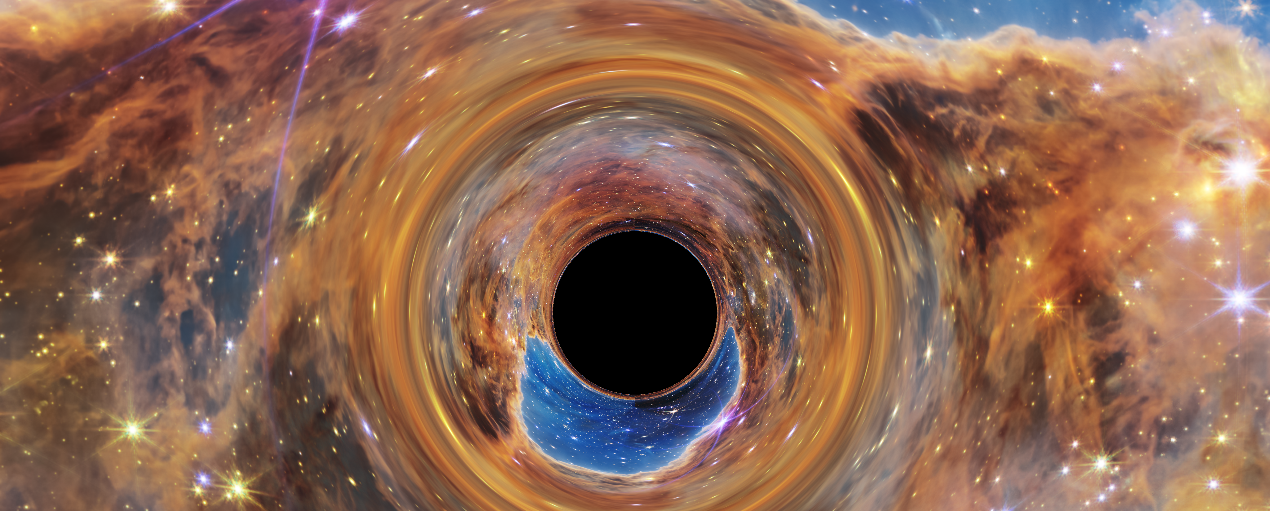
Thank you for your attention!

